Slide 1
GeoMosaic
Ben Russell
Robert Elsner
Chris Grosshans

Slide 2
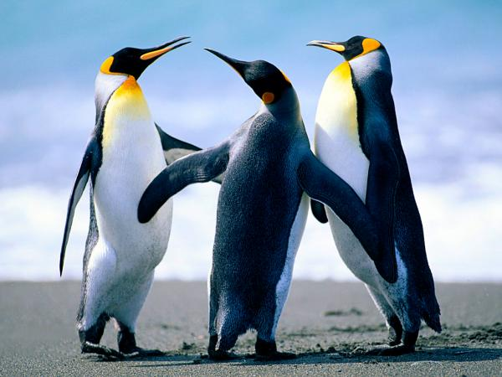
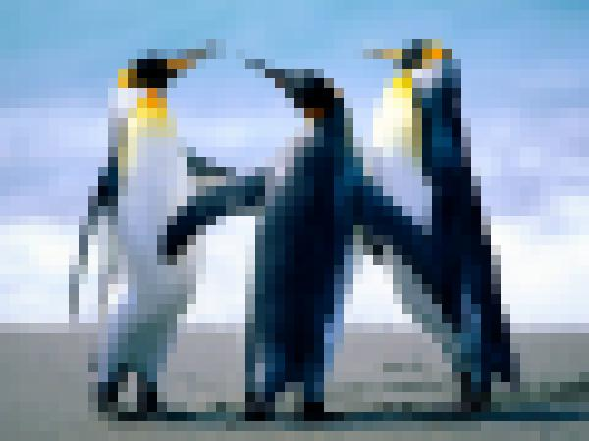
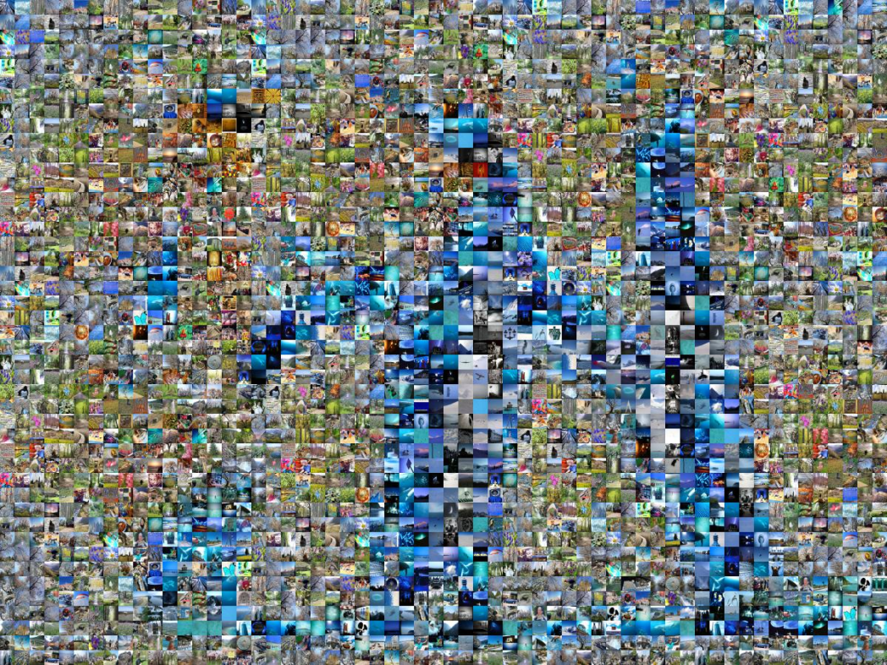
Demo
http://ec2-50-16-153-88.compute-1.amazonaws.com/upload.html

Slide 3
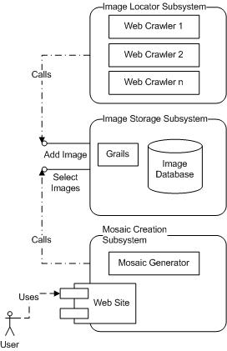
Systems Overview
Three Sub-Systems
Image Locator
Image Storage
Mosaic Creation

Slide 4
Image Locator Subsystem
This portion of the tool populates the Amazon database with geotagged urls.
Flickr.com proved to have a great many available, so we created a tool to crawl flickr and populate the database.
The tool uses the flickr API to download geotagged images, ImageMagick to calculate color averages and WSDL to communicate with our database.

Slide 5
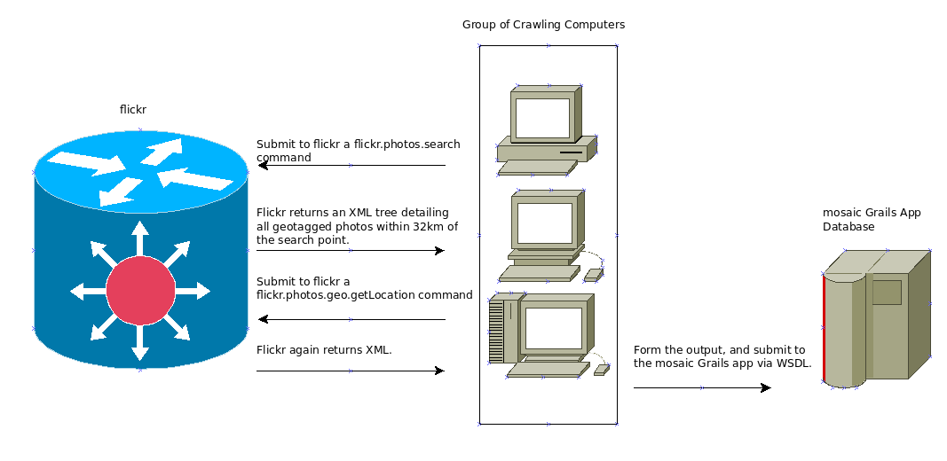
Image Locator Operation

Slide 6
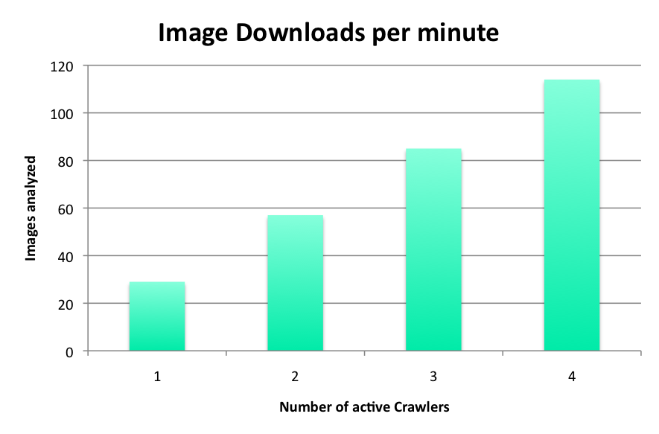
Performance
Each crawler pauses for five seconds between each image download to avoid consuming too much bandwidth.
Using four crawling hosts we analyzed 112,900 images over approximately two weeks.

Slide 7

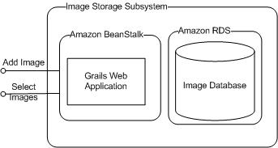
Image Storage - Overview

Slide 8
Image Storage - Application
Amazon Beanstalk
Easy to use, just upload a web deployable.
Groovy on Grails
Easy to produce a web deployable (assuming a java/J2EE background)

Slide 9
Image Storage - Database
SimpleDB - too simplistic
  Not relational
  Only stores UTF-8 String values (no numbers)
  Limits selects to 2500 results
EC2 Relational AMIs – too much configuration
Relational Database Service (RDS) – just right
  Amazon simplifies management (backups, replication…)
  User configures MySQL database

Slide 10
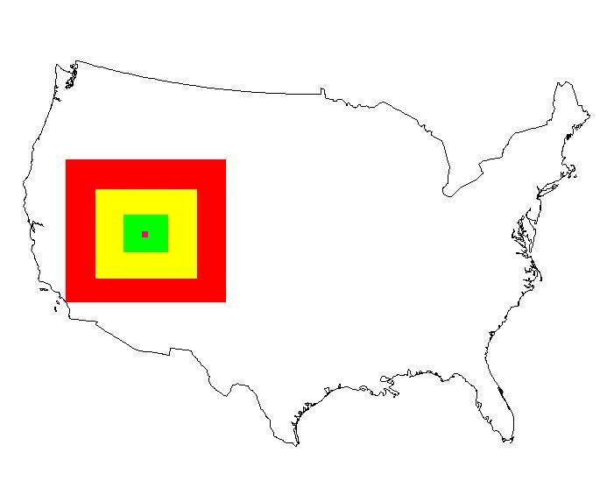
Image Storage – Web Services
saveImage – Stores a new image to DB
selectImagesNearLocation – selects X images near (longitude, latitude)

Slide 11
Image Mosaic UI
Multi-step process
  Generate block color map
  Query web service for images near source
  Select images
  Cache selected images
  Create final output image

Slide 12
Image Storage - Overview

Slide 13
Generate Block Color Map
Block size is minimum 10x10 pixels
If the user selects “Maintain Original Size” then block size is tile size
For each block size, compute the average color
Store in color map

Slide 14
Query Service for Images
Extract GPS coordinates from the source image
Call EBS service with source location and (x_blocks*y_blocks*2) for required number of images
Because the web scraper pre-computes RGB averages, we can exploit this
Potential to push the image selection to EBS service, so we can query by location and RGB values – perhaps better matches?

Slide 15
Select Images
For each color block
  For each available image
    Delta = abs(blockRed-imageRed)+abs(sourceGreen-imageGreen)+abs(sourceBlue-imageBlue)+
  Select the source image where delta is minimized
    Verify this image is not in the surrounding 16x16 square already (to eliminate duplicating the same image over and over)

Slide 16
Cache
Generate a set of unique image URLs
Run CURL multi-threaded to download images
Temporarily cache them on the server HDD
  Deleted when process completes for an image
On Amazon EC2, we get roughly 19MB/s
Final image count will typically be less than x_blocks*y_blocks (since block colors can be similar across an image)

Slide 17
Generate Image
With a hash map that associates the image URL with the temporary cache file,
For each color block
  Copy and resize the cached image to the color blocks location to produce that block picture
Generate a HTML Map to allow users to click each block image and see the source image
Output some statistics and the final image

Slide 18
Future Work
Obviously a distributed hash table that stored the URL as key and the file bytes as value
  Would probably need to keep the nodes in the same data center for increased local bandwidth
Image creation is SLOW!
  Currently uses PHP GD, which is a C library
  Amazon has a GPU enabled instance option
Memory consumption can be high
  SOAP response large, image data large

Slide 19
Lessens Learned
Originally done in Groovy (on Grails)
  Sun's Java image libraries are REALLY slow
  Deployment to EBS caused many problems, difference between Jetty and Tomcat containers, etc
  Rewritten to use PHP
  There are JNI/JNA bindings to imagemagick had we stuck with the JVM
This image manipulation can be multithreaded
  But PHP cannot! (without fork() and lots of work)

Slide 20
Contact Info
Chris Grosshans
720-938-6176
chris.grosshans1
Rob
970-227-9969
beeblebroxrox
Ben
631-879-5754
russeb1

