Slide 1
GeoMosaic
Ben Russell
Robert Elsner
Chris Grosshans

Slide 2
Demo
http://ec2-50-16-153-88.compute-1.amazonaws.com/upload.html

Slide 3
Example Mosaic
<TODO> insert an example mosaic in case the demo does not go very well.
Perhaps add a close up of mosaic as it might be difficult to see in class.

Slide 4
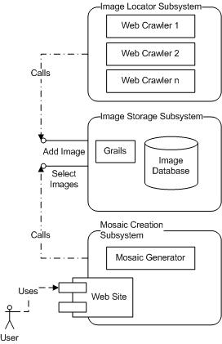
Systems Overview
Three Sub-systems
Image Locator
Image Storage
Mosaic Creation

Slide 5
Image Locator Subsystem
TODO add slides

Slide 6
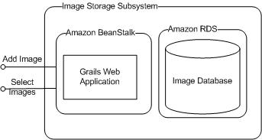
Image Storage - Overview

Slide 7
Image Storage - Application
Amazon Beanstalk
Easy to use, just upload a web deployable.
Groovy on Grails
Easy to produce a web deployable (assuming a java/J2EE background)

Slide 8
Image Storage - Database
SimpleDB - too simplistic
Not relational
Only stores UTF-8 String values (no numbers)
Limits selects to 2500 results
EC2 Relational AMIs – too much configuration
Relational Database Service (RDS) – just right
Amazon simplifies management (backups, replication…)
User configures MySQL database

Slide 9
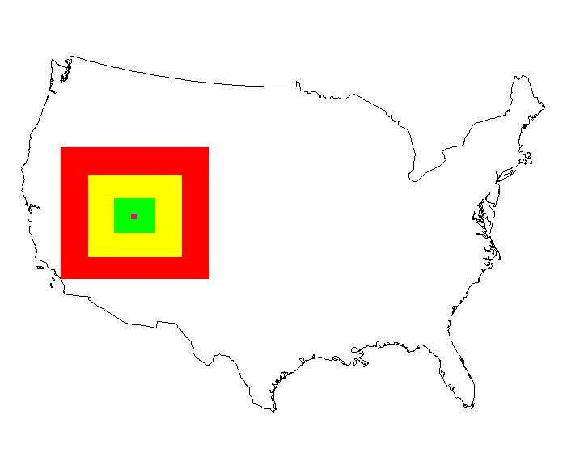
Image Storage – Web Services
saveImage – Stores a new image to DB
selectImagesNearLocation – selects X images near (longitude, latitude)

Slide 10
Mosaic Creation Subsystem

