Slide 1
Summary Presentation
Inference for Misspecified Models with Fixed Regressors
Abadie, Imbens, Zheng (2014)
Simon Dovan Nguyen

Slide 2
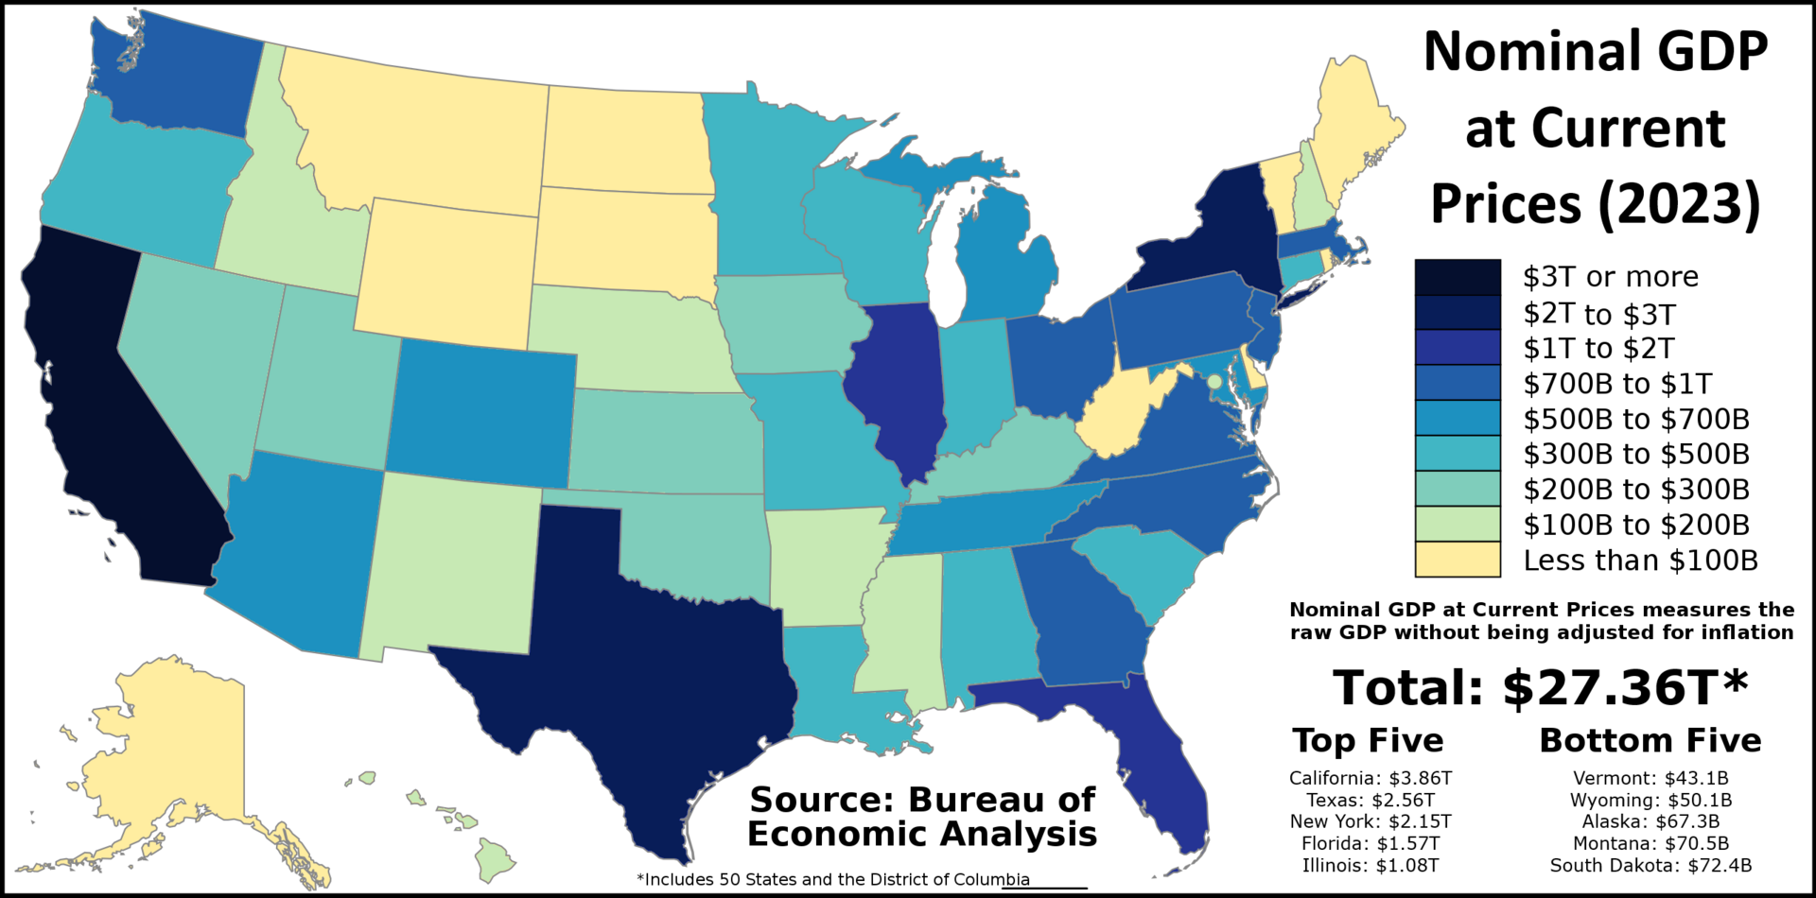
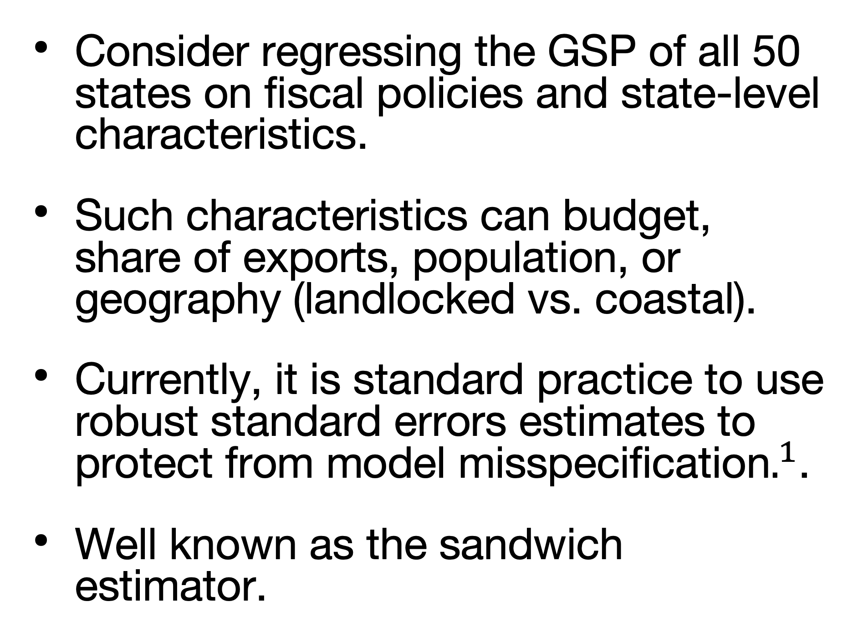
Motivating Example
Gross State Product (GSP)
Consider regressing the GSP of all 50 states on fiscal policies and state-level characteristics.
Such characteristics can budget, share of exports, population, or geography (landlocked vs. coastal).
Currently, it is standard practice to use robust standard errors estimates to protect from model misspecification$.^{1}$.
Well known as the sandwich estimator.
By Doll91939 - Own work, CC BY 4.0, https://commons.wikimedia.org/w/index.php?curid=146898535
[1] Eicker (1967), Huber (1967), White (1982), White (1980a), White (1980b)
Notes:
Heteroskedasticity-consistent standard errors

Slide 3
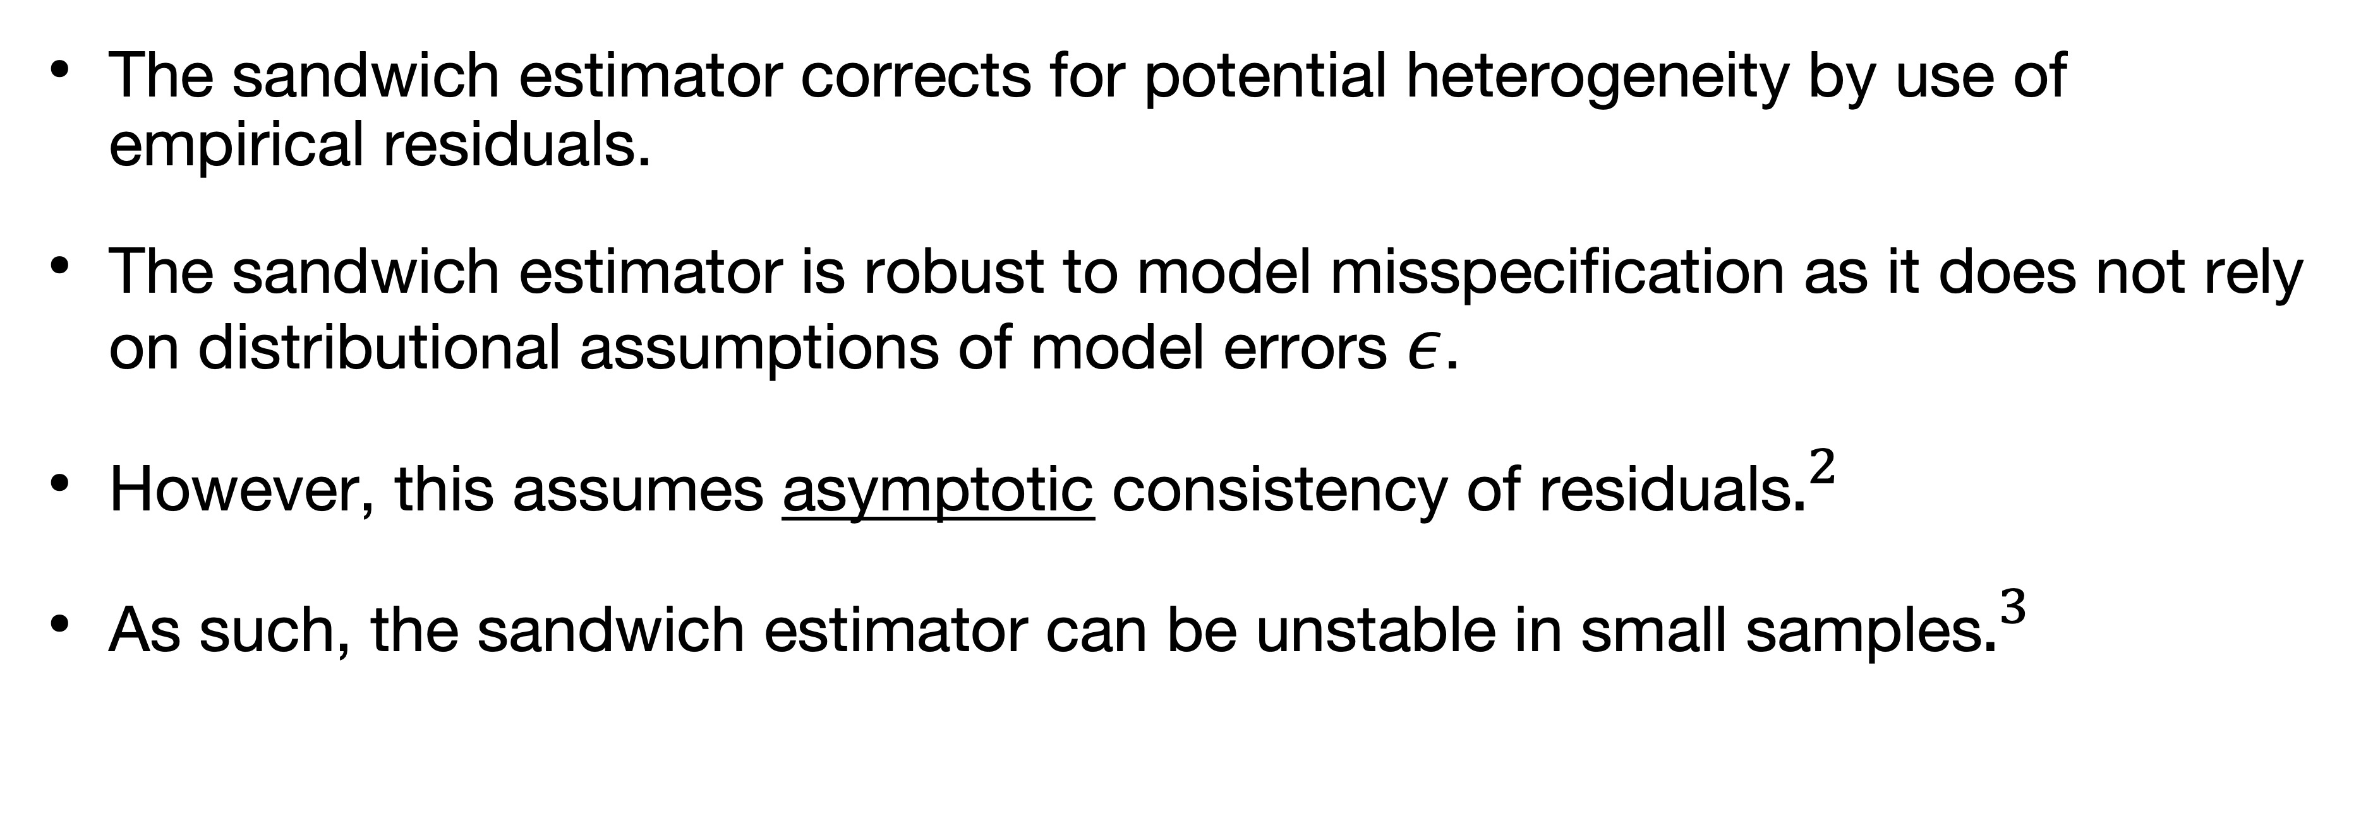
Sandwich Estimator
Appeals and Issues
The sandwich estimator corrects for potential heterogeneity by use of empirical residuals.
The sandwich estimator is robust to model misspecification as it does not rely on distributional assumptions of model errors $ε$.
However, this assumes asymptotic consistency of residuals$.^{2}$
As such, the sandwich estimator can be unstable in small samples$.^{3}$
[2] Eicker (1967)
[3] Wakefield (2013)
Notes:
Weak Law of Large Numbers Its asymptotic properties do not hold in small sample settings.

Slide 4
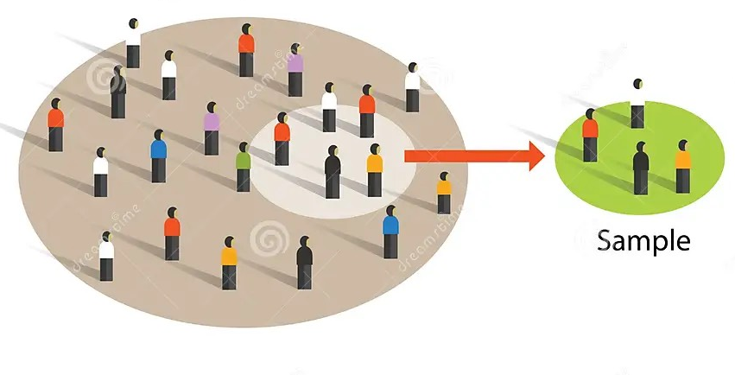
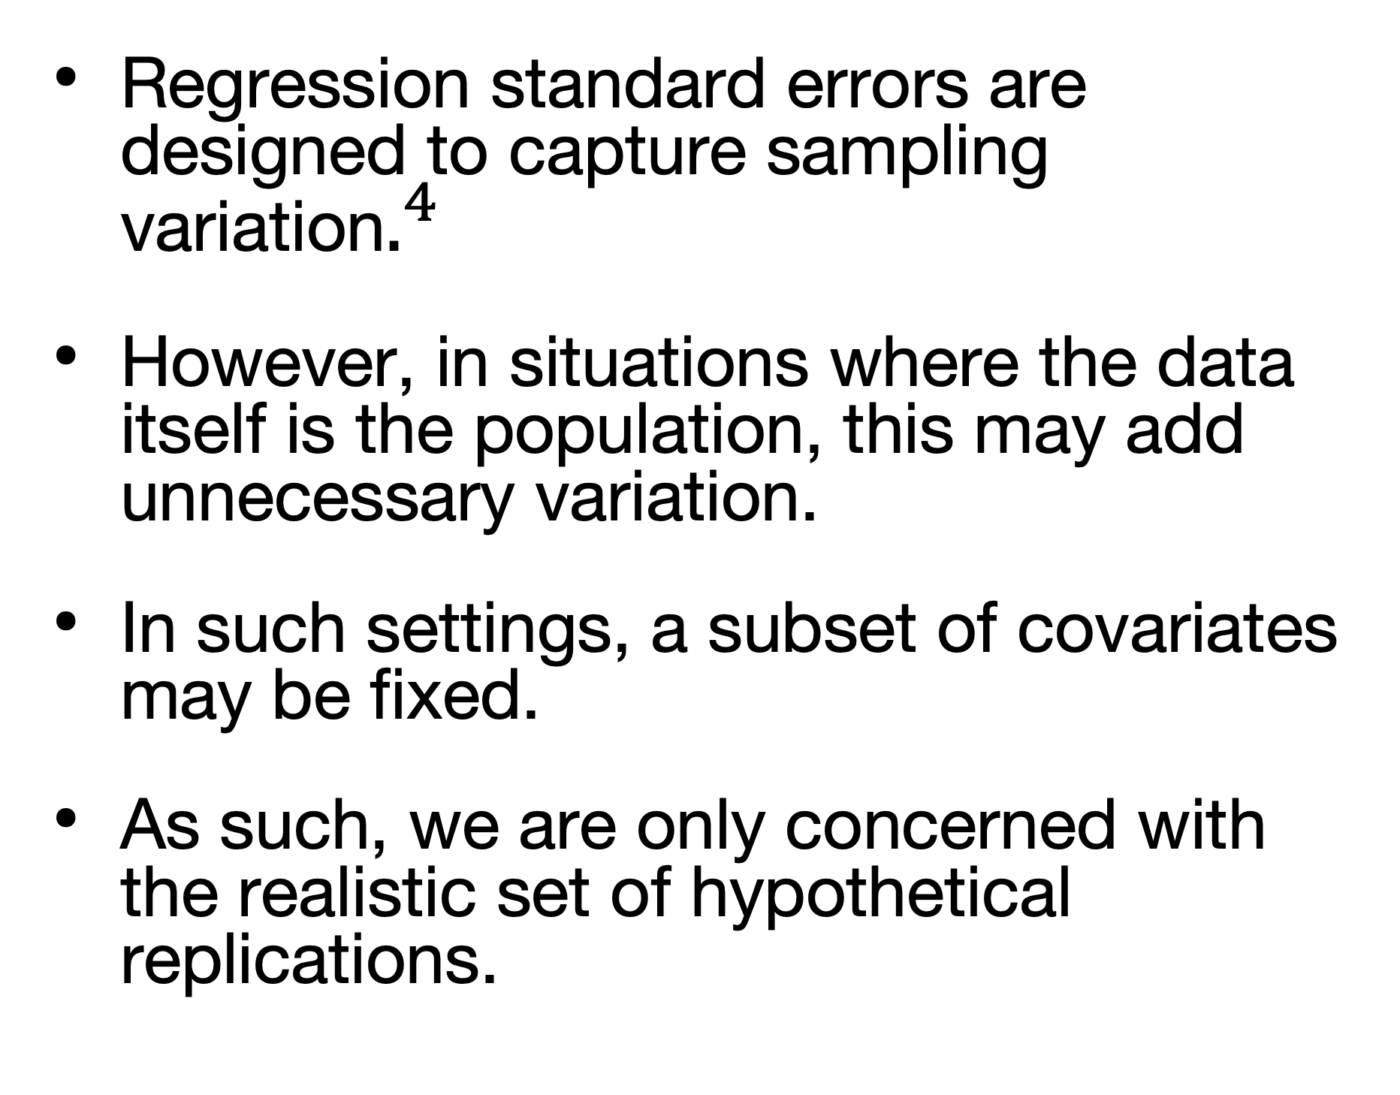
Fixed Regressors
X
Regression standard errors are designed to capture sampling variation$.^{4}$
However, in situations where the data itself is the population, this may add unnecessary variation.
In such settings, a subset of covariates may be fixed.
As such, we are only concerned with the realistic set of hypothetical replications.
Superpopulation
https://www.dreamstime.com/stock-illustration-sample-population-statistics-research-survey-methodology-selection-concept-vector-image97171869
[4] Abadie, Athey, Imbens, Wooldridge (2020)
Notes:
Countries comprising of the whole world
Membership is relatively permanent
Tropical climate

Slide 5
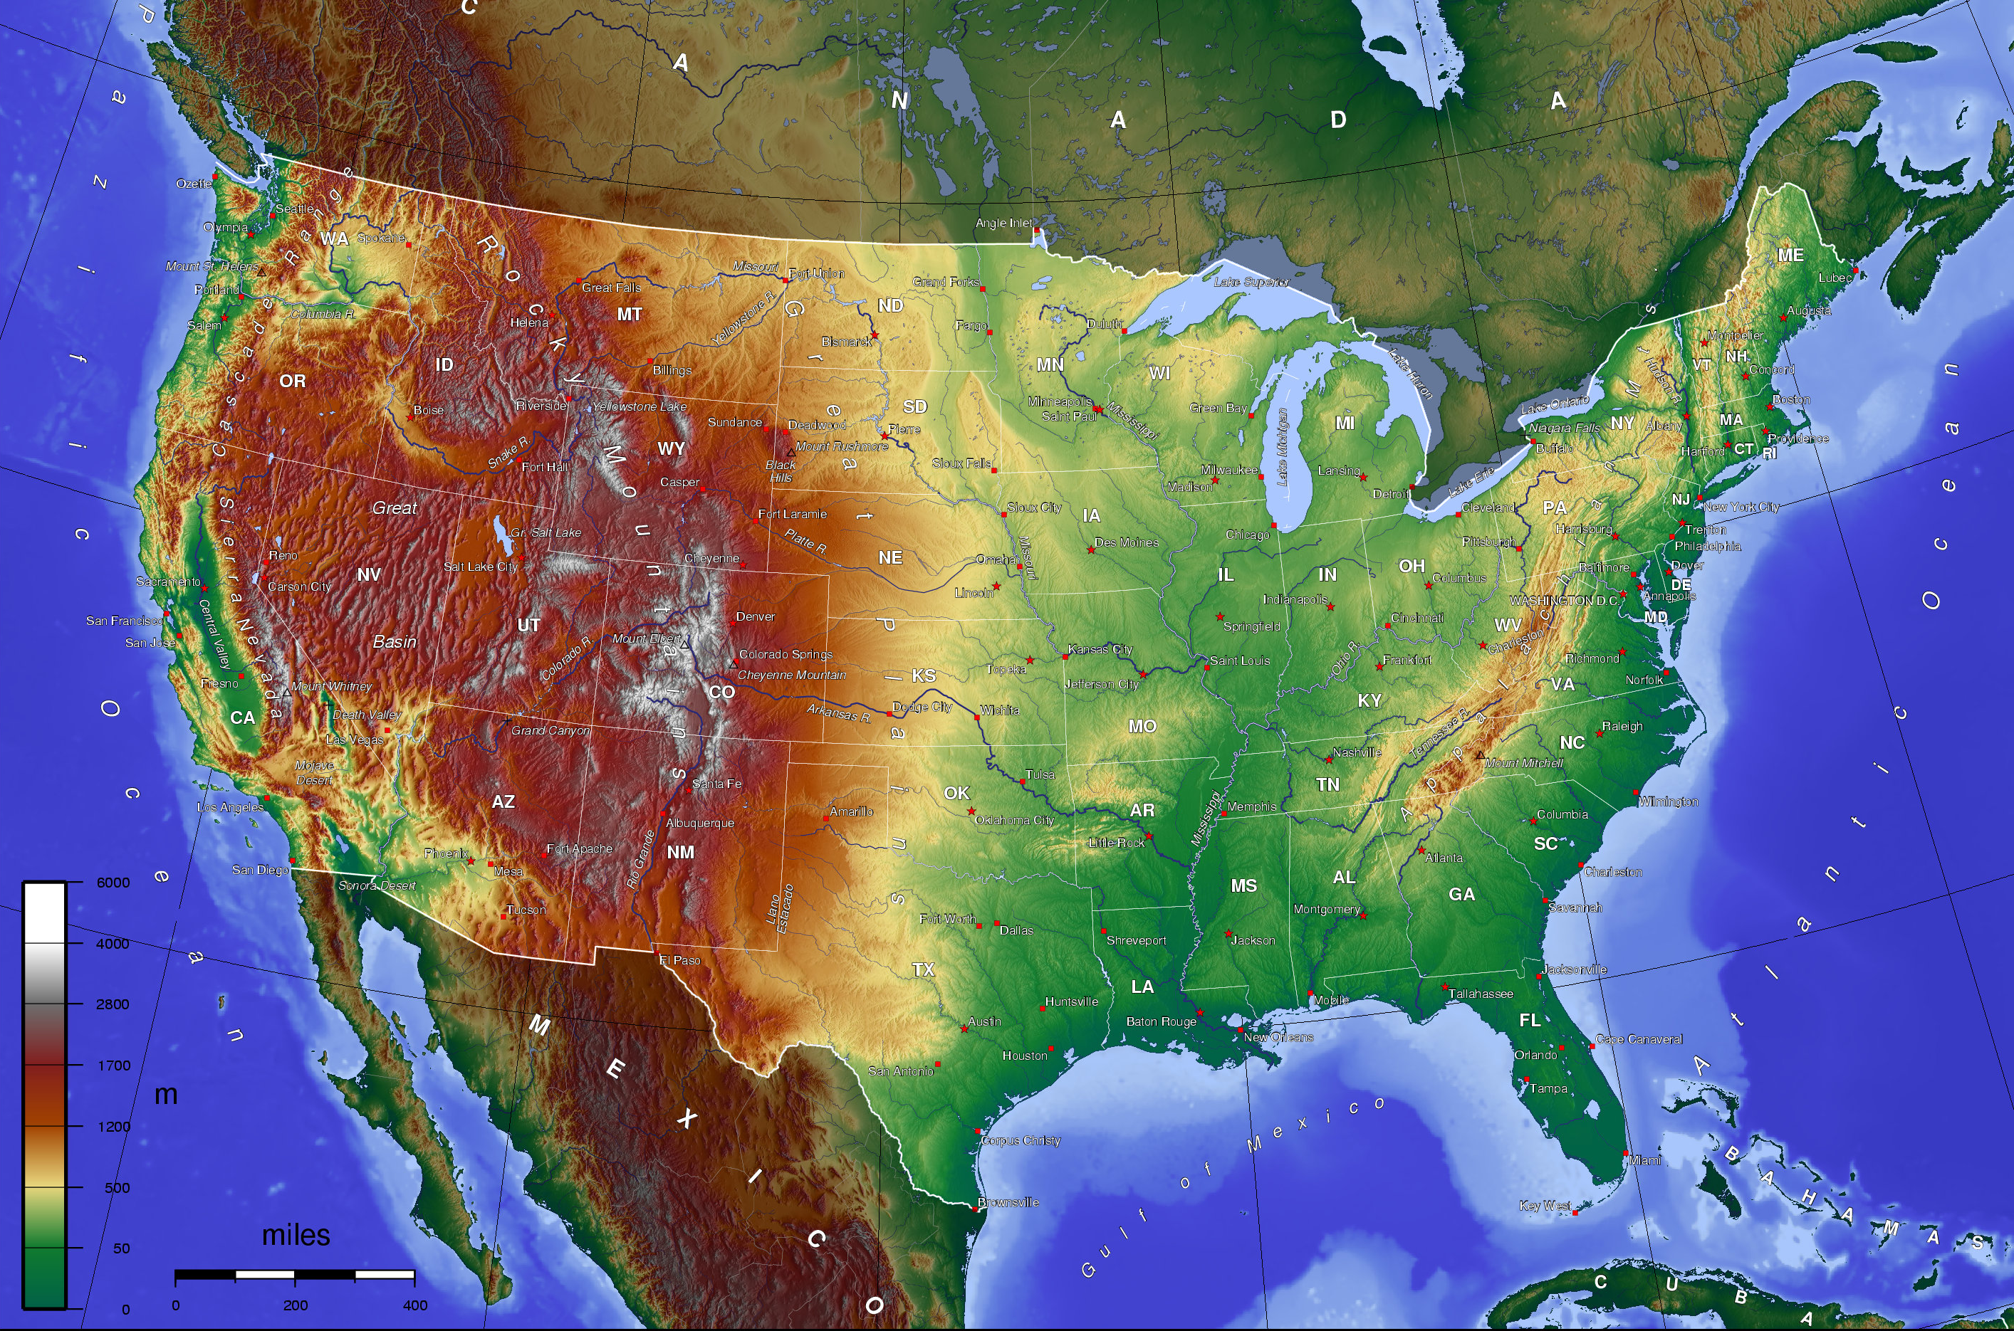
Back to our GSP Example!
In our example, the data units are the 50 states that comprise the entire population of the United States.
In this case, it would be reasonable to view geography (landlocked vs. coastal) as fixed.
Our hypothetical set of replications does not need to consider a landlocked California or coastal Arizona.
It would be more realistic to view the number of coastal and landlocked states as fixed rather than random.
This removes any unnecessary sampling variation.
CC BY-SA 3.0, https://commons.wikimedia.org/w/index.php?curid=1337120
[5] Birnaum (1962)
Notes:
Realistic set of hypothetical realizations
Some statisticians in the mid 20th century had proposed that a valid statistical analysis must include all of the possible experiments which might have been conducted
"Uncertainity factor"
Allan Birnbaum

Slide 6
Inference for Misspecified Models With Fixed Regressors
Abadie, Imbens, Zheng (2014)
Abadie, Imbens, and Zheng extends the results of Eicker, Huber, and White to the setting of fixed regressors.
We will call their main contribution, the “conditional best linear predictor.”
In particular, this work will then generalize this contribution to maximum likelihood estimation and method of moment estimation.
This work will then derive asymptotic distributional results.
We will see that in misspecified models, the robust variance of the conditional estimand is no larger than the sandwich estimator proposed by Eicker, Huber, and White.
This work then proposes consistent estimators for the estimands and its variance so that proper inference can be performed.
Notes:
Even under model misspecification we have desireable results like consistency and normality

