Slide 1
Introduction to Template Haskell
Inductive natural number literals
Heterogeneous list literals
Custom quasi-quoters
Quotation rewriters

Slide 2
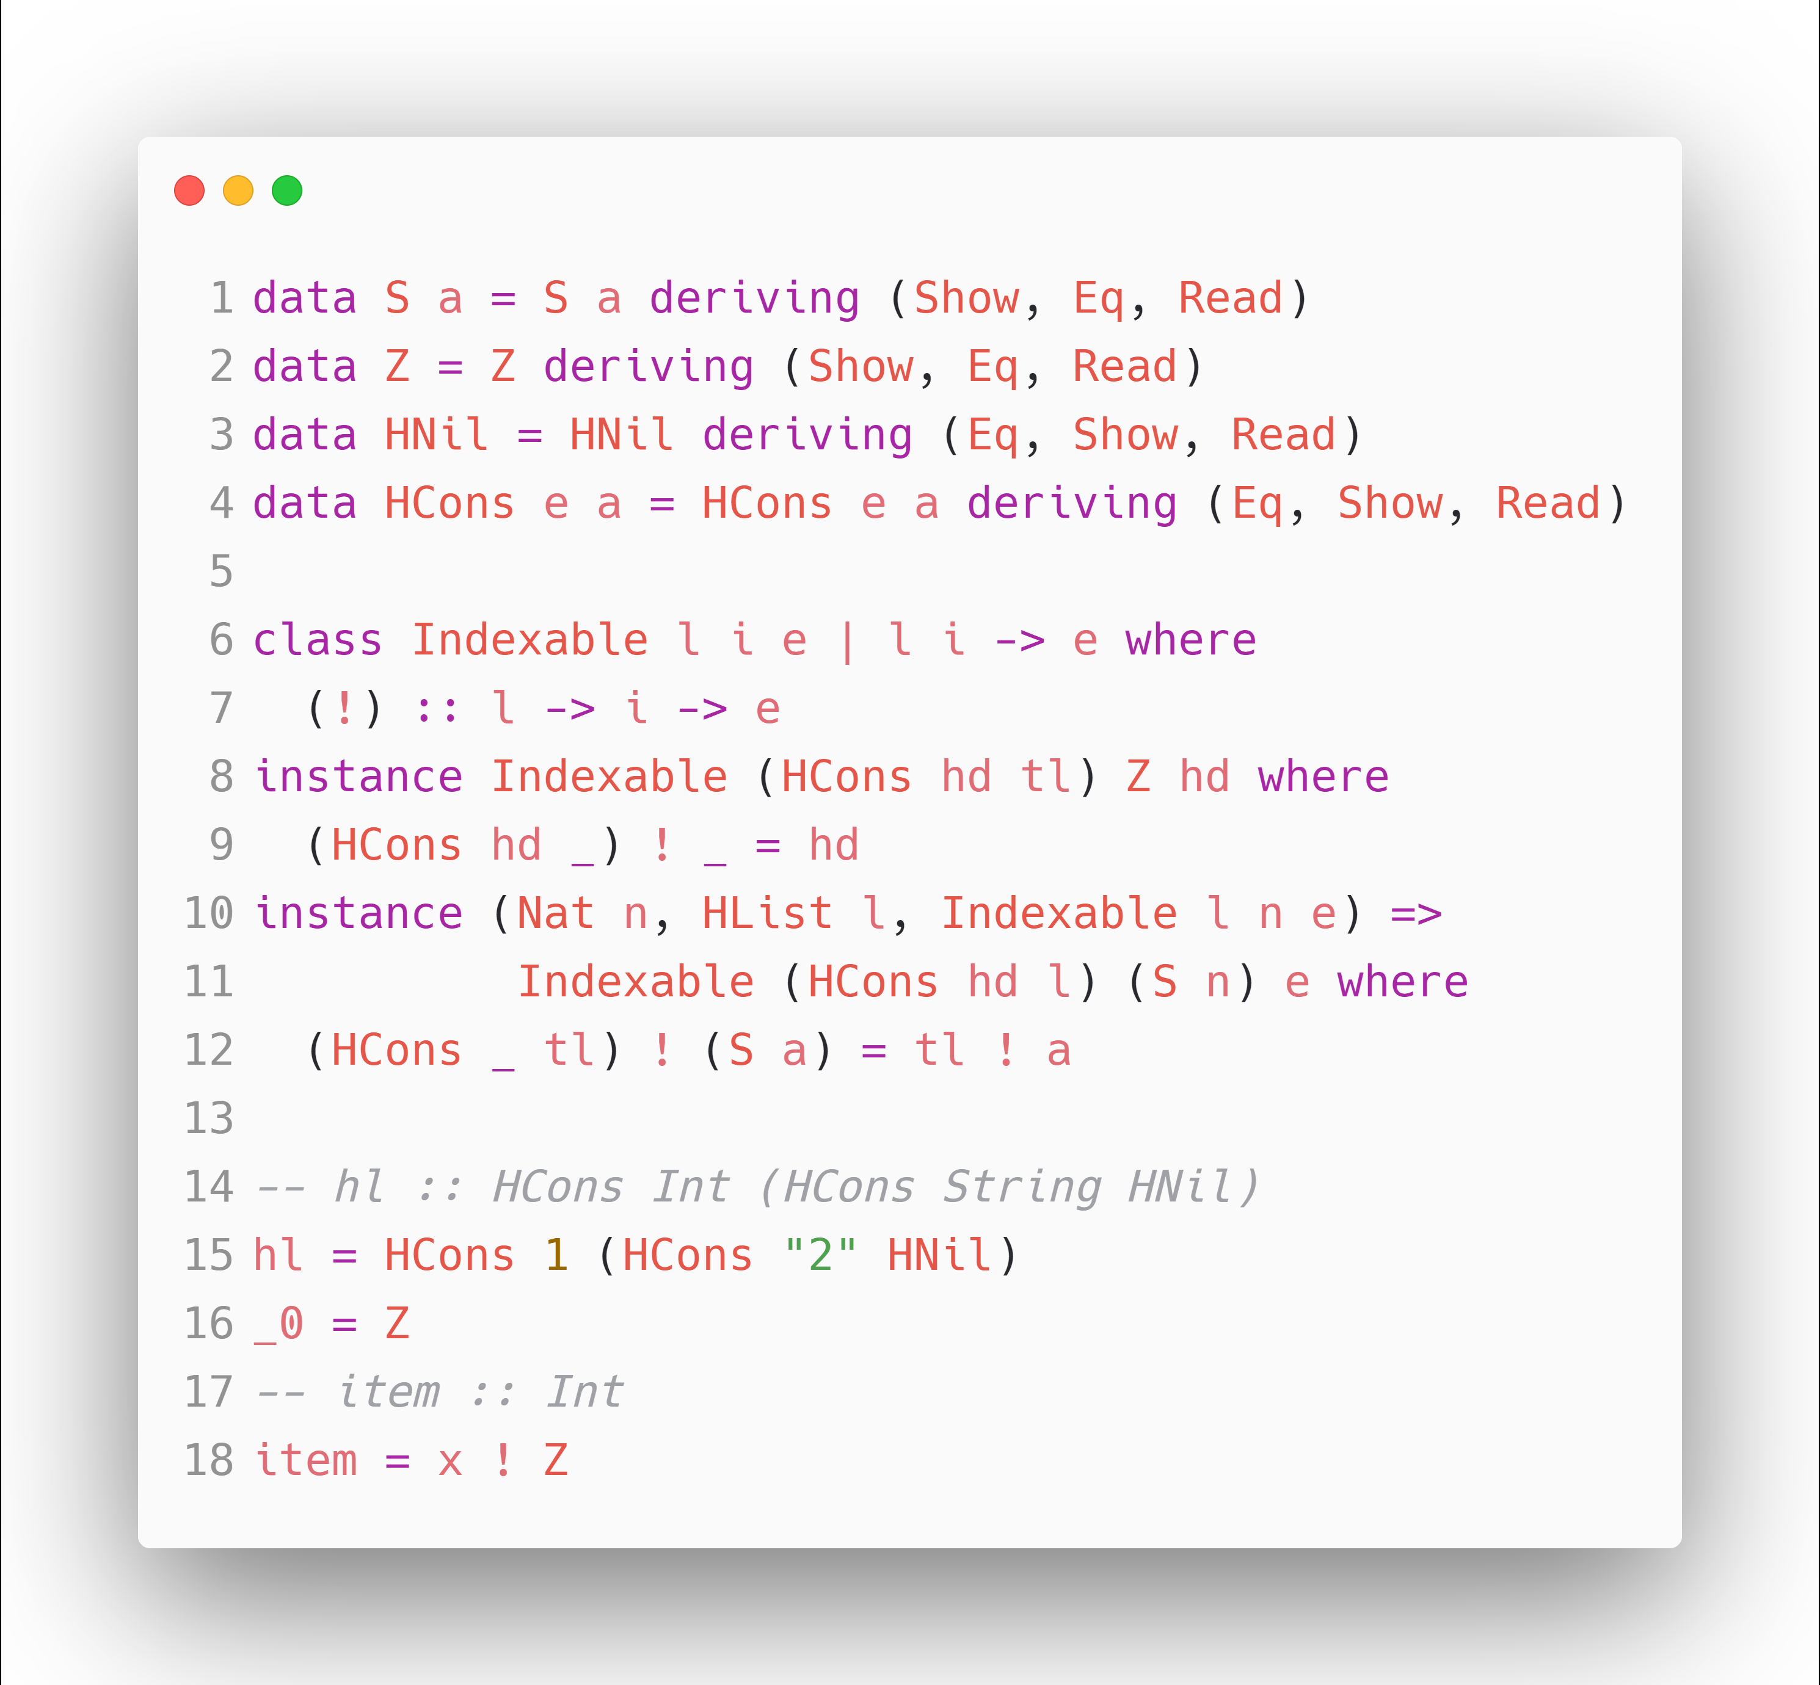
Dependent Integers & Heterogeneous Lists

Slide 3
Dependent Integers & Heterogeneous Lists
Use literals for inductive types and values?

Slide 4
Dependent Integers & Heterogeneous Lists
Use literals for inductive types and values?
Yes!
.. But how?

Slide 5
Dependent Integers & Heterogeneous Lists
Use literals for inductive types and values?
Yes!
hl = [hl|1, "2"|]
item = [nat|hl ! 0|]

Slide 6
Dependent Integers & Heterogeneous Lists
hl = [hl|1, "2"|]
item = [nat|hl ! 0|]
trivially mapped to
hl = Hcons 1 (HCons "2" HNil)
item = Z

Slide 7
Template Haskell
Package:
import Language.Haskell.TH
An expression quotation is written in Oxford brackets:
[a| … | ] :: Q Exp / Q Type / Q Decl / Q Pat
a is defined as a "quotation rule provider":
a :: QuasiQuoter
depends on where you put it

Slide 8
Template Haskell
We mainly want to transform Q Exp and Q Type, where we define quasiquoters nat and hl, so that
x :: [nat|2|] → x :: S (S Z)
x = [nat|2|] → x = S (S Z) x :: [hl|Int, Int] → x :: HCons Int (HCons Int HNil)
x = [hl|1, 2] → x = HCons 1 (HCons 2 HNil)

Slide 9
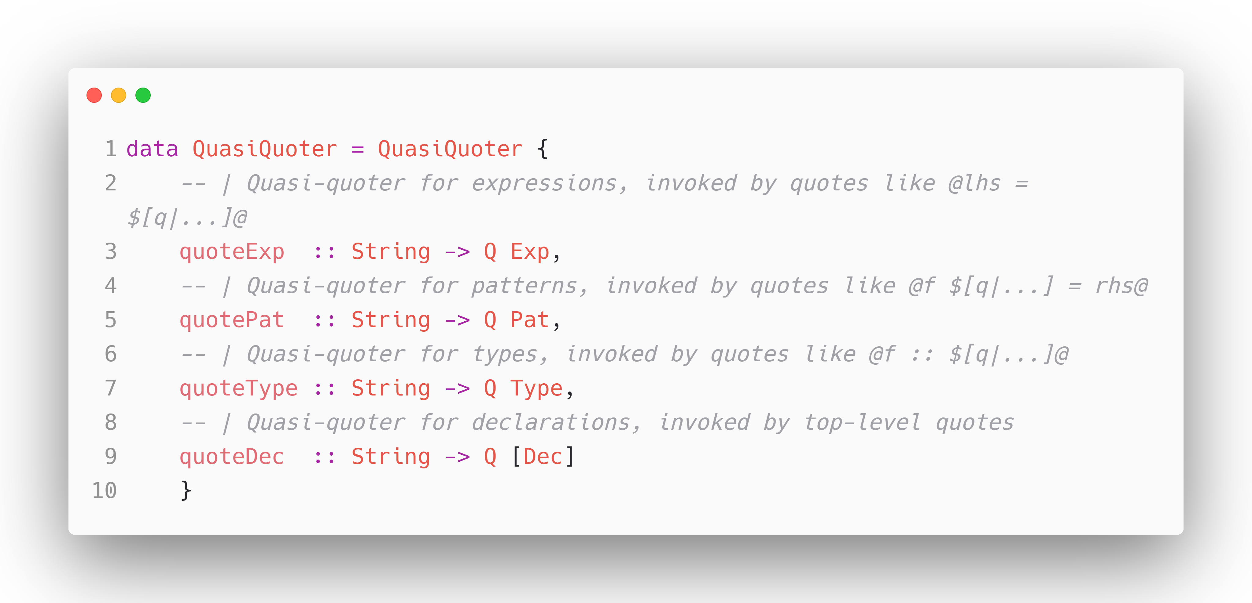
Template Haskell
https://github.com/DanBurton/haskell-src-meta
parsers from compiler
Just parsers!

Slide 10
Template Haskell
So the problem comes out: How could we rewrite Exp or Type.
We firstly use parsers from the Haskell compiler to get the standard quotations, and we also have to rewrite them into expected forms.
e.g.,
[nat | 1 | ] → parse to
LitE (IntegerL 1) → rewrite
AppE (ConE "S") (ConE "Z")

Slide 11
Template Haskell
Part of the constructors of Exp
VarE Name | { x }
ConE Name | data T1 = C1 t1 t2; p = {C1} e1 e2
LitE Lit | { 5 or 'c'}
AppE Exp Exp | { f x }
AppTypeE Exp Type | { f @Int }
InfixE (Maybe Exp) Exp (Maybe Exp) | {x + y} or {(x+)} or {(+ x)} or {(+)}
UInfixE Exp Exp Exp | {x + y}See Language.Haskell.TH.Syntax
ParensE Exp | { (e) }See Language.Haskell.TH.Syntax
LamE [Pat] Exp | { \ p1 p2 -> e }
LamCaseE [Match] | { \case m1; m2 }
TupE [Maybe Exp] | { (e1,e2) }The Maybe is necessary for handling tuple sections. (1,)translates to TupE [Just (LitE (IntegerL 1)),Nothing]
UnboxedTupE [Maybe Exp] | { (# e1,e2 #) }The Maybe is necessary for handling tuple sections. (# 'c', #)translates to UnboxedTupE [Just (LitE (CharL 'c')),Nothing]
UnboxedSumE Exp SumAlt SumArity | { (#|e|#) }
CondE Exp Exp Exp | { if e1 then e2 else e3 }
MultiIfE [(Guard, Exp)] | { if | g1 -> e1 | g2 -> e2 }
LetE [Dec] Exp | { let { x=e1; y=e2 } in e3 }
CaseE Exp [Match] | { case e of m1; m2 }
DoE [Stmt] | { do { p <- e1; e2 } }
Rewriting Exp or Type needs a visitor/traverser, however too many constructors..

Slide 12
Template Haskell
Part of the constructors of Exp
VarE Name | { x }
ConE Name | data T1 = C1 t1 t2; p = {C1} e1 e2
LitE Lit | { 5 or 'c'}
AppE Exp Exp | { f x }
AppTypeE Exp Type | { f @Int }
InfixE (Maybe Exp) Exp (Maybe Exp) | {x + y} or {(x+)} or {(+ x)} or {(+)}
UInfixE Exp Exp Exp | {x + y}See Language.Haskell.TH.Syntax
ParensE Exp | { (e) }See Language.Haskell.TH.Syntax
LamE [Pat] Exp | { \ p1 p2 -> e }
LamCaseE [Match] | { \case m1; m2 }
TupE [Maybe Exp] | { (e1,e2) }The Maybe is necessary for handling tuple sections. (1,)translates to TupE [Just (LitE (IntegerL 1)),Nothing]
UnboxedTupE [Maybe Exp] | { (# e1,e2 #) }The Maybe is necessary for handling tuple sections. (# 'c', #)translates to UnboxedTupE [Just (LitE (CharL 'c')),Nothing]
UnboxedSumE Exp SumAlt SumArity | { (#|e|#) }
CondE Exp Exp Exp | { if e1 then e2 else e3 }
MultiIfE [(Guard, Exp)] | { if | g1 -> e1 | g2 -> e2 }
LetE [Dec] Exp | { let { x=e1; y=e2 } in e3 }
CaseE Exp [Match] | { case e of m1; m2 }
DoE [Stmt] | { do { p <- e1; e2 } }
LitE SomeCase
→
AppE SomeValue
What we need only
Rewriting Exp or Type needs a visitor/traverser, however too many constructors..

Slide 13

How could we easily perform rewriting?
That we write a traverser only handling the LitE case, then maps it to some AppE.

Slide 14
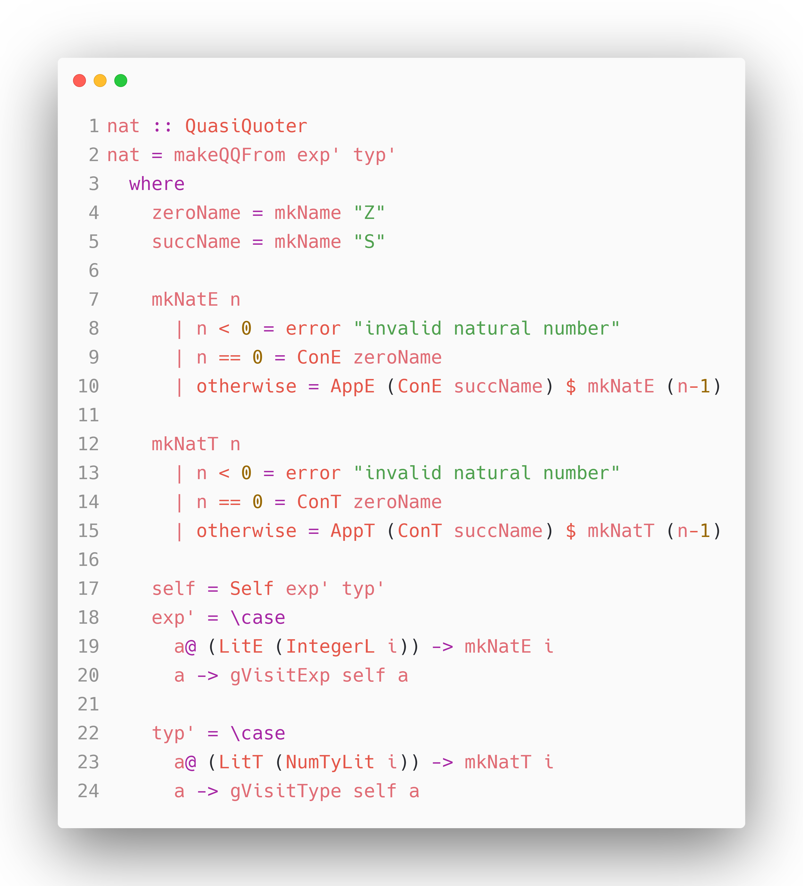
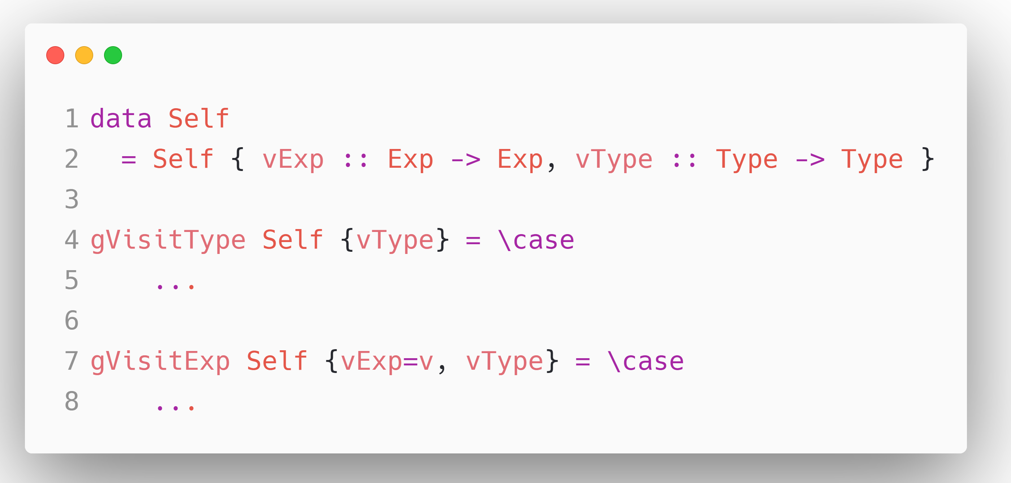

How could we easily perform rewriting?
That we write a traverser only handling the LitE case, then maps it to some AppE.
$$Y^{∗}$$

Slide 15
How could we easily perform rewriting?
That we write a traverser only handling the LitE case, then maps it to some AppE.
Write once,
reuse many times
$$Y^{∗}$$

Slide 16
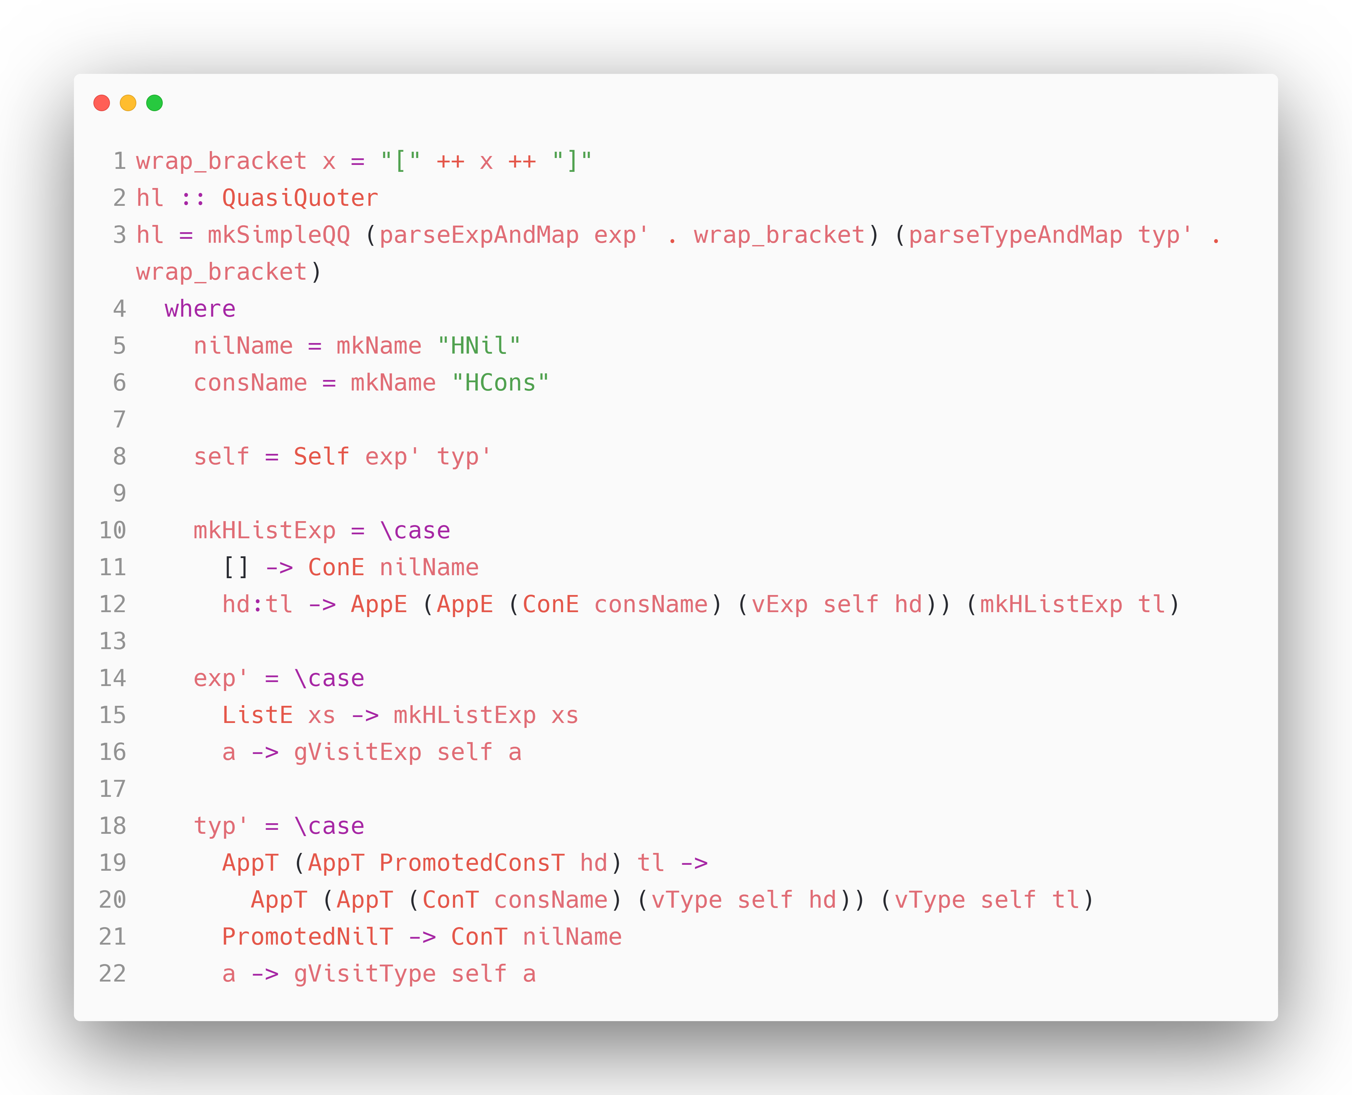
Heterogenous List Literal Implementations

Slide 17
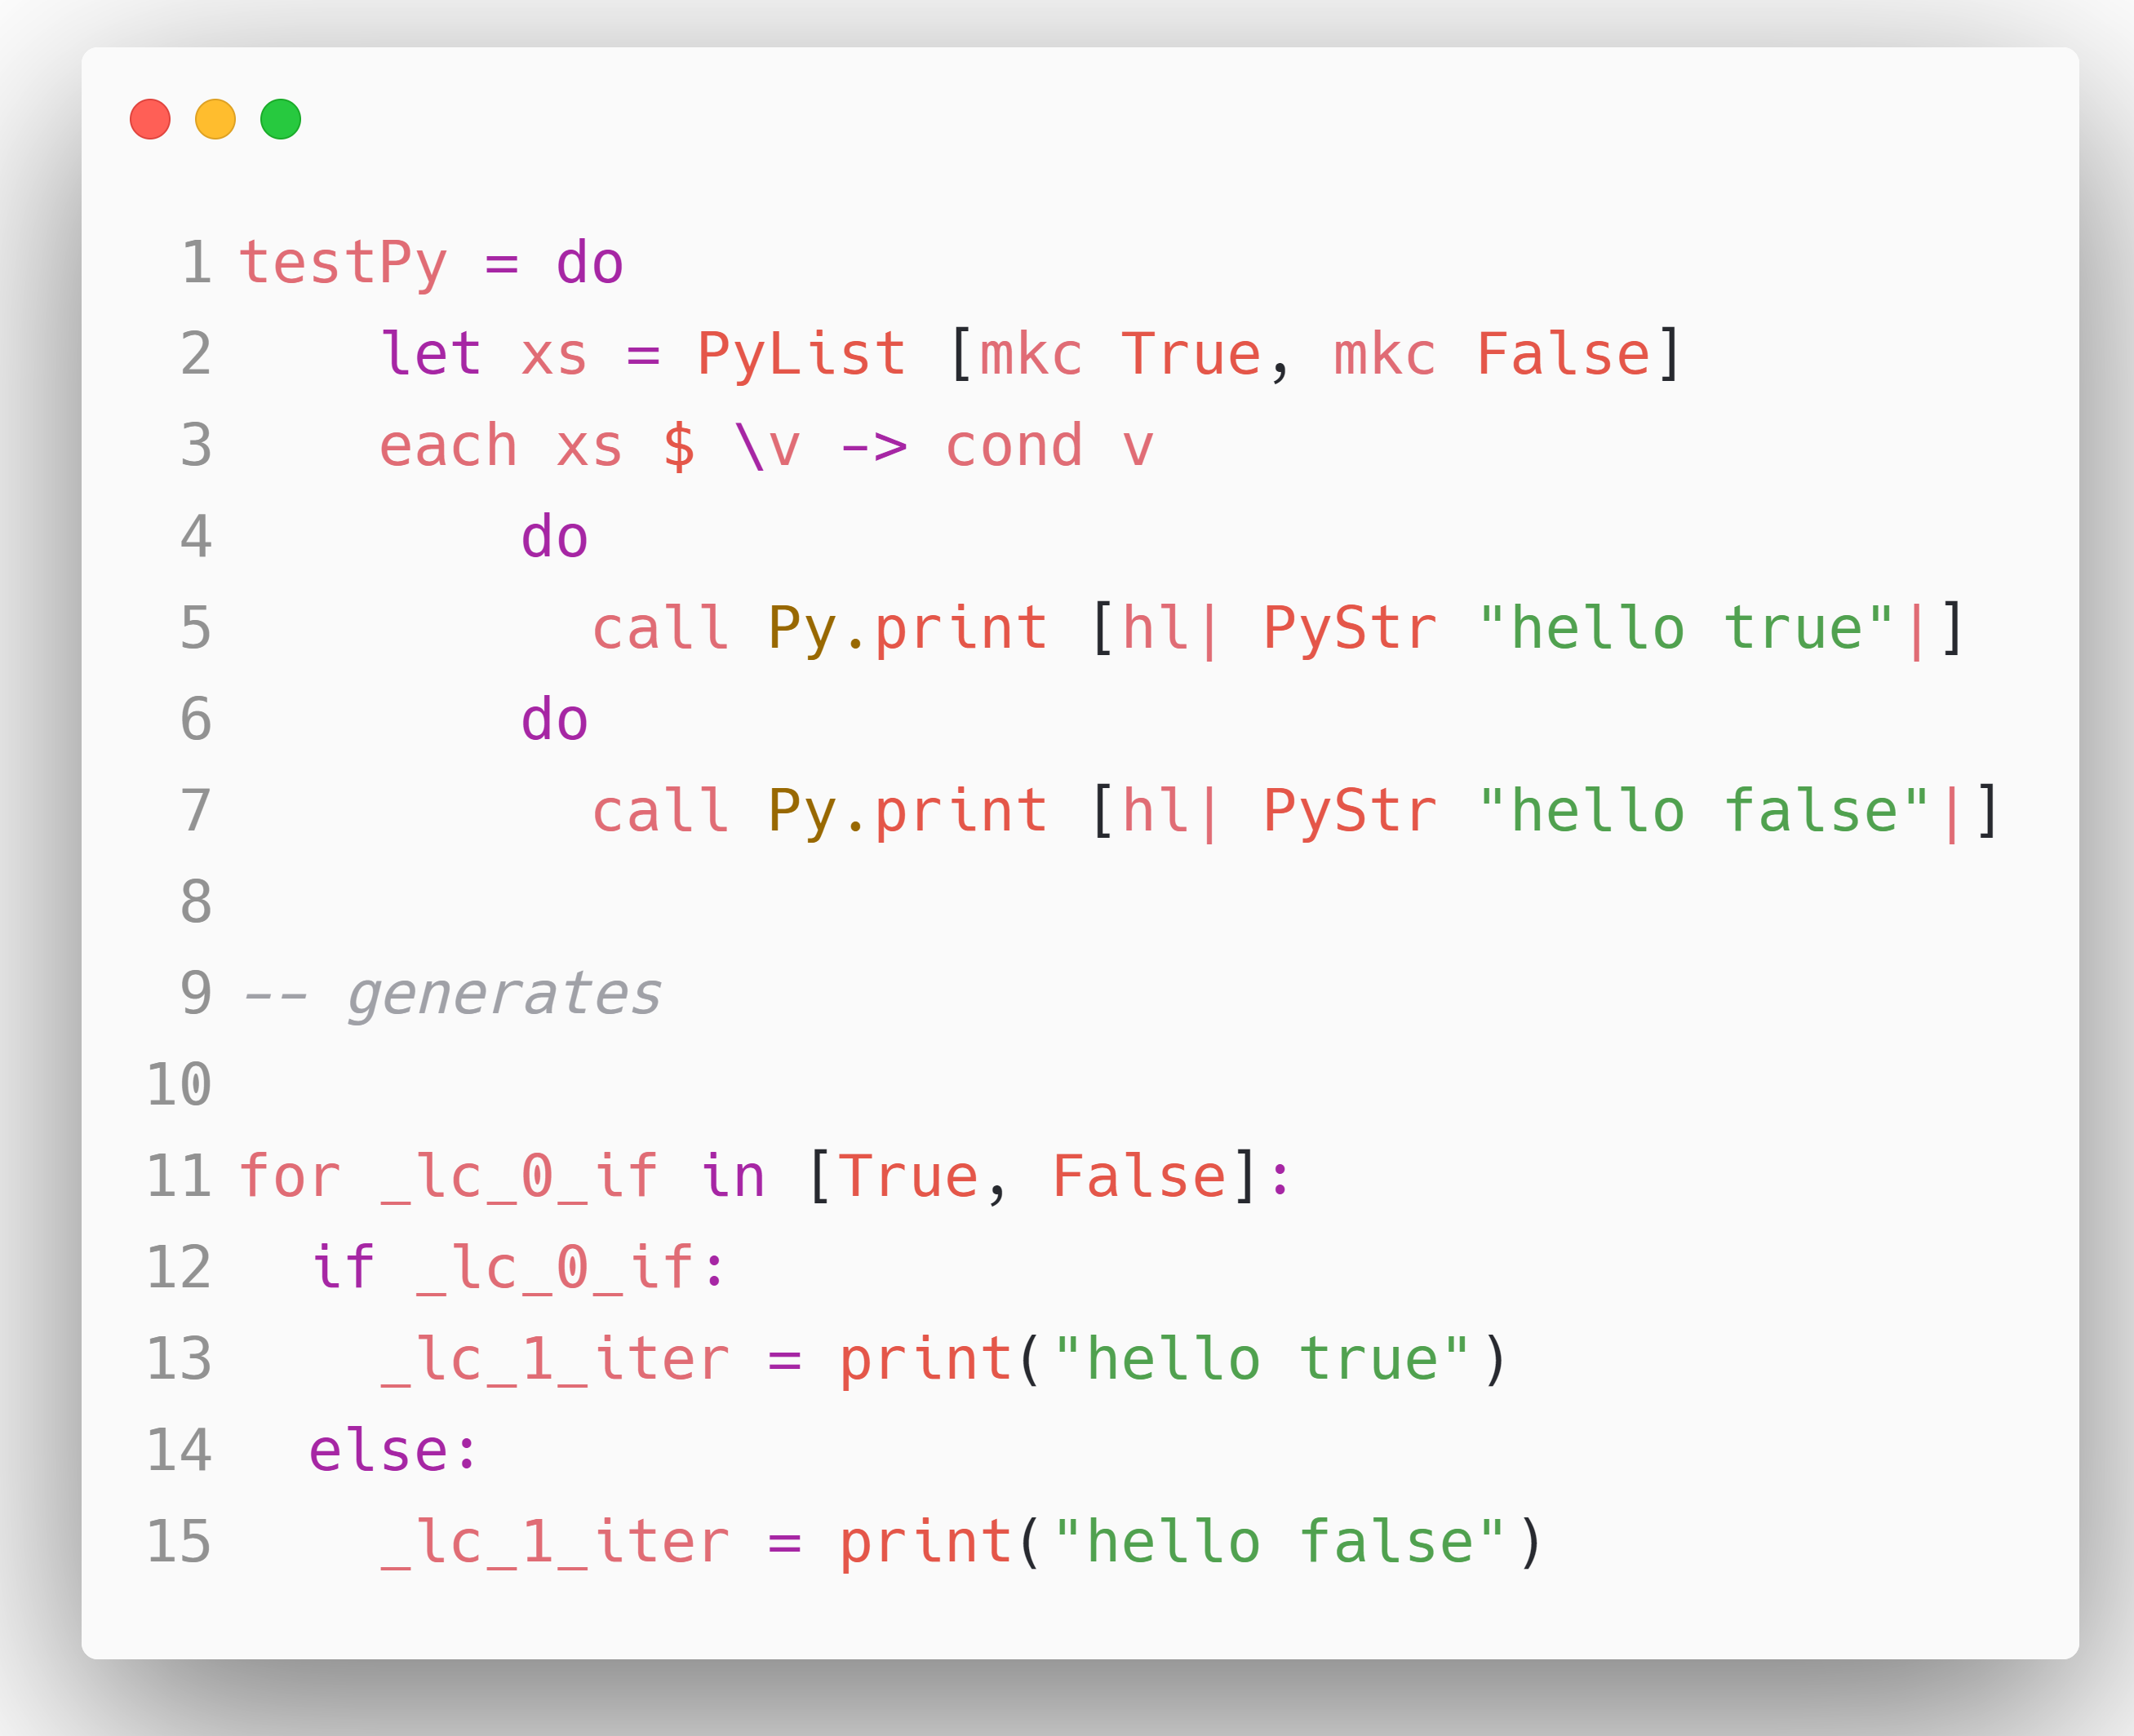
Typed eDSL with Vararg functions

