Slide 1
The First Step of Fully Compatible Python JIT DYNJIT
An Intermediate Language for lowering dynamic and imperative programming languages, for a PE-based JIT
Key Features of DYNJIT for JIT-ting Python code:
Need NO type annotations from the source language
Allow untagged union types, but greatly reduce the overhead
Allow volatile types for variables, but USUALLY eliminate the overhead
Allow runtime type checks, and take advantage of the type checking information to specialize code

Slide 2
Short Comments for CPython
Python is Slow for | Solution
Interpreter overhead | Generating native code(existing works like Cython)
Stack VM manipulations | Converting to Register-based IR(Restrain JIT by me)
(if we compile python) Variable types unstable | ?
Zero-optimized Control Flows | ?
Functions too ad-hoc, and dynamic calls | ?
Boxed objects | ?
Too many runtime type checks(users and internal) | ?
Global variables changeable during runtime | Some Tricks(introduced in previous slides)
… | …

Slide 3

Short Comments for CPython
Addressed!
Python is Slow for | Solution
Interpreter overhead | Generating native code(existing works like Cython)
Stack VM manipulations | Converting to Register-based IR(Restrain JIT by me)
(if we compile python) Variable types unstable | ?
Zero-optimized Control Flows | ?
Functions too ad-hoc, and dynamic calls | ?
Boxed objects | ?
Too many runtime type checks(users and internal) | ?
Global variables changeable during runtime | Some Tricks(introduced in previous slides)
… | …

Slide 4
Functions specialized to “Methods”

Slide 5
Splitting Union Types: Type Stable Variables

Slide 6
Runtime type checks help to optimize control flows

Slide 7
More static, less runtime introspections!
Remove redundant isinstances, static call

Slide 8
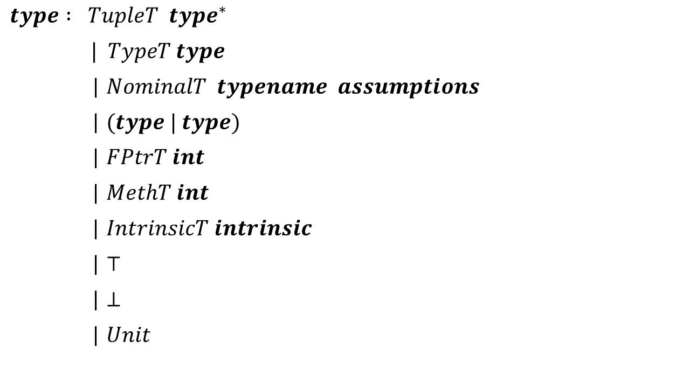
The Language DYNJIT
$$type : TupleT type^{∗}$$
$| TypeT type$
| $NominalT typename assumptions$
| $(type | type)$
| $FPtrT int$
| $MethT int$
| $IntrinsicT intrinsic$
| $⊤$
| $⊥$
| $Unit$

Slide 9
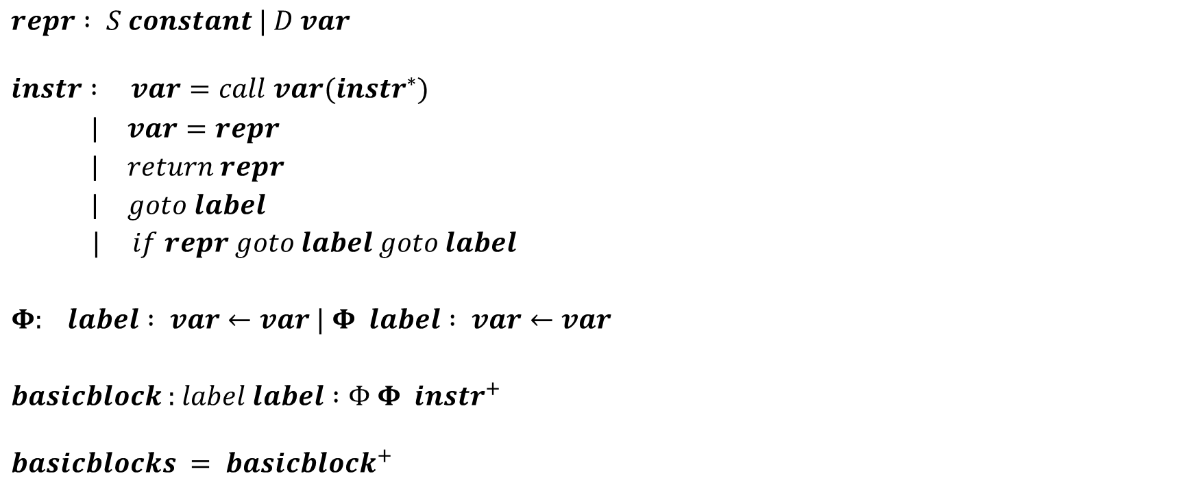
The Language DYNJIT
$$repr : S constant | D var$$
$$instr : var=call var(instr^{∗})$$
| $var=repr$
| $return repr$
| $goto label$
| $if repr goto label goto label$
$Φ$: $label : var←var$| $Φ label : var←var$
$basicblock$ : $label label :Φ Φ instr^{+}$
$$basicblocks = basicblock^{+}$$

