Slide 1
Python JIT: Implementation
Tackling Undecidable Global Variables
Selecting A Compiler and Hooking Python Functions
Transforming Python Bytecode Instructions to Our Core Language
*Keeping Object Identity?(investigating)

Slide 2
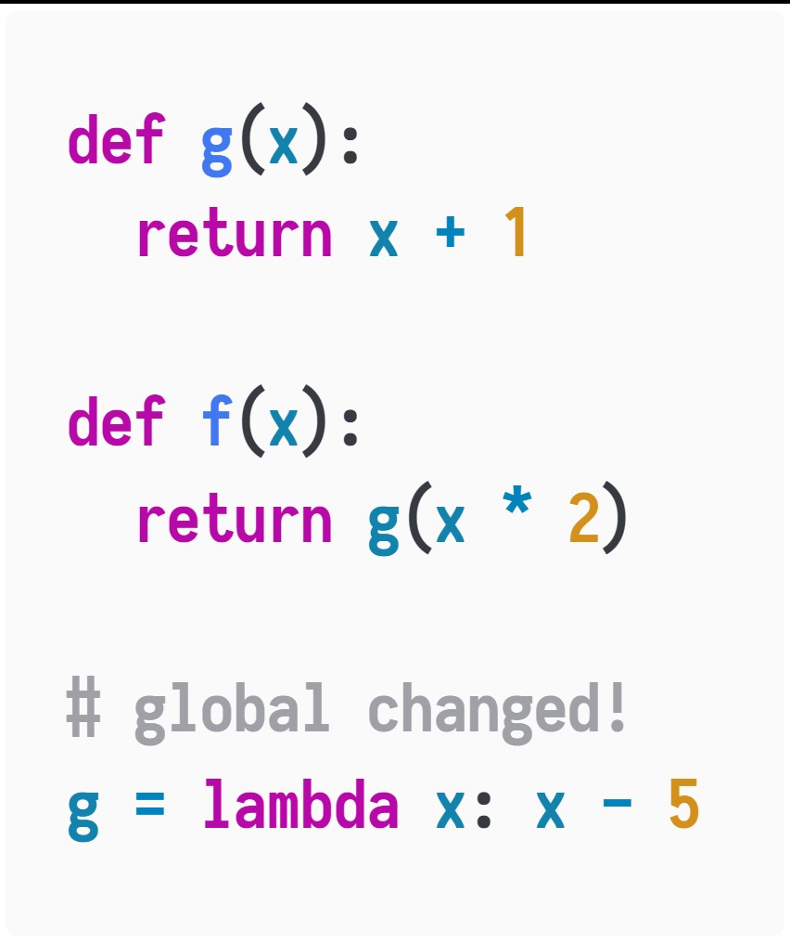
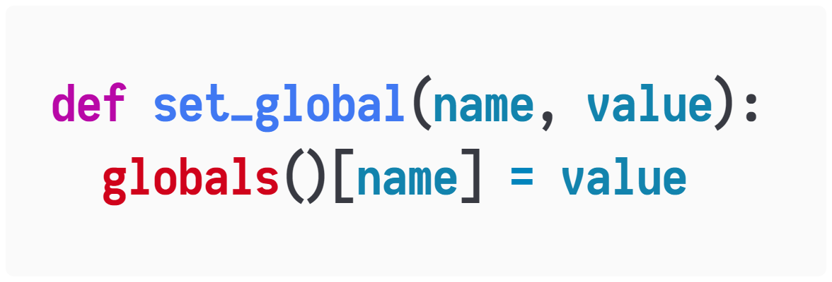
The Global Variable Issues
Tackling Undecidable Global Variables
Python is lexically scoped, however, it looks dynamic when it comes to the global variables.
This makes optimizations hard.
We cannot assume which function the symbol g in f is referring to.
What’s worse:
Globals

Slide 3
What’s the Matter?
Tackling Undecidable Global Variables
If we cannot determine the symbol references even in runtime, we cannot specialize and inline function calls!
If g at here has multiple methods/overloads, we won’t be able to remove the overhead of dynamic dispatch.

Slide 4
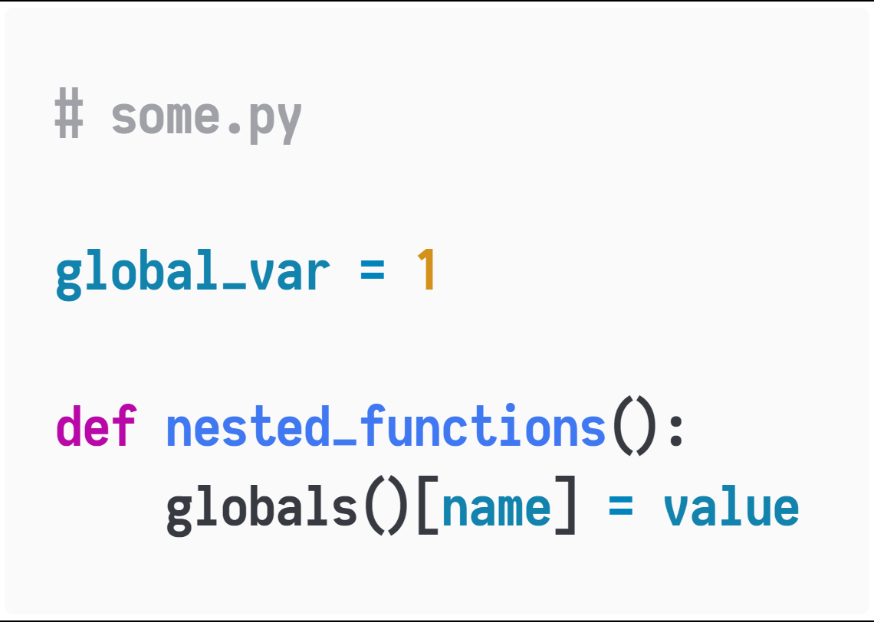
Analysis and Track of Mutations of Global Variables
Tackling Undecidable Global Variables
Fortunately, this is achievable.
Changing Global Variables in Python has 2 approaches:
Via STORE_GLOBAL instructions, this is easy to analyse
Via mutating the dict that globals returns

Slide 5
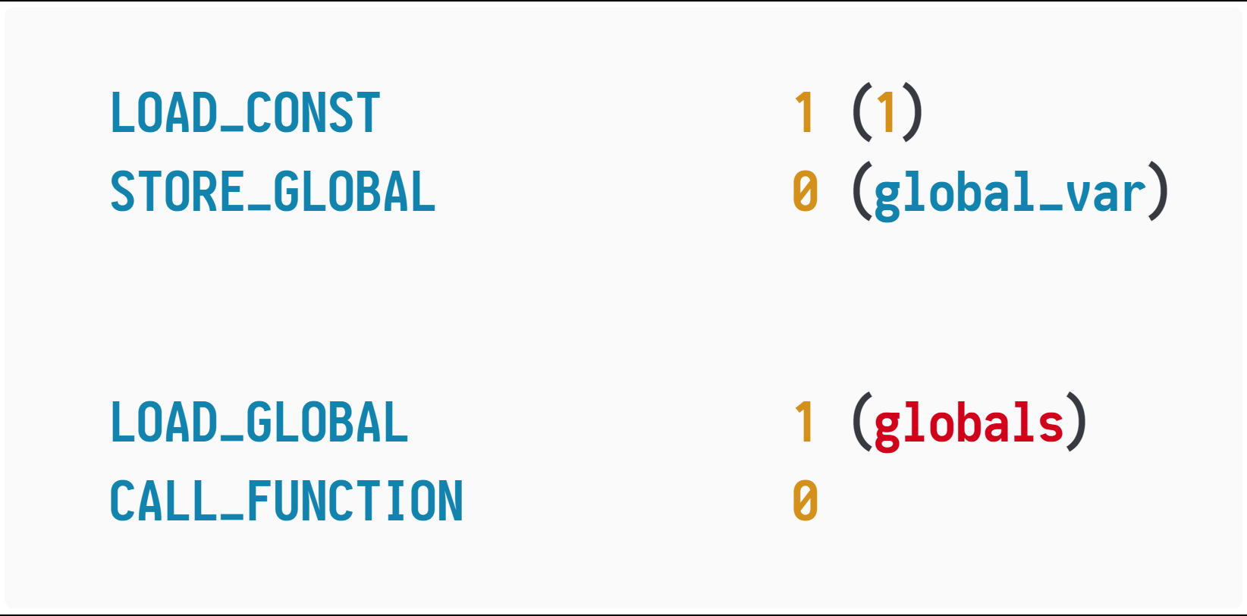
Analysis and Track of Mutations of Global Variables
Tackling Undecidable Global Variables
Changing Global Variables in Python has 2 approaches:
Via STORE_GLOBAL instructions, this is easy to analyse
Via mutating the dict that globals returns

Slide 6
Analysis and Track of Mutations of Global Variables
Tackling Undecidable Global Variables
Insert some instructions here to aware our JIT compiler:
global variable global_var changed in some module!
insert something
insert something
Insert some instructions, to check if the globals loaded here is identical to the builtin one.
If so, we convert it to a proxy one, which could aware our compiler once globals got written.
As a consequence, in every point of the program execution, we know what a symbol is referencing, efficiently(by slowing changing global variables, we gain the chances to optimize more usual code!!)

Slide 7
Implementations about Instruction Insertions
Tackling Undecidable Global Variables
Using Python import machinery:
(PEP 302, PEP 420)
Python programs run by interpreting bytecode instructions. We can hook the process of getting bytecode. We rewrite the bytecode, perform our analysis on it, and inject instructions to support tracking mutations of global variables!

Slide 8
Selecting A Compiler
Selecting A Compiler and Hooking Python Functions
Advantages of using Julia as a JIT compiler:
Avoid invoking a C compiler ourselves
Occupy our code generation with the support of Julia’s CUDA/SIMD/AVX LoopVectorization
There exists a mature Python<->Julia interoperation framework, by this we reduce the need of calling Python primitive C-APIs.
Avoid managing compiled files, including loading and linking issues.
If we use Julia for a JIT compiler, we can use Julia for more parts of our JIT framework, like implementing type inference and PE.
Julia has implementations of pattern matching and type classes, hence, from a user’s perspective coding is more of fun, reliability and modularity.

Slide 9
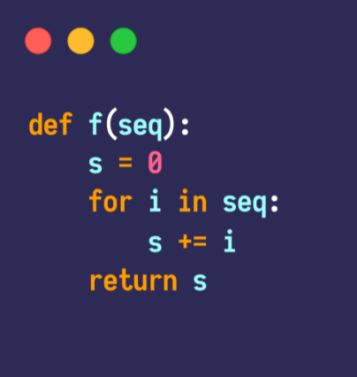
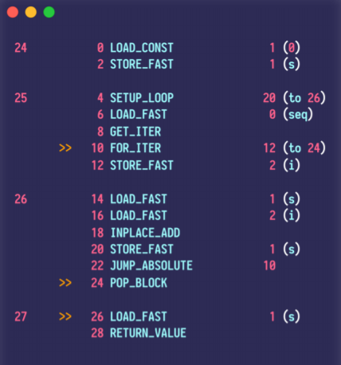
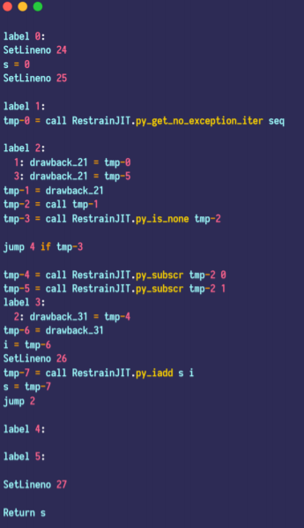
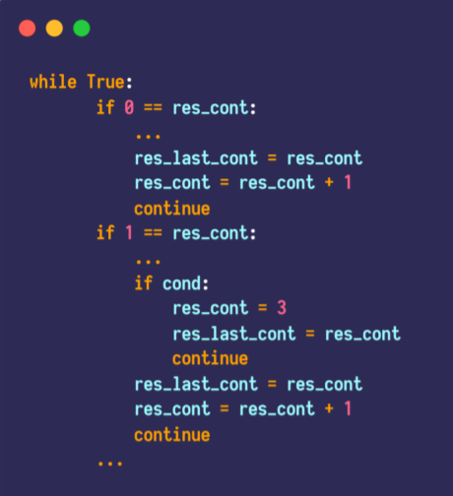
Control Flow Analysis
Transforming Python Bytecode Instructions to Our Core Language
We need to restore the program from
Python code objects(containing scope information and maximum stack usage, etc.)
bytecode instructions
Source Code(not available)
Bytecode(always available)
Some IR
Register-machine IR
Python
does it
Our abstract interpretation
Relooper, PE, etc.

