Slide 1
The First Step of Fully Compatible Python JIT DYNJIT
A PE-based JIT compiler optimizing dynamic and imperative code
Key Features of DYNJIT for JIT-ting Python code:
Need NO type annotations from the source language
Allow untagged union types, but greatly reduce the overhead
Allow volatile types for variables, but USUALLY eliminate the overhead
Allow runtime type checks, and take advantage of the type checking information to specialize code

Slide 2
Short Comments for CPython
Python is Slow for | Solution
Interpreter overhead | Generating native code(existing works like Cython)
Stack VM manipulations | Converting to Register-based IR(Restrain JIT by me)
(if we compile python) Variable types unstable | ?
Zero-optimized Control Flows | ?
Functions too ad-hoc, and dynamic calls | ?
Boxed objects | ?
Too many runtime type checks(users and internal) | ?
Global variables changeable during runtime | Some Tricks(introduced in previous slides)
… | …

Slide 3

Short Comments for CPython
Addressed by DYNJIT!
Python is Slow for | Solution
Interpreter overhead | Generating native code(existing works like Cython)
Stack VM manipulations | Converting to Register-based IR(Restrain JIT by me)
(if we compile python) Variable types unstable | ?
Zero-optimized Control Flows | ?
Functions too ad-hoc, and dynamic calls | ?
Boxed objects | ?
Too many runtime type checks(users and internal) | ?
Global variables changeable during runtime | Some Tricks(introduced in previous slides)
… | …

Slide 4
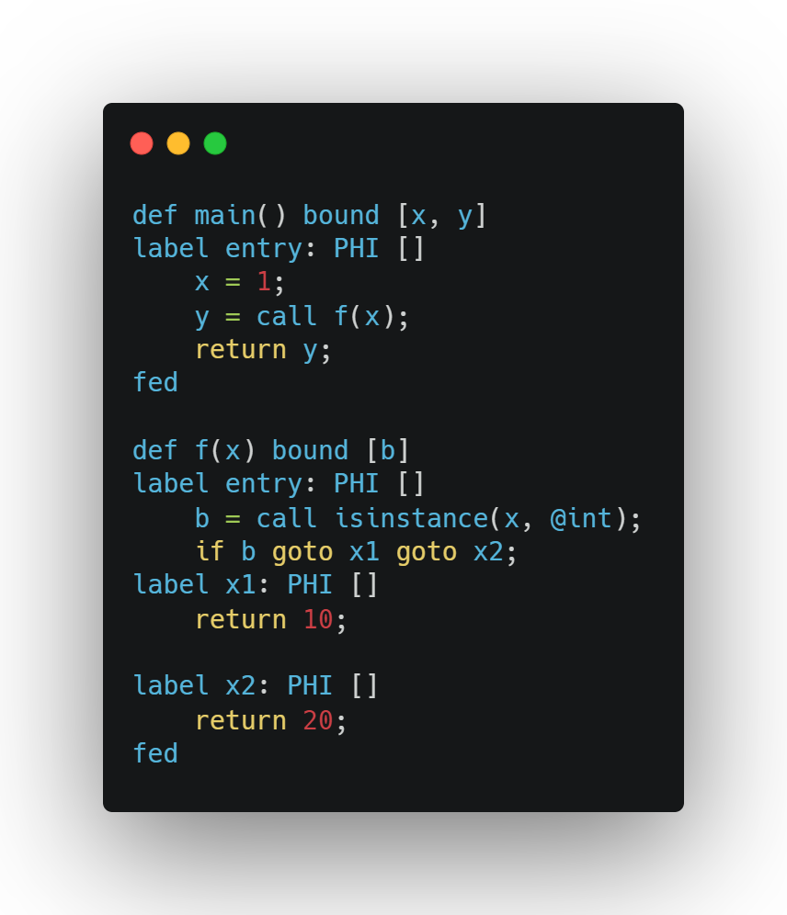
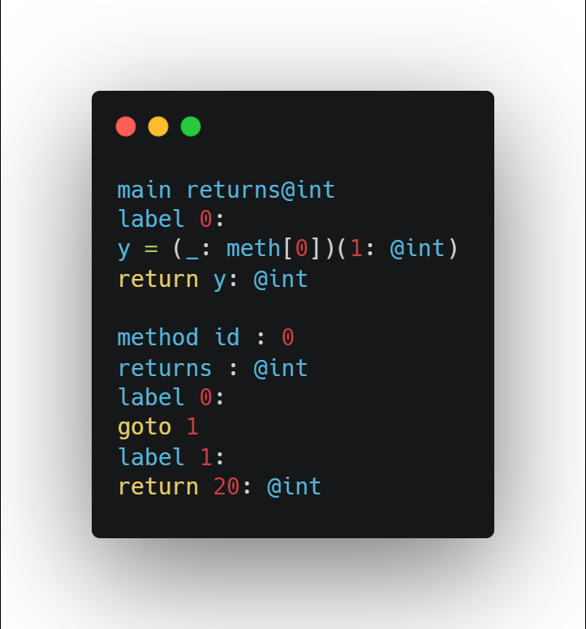
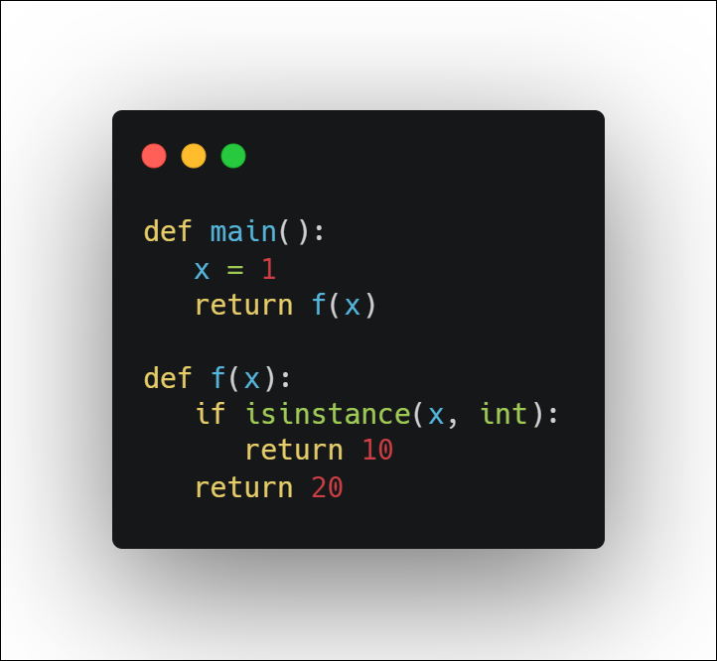


Functions specialized to “Methods”
Python
$$DYNJIT^{Source}$$
$$DYNJIT^{Target}$$

Slide 5
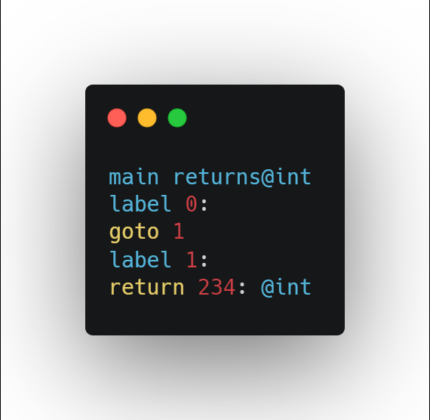
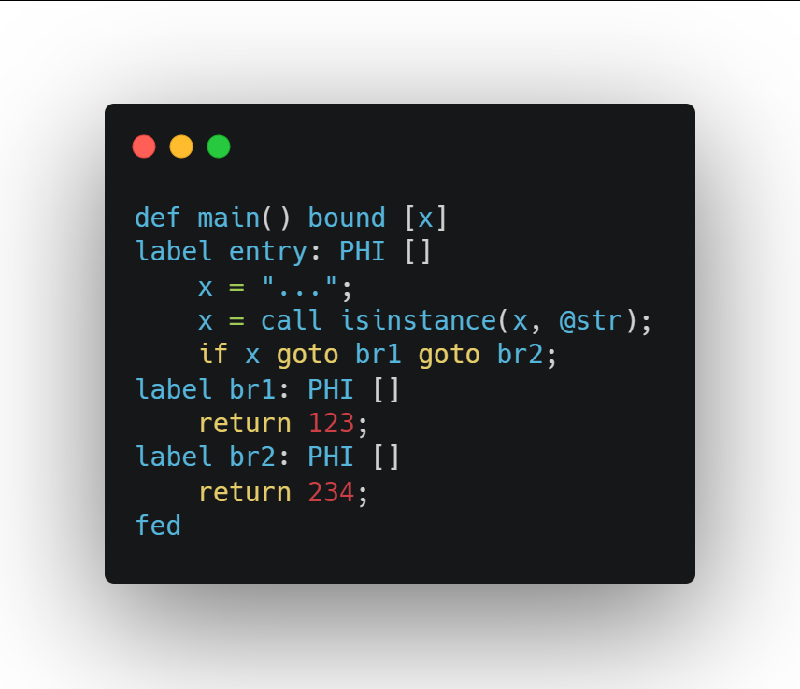
Runtime type checks help to optimize control flows
Target
Source

Slide 6

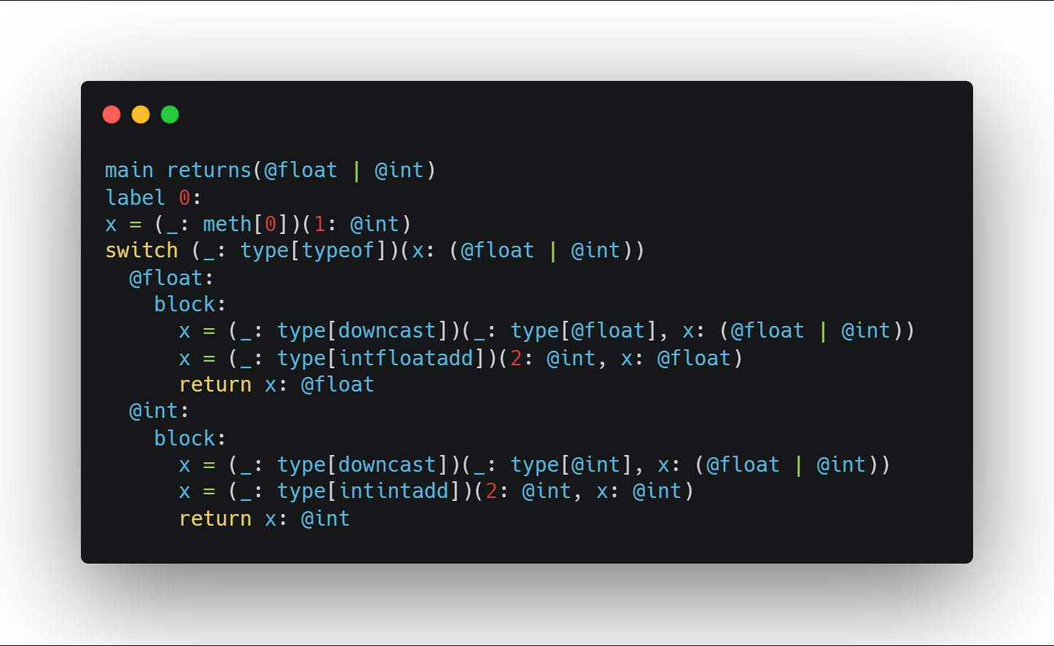
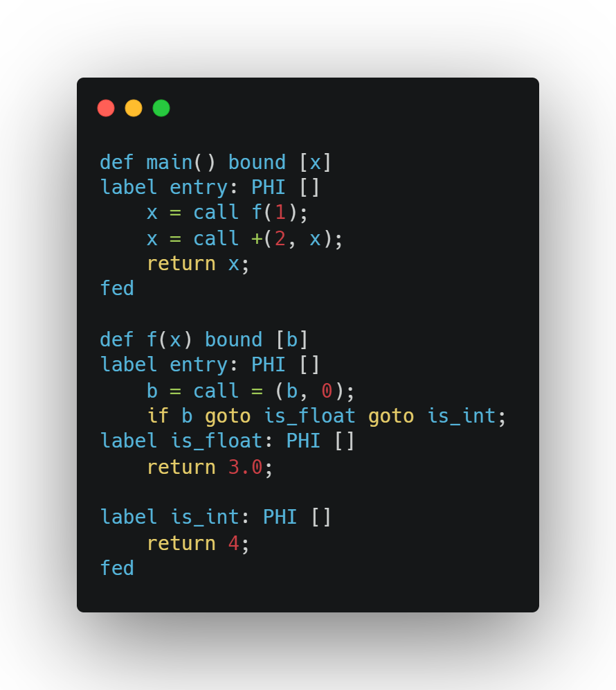
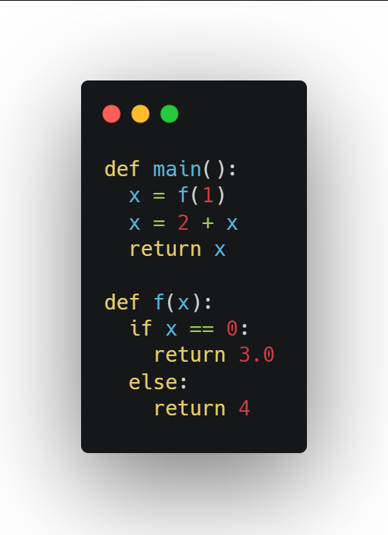



Splitting Union Types: Type Stable Variables
$$DYNJIT^{Target}$$
$$DYNJIT^{Source}$$
$$Python$$

Slide 7
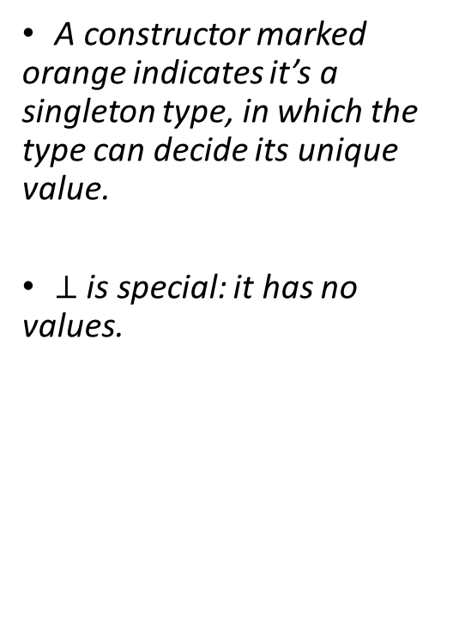
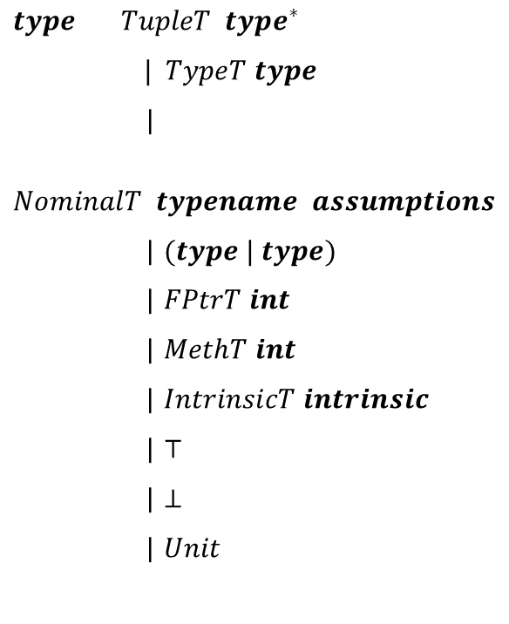
Types in DYNJIT
$type TupleT type^{∗}$
$| TypeT type$
|
$NominalT typename assumptions$
| $(type | type)$
| $FPtrT int$
| $MethT int$
| $IntrinsicT intrinsic$
| $⊤$
| $⊥$
| $Unit$
A constructor marked orange indicates it’s a singleton type, in which the type can decide its unique value.
$⊥$ is special: it has no values.

Slide 8
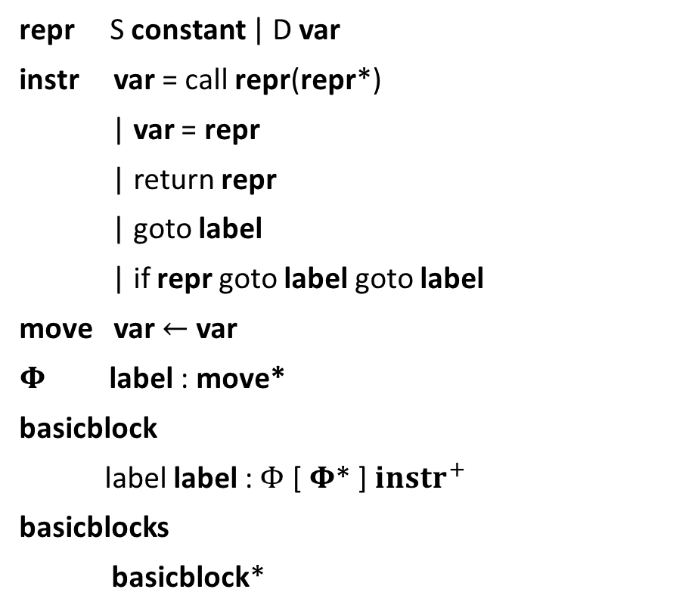
The Source Intermediate Language of DYNJIT
repr S constant | D var
instr var = call repr(repr*)
| var = repr
| return repr
| goto label
| if repr goto label goto label
move var $←$ var
$Φ$ label : move*
basicblock
label label : $Φ$ [ $Φ$* ] ${instr}^{+}$
basicblocks
basicblock*

Slide 9
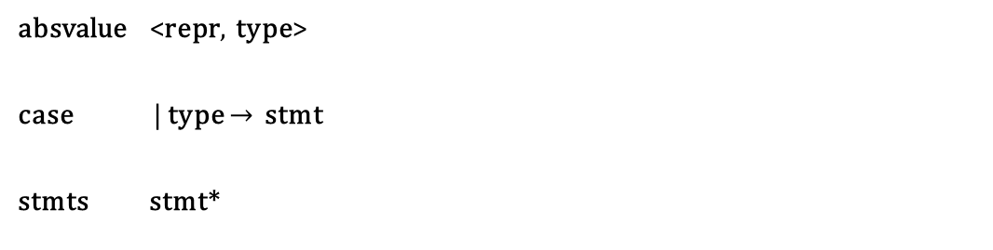
The Target Intermediate Language of DYNJIT
expr absvalue | call expr(expr*)
stmt var = expr
| goto label
| return expr
| if expr goto label goto label
| if expr then stmt else stmt
| do expr
| label label
| { expr* }
| switch expr case*
absvalue <repr, type>
case | type $→$ stmt
stmts stmt*

Slide 10
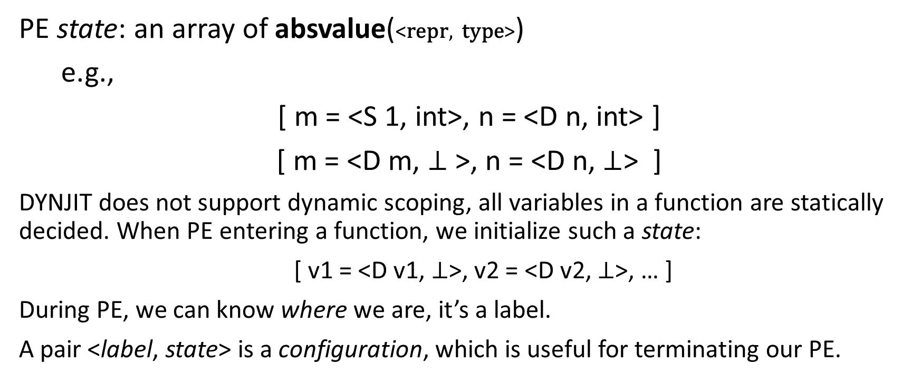
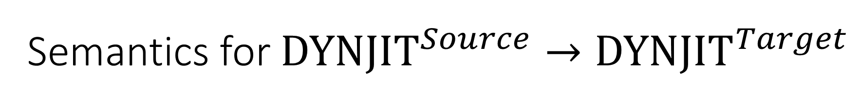
Semantics for ${DYNJIT}^{Source}→{DYNJIT}^{Target}$
PE state: an array of absvalue(<repr, type>)
e.g.,
[ m = <S 1, int>, n = <D n, int> ]
[ m = <D m, $⊥$ >, n = <D n, $⊥$> ]
DYNJIT does not support dynamic scoping, all variables in a function are statically decided. When PE entering a function, we initialize such a state:
[ v1 = <D v1, $⊥$>, v2 = <D v2, $⊥$>, … ]
During PE, we can know where we are, it’s a label.
A pair <label, state> is a configuration, which is useful for terminating our PE.

Slide 11
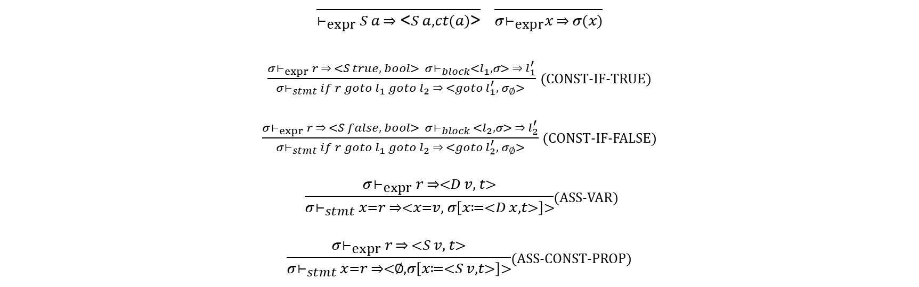
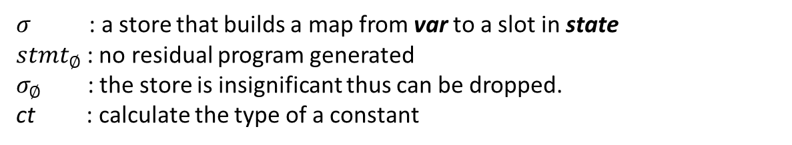
Semantics for ${DYNJIT}^{Source}→{DYNJIT}^{Target}$
$\frac{ }{⊢_{expr} S a ⇒ \text{<}S a, ct(a)\text{>}}$ $\frac{ }{σ⊢_{expr}x ⇒ σ(x)}$
$\frac{σ⊢_{expr} r ⇒ <S true, bool> σ⊢_{block}<l_{1},σ> ⇒ l_{1}^{′}}{σ⊢_{stmt} if r goto l_{1} goto l_{2} ⇒ <goto l_{1}^{′}, σ_{∅}> }$ (CONST-IF-TRUE)
$\frac{σ⊢_{expr} r ⇒ <S false, bool> σ⊢_{block} {<l}_{2},σ> ⇒ l_{2}^{′}}{σ⊢_{stmt} if r goto l_{1} goto l_{2} ⇒ <goto l_{2}^{′}, { σ}_{∅}>}$ (CONST-IF-FALSE)
$\frac{σ⊢_{expr} r ⇒<D v, t>}{σ⊢_{stmt} x=r ⇒<x=v, σ\left[x≔<D x, t>\right]>}$(ASS-VAR)
$\frac{σ⊢_{expr} r ⇒ <S v, t>}{σ⊢_{stmt} x=r ⇒<∅, σ\left[x≔<S v, t>\right]>}$(ASS-CONST-PROP)
Expressions
& Conditional Jump Specialization
$σ$ : a store that builds a map from var to a slot in state
$stmt_{∅}$ : no residual program generated
$σ_{∅}$ : the store is insignificant thus can be dropped.
ct : calculate the type of a constant

Slide 12
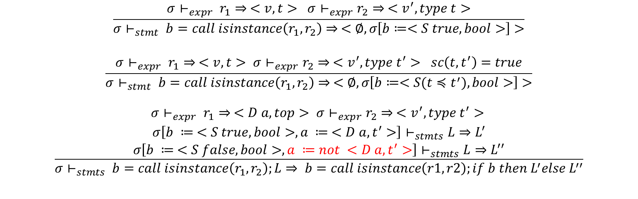
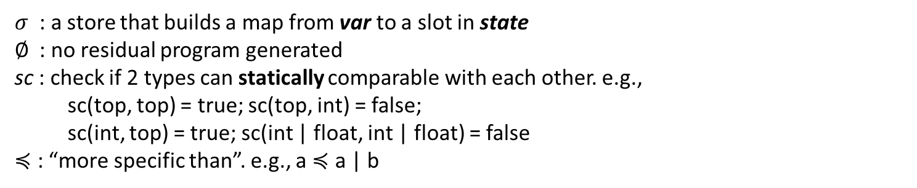
Semantics for ${DYNJIT}^{Source}→{DYNJIT}^{Target}$
$$\frac{σ⊢_{expr} r_{1}⇒ <v, t> σ⊢_{expr}r_{2}⇒ <v^{′}, type t>}{σ⊢_{stmt} b=call isinstance\left(r_{1}, r_{2}\right)⇒ <∅, σ\left[b≔<S true, bool>\right]>}$$
$$\frac{σ⊢_{expr} r_{1}⇒ <v, t> σ⊢_{expr}r_{2}⇒ <v^{′}, type t^{′}> sc\left(t, t^{′}\right)=true}{σ⊢_{stmt} b=call isinstance\left(r_{1}, r_{2}\right)⇒ <∅, σ\left[b≔<S(t≼t^{′}), bool>\right]>}$$
$$\frac{\begin{aligned}σ⊢_{expr} r_{1}⇒ <D a, top> σ⊢_{expr}r_{2}⇒ <v^{′}, type t^{′}> \\ σ\left[b ≔ <S true, bool>, a ≔ <D a, t^{′}>\right]⊢_{stmts}L⇒L^{′} \\ σ\left[b ≔ <S false, bool>,a ≔not <D a, t^{′}>\right]⊢_{stmts}L⇒L^{′′}\end{aligned}}{σ⊢_{stmts} b=call isinstance\left(r_{1}, r_{2}\right);L⇒ b=call isinstance\left(r1, r2\right);if b then L^{′}else L^{′′}}$$
Specializations from user-written runtime type checks
isinstance is an intrinsic literal.
$σ$ : a store that builds a map from var to a slot in state
$∅$ : no residual program generated
sc : check if 2 types can statically comparable with each other. e.g.,
sc(top, top) = true; sc(top, int) = false;
sc(int, top) = true; sc(int | float, int | float) = false
$≼$ : “more specific than”. e.g., a $≼$ a | b
Unfortunately, we cannot use this information in our positive supercompiler ☹

Slide 13
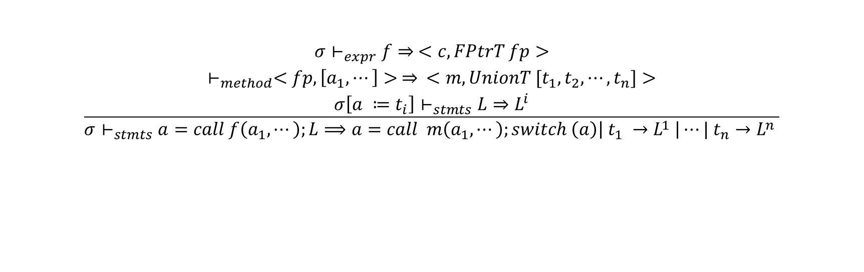
Semantics for ${DYNJIT}^{Source}→{DYNJIT}^{Target}$
Method specializations
& Union type splitting
$$\frac{\begin{aligned} \\ \begin{aligned} \\ \end{aligned} \\ \\ σ⊢_{expr}f⇒ <c, FPtrT fp> \\ ⊢_{method}<fp, \left[a_{1}, ⋯\right]> ⇒ <m,UnionT [t_{1}, t_{2},⋯,t_{n}]> \\ σ\left[a ≔t_{i}\right]⊢_{stmts}L⇒L^{i}\end{aligned}}{σ⊢_{stmts}a=call f\left(a_{1},⋯\right);L⟹a=call m\left(a_{1}, ⋯\right);switch \left(a\right)\left| t_{1} →L^{1} \right|⋯| t_{n}→L^{n} }$$
$σ$ : a store that builds a map from var to a slot in state

Slide 14
A Brief Summary
DYNJIT works for dynamic and imperative code.
It can
optimize control flows,
generate and select specialized “methods” for a too ad-hoc function,
Specialize code followed by a function call returning union types,
Specialize code followed by runtime type checks, and
Unbox objects when the static types are known
Issues:
Loops may be inefficient if types are unstable.
Recursive functions not terminating yet(WIP)
Using assumptions of user defined types to do specializations?
…

