Slide 1
Fully Compatible Python JIT
With Availability and Usability

Slide 2
Previous Attempts
The well-known
Psyco
PyPy
PyJion
Pyston
Numba
Not that well-known
JitPy
HOPE
Restrain-JIT(by me)
Numba and PyPy turns out to be the most popular and successful so far.

Slide 3
The PROBLEM of previous attempts?
Q: Did you heard that Python is a language with JIT support so far?
A: NO.
Why?
You cannot use a JIT to speed up your general Python programs:
You’re likely using CPython , which the majority of users are using.
PyPy cannot work for CPython directly, it’s a separate runtime.
Numba can speed up numeric computation
And for others, how to use , how to fetch it, how to install…
Too difficult, even unavailable.
Specifically, why we insist on CPython, but not migrate to PyPy?

Slide 4
Why no PyPy?
PyPy is nice, but it’s hard to migrate to:
PyPy is not running in CPython runtime, and people are already working on CPython softwares and workflows. They use C extenstions to ease the performance issues.
PyPy does not compat Python’s C extensions well, so far:
PyPy uses optimized runtime object representations, ABI incompatible to CPython
To compat CPython, PyPy is now imitating CPython objects’ memory layouts.
Hence PyPy’s use of CPython’s C extensions is extremely slow

Slide 5
Fully Compatible?
What is the “fully compatible”?
In terms of the effect, users can gain the free lunch, of
a significant speed up, and
“no need to change theirs codes or workflows”, etc.
As for HOWTO:
Either:
A new Python but is strictly superset and superior of CPython(PyPy’s approach).
However we don’t prefer to do this, as it’s quite a huge task.
PyPy is already the state of the art, implementing with alternative methods makes few sense.
Or:
Something in CPython, keep everything, but faster.

Slide 6
Something in CPython, keep everything, but faster
Sounds stupid?
So many attempts before, how could you convince this approach is valid?
Hey dude, notice that almost every one thinks too much!
Please don’t try to make a fancy JIT in the very beginning!
What if we want to achieve a JIT compiler that is
stably effected
easily compatible
concisely implemented
not-that-aggressive(performances as well as behaviours)
extensible and capable of gradually getting improved?

Slide 7
Decades later since the previous attempts…
We have many other successful attempts in JIT to refer:
Julia, a dynamic language with amazing JIT
Ruby MJIT since Ruby 2.6
JIT requires a compiler in runtime, decades ago we don’t have many options, but now we have many related supports from the community and the Python organizations:
Nuikta(Python to C++ compiler)
Cython(state-of-the-art Python to C/C++ compiler)
PEP0384(stable C API for CPython)
HPy(better C API for CPython, avoid CPython’s abstraction leaks)
...

Slide 8
Time to make the dreaming Python JIT!
Runtime specialization:
Review of Psyco
Architecture:
Problems of runtime specialization:
we need Type System
Runtime specialization is awesome!
We need runtime type inference!
Code Inspection and
Compilation Pipeline
By the way, Partial Evaluation and Inline
Memory layout optimizations:
Compact object representations with sufficient type information
Get Code:
AST, IR, Bytecode?
CodeGen, Compile, Load
Compat CPy Objects

Slide 9
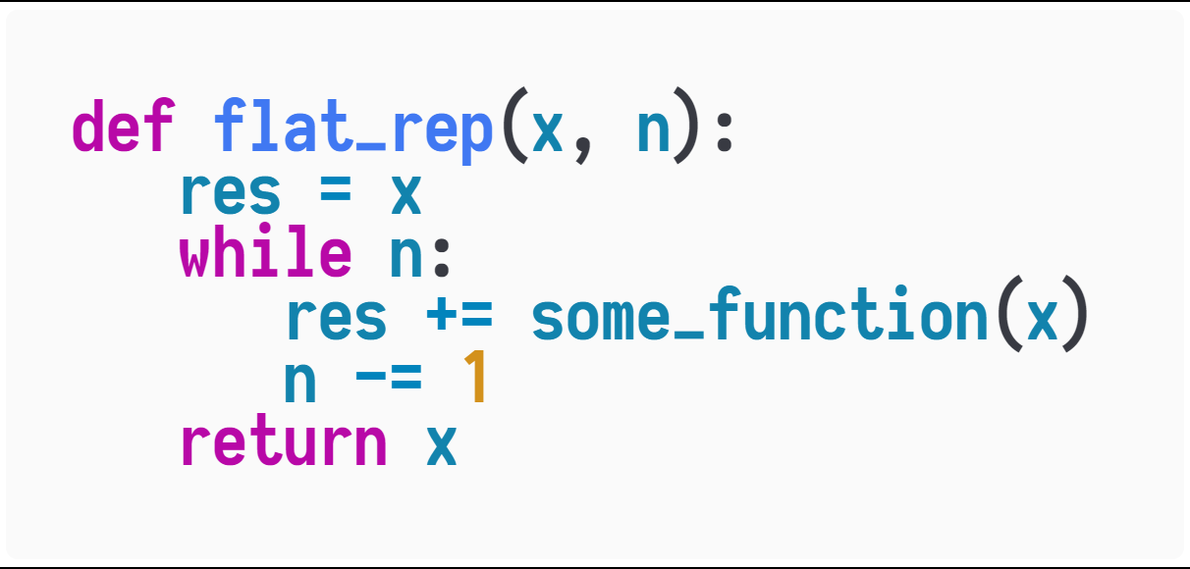
Runtime specialization: Review of Psyco[PEPM 2004]
When calling flat_rep during runtime, it's okay for us to use the types of arguments to select an optimized method.
An optimized method for specific types is also generated in runtime, like flat_rep(str, int) -> str and flat_rep(int, int) -> int.
Why we will benefit from runtime specialization and runtime codegen?

Slide 10
Why do specialization?
See flat_rep, when calling it,
we must be able to specialize flat_rep, and
we might be able to specialize some_function which is invoked inside flat_map, and
we might also be able to specialize inner function calls happened inside some_function,
…

Slide 11
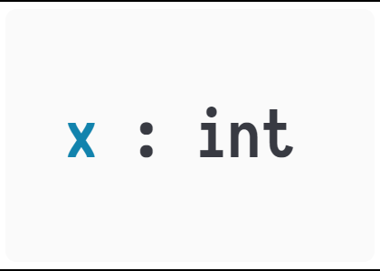
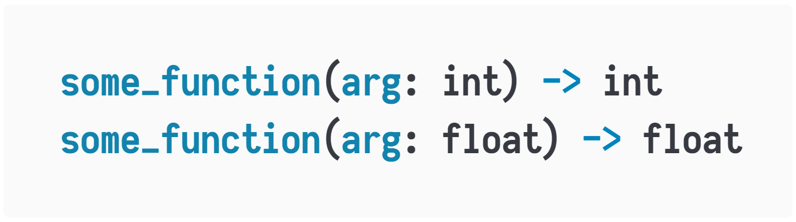
Runtime type inference
We select a specialized some_function when specializing flat_rep!
Notice that,
the possibility of specializing inner function calls,
is just depending on if we can decide the argument types of inner function calls,
which depends on how we infer the types,
so we need runtime type inference!
The use of runtime type inference in Julia programming language just shows
its practicability!

Slide 12
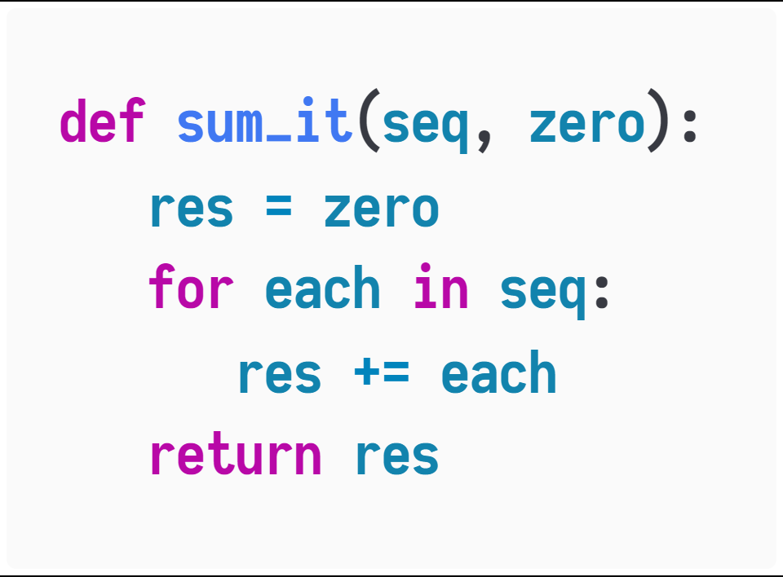

Problems of runtime specialization: Python’s weak type representations
By using Python types, we can successfully dispatch by using the type of the second parameter.
However!
We CANNOT specialize for the first parameter, because it is always a list.
So to make JIT more impressive, we need design a better runtime representations.
sum_it([1, 2, 3], 0) $⇒$ sum_it(list, int) $→$ int.
sum_float([1.0, 2.0, 3.0], 0.0) $⇒$ sum_it(list, float) $→$ float.

Slide 13
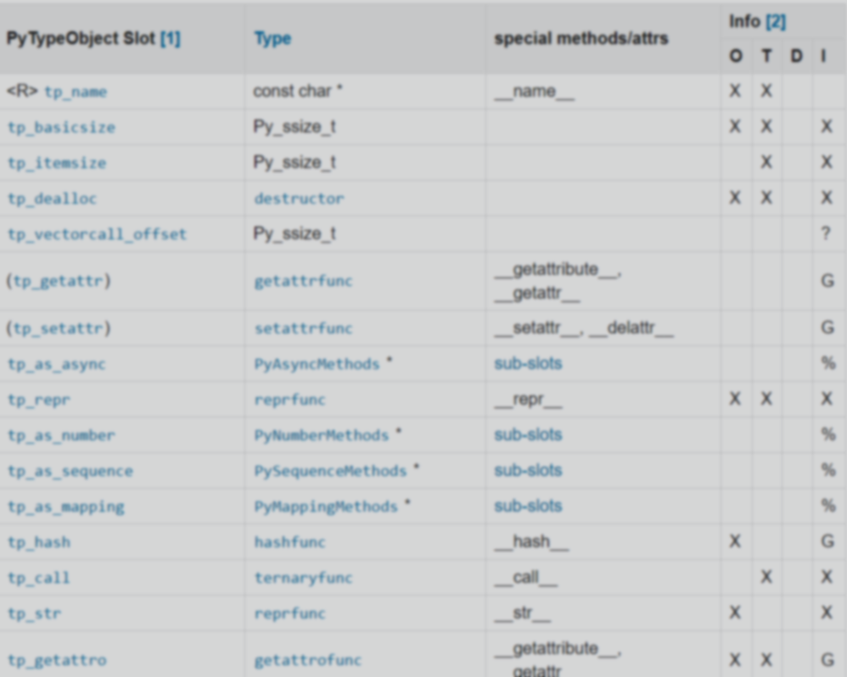
Memory Layouts Optimizations
https://docs.python.org/3/c-api/typeobj.html
Python object representations are too huge and difficult to work with JIT.
We should separate things into
Raw data
Metadata
And make raw data smaller and more compact.
Chances are everywhere,
to avoid accessing and making metadata for each object.

Slide 14
Code Inspection and Compilation Pipeline
Python doesn’t provide a robust way to access its code.
Which compiler to use for JIT compilation?
Code generation, loading compiled code…
…
These’re more of a design, not difficult technical parts.

Slide 15
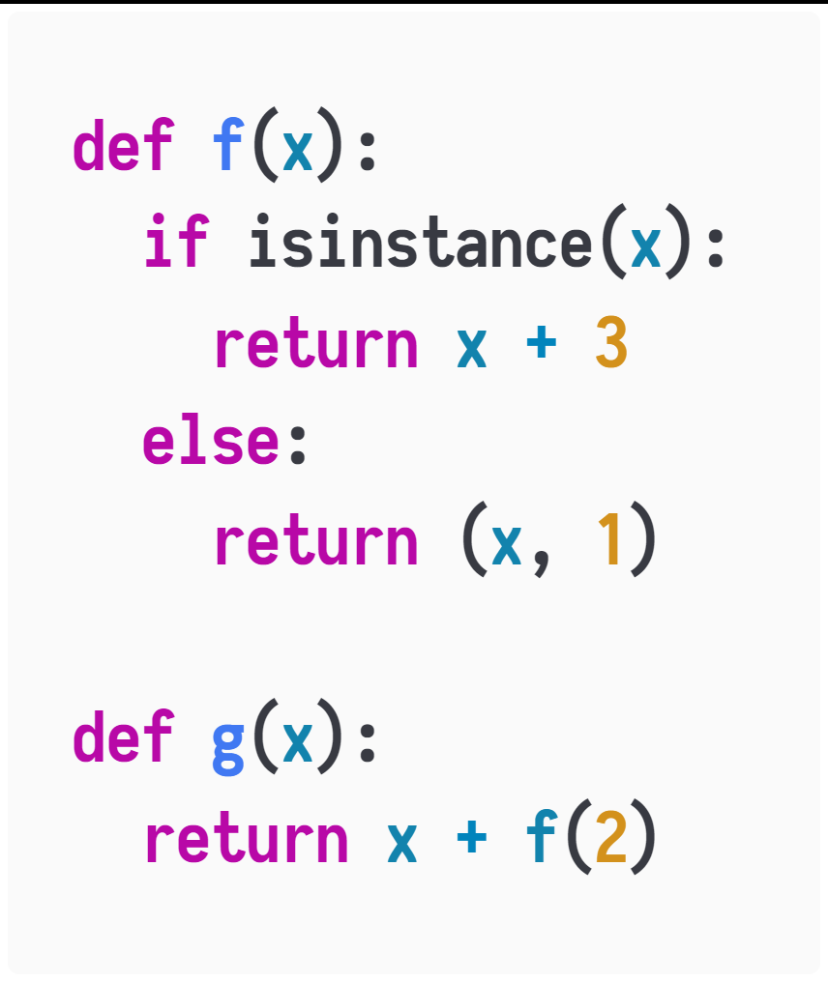
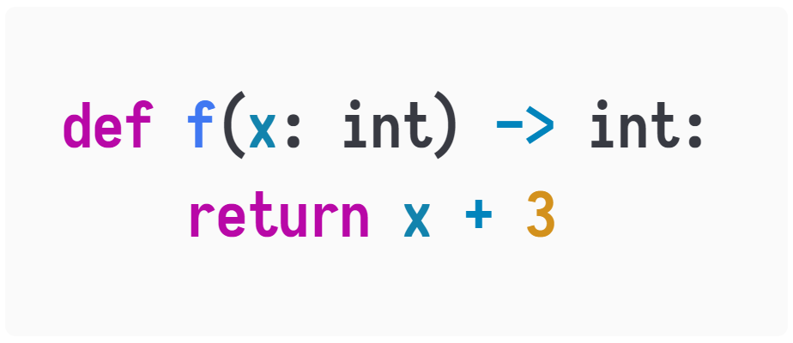
Supplementary 1: Super Compiler and Partial Evaluation
When specializing f(x) with x : int , we maintain the assumption x : int to partial evaluate expressions like isinstance(x, int) and the if statements, which is quite similar to the super compilation.

