Slide 1
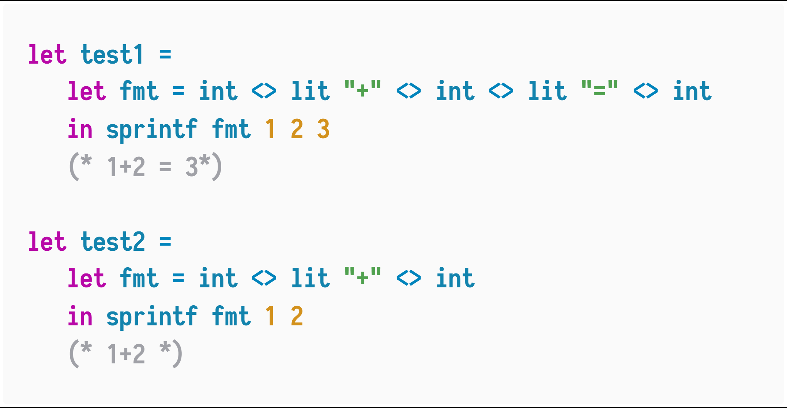
Demystify Functional Unparsing
What we want:

Slide 2
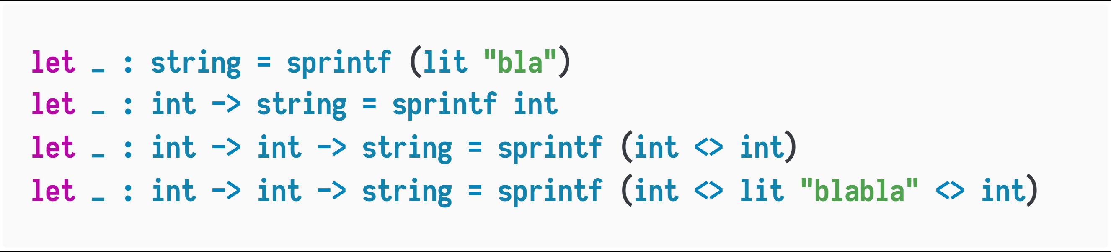
Investigating the effect
Constructing variadic-ary functions?!

Slide 3
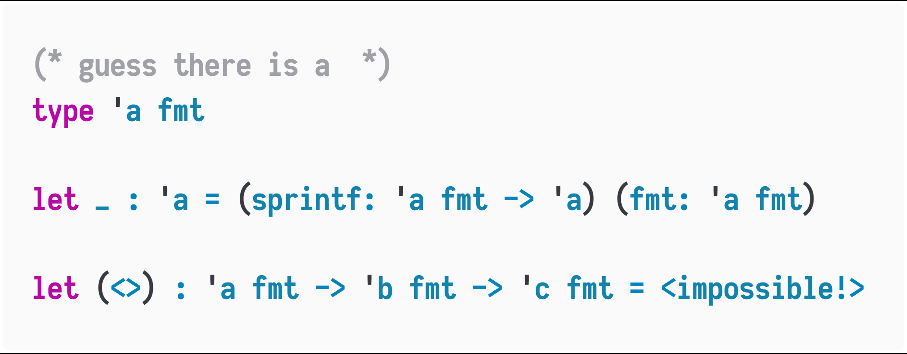
HOW-TO? Think about types:
Decide ‘c from ‘a and ‘b !!

Slide 4
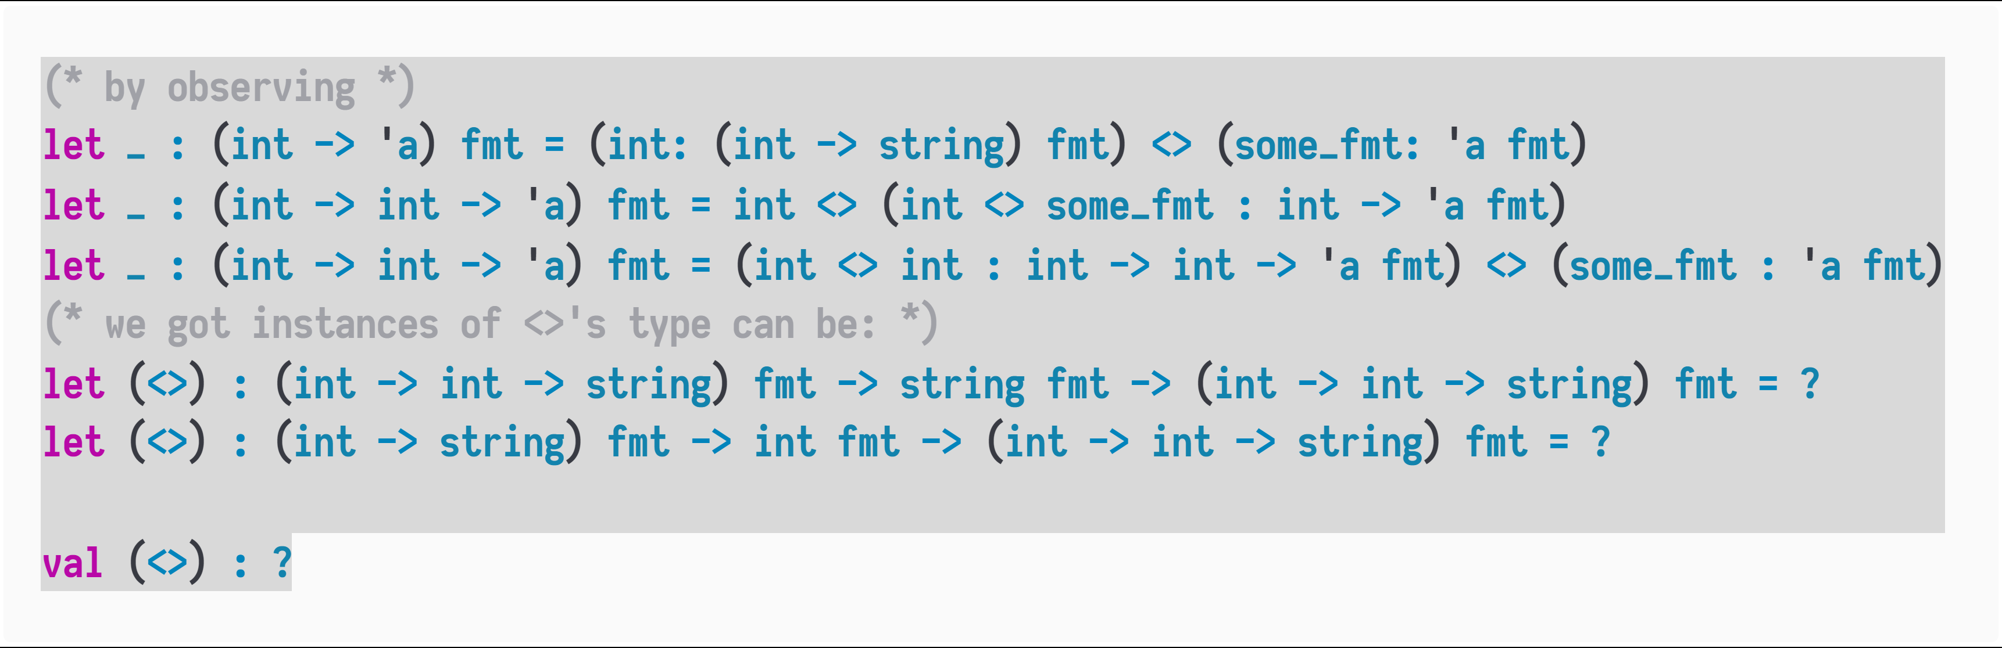
More about types and Case Study
when applying (int <>) to a format object, the output type 'a is expanded to int -> 'a:
value : 'a fmt
int <> value : (int -> 'a) fmt
sprintf (int <> value) : int -> 'a
when applying (lit _ <>), the output type 'a does not change
value : 'a fmt
lit any_string <> value : 'a fmt
sprintf (lit _ <> value) : ‘a
Type expands, we need delta!

Slide 5
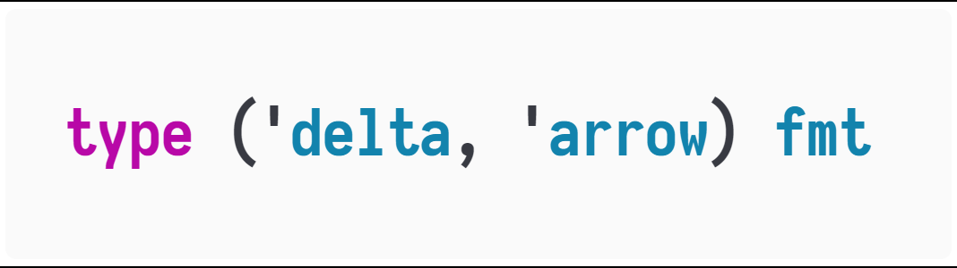
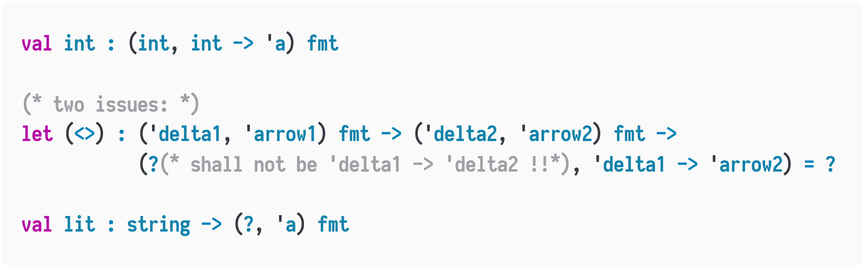
Trial and Error
so we change our type representation
The type does not work with this design!

Slide 6
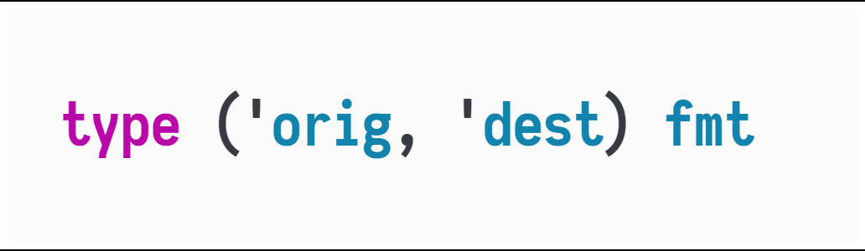
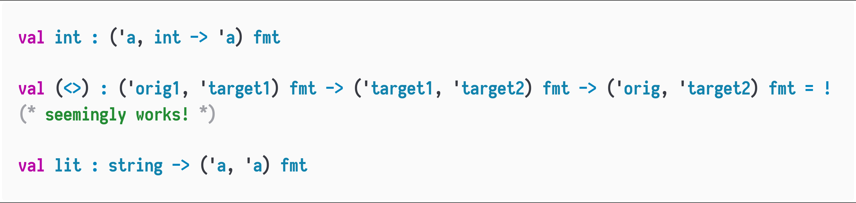
Trial and Error
Transformation!
The type works with this design!

Slide 7
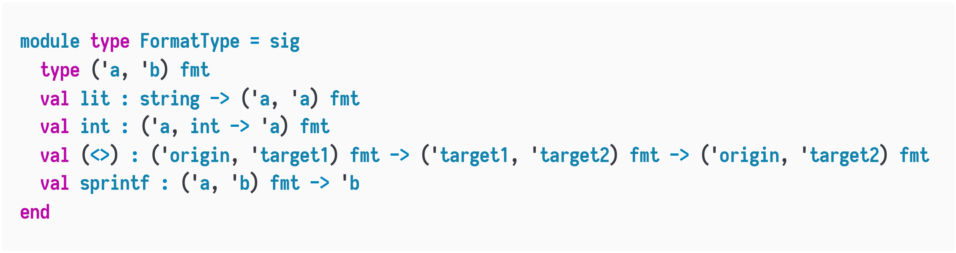
More Comprehensive Notations

Slide 8
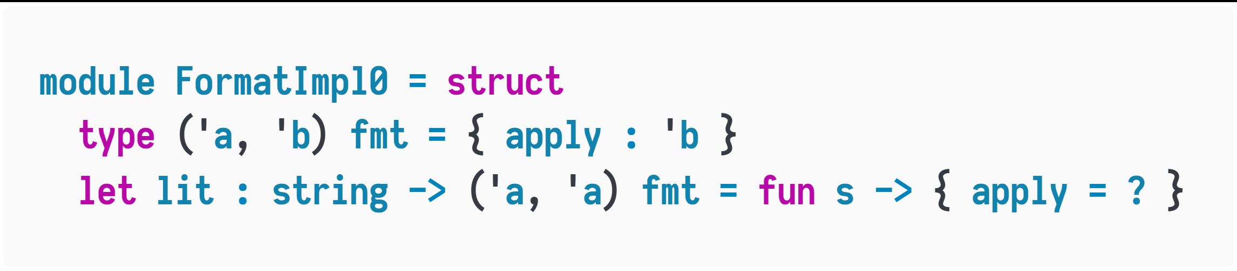
Implementations also, trial and error
A simplest guess:
Think:
sprintf (lit "a") = "a"
The base case(use sprint (lit “…”)) makes the impl of lit becomes
lit : string -> (string, string) fmt = fun s -> { apply = s }
HOWEVER, lit losses its polymorphism.
What we need is
‘a. string -> (‘a, ‘a) fmt
So this definition of (‘a, ‘b) fmt is incorrect!

Slide 9
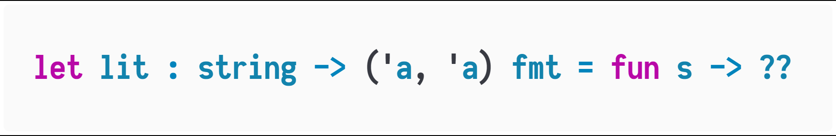
Think:
lit is string -> ('a, 'a) fmt, which has a string argument s
They shouldn’t be redundant information!!
So, we need to change the definition of (‘a, ‘b) fmt,
which should imply a function to invoke the argument
2. finally get a value typed ‘b (check the type of sprintf)

Slide 10
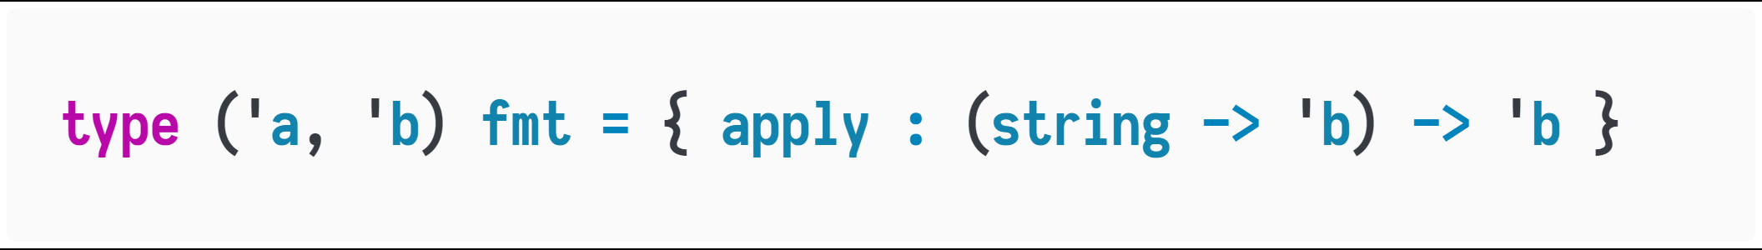
So, the simplest definition for fmt so far:

Slide 11
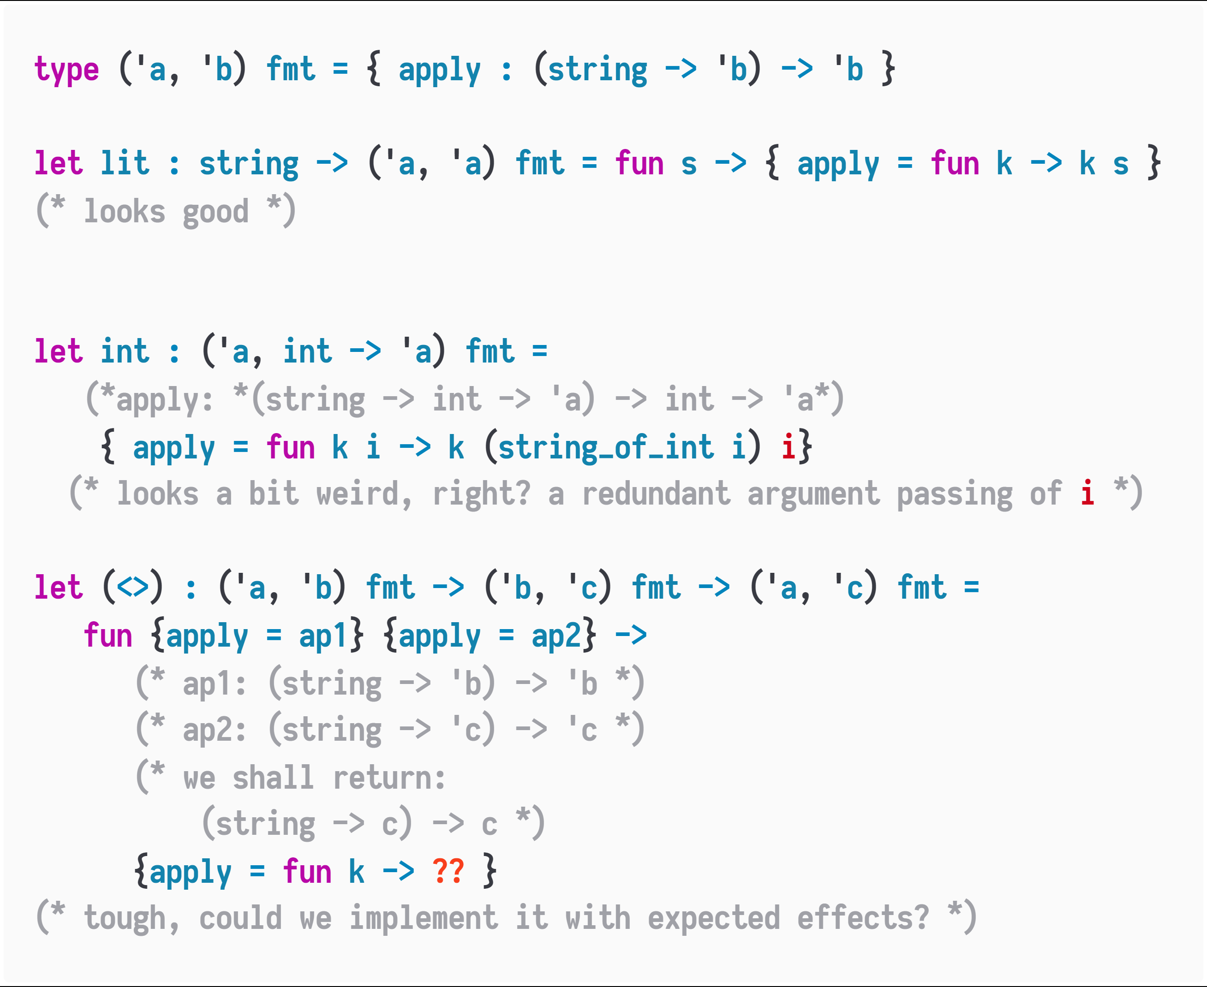
P.S:
I’m not sure if this is sufficiently evident to say this definition of fmt
is incorrect…

Slide 12
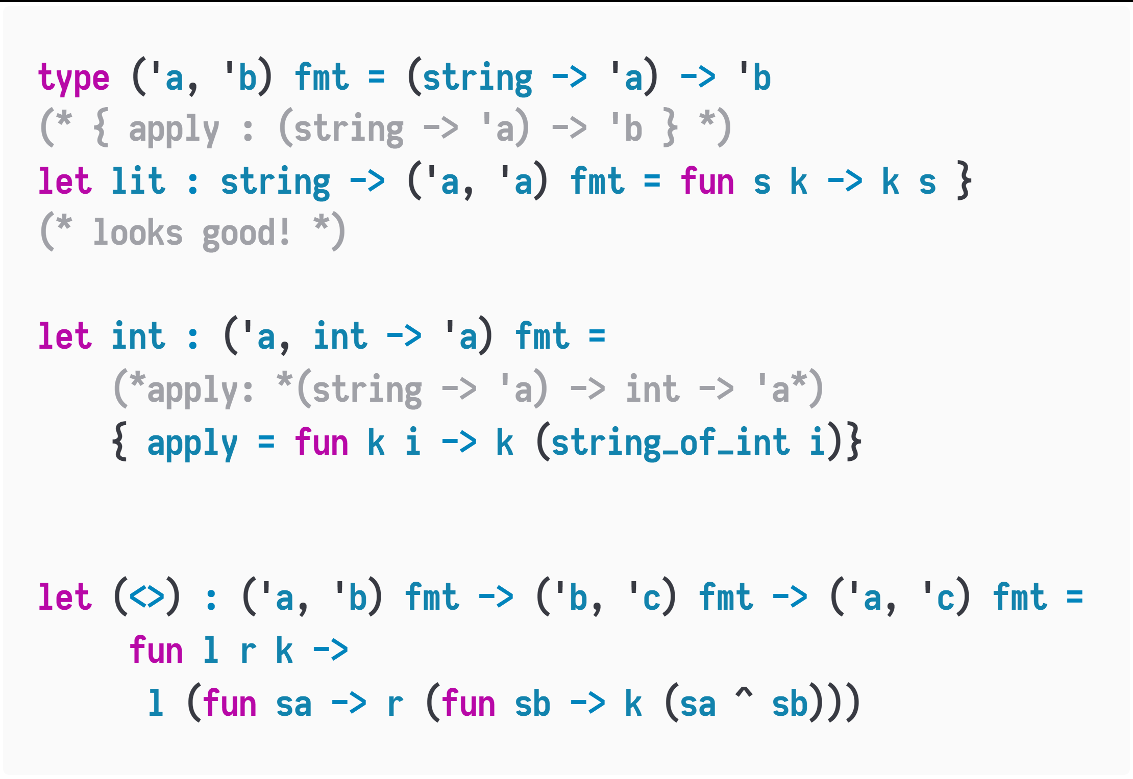
We finally come to Olivier Danvy’s design!
XXXXXXXXX
XXXXXXXXX
This is a modified design(by Oleg Kiselyov) in following lecture, but equivalent to the original.
http://okmij.org/ftp/tagless-final/course/lecture.pdf

