Slide 1
Fully Compatible Python JIT
Taine Zhao(M1), Programming Logic Group, University of Tsukuba

Slide 2
Previous Attempts
The well-known
Psyco
PyPy
PyJion
Pyston
Numba
Not that well-known
JitPy
HOPE
Restrain-JIT(by me)
Numba and PyPy turns out to be the most popular and successful so far.

Slide 3
Problems of Previous Attempts
Roughly,
PyPy is a separate runtime, its C-extension is slow!
People stick to CPython, the dominant implementation.
Numba works for numeric computations only.

Slide 4
Something in CPython, keep everything, but faster?

Slide 5
Decades later since the previous attempts…
We have many other successful attempts in JIT to refer:
Julia, a dynamic language with amazing JIT
Ruby MJIT since Ruby 2.6
JIT requires a compiler in runtime, decades ago we don’t have many options, but now we have many related supports from the community and the Python organizations:
Nuikta(Python to C++ compiler)
Cython(state-of-the-art Python to C/C++ compiler)
PEP0384(stable C API for CPython)
HPy(better C API for CPython, avoid CPython’s abstraction leaks)
...

Slide 6
Time to make the dreaming Python JIT!
Runtime specialization:
Review of Psyco
Architecture:
Problems of runtime specialization:
we need Type System
Runtime specialization is awesome!
We need runtime type inference!
Code Inspection and
Compilation Pipeline
By the way, Partial Evaluation and Inline
Memory layout optimizations:
Compact object representations with sufficient type information
Get Code:
AST, IR, Bytecode?
CodeGen, Compile, Load
Compat CPy Objects

Slide 7
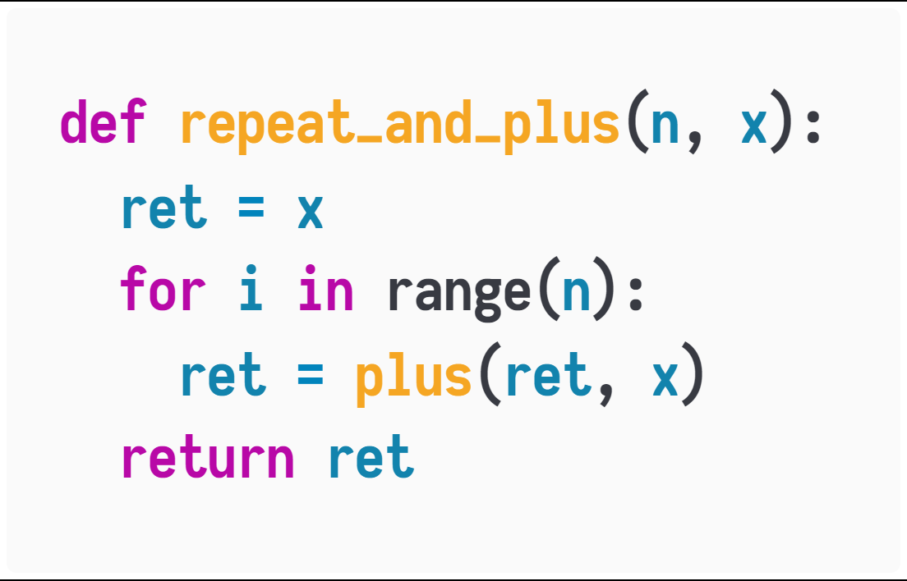
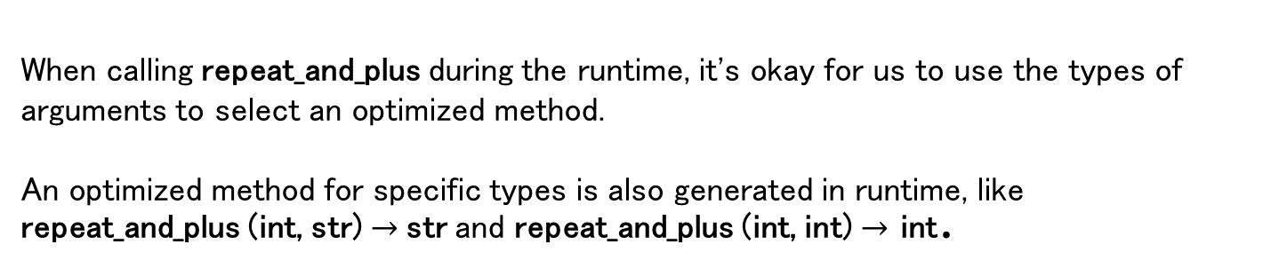
Runtime specialization: Review of Psyco[PEPM 2004]
When calling repeat_and_plus during the runtime, it's okay for us to use the types of arguments to select an optimized method.
An optimized method for specific types is also generated in runtime, like repeat_and_plus (int, str) $→$str and repeat_and_plus (int, int) $→$ int.
Why we will benefit from runtime specialization and runtime codegen?

Slide 8
Runtime Specialization?
See repeat_and_plus, when calling it,
we must be able to specialize repeat_and_plus, and
we might be able to specialize the inner call plus(ret, x) by knowing the argument types,
we might also be able to specialize inner function calls happened inside plus,
…

Slide 9
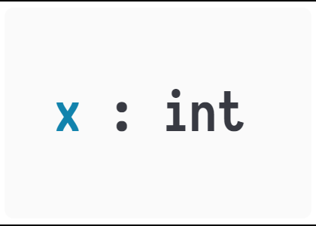
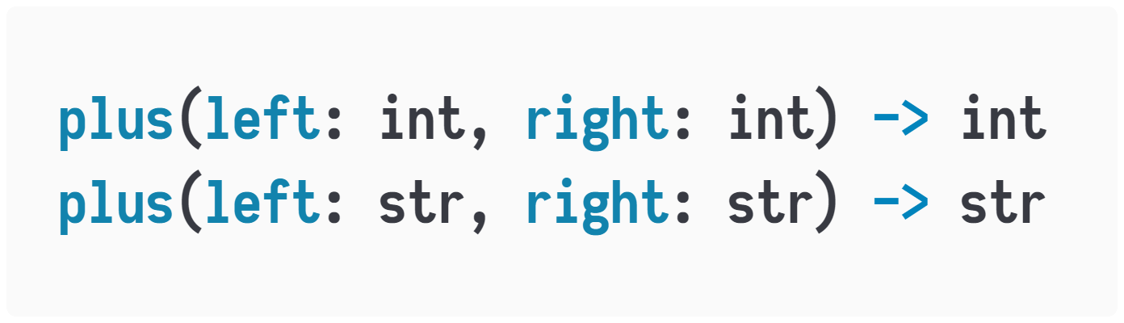
Via Runtime Type Inference!!
We select a specialized plus when specializing repeat_and_plus!
Notice that,
the possibility of specializing inner function calls,
is just depending on if we can decide the argument types of inner function calls,
which depends on how we infer the types,
so we need runtime type inference!
The use of runtime type inference in Julia programming language just shows
its practicability!

Slide 10
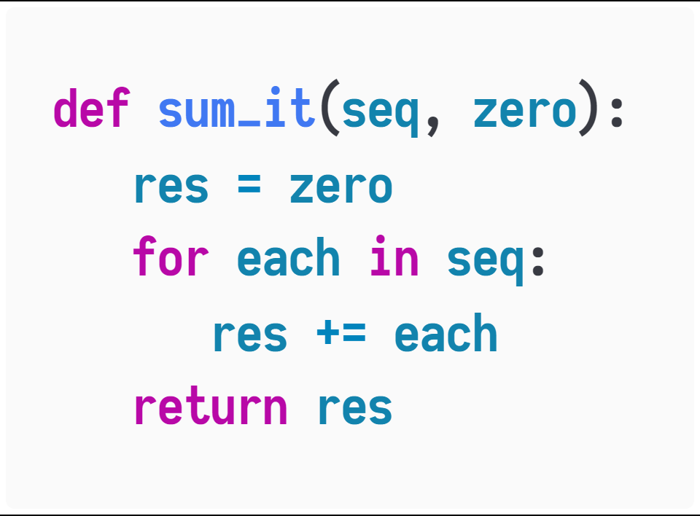
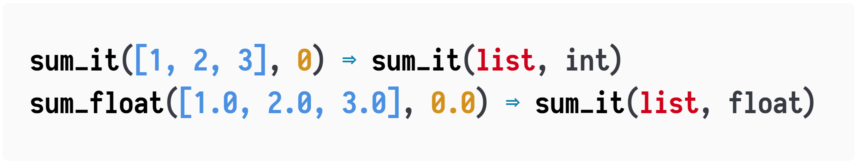
Problems of runtime specialization: Python’s weak type representations
By using Python types, we can successfully dispatch by using the type of the second parameter.
However!
We CANNOT specialize the first parameter, because it is always a list, never a list[int]…
So to make JIT more impressive, we need design a better runtime representations.

Slide 11
Implementation
Tackling Undecidable Global Variables
Selecting A Compiler and Hooking Python Functions
Transforming Python Bytecode Instructions to Our Core Language
*Keeping Object Identity?(investigating)

Slide 12
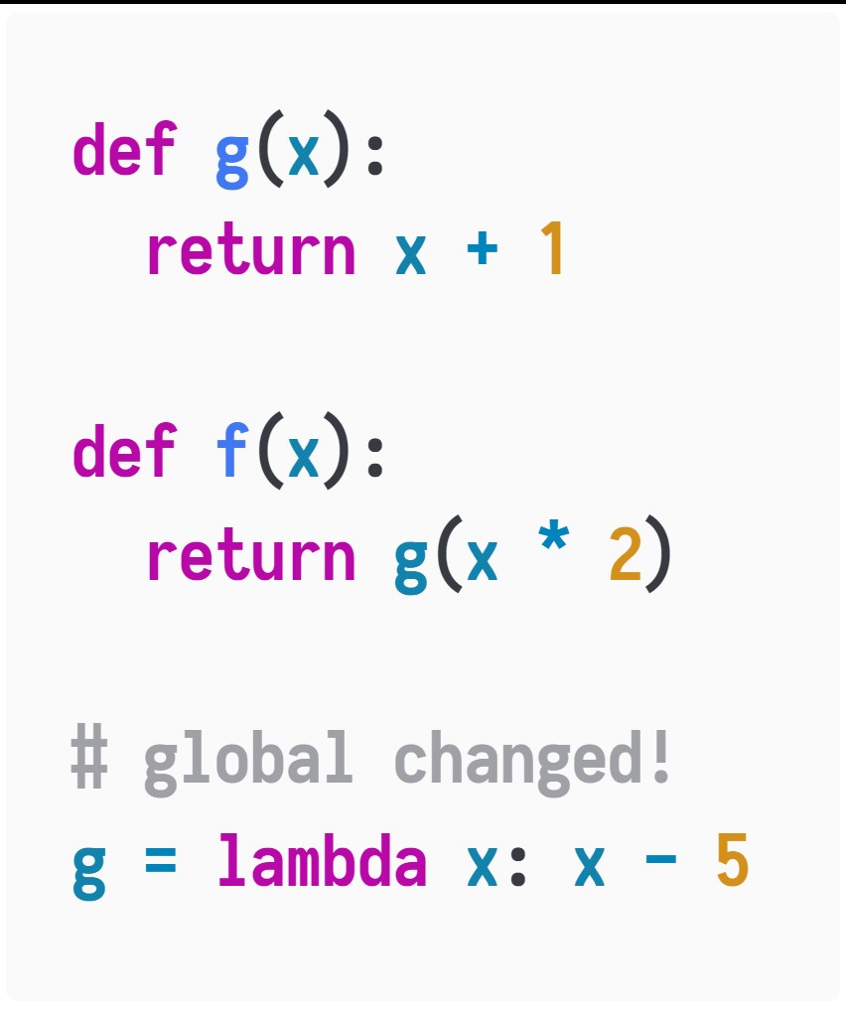
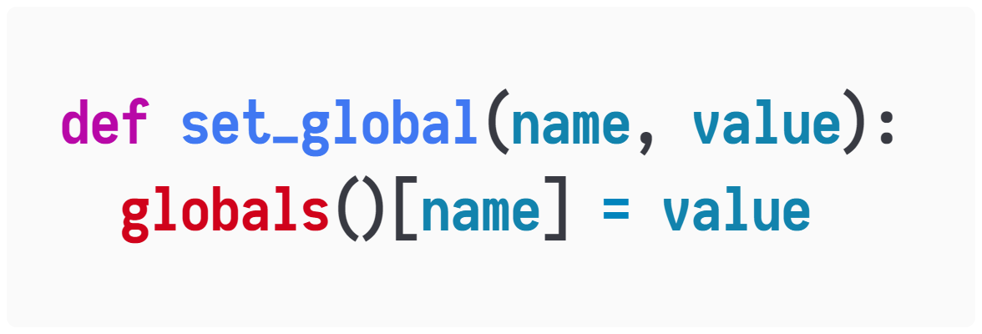
The Global Variable Issues
Tackling Undecidable Global Variables
Python is lexically scoped, however, it looks dynamic when it comes to the global variables.
This makes optimizations hard.
We cannot assume which function the symbol g in f is referring to.
What’s worse:
Globals

Slide 13
What’s the Matter?
Tackling Undecidable Global Variables
If we cannot determine the symbol references even in runtime, we cannot specialize and inline function calls!
If g at here has multiple methods/overloads, we won’t be able to remove the overhead of dynamic dispatch.

Slide 14
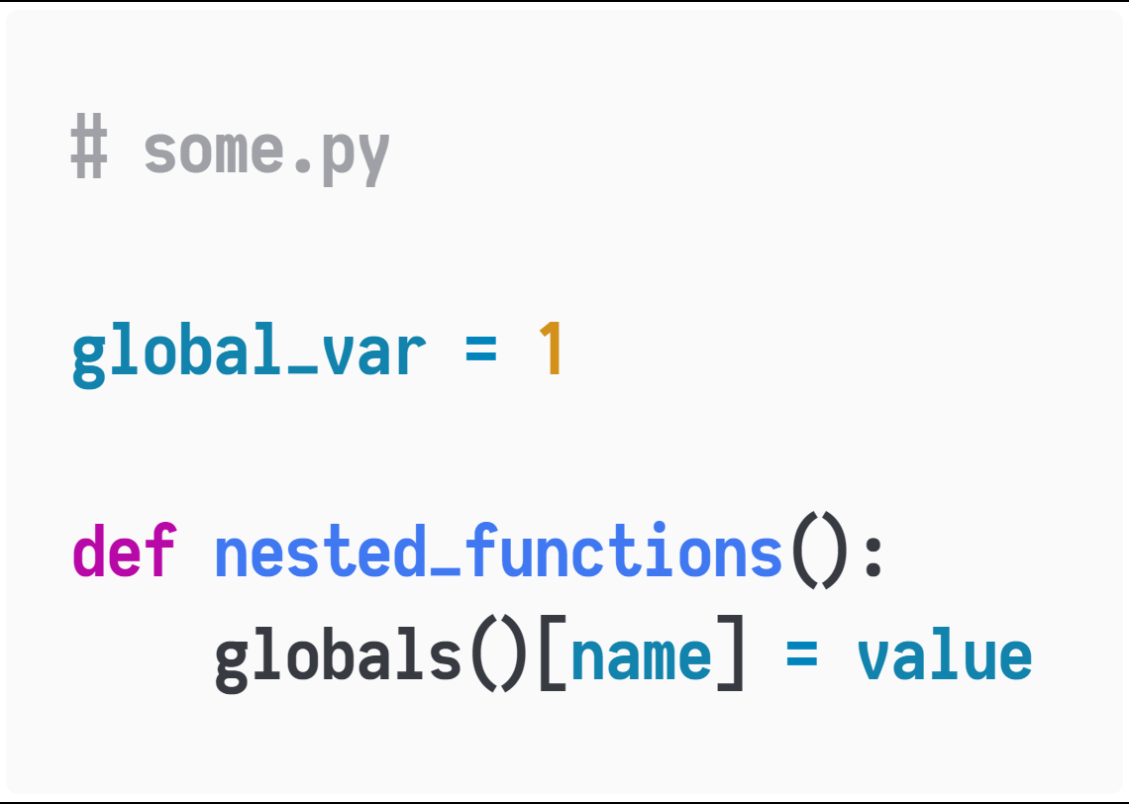
Analysis and Track of Mutations of Global Variables
Tackling Undecidable Global Variables
Fortunately, this is achievable.
Changing Global Variables in Python has 2 approaches:
Via STORE_GLOBAL instructions, this is easy to analyse
Via mutating the dict that globals returns

Slide 15
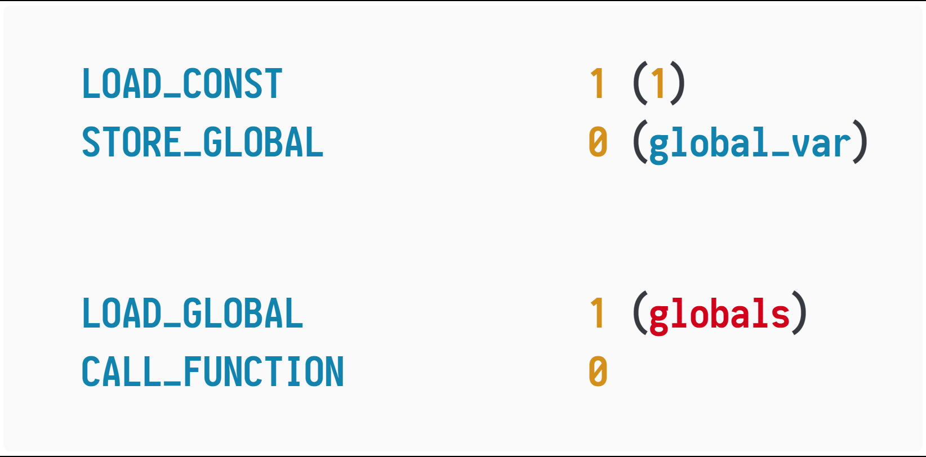
Analysis and Track of Mutations of Global Variables
Tackling Undecidable Global Variables
Changing Global Variables in Python has 2 approaches:
Via STORE_GLOBAL instructions, this is easy to analyse
Via mutating the dict that globals returns

Slide 16
Analysis and Track of Mutations of Global Variables
Tackling Undecidable Global Variables
Insert some instructions here to aware our JIT compiler:
global variable global_var changed in some module!
insert something
insert something
Insert some instructions, to check if the globals loaded here is identical to the builtin one.
If so, we convert it to a proxy one, which could aware our compiler once globals got written.
As a consequence, in every point of the program execution, we know what a symbol is referencing, efficiently(by slowing changing global variables, we gain the chances to optimize more usual code!!)

Slide 17
Implementations about Instruction Insertions
Tackling Undecidable Global Variables
Using Python import machinery:
(PEP 302, PEP 420)
Python programs run by interpreting bytecode instructions. We can hook the process of getting bytecode. We rewrite the bytecode, perform our analysis on it, and inject instructions to support tracking mutations of global variables!

Slide 18
Selecting A Compiler
Selecting A Compiler and Hooking Python Functions
Advantages of using Julia as a JIT compiler:
Avoid invoking a C compiler ourselves
Occupy our code generation with the support of Julia’s CUDA/SIMD/AVX LoopVectorization
There exists a mature Python<->Julia interoperation framework, by this we reduce the need of calling Python primitive C-APIs.
Avoid managing compiled files, including loading and linking issues.
If we use Julia for a JIT compiler, we can use Julia for more parts of our JIT framework, like implementing type inference and PE.
Julia has implementations of pattern matching and type classes, hence, from a user’s perspective coding is more of fun, reliability and modularity.

Slide 19
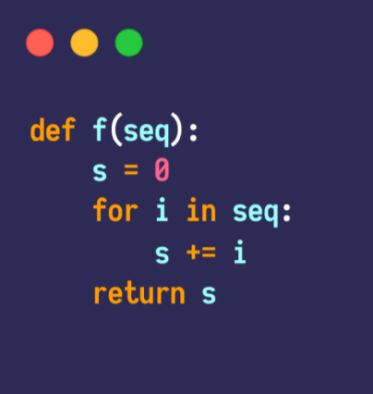
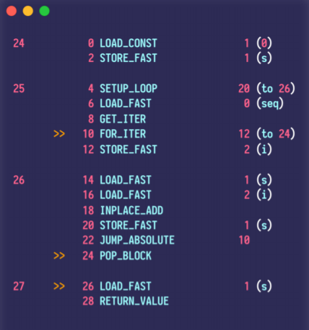
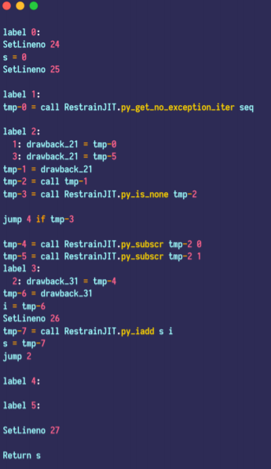
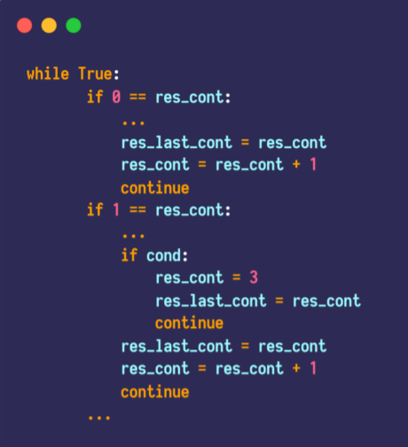
Control Flow Analysis
Transforming Python Bytecode Instructions to Our Core Language
We need to restore the program from
Python code objects(containing scope information and maximum stack usage, etc.)
bytecode instructions
Source Code(not available)
Bytecode(always available)
Some IR
Register-machine IR
Python
does it
Our abstract interpretation
Relooper, PE, etc.

