Slide 1

Terminating
A method to avoid infinite configurations.
This method usually loses the chance to produce efficient code for Python.
Possible Solutions.

Slide 2


A Method to Termination Guarantee
Non-termination of a partial evaluation happens when the configurations(a pair of label and an array of abstract values) are infinite.
During PE, we maintain 2 kinds of information:
Configurations already reached: $Conf$
Labels already reached: $Labels$
To avoid being infinite, we upcast all abstract values($[v1, v2, ⋯, v_{n}]$) to $⊤$, when
we reach a label $l_{k}$ for the 2nd time, i.e., $l_{k}∈Labels$
($l_{k}, [v1, v2, ⋯,v_{n}]$) $∉Conf$

Slide 3
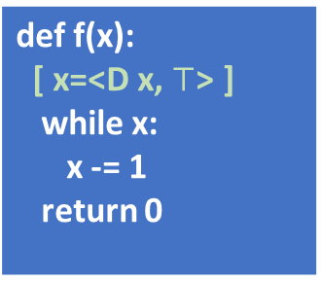
A Method to Termination Guarantee
Before 1st iteration
Before 2nd iteration
def f(x): [ x = <D x, int> ] while x: x -= 1 return 0
def f(x): [ x = <D x, int> ] while x: x -= 1 return 0
Before 1st iteration
Before 2nd iteration
Upcast before 2nd iteration
def f(x): [ x = <D x, int> ] while test(x): x = (x, x) return 0
def f(x): [ x=<D x, int*int> ] while x: x -= 1 return 0
def f(x): [ x=<D x, $⊤$> ] while x: x -= 1 return 0
Avoid being infinite!

Slide 4

Produce Inefficient Code!
1st iteration
2nd iteration
def f(x): j = 10 i = 0 [j = <S 10, int>, i=<S 0, int>, x=<D x, int>] while i < j: i += 1 x += i return x
def f(x): j = 10 i = 0 [j = <S 10, int>, i=<D i, int>, x=<D x, int>] while i < j: i += 1 x += i return x
Will terminate, but i becomes $⊤$

