Slide 1
Backend-Agnostic Parser Generators

Slide 2
Backend-Agnostic Parser Generator
Issue of Reusability
Common DSL
Backend-Agnostic

Slide 3

The Issue of Reusability
Statement
A programming language
has its own parsing frameworks
Declaration
Parsing
Statement $←$ Declaration
Declaration $←$var NAME = Expression ;
Expression $←$ NUM
Expression
NAME
NUM
var f = 1;
Lexing
var
f
=
1
;

Slide 4



The Issue of Reusability
The parser generator is advantageous
generate
Grammar
Generated Code
specify
satisfy
Specification
Hand-written parsers or parser combinators cannot have this property, sometimes mistakes made.

Slide 5
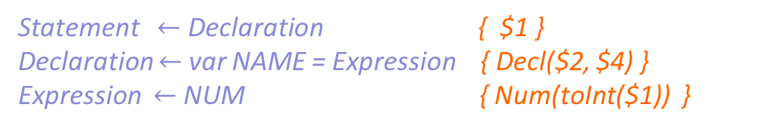
The Issue of Reusability
Semantic actions are useful
Statement $←$ Declaration { $1 }
Declaration $←$var NAME = Expression { Decl($2, $4) }
Expression $←$ NUM { Num(toInt($1)) }
Statement
Parsing
Declaration
A parser directly produces desired data structure
Expression
Decl("f", Num(toInt("1"))
Actions
NAME
Num
var f = 1;
Lexing
var
f
=
1
;

Slide 6
The Issue of Reusability
C++ has YACC/Bison, Java has Antlr4, F#/OCaml has FsYACC/OCamlYACC…
Semantic actions require specific programming languages
Statement $←$ Declaration { $1 }
Declaration $←$var NAME = Expression { Decl($2, $4) }
Expression $←$ NUM { Num(toInt($1)) }
Prog Lang | Parsing Framework | Action Lang
Java | Antlr4 | Java
C++ | Bison/Yacc | C++
OCaml | OCamlYacc | OCaml
… | … | …

Slide 7
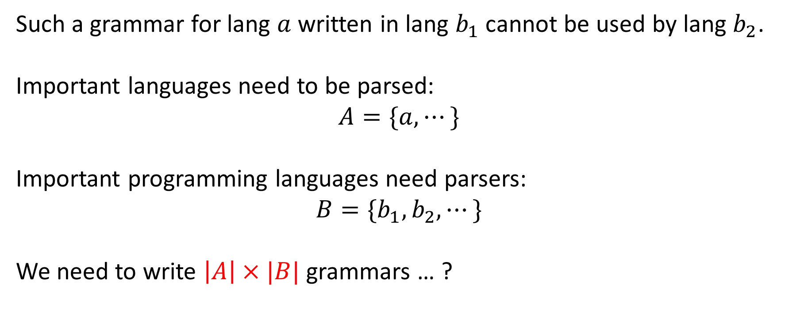
The Issue of Reusability
C++ has YACC/Bison, Java has Antlr4, F#/OCaml has FsYACC/OCamlYACC…
Such a grammar for lang $a$ written in lang $b_{1}$ cannot be used by lang $b_{2}$.
Important languages need to be parsed:
$$A=\{a, ⋯\}$$
Important programming languages need parsers:
$$B=\{b_{1}, b_{2}, ⋯\}$$
We need to write $\left|A\right|×|B|$ grammars … ?

Slide 8













Issue Addressing
 | Write Grammar
 | Write Transpiler
$$a_{1}$$
$$a_{2}$$
$$a_{1}$$
$$a_{2}$$
WE NEED
MIDDLEWARE!!
$$b_{common}$$
$$b_{1}$$
$$⋯$$
$$b_{n}$$
$$b_{1}$$
$$⋯$$
$$b_{n}$$
Reusable!
$\left|A\right|×|B|$ grammars
$|B|$ transpilers + $|A|$ grammars

Slide 9







Common Language
$$a_{1}$$
$$a_{2}$$
$$b_{common}$$
$$b_{1}$$
$$⋯$$
$$b_{n}$$
$|B|$ transpilers + $|A|$ grammars

Slide 10
Common Language(ComLang)
Shall be easy to write translations from ComLang to each existing and potential programming language!
So it’s a simple but well-designed language.

Slide 11
Common Language(ComLang)
Shall be easy to use ComLang to write expressive semantic actions!
So it’s an expressive language.

Slide 12
Common Language(ComLang)
Some languages have static types, but some do not. ComLang should be friendly to both kinds.
So it’s a type-inferenced language.

Slide 13
Common Language(ComLang)
a simple but well-designed
expressive
type-inferenced
*. translated to fast code, etc..

Slide 14
Common Language(ComLang)
Requirements | Why choose ML(Meta Language)
simple but well-designed | within 50 lines of BNF, probably shortest
expressive | effects, closures, objects, generics… All EASY.
type-inferenced | simplest type system + implicit inference
translated to fast code | Typed, rich types. Choose best type mapping.
We design ComLang based on ML.

Slide 15
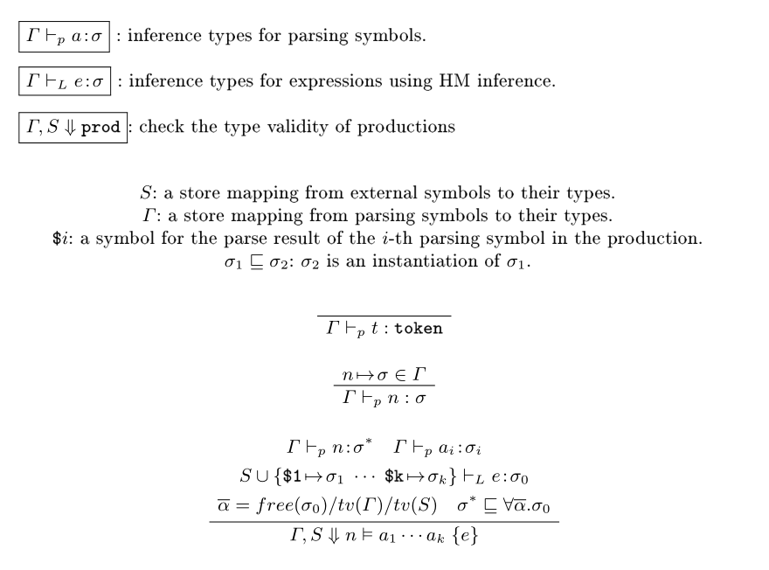
ComLang: Theory Part
Type system

Slide 16
Backend-Agnostic
What is a back end? There are 2 levels.
Grammars using ComLang
language level
(user-awared)
framework level
(optionally user-awared)
Java
Antlr4, JavaCC, ...
C++
Bison, Yacc, …
OCaml
OCamlYacc, Menhir, …
JavaScript
PEG.js, tree-sitter, …
Golang
…

Slide 17
Backend-Agnostic(Issue)
ComLang to *Lang
Language Primitives?
Libraries?
External symbols?

Slide 18
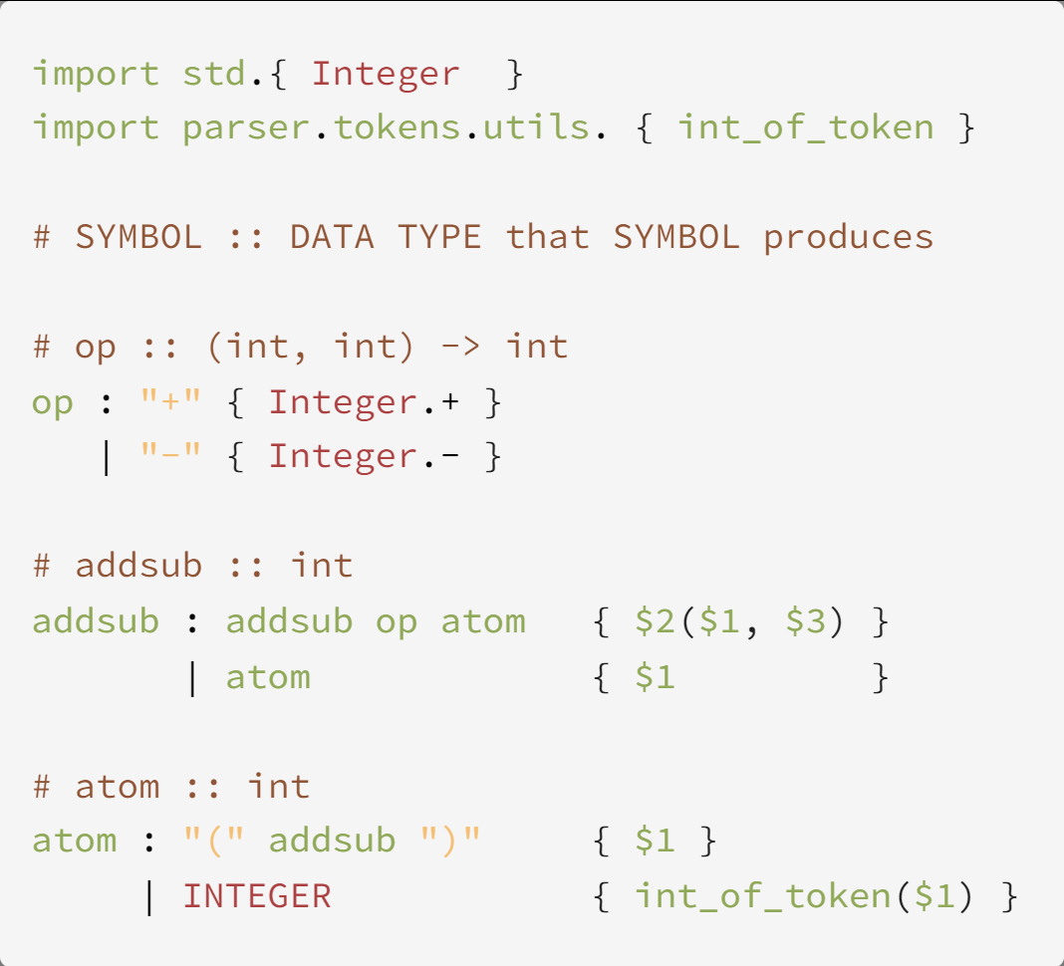
Backend-Agnostic(Issue)
Grammar and Parser for Integer Arithmetic

Slide 19
Backend-Agnostic(Issue Addressing)
Issue | Solution | Future Issues
First-class functions? | Closure conversions | Performance, GC?
Libraries | Libs for all translated langs | Too many*
Primitive data types | Compilers setup primitives for all langs
Operator Overloading | (Investigating…)

Slide 20
Backend-Agnostic(Results)
One grammar, many parsers in many languages
Users: no need to care which framework to use
Handy static typing for even dynamic languages
Precise error report for all backends

