Slide 1
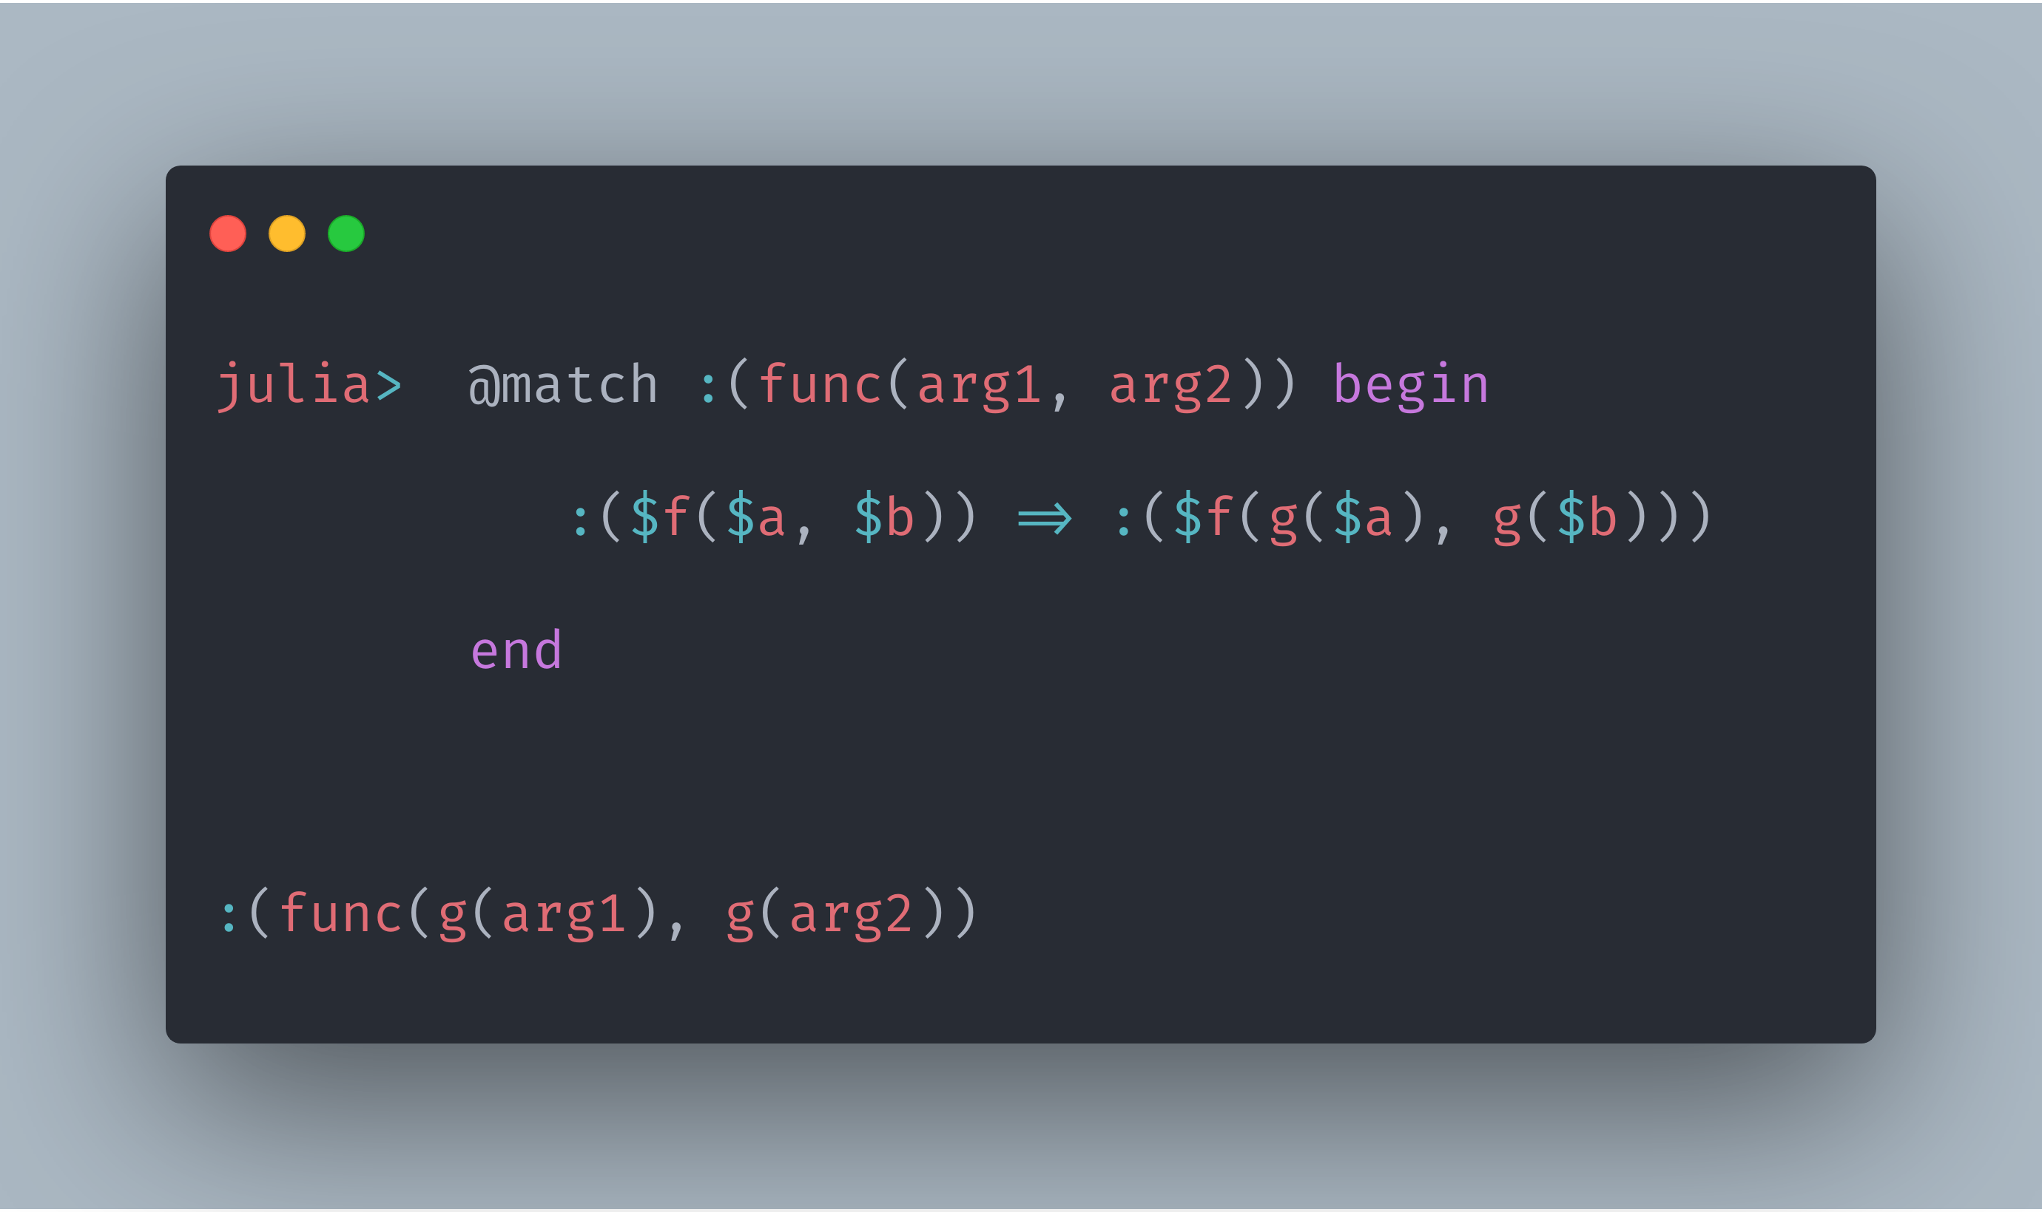
MLStyle.jl
Providing Functional Programming Infrastructures

Slide 2
FP
Static Typing
Pure
Reproducible
Immutable Data
First Class Functions
Safer,
burden less mentally
FP+Static
Easier
Polymorphisms:
Typeclasses, HKTs
Dependent Types and More
Safer
Safe enough but Harder to use
Boilerplate(Code resue)

Slide 3
Motivation:
Used to get addicted to pattern matching
Noticed a valid syntax to express matching
Cannot do this easily in Python
The implementation could be efficient and easy
Don’t know there’s already Match.jl
Possible to define my own patterns, extensible and more
After a bunch of iterations,

Slide 4
What is MLStyle.jl?
Extensible, efficient and consistent pattern matching
Matching ASTs syntactically(NOT an alternative to MacroTools.jl!)
Data types, syntax extensions
After a bunch of iterations,

Slide 5
Why use MLStyle.jl?
1. Greatly simplify processing complex conditional logics
2. Fast
3. Frequent and compatible updates for incoming features to fit the real world
4. Fast issue solving
5. I’m doing research in the concerned fields and I have rich skills on the concerned topics.

Slide 6
In terms of MLStyle.jl itself, why so good?
How to design and implement the pattern matching that is
Extensible, efficient?

Slide 7
Basic Idea
Target
Or
Is a Tuple{T1, T2, T3}
Is a Vector
Whatever
Elts[1]
Elts[1]
Capture as a
Capture as hd
Elts[2:length(Elts)]
Elts[2]
Capture as tl
Whatever
Elts[3]
=== 3

Slide 8
Compilation
Body -> Let TARGET = Target
body
end
patternOr
f(target::Tuple{T1, T2, T3})
Is a Vector
Whatever
Let target = Elts[1]
Elts[1]
Capture as a
Capture as hd
Elts[2:length(Elts)]
Elts[2]
Capture as tl
Whatever
Elts[3]
=== 3

Slide 9
Extensibility: customized patterns
Def_app_patterns
Def_patterns
Def_gapp_patterns

Slide 10
Extensibility++: implementation independent
Active patterns(view patterns), planning to add view patterns

Slide 11
Impediment and limitations:
Redundancy removal: due to the fast protyping we made something useful and convenient, but caused a bias against canonical implementations. No case trees and case merging.
Side effects preventing decision tree optimizations. The order of matching is mandatory(roughly, from left to right). Cannot merge cases like `(1, _, 2) | (3, _, 2)`.
0.3.1 is the latest versions to hold current implementation.
Will make the behavior more statically since 0.4.0. Users don’t need to aware this if you didn’t use the 3 impl-specific ways to define custom patterns.

Slide 12
Use case
Parsing, parsing expression generator
Query eDSL
Transpiler
DSL/full featured programming languages
Debugger
Extending literal syntaxes
Syntax extension
Static type checking for Julia, special thanks to J
Playful: Lisp lang, lisp-flavored cond, self recursion notation

Slide 13
Template Julia
Syntactically matching ASTs
deconstruct data just as how they’re constructed!
Why should use Template Julia/Syntactically matching/AST patterns?
我想起高兴的事.
Racket2在做了，做好了他们也有MLStyle.jl了☺

Slide 14
Special thanks to the evert one of our community!

Slide 15
Simple Flow Chart Template
START
Edit here
No
Question?
Yes
Edit here
Edit here
END

Slide 16
Simple Flow Chart Template
START
You can edit this content.
This is a flow chart PowerPoint Template.
You can edit this content.
Edit here
No
Question?
Yes
Edit here
Edit here
END

Slide 17


