Slide 1
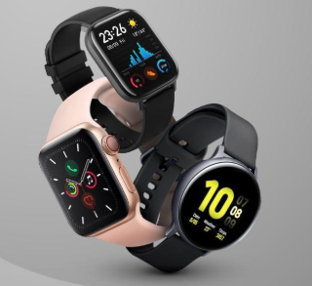
SMARTWATCH SENTIMENT ANALYZER

Slide 2
GROUP MEMBERS:
M.Thavanesh Krishna - AP23110010619
B.Murali Krishna - AP23110010656
K.Harshavardhini - AP23110011144
K.Mahasvin - AP23110010075
B.Saicharan - AP23110010173

Slide 3
PROBLEM STATEMENT & OBJECTIVES
Problem Statement:
Salesforce SmartBridge Company wants a simple and efficient way to understand customer opinions from smartwatch reviews. Since reviews often contain mixed or unclear feedback, the company needs a tool that can automatically identify whether a review is positive, negative, or neutral. The goal is to identify customer sentiment and improve product development.
Objectives:
Develop a user-friendly sentiment analysis tool
Automatically classify customer reviews into Positive, Negative, or Neutral
Help the company gather actionable insights
Improve product development based on customer feedback

Slide 4
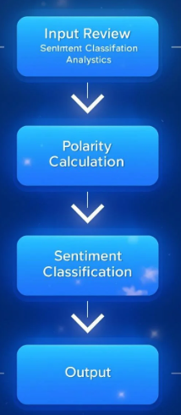
PROPOSED SOLUTION & WORKFLOW
Flask API for Real-Time Sentiment Analysis
A lightweight Flask-based REST API that performs real-time sentiment analysis on customer review text using the TextBlob sentiment polarity method.
Workflow:
The user enters a smartwatch review on the web interface.
The review text is sent as a request to the Flask backend API.
The Flask API analyzes the text using TextBlob to calculate polarity (−1 to +1).
The calculated polarity is converted into a sentiment category (Positive, Neutral, or Negative).
The API sends the sentiment result back to the web application for display.

Slide 5
DATASET & METHADOLOGY
Dataset:
Smartwatch_genai.csv(1,597+ customer reviews)
This dataset provides 27 features, including product brand, categories, dimensions-allowing both product-level and review-level analysis.
The dataset includes detailed review texts, ratings, and titles, making it suitable for sentiment analysis, opinion mining, and customer feedback analytics for smartwatch products.
Methodology:
Classical ML Models
Logistic Regression, Random Forest, SVM, etc.
Result: <50% accuracy
Apply TextBlob sentiment polarity
Polarity > 0 → Positive
Polarity < 0 → Negative
Polarity = 0 → Neutral

Slide 6
TECHNOLOGIES USED
Flask
Flask is a lightweight Python web framework that enables rapid development of web applications and RESTful APIs..
TextBlob
Used for:
Sentiment polarity calculation
Sentence detection
Classification into positive/negative/neutral.
Python
Python is a versatile programming language for data analysis.
VS Code
Integrated Development Environments streamline coding and debugging processes.

Slide 7
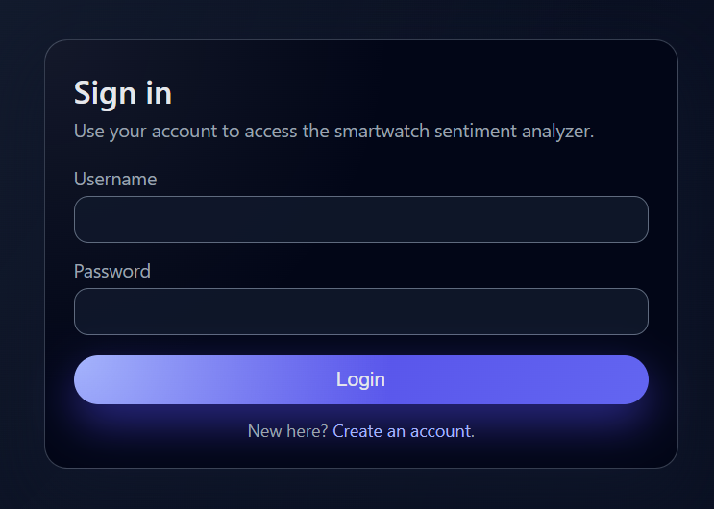
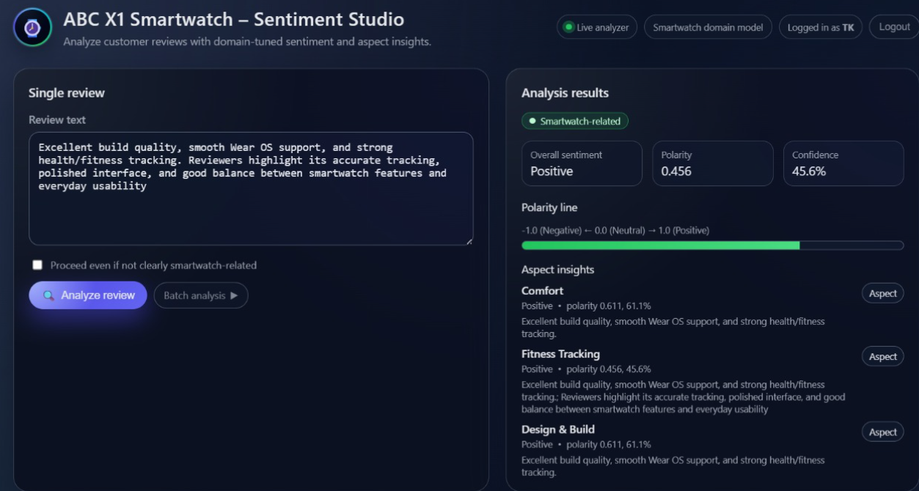
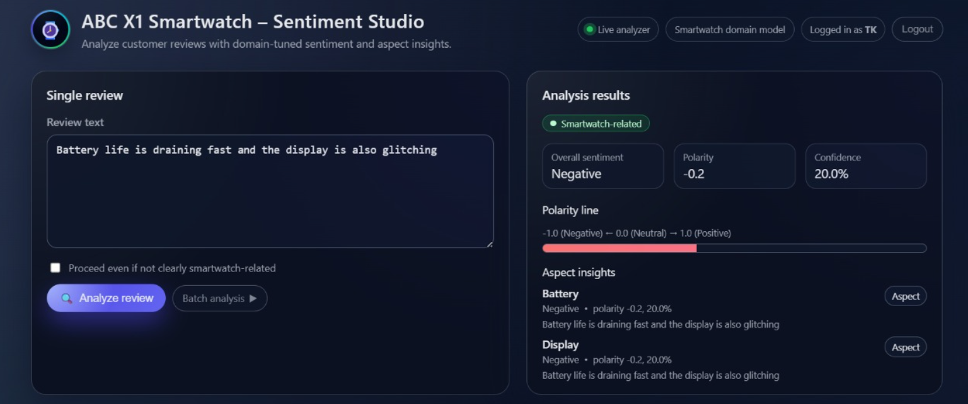
RESULTS & FINDINGS
LOGIN PAGE
POSITIVE REVIEWS
NEGATIVE REVIEWS

Slide 8
CONCLUSION & FUTURE SCOPE
Conclusion:
The Smartwatch Sentiment Analyzer project successfully demonstrates how customer feedback can be transformed into meaningful insights using simple yet powerful tools. By combining Streamlit for an interactive interface and TextBlob for sentiment analysis, the system provides quick and accurate interpretations of customer reviews for the ABC X1 Smartwatch. This enables ABC Company to better understand user opinions, recognize strengths, and identify areas for improvement. Overall, the project highlights the value of sentiment analysis in guiding product enhancement, strengthening customer satisfaction, and supporting informed decision-making in future product development.
Future Scope:
Aspect-based sentiment analysis (battery, display, features)
Multi-language support expansion
Real-time dashboard for review monitoring
Integration with customer support systems
Mobile application deployment

Slide 9
THANK YOU

