Slide 1
An Automatic Workload-driven Method for NoSQL Database Generation − Supplementary Material June 2020

Slide 2
Case Study#1: Easy Anti Cheat

Slide 3
Case Study Description
The objective of this case study [1] is to gather information of the state of each player during play sessions, in order to detect anomalous behaviors that might uncover forbidden game practices or abuses, such as flying, teleportation, wall-hacking or perfect aim. These abuses commonly known as cheats.
A Server handles different Sessions, each one associated with a Player. During each session, the State of a player is captured at different time intervals. The state of a player consists of the x, y and z positions in the game, as well as an associated timestamp.
The domain entities that conform this case study and their relations are shown in the UML class diagram in Fig. 1.

Slide 4
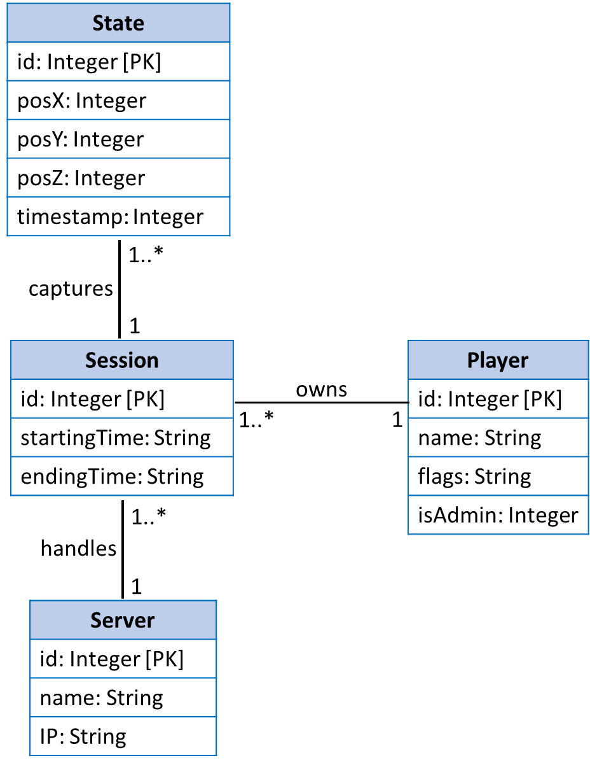
Fig. 1: Easy Anti Cheat conceptual model represented with UML class diagram

Slide 5
Fig. 2: Textual representation of the conceptual model in Fig. 1
entity Session {
int id [K],
string startingTime,
string endingTime,
ref Player[1] owns,
ref Server[1] handles,
ref State[*] captures
}
entity State {
int id [K],
int posX,
int posY,
int posZ,
int timestamp,
ref Session[1] captures
}
entity Player {
int id [K],
string name,
string flags,
int isAdmin,
ref Session[*] owns
}
entity Server {
int id [K],
string name,
string ip,
ref Session[*] handles
}

Slide 6
Fig. 3: Entity Graph representation of the conceptual model in Fig. 1
State
captures
owns
Session
Player
handles
Server

Slide 7
Listing 1: Query workload associated with the case study
Q1 – Return the latest state of a player in a server, given the id of the player and server.
Q2 – Return the latest state of all players in a server, given the id of this server.
Q3 – Return the information of a server, given the id of this server.
Q4 – Check if a server exists, given the id of this server.
Q5 – Return all sessions of a player, given the id of this player.
Q6 – Insert a new server, given the id of this server.
Regarding the workload, Server is an HA entity type that is accessed by a majority of queries (Q1, Q2, Q3 and Q4)

Slide 8
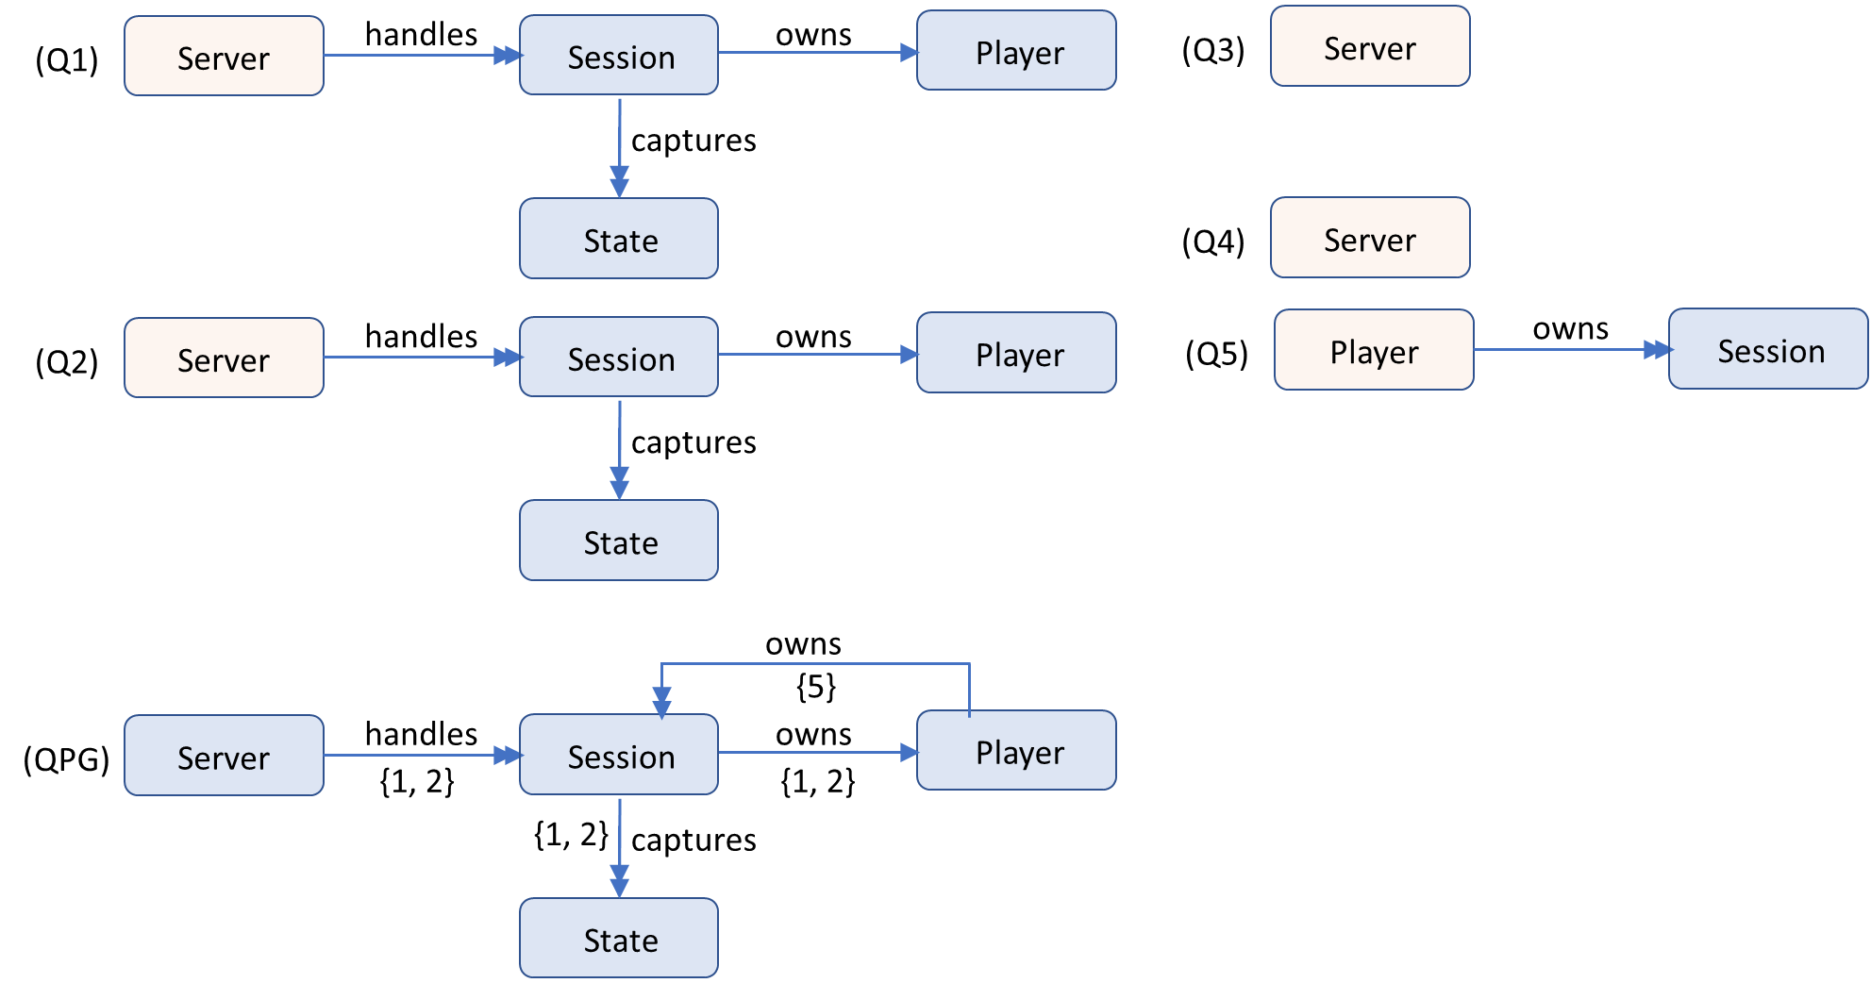
Fig. 4: Query Path Graph (QPG) regarding the queries in Listing 1 and the entity graph in Fig. 3
Notes:
NoAM does not focus on columnar DBs, and does not consider all the conceptual constructs, such as composite attributes and N:M relationships, nor formalizes conversion rules between a conceptual modeling and logical representations in the NoAM model.
“A big data modeling methodology for apache Cassandra” covers all concepts from an ER conceptual model (without extensions introduced by EER) for a logical design “

Slide 9
SQL-like representation of read queries
Q1 - SELECT Session.id, State.id, State.posX, State.posY, State.posZ, State.timestamp
FROM Server.handles.Session.captures.State; Session.owns.Player
WHERE Server.id = ? AND Player.id= ?
Order by State.timestamp
Q2 - SELECT Player.id, Session.id, State.id, State.posX, State.posY, State.posZ, State.timestamp
FROM Server.handles.Session.captures.State; Session.owns.Player
WHERE Server.id = ?
Order by State.timestamp, Player.id
Q3 - SELECT Server.name, Server.IP,
FROM Server
WHERE Server.id = ?
Q4 - SELECT Server.name,
FROM Server
WHERE Server.id = ?
Q5 - SELECT Session.id
FROM Player.owns.Session
WHERE Player.id = ?

Slide 10
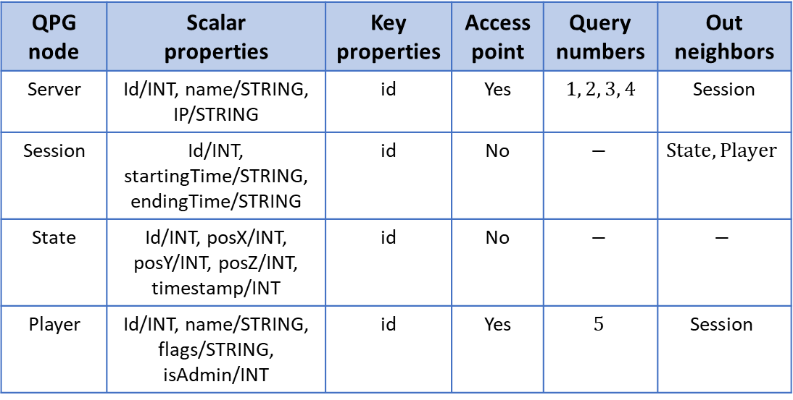
Table 1: QPG node specification
QPG node | Scalar properties | Key properties | Access point | Query numbers | Out neighbors
Server | Id/INT, name/STRING, IP/STRING | id | Yes | $$1, 2, 3, 4$$ | Session
Session | Id/INT, startingTime/STRING, endingTime/STRING | id | No | $$−$$ | $$State, Player$$
State | Id/INT, posX/INT, posY/INT, posZ/INT, timestamp/INT | id | No | $$−$$ | $$−$$
Player | Id/INT, name/STRING, flags/STRING, isAdmin/INT | id | Yes | $$5$$ | $$\text{Session}$$
Notes:
NoAM does not focus on columnar DBs, and does not consider all the conceptual constructs, such as composite attributes and N:M relationships, nor formalizes conversion rules between a conceptual modeling and logical representations in the NoAM model.
“A big data modeling methodology for apache Cassandra” covers all concepts from an ER conceptual model (without extensions introduced by EER) for a logical design “

Slide 11
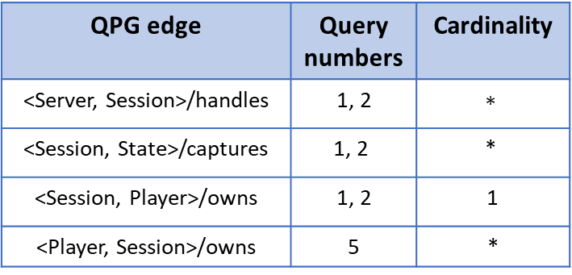
Table 2: QPG edge specification
QPG edge | Query numbers | Cardinality
<Server, Session>/handles | 1, 2 | $$∗$$
<Session, State>/captures | $$\text{1, 2}$$ | $$\text{∗}$$
<Session, Player>/owns | 1, 2 | 1
<Player, Session>/owns | 5 | *
Notes:
NoAM does not focus on columnar DBs, and does not consider all the conceptual constructs, such as composite attributes and N:M relationships, nor formalizes conversion rules between a conceptual modeling and logical representations in the NoAM model.
“A big data modeling methodology for apache Cassandra” covers all concepts from an ER conceptual model (without extensions introduced by EER) for a logical design “

Slide 12
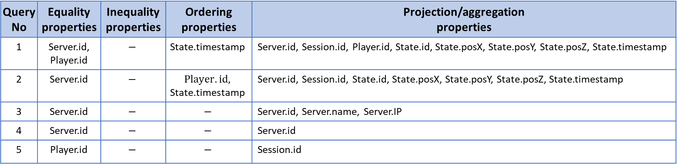
Table 3: QPG query specification
Query No | Equality properties | Inequality properties | Ordering properties | Projection/aggregation properties
1 | Server.id, Player.id | $$−$$ | $$\text{State}\text{.}\text{timestamp}$$ | Server.id, Session.id, Player.id, State.id, State.posX, State.posY, State.posZ, State.timestamp
2 | Server.id | $$−$$ | $$Player.id,$$ $$\text{State}\text{.}\text{timestamp}$$ | Server.id, Session.id, State.id, State.posX, State.posY, State.posZ, State.timestamp
3 | Server.id | $$−$$ | $$−$$ | Server.id, Server.name, Server.IP
4 | Server.id | $$−$$ | $$−$$ | Server.id
5 | Player.id | $$−$$ | $$−$$ | Session.id
Notes:
NoAM does not focus on columnar DBs, and does not consider all the conceptual constructs, such as composite attributes and N:M relationships, nor formalizes conversion rules between a conceptual modeling and logical representations in the NoAM model.
“A big data modeling methodology for apache Cassandra” covers all concepts from an ER conceptual model (without extensions introduced by EER) for a logical design “

Slide 13
Fig. 5: CF schemas associated with the case study, generated by our method where CF₃ and CF₄ are compatible
CF₁
Server.id
Player.id
State.timestamp
State.id
Session.id
State.posX
State.posY
State.posZ
PK
PK
CK+
CK+
CK+
CF₂
Server.id
Player.id
State.timestamp
State.id
Session.id
State.posX
State.posY
State.posZ
PK
CK+
CK+
CK+
CK+
CF₃
PK
Server.id
Server.name
Server.IP
CF₅
PK
CK+
Player.id
Session.id
CF₄
PK
Server.id
PK means partition key, and CK means clustering key where –/+ means <DESC>/<ASC> order

Slide 14
Fig. 6: Combining CF₃ and CF₄ as they are compatible
CF₃
PK
Server.id
Server.name
Server.IP
CF_{3/4}
Server.id
Server.name
Server.IP
Merging
CF₄
PK
Server.id

Slide 15
Fig. 7: CF schemas associated with the case study, generated by our method
CF₁
Server.id
Player.id
State.timestamp
State.id
Session.id
State.posX
State.posY
State.posZ
PK
PK
CK+
CK+
CK+
CF₂
Server.id
State.timestamp
Player.id
State.id
Session.id
State.posX
State.posY
State.posZ
PK
CK+
CK+
CK+
CK+
CF_{3/4}
PK
Server.id
Server.name
Server.IP
CF₅
PK
CK+
Player.id
Session.id
PK means partition key, and CK means clustering key where –/+ means <DESC>/<ASC> order

Slide 16
Generated Cassandra Tables by our Method
Table | Create Statement
CF1 | "create table if not exists CFTable1 (\n" + "Server_id int,\n" + "Player_id int,\n" + "State_timestamp bigint,\n" "State_id int,\n" + "Session_id int,\n" + "State_posX int,\n" + "State_posY int,\n" + "State_posZ int,\n" + "PRIMARY KEY ((Server_id,Player_id),State_timestamp,State_id,Session_id)\n" +")WITH CLUSTERING ORDER BY (State_timestamp ASC,State_id ASC,Session_id ASC);\n"

Slide 17
Generated Cassandra Tables by our Method
Table | Create Statement
CF2 | "create table if not exists CFTable2 (\n" + "Server_id int,\n" + "State_timestamp bigint,\n" + //TODO 关于long类型转换的选择 "Player_id int,\n" + "State_id int,\n" + "Session_id int,\n" + "State_posX int,\n" + "State_posY int,\n" + "State_posZ int,\n" + "PRIMARY KEY (Server_id,State_timestamp,Player_id,State_id,Session_id)\n" + ")WITH CLUSTERING ORDER BY (State_timestamp ASC,Player_id ASC,State_id ASC,Session_id ASC);\n"

Slide 18
Generated Cassandra Tables by our Method
Table | Create Statement
CF3/4 | "create table if not exists CFTable3 (\n" + "Server_id int,\n" + "Server_name text,\n" + "Server_IP text,\n" + "PRIMARY KEY (Server_id)\n" + ");\n"
CF5 | "create table if not exists CFTable5 (\n" + "Player_Id int,\n" + "Session_Id int,\n" + "PRIMARY KEY (Player_Id,Session_Id)\n" + ")WITH CLUSTERING ORDER BY (Session_Id ASC);\n"

Slide 19
CQL Queries
Query | CQL Statement
Q1 | "select * from CFTable1 where server_id = ? AND player_id = ? ORDER BY State_timestamp DESC limit 1;"
Q2 | "select * from CFTable2 where server_id = ? ORDER BY State_timestamp DESC limit 1;"
Query | CQL Statement
Q6_CFTable1 | Query : "SELECT * FROM CFTable1 where server_id = ? ALLOW FILTERING;“ Delete : "DELETE FROM CFTable1 where server_id = ? AND player_id = ?;“ Insert :"insert into CFTable1 (keys) values (?)
Q6_CFTable2 | Query : "SELECT * FROM CFTable2 where server_id = ?;" Delete : "DELETE FROM CFTable2 where server_id = ?;" Insert :"insert into CFTable2 (keys) values (?)
Q6_CFTable3 | Query : "SELECT * FROM CFTable3 where server_id = ?;“ Delete : "DELETE FROM CFTable3 where server_id = ?;" Insert :"insert into CFTable3 (keys) values (?)

Slide 20
Database Population
We populated the CF tables, in Cassandra store, with 1000 players and 10 servers, where each player owns by average 10 sessions, each server handles by average 1000 sessions and each session captures by average 5 states.

Slide 21
The Performance of Queries
 | Q1 | Q2 | Q6
1 | 7.2707 | 7.405 | 897.09
2 | 7.3358 | 7.4636 | 933.08
3 | 7.3221 | 7.4328 | 979.63
4 | 7.3081 | 7.4253 | 981.15
5 | 7.3103 | 7.4321 | 987.7
avg | 7.3094 | 7.43176 | 955.73

Slide 22
Fig. 8: CF schemas associated with the case study, generated by Mior et el. [1]
CF_{1/2}
Server.id
State.timestamp
Player.id
State.id
Session.id
State.posX
State.posY
State.posZ
PK
CK+
CK+
CK+
CK+
CF_{3/4}
PK
Server.id
Server.name
Server.IP
CF₅
PK
CK+
Player.id
Session.id
PK means partition key, and CK means clustering key where –/+ means <DESC>/<ASC> order

Slide 23
Cassandra Tables for Mior et al.
Table | Create Statement
MergeTable1 | "create table if not exists MergeTable1 (\n" + "Server_id int,\n" + "State_timestamp bigint,\n" + "Player_id int,\n" + "State_id int,\n" + "Session_id int,\n" + "State_posX int,\n" + "State_posY int,\n" + "State_posZ int,\n" + "PRIMARY KEY (Server_id,State_timestamp,Player_id,State_id,Session_id)\n" + ")WITH CLUSTERING ORDER BY (State_timestamp ASC,Player_id ASC,State_id ASC,Session_id ASC);\n";

Slide 24
Cassandra Tables for Mior et al.
Table | Create Statement
MergeTable3 | "create table if not exists MergeTable3 (\n" + "Server_id int,\n" + "Server_name text,\n" + "Server_IP text,\n" + "PRIMARY KEY (Server_id)\n" + ");\n"
MergeTable5 | "create table if not exists MergeTable5 (\n" + "Player_Id int,\n" + "Session_Id int,\n" + "PRIMARY KEY (Player_Id,Session_Id)\n" + ")WITH CLUSTERING ORDER BY (Session_Id ASC);\n"

Slide 25
CQL Queries
Query | CQL Statement
Q1 | "select * from MergeTable1 where server_id = ? AND player_id = ? ORDER BY State_timestamp DESC limit 1 ALLOW FILTERING;"
Q2 | "select * from MergeTable1 where server_id = ? ORDER BY State_timestamp DESC limit 1;"
Query | CQL Statement
Q3_MergeTable1 | Query : "SELECT * FROM MergeTable1 where server_id = ?;" Delete : "DELETE FROM MergeTable1 where server_id = ?;" Insert :"insert into MergeTable1 (keys) values (?)
Q3_MergeTable3 | Query : "SELECT * FROM MergeTable3 where server_id = ?;“ Delete : "DELETE FROM MergeTable3 where server_id = ?;" Insert :"insert into MergeTable3 (keys) values (?)

Slide 26
The Performance of Queries
 | Q1 | Q2 | Q6
1 | 12.0139 | 7.9237 | 335.9
2 | 11.4933 | 7.8122 | 334.6
3 | 12.934 | 7.4912 | 322.23
4 | 11.4507 | 7.8258 | 319.51
5 | 12.1354 | 7.8979 | 325.76
avg | 12.00546 | 7.87016 | 327.6

Slide 27
Comparing the Performance of Queries in our method vs. Mior et al.
Query | exp23 | exp24
Q1 | 7.3094 | 12.00546
Q2 | 7.43176 | 7.87016
Q6 | 955.73 | 327.6

Slide 28
Case Study#2: Online Store

Slide 29
Case Study Description
In Online Store [2], Customers can make Orders of different Products. Each order includes Payment information and the Carrier that delivered it. Products belong to a concrete Category and have a concrete Supplier.
The domain entities that conform this case study and their relations are shown in the UML class diagram in Fig. 9.

Slide 30
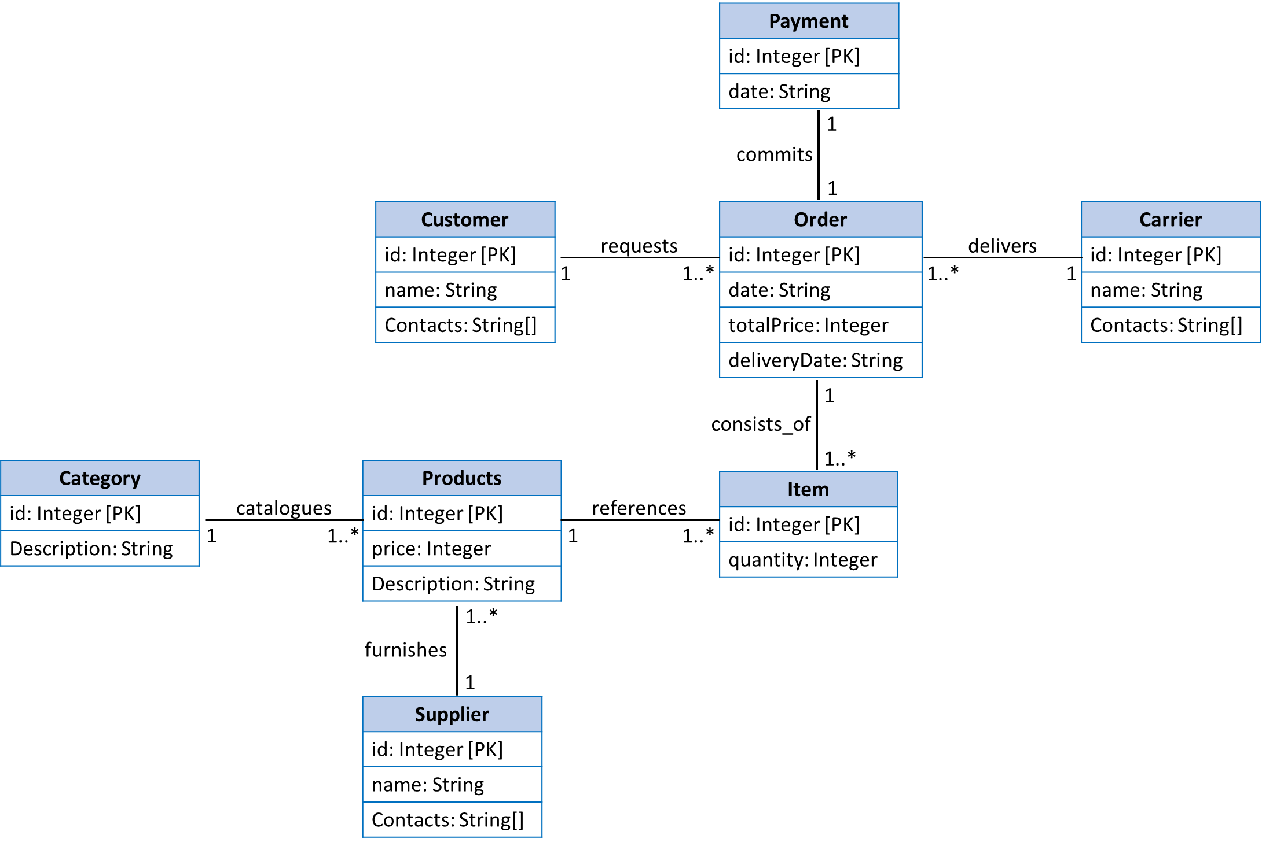
Fig. 9: Online Store conceptual model represented with UML class diagram

Slide 31
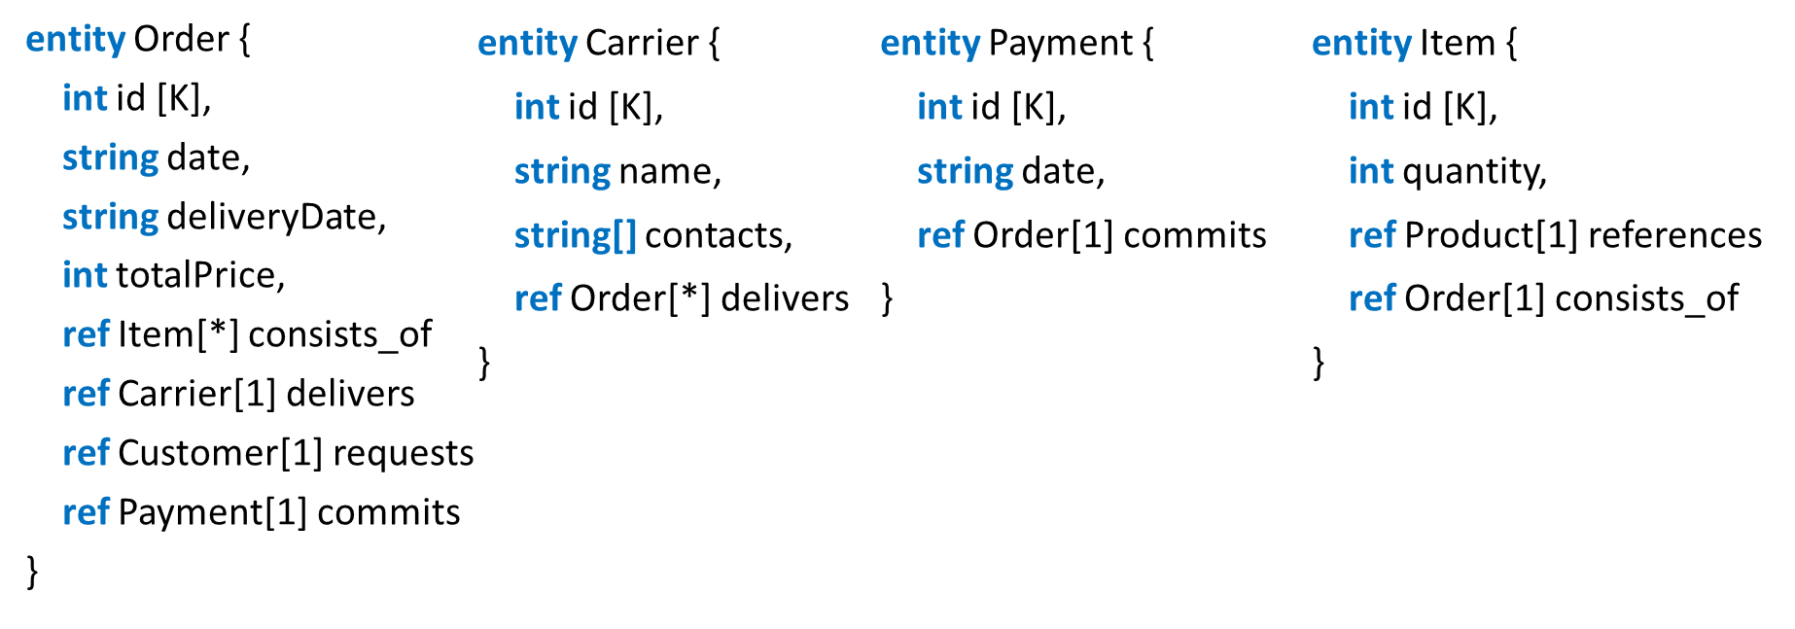
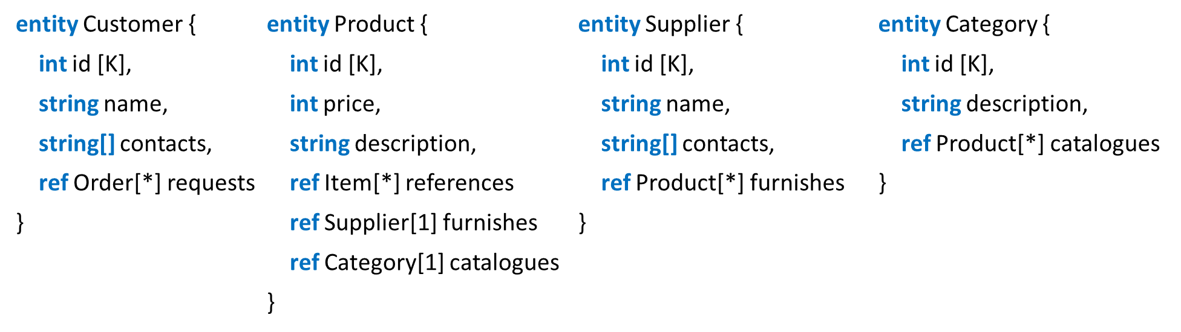
Fig. 10: Textual representation of the conceptual model in Fig. 9

Slide 32
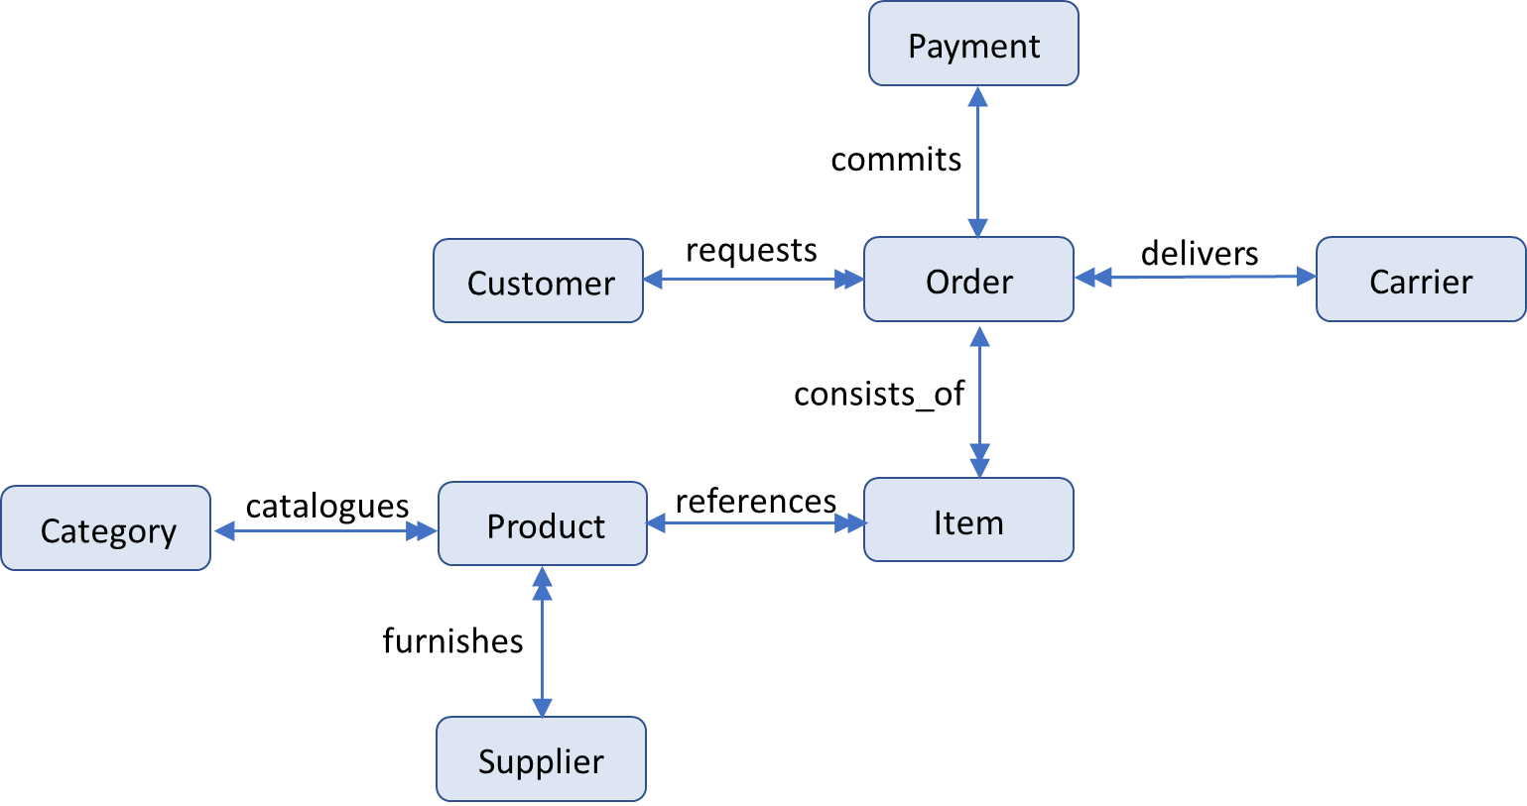
Fig. 11: Entity Graph representation of the conceptual model in Fig. 9

Slide 33
Listing 2: Query workload associated with the case study
Q1 – Return all requested orders and related items and products of a customer, given the id of this customer.
Q2 – Return all requested orders and related payments of a customer, given the id of this customer.
Q3 – Return all requested orders and related carriers of a customer, given the id of the customer.
Q4 – Return all products of a category, given the id of this category.
Q5 – Return all products of a supplier, given the id of this supplier.
Q6 – Return the information of a product including its category and supplier, given the id of this product.
Regarding the workload, Product is an HA entity type that is accessed by a majority of queries (Q1, Q4, Q5 and Q6). In addition, Order is an HW entity type.

Slide 34
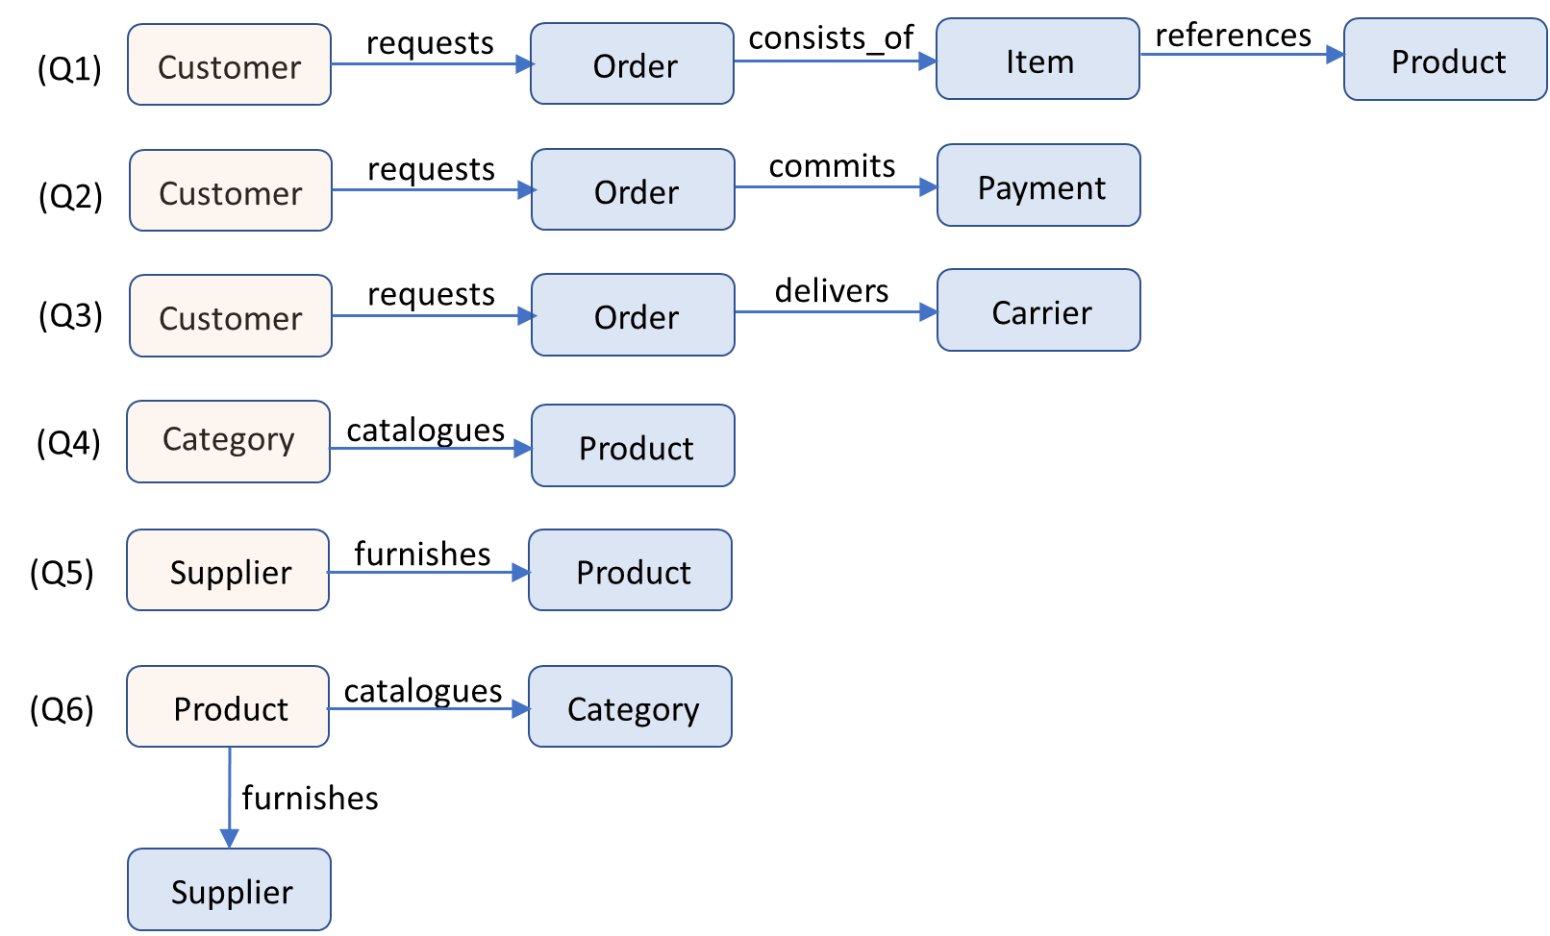
Fig. 12: Query paths regarding the queries in Listing 2 and the entity graph in Fig. 11
Notes:
NoAM does not focus on columnar DBs, and does not consider all the conceptual constructs, such as composite attributes and N:M relationships, nor formalizes conversion rules between a conceptual modeling and logical representations in the NoAM model.
“A big data modeling methodology for apache Cassandra” covers all concepts from an ER conceptual model (without extensions introduced by EER) for a logical design “

Slide 35
SQL-like representation of read queries
Q1 - SELECT Customer.name, Customer.contacts, Order.id, Order.date, Order.deliveryDate, Order.totalPrice, Item.id, Item.quantity, Product.id, Product.price, Product.description
FROM Customer.requests.Order.consists_of.Item.references.Product
WHERE Customer.id = ?
Q2 - SELECT Customer.name, Customer.contacts, Order.id, Order.date, Order.deliveryDate, Order.totalPrice, Payment.id, Payment.date
FROM Customer.requests.Order.commits.Payment
WHERE Customer.id = ?
Q3 - SELECT Customer.name, Customer.contacts, Order.id, Order.date, Order.deliveryDate, Order.totalPrice, Carrier.id, Carrier.name, Carrier.contacts
FROM Customer.requests.Order.delivers.Carrier
WHERE Customer.id = ?
Q4 - SELECT Product.id, Product.price, Product.description
FROM Category.catalogues.Product
WHERE Category.id = ?
Q5 - SELECT Product.id, Product.price, Product.description
FROM Supplier.furnishes.Product
WHERE Supplier.id = ?

Slide 36
SQL-like representation of read queries
Q6 - SELECT Product.id, Product.price, Product.description , Category.id, Category.description, Supplier.id, Supplier.name, Supplier.contacts
FROM Product.catalogues.Category; Product.funishes.Supplier
WHERE Product.id = ?

Slide 37
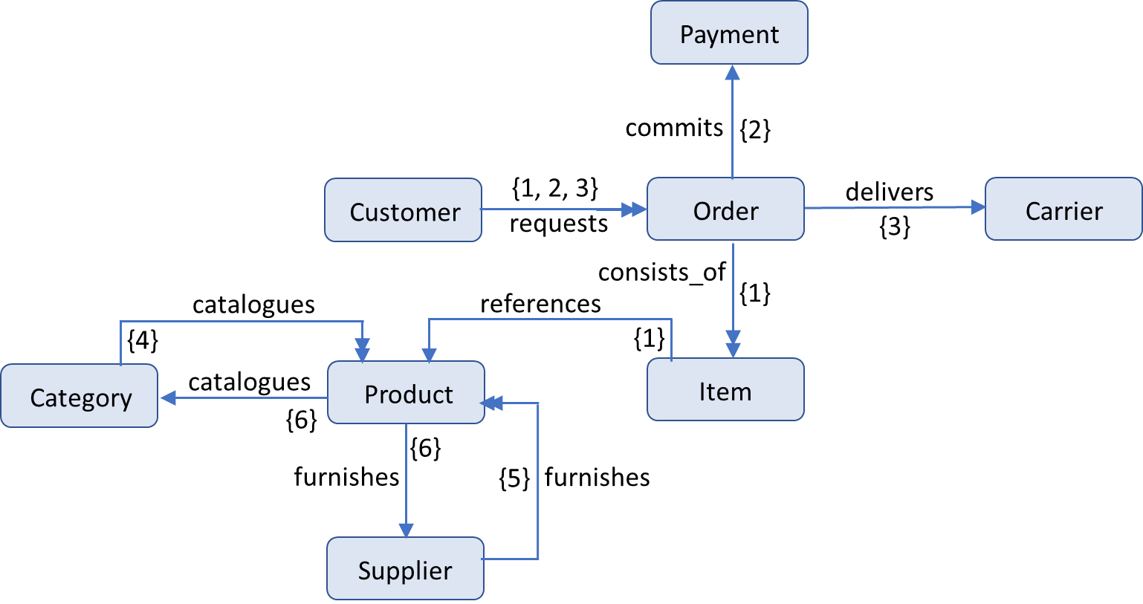
Fig. 13: Query Path Graph (QPG) regarding the queries in Listing 2 and the entity graph in Fig. 11
Notes:
NoAM does not focus on columnar DBs, and does not consider all the conceptual constructs, such as composite attributes and N:M relationships, nor formalizes conversion rules between a conceptual modeling and logical representations in the NoAM model.
“A big data modeling methodology for apache Cassandra” covers all concepts from an ER conceptual model (without extensions introduced by EER) for a logical design “

Slide 38
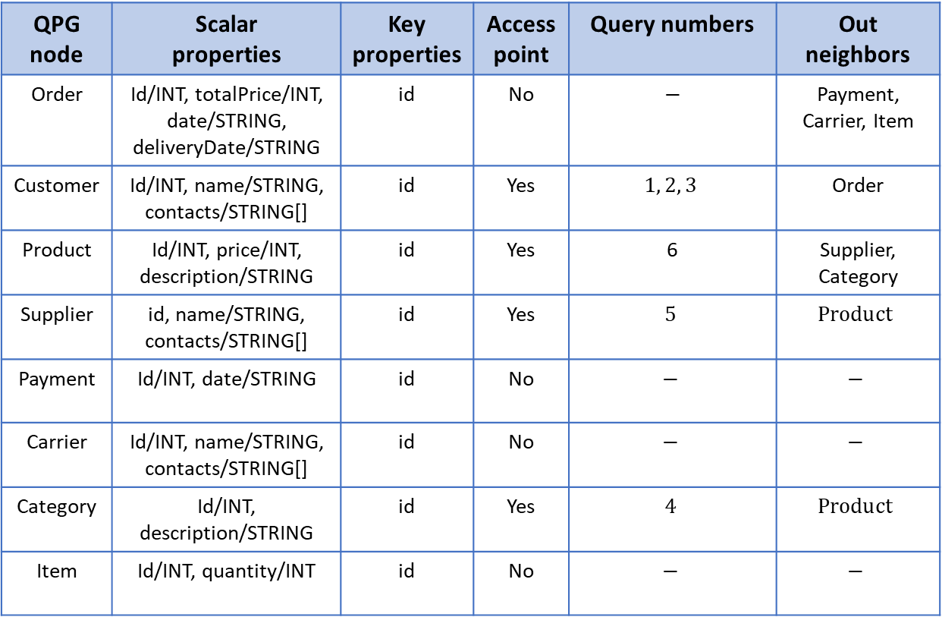
Table 4: QPG node specification
Notes:
NoAM does not focus on columnar DBs, and does not consider all the conceptual constructs, such as composite attributes and N:M relationships, nor formalizes conversion rules between a conceptual modeling and logical representations in the NoAM model.
“A big data modeling methodology for apache Cassandra” covers all concepts from an ER conceptual model (without extensions introduced by EER) for a logical design “

Slide 39
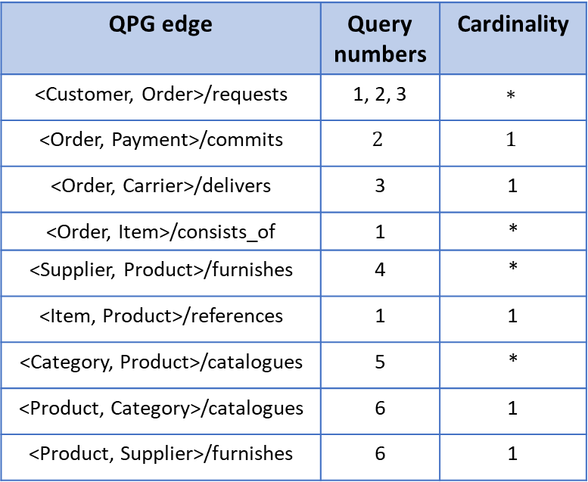
Table 5: QPG edge specification
Notes:
NoAM does not focus on columnar DBs, and does not consider all the conceptual constructs, such as composite attributes and N:M relationships, nor formalizes conversion rules between a conceptual modeling and logical representations in the NoAM model.
“A big data modeling methodology for apache Cassandra” covers all concepts from an ER conceptual model (without extensions introduced by EER) for a logical design “

Slide 40
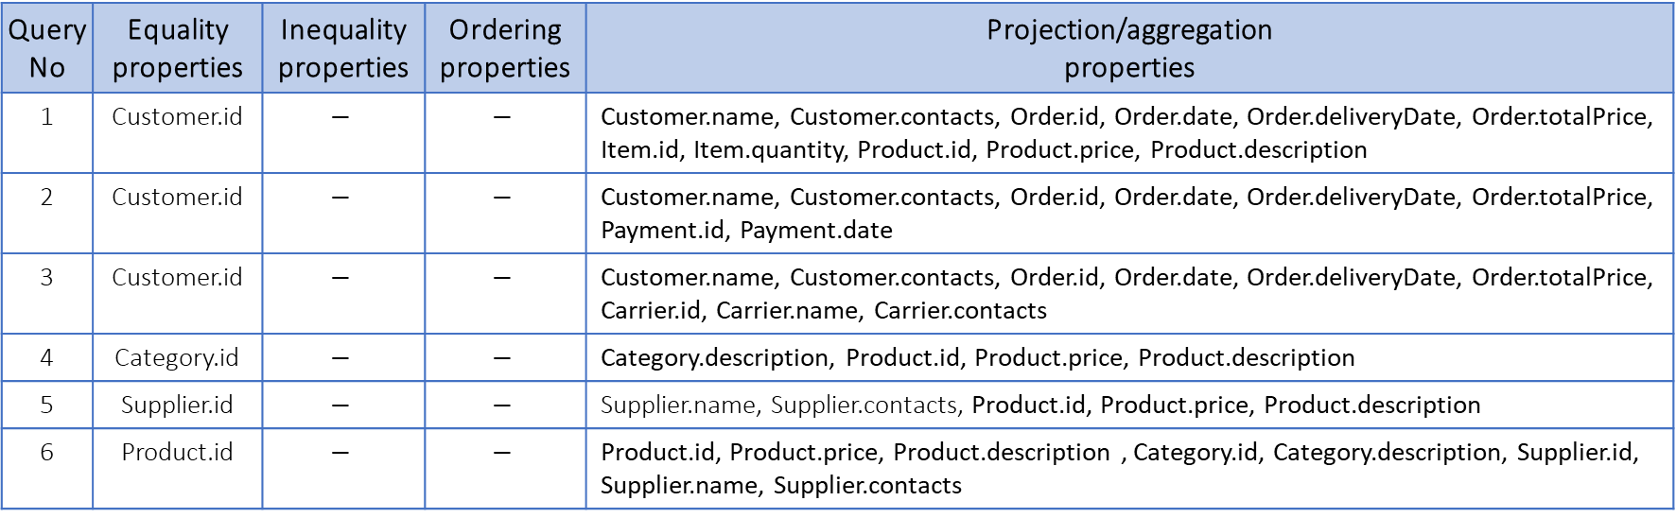
Table 6: QPG query specification
Notes:
NoAM does not focus on columnar DBs, and does not consider all the conceptual constructs, such as composite attributes and N:M relationships, nor formalizes conversion rules between a conceptual modeling and logical representations in the NoAM model.
“A big data modeling methodology for apache Cassandra” covers all concepts from an ER conceptual model (without extensions introduced by EER) for a logical design “

Slide 41
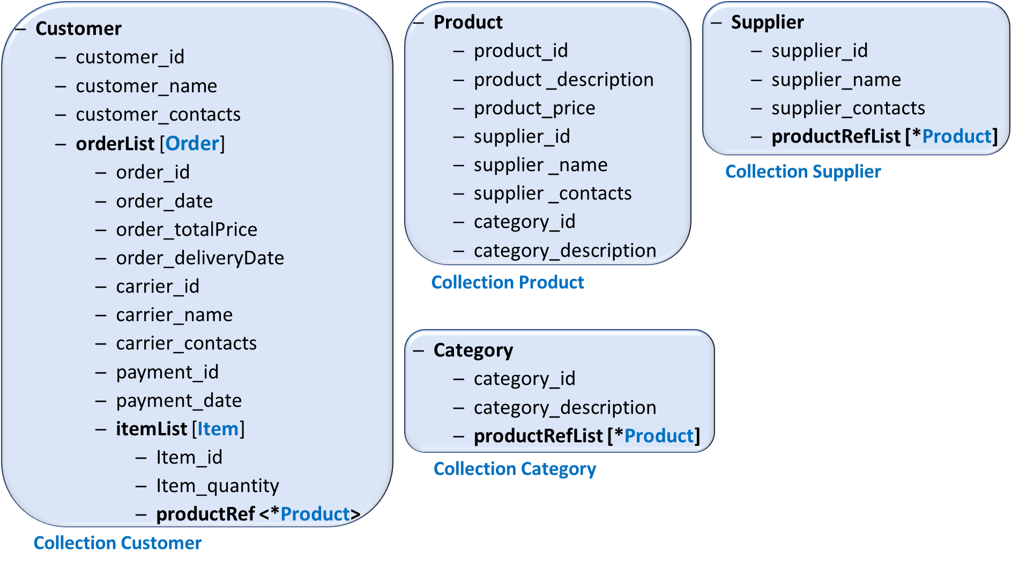
Fig. 14: Document schemas associated with the case study, generated by our method with control on the denormalization degree of Product

Slide 42
MongoDB Queries based on our design
Query | Statement
Q1 | db.customer.findOne({'_id ': Id}, {'orderList.order_id': 1, 'orderList.order_saleDate': 1, 'orderList.order_totalPrice': 1, 'orderList.carrier_deliveryDate': 1 ,'orderList.itemList':1});
Q2 | db.customer.findOne({_id: Id}, {'orderList.order_id': 1, 'orderList.order_saleDate': 1, 'orderList.order_totalPrice': 1, 'orderList.carrier_deliveryDate': 1, 'orderList.payment_id':1, 'orderList.payment_date':1})
Q3 | db.customer.findOne({_id: Id}, {'orderList.order_id': 1, 'orderList.order_saleDate': 1, 'orderList.order_totalPrice': 1, 'orderList.carrier_deliveryDate': 1, 'orderList.carrier_id': 1, 'orderList.carrier_name': 1, 'orderList.carrier_contacts': 1});
Q4 | db.category.findOne({_id: Id}, {productRefList': 1});
Q5 | db.supplier.findOne({_id: Id}, {productRefList': 1});
Q6 | db.product.findOne({_id: Id});
Q7 | db.customer.update({_id: Id}, {$push: {orderList: {orderKeys: orderValues}}});

Slide 43
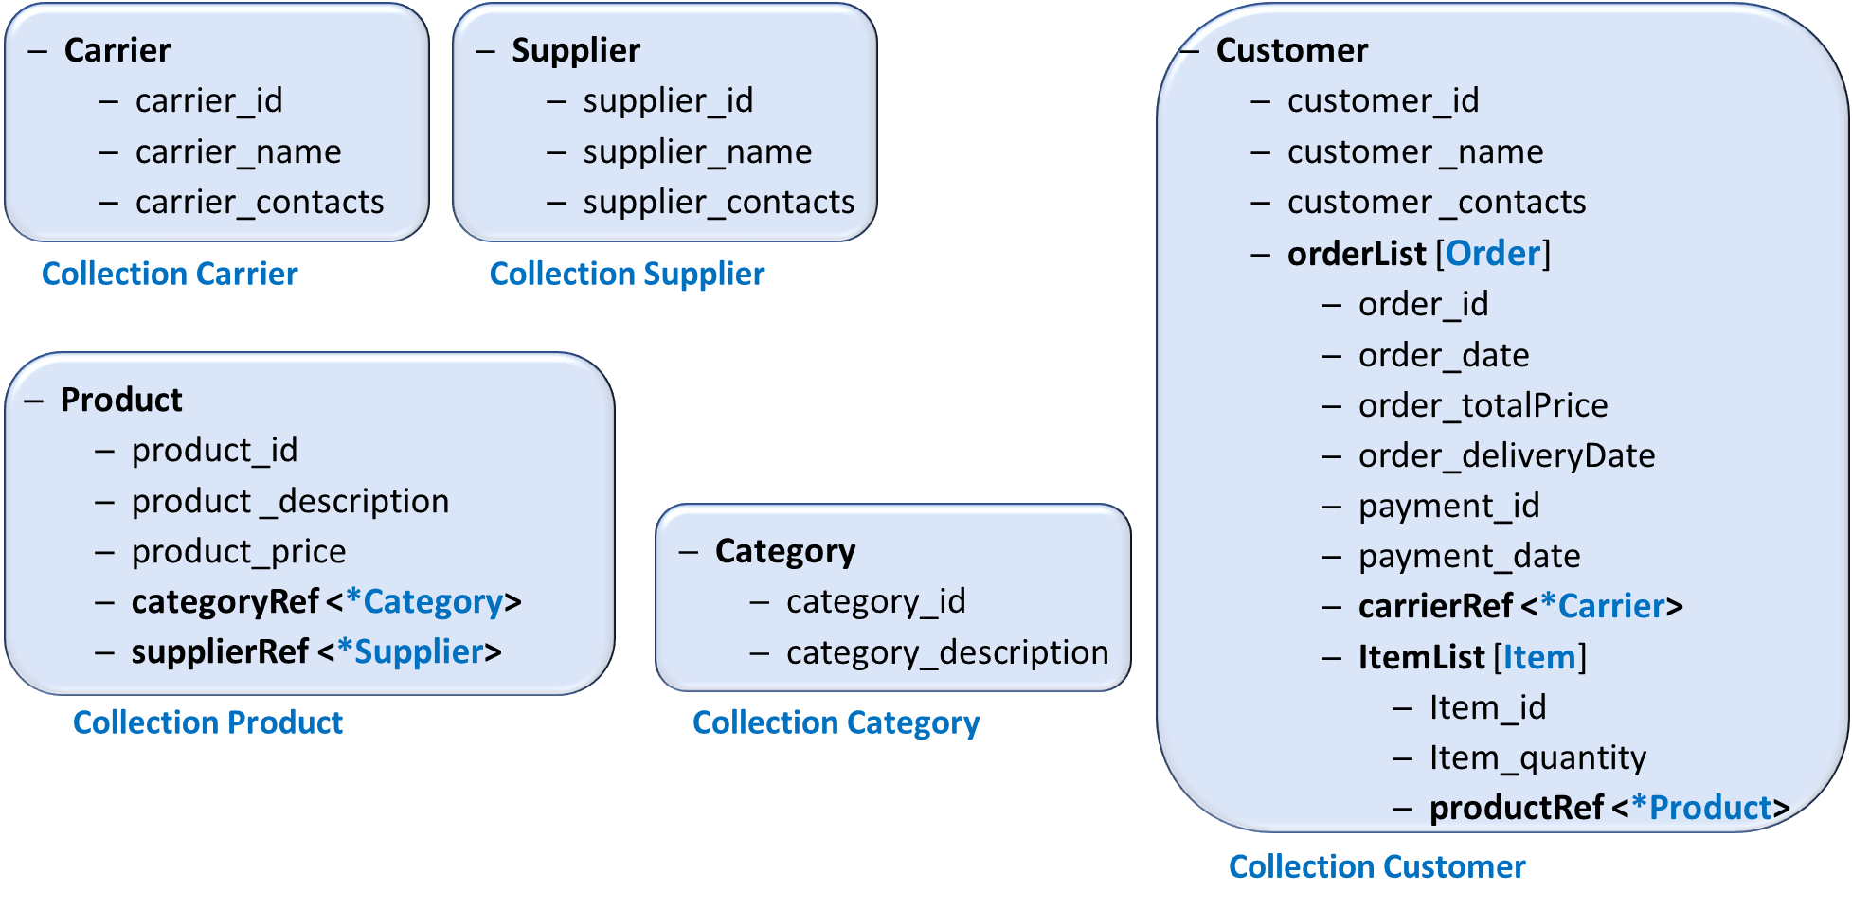
Fig. 15: Document schemas generated with respect to de Lima’s method

Slide 44
MongoDB Queries based on de Lima’s design
Query | Statement
Q1 | db.customer.findOne({'_id ': Id}, {'orderList.order_id': 1, 'orderList.order_saleDate': 1, 'orderList.order_totalPrice': 1, 'orderList.carrier_deliveryDate': 1, 'orderList.itemList':1});
Q2 | db.customer.findOne({_id: Id}, {'orderList.order_id': 1, 'orderList.order_saleDate': 1, 'orderList.order_totalPrice': 1, 'orderList.carrier_deliveryDate': 1, 'orderList.payment_id':1, 'orderList.payment_date':1});
Q3 | db.customer.findOne({_id: Id}, {'orderList.order_id': 1, 'orderList.order_saleDate': 1, 'orderList.order_totalPrice': 1, 'orderList.carrier_deliveryDate': 1, 'orderList.carrierRef': 1});
Q4 | db.product.find({'categoryRef.$id': Id}, {'product_id': 1, 'product_description': 1, 'product_price': 1});
Q5 | db.product.find({'supplierRef.$id': Id}, {'product_id': 1, 'product_description': 1, 'product_price': 1});
Q6 | db.product.findOne({_id: Id});
Q7 | db.customer.update({_id: Id}, {$push: {orderList: {orderKeys: orderValues}}});

Slide 45
Listing 2: Query workload associated with the case study
Q1 – Return all requested orders and related items and products of a customer, given the id of this customer.
Q2 – Return all requested orders and related payments of a customer, given the id of this customer.
Q3 – Return all requested orders and related carriers of a customer, given the id of the customer.
Q4 – Return all products of a category, given the id of this category.
Q5 – Return all products of a supplier, given the id of this supplier.
Q6 – Return the information of a product including its category and supplier, given the id of this product.
Regarding the workload, Product is an HA entity type that is accessed by a majority of queries (Q1, Q4, Q5 and Q6). In addition, Order is an HW entity type.

Slide 46
The Mapping of Queries to the Employed Collections
Accessed collections in Our design
Accessed collections in De Lima’s design
Query | Customer | Product | Supplier | Category
Q1 | ✓ | ✓
Q2 | ✓
Q3 | ✓
Q4 |  | ✓ |  | ✓
Q5 |  | ✓ | ✓
Q6 |  | ✓
Query | Customer | Product | Supplier | Category | Carrier
Q1 | ✓ | ✓
Q2 | ✓
Q3 | ✓ |  |  |  | ✓
Q4 |  | ✓ |  | ✓
Q5 |  | ✓ | ✓
Q6 |  | ✓ | ✓ | ✓

Slide 47
Database Population
We populated the document collections, in MongoDB, with 100,000 customers, 100 carriers, 100 products, 10 suppliers and 50 categories, where each customer has by average 100 orders and each order has by average 10 items.

Slide 48
The performance of queries in our design
round | Q1 | Q2 | Q3 | Q4 | Q5 | Q6
1 | 18.912 | 8.3433 | 7.467 | 0.7586 | 0.7265 | 0.2944
2 | 18.293 | 8.6626 | 7.5355 | 0.7776 | 0.7205 | 0.2946
3 | 18.307 | 8.6903 | 7.5393 | 0.7671 | 0.7795 | 0.2973
4 | 19.821 | 8.6744 | 7.8235 | 0.7746 | 0.7266 | 0.2838
5 | 18.533 | 8.2501 | 6.8445 | 0.7468 | 0.7423 | 0.2904
avg | 18.673 | 8.4944 | 7.4419 | 0.7649 | 0.7390 | 0.2921

Slide 49
The performance of queries in de Lima’s design
round | Q1 | Q2 | Q3 | Q4 | Q5 | Q6
1 | 18.351 | 8.9505 | 15.7966 | 0.7110 | 0.7324 | 0.8489
2 | 18.523 | 8.186 | 17.584 | 0.7314 | 0.7502 | 0.8913
3 | 18.384 | 7.8781 | 18.3637 | 0.7283 | 0.7492 | 0.8811
4 | 18.457 | 7.9893 | 17.0804 | 0.7164 | 0.7446 | 0.8916
5 | 18.102 | 8.2501 | 16.0627 | 0.6890 | 0.6808 | 0.8065
avg | 18.203 | 8.1308 | 16.9774 | 0.7152 | 0.7314 | 0.8638

Slide 50
Case Study#3: Digital Library

Slide 51
Case Study Description
This case study [3] describes data related to a venues’ platform. Venues takes place yearly. In each venue, a set of digital Artifacts is included. Users can perform Reviews of these artifacts, including a comment and a rating. Also, users can like reviews, digital artifacts and concrete venue editions.
The domain entities that conform this case study and their relations are shown in the UML class diagram in Fig. 14.

Slide 52
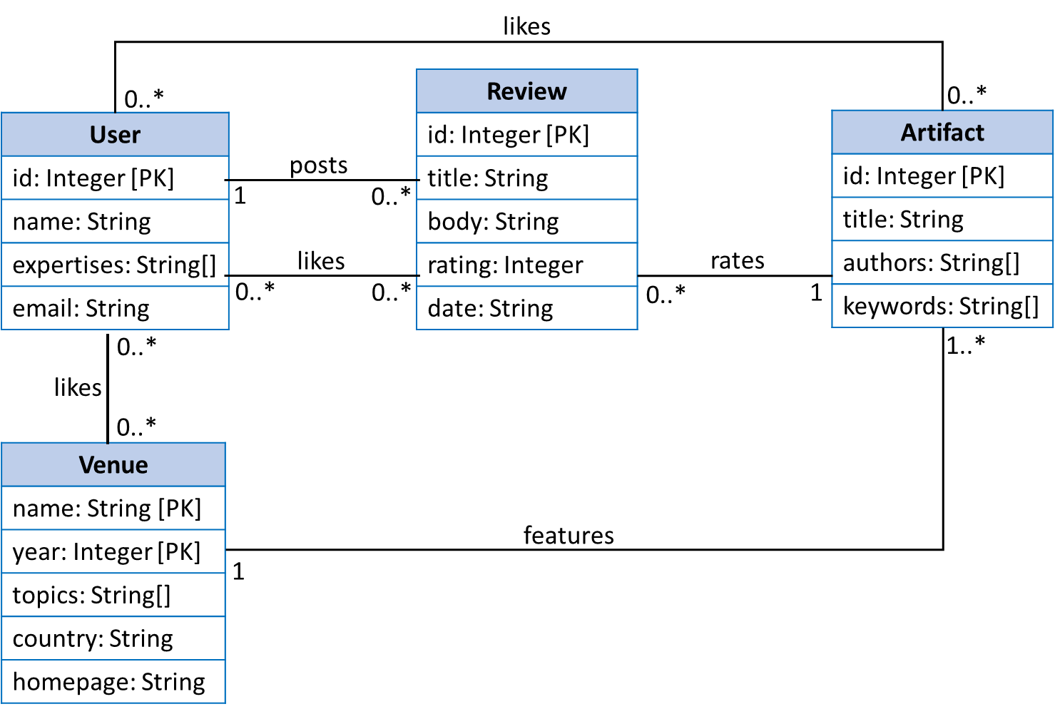
Fig. 14: Digital Library conceptual model represented with UML class diagram

Slide 53
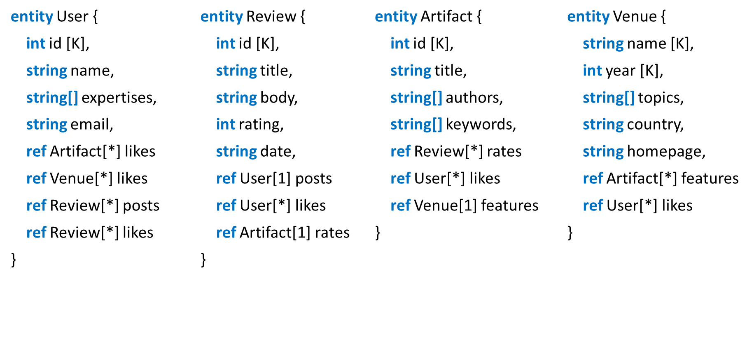
Fig. 15: Textual representation of the conceptual model in Fig. 14

Slide 54
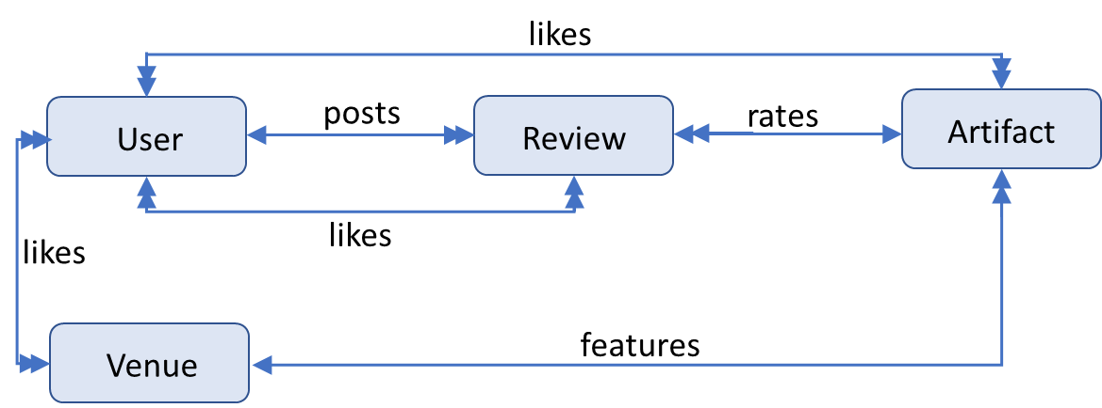
Fig. 16: Entity Graph representation of the conceptual model in Fig. 14

Slide 55
Listing 3: Query workload associated with the case study
Q1 - Return all Artifacts published in a Venue, given the name of this venue, after a given year, and ordered by year[Desc].
Q2 - Return all Artifacts and related venue names, given the author of these artifacts, and ordered by year[Desc].
Q3 - Return all Users who like an Artifact, given the id of this artifact.
Q4 - Return all Users who like an Artifact, given the id of this artifact, who have a given expertise.
Q5 - Return the average rating of an Artifact, given the id of this artifact.
Q6 - Return all Venues liked by a User, given the id of this user.
Q7 - Return all Artifacts published after a given Year, that a User liked, given the id of this user, and ordered by year[Desc].
Q8 - Return all Reviews posted by a User, given the id of this author, with a rating greater than a given value, and ordered by rating[Desc].
Q9 - Return information about an Artifacts, given the id of this artifact.
Q10 – Insert an existing Review.
Regarding the workload, Review is an HW entity type

Slide 56
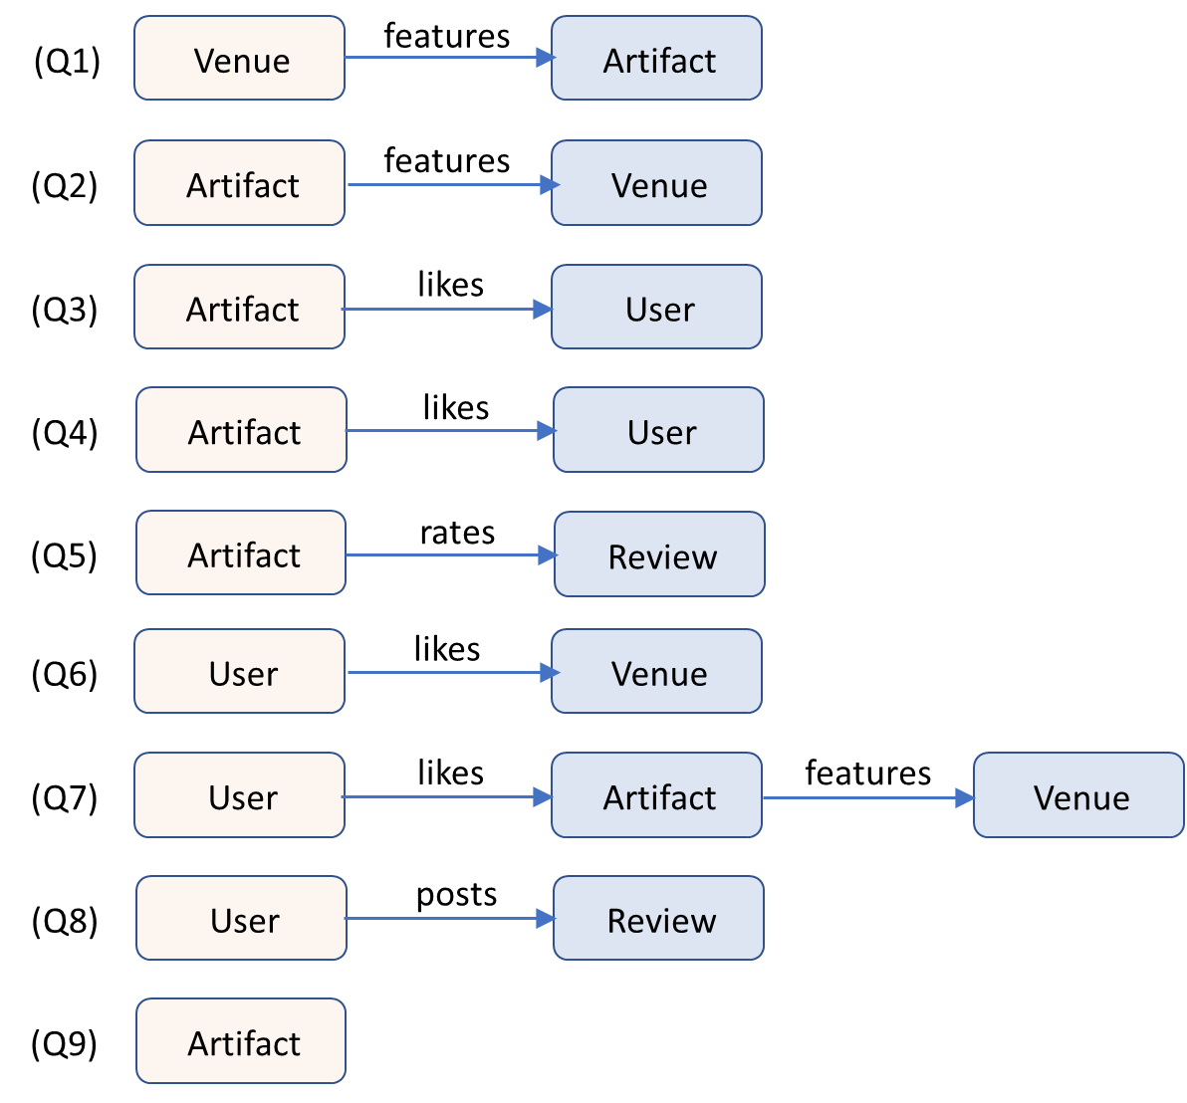
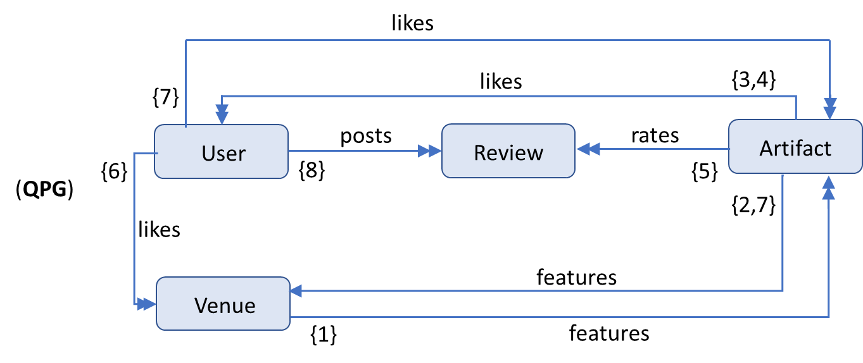
Fig. 17: Query Path Graph (QPG) regarding the queries in Listing 3 and the entity graph in Fig. 16
Notes:
NoAM does not focus on columnar DBs, and does not consider all the conceptual constructs, such as composite attributes and N:M relationships, nor formalizes conversion rules between a conceptual modeling and logical representations in the NoAM model.
“A big data modeling methodology for apache Cassandra” covers all concepts from an ER conceptual model (without extensions introduced by EER) for a logical design “

Slide 57
SQL-like representation of read queries
Q1 - SELECT Artifact.id, Artifact.title, Artifact.authors, Artifact.keywords
FROM Venue.features.Artifact
WHERE Venue.name = ? AND Venue.year >= ?
ORDER BY Venue.year(DESC)
Q2 - SELECT Artifact.id, Artifact.title, Artifact.authors, Artifact.keywords, Venue.name
FROM Artifact.features.Venue
WHERE Artifact.author = ?
ORDER BY Venue.year(DESC)
Q3 - SELECT User.id, User.name, User.email, User.expertises
FROM Artifact.likes.User
WHERE Artifact.id = ?
Q4 - SELECT User.id, User.name, User.email, User.expertises
FROM Artifact.likes.User
WHERE Artifact.id = ? AND User.expertises = ?
// In here, expertises = “…” means an element of expertises not the whole array.
Q5 - SELECT Review.rating
FROM Artifact.rates.Review
WHERE Artifact.id = ?

Slide 58
SQL-like representation of read queries
Q6 - SELECT Venue.name, Venue.year, Venue.homepage, Venue.country, Venue.topics
FROM User.likes.Venue
WHERE User.id = ?
Q7 - SELECT Artifact.title, Artifact.authors
FROM User.likes.Artifact.features.Venue
WHERE User.id = ? AND Venue.year >= ?
ORDER BY Venue.year(DESC)
Q8 - SELECT Review.id, Review.rating, Review.body, Review.date, Review.title
FROM User.posts.Review
WHERE User.id = ? AND Review.rating >= ?
ORDER BY Review.rating(DESC)
Q9 - SELECT Artifact.id, Artifact.title, Artifact.authors, Artifact.keywords
FROM Artifact
WHERE Artifact.id = ?

Slide 59
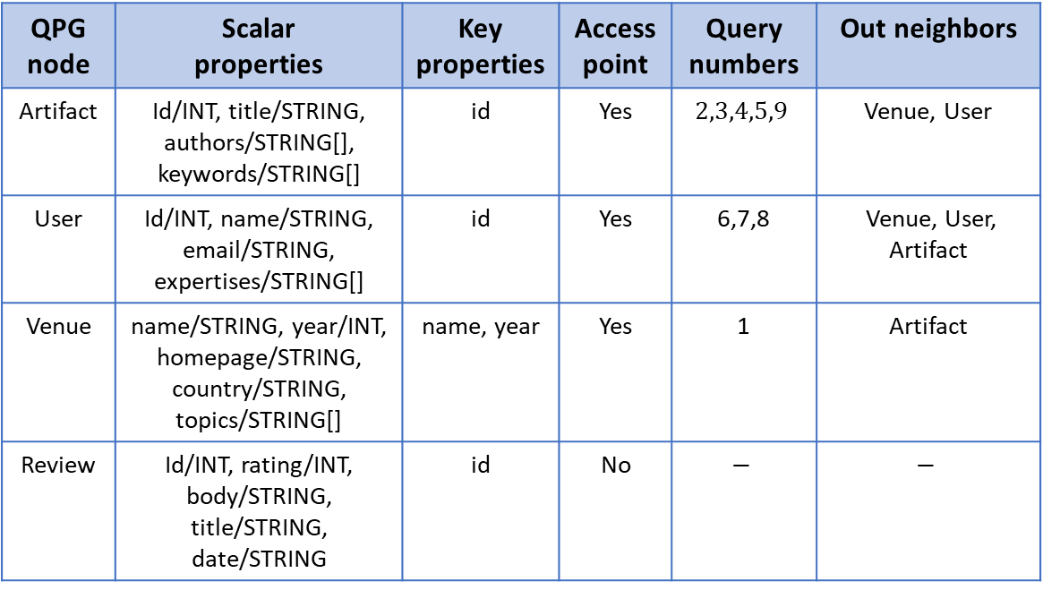
Table 7: QPG node specification
Notes:
NoAM does not focus on columnar DBs, and does not consider all the conceptual constructs, such as composite attributes and N:M relationships, nor formalizes conversion rules between a conceptual modeling and logical representations in the NoAM model.
“A big data modeling methodology for apache Cassandra” covers all concepts from an ER conceptual model (without extensions introduced by EER) for a logical design “

Slide 60
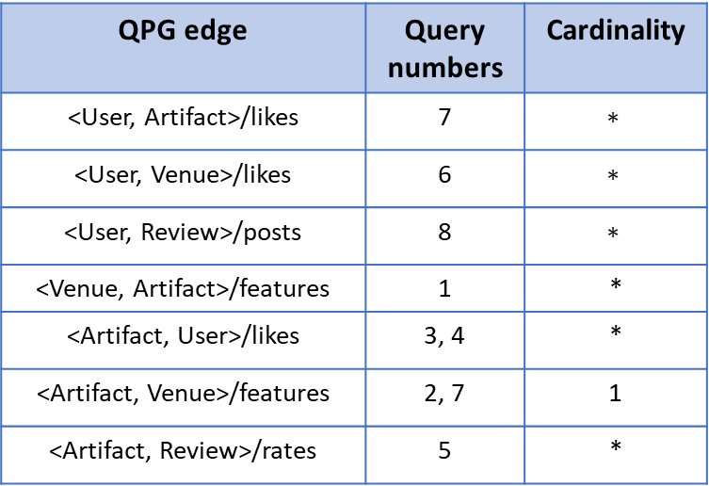
Table 8: QPG edge specification
Notes:
NoAM does not focus on columnar DBs, and does not consider all the conceptual constructs, such as composite attributes and N:M relationships, nor formalizes conversion rules between a conceptual modeling and logical representations in the NoAM model.
“A big data modeling methodology for apache Cassandra” covers all concepts from an ER conceptual model (without extensions introduced by EER) for a logical design “

Slide 61
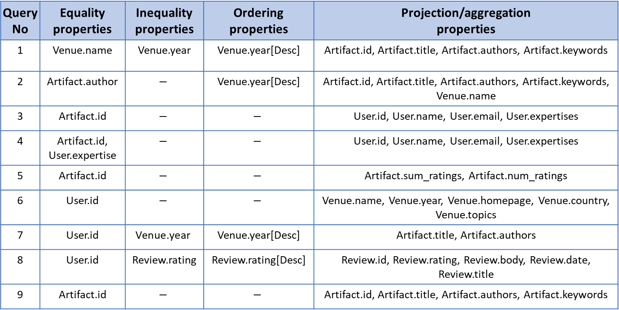
Table 9: QPG query specification
Notes:
NoAM does not focus on columnar DBs, and does not consider all the conceptual constructs, such as composite attributes and N:M relationships, nor formalizes conversion rules between a conceptual modeling and logical representations in the NoAM model.
“A big data modeling methodology for apache Cassandra” covers all concepts from an ER conceptual model (without extensions introduced by EER) for a logical design “

Slide 62
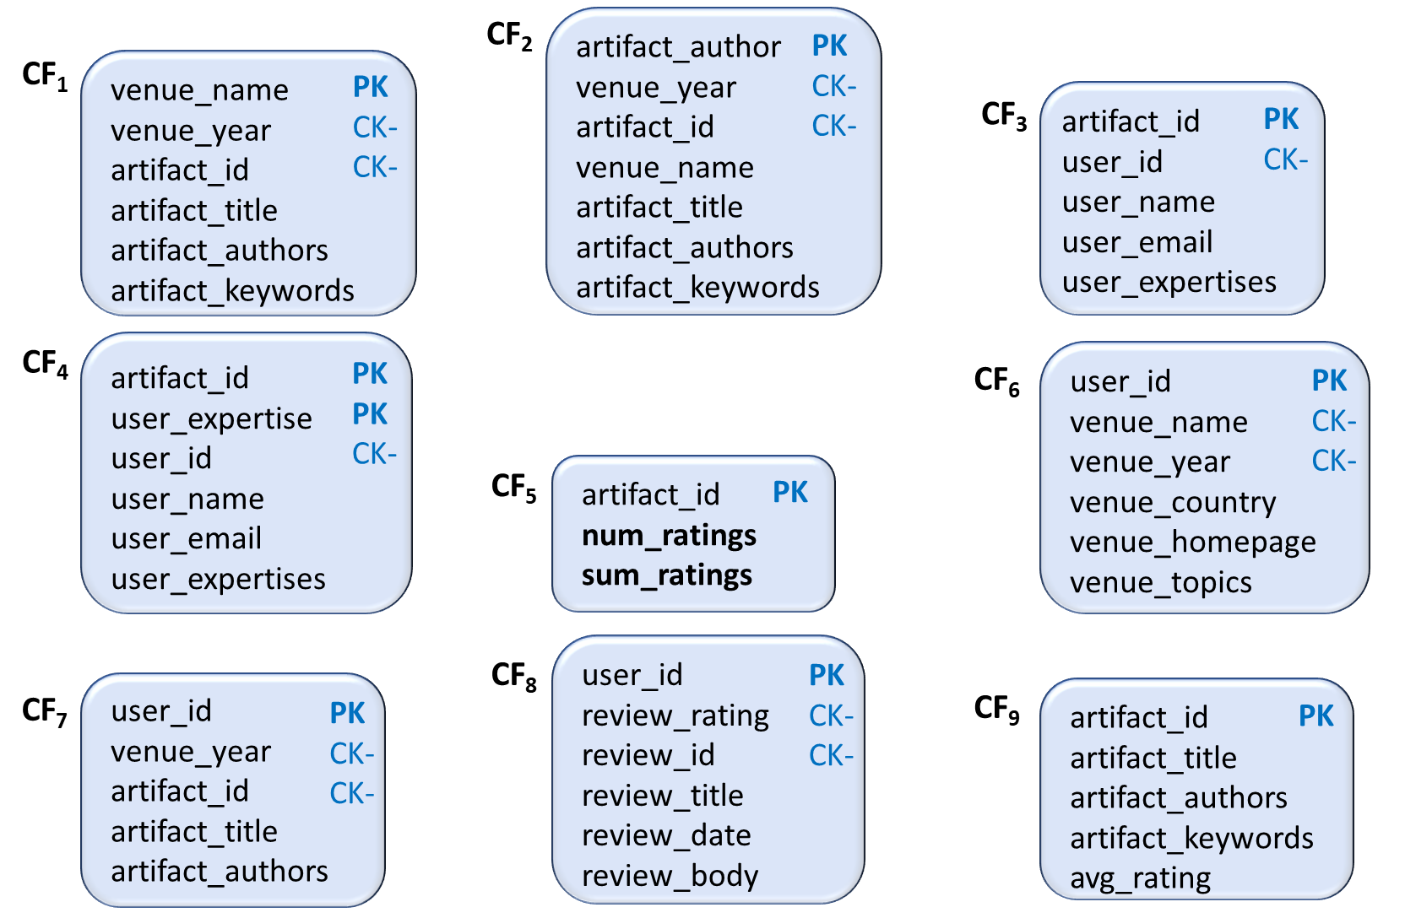
Fig. 18: CF schemas associated with the case study, generated by our method where CF₅ and CF₉ are compatible

Slide 63
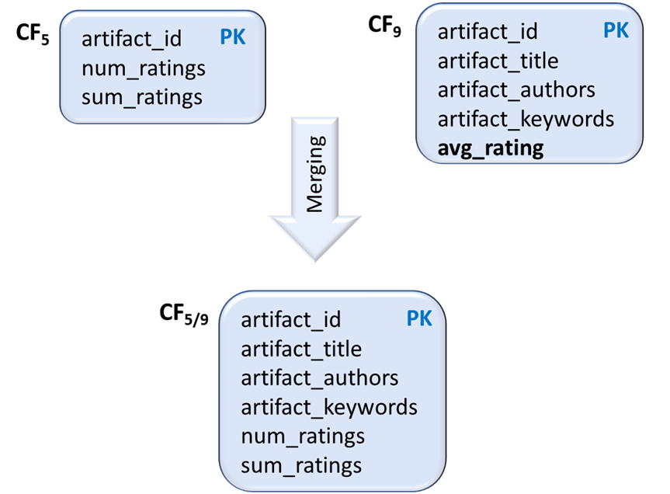
Fig. 19: Combining CF₅ and CF₉ as they are compatible

Slide 64
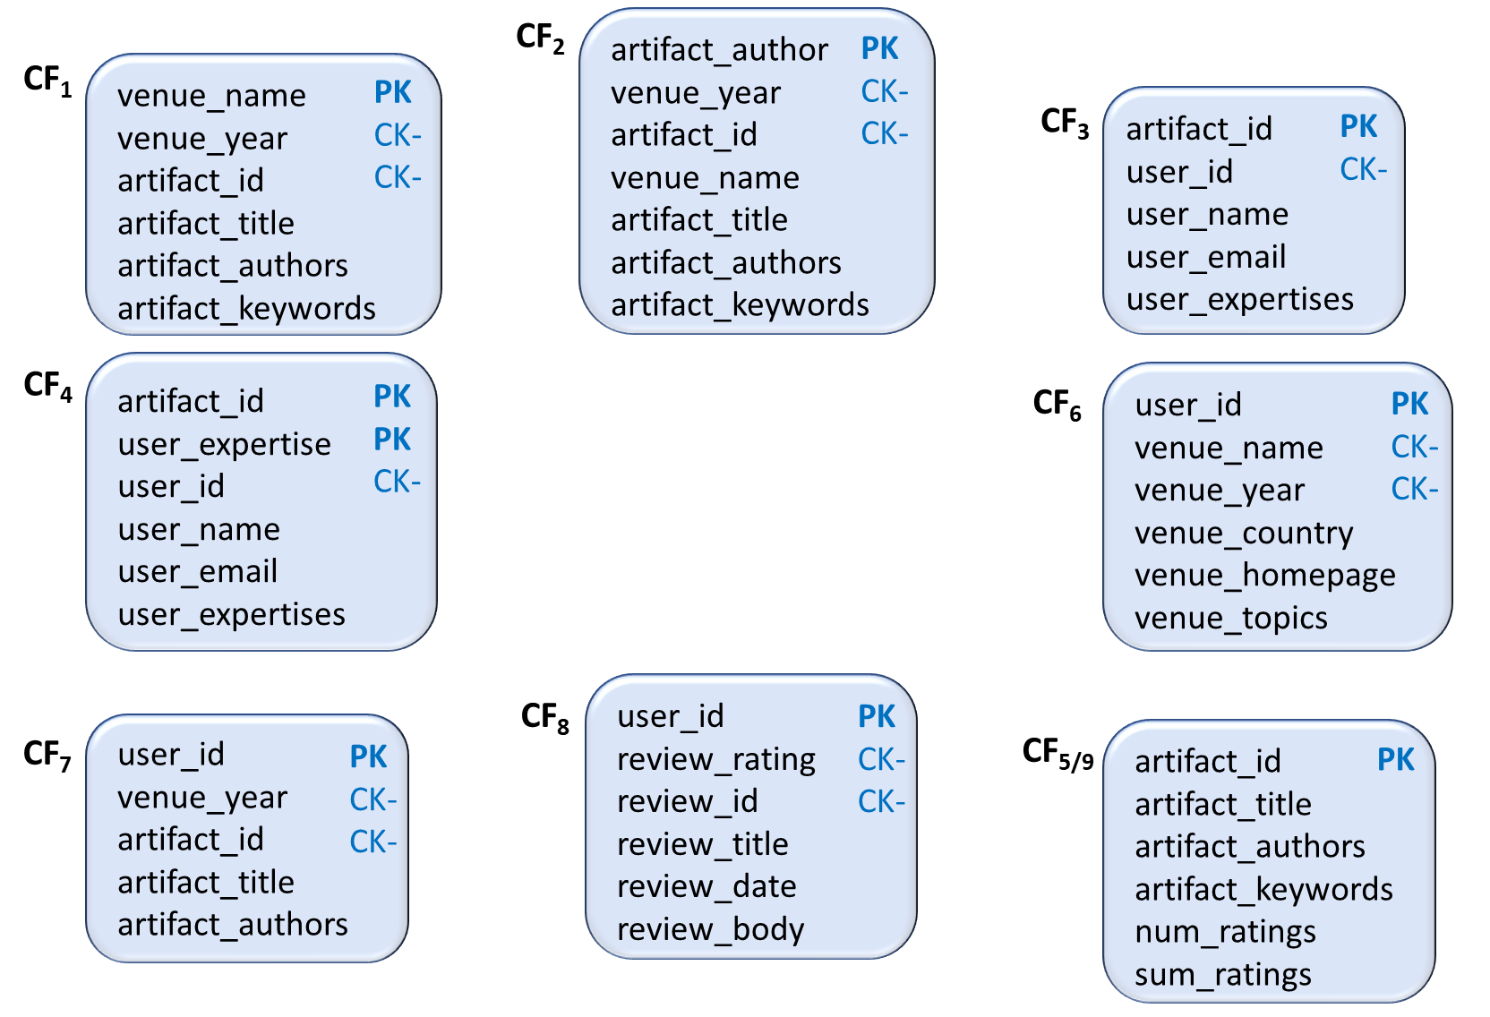
Fig. 20: CF schemas associated with the case study, generated by our method

Slide 65
The generated CQL code for the tabkle CF5 and CF9 shown in Fig. 18.
CF table | Table CQL
CF5 | "create table if not exists CFTable5 (\n" + "artifact_id int,\n" + "num_ratings int,\n" + "sum_ratings int,\n" + "PRIMARY KEY (artifact_id)\n" + ");\n"
CF9 | "CFTable9{" + "artifact_id=" + artifact_id + ", artifact_title='" + artifact_title + '\'' + ", artifact_authors=" + artifact_authors + ", artifact_keywords=" + artifact_keywords + ", avg_rating=" + avg_rating + "};\n"

Slide 66
The generated CQL code for the merged table CF5/CF9 shown in Fig. 19.
CF table | Table CQL
CF5-9 | "create table if not exists CF5-9 (\n" + "artifact_id int,\n" + "num_ratings int,\n" + "sum_ratings int,\n" + "artifact_title text,\n" + "artifact_authors list<text>,\n" + "artifact_keywords set<text>,\n" + "PRIMARY KEY (artifact_id)\n" + ");\n"

Slide 67
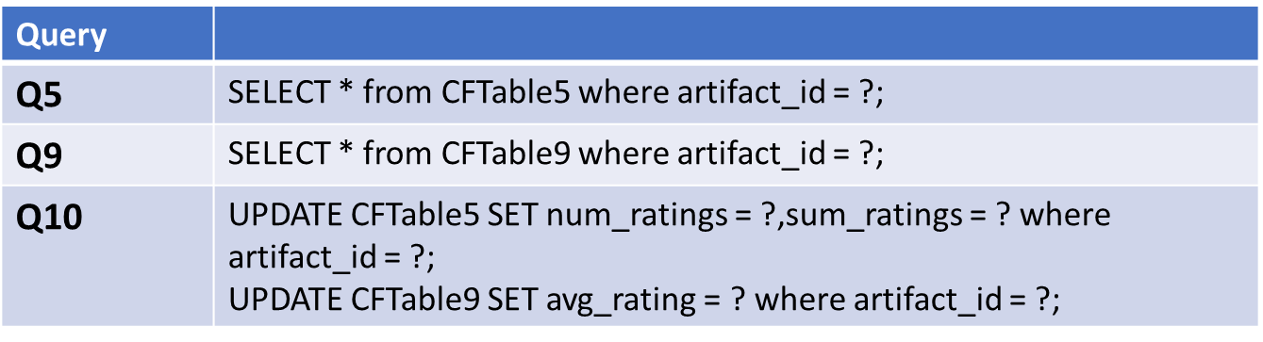
The CQL queries equivalent to Q5, Q9 and Q10.

Slide 68
Database Population
We populated the CF tables, in Cassandra store, with 100 users, 100 venues, 1000 author, 1000,000 articles and 2000 reviews.

Slide 69
Comparing the performance of Q5, Q9 and Q10 obtained before and after merging the compatible schemas CF5 and CF9.
Table | Q5 | Q9 | Q10
Before merging (Chebotko et al.) | 4.7449 | 4.7906 | 14.2817
After merging (our design) | 4.7915 | 4.811 | 9.523

Slide 70
References
[1] Michael Joseph Mior, Kenneth Salem, Ashraf Aboulnaga, and Rui Liu. 2017. NoSE: Schema design for NoSQL applications. IEEE Transactions on Knowledge and Data Engineering 29, 10 (2017), 2275–2289.
[2] Claudio de Lima and Ronaldo Santos Mello. 2016. On proposing and evaluating a NoSQL document database logical approach. International Journal of Web Information Systems 12, 4 (2016), 398–417.
[3] Artem Chebotko, Andrey Kashlev, and Shiyong Lu. 2015. A big data modeling methodology for Apache Cassandra. In International Congress on big data. IEEE, 238–245.

