Slide 1
Mini-Web Agent for Choosing the Right Product
University of Technology (Yatanarpon Cyber City)
Faculty of Information and Communication Technology
Department of Information Science
Second Seminar
Supervised by
Dr. Nandar Win Min
Presented by
Thaw De Zin (6IST-66)

Slide 2
Outline
Abstract
Objectives
Scope of Thesis
Field Background
System Design
Expected Output
Future work
Conclusion

Slide 3
Abstract
Web scraping is an automated tool for finding and extracting data from on-line sources.
It is also referred to as automated data collection, web extracting, web crawling, or web content mining.
It commonly used in price comparison, president election, brand promoting and miscellaneous purposes.
The proposed system is to develop web agent for people to choose which products they should buy.
The web crawler is used to get information about products across the web resources.
In this system, after crawling the entire website pages/links, TF-IDF will be used to filter the pages/links about the product (laptop).
The system will give 10 most relevant laptops according to the user input using Random Forest.

Slide 4
Objectives
To understand how a crawler and search engine works
To study web scraping use cases and applied areas
To develop simple web scraping tool for choosing suitable product from e-commerce websites.
To help people in finding the products that they want in a short period of time.

Slide 5
Scope of Thesis
This system will crawl maximum of 3 websites.
http://www.technoland.com.mm
http://www.kmdshopping.com
http://www.linnonlinestore.com
Frequently changed layout of website will not be processed.
The working product is only specific one. (Example., Laptops)

Slide 6
Field Background
Web Crawling
Crawling
Indexing (TF*IDF)
Web Scraping
Ranking (HTML Parsing)

Slide 7
Web Crawling
The major search engines on the Web all have such a program, which is also known as a "spider" or a "bot."
Crawlers consume resources on visited systems and often visit sites without approval.
A crawler is a program that visits Web sites and reads their pages and other information in order to create entries for a search index.
Crawlers are typically programmed to visit sites that have been submitted by their owners as new or updated.
Entire sites or specific pages can be selectively visited and indexed.
Crawlers apparently gained the name because they crawl through a site a page at a time, following the links to other pages on the site until all pages have been read.

Slide 8
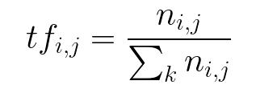
Term Frequency (tf)
TF gives us the frequency of the word in each document in the corpus.
It is the ratio of number of times the word appears in a document compared to the total number of words in that document.
It increases as the number of occurrences of that word within the document increases. Each document has its own tf.

Slide 9
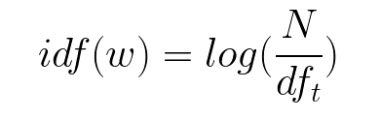
Inverse Data Frequency (idf)
IDF used to calculate the weight of rare words across all documents in the corpus.
The words that occur rarely in the corpus have a high IDF score.
It is given by the equation below.

Slide 10
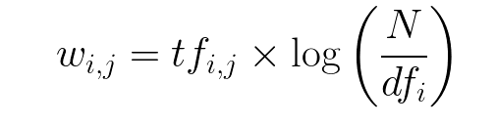

TF*IDF
Combining these two we come up with the TF-IDF score (w) for a word in a document in the corpus.
It is the product of tf and idf.

Slide 11
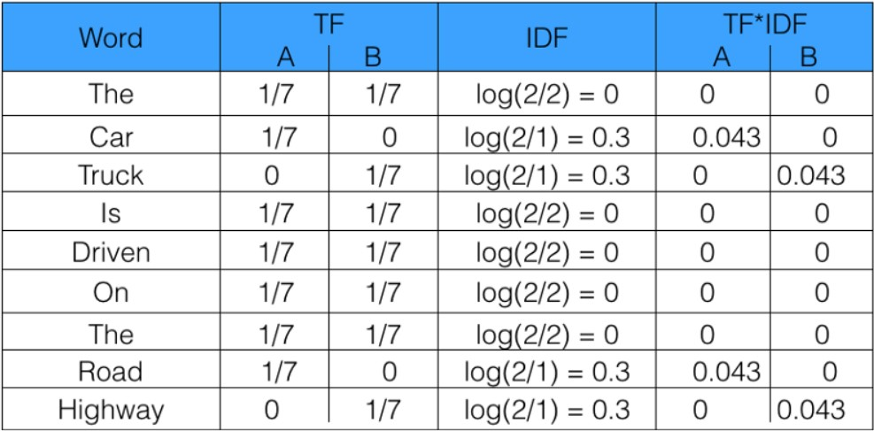

TF*IDF
Sentence 1 : The car is driven on the road.
Sentence 2: The truck is driven on the highway.

Slide 12
HTML Parsing
Top Down Parsing
Tree Structure (Depth First Tree Transversal)
Name = response.css(“h2::text”).extract()

Slide 13
Basic Layout to Tree Structure
html
<html>
<head>
<title> <title>
</head>
<body>
<div>
<h1></h1>
<a></a>
</div>
<p>
<img>
<ul></ul>
</p>
</body>
</html>
head
body
div
p
title
h1
a
img
ul

Slide 14
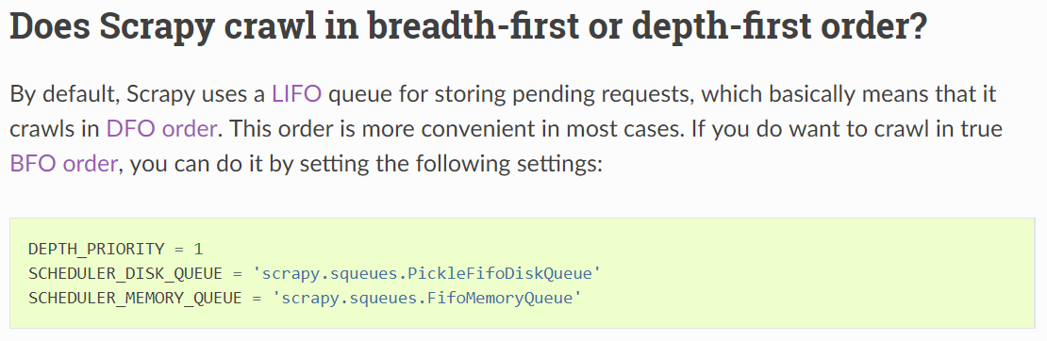
Depth-first or Breadth-first
http://docs.scrapy.org/en/latest/faq.html#does-scrapy-crawl-in-breadth-first-or-depth-first-order

Slide 15
System Design for Crawling
Start
Pages/
Links
Crawl entire 3 websites
Filter the Laptop pages using IT-IDF
Extract laptop’s features
Normalization for
laptop entry
Normalized laptop list
End

Slide 16
System Design for Searching
Start
Laptop’s feature
Determine relevant laptop by using Random Forest (D/T)
Normalized laptop list
Display 10 relevant laptops
End

Slide 17
Laptop Features
Brand
Price
Processor (Generation and type)
RAM (Capacity)
Graphic Card
Display Type
HDD (Capacity and RPM)
Specifications

Slide 18
User Input Limitations
Specification
Price
Brand
Available format!
S+B
S+P
B+P
B+S+P is not available

Slide 19
Expected Output
The mini-web agent can support the people to choose which products they should buy across the web resources

Slide 20
Future Work
Exact page to Scrape
Scraping the required information about product
Determine 10 relevant laptops to display

Slide 21
Conclusion
This system will give too much knowledge about web scraping and web crawlers.
The user can get the information about the suitable product during a short period of time without the need for visiting too many websites.

Slide 22
Thank You

