Slide 1

COVID-19 ANALYSIS
DATA VISUALIZATION

Slide 2

INTRODUCTION
To analyze the INDIA’s state wise covid-1 9 dataset and also see how many people affected with the covid-19 cases and how people vaccinated by performing visualization by tableau

Slide 3

OBJECTIVE
To analyze state wise covid-19 dataset and extract useful information using visualizations from Tableau

Slide 4
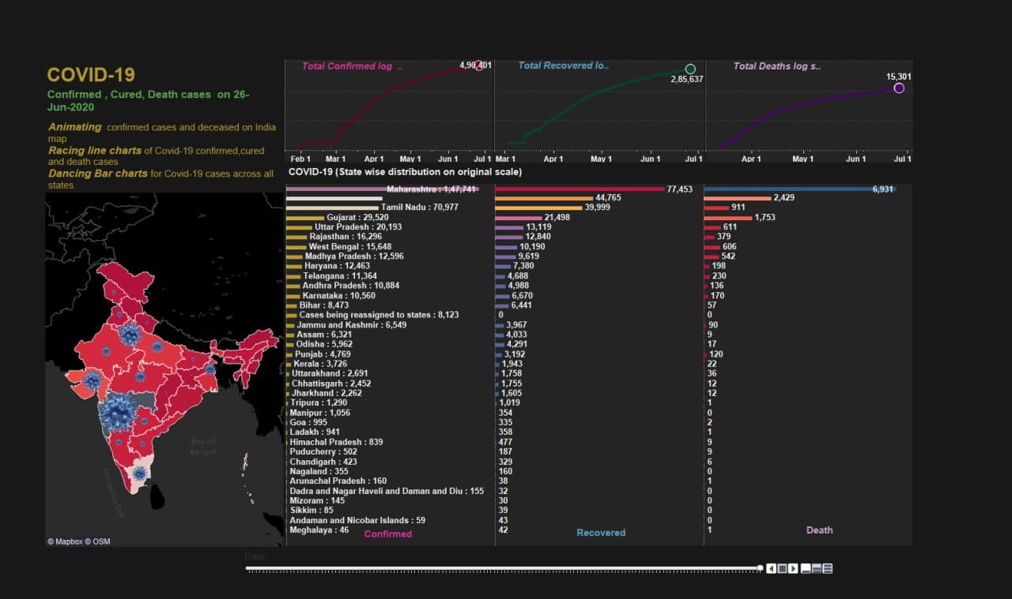
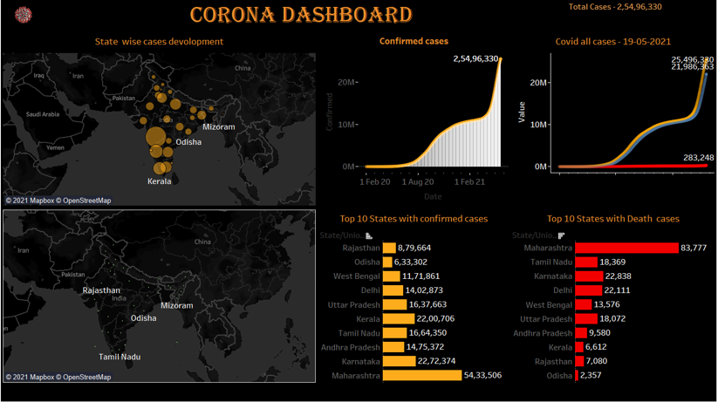
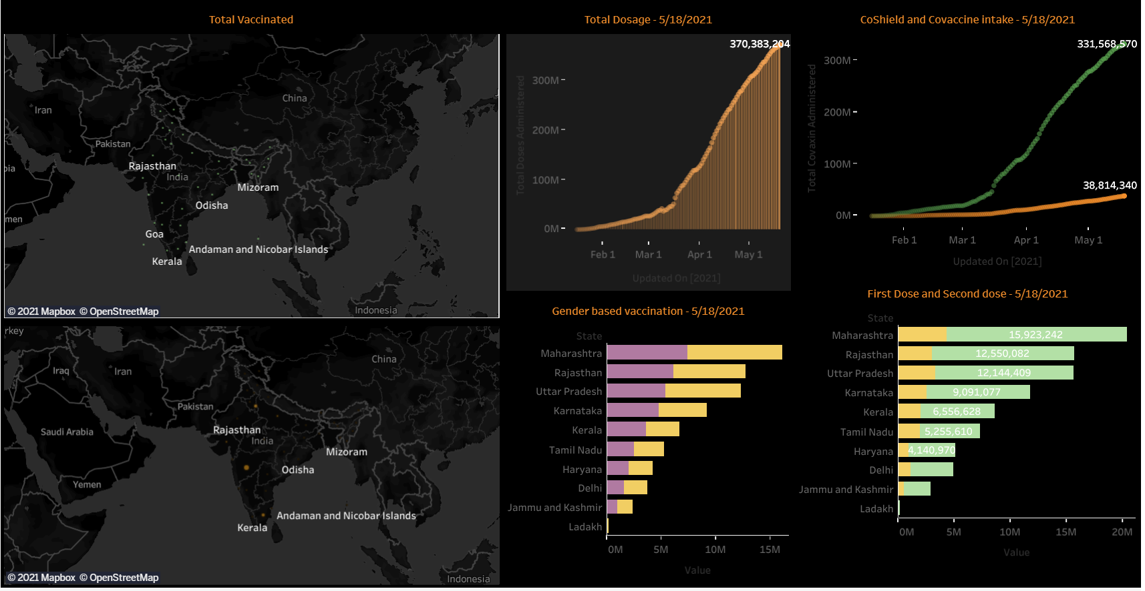
TOTAL CASES
In first dashboard we done the visualization on the first wave of the covid-19 cases
In second dashboard we done visualization on the statewise cases and also done visualization on the confirmed cases

Slide 5
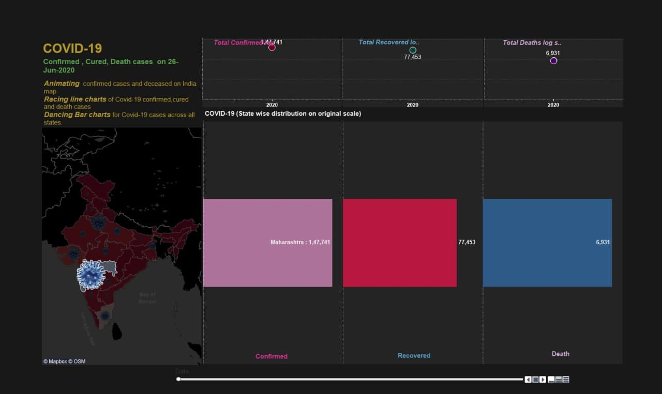
Total cured cases
This dashboard shows for the visualization on the cured cases and death cases in early corona crisis on different states
.

Slide 6

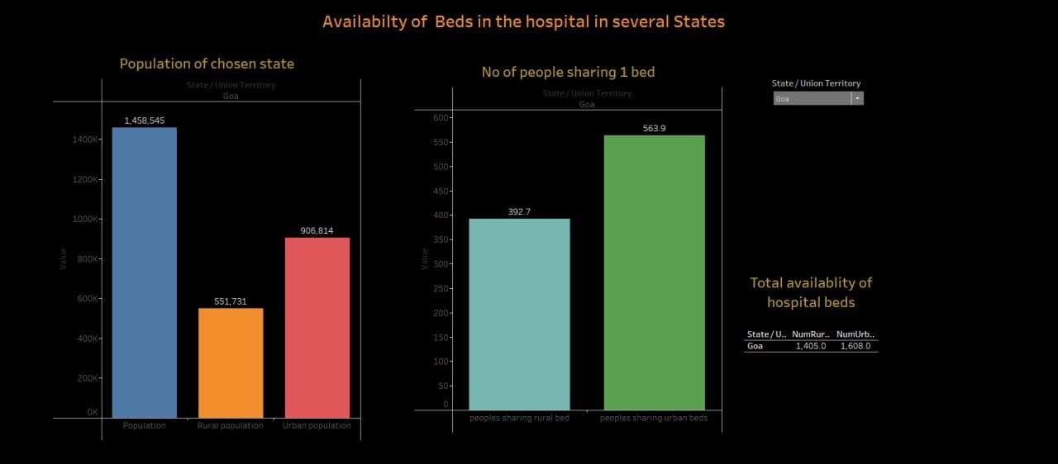
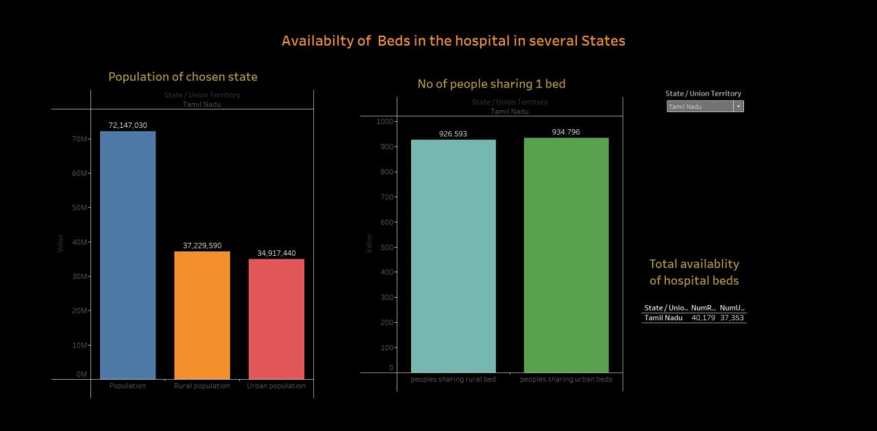
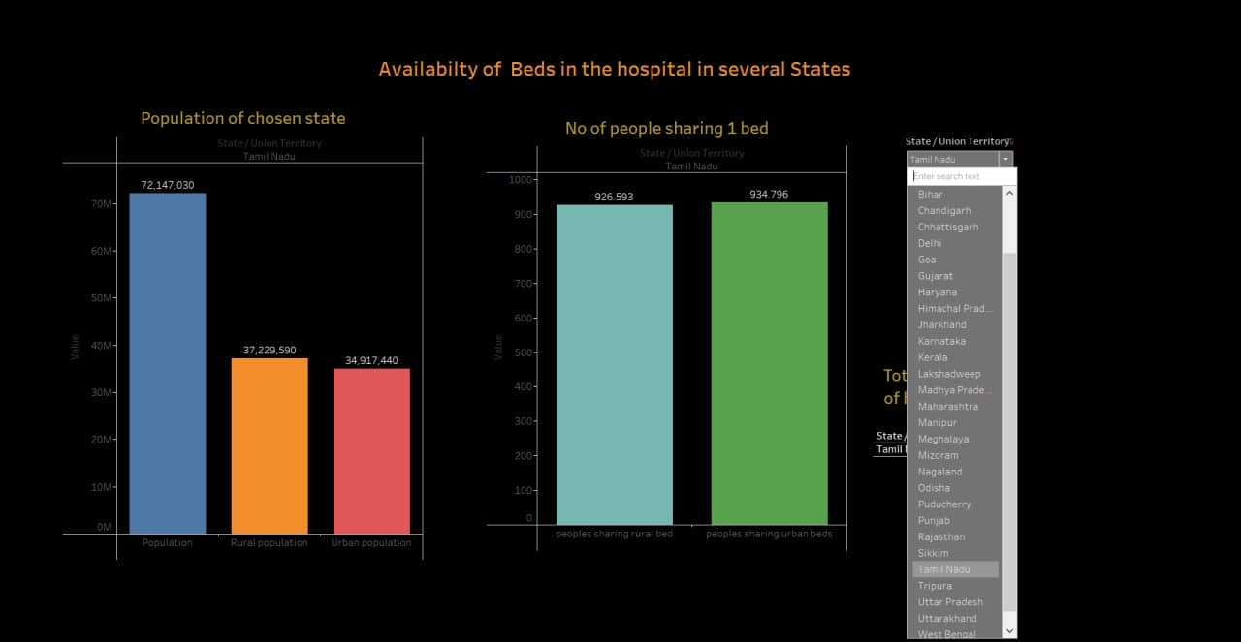
availability of beds in hospital
This dashboard visualizes on the availability of beds in the hospital
And No of peoples sharing the per bed for admitting in the hospital

Slide 7
Conclusion
THE TRUTH ABOUT FACE MASKS
From covid 19 analysis dashboard which was made by our team allows us to infer that spread of covid-19 among India .this helps us to take precautions against covid 19 to avoid deaths and spread covid-19

