Slide 1

Do U.S. Presidents influence Gas Prices?
Timothy J. Haymer, MBA
Nashville Software School

Slide 2
PEST
Political
Economics
Social
Technology
Basically, a PEST analysis helps determine how these factors will affect the performance and activities of a business in the long-term.

Slide 3
Presidents
Democratic Party
Franklin D. Roosevelt
Harry S. Truman
John F. Kennedy
Lyndon B. Johnson
Jimmy Carter
Bill Clinton
Barack Obama
Republican Party
Dwight D. Eisenhower
Richard Nixon
Gerald Ford
Ronald Reagan
George H. W. Bush
George W. Bush
Donald Trump

Slide 4
Common Ground
Consumer Price Index
The Consumer Price Index (CPI) is a measure that examines the weighted average of prices of a basket of consumer goods and services.
How to calculate the inflation rate for gas, 1935-2021. Start with the inflation rate formula:
CPI in 2021 / CPI in 1935 = 2021 USD value

Slide 5
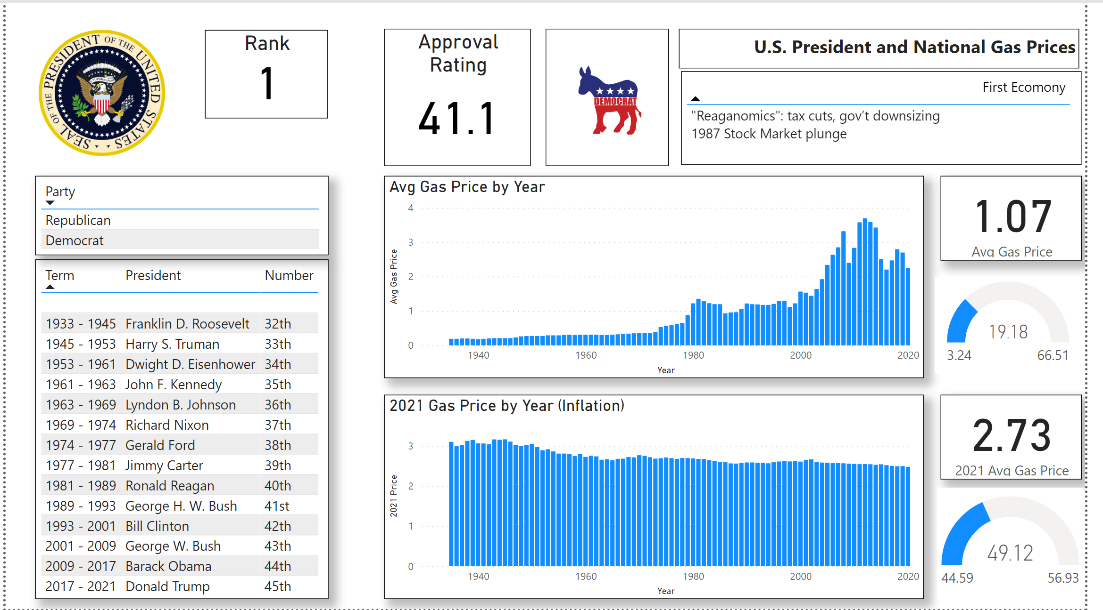
Power BI Presentation

