Slide 1


Quarterly Business Report
Thay Chansy

Slide 2
Business Overview
Total Orders: 1000
Total Customers: 994
Average Rating (Out of 5): 3.07
Total Revenue: $124,714,086.32
Last Qtr Revenue: $23,346,779.63
Last Qtr Orders: 199
Avg Days to Ship: 105
% Very Good Feedback: 23.32%

Slide 3
Customer Metrics

Slide 4
Distribution of Customers across State
Observations/Findings:
Top 5: California and Texas lead the nation in car purchases, followed by Florida, New York and the District of Columbia.
Population Density: These states tend to have high population densities, which could lead to a greater overall need for cars.
Urbanization: More urban areas often rely less on public transportation and more on personal vehicles.

Slide 5
Average Customer Ratings by Quarter
Observations/Findings:
Decrease: There have been a steady decrease in the % of customer satisfaction rating received from each quarter.
Dissatisfaction: The recurring decline suggest the customer are unhappy with the product or service provided.
Customer support: Is customer support responsive and helpful to remedy problems?

Slide 6
Trend of Customer Satisfaction
Observations/Findings:
The severity of the terms from “very good’’ to “very bad” suggest a substantial shift in the customer perception.
Potential issue with the product, service, or customer experience.
Progressive worsening of the situation since the continuous decline. Not a one-time event.

Slide 7
Top Vehicle Makers Preferred By Customers
Observations/Findings:
Domestic vehicle maker make up the majority of customer purchases.
Chevrolet emerges as the most preferred vehicle maker among customers.
Ford follows behind in second place
Toyota secures the third position, Pontiac and Dodge follows closely behind in fourth and fifth respectively.

Slide 8
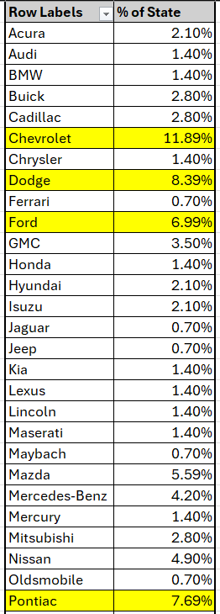
Most Preferred Vehicle Make In Each State
Observations/Findings:
Chevrolet emerges as the most preferred vehicle maker across states.
Dodge follows behind in second place.
Pontiac secures the third position; Ford follows behind in fourth and many others.

Slide 9
Revenue Metrics

Slide 10
Trend of Purchases by Quarter
Observations/Findings:
Q1: Highest purchase volume at 310.
Q2: Dip from Q1, with purchases at 262.
Q3/Q4: Continued decline, at 229 and 199 purchases.

Slide 11
Quarter on Quarter % Change in Revenue
Observations/Findings:
Q2: Revenue decreased by 17% compared to Q1.
Q3: Revenue improved relative to Q2.
Q4: Revenue decreased by 20% compared to Q3.

Slide 12
Trend of Revenue and Orders by Quarter
Observations/Findings:
Q1: Highest revenue at ~$39 million.
Steady Decline: Revenue dropped to ~$32 million in Q2 and continue to decline in Q3 and Q4.
Overall Decrease: ~Approximately 41% from Q1 to Q4.

Slide 13
Shipping Metrics

Slide 14
Average Discount Offered by Credit Card Type
Observations/Findings:
Top 5 Credit Card Type Discounts:
1. Laser
2. Mastercard
3. Maestro
4. Visa-Electron
5. China-Unionpay

Slide 15
Time Taken to Ship Orders by Quarter
Observations/Findings:
Q1: Average shipping time was 57 days.
Sharp Increases: Shipping times jumped to 71 days in Q2 at 24% increase.
Overall increase: This represents a tripling of shipping times from Q1 to Q4 (174 days vs 57 days).

Slide 16
Insights and Recommendations
Market conditions: Has there been a downturn in the overall market that's impacting your industry?
Product/Service Issues: Were there any quality issues or negative customer feedback that affected sales?
Competition: Have new competitors emerged, or have existing competitors gained market share?
Marketing/Sales Strategies: Were there any changes in marketing or sales strategies that might have negatively impacted revenue?
To better understand the reasons behind the decline, gather additional data and investigate root cause:
Analyze customer feedback: Look for recurring themes or complaints that might indicate specific areas needing improvement.
Conduct surveys: Survey your customers directly to understand their satisfaction levels and gather their feedback.
Monitor social media: See what customers are saying about your brand on social media platforms.
Communicate with Customers: Be transparent about delays and offer faster shipping options.

