Slide 1
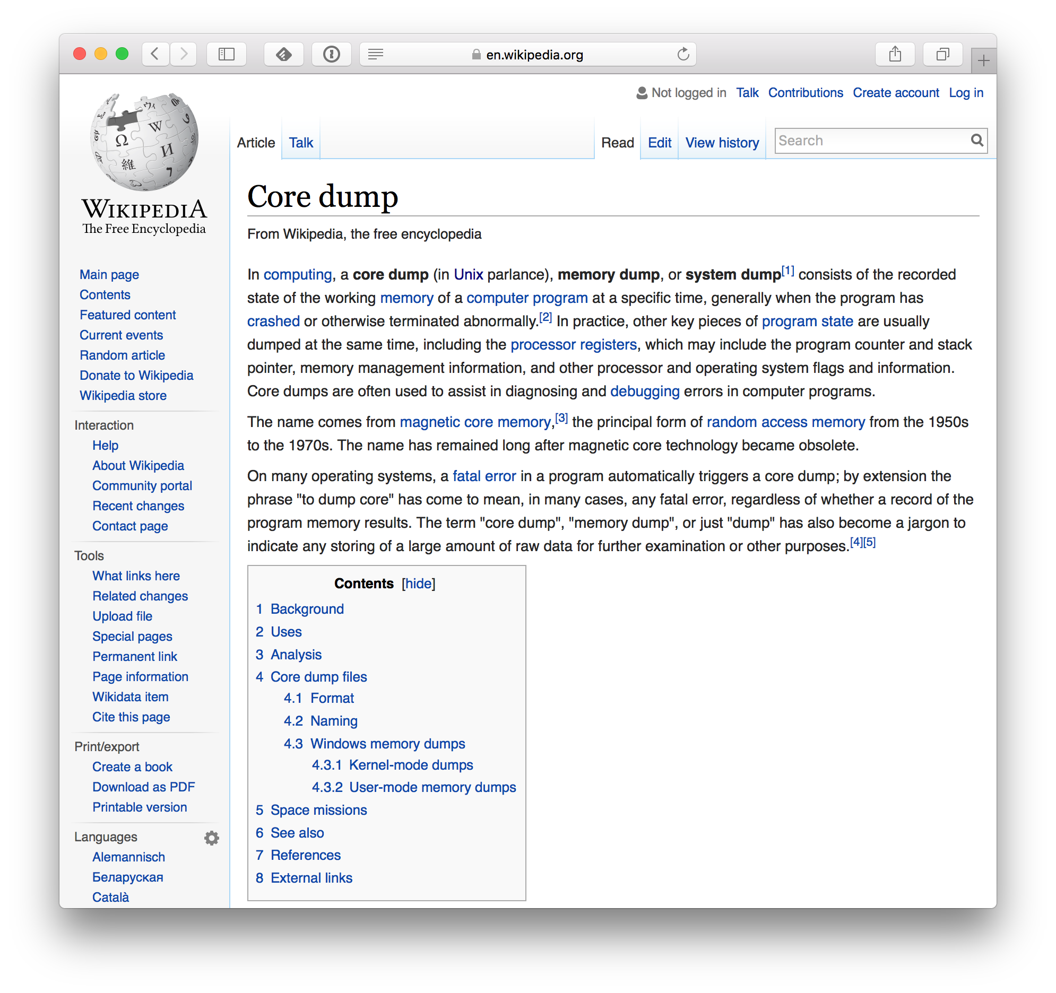
Segmentation fault (core dumped)
Why do we say
“core dumped”?

