Slide 1

Preservation & Restoration of the Nervous System in Multiple Trauma
-
Cell-Based Repair
Eric E. Sabelman, PhD
Kaiser Permanente, Dept of Neurosurgery
Redwood City, CA 94063

Slide 2
Tissue Engineering for PNS and CNS Repair
isolate
expand in
cells
culture
living
tissue
reconstructed
matrix
biochemical
structural
micro-scale
interface
biomaterials
fabrication tools

Slide 3
Examples
Peripheral nerve graft for traumatic loss
Fetal neurons for Parkinson’s Disease
Retinal cells for Parkinson’s Disease
Concepts for SCI bridging

Slide 4
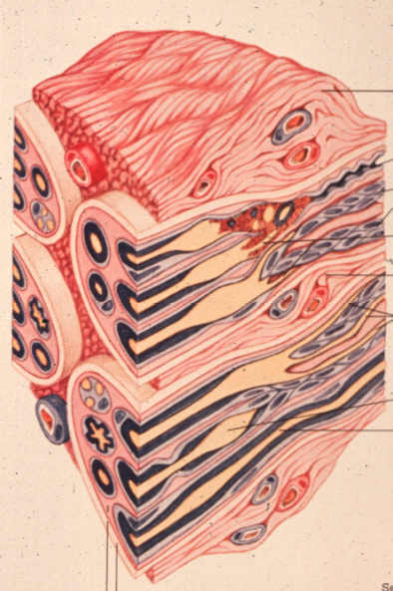
normal healing of injured peripheral nerve
Schwann cell proliferation
regeneration of axons

Slide 5
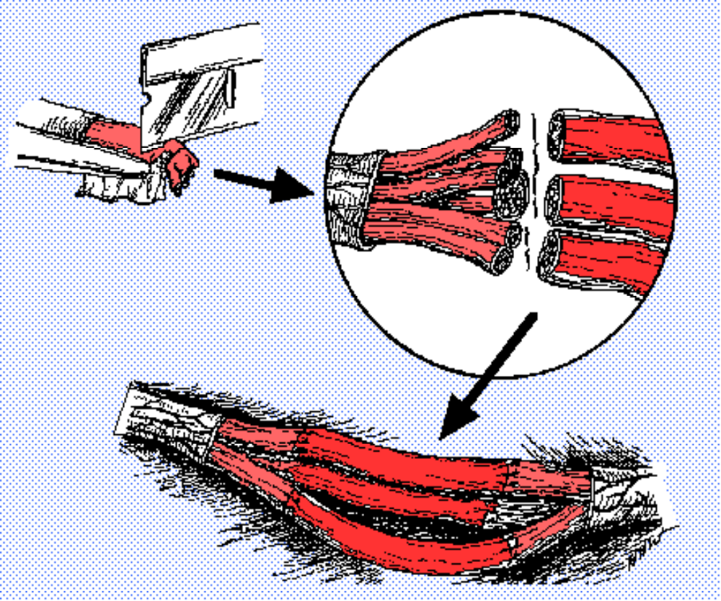
Peripheral Nerve Graft
After trauma to peripheral nerve, a significant gap may remain between cut ends
The present treatment of choice is an autograft to bridge the gap.

Slide 6
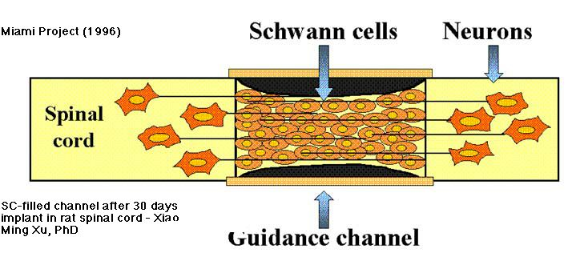
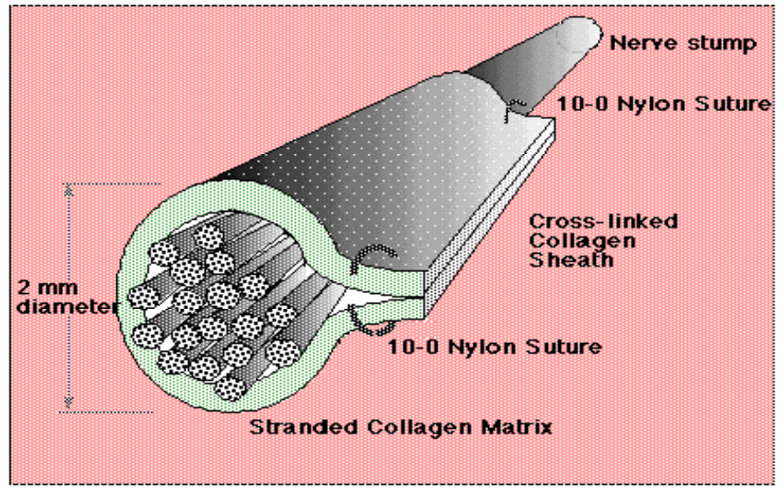
Artificial Peripheral Nerve Graft
VA design:
resorbable sheath,
oriented controlled-porosity core,
cultured Schwann cells distributed through the core.

Slide 7
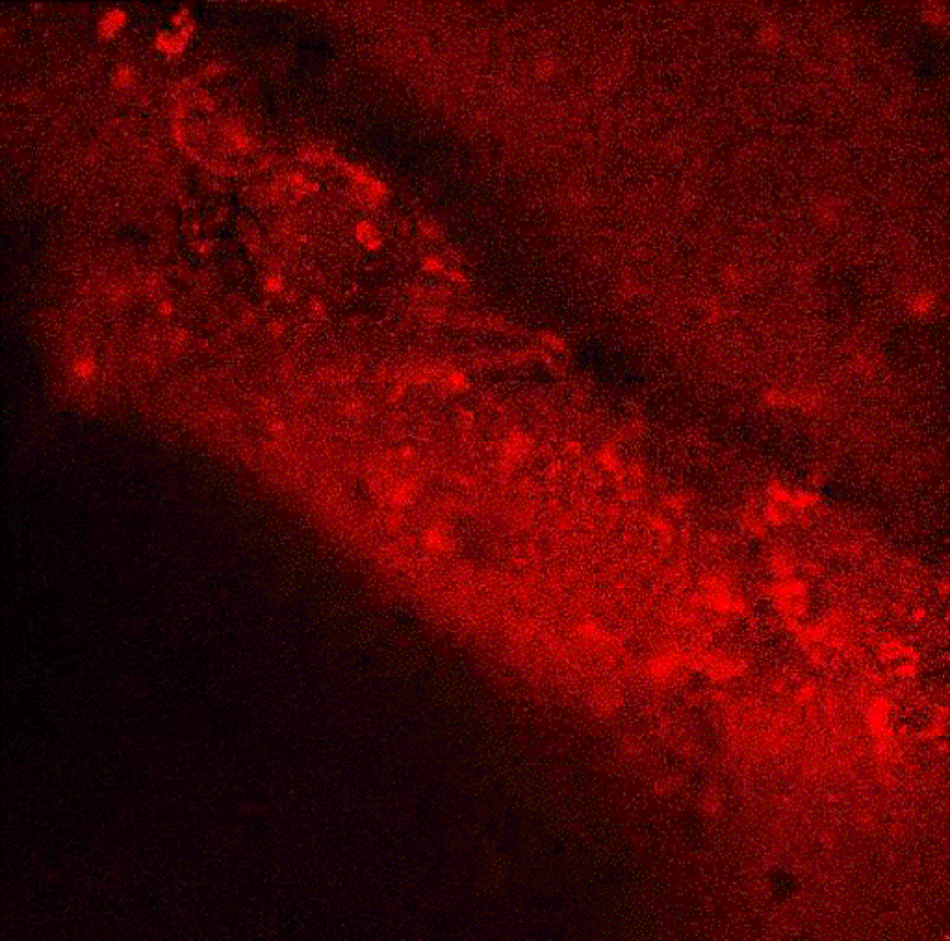
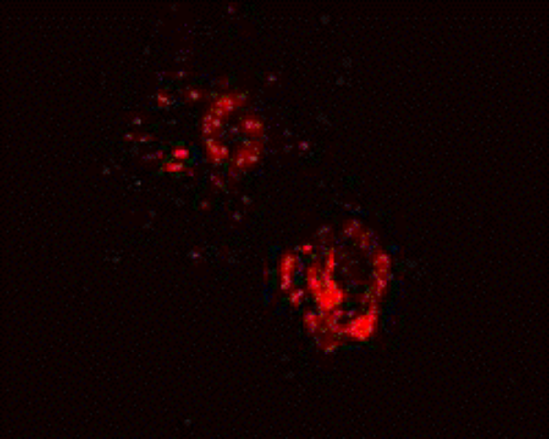
Schwann cell distribution on collagen strands
Cells pre-labeled with
PKH-26 fluorescent
membrane marker

Slide 8
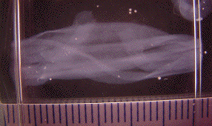
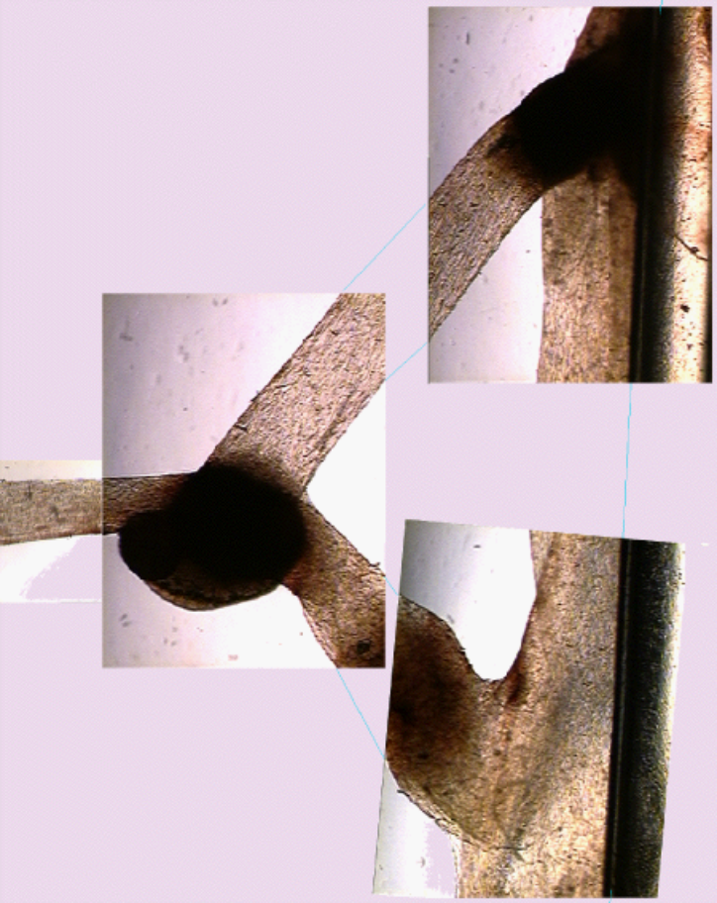
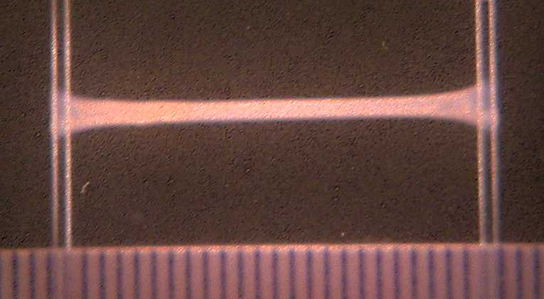
ANG core culture under tension

Slide 9
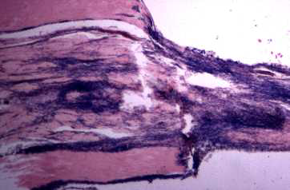
Schwann Cell+Collagen ANG
rat peroneal nerve, 28 days post-surgery, H&E stain
sheath
core
proximal
sheath
100 µm

Slide 10
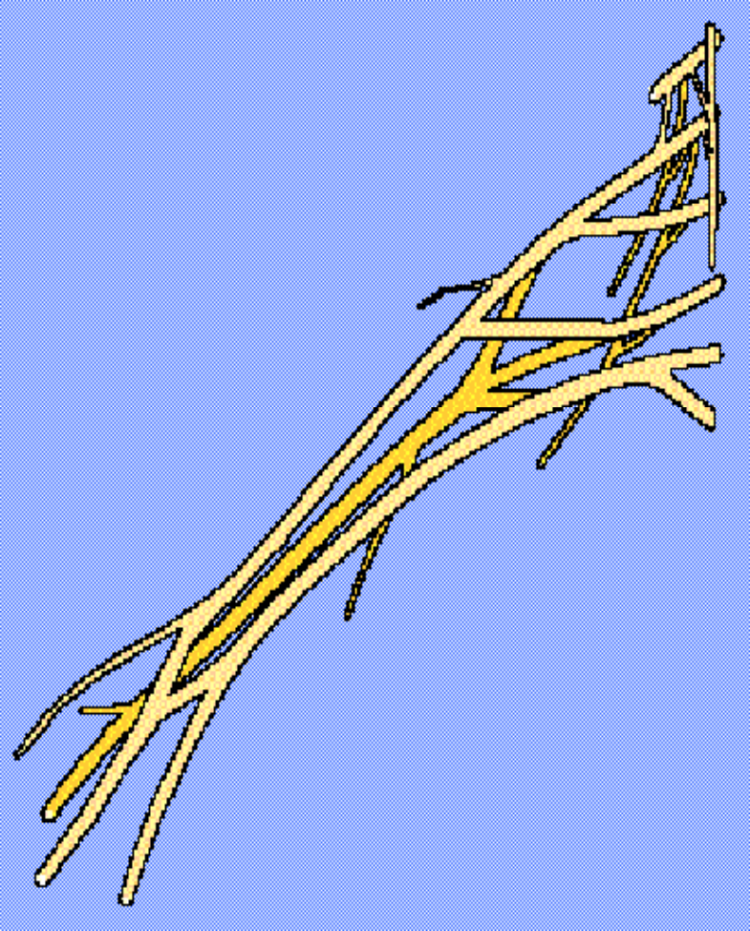
PNS Clinical Implant Sites
C4
Digital nerve(s)
Sural nerve donor site (<15 cm )
Multifascicular nerve trunk (>6 cm)
Non-limb nerves (e.g.: facial nerve)
Brachial plexus
C5
C6
C7
C8
T1
radial n.
median n.
ulnar n.

Slide 11
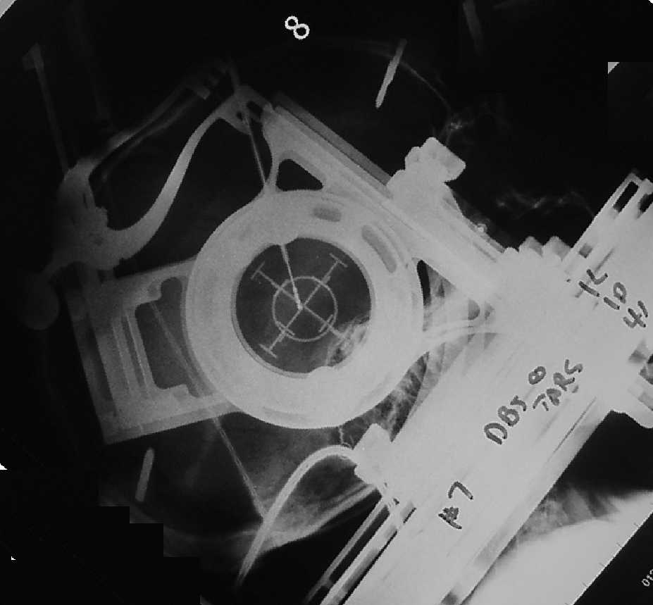
Focal Brain Damage:
Prosthesis vs. Regeneration
Deep Brain Stimulation:
  Electrical signal overrides local activity
Cell Transplantation:
  Grafted cells generate neurotransmitter and/or axon signals
Regeneration:
  Host cells induced to replace lost function
< stereotactic frame for accessing
target with +/- 0.5 mm accuracy

Slide 12
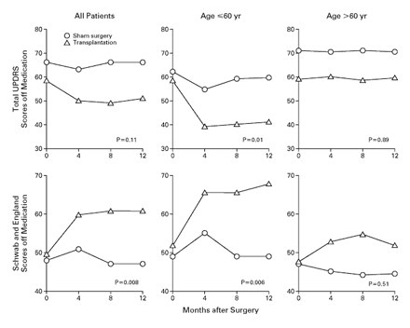
Clinical Trial of Parkinsons Cell Therapy
Transplantation of Embryonic Dopamine Neurons for Severe Parkinson's Disease
Curt R. Freed, M.D., Paul E. Greene, M.D., Robert E. Breeze, M.D., Wei-Yann Tsai, Ph.D., William
DuMouchel, Ph.D., Richard Kao, Sandra Dillon, R.N., Howard Winfield, R.N., Sharon Culver, N.P.,
John Q. Trojanowski, M.D., Ph.D., David Eidelberg, M.D., and Stanley Fahn, M.D.
The New England Journal of Medicine Volume 344:710-719 March 8, 2001 Number 10
Notes:
Transplantation of Embryonic Dopamine Neurons for Severe Parkinson's Disease
Curt R. Freed, M.D., Paul E. Greene, M.D., Robert E. Breeze, M.D., Wei-Yann Tsai, Ph.D., William DuMouchel, Ph.D., Richard Kao, Sandra Dillon, R.N., Howard Winfield, R.N., Sharon Culver, N.P., John Q. Trojanowski, M.D., Ph.D., David Eidelberg, M.D., and Stanley Fahn, M.D.
The New England Journal of Medicine Volume 344:710-719 March 8, 2001 Number 10
ABSTRACT
Background Transplantation of human embryonic dopamine neurons into the brains of patients with Parkinson's disease has proved beneficial in open clinical trials. However, whether this intervention would be more effective than sham surgery in a controlled trial is not known.
Methods We randomly assigned 40 patients who were 34 to 75 years of age and had severe Parkinson's disease (mean duration, 14 years) to receive a transplant of nerve cells or undergo sham surgery; all were to be followed in a double-blind manner for one year. In the transplant recipients, cultured mesencephalic tissue from four embryos was implanted into the putamen bilaterally. In the patients who underwent sham surgery, holes were drilled in the skull but the dura was not penetrated. The primary outcome was a subjective global rating of the change in the severity of disease, scored on a scale of Ð3.0 to 3.0 at one year, with negative scores indicating a worsening of symptoms and positive scores an improvement.
Results The mean (±SD) scores on the global rating scale for improvement or deterioration at one year were 0.0±2.1 in the transplantation group and Ð0.4± 1.7 in the sham-surgery group. Among younger patients (60 years old or younger), standardized tests of Parkinson's disease revealed significant improvement in the transplantation group as compared with the sham-surgery group when patients were tested in the morning before receiving medication (P=0.01 for scores on the Unified Parkinson's Disease Rating Scale; P=0.006 for the Schwab and England score). There was no significant improvement in older patients in the transplantation group. Fiber outgrowth from the transplanted neurons was detected in 17 of the 20 patients in the transplantation group, as indicated by an increase in 18F-fluorodopa uptake on positron-emission tomography or postmortem examination. After improvement in the first year, dystonia and dyskinesias recurred in 15 percent of the patients who received transplants, even after reduction or discontinuation of the dose of levodopa.
Conclusions Human embryonic dopamine-neuron transplants survive in patients with severe Parkinson's disease and result in some clinical benefit in younger but not in older patients.

Slide 13
Results of clinical trial of Parkinsons cell therapy
“Fiber outgrowth from the transplanted neurons was detected in 17 of the 20 patients in the transplantation group, as indicated by an increase in 18F-fluorodopa uptake on positron-emission tomography or postmortem examination.”
“After improvement in the first year, dystonia and dyskinesias recurred in 15 percent of the patients who received transplants, even after reduction or discontinuation of the dose of levodopa.” [patients were implanted with DBS electrodes]
Freed, et al., NEJM, 3/01

Slide 14
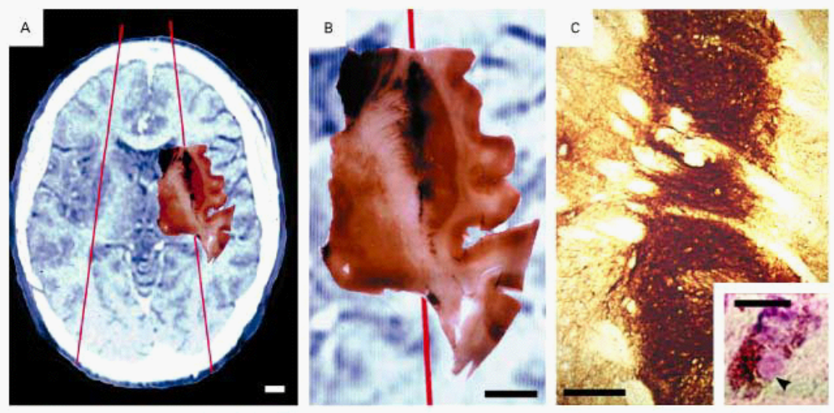
Results of clinical trial of Parkinsons cell therapy
Freed, et al., NEJM, 3/01

Slide 15
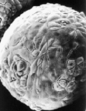
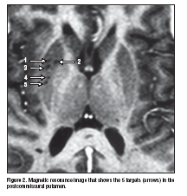
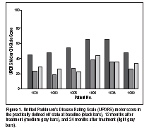
Non-Neuronal Cell Transplant for PD
Intrastriatal Implantation of Human Retinal Pigment Epithelial Cells Attached to Microcarriers in Advanced Parkinson Disease
Natividad P. Stover, MD; Roy A. E. Bakay, MD; Thyagarajan Subramanian, MD; Cathy D. Raiser, RN;
Michael L. Cornfeldt, MS; Alfred W. Schweikert, PhD; Richard C. Allen, PhD; Ray L. Watts, MD
ARCH NEUROL/VOL 62, DEC 2005 WWW.ARCHNEUROL.COM
Notes:
Intrastriatal Implantation of Human Retinal Pigment
Epithelial Cells Attached to Microcarriers
in Advanced Parkinson Disease
Natividad P. Stover, MD; Roy A. E. Bakay, MD; Thyagarajan Subramanian, MD; Cathy D. Raiser, RN;
Michael L. Cornfeldt, MS; Alfred W. Schweikert, PhD; Richard C. Allen, PhD; Ray L. Watts, MD
Background: Human retinal pigment epithelial (RPE)
cells produce levodopa and can be isolated from postmortem
human eye tissue, grown in culture, and implanted
into the brain attached to microcarriers. These
implants ameliorated the motor deficits in rodent and nonhuman
primate models of Parkinson disease.
Objective: To evaluate the safety and efficacy of unilateral
implantation of human RPE cells attached to
gelatin microcarriers into the putamen contralateral to
the more symptomatic side of patients with Parkinson
disease.
Design: Open-label pilot study.
Setting: A tertiary referral center for movement disorders.
Patients: Six patients with advanced Parkinson disease.
Interventions: We performed stereotactic intrastriatal
implantation of approximately 325 000 RPE cells on microcarriers.
Main Outcome Measure: Change from baseline to 12
months in the Unified Parkinson’s Disease Rating Scale
motor subscore with the patients in the practically defined
off state (not taking antiparkinsonian medications
for at least 12 hours overnight).
Results: The implants were well tolerated. We observed
an average improvement of 48% at 12 months after
implantation in the Unified Parkinson’s Disease Rating
Scale motor subscore with the patient in the off state,
which was sustained through 24 months. Improvement
was also observed in activities of daily living, quality of
life, and motor fluctuations. No off-state dyskinesias were
observed.
Conclusions: Implants of human RPE cells attached to
gelatin microcarriers appear to be safe and well tolerated,
and they improved motor symptoms in patients with
Parkinson disease. On the basis of these results, a randomized,
double-blind, placebo-controlled study has been
initiated.
Arch Neurol. 2005;62:1833-1837

Slide 16
Lessons Learned
Titrate cell number (age is a factor).
Neurons need spatial guidance (without, they may misconnect).
Non-neuronal cells are a poor replacement for neurons.
Design for greatest patient benefit (not purity of experimental variables).

Slide 17
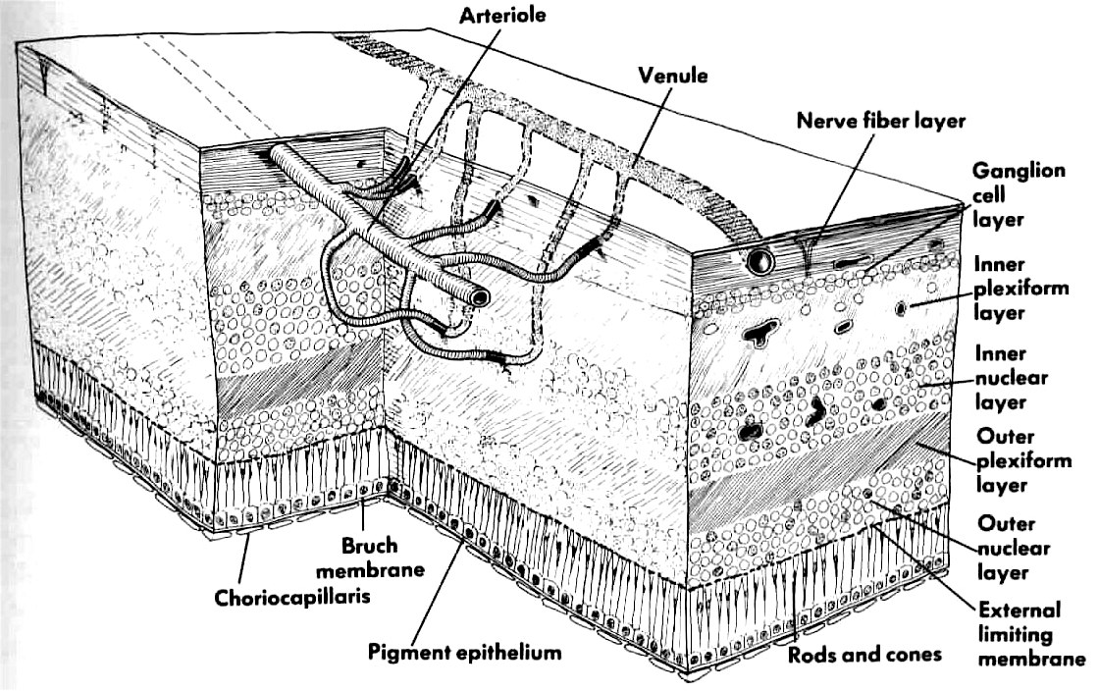
Tissue Engineering of Retinal Pigmented Epithelium

Slide 18
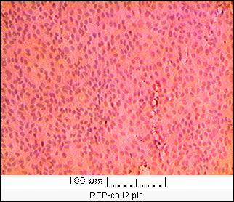
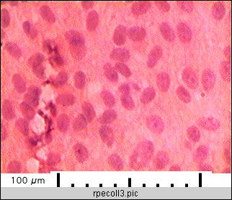
Collagen film + retinal pigmented epithelial after 2 weeks culture

Slide 19
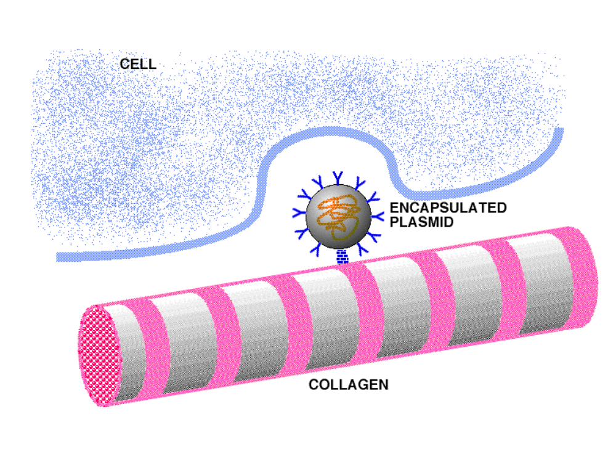
“Smart matrix” concept - phenotypic modulation of cells migrating into graft

Slide 20
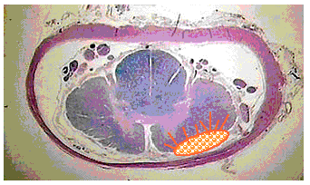
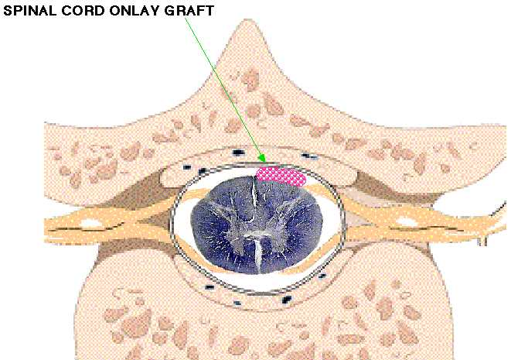
SCI onlay graft

Slide 21
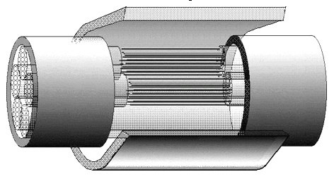
SCI Partial Transection Graft
Fasciculated artificial grafts replace lost spinal tracts
Intact spinal tracts
Crosslinked collagen sheath

Slide 22
Acknowledgements
VA Rehabilitation R&D Merit Review projects B588-RA, -2RA, -3RA
Stanford University Medical School
Co-Principal Investigators: J. Rosen, MD; V. R. Hentz, MD
Co-Investigators: M. Hu, MD PhD, F. Zhang, MD, H. Fishman, MD PhD
NovaGen, Inc.: S. Gunasekaran
Research Assistants: S. Lai, C. Tsai, Y. Cao,
  S. Shah, G. Giannini, E. Huang, J. Lu
Computation support: D. L. Jaffe

