Slide 1
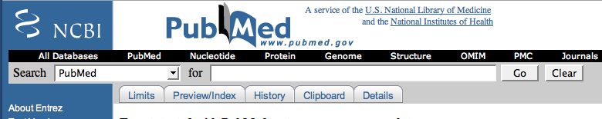
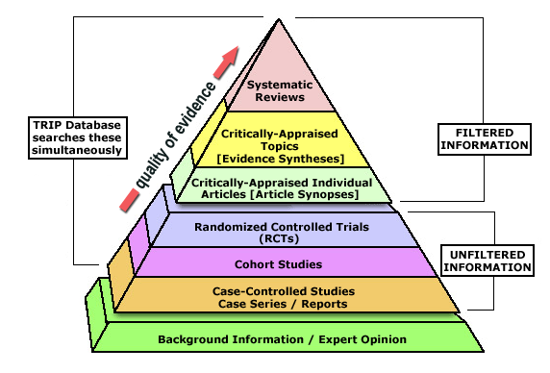
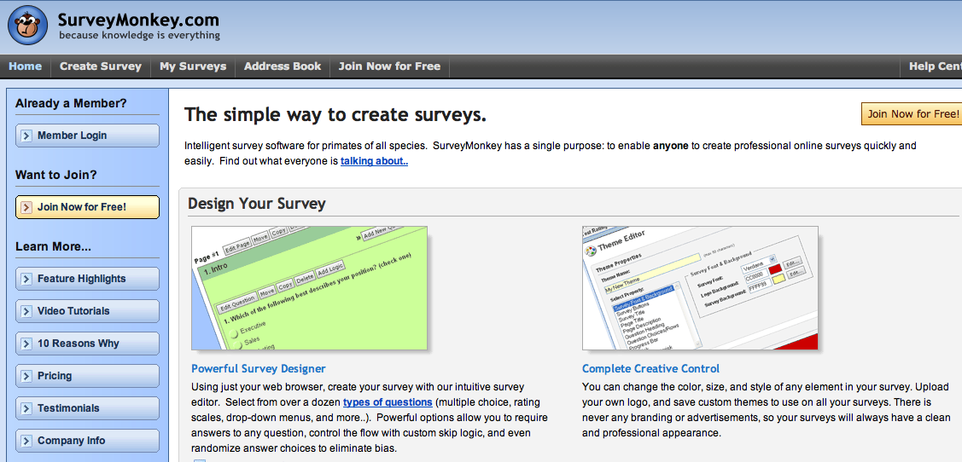
Informatics Seminars
March 8-22, 2008
NHP, Hanoi, Vietnam; and community clinics
Introduction to PubMed This seminar will introduce the online resource PubMed to find journal articles. We will review how to select and combine search terms to develop an effective search strategy. We will demonstrate tools found in PubMed, such as limits, clipboard, and "details" functions, that can make your searching more efficient | Advanced Strategies for Effective PubMed Searching This seminar is for people who have some experience searching PubMed and want to learn more advanced features of the PubMed interface: searching with medical subject headings (MeSH), clinical queries, utilizing the citation matcher, saving searches and auto-alerts, and other My NCBI features.
Evidence -Based Medicine
Evidence-Based Medicine: Finding Answers to Clinical Questions This seminar will help you formulate an searchable clinical question and develop effective search strategies to help you find answers. We will explore the database TRIP (Turning Research into Practice) and demonstrate features in PubMed to help you discover the highest level of research related to your topic as efficiently as possible. Evidence-Based Medicine: Appraising the Evidence This seminar will introduce a systematic approach to appraising research studies, with a focus on therapy studies. You will learn about criteria to evaluate whether the study design was valid, and methods for determining the clinical importance of the findings
SurveyMonkey: Introduction to Creating and Managing Online Surveys SurveyMonkey allows you to create and distribute online surveys. SurveyMonkey has a free ("basic") version and a paid-for ("professional") version. In this seminar you will learn to how to create surveys using the basic (free) version, the options for distributing them, and how to view and share survey results.

Slide 2


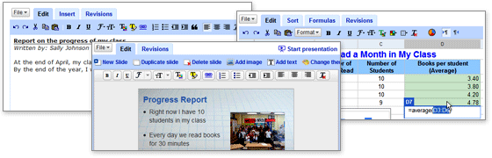
PowerPoint
PowerPoint Basics This seminar will cover how to use the basic features of Microsoft PowerPoint. Topics include adding and modifying text, incorporating graphics, charts and graphs, and using a template Composing Effective Presentations using PowerPoint PowerPoint can be an effective tool to support presentations, but it can also obscure the goal of the presentation. Learn some strategies for creating effective PowerPoint presentations. This seminar will cover planning what content to include in your slides, designing for readability and clarity, and some tips to use while you are presenting.
Collaborating with Google Documents If you have Internet access you can use Google Documents to create documents, spreadsheets, and presentations online. These documents are good tools to use when collaborating because multiple authors can view and edit them. This seminar will demonstrate features of Google Documents and how to use them.

