Slide 1
PROJECT 1 – WFH Impact on Employee Commute Expenses
Casey, Dick, Juan, Fatih Dec 2021

Slide 2



Work From Home Impact on Merit Increase
Pandemic created challenges as well as opportunities. In this project we have analyzed inflation on gas prices and its impact on associate’s cost of commute.
Research Question
Should the company’s merit increase account for inflation on gas prices while average commute has decreased since early 2020 ?
Hypothesis 1:
Gas prices have increased during the pandemic.
Hypothesis 2 :
Average commute of an associate decreased.
Notes:
I have thought of a solution that address two issues which should enable
1- Promotion of the program to much bigger audience by adding it to every eligible IM quote.
2- Make the backoffice process more streamlined from application to funding.

Slide 3


APPROACH
STEP #1 - We assumed average commute distance numbers per region and calculated reduction of miles commuted per month. We picked Feb 2020 as the date company switched to hybrid work. Then created a df
Region | Miles Driven per month
 | Before | After | Savings
Northeast | 75 | 30 | 45
Midwest | 120 | 48 | 72
South | 60 | 24 | 36
West | 150 | 60 | 90
STEP #2 - We used combination of manual and automated methods to prepare the data
Used BLS public API to extract prices
Manually downloaded meta-data and merged with the API response

Slide 4

APPROACH
STEP #3 - We visualized price trend over time to confirm our 1st hypothesis:
“ Have the gas prices increased since pandemic started till now? ”
Used pandas and json libraries to prepare a dataframe for data analysis
Used hvplot, geoviz library to visualize pricing trends
STEP #4 - We merged commute dataframe and gas prices data frame into a single dataframe

Slide 5


PROJECT 1 : DATA Analysis
% Change month to month
%Change on gas prices
%Change on commute driven
Miles driven change on commute driven
$ Change month to month
Avg $Change on gas prices
Metrics used
Dimensions & Measures
Areas, Months, Years, $Cost, %Change on Cost

Slide 6
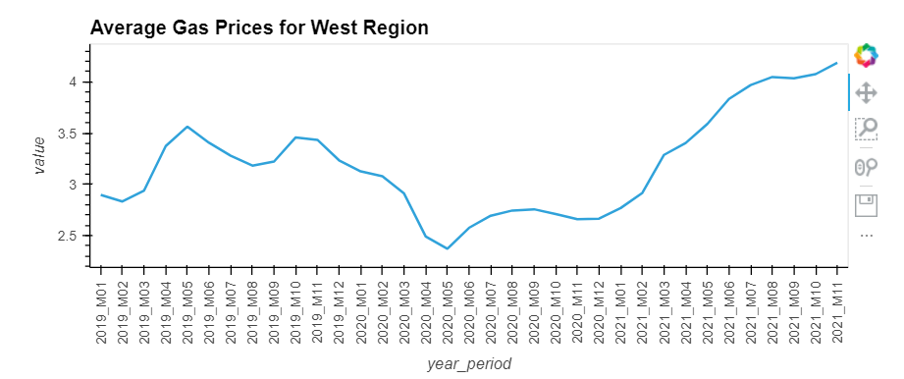
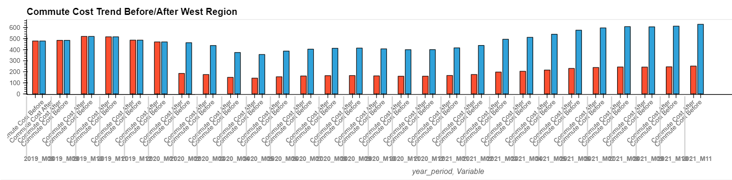
Price Trend Analysis – West Region
Conclusion #1
As of pandemic start date of Feb 2020, gas prices significantly dropped for a few months, flattened from summer through the end of the year then significantly increased.
Pandemic Start
Average Gas Price=$3.08
Conclusion #2
60% reduction in commute provided significant savings to associates even though per gallon prices increased. As the gas prices increased, associate savings increased.
Average commute
150 miles/month
Average commute
60 miles/month
Pandemic Start

Slide 7
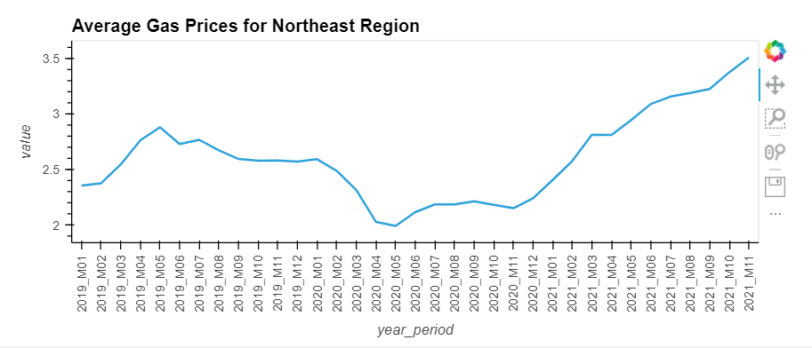
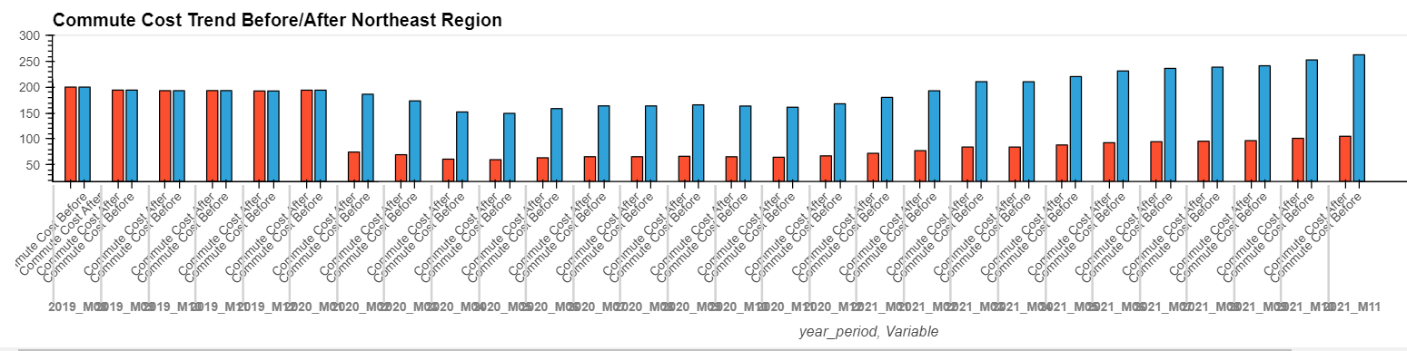
Price Trend Analysis – Northeast Region
Conclusion #1
As of pandemic start date of Feb 2020, gas prices significantly dropped for a few months, flattened from summer through the end of the year then significantly increased.
Pandemic Start
Average Gas Price=$2.48
Conclusion #2
60% reduction in commute provided significant savings to associates even though per gallon prices increased. As the gas prices increased, associate savings increased.
Average commute
75 miles/month
Average commute
30 miles/month
Pandemic Start

Slide 8
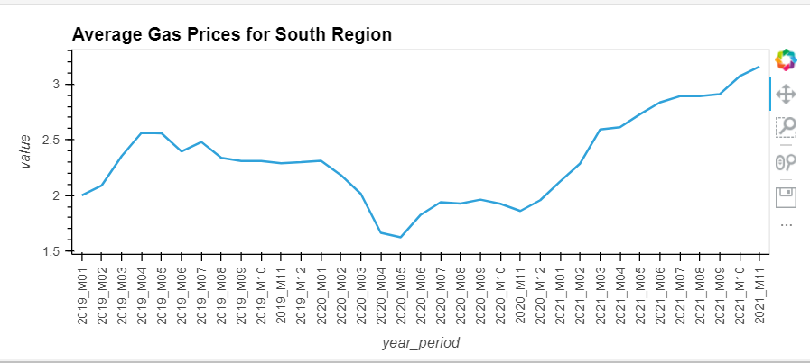
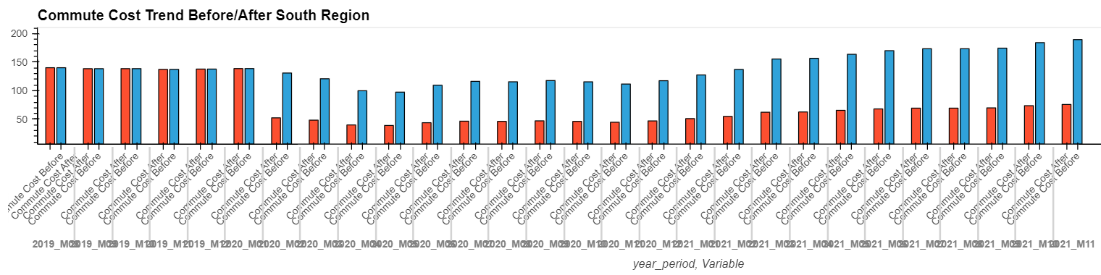
Price Trend Analysis – South Region
Conclusion #1
As of pandemic start date of Feb 2020, gas prices significantly dropped for a few months, flattened from summer through the end of the year then significantly increased.
Pandemic Start
Average Gas Price=$2.18
Average commute
120 miles/month
Conclusion #2
60% reduction in commute provided significant savings to associates even though per gallon prices increased. As the gas prices increased, associate savings increased.
Average commute
48 miles/month

Slide 9
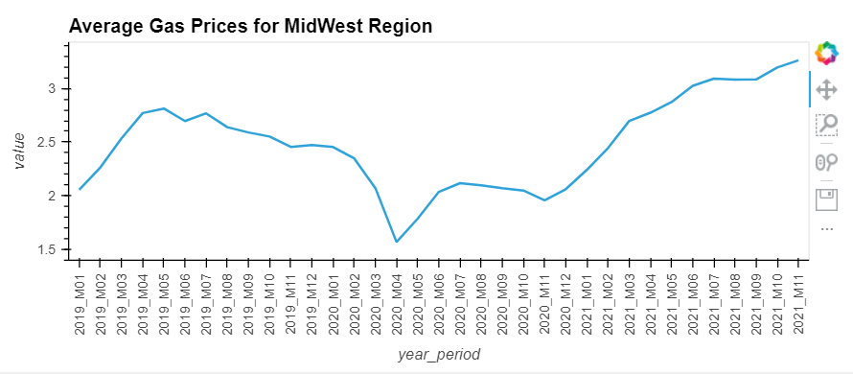
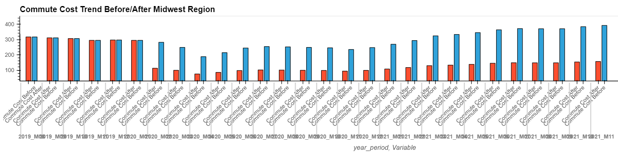
Price Trend Analysis – Midwest Region
Conclusion #1
As of pandemic start date of Feb 2020, gas prices significantly dropped for a few months, flattened from summer through the end of the year then significantly increased.
Pandemic Start
Average Gas Price=$2.34
Average commute
120 miles/month
Average commute
72miles/month
Conclusion #2
60% reduction in commute provided significant savings to associates even though per gallon prices increased. As the gas prices increased, associate savings increased.

Slide 10
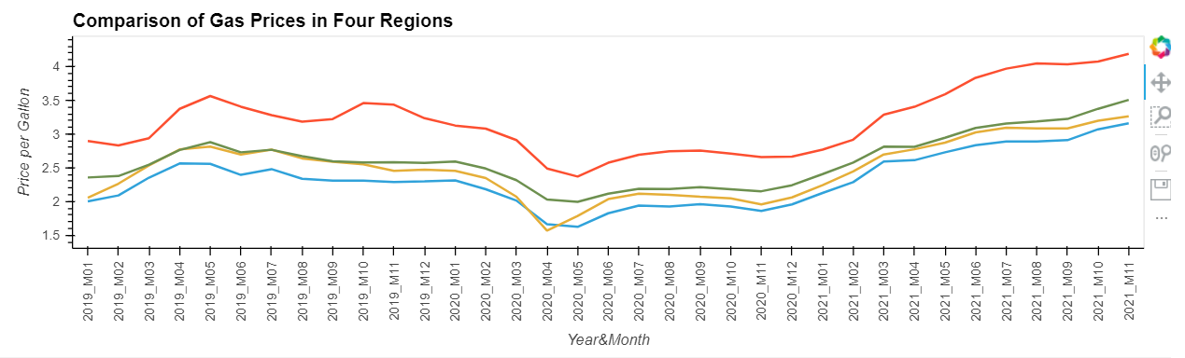
Analysis – Overall
Pandemic Start
Average Gas Price=$2.34
Average commute
150 miles/week
Average commute
60 miles/week
Gas prices followed similar trends in all regions despite being different levels.
Right after Feb 2020, prices steadily decreased for two months, picked up then levelled until the end of the year then steadily increased till now.
Overall commute cost significantly decreased after Feb2020 and despite inflation in gas prices, never reached to pre-pandemic levels.
RECOMMENDATION : Pandemic has positive impact to associate commute costs . Company may adjust merit increase downwards due to changes in commute behavior after pandemic .

