Slide 1
Real-Time Credit Card Fraud Detection System
An End-to-End Machine Learning Solution for Real-Time Fraud Detection and Governed Deployment
FINAL PROJECT PRESENTATION
Team 07
Maung Naing Win Kyaw (4288602M)
Tha Zin Oo (1114879N)
Lionel Tay Choon Thye (5361180E)
01
Notes:
Our goal was not simply to train an accurate model. We wanted to build an end-to-end solution that detects fraud in real time, controls false alerts, avoids data leakage, and can be deployed through a governed machine-learning process.

Slide 2
From problem definition to governed fraud detection
MODEL DEVELOPMENT
1
Business & ML
formulation
2
Data Audit
3
Feature
engineering
4
Model
experiments
Binary classification;
recall within FPR limits
Quality checks, imbalance
and leakage detection
Leakage-safe time and
behavioural features
Logistic Regression vs
XGBoost candidates
OPERATIONALIZATION & GOVERNANCE
8
Deployment &
artifacts
7
Testing &
governance
6
MLOps pipeline
5
Champion &
threshold
Endpoint, application, logs and versioned outputs
Unseen test dataset, quality gates and manual approval
MLflow tracking and
SageMaker registration
Select XGBoost; freeze
threshold on validation
A leakage-safe, validation-driven and reproducible ML workflow
02
Notes:
Let’s first look at the complete project workflow.
I’ll begin with the business problem and data preparation, then explain our model selection, testing, deployment, and governance approach.

Slide 3
Business & ML formulation
BUSINESS PROBLEM
Identify risky card transactions early enough to support review or intervention—without overwhelming legitimate customers with false alerts.
Binary classification
Operating constraint
Fraud vs non-fraud probability
Max false-positive rate: 5%
DECISION LOGIC
1
Score
2
Threshold
3
Act
Predict fraud probability
Freeze on validation only
Alert if p ≥ 0.1947
Primary metric: Maximize Fraud Recall subject to a validation FPR budget.
03
Notes:
Technically, this is a binary-classification problem. The model outputs a probability that a transaction is fraudulent. We then compare that probability with a fixed decision threshold.
Our selected threshold is 0.1947, which is equivalent to 19.47%. If the predicted fraud probability is at least 19.47%, the transaction is flagged. Otherwise, it is classified as non-fraud.
Transition : Before training any model, however, we had to verify that the available data was trustworthy.

Slide 4
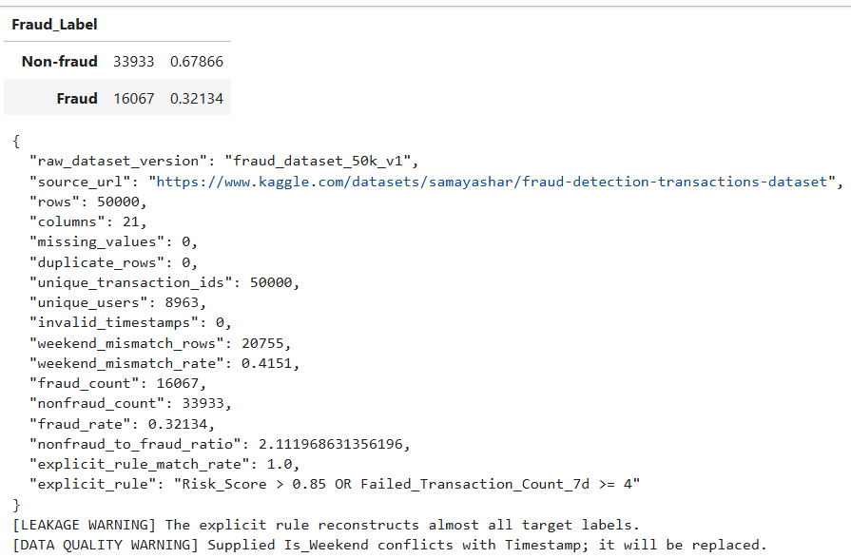
Target leakage and data-quality findings
Leakage detected
Risk_Score reconstructed almost all target labels.
Data-quality conflict
Supplied Is_Weekend disagreed with Timestamp for 41.5% of rows.
Mitigation
Exclude Risk_Score; derive weekend and time features from Timestamp; keep feature policy versioned.
Finding → decision: generalization evidence must be leakage-safe, even when headline recall declines.
04
Notes:
We then audited the data, identified leakage and data-quality issues, and created leakage-safe features.

Slide 5
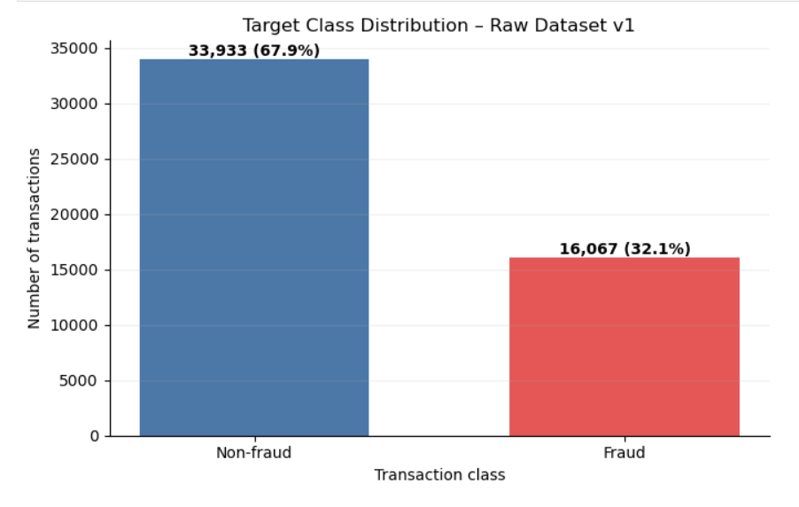
Feature Engineering
50,000
21
32.1%
rows
raw columns
fraud rate
Feature engineering
Split & safeguards
• Hour, day-of-week, month
• Cyclic hour sin/cos
• Derived weekend flag
• Behavioural 7-day features
• One-hot categorical encoding
• Stratified 60 / 20 / 20
• Train: 30k
• Validation: 10k
• Test: 10k
• Unseen test dataset until final evaluation
No missing values or duplicate rows; imbalance is moderate, so metrics emphasize recall, precision, F1 and FPR—not accuracy alone.
05
Notes:
Data preparation, features and split

Slide 6
Logistic Regression and XGBoost experiments
Model A — Logistic Regression
Model B — XGBoost
Shared Decision Layer
Interpretable linear baseline
4 candidate runs
Tests whether engineered signals are sufficient without nonlinear interactions.
Nonlinear boosted trees
6 candidate runs
Tests interaction effects and ranks candidates at the same FPR constraint.
Validation-only thresholding
FPR budgets: 1%–5%
Champion = highest validation recall while meeting the 4% target.
Member 1:
Maung Naing Win Kyaw
Model A + Data/EDA
Member 2:
Tha Zin Oo
Model B + Data/EDA
Member 3:
Lionel Tay Choon Thye
Deployment + MLOps
06
Notes:
Experiments tested model complexity and operating thresholds separately.

Slide 7
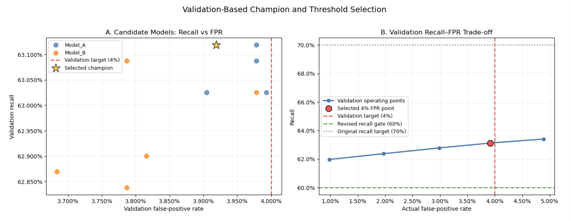
Model comparison and champion selection
Champion
XGBoost candidate 05
Threshold 0.1947
63.12%
3.92%
validation recall
validation FPR
Why it won
Highest recall among feasible candidates; 4% target keeps margin below the 5% deployment gate.
The gain over logistic regression is small—selection is evidence-based, not a claim of a dramatic algorithmic leap.
07
Notes:
Next, we compared Logistic Regression and XGBoost candidates. We selected the champion model and fixed its decision threshold using only the validation set.

Slide 8
Selecting the Fraud Decision Threshold
Original 70% recall gate
Not supported after leakage removal.
Selected operating point
Threshold 0.1947
Recall 63.12% | FPR 3.92%
392 false alerts / 10k legitimate
Decision
Keep the 60% prototype recall gate and 5% final FPR gate; freeze threshold before touching test data.
08
Notes:
Threshold trade-off

Slide 9
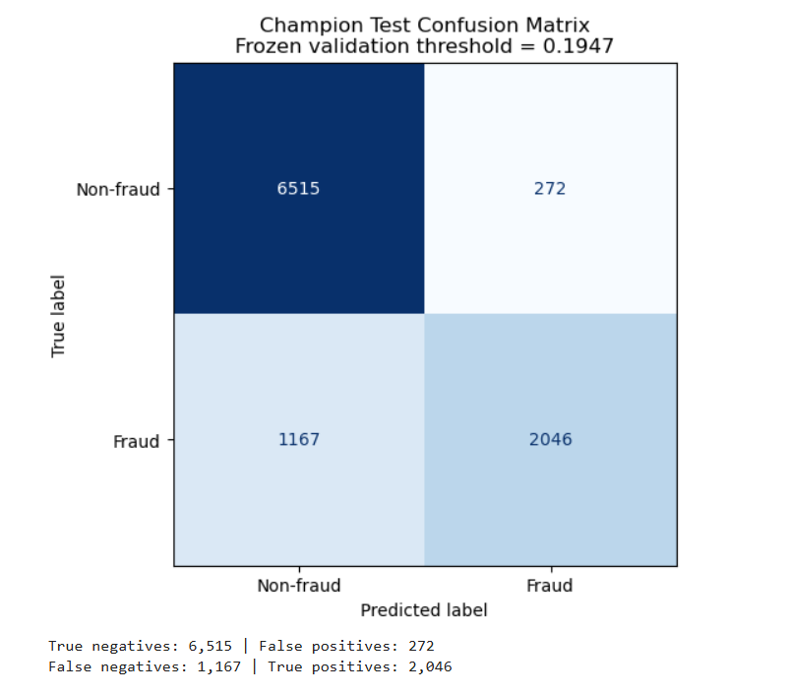
Final Model Evaluation & Test Results
2,046
1,167
fraud caught
fraud missed
272
6,515
false alerts
legitimate cleared
Test recall ≈ 63.68% • Test FPR ≈ 4.01%
Within the 5% deployment FPR gate.
Error implication: false negatives remain the main residual risk; the app should support human review and feedback-driven retraining.
09
Notes:
Frozen Test set – Fixed/predefined threshold testing confirmed deployment readiness—with known misses

Slide 10
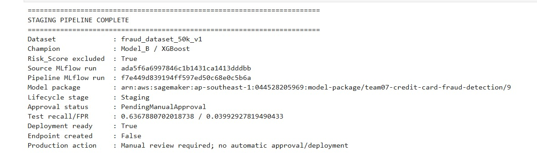
SageMaker/MLflow pipeline
1
2
3
4
5
6
Audit + preprocess
Train candidates
Track + compare
Quality gate
Register
Approve + deploy
S3 versioned data
LR + XGBoost
MLflow runs
Recall / FPR
SageMaker package
Manual promotion
The pipeline makes every decision reproducible and auditable. Model package remains PendingManualApproval: passing metrics enables review; it does not bypass governance.
10
Notes:
Finally, we built an MLOps pipeline, evaluated the model once on an unseen test set, registered the model, and deployed it with monitoring and manual approval controls.

Slide 11
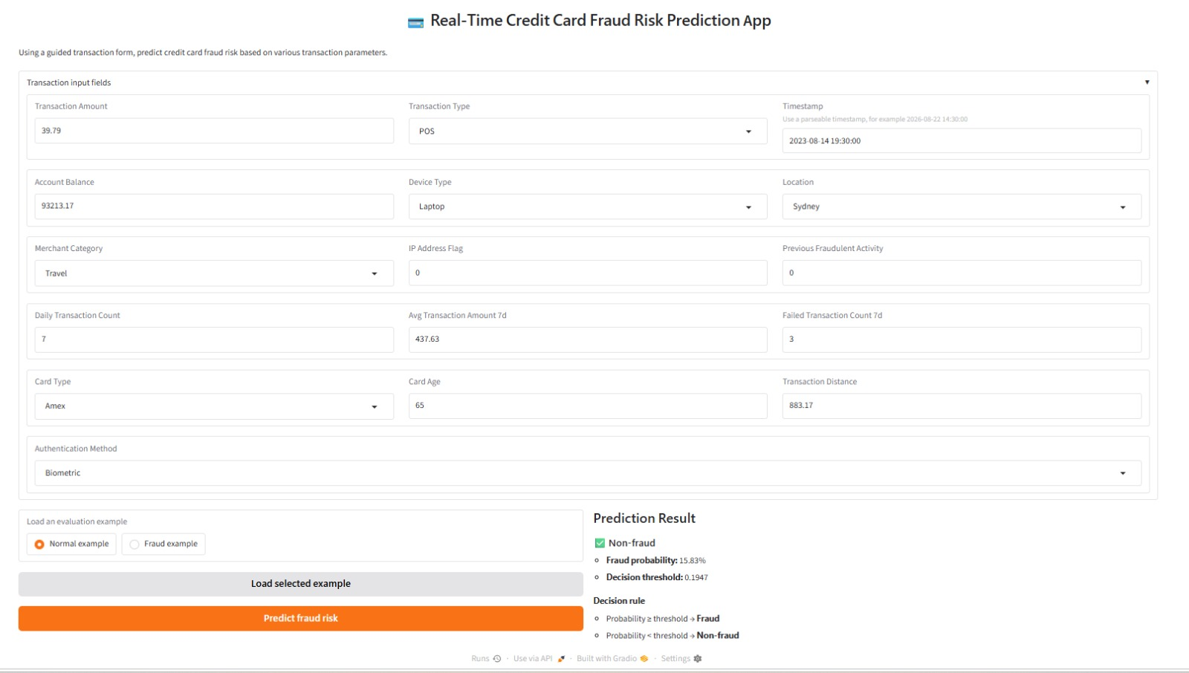
FINAL PROJECT PRESENTATION
Demo Application : The Real-Time Credit Card Fraud Risk Prediction demo application, showing a live prediction against the In Service endpoint: 15.83% fraud probability vs. the 0.1947 threshold, correctly classified Non-fraud (Section 4.5).
URL : https://e722405ddec0df92f9.gradio.live/
11

Slide 12
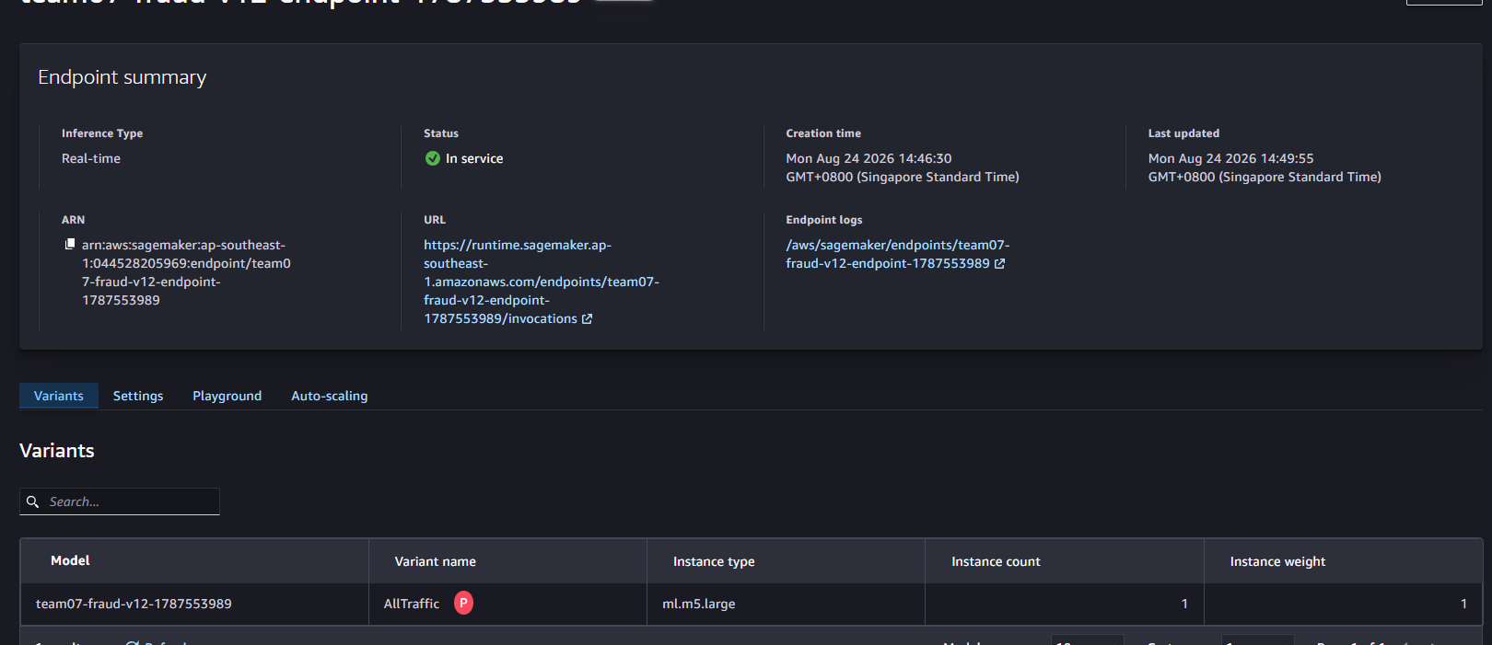
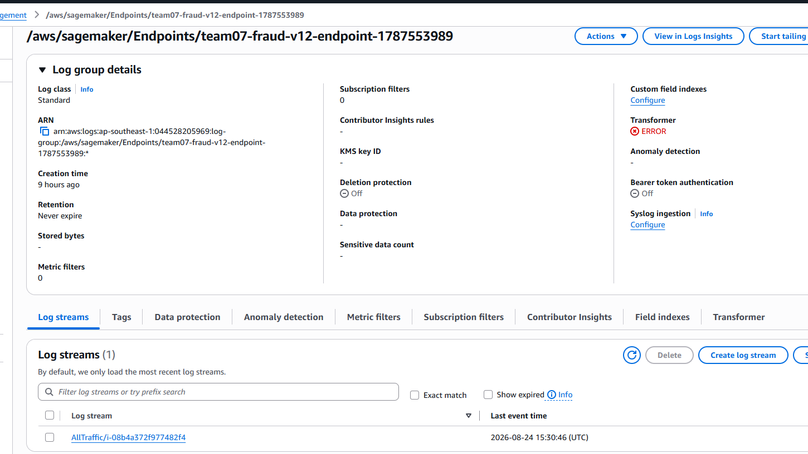
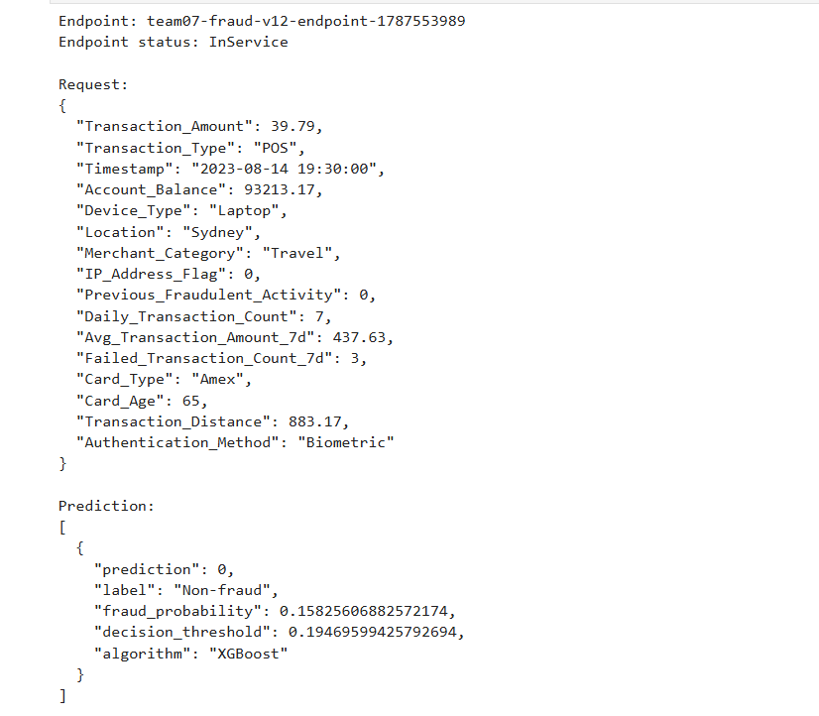
Deployment & artifacts
Runtime controls
CloudWatch endpoint logs • request/response validation • threshold returned with prediction • model version and algorithm traceability
12
Notes:
The central principle throughout the project was reproducibility: the same data, code, model, and threshold should produce the same result.

Slide 13
Final package, governance and next steps
DELIVERED ARTIFACTS
GOVERNANCE & NEXT TESTS
• Versioned raw + processed datasets
• Leakage-safe feature pipeline
• 10 tracked candidate runs
• XGBoost champion + Fixed decision threshold
• Registered SageMaker model package
• Real-time endpoint + prediction app
• CloudWatch operational logs
• Manual approval before promotion
• Monitor input drift and alert rate
• Track recall/FPR when labels arrive
• Segment checks by location, device, merchant and authentication method
• Investigate false negatives first
• Retrain only through the gated pipeline
13
Notes:
Final package: deploy with guardrails, then learn from production

Slide 14
THANK YOU
Notes:
[Sources]
- User-provided project evidence: Bes_Run_Name.png
- User-provided project evidence: SageMaker_Pipeline_ExecutionResult.jpeg
- User-provided project evidence: CloudWatchLog.png
[/Sources]

