Slide 1
🌲
Forest Ecosystem Simulation
Interactive 3D Environment using Three.js
Computer Graphics Project • Three.js • 2024

Slide 2
Presentation Outline
1
Project Overview & Objectives
2
Technologies & Tools
3
System Architecture & Design
4
Implementation Details
5
Day/Night Cycle Feature
6
Results & Demonstration
7
Conclusion & Future Work

Slide 3
01
🎯
Project Overview

Slide 4
🌲
What is Forest Ecosystem Simulation?
✓
Web-based 3D forest visualization
✓
Low-poly stylized aesthetic
✓
Interactive day/night cycle
✓
Real-time WebGL rendering
✓
No external 3D models needed
✓
Single HTML file deployment

Slide 5
🎯
Project Objectives
Master Three.js and WebGL 3D graphics programming
Understand scene composition: camera, lighting, materials
Create appealing low-poly visual aesthetic
Implement smooth day/night cycle transitions
Build intuitive time control interface
Optimize for 60 FPS browser performance

Slide 6
02
⚙
Technologies
Used

Slide 7
💻
Technology Stack
✓
Three.js v0.160.0 - 3D Library
✓
WebGL 2.0 - GPU Rendering
✓
HTML5 / CSS3 - Structure
✓
JavaScript ES6+ - Logic
✓
OrbitControls - Camera
✓
CDN - No Build Required

Slide 8
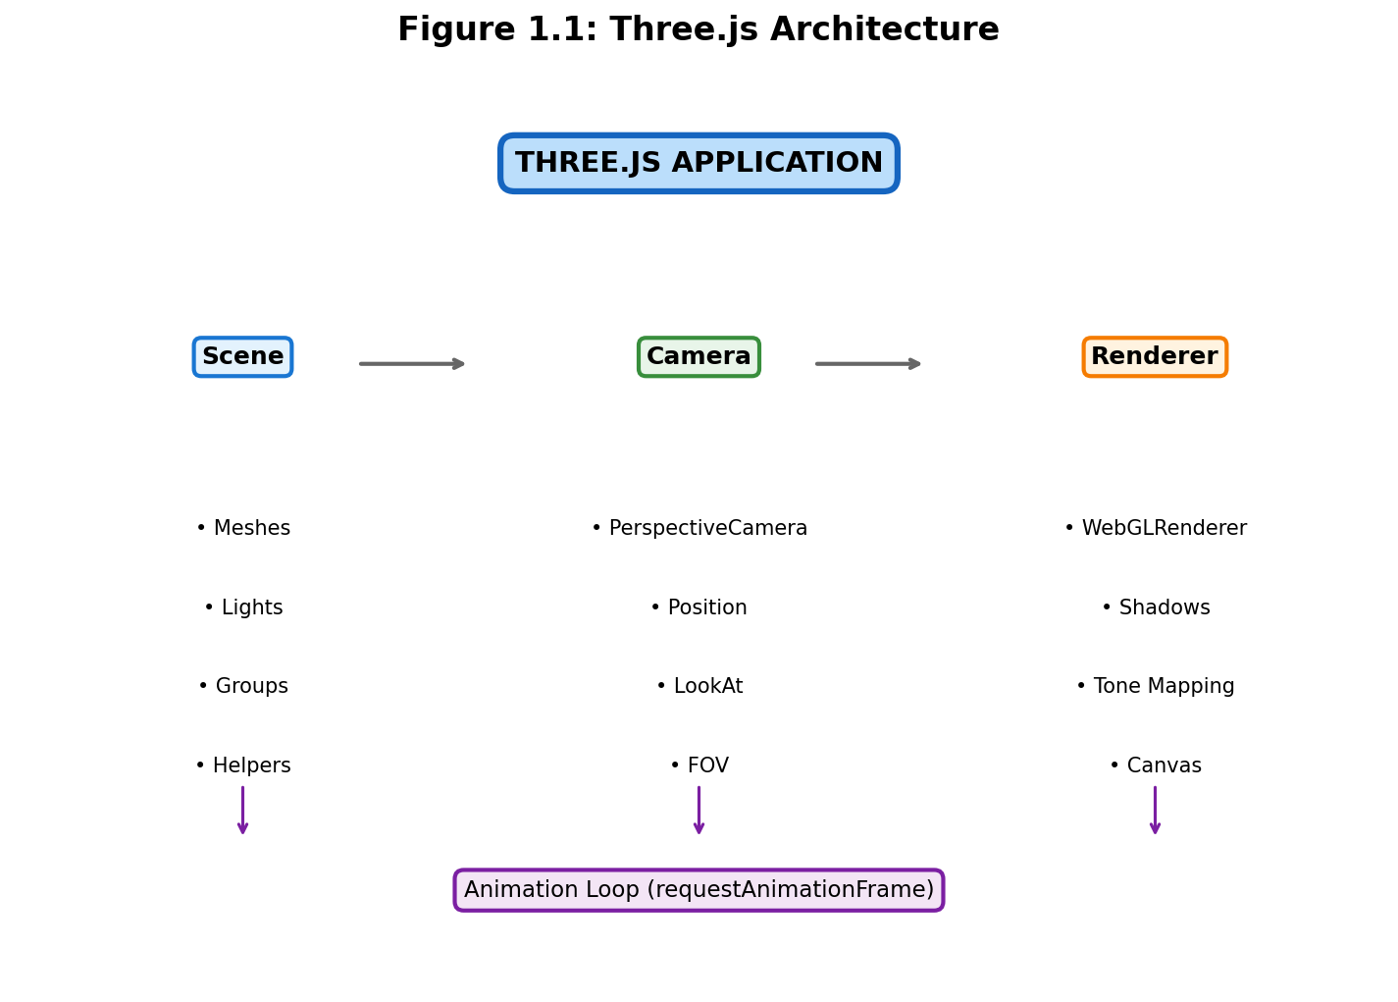
⚙
Three.js Architecture
▸
Scene - Object container
▸
Camera - Viewpoint definition
▸
Renderer - Screen drawing
▸
Mesh = Geometry + Material
▸
Lights - Scene illumination

Slide 9
📐
Primitive Geometries
CylinderGeometry → Tree trunks, flower stems
ConeGeometry → Pine foliage, grass blades
SphereGeometry → Round trees, bushes, flowers
IcosahedronGeometry → Rocks with flatShading
PlaneGeometry → Ground surface

Slide 10
03
🎨
System Design

Slide 11
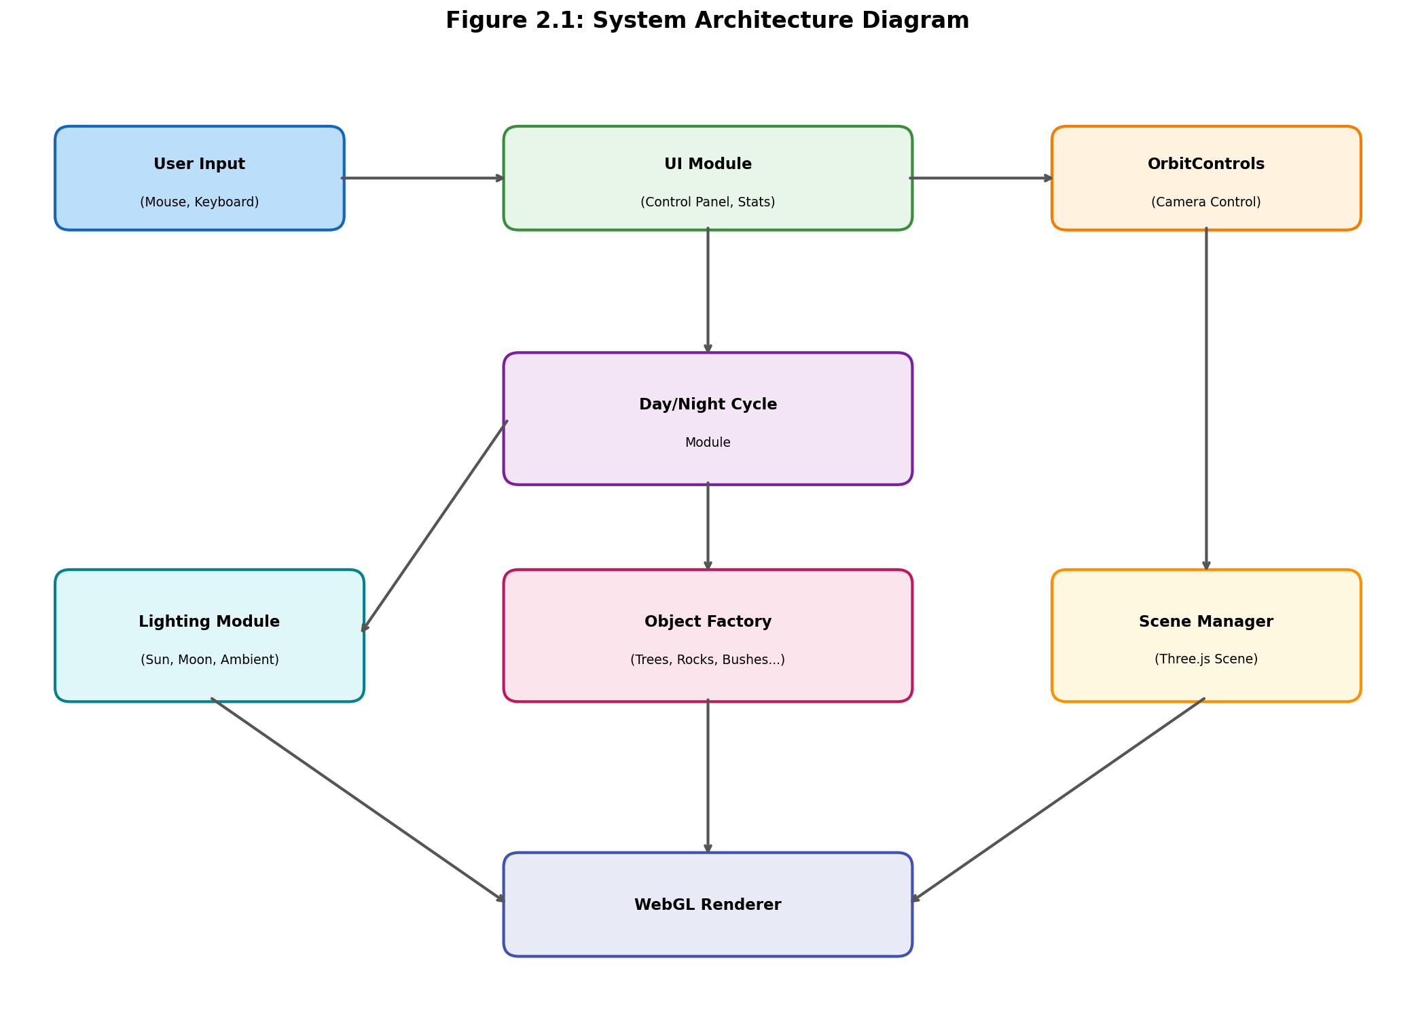
System Architecture Diagram
Modular architecture with interconnected components

Slide 12
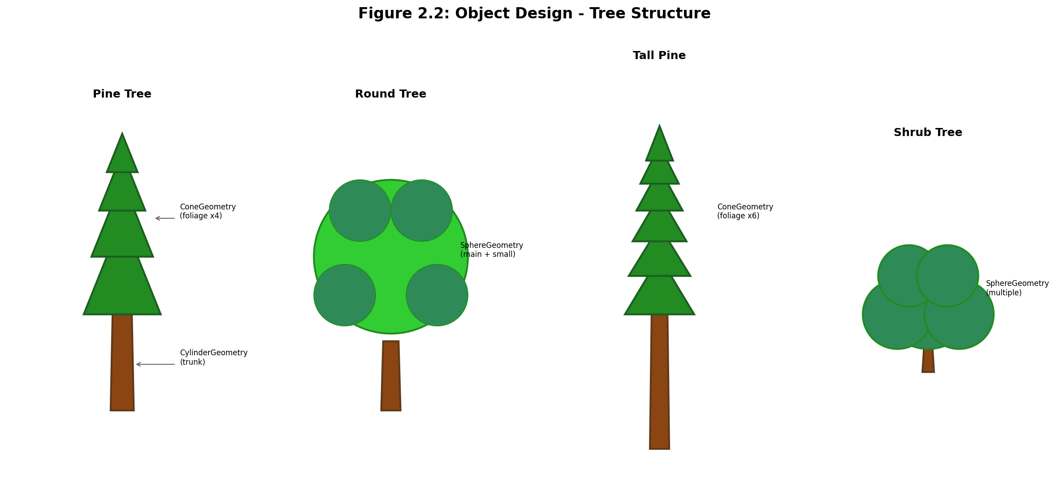
Tree Object Design - 4 Types
Pine Tree • Round Tree • Tall Pine • Shrub Tree

Slide 13
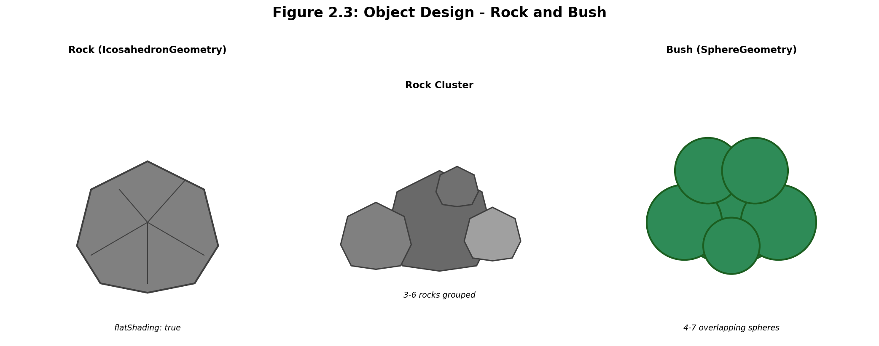
Rock & Bush Object Design
IcosahedronGeometry for rocks, clustered SphereGeometry for bushes

Slide 14
04
💻
Implementation

Slide 15
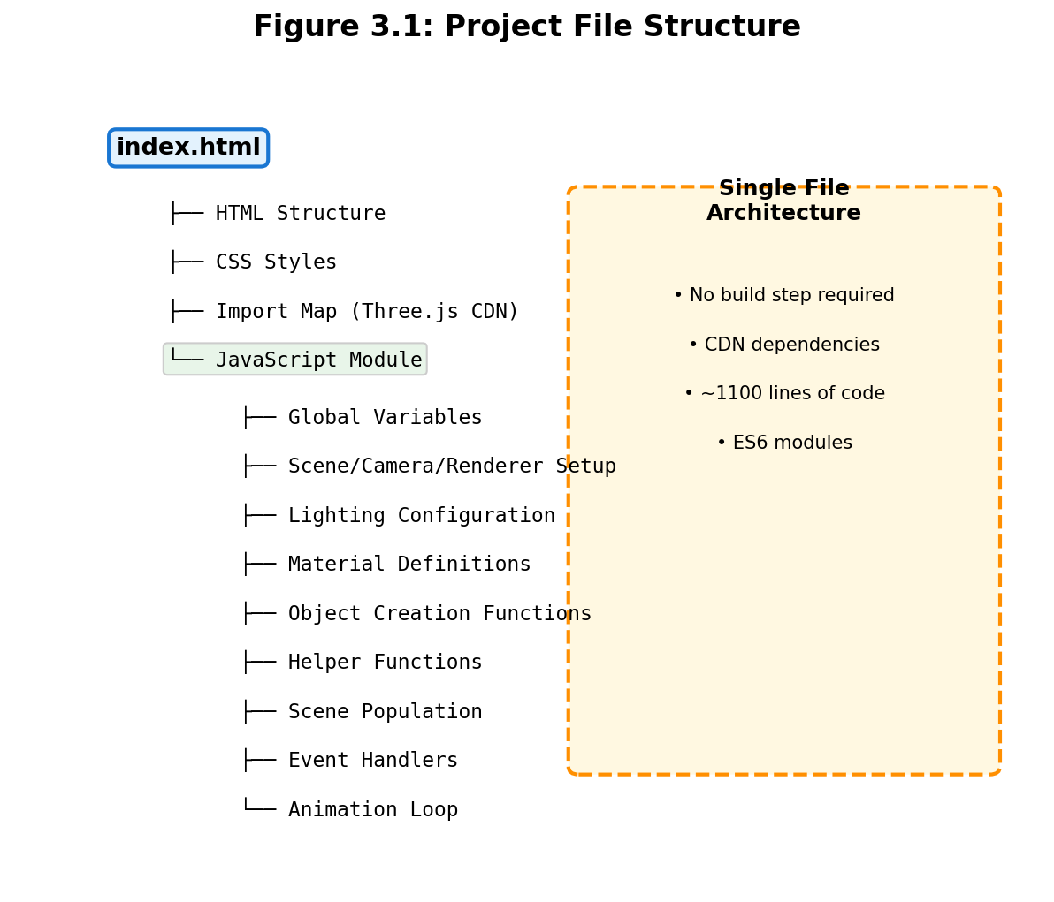
📁
Project Structure
▸
Single HTML file (~1100 lines)
▸
ES6 module architecture
▸
CDN-loaded dependencies
▸
No build step required
▸
Organized code sections

Slide 16
🎬
Scene Configuration
PerspectiveCamera: 60° FOV, position (20, 15, 20)
WebGLRenderer: Antialiasing + PCFSoftShadowMap
ACES Filmic tone mapping for cinematic look
Linear fog for atmospheric depth effect
OrbitControls with damping for smooth navigation

Slide 17
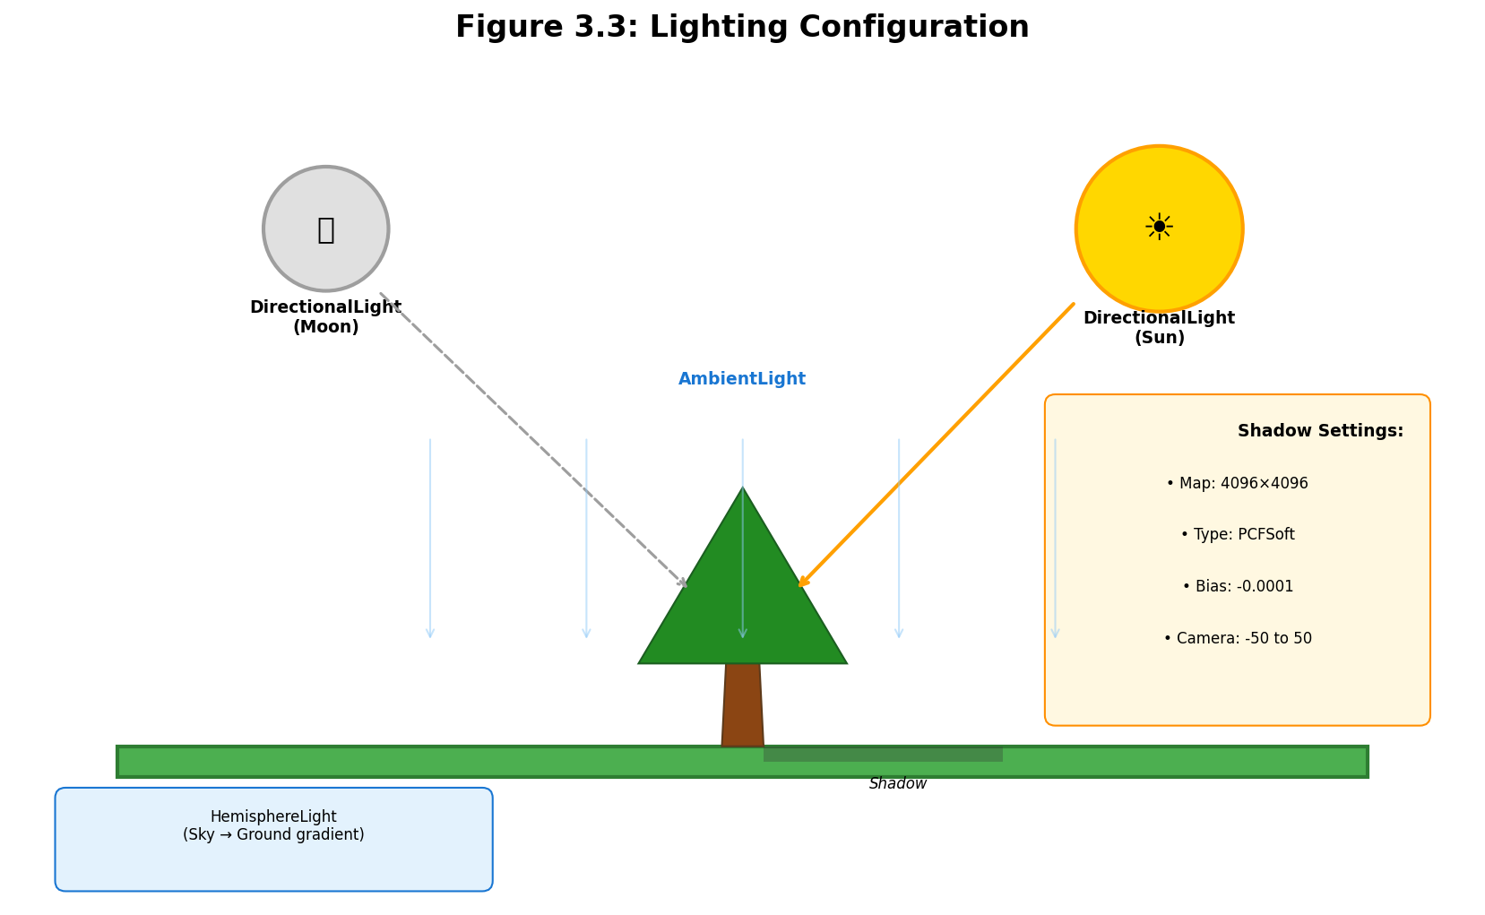
Lighting Configuration
Ambient + Directional (Sun/Moon) + Hemisphere lights

Slide 18
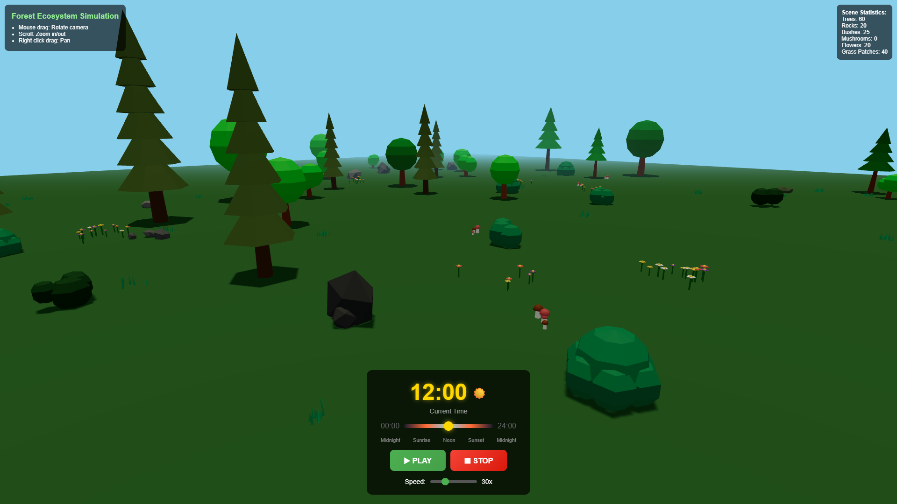
🌳
Forest Objects Created
▸
60 trees (4 different types)
▸
20 rocks (single + clusters)
▸
25 bushes (2 variations)
▸
15 mushroom clusters
▸
20 flower patches
▸
40 grass patches

Slide 19
05
☀
Day/Night Cycle

Slide 20
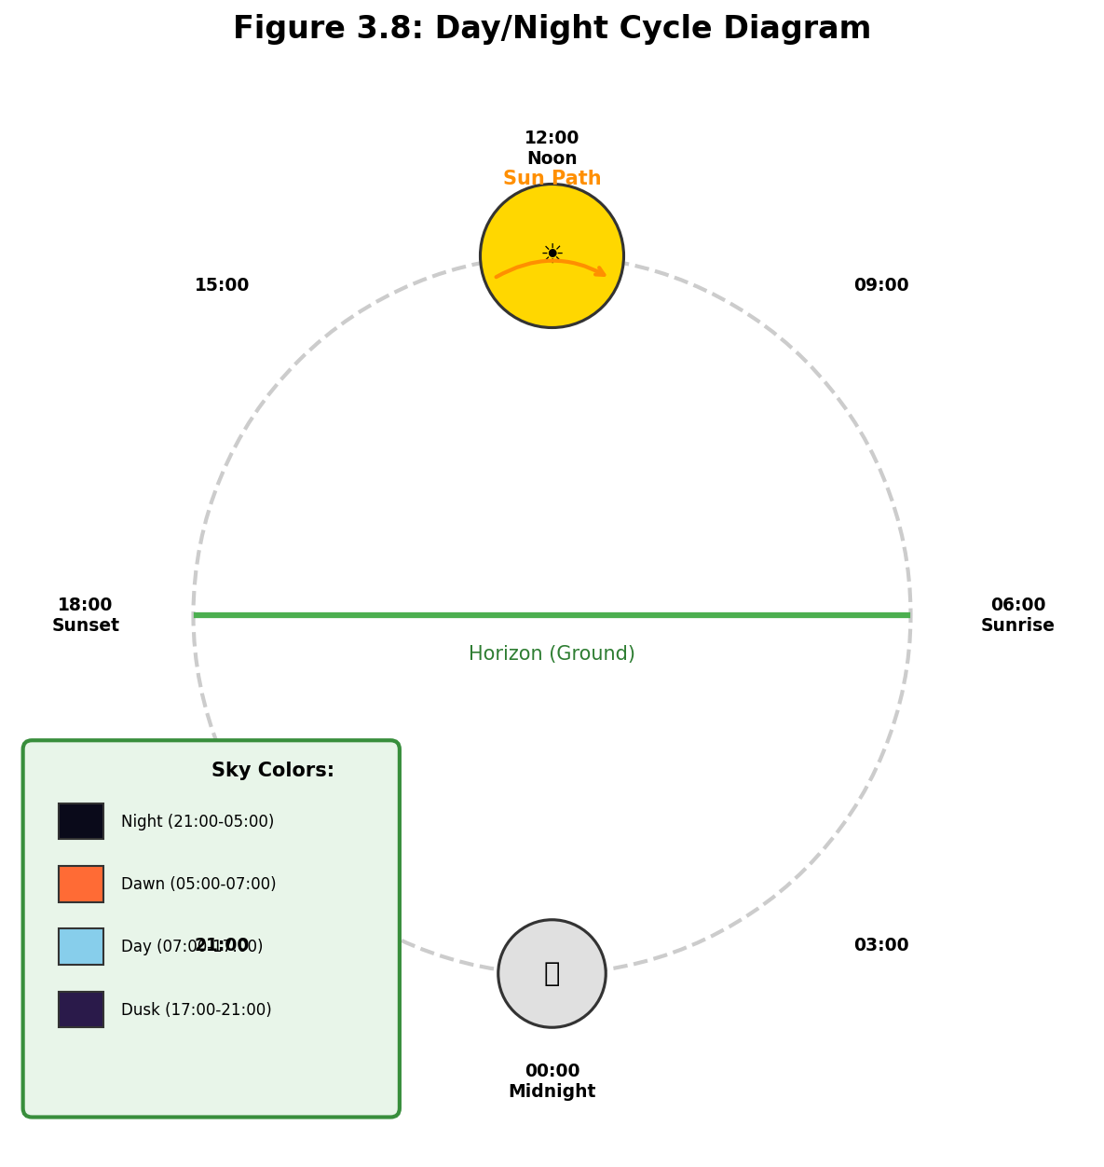
Day/Night Cycle System
Circular sun/moon paths with smooth color interpolation

Slide 21
⏰
Time System Features
✓
Minutes 0-1440 (00:00-24:00)
✓
Trigonometric position calc
✓
Smooth color interpolation
✓
Dynamic light intensity
✓
Speed control: 1x to 100x
✓
Interactive time slider

Slide 22
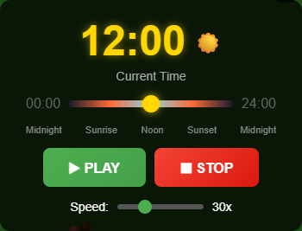
🎮
Control Panel Interface
▸
Large digital time display
▸
Sun/Moon emoji indicator
▸
Color-coded time slider
▸
Play/Stop buttons
▸
Adjustable speed (1x-100x)

Slide 23
06
📊
Results & Demo

Slide 24
Scene Statistics
🌲
🪨
🌿
~60
~20
~25
Trees
Rocks
Bushes
🍄
🌸
🌱
~15
~20
~40
Mushrooms
Flowers
Grass Patches

Slide 25
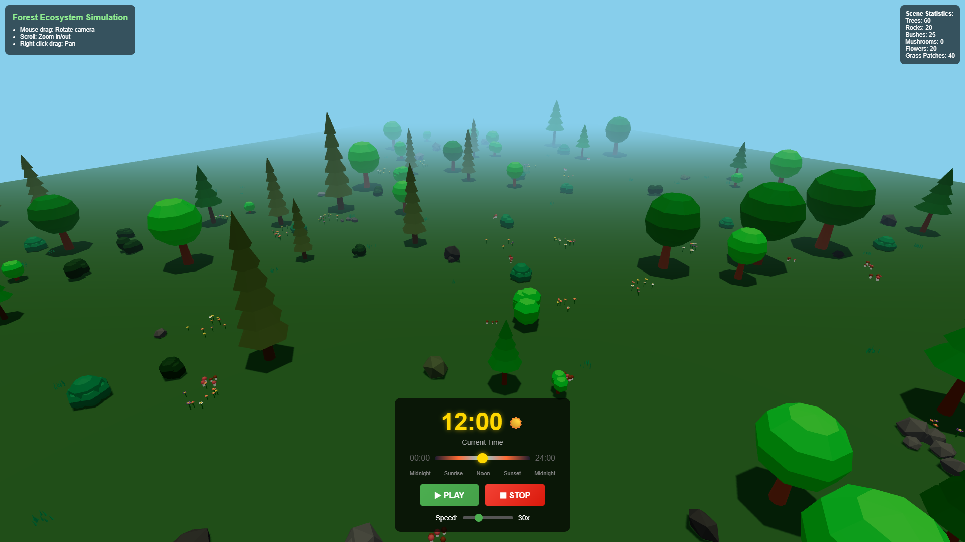
Daytime View (12:00)
Full lighting • Vibrant colors • Crisp shadows

Slide 26
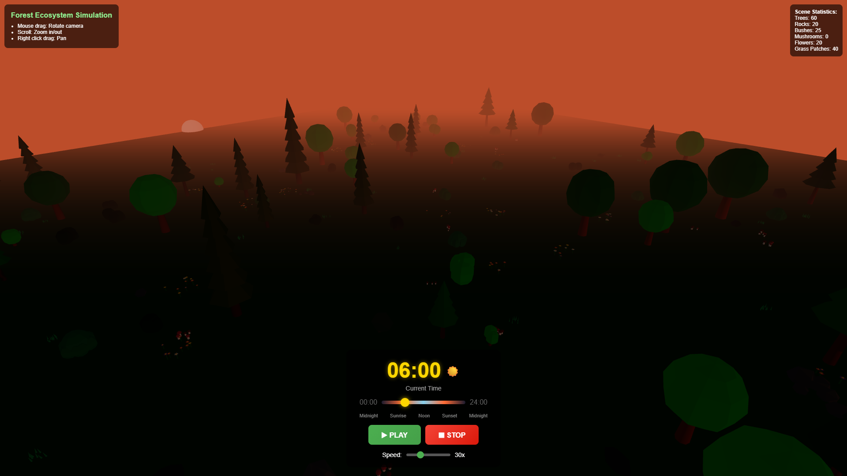
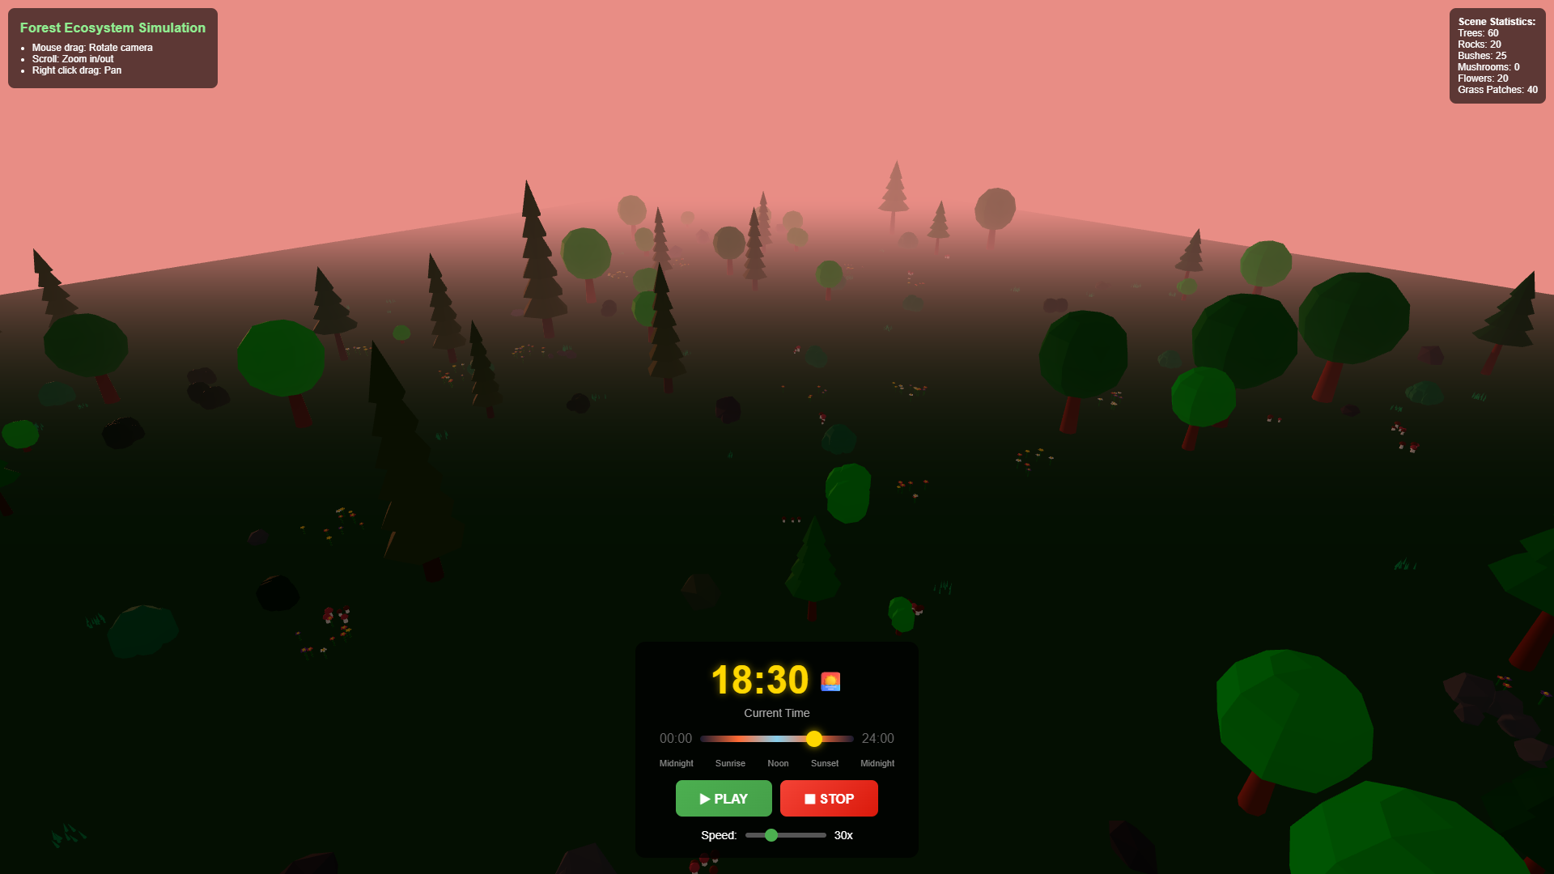
Dawn & Sunset Transitions
🌅 Dawn (06:00)
🌇 Sunset (18:30)

Slide 27
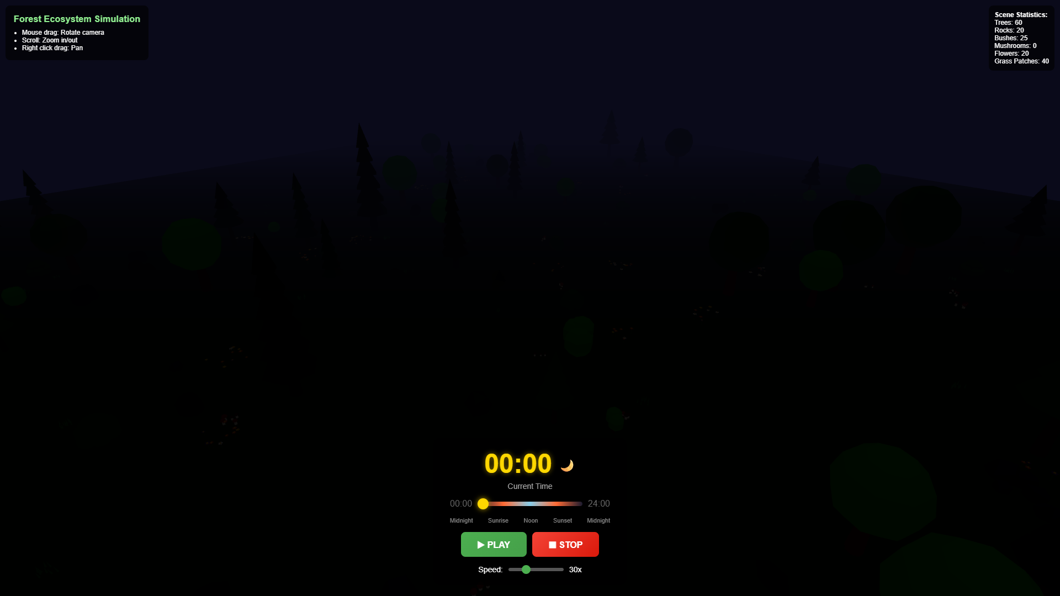
Night View (00:00)
Moonlit scene • Dark blue sky • Atmospheric fog

Slide 28
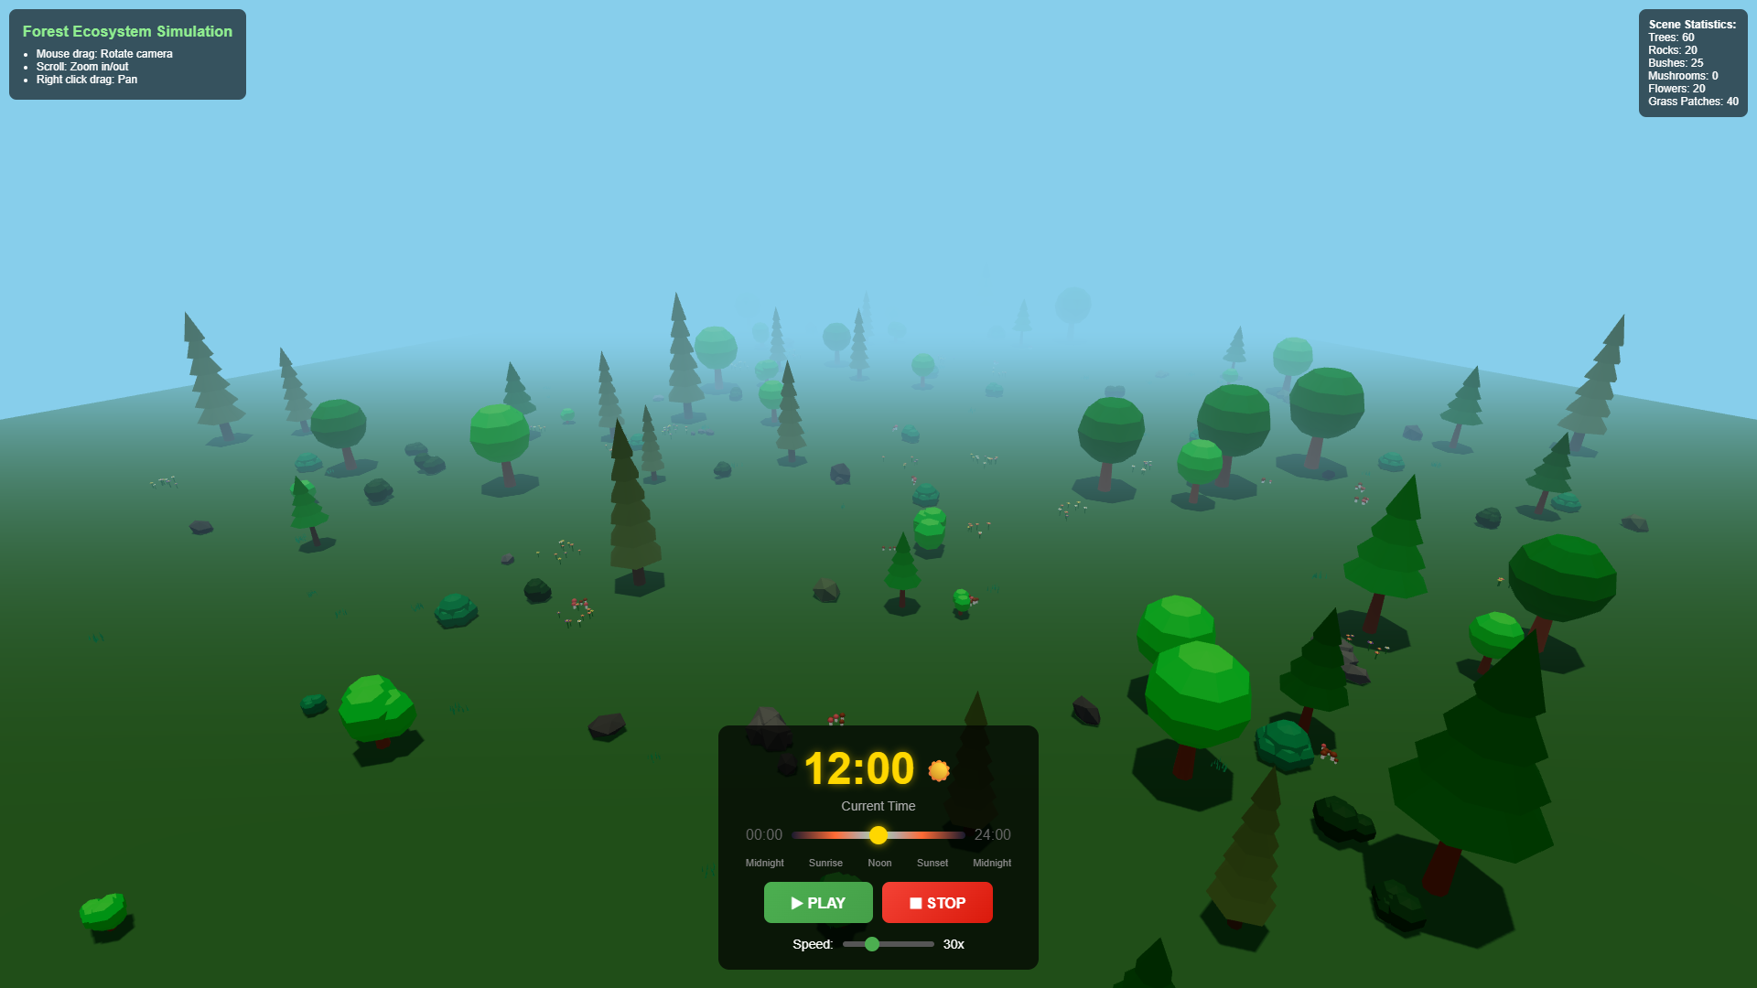
Wide Overview Shot
Complete forest scene from elevated perspective

Slide 29
07
🏁
Conclusion

Slide 30
✅
Key Achievements
✓
Interactive 3D forest visualization
✓
Consistent low-poly aesthetic
✓
Smooth day/night transitions
✓
60 FPS on modern browsers
✓
Intuitive time controls
✓
Clean modular codebase

Slide 31
🚀
Future Improvements
🌬 Animated wind effects on trees and grass
⛰ Procedural terrain with hills and valleys
💧 Water features: lakes, streams, reflections
🌧 Weather effects: rain, snow, clouds
🚶 First-person exploration mode
🔊 Ambient audio and sound effects

Slide 32
🌲
Thank You!
Questions & Discussion
Forest Ecosystem Simulation
Three.js • WebGL • 2024

