Slide 1

Your Code Runs in Docker, Why Not Your IDE?
Thomas Bley
PHP UG Darmstadt October 2021

Slide 2

About me
Senior PHP Developer
Linux, PHP, MySQL since 2001
studied at TU München
working for Bringmeister
in Berlin

Slide 3
Why use Docker?
easy to manage different isolated environments
quick and easy to setup development environments
easy to share with other developers
easy to integrate in continuous integrations
easy to standardize environments
easy to test new things
write once, run anywhere
big ecosystem with Docker Hub
➔ we love to run our code in Docker

Slide 4
Why use an IDE?
IDE = Integrated Development Environment
flexible text editor
code completion, formatting
automatic checks for errors, debugging
integrated version control
many other features with extensions
➔ more productivity, more quality
but: installed as desktop application, configured manually

Slide 5
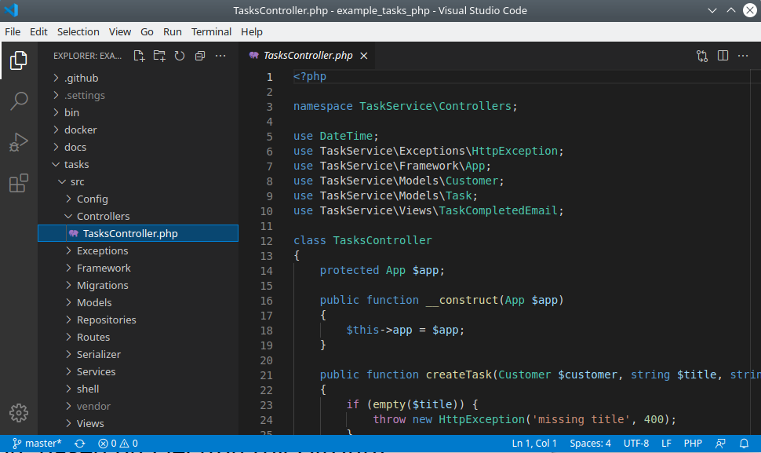
What is Visual Studio Code?
free and open source IDE
from Microsoft
lightweight, very fast
supports many programming
languages
big community
many extensions
desktop application, based on Electron (by GitHub)
marketplace is not open source, proprietary license

Slide 6
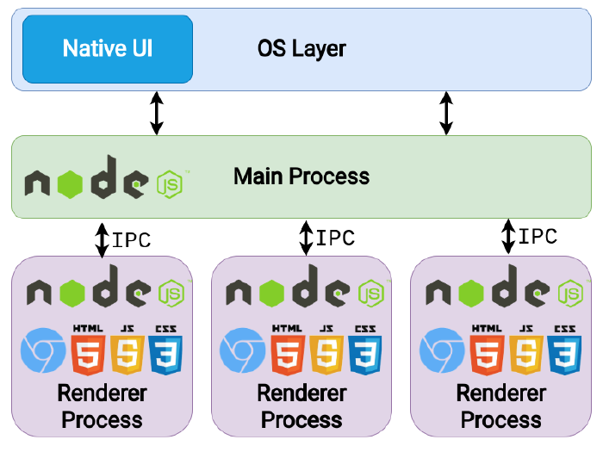
What is Electron?
Framework for cross platform desktop applications from GitHub
combines the Chromium rendering engine (Frontend)
with node.js runtime (Backend)
source: livecodestream.dev/post/how-to-build-desktop-applications-using-electron-the-right-way/

Slide 7
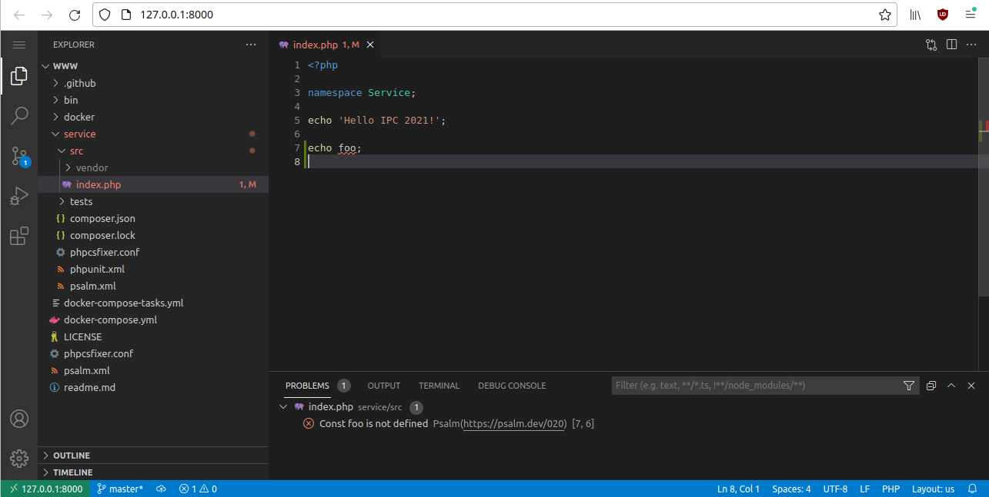
Can we run VS Code in the browser?

Slide 8
Code-Server
“VS Code in the browser”
fork of VS Code, open source
runs backend part on server, frontend part in browser
supports VSX extensions
can be installed as Debian package (95M)
not allowed to use VS Code Marketplace
uses Open VSX Registry as marketplace (open-vsx.org)
sources:
github.com/cdr/code-server
github.com/cdr/code-server/blob/main/docs/FAQ.md

Slide 9
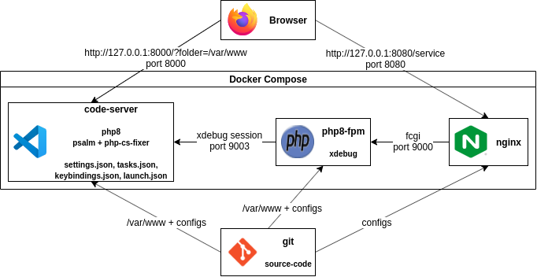
Setup

Slide 10
Dockerfile
# Setup a Debian container with PHP 8.0 and code-server
# docker-compose build --build-arg UID=$(id -u)
FROM debian:bullseye-slim
RUN apt-get -y update \
&& DEBIAN_FRONTEND=noninteractive apt-get -y --no-install-recommends install apt-transport-https curl \
ca-certificates \
&& echo "deb https://packages.sury.org/php/ bullseye main" >/etc/apt/sources.list.d/ondrej-debian-php.list \
&& curl -s https://packages.sury.org/php/apt.gpg >/etc/apt/trusted.gpg.d/php.gpg \
&& apt-get -y update \
&& DEBIAN_FRONTEND=noninteractive apt-get -y --no-install-recommends install git php8.0-cli \
php8.0-mbstring php8.0-curl php8.0-xml php8.0-zip \
&& curl -#L -o /tmp/code-server.deb \
https://github.com/cdr/code-server/releases/download/v3.12.0/code-server_3.12.0_amd64.deb \
&& dpkg -i /tmp/code-server.deb
ARG UID
RUN useradd -m docker -u ${UID} -d /config -s /bin/bash
USER docker

Slide 11
Dockerfile #2
# Install VS Code extensions, start code-server
ENV SERVICE_URL=https://open-vsx.org/vscode/gallery
ENV ITEM_URL=https://open-vsx.org/vscode/item
ADD LouisWT.regexp-preview-0.1.5.vsix /tmp/
RUN code-server --install-extension felixfbecker.php-debug \
--install-extension fterrag.vscode-php-cs-fixer \
--install-extension alphabotsec.vscode-eclipse-keybindings \
--install-extension hediet.vscode-drawio \
--install-extension getpsalm.psalm-vscode-plugin \
--install-extension /tmp/LouisWT.regexp-preview-0.1.5.vsix \
&& chmod -R a+w /config
WORKDIR /var/www
EXPOSE 8000
CMD [ "code-server", "--auth", "none", "--disable-telemetry", "--disable-update-check", "--bind-addr", "0.0.0.0:8000" ]

Slide 12
docker-compose.yml
code-server:
build:
context: ./docker/code-server
args: [UID]
cap_drop: [all]
userns_mode: "host"
volumes:
- ./:/var/www
- ./bin:/usr/local/sbin
- ./docker/code-server/settings.json:/config/.local/share/code-server/User/settings.json
- ./docker/code-server/tasks.json:/config/.local/share/code-server/User/tasks.json
- ./docker/code-server/keybindings.json:/config/.local/share/code-server/User/keybindings.json
- ./docker/code-server/launch.json:/var/www/.vscode/launch.json #xdebug
ports:
- "127.0.0.1:8000:8000"

Slide 13
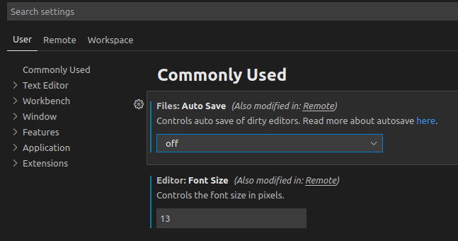
Pre-Configure VS Code settings
# settings.json
{
"files.autoSave": "afterDelay",
"editor.minimap.enabled": false,
"editor.renderIndentGuides": false,
"editor.fontSize": 13,
"workbench.colorTheme": "Default Dark+",
....
}
git diff docker/code-server/settings.json
+++ b/docker/code-server/settings.json
@@ -35,5 +35,6 @@
+ "files.autoSave": "off"
}

Slide 14
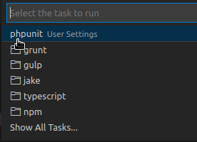
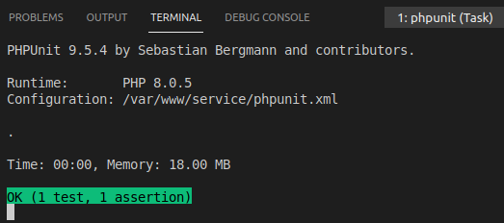
Can we run tasks?
# tasks.json (Ctrl + Shift + t)
{
// See https://code.visualstudio.com/docs/editor/tasks#vscode
"version": "2.0.0",
"tasks": [{
"label": "phpunit",
"type": "shell",
"problemMatcher": [],
"command": "phpunit.phar",
"options": {"cwd": "/var/www/service"},
"presentation": {
"showReuseMessage": false,
"echo": false,
"clear": true
}
]}
}

Slide 15
How about keyboard shortcuts?
# keybindings.json
[
{"key": "ctrl+shift+t", "command": "workbench.action.tasks.runTask"},
// switch file tabs, normally: ctrl+tab
{"key": "ctrl+[Backquote]", "command":
"workbench.action.quickOpenLeastRecentlyUsedEditorInGroup"},
{"key": "ctrl+[Backquote]", "command":
"workbench.action.quickOpenNavigateNextInEditorPicker",
"when": "inEditorsPicker && inQuickOpen"},
// close active file tab, normally: ctrl+w
{"key": "ctrl+e", "command": "workbench.action.closeActiveEditor"}
]
# Some keyboard shortcuts are exclusively reserved to the browser (e.g. ctrl+tab).
# With Chrome you can use “Menu -> Install code-server” to run code-server
as a Chrome App to bypass reserved keyboard shortcuts.

Slide 16
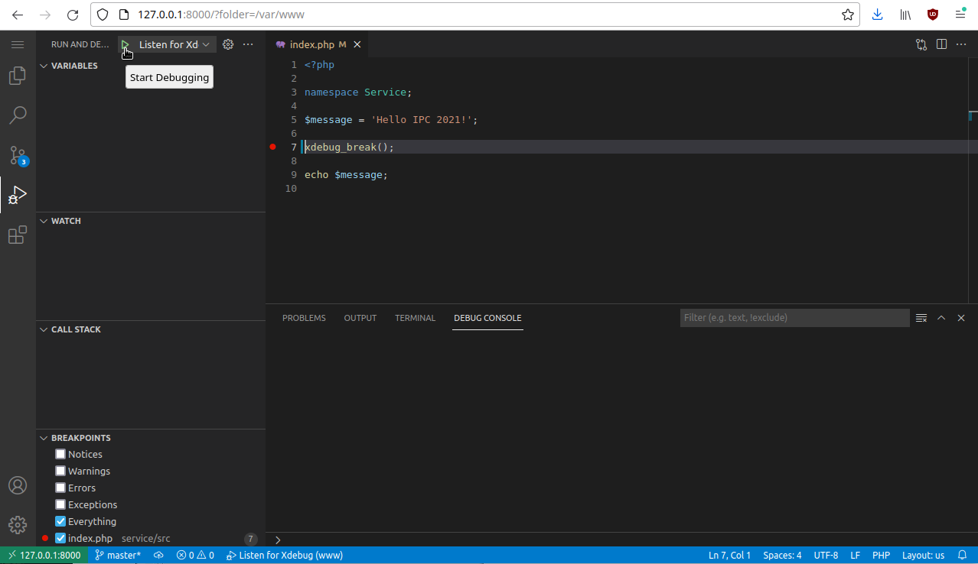
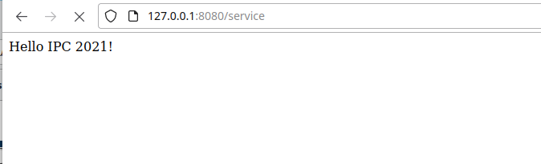
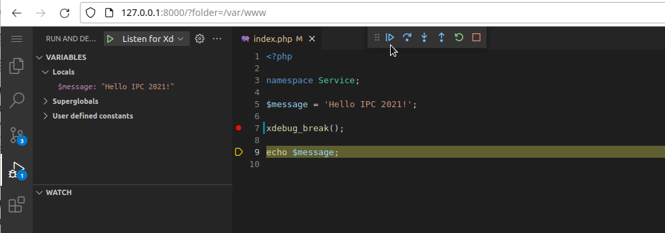
Debugging (xdebug)

Slide 17
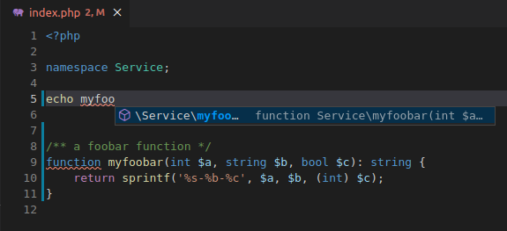
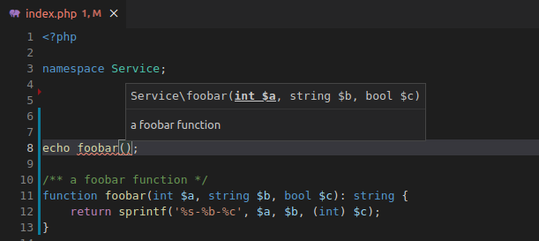
Auto-Completion (psalm language server)

Slide 18
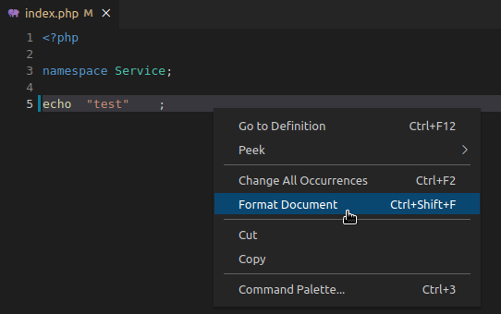
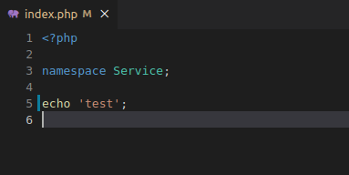
Auto-Formatting (php-cs-fixer)

Slide 19
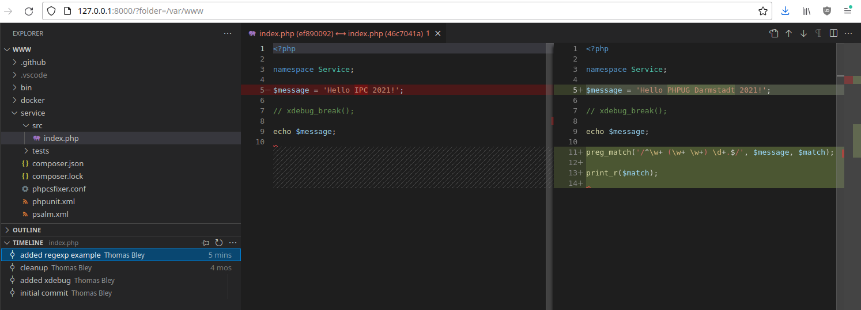
Git

Slide 20
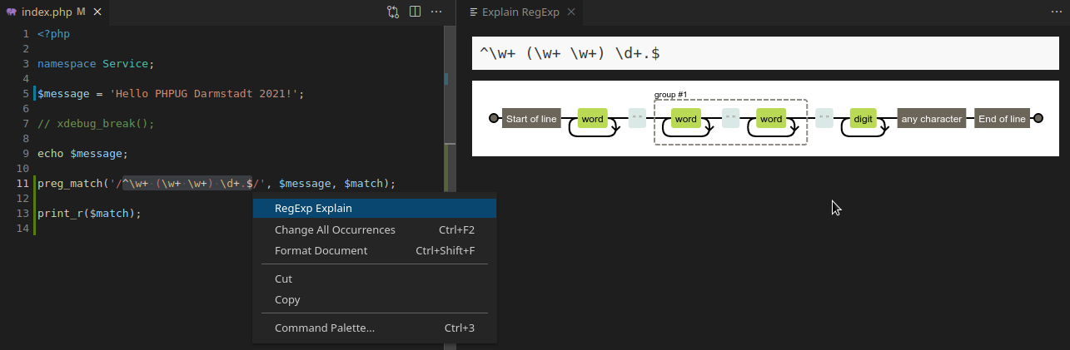
Regexp preview

Slide 21
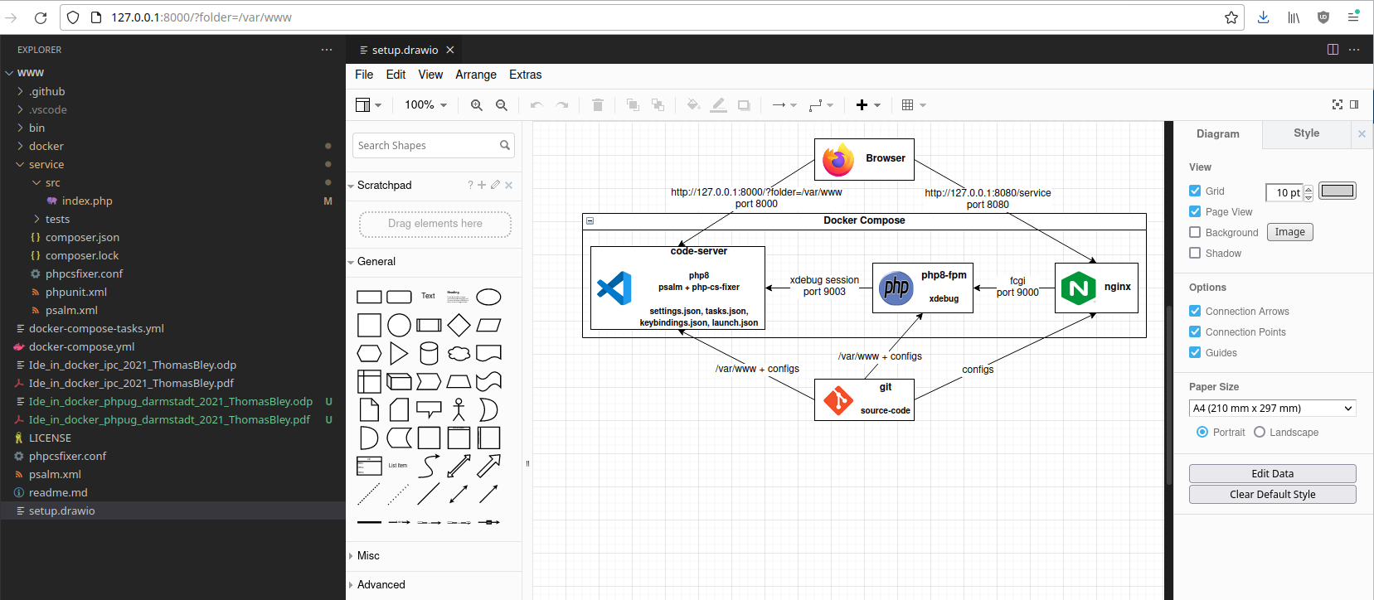
Draw.io

Slide 22
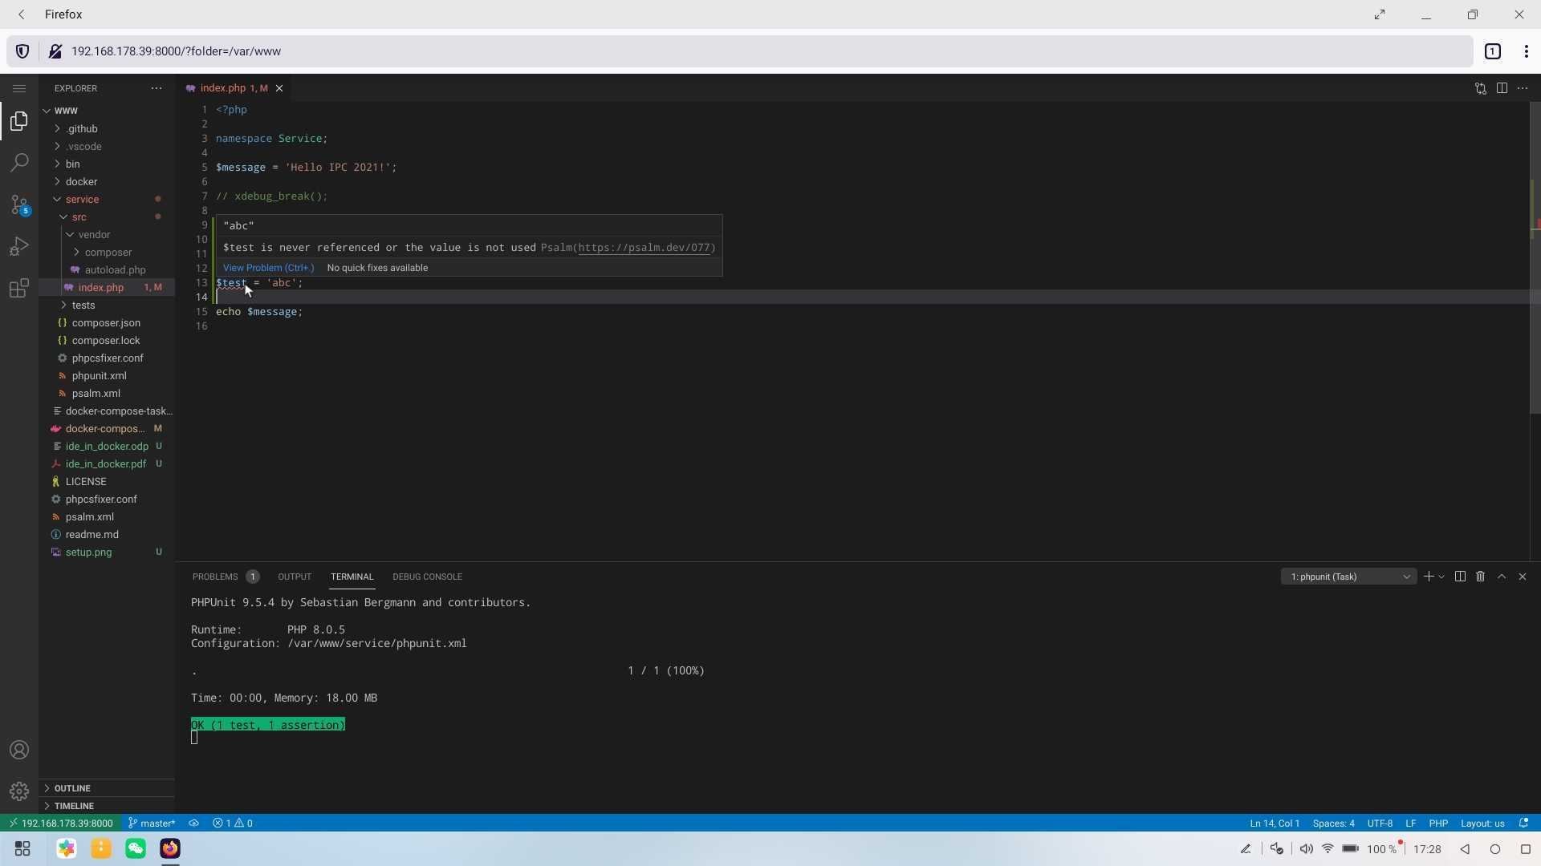
DEMO
Firefox 88 on Huawei P40 Desktop mode

Slide 23

Thanks for listening!
Thanks for listening!
Thanks for listening!
Questions?
slides and sources:
github.com/thomasbley/ide_in_docker
follow me:
twitter.com/thbley

