Slide 1
Getting Started with PHP-FFI
Thomas Bley, June 2021 @ ipc

Slide 2

About me
Senior PHP Developer
Linux, PHP, MySQL since 2001
studied at TU München
working for Bringmeister
in Berlin

Slide 3
What is PHP-FFI?
PHP Foreign Function Interface
PHP extension
requires PHP 7.4
currently experimental
allows
  loading of shared libraries (.so)
  calling C functions and accessing C data structures
  in pure PHP during runtime
requires converting PHP types to C types
source:
php.net/manual/en/intro.ffi.php
phpconference.com/blog/php-ffi-and-what-it-can-do-for-you/

Slide 4
PHP-FFI use cases
call C/C++ as shared libraries
  allows direct hardware access (e.g. webcams, GPU)
  gives more performance (e.g. image or video rendering)
  integrate databases that have no PHP integration (e.g. DuckDB)
call Go / Rust compiled as shared libraries
easier than writing PHP extensions
source: github.com/gabrielrcouto/awesome-php-ffi

Slide 5
What is Go?
programming language
designed by Google
statically typed
memory safety, fast garbage collection
more performance and concurrency
can be compiled as a shared library
➔ combining PHP and Go gives a lot of new opportunities
source: en.wikipedia.org/wiki/Go_(programming_language)

Slide 6
PHP-Example: Ackermann function
<?php
function ackermann(int $n, int $m): int {
if ($n == 0) {
return $m + 1;
} else if ($m == 0) {
return ackermann($n - 1, 1);
} else {
return ackermann($n - 1, ackermann($n, $m - 1));
}
}
echo ackermann(3, 11);
// time php -dopcache.enable_cli=0 ackermann.php # 12.8s
// time php -dopcache.enable_cli=1 ackermann.php # 4.8s
// time php -dopcache.enable_cli=1 -dopcache.jit_buffer_size=32M ackermann.php # 3.2s
source: en.wikipedia.org/wiki/Ackermann_function
rosettacode.org/wiki/Ackermann_function

Slide 7
Go-Example: Ackermann function
package main
import "C"
func main() {
println(ackermann(3, 11));
}
//export ackermann
func ackermann(n int, m int) int {
if n == 0 {
return m + 1
} else if m == 0 {
return ackermann(n-1, 1)
}
return ackermann(n-1, ackermann(n, m-1))
}
// time go run ackermann.go # 0.7s
// go build ackermann.go && time ./ackermann # 0.5s (C/C++/Rust: 0.2s)

Slide 8
Calling Go from PHP
// create ackermann.so and ackermann.h:
// go build -o ackermann.so -buildmode=c-shared ackermann.go
<?php
error_reporting(E_ALL);
$ffi = FFI::cdef('long ackermann(long n, long m);', __DIR__ . '/ackermann.so');
echo $ffi->ackermann(3, 11);
unset($ffi);
// time php -dffi.enable=1 ackermann.php # 0.5s
// cat ackermann.h | grep -E "ackermann|GoInt;|GoInt64"
// typedef long long GoInt64;
// typedef GoInt64 GoInt;
// extern GoInt ackermann(GoInt n, GoInt m);

Slide 9
Using complex data types
// php
$ffi = FFI::cdef('long ackermann(char* input);', __DIR__ . '/ackermann.so');
$result = $ffi->ackermann_json(json_encode([3, 11]));
echo json_decode(FFI::string($result));
FFI::free($result); // avoid memory leak
unset($ffi);
// go
import "C"
import "encoding/json"
//export ackermann_json
func ackermann_json(input *C.char) *C.char {
var params [2]int
err := json.Unmarshal([]byte(C.GoString(input)), &params)
if err != nil { return nil }
data, err := json.Marshal(ackermann(params[0], params[1]))
if err != nil { return nil }
return C.CString(string(data))
}

Slide 10
Checking memory leaks
// php
$ffi = FFI::cdef('long ackermann(char* input);', __DIR__ . '/ackermann.so');
for ($i=0; $i < 10000000) {
$result = $ffi->ackermann_json(json_encode([0, 1]));
FFI::free($result);
}
unset($ffi);
php -dffi.enable=1 ackermann.php &
while :; do pmap -x `pgrep php` | grep total; sleep 1; done
total kB 1489596 44040 16884
total kB 1489596 43864 16708
total kB 1489596 44568 17412
total kB 1489596 44048 16892
total kB 1489596 43896 16740
...

Slide 11
What is DuckDB?
embedded database (similar to SQLite)
optimized for analytical queries (OLAP)
optimized for large tables, large resultsets
column storage, 1 database = 1 single file
vectorized query execution engine
open source
very fast
but: no PHP extension available
source: duckdb.org/docs/why_duckdb

Slide 12
Using DuckDB
./duckdb
v0.2.6 8295e245d
D .open test.db
D PRAGMA enable_profiling;
D CREATE TABLE test1 AS SELECT * FROM read_csv_auto('test.csv.gz');
│ Total Time: 8.63s │
D SELECT count(*) FROM test1;
│ Total Time: 0.0166s │
│ count_star() │
│ 50000000 │
D DESCRIBE test1;
│ Field │ Type │ Null │ Key │ Default │ Extra │
│ customer_id │ INTEGER │ YES │ │ │ │
│ product_id │ INTEGER │ YES │ │ │ │

Slide 13
Getting started with DuckDB
download libduckdb-linux-amd64.zip
extract duckdb.h and libduckdb.so
C preprocessor directives are not supported in header files
  remove “#ifdef __cplusplus...#endif” from duckdb.h
  remove “DUCKDB_API ” from duckdb.h
  remove lines with “duckdb_bind_uint8”, “duckdb_bind_uint16”
FFI::cdef($header, $soLibrary) — Creates a new FFI object
FFI::new($type) — Creates a C data structure
FFI::addr($ptr) — Creates an unmanaged pointer to C data

Slide 14
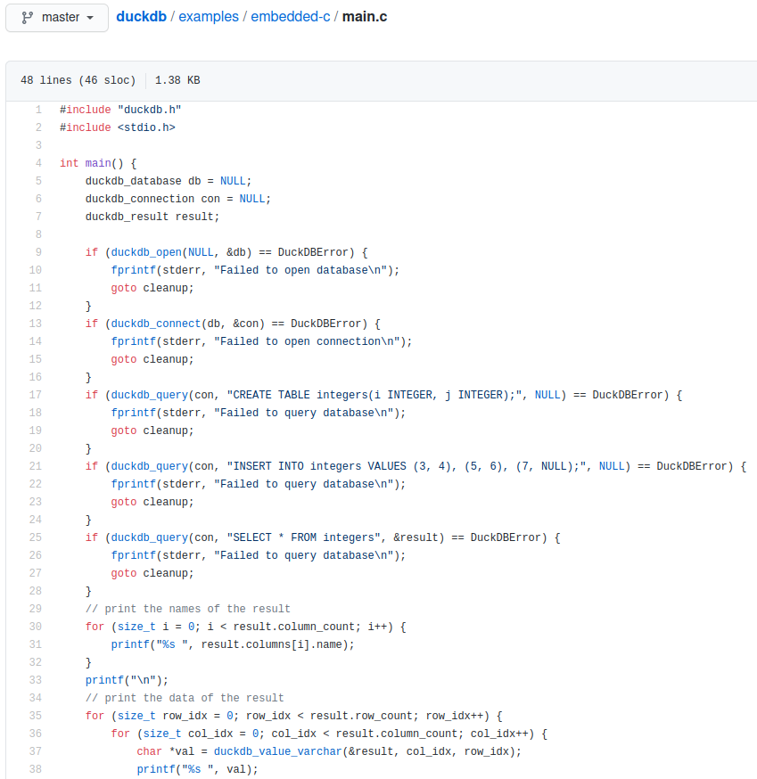
How to integrate DuckDB?
<?php
$ffi = FFI::cdef(
file_get_contents(__DIR__ . '/duckdb.h'),
__DIR__ . '/libduckdb.so');
$db = $ffi->new('duckdb_database');
$con = $ffi->new('duckdb_connection');
$result = $ffi->new('duckdb_result');
$ffi->duckdb_open(null, FFI::addr($db));
$ffi->duckdb_connect($db, FFI::addr($con));
$query = 'select current_date;';
$ffi->duckdb_query(
$con, $query, FFI::addr($result));
$val = $ffi->duckdb_value_varchar(
FFI::addr($result), 0, 0);
echo FFI::string($val);

Slide 15
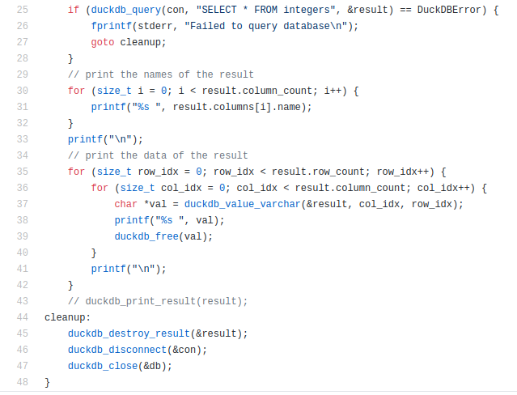
Cleanup resources
<?php
FFI::free($val);
$ffi->duckdb_destroy_result(
FFI::addr($result)
);
$ffi->duckdb_disconnect(FFI::addr($con));
FFI::free($con);
$ffi->duckdb_close(FFI::addr($db));
FFI::free($db);
unset($ffi);

Slide 16
DEMO

Slide 17

Thanks for listening!
Thanks for listening!
Thanks for listening!
Questions?
slides and sources:
github.com/thomasbley/php-go-integration
github.com/thomasbley/php-duckdb-integration

