Slide 1


Thomas Bley
Getting started with PHP on AWS Lambda
Application Development

Slide 2

About me
Senior PHP Developer
Linux, PHP, MySQL since 2001
studied at TU München
working for Bringmeister
in Berlin

Slide 3
What is AWS Lambda?
event-driven, serverless computing platform
a managed service that runs code in response to events
computing resources are automatically managed (scaling)
purpose: build smaller, on-demand applications that are responsive to events
starting a Lambda instance (VM) within 100ms of an event
now also available for PHP!
sources:
https://en.wikipedia.org/wiki/AWS_Lambda
https://aws.amazon.com/de/blogs/apn/aws-lambda-custom-runtime-for-php-a-practical-example/

Slide 4
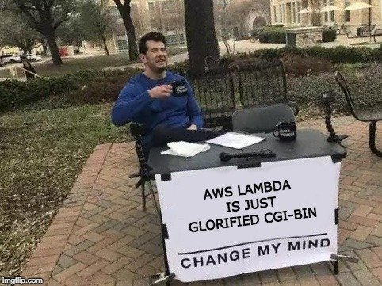
Serverless ≟ proprietary CGI

Slide 5
AWS Firecracker (microVM)
lightweight virtual machine for serverless computing
higher security level and isolation (uses own kernel, KVM)
decreases startup time (100ms)
decreases memory overhead (5MB)
increases hardware utilization
designed for short-lived workloads
sources:
https://firecracker-microvm.github.io/
https://fosdem.org/2019/schedule/event/containers_firecracker/attachments/slides/3188/export/events/attachments/containers_firecracker/slides/3188/Firecracker_as_a_container_runtime_FOSDEM2019_4_3.pdf

Slide 6
No longer required
building, shrinking, uploading containers
nginx, php-fpm
host or kernel updates
load balancers
auto-scaling groups
blue green deployments
over-provisioning
service discovery

Slide 7
Getting started
compile PHP binary (bootstrap layer)
composer.json, populate vendor folder (vendor layer)
create php files (application layer)
create zip files for php binary, php application, vendor folder
set up a IAM role in AWS
setup Lambda layers in AWS (upload zip files)
create Lambda function in AWS (upload zip file)
update Lambda function in AWS (upload zip file)
feels like how we deployed 10 years ago?

Slide 8
Compile PHP binary
# Build PHP for Lambda
FROM amazonlinux:2017.03.1.20170812 as builder
RUN sed -i 's;^releasever.*;releasever=2017.03;;' /etc/yum.conf && \
yum clean all && \
yum install -y autoconf bison gcc gcc-c++ libcurl-devel libxml2-devel openssl-devel
RUN curl -sL https://github.com/php/php-src/archive/php-7.3.1.tar.gz | tar -xz && \
cd php-src-php-7.3.1 && \
./buildconf --force && \
./configure --prefix=/opt/php/ --with-openssl --with-curl --with-mysqli --with-pdo-mysql \
--with-zlib --enable-mbstring --without-sqlite3 --without-pdo-sqlite --without-pear && \
make install
# Create runtime container for use with lambdaci
FROM lambci/lambda:provided as runtime
COPY --from=builder /opt/php/bin/php /opt/bin/php
# sources:
# https://hub.docker.com/r/lambci/lambda/
# https://github.com/akrabat/lambda-php/tree/2019-01-31-article/hello-world

Slide 9
Compile PHP binary: build & test
Compile php binary:
docker build -t lambda-php-runtime .
Test php binary:
docker run --rm --entrypoint /opt/bin/php lambda-php-runtime -v
docker run --rm --entrypoint /opt/bin/php lambda-php-runtime -m
docker run --rm --entrypoint /opt/bin/php lambda-php-runtime -r 'echo 0.7+0.1;'
docker run --rm --entrypoint /opt/bin/php lambda-php-runtime -r 'echo json_encode(0.7+0.1);'
Copy php binary from container to host:
docker run --rm --entrypoint bash lambda-php-runtime -c "cat /opt/bin/php" >bin/php

Slide 10
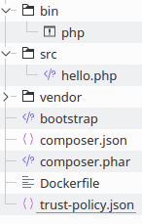
PHP Lambda Project
hello.php:
<?php
function hello($eventData)
{
print_r($eventData);
return 'Hello all!';
}

Slide 11
PHP Lambda Project: bootstrap
bootstrap:
#!/opt/bin/php
<?php
error_reporting(E_ALL);
require __DIR__ . '/vendor/autoload.php';
do {
$request = getNextRequest();
$handlerFunction = preg_replace('/[^a-zA-Z0-9_]+/', '', $_ENV['_HANDLER']);
require_once $_ENV['LAMBDA_TASK_ROOT'] . '/src/' . $handlerFunction . '.php';
$response = $handlerFunction($request);
sendResponse($request['invocationId'], $response);
} while (true);

Slide 12
PHP Lambda Project: testing
Local testing:
docker run --rm -v "$PWD":/var/task lambda-php-runtime hello '{"Hello": "bephpug"}'
START RequestId: 52fdfc07-2182-154f-163f-5f0f9a621d72 Version: $LATEST
Array(
[invocationId] => 52fdfc07-2182-154f-163f-5f0f9a621d72
[payload] => Array([Hello] => bephpug)
)
END RequestId: 52fdfc07-2182-154f-163f-5f0f9a621d72
REPORT RequestId: 52fdfc07-2182-154f-163f-5f0f9a621d72 Init Duration: 9.52 ms Duration: 2.04 ms Billed Duration: 100 ms Memory Size: 1536 MB Max Memory Used: 24 MB
"Hello all!"

Slide 13
Setup AWS Lambda
Create zip files (layers):
zip -r runtime.zip bootstrap bin
zip -r vendor.zip vendor/
zip hello.zip src/hello.php
source: https://aws.amazon.com/de/blogs/apn/aws-lambda-custom-runtime-for-php-a-practical-example/

Slide 14
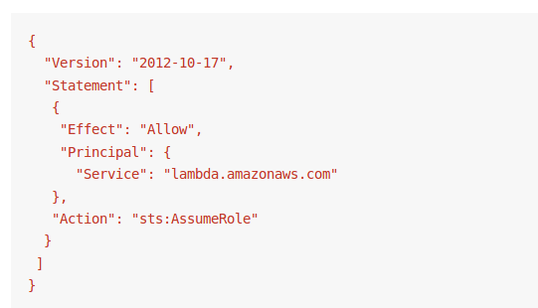
Setup AWS Lambda: IAM
trust-policy.json:
source:
https://aws.amazon.com/de/blogs/apn/aws-lambda-custom-runtime-for-php-a-practical-example/

Slide 15
Setup AWS Lambda: create layers
aws iam create-role \
--role-name LambdaPhp --path "/service-role/" \
--assume-role-policy-document file://trust-policy.json
aws lambda publish-layer-version \
--layer-name php-runtime --region eu-central-1 \
--zip-file fileb://runtime.zip
aws lambda publish-layer-version \
--layer-name php-vendor --region eu-central-1 \
--zip-file fileb://vendor.zip
source:
https://aws.amazon.com/de/blogs/apn/aws-lambda-custom-runtime-for-php-a-practical-example/

Slide 16
Setup AWS Lambda: create function
aws lambda create-function --function-name php-hello --handler hello \
--runtime provided --region eu-central-1 \
--zip-file fileb://hello.zip \
--role "arn:aws:iam::<given output from trust-policy upload>" \
--layers "arn:aws:lambda:<given output from runtime zip upload>" \
"arn:aws:lambda:<given output from vendor zip upload>" \
--memory-size 128 --timeout 5
source:
https://aws.amazon.com/de/blogs/apn/aws-lambda-custom-runtime-for-php-a-practical-example/

Slide 17
Setup AWS Lambda: deploy function
zip hello.zip src/hello.php
aws lambda update-function-code --function-name php-hello \
--zip-file fileb://hello.zip \
--region eu-central-1
source:
https://aws.amazon.com/de/blogs/apn/aws-lambda-custom-runtime-for-php-a-practical-example/

Slide 18
Setup AWS Lambda: execute function
aws lambda invoke --function-name php-hello \
--region eu-central-1 --log-type Tail --query 'LogResult' \
--output text --payload '{"Hello": "bephpug"}' \
output.txt | base64 --decode
cat output.txt
"Hello all!"
source:
https://aws.amazon.com/de/blogs/apn/aws-lambda-custom-runtime-for-php-a-practical-example/

Slide 19
Problems
Event loop
  you need to close your resources manually (!!)
  you need to take care for memory leaks (!)
Error handling
Logging (read-only file system, only /tmp is writable)
Caching
Memory limit, maximum execution time
Globals are not pre-populated ($_GET, $_POST, $_REQUEST, etc.)
Scaling PHP ≠ scaling databases

Slide 20
Problems: error handling
AWS Trigger | Invocation | Failure Behavior
API Gateway | Synchronous | API Gateway returns error to client
Kinesis Streams | Synchronous | Retry until success, blocks stream
Simple Notification Service, S3 Events, Simple Email Service | Asynchronous | Up to 3 retries, possible to configure a dead letter queue (SQS, SNS)
Simple Queue Service | Asynchronous | Event returned to queue, no blocking
source: https://docs.aws.amazon.com/lambda/latest/dg/retries-on-errors.html

Slide 21
Problems: memory limit
bootstrap:
#!/opt/bin/php
<?php
error_reporting(E_ALL);
require __DIR__ . '/vendor/autoload.php';
do {
$request = getNextRequest();
$handlerFunction = preg_replace('/[^a-zA-Z0-9_]+/', '', $_ENV['_HANDLER']);
require_once $_ENV['LAMBDA_TASK_ROOT'] . '/src/' . $handlerFunction . '.php';
$response = $handlerFunction($request);
sendResponse($request['invocationId'], $response);
} while (memory_get_peak_usage(true) < 83886080); // 80M

Slide 22
API Gateway handling
function hello($eventData)
{
$responseData = ...;
$response = [];
$response['isBase64Encoded'] = false;
$response['statusCode'] = 200;
$response['headers'] = ['Content-type' => 'application/json'];
$response['body'] = json_encode($responseData);
return $response;
}

Slide 23
Limitations
max. 3 GB RAM
max. execution time 15 min.
max. layers: 5
zip package: 50 MB (zipped), 250 MB (unzipped, incl. layers)
/tmp storage: 512 MB
Concurrent executions: 1000 (can be increased)
source: https://docs.aws.amazon.com/en_en/lambda/latest/dg/limits.html

Slide 24
Pricing
Number of requests
0.20 USD per 1M additional requests (1M requests for free per month)
Duration of requests (billing rounded to 100ms)
0.00001667 USD per GB-second (400k GB-seconds for free per month)
Example comparison (duration)
Lambda: 8 x 1 GB = 9.6 USD per day (if continuously running)
EC2: T3 Large 8 GB, 2 vCPU = 2.3 USD per day (on demand)
Other costs: CloudWatch, API Gateway, Data transfer
sources: https://www.ec2instances.info https://aws.amazon.com/lambda/pricing/

Slide 25
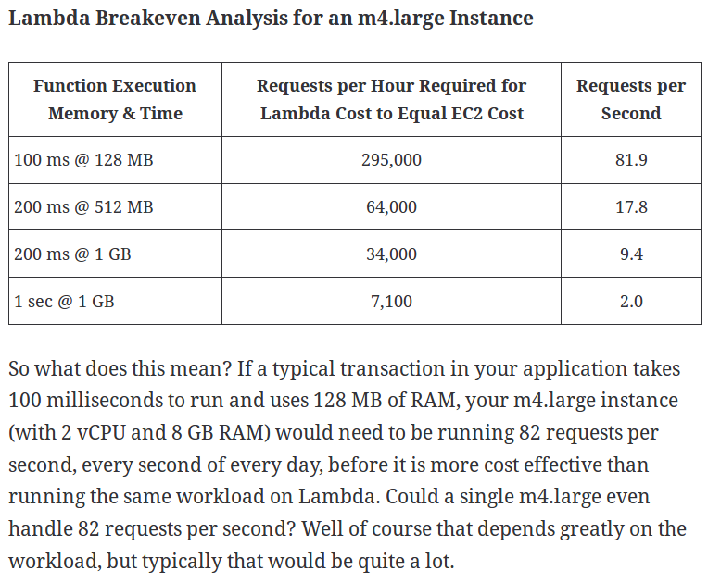
source: https://www.trek10.com/blog/lambda-cost/

Slide 26
Use cases
cronjobs (don’t pay for idle)
websites with unknown traffic spikes
event based workers (Kinesis, SQS, S3, etc.)
event based backend tasks (image resizing, creating pdfs, sending emails, etc.)
integration with database events, e.g. RDS Aurora:
CALL lambda_async('arn:aws:lambda:...', '{"operation": "ping"}');
SELECT lambda_sync('arn:aws:lambda:...', '{"operation": "ping"}');
source: https://docs.aws.amazon.com/AmazonRDS/latest/AuroraUserGuide/AuroraMySQL.Integrating.Lambda.html

Slide 27

Thanks for listening!
Questions?
slides and sources:
github.com/thomasbley/php-lambda

Slide 28
Further reading
How to operate reliable AWS Lambda applications
https://www.concurrencylabs.com/blog/how-to-operate-aws-lambda/
PHP JIT
https://wiki.php.net/rfc/jit
Using opcache for php-cli
https://tideways.com/profiler/blog/dodge-the-thundering-herd-with-file-based-opcache-in-php7
Disable eval()
https://github.com/mk-j/PHP_diseval_extension
Loop mode for php-cli
https://github.com/mnapoli/php-src/pull/2

