Slide 1

Thomas Bley
From a monolith to a microservice shop architecture
PHP UG Darmstadt June 2021

Slide 2

About me
Senior PHP Developer
Linux, PHP, MySQL since 2001
studied at TU München
working for Bringmeister
in Berlin

Slide 3
The Monolith
Magento 1 Enterprise: support was discontinued by Adobe, license costs
Large codebase with 1.8 mloc, developed over 10y years by 130 developers:
  high complexity, strong coupling, multiple API layers
  unused / unknown / bad code, hard to maintain, bugs
  security issues, not designed for GDPR
  many frameworks: Magento Varien, Zend Framework 1, Symfony 2, Laravel 5,
  ReactPHP, node.js
  no Composer
Performance issues:
  add product to cart 400 queries, order placement 3.2k queries (5 transactions)
  slow queries, deadlocks, memory limit issues
  Admin login >60s, single order search in Admin 15s
  database designed by Entity–attribute–value model (big joins)
  aggregation tables filled synchronously
➔ difficult to scale the business

Slide 4
The Monolith #2
Tests:
  coverage <10%, require 7 GB database dump
  many tests broken, only run locally, CI only used for deployment
  mostly manual testing
Productivity:
  slow development of new features
  analyzing production issues very complex
  updates only applied manually
Multiple sources for product data, mostly not in sync:
  Database
  Solr, Algolia
Small team: 5 developers
Developers not happy, Management not happy, Customers not happy with the shop

Slide 5
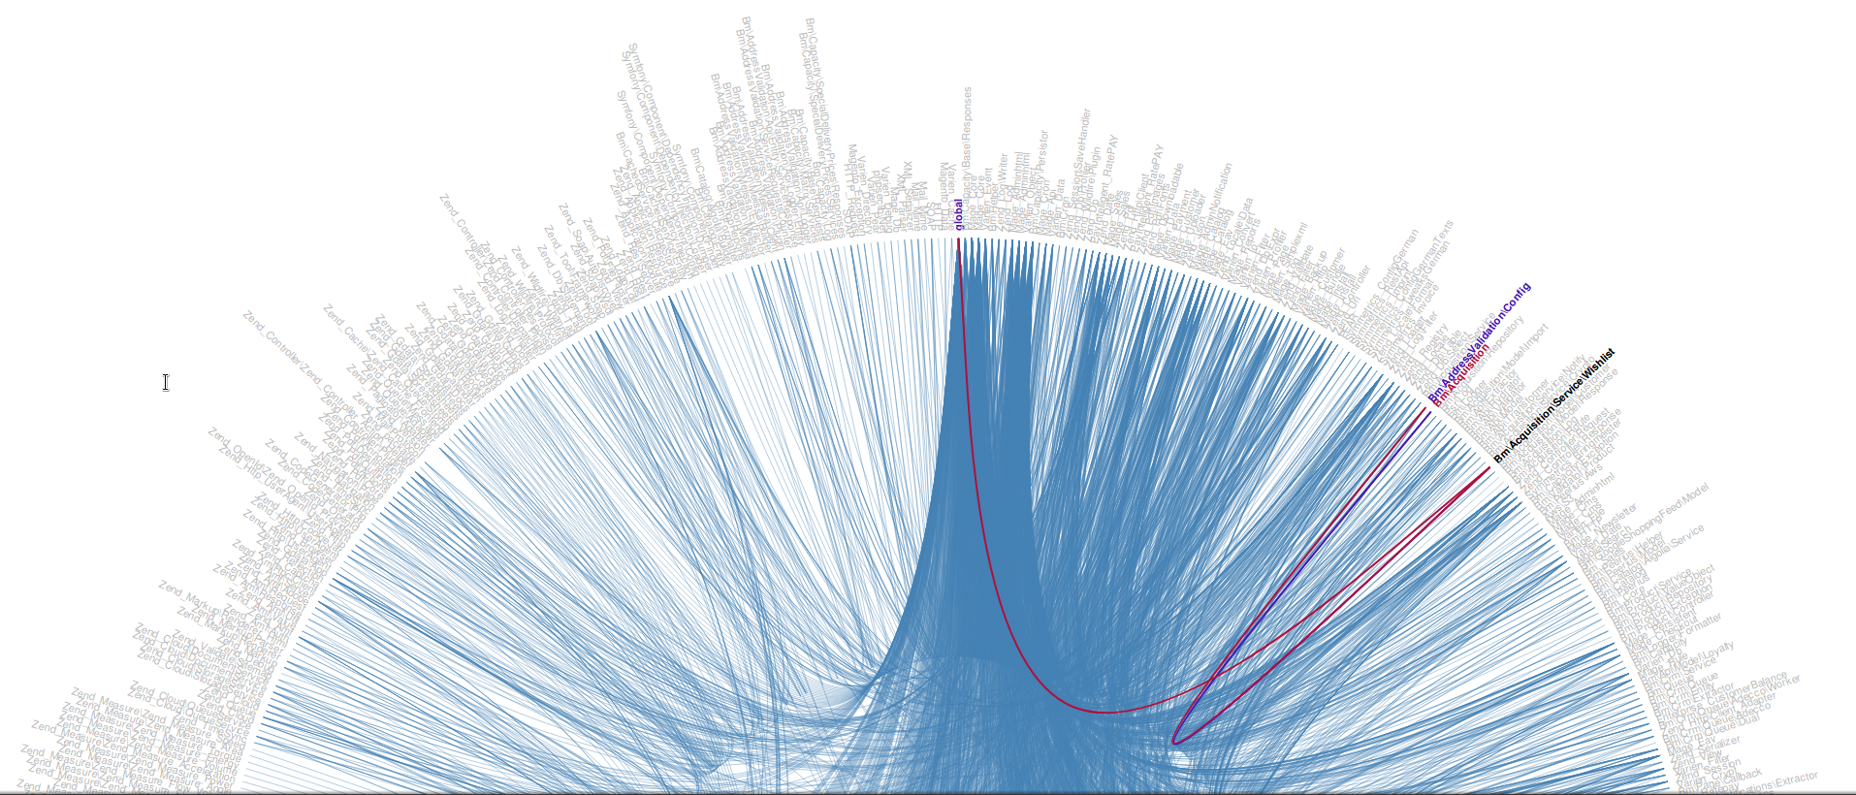
How does the monolith look like?

Slide 6
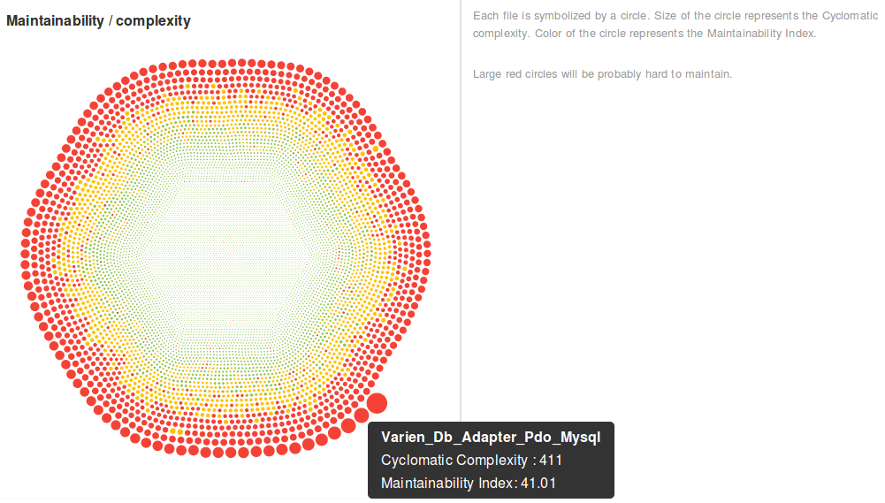
How complex is it?

Slide 7

CI/CD, Operations

Slide 8
Why microservices?
Smaller code base to work on
  easier to develop, easier to change, easier to maintain
  less complexity, focus on problem solving
More options for databases and programming languages
Easier to split work on multiple teams
Hard system boundary with standard communication between services
Limit impact of bugs and failures
Isolation of data
  less complexity in data storage
  more complexity to join data

Slide 9
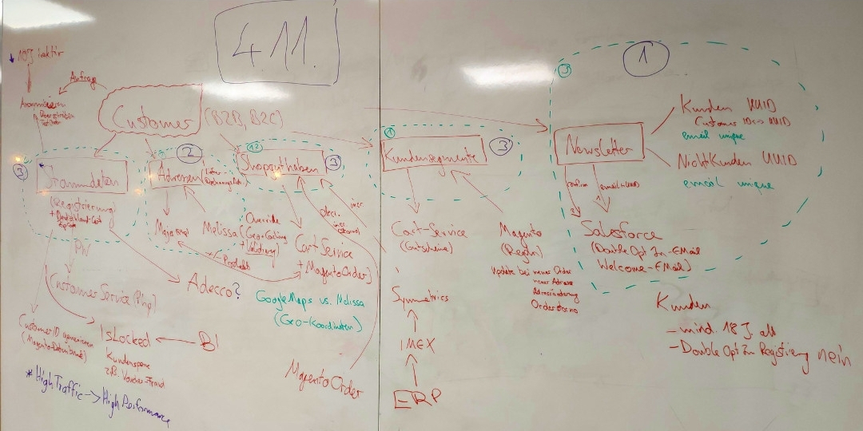
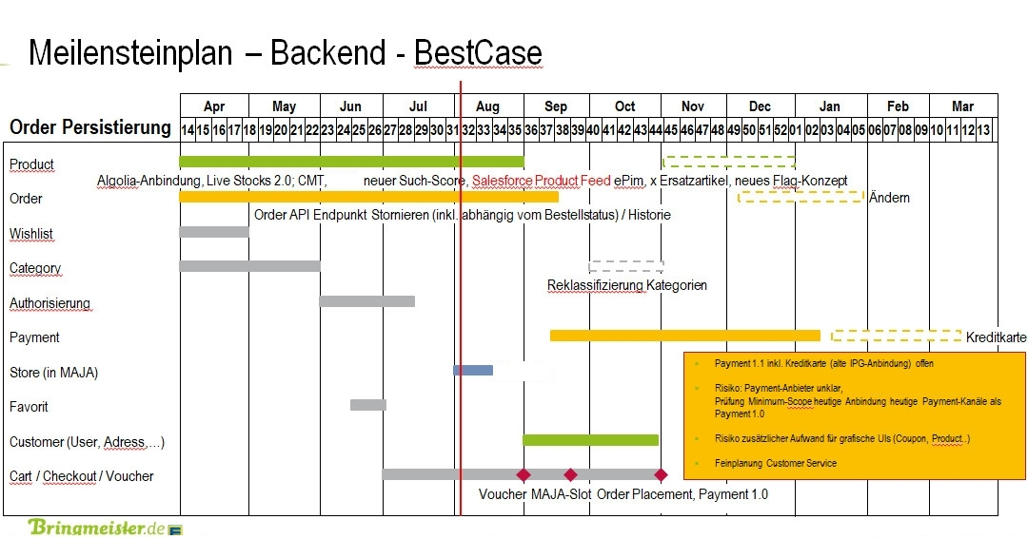
Explaining the project to developers
Explaining the project to management

Slide 10
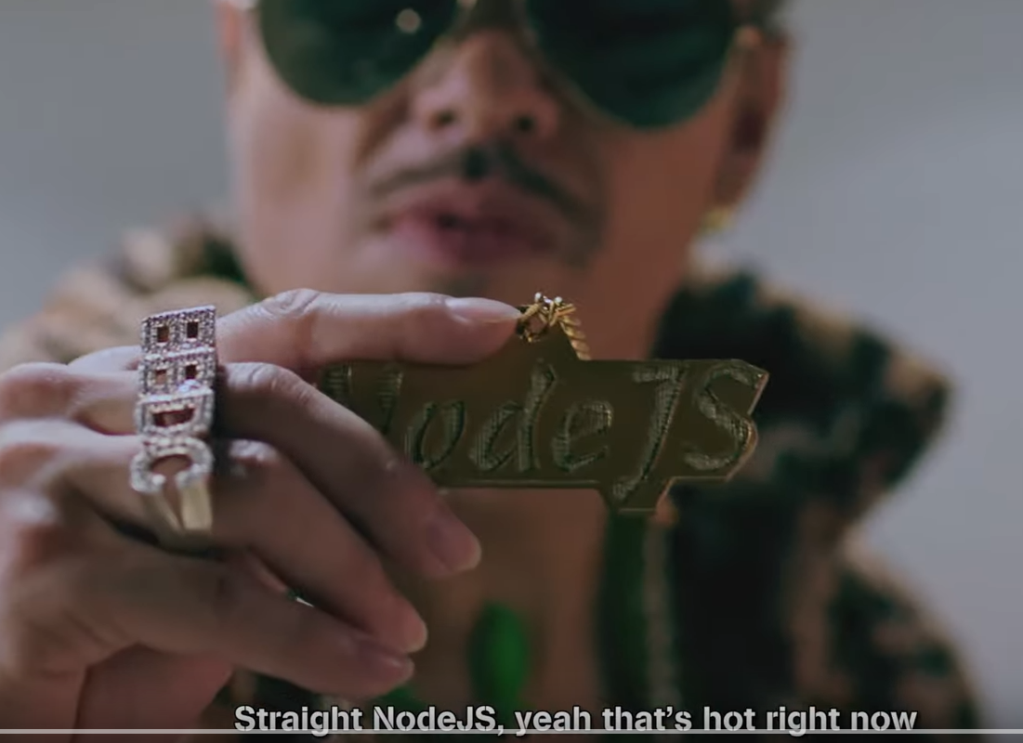
Define the future architecture
We decided to stay with PHP and MySQL
most experience, all required libraries and SDKs available, easier to port from PHP to PHP
Keep existing server infrastructure
No fullstack framework
➔ use our own mini-framework (200 loc)
Write queries and schema definitions directly in SQL, no ORM, reduce joins by using JSON columns, no foreign keys
Use JWT instead of sessions
Single Monorepo for all services, each service with own code base, own database, own composer.json, etc.
All product data in Algolia
SOLID, Kiss
source: https://www.youtube.com/watch?v=fCt2_AsCWKI
100% test coverage, keep Behat tests
Static code analysis with Psalm
Enforce coding styles with PHP-CS-Fixer
new CI/CD with Bitbucket Pipelines

Slide 11
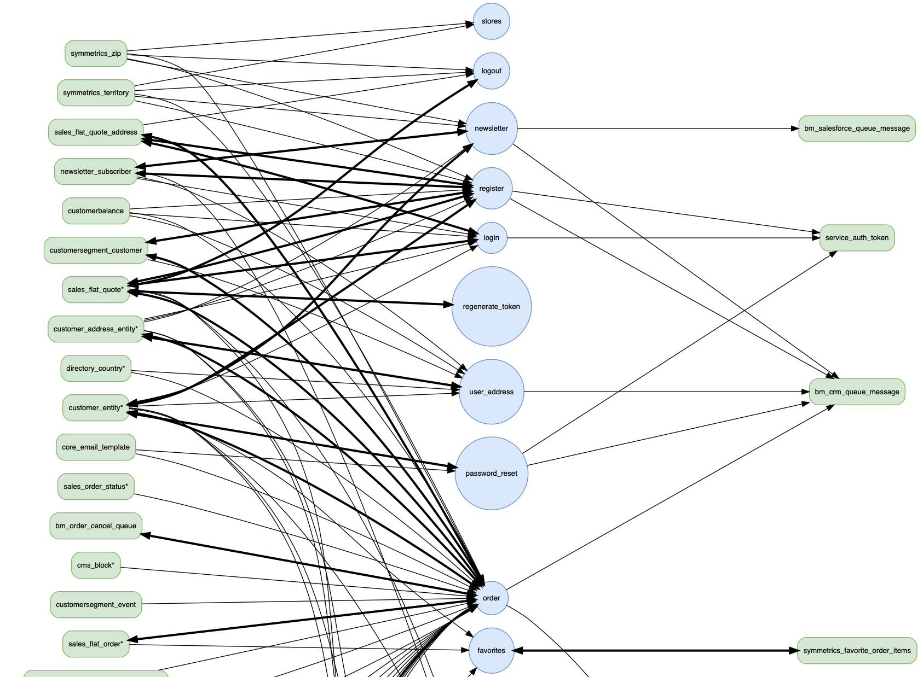
Analyze dependencies on database level

Slide 12
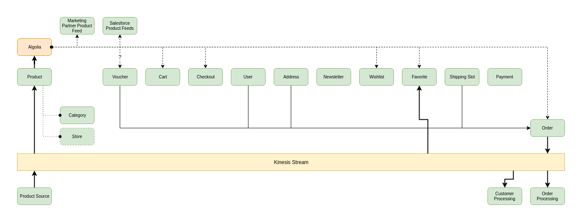
Identify services

Slide 13
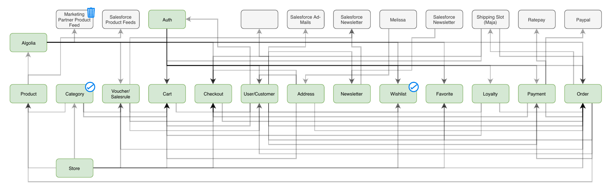
Start with easy services

Slide 14
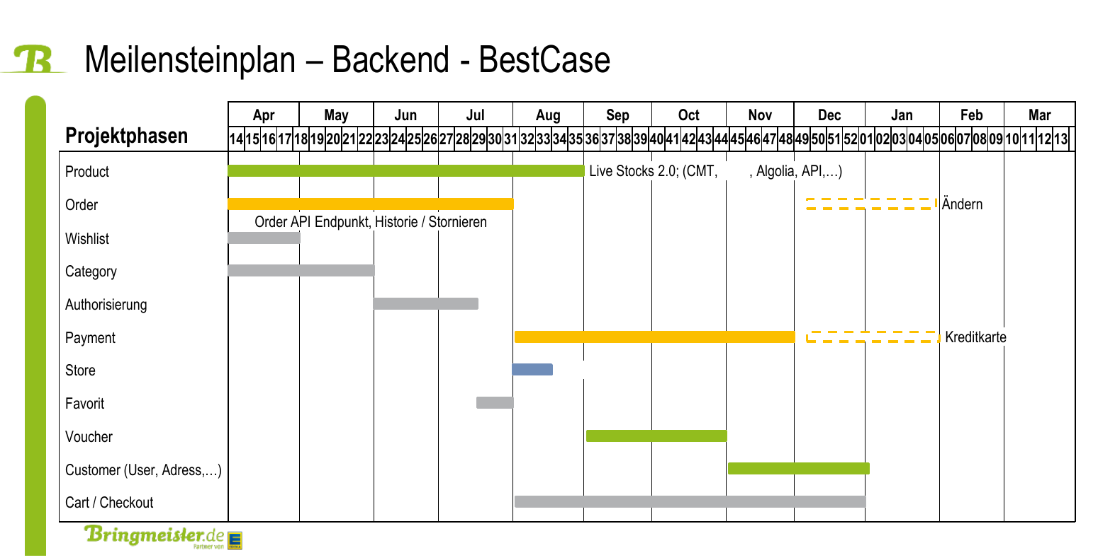
Implement and launch one by one

Slide 15
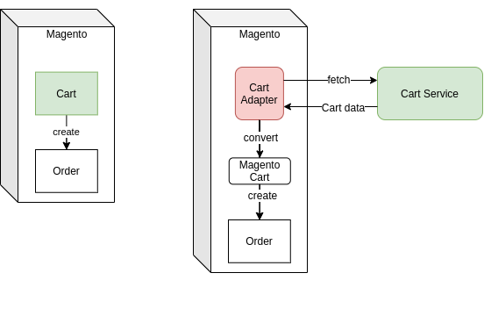
Build adapters to cut out components with strong dependencies
Before:
After:

Slide 16
Communication between Microservices and external providers
Synchronous using REST, load balancer (strong consistency)
  Customer master data, addresses
  Cart, Vouchers
  Product data
  Payment providers
Synchronous using SOAP (strong consistency)
  Legacy systems (tour planning)
Asynchronous using Events (Kinesis)
  Orders, Logging
Asynchronous using REST and queues
  external providers (CRM, Customer Support systems, etc.)
Forward customer’s JWT token between services

Slide 17
Data migration (EAV ➔ JSON)
Using SQL to copy data from old schema to new schema:
INSERT INTO customers.customer (email, attributes, created)
SELECT * FROM magento.customer_entity
LEFT JOIN magento.customer_entity_varchar as firstname on
firstname.entity_id = customer_entity.entity_id and firstname.attribute_id = 5
LEFT JOIN magento.customer_entity_varchar as lastname on
lastname.entity_id = customer_entity.entity_id and lastname.attribute_id = 7
LEFT JOIN magento.customer_entity_datetime as birthdate on
birthdate.entity_id = customer_entity.entity_id and birthdate.attribute_id = 11
SET email = customer_entity.email,
attributes = json_object(
'first', firstname.value,
'last', lastname.value,
'birth', date(birthdate.value),
'orders', (select count(*) from magento.sales_flat_order
where customer_id = customer_entity.entity_id)
),
created = customer_entity.created_at;

Slide 18
Data anonymization
Using a separate database and views to provide anonymized production data:
SELECT * FROM customers.customer WHERE id = 1234;
id: 1234
email: foo.bar@baz.com
attributes: {"first": "Thomas", "last": "Bley", "birth": "1930-02-01", "orders": 42}
created: 2021-05-06 12:41:11
CREATE or REPLACE VIEW customers_anonymized.customer AS
SELECT id,
concat('invalid_', id, '@bringmeister.de') AS email, # invalid_1234@bringmeister.de
json_object(
'first', concat('first_', id), 'last', concat('last_', id), # first_1234, last_1234
'birth', '1980-01-02', 'orders', attributes->>"$.orders" # 1980-01-02, 42
) AS attributes,
created
FROM customers.customer;

Slide 19
Results
Project finished in time and in quality (Mar - Nov 2019)
10 microservices, 3 admin interfaces
99.99% test coverage with unit and integration tests
Code size reduced to 100 kloc (coming from 1.8 mloc)
Data size in database reduced by 80%
System performance and revenue significantly increased
Hardware costs reduced by 50%
External security audit passed
Tests, Build and Deployment in < 10 minutes
Development of new features and maintenance much quicker and easier
Developers happy, Management happy, Customers happy with the shop

Slide 20

Thanks for listening!
Questions?
download slides:
TODO

