Slide 1


Freight Out Classification Decision

Slide 2
Background
JUUL is undergoing financial statements audit for FY 2018 and would like to comply with SEC rules since Altria may have to disclose JUUL’s financial statements under it’s SEC filings
US GAAP/SEC guidance says that all costs directly attributable to production of goods shall be included in COGS; there is no bright line test
JUUL does not include cost of supply chain team (overheads) that is directly attributable to production of goods
JUUL includes Freight Out (cost to transport goods to customers/distributors) in COGS
JUUL may consider including cost of directly attributable supply chain costs to the manufacturing process from G&A to COGS / Inventory to begin recording it as an overhead related to the production of inventory
This deck provides the options and cost impact of a) electing to keep Freight Out as a COGS item, or b) treating Freight Out as a Selling Expense going forward
Notes:
2

Slide 3
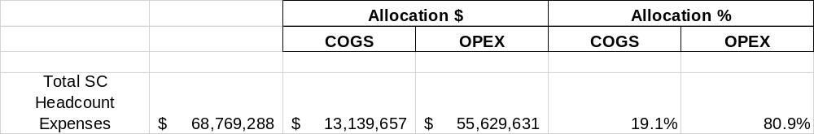
Supply Chain Headcount Expense
Based on a classification review of the Supply Chain related headcount cost, Accounting has determined $13.1 million of the cost pool would be reclassified as an Inventory related overhead for 2018
  Since the company finished 2018 with 90 days of inventory on hand, 25% of this cost would be capitalized as part of inventory value ($3.3 million)
  75% of this cost pool would be reclassified to COGS (P&L) in 2018 ($9.9 million)
Notes:
3

Slide 4
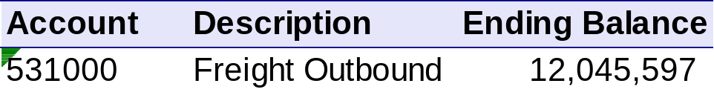
2018 Freight Out Cost
At the same time, Freight Out expense for 2018 was $12 million, which would potentially be shifted from COGS to Selling Expense providing a net $2 million increase to Gross Margins in 2018
If the company elects to keep Freight Out classified as a COGS item the net change for 2018 would be a reduction in gross margin of $9.9 million
Accounting feels either classification is justifiable, PwC has concurred with that position based on the fact pattern behind freight mechanics at JUUL
Notes:
4

Slide 5
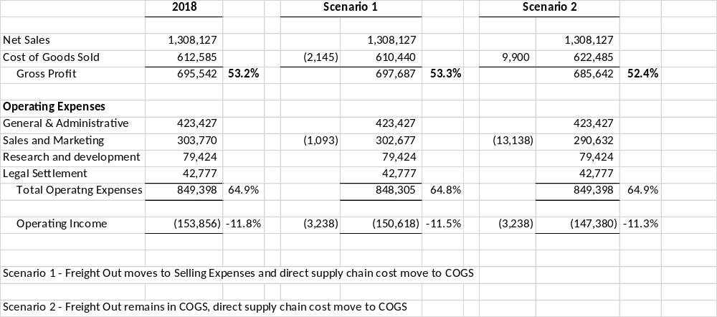
Impact of Both Scenarios on 2018 Financials
Notes:
5

Slide 6
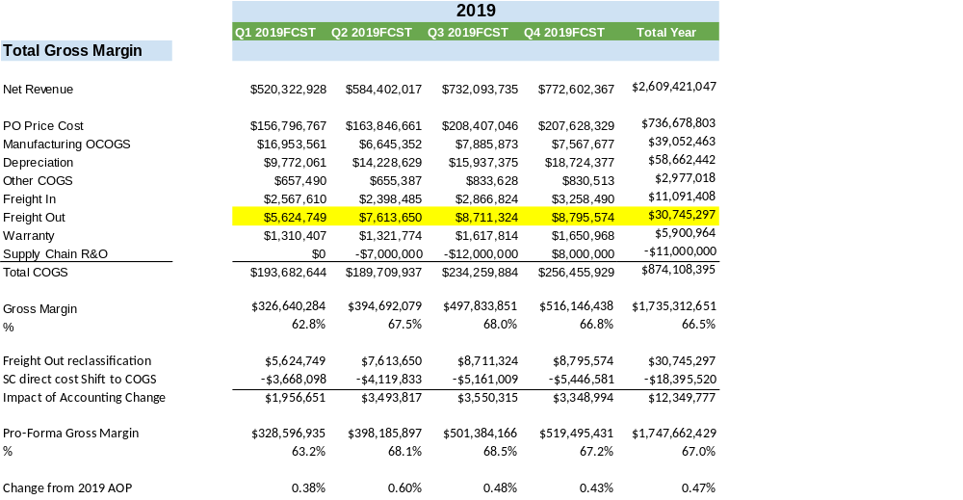
Impact to 2019 Projections – Assuming Freight Out Reclassification
Notes:
6

Slide 7
Summary
For 2019 the net impact of reclassifying Freight Out expense to below the Gross Margin line is roughly 47 bps improvement
Assuming Supply Chain demonstrates operating leverage over headcount as the company grows this benefit should increase in subsequent years as freight out expense would grow at a faster rate than headcount
Decision to be made by Exec team is what is the preference on go forward treatment knowing any changes in the future would require significant justification to change and trigger retroactive restatements
Notes:
7

