Slide 1
Business Review For
Endo Pharmaceuticals Inc.
January 22, 2004

Slide 2
Participants
Endo Participants
Daniel Carbery
Jill Connell
Lisa Walker
Pat Comley
Anne Keyser
UPS-SCS Participants
Tim Quinn
Kim Kohler
Ken Wood
Jen Trone
Mike Glass
Suzanne Young
Kim Legg
Becky Lovin

Slide 3
Agenda
Introductions 10:00 – 10:15
Where we left off 10:15 – 10:30
Business Challenges 10:30 – 10:45
Quality Assurance/Regulatory 10:45 – 11:15
CSOS 11:15 – 11:30
IT Update 11:30 – 11:45
Sales Data 11:45 – 12:00
Lunch 12:00 – 12:30
Memphis Distribution 12:30 – 1:00
Client Services 1:00 – 1:30
Next 6 Months 1:30 – 2:00
Open Discussion 2:00 – 2:30

Slide 4
Where we left off…
Oxycodone ER Tentative Approval
Future Warehouse Needs
Work Instruction Completion Status
Error Log Research and Conversion
Continue Success in Maintaining Low Error Count
Assist Endo in achieving their sales goal for the year
Moving Forward with CSOS Project
A/R Reconciliation Projects

Slide 5
Quality Assurance

Slide 6
Quality Assurance
UPDATE FROM LAST REVIEW ITEMS
Resources…Significantly augmenting our compliance resources throughout the country (update: complete)
Audit Program…Enhancing our program to include Corporate Audit of each facility once per year (update: complete)
Training Program…Enhancing our program to provide different modules for different audiences (update: on- going)
Regulatory…Revised draft Regulatory Manual 75% complete. Corporate review and training to be scheduled. (update: currently ~99% complete)

Slide 7
Quality Assurance
RESOURCES: Staffing Update
09/01/03 Sue Maebert Young, East District QA Manager (Newark)
Kathy Mendala, Client Services QA Supervisor (Newark)
10/01/03 Joe Rokita, QA Supervisor, Harrisburg DC
10/20/03 Lisa Stenta, Document/Data Control Administrator (Newark)
11/01/03 Lisa Marianni, QA Business Analyst (Atlanta)
01/01/04 Valerie Hannig & James Channel, Food Compliance Supervisors (Newark DE and Ontario CA)

Slide 8
Quality Assurance
CURRENT INITIATIVES
Documentation – Optimization and centralization of Document Control function (Coordinator), SOP Revisions, WI Reviews/revisions.
Audits- Internal QA audit program expansion to Client Services, and addition of walk-through inspections.
Training- Program optimization, including intranet based modules, standardized training content/format, and documentation/records.

Slide 9
Quality Assurance
CURRENT INITIATIVES
Metrology – Equipment calibration: Centralized program implementation
Facility Validation - Summer mappings complete, repairs being made as necessary, winter mappings underway.
Consistency Across Sites – Critical review of procedures and processes across the United States at various DCs
Computer Validation - (LMS- next slide), PKMS- ongoing, other projects under evaluation & consideration

Slide 10
LMS System Validation
  LMS System Validation Status
  LMS Audit Trail is completed and was implemented December 1
  LMS SOPs will be implemented January 30
  With implementation of SOPs, Validation deviations will be addressed
  Validation Final Report is drafted, but cannot be signed until SOP deviation is completed
  Validation Final Report will be sent out for final approval February 1

Slide 11
Information Technology

Slide 12
Information Technology
SAP Upgrade…Returns testing completed
Code Integration…Integrating U.S. and Canadian Code

Slide 13
CSOS Update

Slide 14
CSOS UPDATE
DEA expected to approve program Q2 2004
Software vendors have completed encryption based on current specification requirements
UPS has submitted a business case to receive development funding

Slide 15
Business Challenges
Oxycodone ER launch
Product management due to excessive wholesaler orders
Managing orders to quarterly/year end sales number
Inbound release process
Destruction/Returns process
Shipment Security Issues
Recall of MSER Lot TP168A

Slide 16
Sales Data

Slide 17
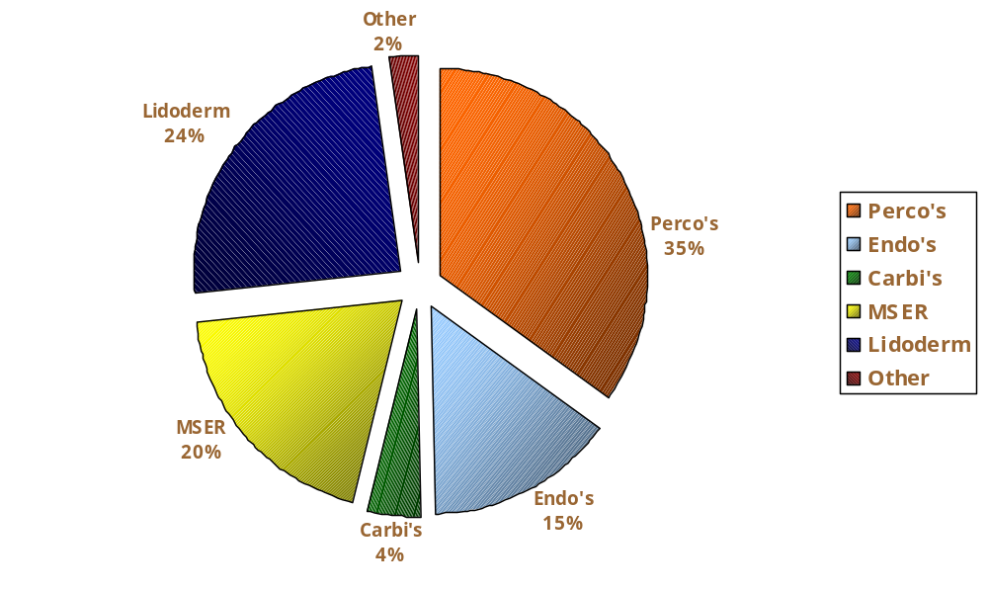
Sales By Product
Gross Invoice Amount $454,772,093.38
Notes:
Perco's
158,814,386
Endo's
67,223,933
Carbi's
18,688,641
MSER
89,251,763
Lidoderm
110,758,960
Other
10,034,410

Slide 18
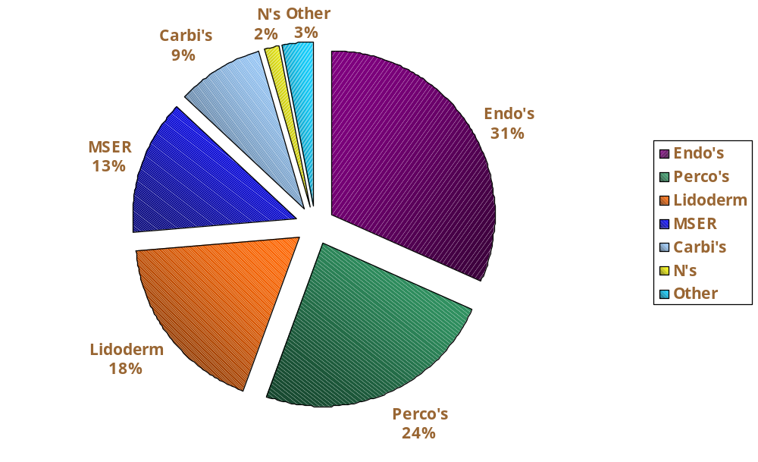
Sales by Unit
Invoiced Unit Quantity: 5,096,601
Notes:
Endo's Perco's
1,606,856 1,226,173
Lidoderm MSER
922,466 670,741
Carbi's N's
437,378 77,748
Other
155,239

Slide 19
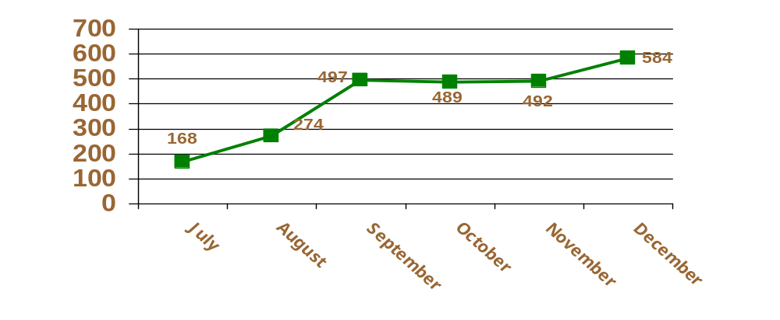
Patient Assistance Orders
Total PAP Lines Shipped: July 2003 - December 2003
2,504 Total PAP Lines

Slide 20
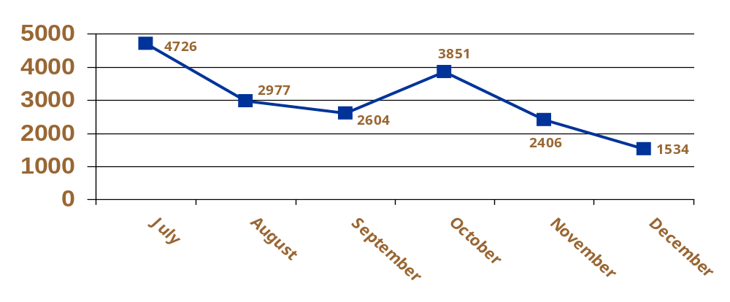
Total Orders
Total Orders Shipped: July 2003 - December 2003
18,089 Total Orders

Slide 21
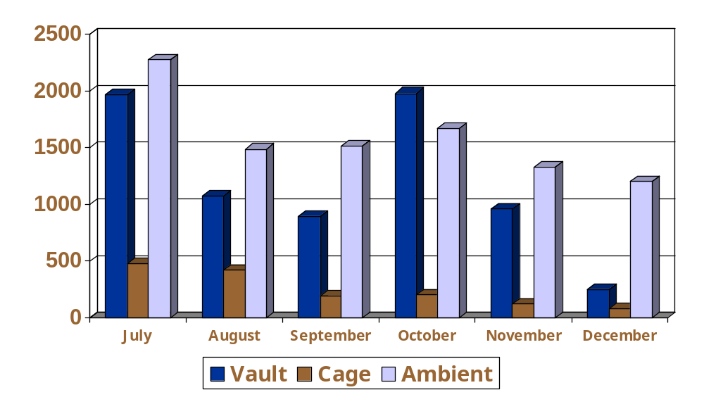
Total Orders By Type
Total Orders Shipped: July 2003 - December 2003
Vault 7,131
Cage 1,483
Ambient 9,484

Slide 22
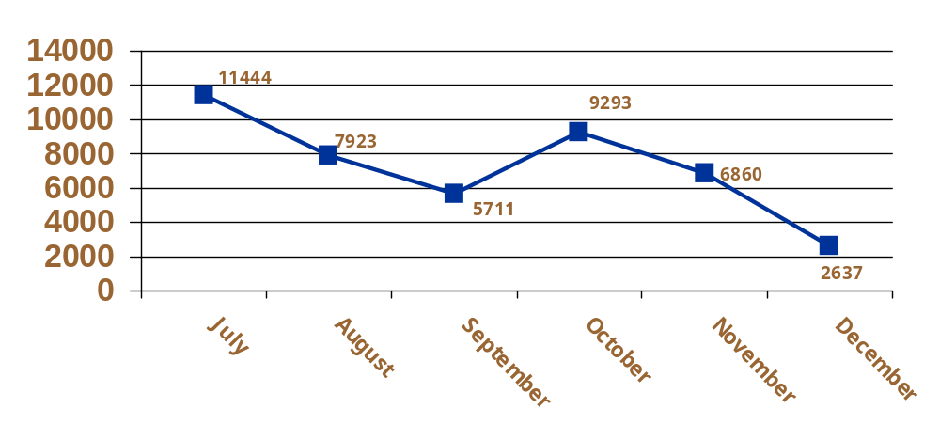
Total Lines
Total Lines Shipped: July 2003 - December 2003
43,868 Total Lines

Slide 23
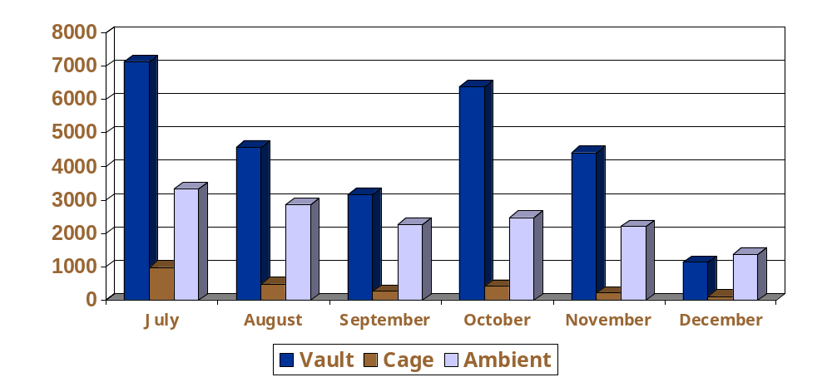
Total Lines By Type
Total Lines by Type: July 2003 - December 2003
Vault 26,807
Cage 2,531
Ambient 14,530

Slide 24
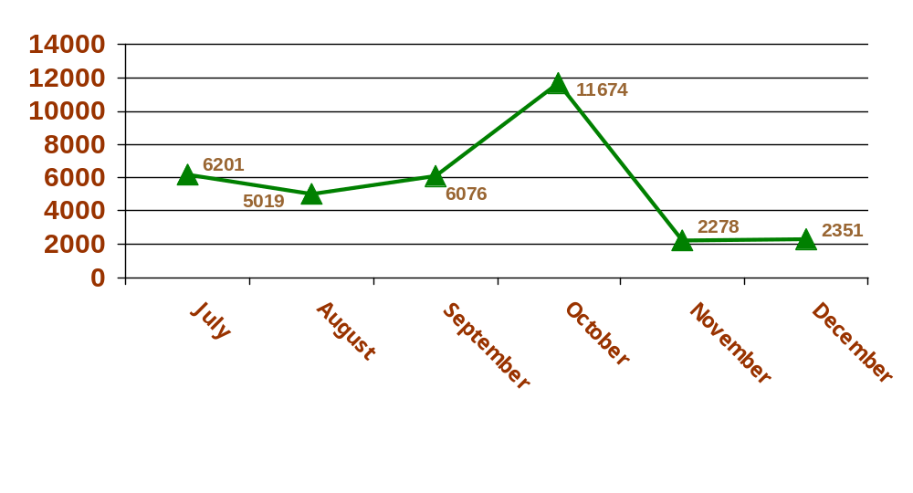
Returns
Total Return Units: July 2003 - December 2003
33,599 Total Units

Slide 25
Memphis Operations / QA

Slide 26
Significant Events
Oct ‘02 Endodan QA shipment investigation closed by QA
Jan ‘03 Lidoderm QA shipment investigation closed by QA
Re-trained all Endo DC associates on Endo work instructions
Re-design of Sector 4 / 5 layout to account for LTL volume completed
Storage solution for QQ product finalized.
  Vault Product was transferred to DE DC
  Lidoderm product was received at ATL DC
McKesson RDC order fulfillment began
Increased presence of QA audits assist in Error Log reduction

Slide 27
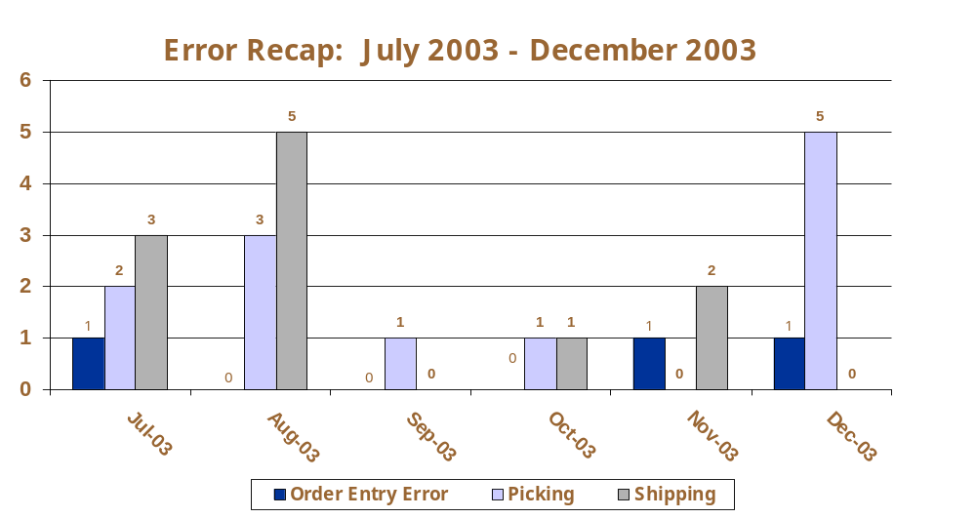
Error Recap

Slide 28
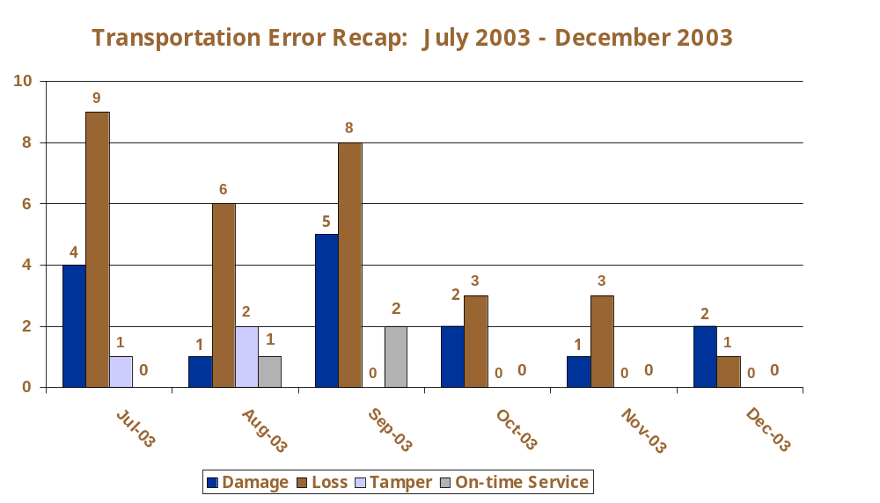
Detailed Transportation Errors

Slide 29
Memphis Corrective Action and Key Changes Summary
LTL Volume:
  MDC instituted 5 a.m. receiving time-frame in March ‘03
  New facility layout complete
  McKesson RDC transfers began. Reduce order volume in vault and ambient
  McKesson transfer increased pallet pick processes
  Shifted Emery volume to FedEx Freight 2-Day Guarantee Service

Slide 30
Memphis Corrective Action and Key Changes Summary
Transportation Errors:
  New pallet shippers for LTL shipments
  Change in Carrier – Emery to FedEx Freight for Expedite
Picking / Packing / Shipping Errors:
  “Quality vs. Production”
  New Client Work Instructions implemented and trained
  Increased Training and Accountability
  Continue Active Blind Cycle Counts for Vault, Cage, and Ambient
  Order is packed after it is checked – sealed with H-tape process.
  Full RF picking (Lot/Exp. enabled)
  Red List items completed
  QC Check Process continues at 100%

Slide 31
Client Services

Slide 32
Customer Service
Significant Events
Endo Staffing Changes
Recall of MSER Lot TP168A
McKesson RDC
Product Management
Wholesaler Management
Promotions/Allocations
SAP Testing
KAI/Teikoku/Product Complaints
Indirect Returns/EDI Indirect Returns
Error Log Conversion and Success
New Product’s
Updated Work Instructions

Slide 33
Telephone Statistics
17,906 calls answered in from July through December 2003
Total number of abandoned calls: 21 (0.0012%)
  GOAL: Not to exceed 2% of total calls
Average speed of answer: 6.5 seconds
  GOAL: Not to exceed 8 seconds

Slide 34
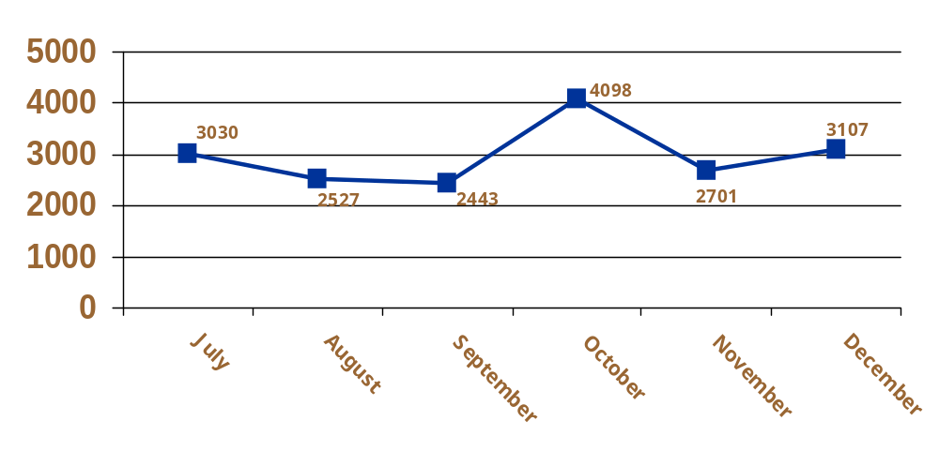
Inbound Calls
Phone Calls Received: July 2003 - December 2003
17,906 Total Calls

Slide 35
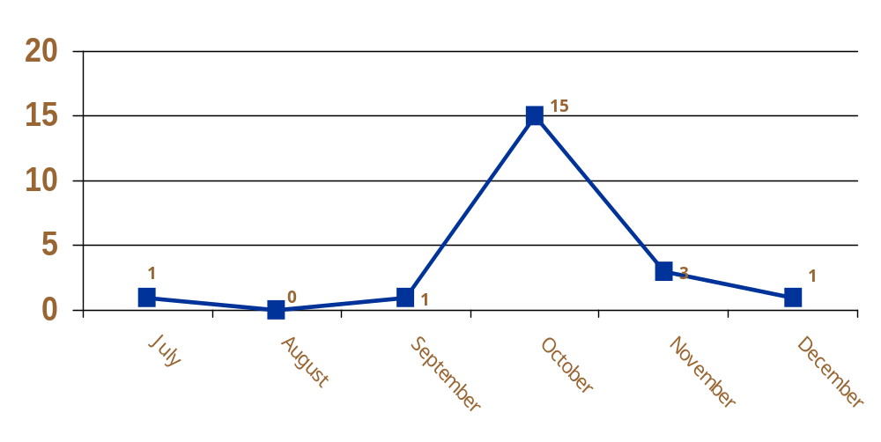
Abandoned Calls
Abandoned Calls: July 2003 - December 2003
21 Total Abandoned Calls
Notes:
Abandoned calls in October related to Recall Volumes. In October, C/S received 4098 calls. September calls were 2443 & November calls were 2701.

Slide 36
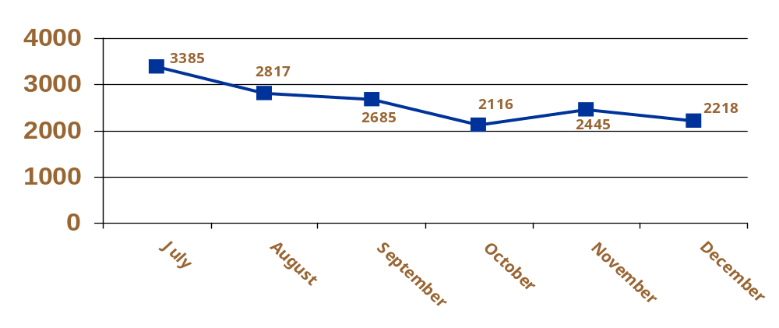
Third Party Returns
Total Destruction Lines: July 2003 - December 2003
15,666 Total Destruction Lines

Slide 37
Accounts Receivable
Significant Events
Employee traveling to Chadds Ford once a week
Reduced overdue balances over 120 days from 21 million dollars to 12.7 million dollars
A/R projects
Automated lock box up and running
Initiated A/R Work Instructions
Evaluated and changed deduction/collections process

Slide 38
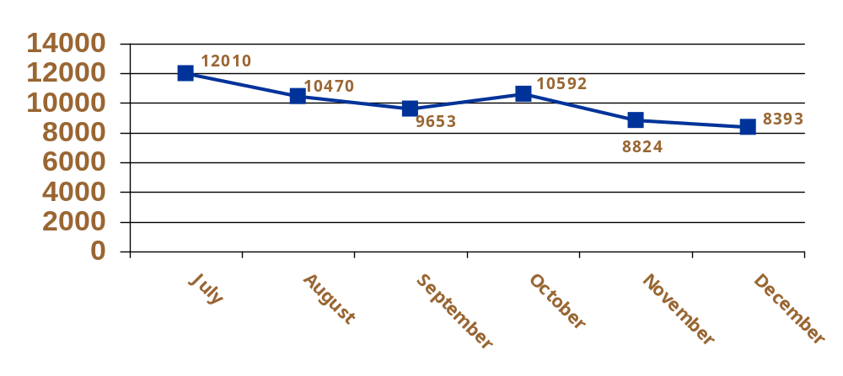
Invoice Activity
Total Invoices Processed: July 2003 - December 2003
59,942 Total Invoices

Slide 39
Chargeback Processing
Significant Events
McKesson TMOP project completed
Initiated Chargeback work instructions
Amerisource 1999 Project
Amerisource incorrect contract number project completed
Potential for increase in McKesson chargeback (STOP Program)

Slide 40
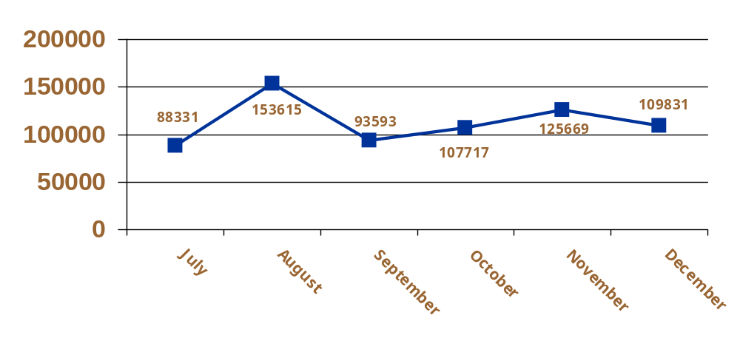
Chargeback Activity
Total Chargebacks Processed: July 2003 - December 2003
678,756 Total Chargebacks

Slide 41
Next 6 Months
Oxycodone ER Tentative Approval and Launch
Complete Web-Based Error Log
Continue work on CSOS project
Continue to decrease overdue A/R balances
A/R Reconciliation Projects
EDI Chargeback Text
Complete A/R and Chargeback Work Instructions
Assist Endo in Meeting Quarterly Sales Goals
New Product Launches

Slide 42
Open Discussion

