Slide 1


Delivering Value for Endo Health
Business Review
March 19, 2014

Slide 2

The Teams
Endo Pharmaceuticals Team
Brian Lorte SVP Brand Pharmaceuticals
Kevin OBrien Senior Director Distribution
Lisa Walker Associate Director Distribution
Mike Ivers Senior Mgr Procurement
UPS Team
Brian Smith VP Healthcare Sales
David Quintilio VP US Distribution
David McLean VP Healthcare Distribution
Jennifer Lancer Director Enterprise Healthcare
Kim Kohler Director OTC Operations
Jackie Kiefer Manager Trans Management

Slide 3
Agenda
UPS News
Endo News
The Teams
Metrics
  Small package
  Order to Cash
  Transportation Management
  Distribution
    Memphis, Harrisburg
Overview of Temp True solution portfolio
Next steps; discussion timeline of “go-live” transportation, distribution

Slide 4
UPS Partnership Slide Global Enterprise Sales

Slide 5

Healthcare Coverage Expands
Distribution Network Provides Broader Coverage in Europe for Greater Patient Access
UPS® has acquired Polar Speed, a leader in active temperature-controlled pharmaceutical supply chain solutions in the United Kingdom.
  Headquartered in Leighton Buzzard, near London, U.K., the company has three warehousing facilities in London as well as eleven forward stocking locations throughout the U.K.
  The company’s facilities provide about 38,000 ft² (more than 3,700 m²) healthcare-dedicated warehouse space, licensed by the Medicines and Healthcare Regulatory Agency (MHRA)-licensed, and ISO 9001:2008-certified
  Its experienced team has a focus on quality assurance compliance, unique active transportation solutions, and is well positioned in the U.K. home care market — an excellent fit with UPS

Slide 6
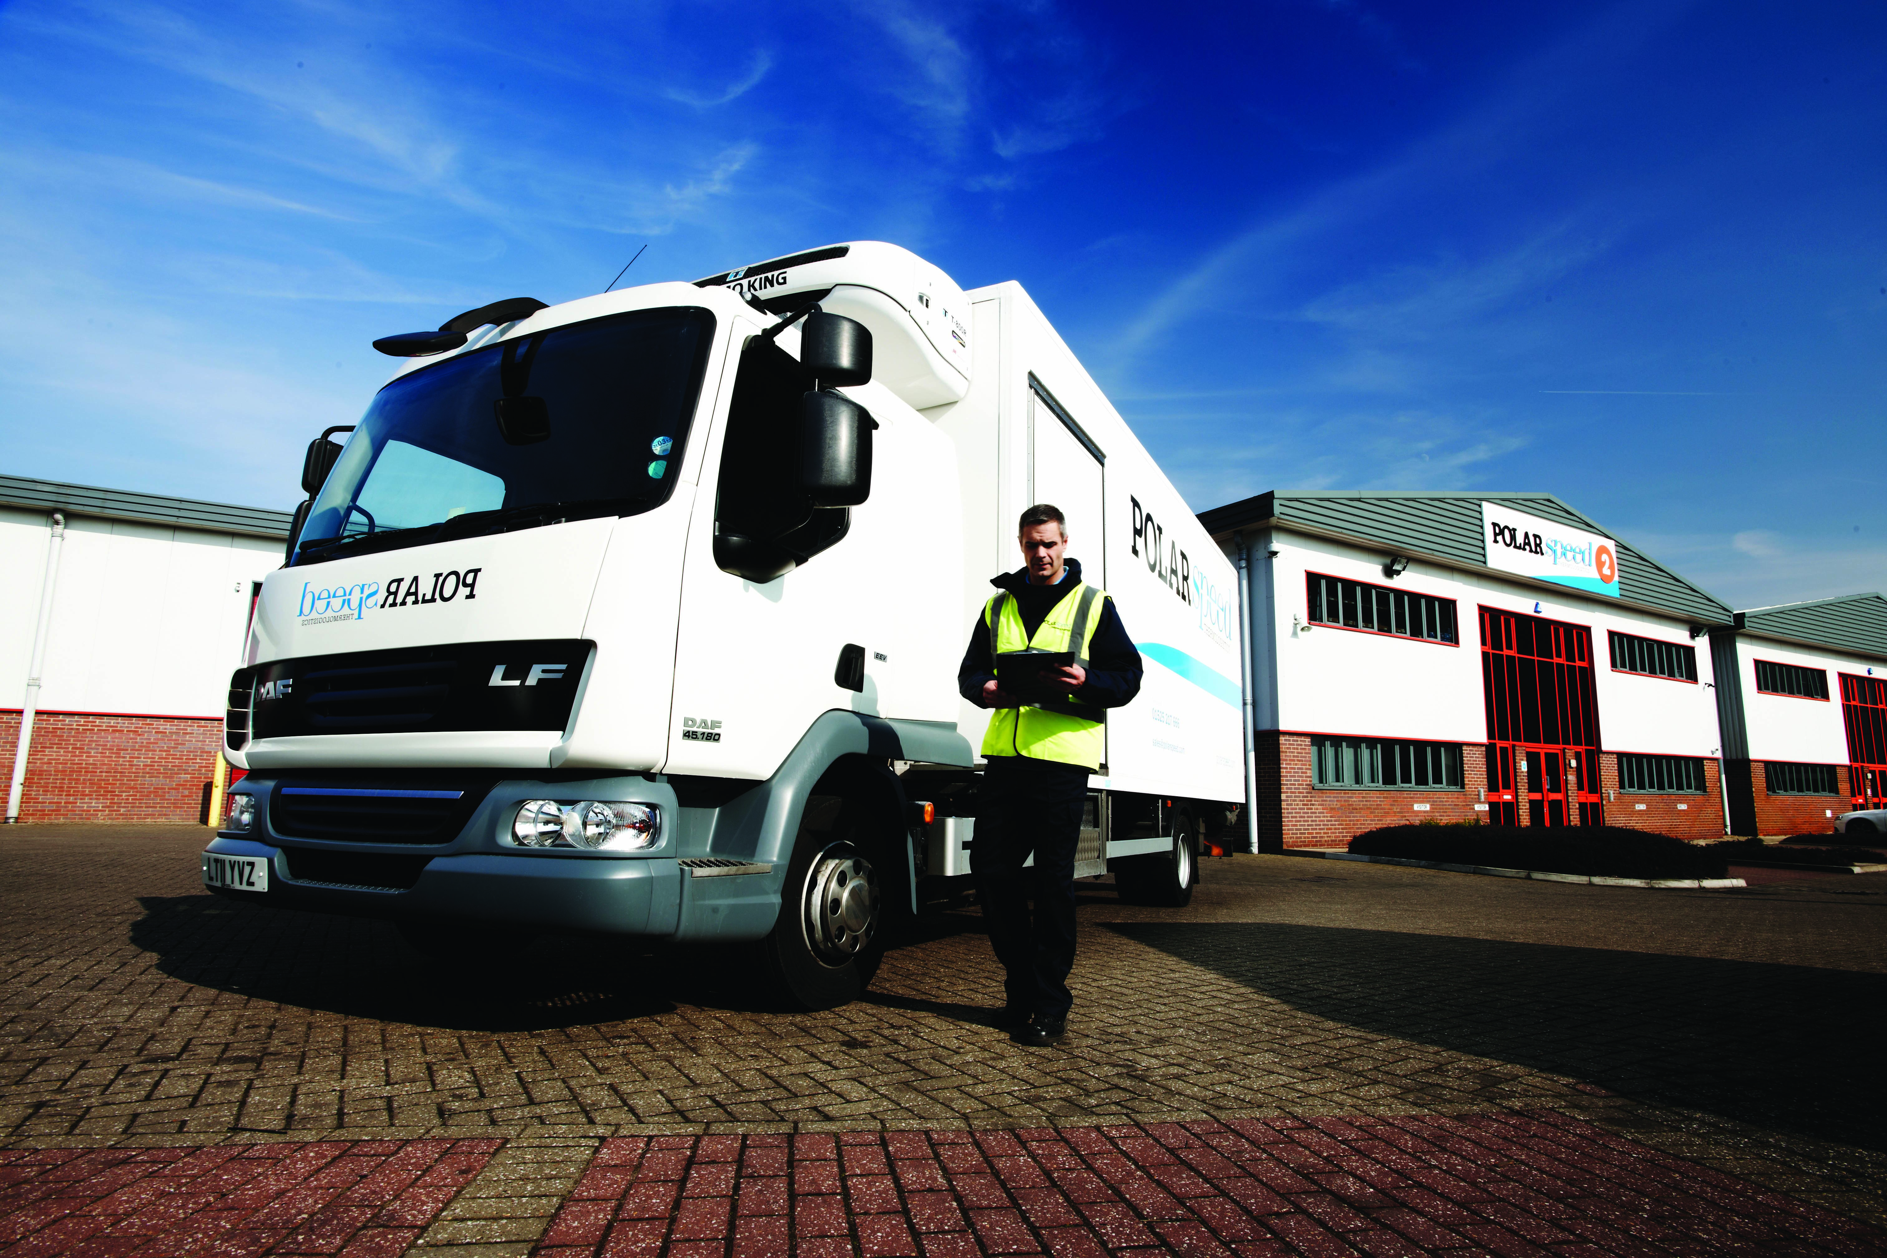
Hi-tech Transportation
Dual-Zone Vehicle Fleet Supports Sustainable Logistics
Polar Speed is the premier transportation network in the U.K. for next day delivery of pharmaceutical products.
Polar Speed’s more than 118 dual temperature zone (2-8ºC and 15–25ºC) vehicles offer active (vs. passive) cold chain transportation in compliance with MHRA standards.
These vehicles provide efficient, environmentally-friendly transportation, moving pharmaceuticals that must be kept at strictly controlled temperatures, including controlled room temperature.
Polar Speed’s fleet enables the safe cold chain distribution and delivery of pharmaceuticals to hospitals, pharmacies, doctors’ offices and patients at home, right across the U.K.

Slide 7
Built for Speed, Flexibility and Efficiency
Investing in Healthcare
More than 6.4 million ft² (nearly 600,000 sq. meters) of cGMP- or CGDP-compliant, dedicated healthcare distribution space globally
45 dedicated healthcare facilities worldwide
UPS®’s global integrated logistics network enables you to:
  Access more than 80 percent of the world’s healthcare
  consumption on one transportation and technology platform
  Save time, reduce complexities and limit hand-offs
  by reducing the number of providers to manage and integrate systems
  Increase flexibility to scale up or down with the needs
  of the market or your business, without significant capital
  investment in facilities and people
  Execute consistent, reliable service for a better customer
  experience

Slide 8
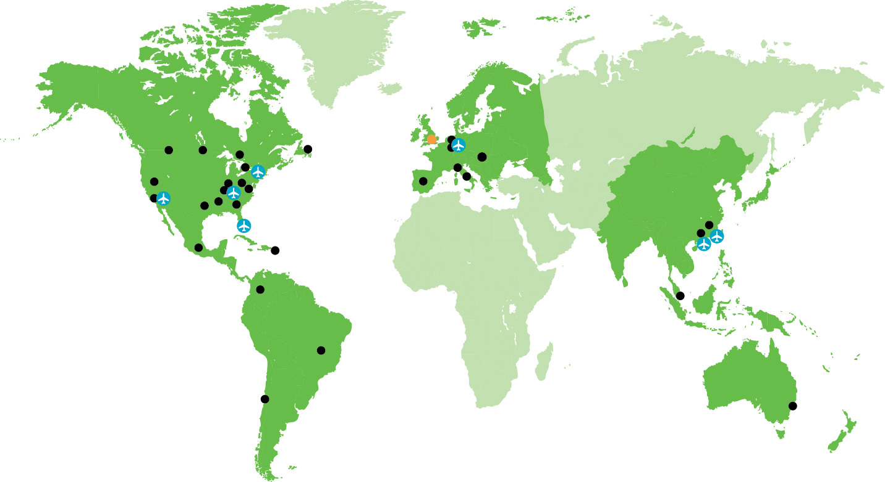
Global Healthcare Integrated Distribution Network
AMERICAS
Atlanta, GA
Dallas, TX
Harrisburg, PA
Louisville, KY
Louisville, KY Air Hub
Memphis, TN
Miami, FL Air Hub
Mira Loma, CA
Newark, DE
Ontario, CA Air Hub
Philadelphia, PA Air Hub
Reno, NV
Suwanee, GA
Burlington, ON
Calgary, AB
Mount Pearl, NL
Toronto, ON
Winnipeg, MB
Bogota, CO
Goiania, BR
Mexico City, MX
San Juan, PR
Santiago, CL
EUROPE
Budapest, HU
Cologne Air Hub, DE
Leighton Buzzard, UK
Madrid, ES
Milan, IT
Rome, IT
Roermond, NL
Venlo, NL
Network of 45 facilities
More than 6.4 million ft²
(nearly 600,000 m²)
ASIA PACIFIC
Hangzhou, CN
Int’l Air Hub – CN
Intra-Asia Air Hub – CN
Shanghai, CN
Singapore, SG
Sydney, AU

Slide 9
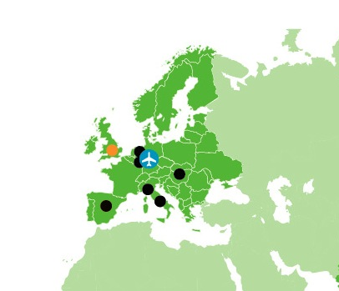
Compliant Healthcare Storage and Distribution Across Europe
New U.K. network extends capabilities throughout the United Kingdom
Netherlands Campus is strategically located in the heart of Europe for access to Western and Northern Europe
Italy distribution centers are situated to serve the local Italian market and Southern Europe
UPS® distribution facilities in Budapest, Hungary, serve the growing Central and Eastern European market
Madrid, Spain, facility is located for conducting business across Europe,
in particular, the Iberian Peninsula
Notes:
There is a shift underway in Europe to move from per country warehousing and distribution to regional operations. The per country set-up creates costly inefficiencies while the shift to a centralized approach enables more control, efficiency and compliance. For example, managing a central repository of stock, reduces stockouts and relabeling activities, improves fill rates, and can reduce the divergence of product across the region.
UPS’s key strengths are one controlled, unified global network to meet the demands that are most relevant in the industry such as:
Controlled transportation solutions to ensure product integrity
One technology platform which allows for seamless and fast data for tracking product
One consistent approach to international regulatory affairs and compliance
One consistent approach to service and performance KPIs which UPS customers are being measured against
9

Slide 10
UPS® in Europe
Region headquarters: | Brussels, Belgium
2012 delivery volume: | 4.1 billion packages and documents
Service area: | 60 countries and territories (more than 120 including the Middle East and Africa)
Employees: | 43,000 in Europe; nearly 400,000 worldwide
Delivery fleet: | Approximately 8,800 (package cars, vans and tractors)
Operating facilities: | Approximately 460 (offices, package centers, hubs, gateway offices, distribution centers and warehouses)
Daily flight segments: | Intra-Europe 251; International 107
Europe air hub: | Cologne/Bonn Airport, Germany
UPS access points: | Approximately 2,500 (UPS centers, MBE centers, UPS drop-off locations and UPS Access PointTM locations)

Slide 11

Package Results
Volume, Net Spend & Accessorials

Slide 12
Endo Pharmaceuticals
Package Volume & Net Spend by Product
Annual, 2012 vs. 2013
SP2
 | Volume |  | Net Spend
Product | 2012 | 2013 | 2012 | 2013
NEXT DAY AIR | 29,357 | 18,169 | $1,311,588 | $872,025
GROUND | 56,496 | 55,861 | $592,767 | $593,036
WW EXPRESS | 179 | 265 | $13,006 | $25,638
2ND DAY AIR | 24,143 | 14,446 | $772,453 | $601,060
3 DAY SELECT | 415 | 204 | $18,134 | $15,937
STANDARD GROUND | 13 | 51 | $389 | $1,141
WW EXPEDITED | 32 | 14 | $4,681 | $2,772
UPS EXPRESS CRITICAL | 1 | 0 | $796 | $0
Totals: | 110,636 | 89,010 | $2,713,815 | $2,111,609

Slide 13
Endo Pharmaceuticals
Package Volume & Net Spend by Location
Annual, 2012 vs. 2013
SP3a
 | Volume |  | Net Spend
Location | 2012 | 2013 | 2012 | 2013
647A3R - MEMPHIS, TN | 21,461 | 20,903 | $1,095,586 | $1,113,704
1552X5 - WEST CALDWELL, NJ | 25,658 | 34,483 | $265,668 | $360,977
77AF52 - NEWARK, DE | 33,951 | 18,037 | $683,826 | $292,201
8AT669 - MALVERN, PA | 6,567 | 5,460 | $189,237 | $158,135
07V553 - KING OF PRUSSIA, PA | 6,181 | 2,338 | $168,107 | $48,385
1846A1 - NEWARK, DE | 2,244 | 2,424 | $56,809 | $35,923
W8264E - HARRISBURG, PA | 283 | 1,413 | $5,357 | $18,965
6092AY - AUSTIN, TX | 379 | 914 | $6,681 | $17,666
01X6E1 - CRANBURY, NJ | 627 | 509 | $19,459 | $13,438
953022 - SAN JOSE, CA | 492 | 565 | $13,425 | $11,443
ALL OTHERS | 12,793 | 1,964 | $209,659 | $40,773
Totals: | 110,636 | 89,010 | $2,713,815 | $2,111,609

Slide 14
Endo Pharmaceuticals
Package Top Accessorials by Net Spend
Annual, 2012 vs. 2013
SP6
 | Accessorial Spend
Description | 2012 | 2013
FUEL SURCHARGE | $256,211 | $157,024
HAZMAT-CLASS 1-8 INACCESSIBLE | $150 | $115,913
CUSTOM DC SIGNATURE RESPONSE | $113,015 | $103,618
HAZMAT-CLASS 9 INACCESSIBLE | $181,800 | $95,438
ADDRESS CORRECTION | $11,407 | $19,938
ACCOUNT MAINTENANCE (DLY/WKLY SVC) | $14,630 | $18,095
DECLARED VALUE | $13,779 | $10,558
FIRST WEEKEND DAY-SATURDAY-DELIVERY | $9,195 | $9,285
GOV DUTY AMOUNT | $908 | $2,502
TRANSIT/TRANSFER FEE | $114 | $1,979
ALL OTHERS | $10,177 | $6,893
Totals: | $611,386 | $541,242

Slide 15
Endo Pharmaceuticals
Package Accessorials Net Spend by Location
Annual, 2012 vs. 2013
SP7a
 | Accessorial Spend
Location | 2012 | 2013
647A3R - MEMPHIS, TN | $287,747 | $295,888
1552X5 - WEST CALDWELL, NJ | $108,699 | $134,345
77AF52 - NEWARK, DE | $75,674 | $33,989
8AT669 - MALVERN, PA | $36,173 | $32,948
W8264E - HARRISBURG, PA | $2,647 | $5,871
07V553 - KING OF PRUSSIA, PA | $19,736 | $4,625
1846A1 - NEWARK, DE | $12,625 | $4,522
01X6E1 - CRANBURY, NJ | $5,407 | $3,993
6092AY - AUSTIN, TX | $1,076 | $2,608
8E24A8 - WESTBURY, NY | $3,308 | $2,551
ALL OTHERS | $58,294 | $19,901
Totals: | $611,386 | $541,242

Slide 16

Package Results
On-Time Performance

Slide 17
Endo Pharmaceuticals
Package On-Time Performance by Product
Annual, 2012 vs. 2013
SP8
 | Packages Measured |  | Total On-Time |  | Percent On-Time
Product | 2012 | 2013 | 2012 | 2013 | 2012 | 2013
NEXT DAY AIR | 23,425 | 15,368 | 23,089 | 15,095 | 98.6% | 98.2%
NEXT DAY AIR SAVER | 1,536 | 1,458 | 1,517 | 1,446 | 98.8% | 99.2%
NEXT DAY EARLY AM | 384 | 220 | 371 | 211 | 96.6% | 95.9%
GROUND | 47,137 | 52,878 | 46,730 | 52,302 | 99.1% | 98.9%
INTERNATIONAL EXPRESS SAVER | 266 | 248 | 263 | 246 | 98.9% | 99.2%
INTERNATIONAL EXPRESS | 88 | 113 | 88 | 111 | 100.0% | 98.2%
SECOND DAY AIR | 20,776 | 13,903 | 20,578 | 13,718 | 99.0% | 98.7%
SECOND DAY EARLY AM | 153 | 111 | 153 | 110 | 100.0% | 99.1%
THREE DAY SELECT | 458 | 554 | 457 | 551 | 99.8% | 99.5%
INTERNATIONAL STANDARD | 2 | 16 | 2 | 16 | 100.0% | 100.0%
INTERNATIONAL EXPRESS PLUS | 22 | 20 | 21 | 19 | 95.5% | 95.0%
INTERNATIONAL EXPEDITED | 36 | 94 | 36 | 92 | 100.0% | 97.9%
Totals: | 94,283 | 84,983 | 93,305 | 83,917 | 99.0% | 98.7%

Slide 18
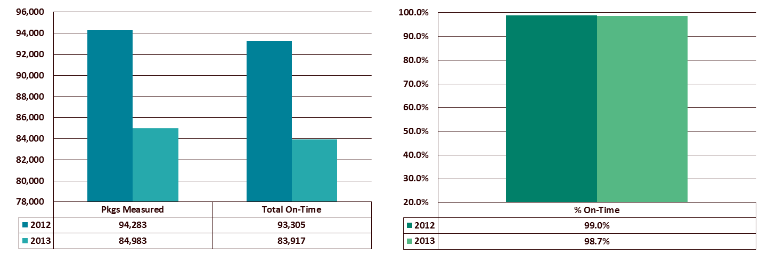
Endo Pharmaceuticals
Package On-Time Performance Summary
Annual, 2012 vs. 2013
SP9

Slide 19

Freight Forwarding Results
Volume, Net Spend & On-Time Performance

Slide 20
Endo Pharmaceuticals
Freight Forwarding Volume & Net Spend by Service Category
Annual, 2012 vs. 2013
SCS1
 | Shipments |  | Billed Weight (lbs) |  | Total Spend
Description | 2012 | 2013 | 2012 | 2013 | 2012 | 2013
INTERNATIONAL AIR FREIGHT | 52 | 42 | 2,440,913 | 1,178,040 | $8,109,033 | $3,512,782
NORTH AMERICA AIR FREIGHT | 2 | 5 | 1,169 | 4,190 | $2,934 | $8,260
OCEAN FREIGHT | 10 | 136 | 195,107 | 2,652,480 | $112,406 | $1,689,058
CUSTOMS BROKERAGE SERVICES | 3 | 1 | 33,226 | 8,719 | $24,974 | $77,220
DISTRIBUTION SERVICES | 0 | 0 | 0 | 0 | $8,784,629 | $8,153,313
Totals: | 67 | 184 | 2,670,415 | 3,843,429 | $17,033,977 | $13,440,633

Slide 21
Endo Pharmaceuticals
Freight Forwarding Volume & Net Spend by Service Level
Annual, 2012 vs. 2013
SCS2
 | Shipments |  | Billed Weight (lbs) |  | Total Spend
Service Level | 2012 | 2013 | 2012 | 2013 | 2012 | 2013
AIR FREIGHT CONSOLIDATED | 11 | 7 | 3,735 | 2,487 | $10,743 | $3,357
OCEAN FCL | 10 | 136 | 195,107 | 2,652,480 | $112,406 | $1,689,058
OCEAN CUSTOMS BROKERAGE | 3 | 1 | 33,226 | 8,719 | $2,736 | $987
AIR FREIGHT DIRECT | 41 | 35 | 2,437,178 | 1,175,553 | $8,098,290 | $3,509,425
3 DAY FREIGHT | 1 | 3 | 44 | 1,102 | $42 | $779
2ND DAY AIR FREIGHT | 1 | 0 | 1,125 | 0 | $2,892 | $0
NEXT DAY AIR FREIGHT | 0 | 2 | 0 | 3,088 | $0 | $7,480
Totals: | 67 | 184 | 2,670,415 | 3,843,429 | $8,227,109 | $5,211,086

Slide 22
Endo Pharmaceuticals
Freight Forwarding Volume & Net Spend Summary
Annual, 2012 vs. 2013
SCS3

Slide 23
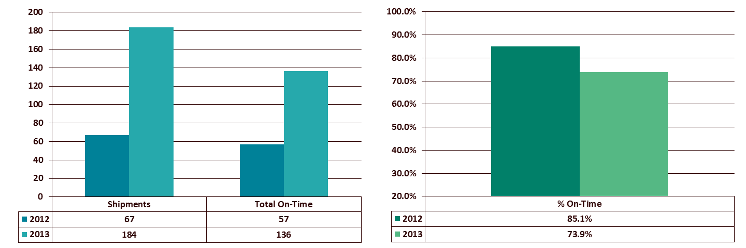
Endo Pharmaceuticals
Freight Forwarding On-Time Performance Summary
Annual, 2012 vs. 2013
SCS4

Slide 24

Customer Service
24
PROPRIETARY AND CONFIDENTIAL: THIS PRESENTATION MAY NOT BE USED OR DISCLOSED TO ANY PERSON OTHER THAN EMPLOYEES OF CUSTOMER, UNLESS EXPRESSLY AUTHORIZED BY UPS.
Notes:
24

Slide 25
Newark Customer Service Org Chart
David Quintilio
Vice President – Healthcare Operations
Kim Kohler
Senior Manager - Order to Cash
Joanie Page
Customer Service Manager
Peter Jennings
Supervisor
Dian Truitt
Team Lead
Linda Cichocki (CMA)
Sherie Longshore (CMA)
Kirk Slaughter (CMA)
Babs Johnston (Returns)

Slide 26

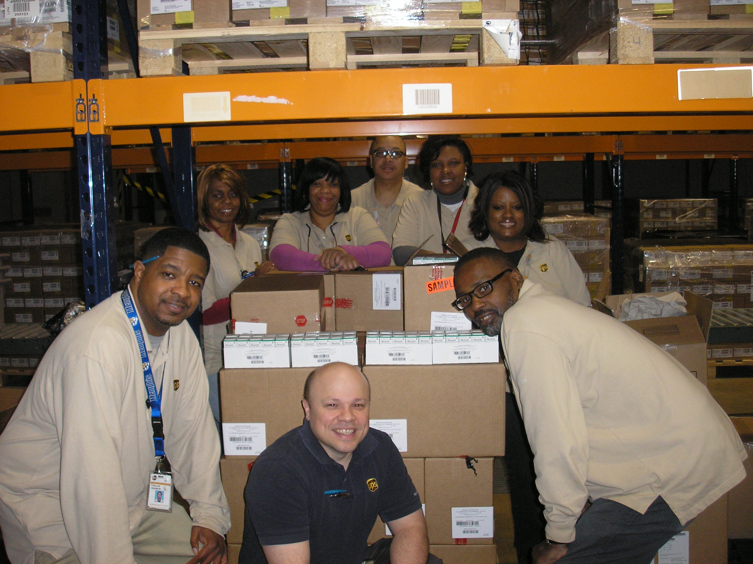
AVEED LAUNCH!! March 10, 2014
Memphis DC and Newark Customer Service with first order to Besse Medical
26
Proprietary and Confidential: This presentation may not be used or disclosed to any person other than employees of Customer, unless expressly authorized by UPS.

Slide 27
Inbound Calls – Yearly Comparison

Slide 28
Overall Abandoned Calls
Notes:
28

Slide 29
Daily Average Speed of Answer (ASA)
Notes:
29

Slide 30
Manual Orders (includes Cold Chain Orders)

Slide 31
Destructions:
ZRE (Direct) vs. ZREI (Indirect)

Slide 32
UPS Transportation – ENDO
Business Review 2013
March, 2014
Notes:
32

Slide 33
Organizational Chart
Jared Ragains
Division Manager
Jackie Kiefer
Transportation Manager
Richard Beckmann
Lead Supervisor
Jessica Fischer
Transportation Coordinator
Melonee Tubb
Transportation Back Up
Notes:
33

Slide 34
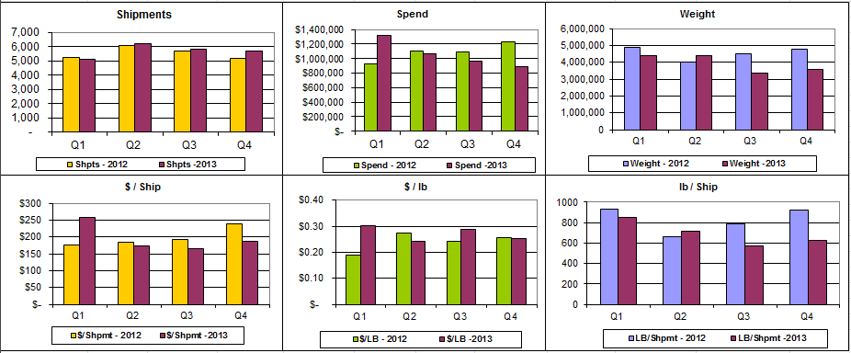
2013 Dashboard Review
Q1 2013 had almost double the Air Freight shipments as the following Quarters causing the spend to increase.
Notes:
Q1 2013 had 459 Air Freight shipments. The average for the other 3 Quarters is 233.
Shipments Spend Weight
Q1 2012 – 5,238 Q1 2012 – $921,566.87 Q1 2012 – 4,879,671.0
Q2 2012 – 6,068 Q2 2012 - $1,108,863.47 Q2 2012 – 4,082,248.8
Q3 2012 – 5,704 Q3 2012 - $1,089,919.55 Q3 2012 – 4,477,558.8
Q4 2012 – 5,192 Q4 2012 - $1,234,230.89 Q4 2012 – 4,793,473.0
Q1 2013 – 5,118 Q1 2013 - $1,321,882.94 Q1 2013 – 4,371,474.3
Q2 2013 – 6,175 Q2 2013 - $1,067,759.07 Q2 2013 – 4,416,233.7
Q3 2013 – 5,844 Q3 2013 - $970,582.52 Q3 2013 – 3,369,284.1
Q4 2012 – 5,709 Q4 2013 - $895,387.87 Q4 2013 – 3,553,628.4
$/Shipment $/lb lb/Shipment
Q1 2012 - $175.94 Q1 2012 - $0.19 Q1 2012 – 931.6
Q2 2012 - $182.74 Q2 2012 - $0.28 Q2 2012 – 663.9
Q3 2012 - $191.08 Q3 2012 - $0.24 Q3 2012 – 785.0
Q4 2012 - $237.72 Q4 2012 - $0.26 Q4 2012 – 923.2
Q1 2013 - $258.28 Q1 2013 - $0.30 Q1 2013 – 854.1
Q2 2013 - $172.92 Q2-2013 - $0.24 Q2 2013 – 715.2
Q3 2013 - $166.08 Q3 2013 - $0.29 Q3 2013 – 576.5
Q4 2013 - $156.84 Q4-2013 - $0.25 Q4 2013 – 622.5
34

Slide 35
2013 Carrier On Time Performance
Notes:
Memphis had 20,000 shipments is 2013 compared to the 2,000 that Harrisburg had causing the possibility for late shipments to be much greater for Memphis.
55 Late shipments Memphis – 30 Small Pack (left at UPS facility, flight/train delays), 14 UPS Freight (mostly breakdowns), 11 Air Freight (bumped shipments)
2 Late shipments Harrisburg – Both UPS Freight (breakdown and missed appointment)
35

Slide 36
2013 Shipment Stats by Mode – Total
Carrier | Shipments | Spend | $ per lb
UPS Small Package | 19,056 | $ 1,190,677.75 | $ 3.77
Less Than Truckload | 2,144 | $ 428,520.81 | $ 0.18
Air Freight | 1,160 | $ 1,797,054.72 | $ 1.80
Truckload | 486 | $ 839,359.12 | $ 0.07
Grand Total | 22,846 | $ 4,255,612.40 | $ 0.27
Notes:
36
Shipments Spend $/lb
Q1 2012 – 5,238 Q1 2012 – $921,566.87 Q1 2012 - $0.19
Q2 2012 – 6,068 Q2 2012 - $1,108,863.47 Q2 2012 - $0.28
Q3 2012 – 5,704 Q3 2012 - $1,089,919.55 Q3 2012 - $0.24
Q4 2012 – 5,192 Q4 2012 - $1,234,230.89 Q4 2012 - $0.26
Q1 2013 – 5,118 Q1 2013 - $1,321,882.94 Q1 2013 - $0.30
Q2 2013 – 6,175 Q2 2013 - $1,067,759.07 Q2-2013 - $0.24
Q3 2013 – 5,844 Q3 2013 - $970,582.52 Q3 2013 - $0.29
Q4 2012 – 5,709 Q4 2013 - $895,387.87 Q4-2013 - $0.25

Slide 37
2013 Shipment Stats by Mode – Memphis
Carrier | Shipments | Spend | $ per lb
UPS Small Package | 17,643 | $ 1,170,037.24 | $ 3.97
Less Than Truckload | 1,067 | $ 238,304.48 | $ 0.18
Air Freight | 1,144 | $ 1,762,066.43 | $ 1.80
Truckload | 361 | $ 727,505.40 | $ 0.08
Grand Total | 20,215 | $ 3,897,913.55 | $ 0.35
Notes:
37
Shipments Spend $/lb
Q1 2012 - 4,942 Q1 2012 - $830,868.88 Q1 2012 - $0.24
Q2 2012 - 5,591 Q2 2012 - $1,032,646.97 Q2 2012 - $0.37
Q3 2012 - 5,392 Q3 2012 - $1,011,554.44 Q3 2012 - $0.31
Q4 2012 - 4,902 Q4 2012 - $1,146,354.91 Q4 2012 - $0.36
Q1 2013 - 4,769 Q1 2013 - $1,245,092.70 Q1 2013 - $0.39
Q2 2013 - 5,330 Q2 2013 - $989,106.99 Q2 2013 - $0.30
Q3 2013 - 5,119 Q3 2013 - $857,026.30 Q3 2013 - $0.34
Q4 2013 - 4,997 Q4 2013 - $806,687.56 Q4 2013 - $0.36

Slide 38
2013 Shipment Stats by Mode – Harrisburg
Carrier | Shipments | Spend | $ per lb
UPS Small Package | 1,413 | $ 20,640.50 | $ 1.00
Less Than Truckload | 1,077 | $ 190,219.33 | $ 0.18
Air Freight | 16 | $ 34,988.30 | $ 1.97
Truckload | 123 | $ 107,749.74 | $ 0.03
Grand Total | 2,629 | $ 353,597.87 | $ 0.08
Notes:
38
Q3 had 11 Air Freight Shipments vs. an average of 2 per Quarter.
Shipments Spend $/lb
Q1 2012 - 296 Q1 2012 - $90,697.99 Q1 2012 - $0.07
Q2 2012 - 477 Q2 2012 - $76,216.50 Q2 2012 - $0.06
Q3 2012 - 312 Q3 2012 - $78,365.11 Q3 2012 - $0.06
Q4 2012 - 290 Q4 2012 - $87,875.98 Q4 2012 - $0.05
Q1 2013 - 349 Q1 2013 - $76,790.24 Q1 2013 - $0.07
Q2 2013 - 845 Q2 2013 - $78,655.08 Q2 2013 - $0.07
Q3 2013 - 725 Q3 2013 - $95,525.96 Q3 2013 - $0.12
Q4 2013 - 710 Q4 2013 - $84,596.34 Q4 2013 - $0.07

Slide 39
2013 Shipment Statistics – Damages and Shortages
Notes:
All 5 Damages in July are UPS Freight. 3 out of the 5 were shipped to ABC in Kansas City, MO.
6 damages – Harrisburg
10 damages – Memphis
6 Short/Lost – Memphis
39

Slide 40
2013 Perfect Load
Total Shipments: 22,846
Total Exceptions: 337
DPE: 67.79
Effective: 98.52%
Notes:
13 Breakdown – 8 of those only delivered one day late
128 Uncontrollable – 123 of those were weather exceptions. The other 5 were train derailments.
3 Refused
17 Damages
126 Documents – 101 were Hazmat issues, 6 address issues, 19 Commercial Invoice issues.
6 Short/Lost
44 Carrier Delayed – 2 missed appointments, 2 lost/found, 5 late train/plane, 15 left at facility, 10 bumped air freight, 10 late due to carrier error
40

Slide 41
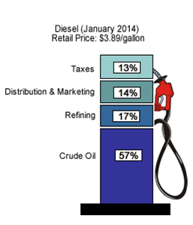
National Historic Diesel Prices

Slide 42
2013 Transportation Review
Looking Back ABC Tracking Started tracking all ABC Shipments in August to ensure on time delivery per ABCs delivery requirements. There were 40 shipments that delivered past the ABC Lead Times – 20 of these were late due to uncontrollable exceptions. On-Time Percentage: 99.35% | Looking Forward New Truckload Business Scheduling approximately 100 trailers round trip between Allentown, PA and Easton, MD.
Notes:
42

Slide 43
Endo Executive Summary – Memphis and Harrisburg DC’s
Highlights
Challenges
Hazmat shipments- assisted Endo with the change from Class III to Limited Quantity due to government changes
Huntsville- created ambient overflow space
ANDA – picked specific lots and arranged transportation
Deloitte and Touche- passed successful year end audit
Quarter End Push- worked two Saturdays during heavy qtr end volume activity
Opana Returns- Special shipment to Sharp (created 222 forms).
ABC Orders- customer changed distribution strategy from multi DC to centralize inbound processing
GWS Implementation scheduled in August
Endo’s SAP upgrade
Implementations
Opportunities
Aveed Hazmat- new product worked Sunday to process material
Started Inspection and Sample Process in September
Cranbury Returns- recovered plastic pallets associated with Vantes and Supperlin
Cage expansion- creating more than 600 pallet positions of DEA CIII-CV space.
Cold Chain packaging opportunity
GWS Implementation- Cardinal pallet content labels
Notes:
43

Slide 44
2012 vs. 2013 Comparison - Memphis
Measurement period – January through Dec

Slide 45
Memphis Total Orders Shipped
Measurement period – January- December 2013
2012 Monthly Average = 1,445
2013 Monthly Average = 1,283
Orders Shipped on Time Average = 100.00%

Slide 46
KPI’s - Memphis
Ref | Element | Goal | KPI | Q1 2012 | Q2 2012 | Q3 2012 | Q4 2012 | Q1 2013 | Q2 2013 | Q3 2013 | Q4 2013 | YTD 2013
Contractual KPI | Order Accuracy | 100% | 99.80% | 99.96 | 99.96 | 99.88 | 99.95 | 99.98 | 100 | 99.97 | 99.92 | 99.95
Contractual KPI | On-time Shipping Performance | 100% | 99.50% | 100 | 99.88 | 100 | 99.97 | 100 | 99.95 | 100 | 100 | 99.98
Contractual KPI | Inventory Accuracy | 100% | 99.00% | 99.92 | 99.996 | 99.999 | 99.92 | 100 | 99.86 | 99.996 | 99.94 | 99.95
Contractual KPI | Returns Processed Timely | 100% | 100% | 100 | 100 | 100 | 100 | 100 | 100 | 100 | 100 | 100

Slide 47
Memphis DC Error Recap
Error Summary
January – December 2013

Slide 48
2012 vs. 2013 Comparison - Harrisburg
Measurement period – January through December

Slide 49
Harrisburg Total Orders Shipped
2012 vs. 2013
Measurement period – January through December
2012 Monthly Average = 88
2013 Monthly Average = 119
Orders Shipped on Time Average = 100.00%

Slide 50
KPI’s - Harrisburg
Ref | Element | Goal | KPI | Q1 2012 | Q2 2012 | Q3 2012 | Q4 2012 | Q1 2013 | Q2 2013 | Q3 2013 | Q4 2013 | YTD 2013
Contractual KPI | On Time Receiving | 100% | 99.00% | 100 | 100 | 100 | 100 | 100 | 100 | 100 | 99.9 | 99.99
Contractual KPI | Client Order Accuracy | 100% | 98.00% | 100 | 100 | 100 | 100 | 100 | 100 | 100 | 100 | 100
Contractual KPI | Order Shipped on Time | 100% | 98.00% | 100 | 100 | 100 | 100 | 100 | 100 | 100 | 100 | 100
Contractual KPI | Inventory Accuracy | 100% | 99.00% | 100 | 100 | 100 | 100 | 100 | 100 | 100 | 100 | 100

Slide 51
Harrisburg DC Error Recap
Error Summary
March– February 2013
Notes:
Feb – Late shipment - ABC Honolulu, HI received product as 2nd day air should have gone NDA.
May
1.) ABC – Bethlehem, PA. –short ship 48 pcs/Endocet. Pieces went to McKesson/ overage
2.) Valley Wholesale – Stockton, CA – received shipment for Value Drugs – Altoona, Pa – incorrect address. Shipment was re-routed to correct customer.
3.) Drogueria Borschow Hospital & Medical Supply San Juan, PR. – Shipped to incorrect location. Address error on warehouse level. Product picked up and delivered to correct location.
July
1.) Morris & Dickson – Shreveport, LA.- Morphine – 24 pcs incorrect shipped to ABC – Thorofare, NJ. ABC – Thorofare refused shipment and returned to Memphis. Credit issued to M& D Shreveport, LA
2.)ABC Bethlehem, PA short shipped 48 pcs Endocet / 48 pcs received at McKesson Overage processed to McKesson and shortage credit to ABC Bethlehem, PA.
3.) ABC Thorofare, NJ short 6 pcs Percocet. Investigation into possible pilferage of product. No shortages indicated and the MDC. Product tampering.
August
1.) ABC Kansas City, MO. – received order that was not theirs. Should have been AMD- Amityville, NY – incorrect packing slip on outside of pallet. ABC Kansas opt to keep shipment.
2.)AMD- did not receive order due to above to ABC Kansas, City, MO
3.) Miami- Luken – Springboro, OH – did not receive 216 pcs Lidoderm/1 each Moban- tracking information indicates “ no records found”. Claim file at UPS Freight.
NOTE - All errors were reviewed with team. Training and documentation was conducted and place in employee records.

Slide 52

UPS and Endo Pharmaceuticals
Building Our Strategic Partnership
Transition 8

Slide 53

UPS Temperature True®
March 2014

Slide 54

UPS Temperature True®
Assessing the pain in your temperature-sensitive supply chain
Managing cost while staying compliant both at home and abroad can present daily challenges for you to:
  Ensure your products arrive intact
  Maintain 24/7 shipment visibility to prevent packout expiry before delivery
  Stay up to date on multi-country healthcare and customs regulations and other laws affecting transportation of healthcare goods
  Access the latest technology to protect your shipments from various vendors around the globe
  Expand supply chains to emerging markets and manage multi-country providers, vendors and carriers
Find a holistic global logistics partner who understands the complexity of your world
54
Proprietary and Confidential: This presentation may not be used or disclosed to any person other than employees of Customer, unless expressly authorized by UPS.

Slide 55

Temperature True® Plus
When you shipments require the highest degree of control
For biologics, vaccines and sensitive pharmaceuticals requiring tight temperature control to maintain stability, you need a robust process with the highest level of risk mitigation
By partnering with qualified carriers that offer specialized pharma service, your shipments receive the expert care they require
As an added layer of protection, we provide access to the latest technology in active containers and passive packaging
And we provide proactive support along the way to make it easier to protect your products, like container preconditioning and repositioning, re-icing and battery replenishment
55
Proprietary and Confidential: This presentation may not be used or disclosed to any person other than employees of Customer, unless expressly authorized by UPS.

Slide 56
Temperature True® Plus
When you shipments require the highest degree of control
Our experienced healthcare control towers actively monitor shipments from
the first pre-alert that a temperature-sensitive product is entering our system through the final destination, and every critical milestone in between
Immediate intervention begins if there is any indication of a potential shipment
in distress
Robust contingency plans include: preselected redundant flight routings, access to on-airport cold storage areas to extend packouts in case of delay, container re-icing, and documented escalation paths
56
Proprietary and Confidential: This presentation may not be used or disclosed to any person other than employees of Customer, unless expressly authorized by UPS.

Slide 57

Temperature True® Standard
When timing is simply everything
For robust pharmaceuticals, consumer health products, nutraceuticals and more with stability data and/or passive packaging* that eliminate the need for added control, we monitor to ensure shipments arrive on-time
  You tell us when your pack-out expires and we find the optimal routing through our preferred providers
  Our global control towers monitor milestones to enable shipments travel unimpeded
The same healthcare experts in control towers, solutions, implementations and quality follow a single Global Master Operating Plan to deliver reliable results
*Active containers and some passively packed shipments with tight transportation temperature requirements are not accepted on UPS Temperature True Standard”
57
Proprietary and Confidential: This presentation may not be used or disclosed to any person other than employees of Customer, unless expressly authorized by UPS.

Slide 58
Temperature True® Standard
When timing is simply everything
For added control we offer additional services including:
  Freight pickup and delivery in refrigerated vehicles to extend packout expiration
  Expert clearance and last mile delivery to help avoid destination delays
  Contingency options for unavoidable delays including:
    Shipment rescue or rerouting
    Prearranged temporary storage in a controlled environment (where available)
  Access to the latest options in passive thermal control packaging
  Help qualifying lanes and temperature profiling studies
58
Proprietary and Confidential: This presentation may not be used or disclosed to any person other than employees of Customer, unless expressly authorized by UPS.

Slide 59

Temperature True® Saver – New for 2014
When cost is priority
Because global expansion and cost containment are challenging you to move high volume shipments overseas while managing your supply chain budget, we are developing a new level of service to meet this challenge
Currently in pilot, UPS Temperature True Saver will offer:
  Global carrier relationship management to ensure your shipments receive the attention and level of support they require
  Access to reefers to support temperature controlled shipments
  Inland pickup and delivery of containers, and repositioning empty containers to the ports
  Customs clearance for expedited release
  Support from trained personnel on global procedures designed to mitigate risk
  24x7x365 shipment milestone tracking
59
Proprietary and Confidential: This presentation may not be used or disclosed to any person other than employees of Customer, unless expressly authorized by UPS.

Slide 60

Thank you

Slide 61

Endo Supply Chain Re-Design
Key Events
Implementation Kick-Off / BRV
Contract Negotiations Completed
Network update – Mira Loma to Reno
Meeting with Endo Team
Generics Network Update
Huntsville / Reno
Endo team provides
new network approach
Initial Proposal
Submitted
Updated Proposal Submitted
Network Optimization Analysis
Site Visit to Huntsville Operation
Verbal Award of business
2-DC Network Update
Meeting with Qualitest Team
Network Update
Generics – 80/20 Split
Brand – Lidoderm/Voltarem
RFP
Released
Endo CEO Change Process on hold
Proposal Review
Jun 2012
Aug 2012
Oct 2012
Feb 2013
Jun 2013
Nov 2013
May 2012
Jul 2012
Sept 2012
Dec 2012
March 2013
Jul/Aug 2013

Slide 62
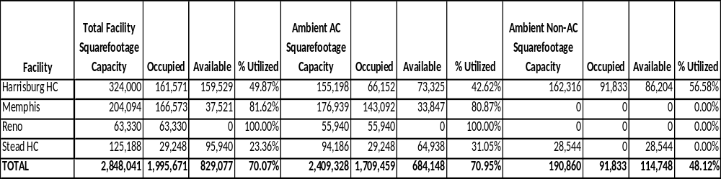
Blank
Endo/UPS next steps
Distribution & Transportation timeline & discussion
Meeting March 20th with Qualitest; discussion
Go live with transportation by end of first quarter; update.
Pull all transportation numbers (current small pkg) under trans mgmt; update
System discussion on Huntsville using GWS; discussion

Slide 63

Thank you

