Slide 1
uRobo:
The Voice that (Could) Sound Like You

Slide 2
uRobo: Speech Synthesis with Limited Data
Speaker specific speech synthesis is an important area across domains
  Medicine
  Media Production
  Chat bots
How to produce speech that sounds like one person when you have limited audio of that person’s voice?

Slide 3
Urobo: Speech Synthesis (ctd.)
Multiple different speech models exist
  Parametric
  Neural Network End-to-End
  Concatenative
Concatenative
  Uses Actual Human Speech vs. Parametric Vocoder artifacting
  Does not require massive resources or training time

Slide 4
A 4-Layer System
ASR/Alignment
  Uses Kaldi to train alignment models on LibriSpeech data (collected and processed by Kaldi)
  Final Forced Alignments used in Preprocessing Step
Preprocessing
  Break each utterance into n-phones (triphones with diphone and monophone backoff)
  Extract Features from each nphone
Target Feature Prediction
  Train a Neural Model predict the features extracted in step 2
Concatenative Synthesis
  Build a data set of audio units from preprocessed data
  Select units by minimizing target and concatenation cost

Slide 5
ASR
Kaldi downloads the entire LibriSpeech corpus^{[2]}
Trains multiple acoustic models over 1000 hours of data
uRobo performs forced alignment on the initial 100 clean hours of training data for future preprocessing

Slide 6
Preprocessing
Take Language Models / Alignment Information extracted by Kaldi, reformat for easier Python ingestion
Chunk phones into n-phones (triphones with diphone and monophone backoff and single phone overlap
Only triphones and diphones composing > 1% or .1% of total corpus respectively are chunked

Slide 7
Preprocessing
Hello my name...
HH_B, EH0_I, L_I, OW1_E, M_B, AY1_E, N_B, EY1_I, M_E...
HH_B, EH0_I, L_I, [OW1_E, M_B],
[M_B, AY1_E],
[AY1_E, N_B],
[N_B, EY1_I],
[EY1_I, M_E],
M_E...

Slide 8
Preprocessing
Hello my name...
HH_B, EH0_I, L_I, OW1_E, M_B, AY1_E, N_B, EY1_I, M_E...
HH_B, EH0_I, L_I, [OW1_E, M_B],
[M_B, AY1_E],
[AY1_E, N_B],
[N_B, EY1_I],
[EY1_I, M_E],
M_E...

Slide 9
Preprocessing
Extract target features
  Duration
  Initial Phone F₀
  Final Phone F₀
  Energy
Features are scaled by z-score respective to speaker stats^{[3]}

Slide 10
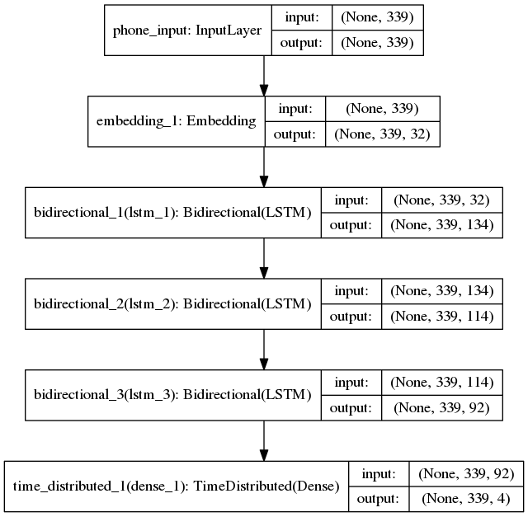
Target Feature Prediction
N-phone indexes are fed into a 3-layer bidirectional LSTM neural network and trained on features^{[4]}

Slide 11
Concatenative Synthesis
Classic Concatenation involves “unit selection” from a data set of audio units thought to represent a given utterance
These are spliced together to form a final file
Minimization of
  target cost (what should the unit sound like)
  concatenation cost (how well does it follow the preceding unit)^{[1]}
Viterbi algorithm (dynamic programming) used to determine the final sequence of units
Logarithmic crossfade across overlapping monophones used during concatenation

Slide 12
Concatenative Synthesis (ctd.)
Target Cost was the sum of the absolute difference between Z-Scored features (duration, 1st phone f₀, Last phone f₀, energy)
Concatenation Cost was the sum of the absolute difference between Z-Scored features (overlapping/joining phone f₀, energy)

Slide 13
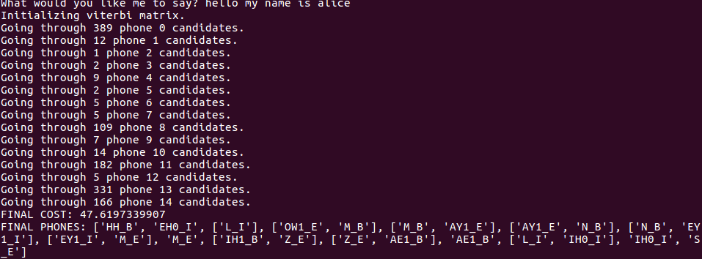
Speech

Slide 14
Experiment
To determine the effectiveness of the architecture, three voices were tested against a control voice c
  t10f: 10 hours of audio units from different female speakers
  ts39: 25 minutes of audio units from a single female speaker
  ts39_m: Same as above but only utilizing monophones rather than n-phones

Slide 15
Experiment (ctd.)
10 utterances generated from the 3 voices
  5 words of 1-5 syllables each (in ascending order)
  5 sentences of increasing complexity
  All compared against a human voice from the LibriSpeech test corpus
5 unique workers listened to each utterance
  Judged the utterance based on
    Intelligibility
    Humanity (how “human” it sounded)
    Smoothness
A total of 28 workers participated

Slide 16
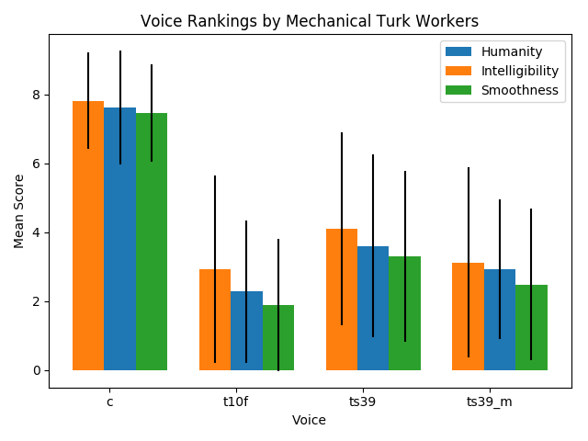
Experiment Results

Slide 17
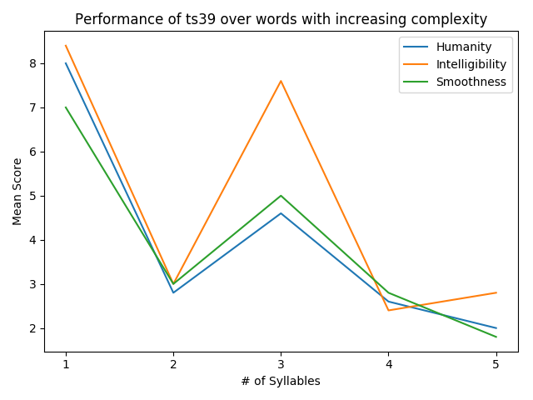
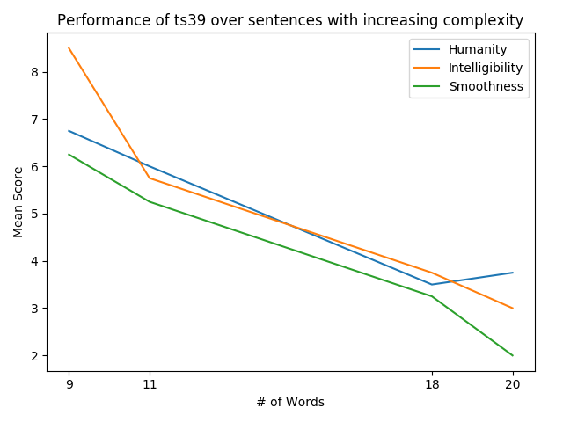
Experiment Results (ctd.)

Slide 18
Conclusions/Avenues for Future Work
Performance surprising given the low amount of base unit data used to synthesize the voice
uRobo is a complex system and could be tuned at many different layers to show improvement
  Different treatment of silences / sequence to sequence of words to phones
  HMM/GMM model for preselection
Different voice models may also help
  Single Speaker with 10 hours of Data
    Increased Variation of pronunciations over 25 minutes
    Better phonetic coverage
  Multi-Speaker with pitch contour normalization

Slide 19
References
[1] A. J. Hunt and A. W. Black, “Unit selection in a concatenative speech synthesis system using a large speech database,” in Proceedings of the Acoustics, Speech, and Signal Processing, 1996. On Conference Proceedings., 1996 IEEE International Conference- Volume 01, ser. ICASSP ’96. Washington, DC, USA: IEEE Computer Society, 1996, pp. 373–376. [Online]. Available: http://dx.doi.org/10.1109/ICASSP.1996.541110
[2] D. Povey, A. Ghoshal, G. Boulianne, L. Burget, O. Glembek, N. Goel, M. Hannemann, P. Motlicek, Y. Qian, P. Schwarz, J. Silovsky, G. Stemmer, and K. Vesely, “The kaldi speech recognition toolkit,” in IEEE 2011 Workshop on Automatic Speech Recognition and Understanding. IEEE Signal Processing Society, Dec. 2011, iEEE Catalog No.: CFP11SRW-USB.
[3] H. Beigi, Fundamentals of Speaker Recognition. Springer Publishing Company, Incorporated, 2011.
[4] F. Chollet et al., “Keras,” https://github.com/fchollet/keras, 2015

