Slide 1
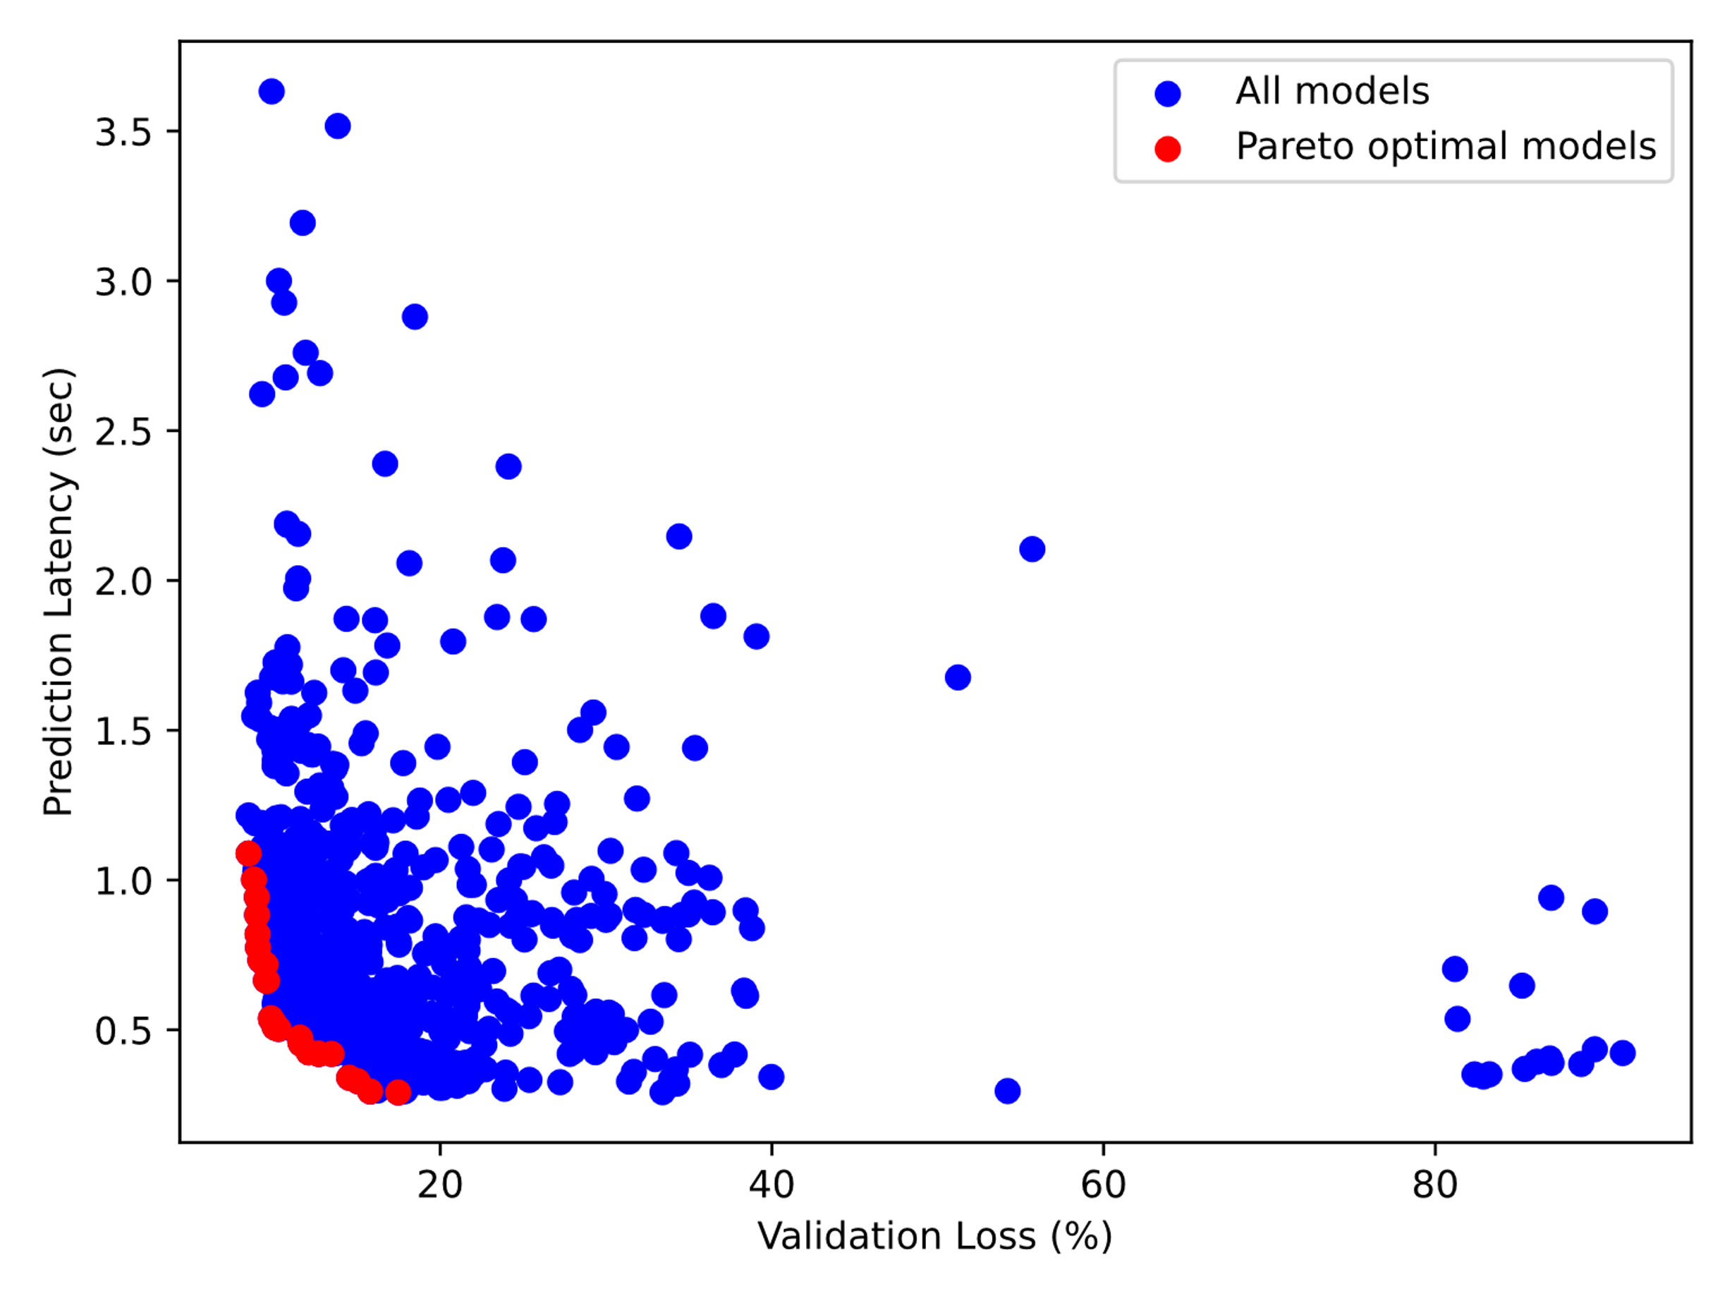
Multiobjective Optimization in DeepHyper
Open Research Question
Ensembles of networks can outperform individual networks for many tasks and offer benefits such as uncertainty quantification
By using multiobjective hyperparameter optimization can we generate a more diverse ensemble of networks?
Will this diversity of the ensemble improve the robustness of the predictions?
DeepHyper Multiobjective Optimization
DeepHyper currently supports several common scalarization techniques for multiobjective optimization
Linear (weighted-sum) scalarization
Quadratic scalarization
(Augmented) Chebyshev scalarization method
Progressive-boundary intersection (PBI)
Can we generate a robust ensemble by running different scalarizations on each node?
Preliminary results from using DeepHyper with randomized scalarizations to perform joint architecture-hyperparameter search on the JAHS_201_Benchmark problem for the CIFAR-10 dataset
Notes:
Technical Contacts: Tyler Chang (tchang@anl.gov) & Stefan Wild (wild@anl.gov)
Supported by: SciDAC FASTMath (PI Munson) and Argonne LDRD SDL (PI Stevens)
Notes:
During material manufacturing, material scientists have to decide how to mix chemical reagents and bases, in order to maximize yield and minimize unwanted byproducts
It may take several months for material scientists to identify suitable manufacturing conditions via trial and error
The software library ParMOO, developed at Argonne through the SciDAC FASTMath program, was designed to solve similar problems using numerical simulations
In this project, ParMOO was directly connected to the CFR and NMR output, so that it could run physical experiments instead of numerical simulations
By using machine learning surrogate models of the underlying phenomena, ParMOO reduces the total number of experiments that are needed, thereby reducing total time and material expense
Additionally, because this is a closed loop, ParMOO can perform many more experiments per day, since no operator or material scientist needs to be present
We have already implemented a proof of concept (shown in the image), which was able to identify several unexpected properties of a real-world reagent/base mixture problem
Our goal is that this process will be used by material scientists to run a design over the weekend, and then come back to find several suggested configurations on Monday morning, drastically reducing the time-to-manufacturing
The ParMOO software is written in Python and planned for release on GitHub, pip, and spack within the next two months, and will be a publicly available software, with support and documentation

