Slide 1
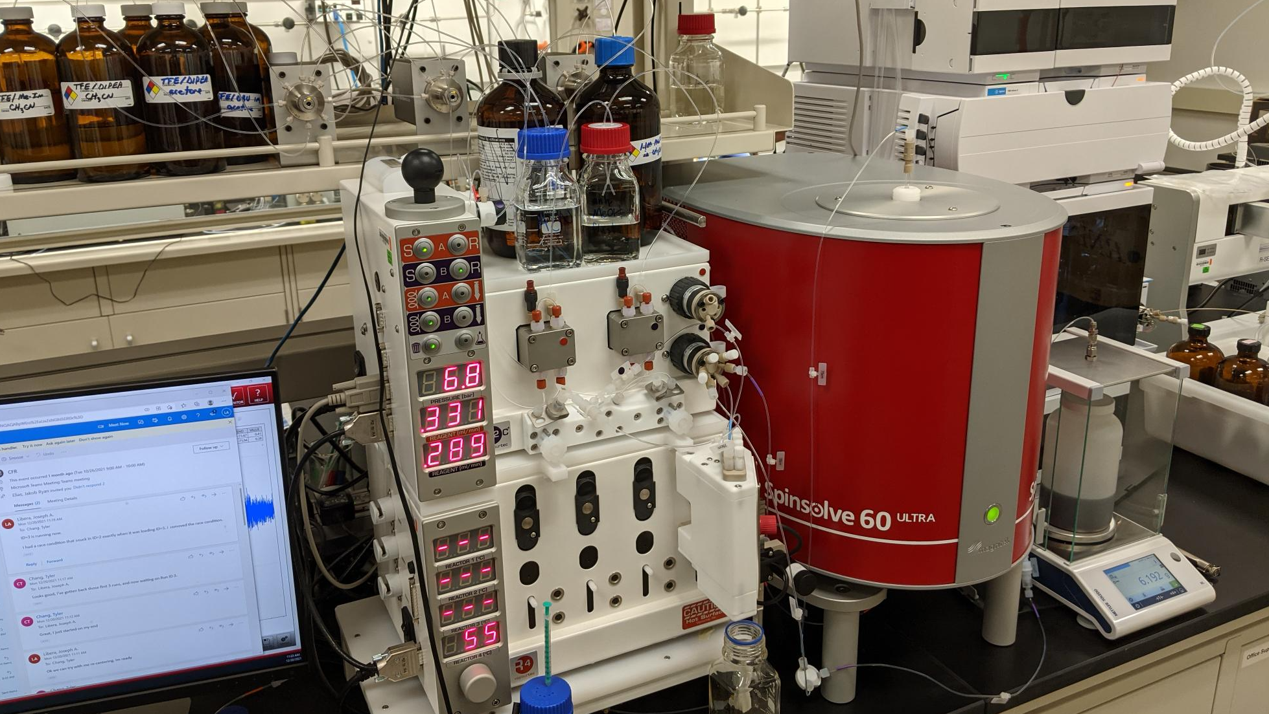
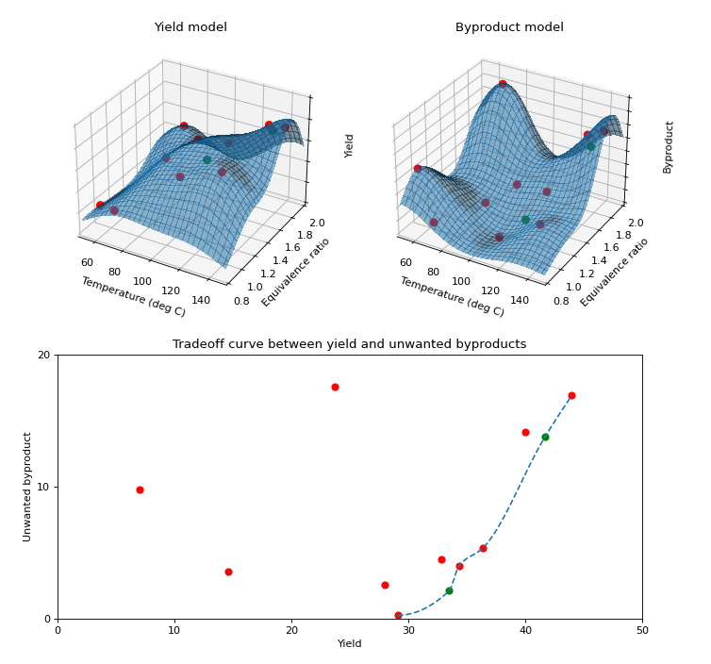

Using ParMOO to Drive Materials Design
FASTMath (PI Munson) Argonne SDL (PI Stevens)
Scientific Achievement
FASTMath-funded multiobjective optimization software ParMOO is backbone for self-driving continuous-flow chemistry lab for materials design and manufacturing
Significance and Impact
By integrating multiobjective optimization with a continuous-flow reactor (CFR) and nuclear magnetic resonance (NMR) spectroscopy, we save significant time and resources in materials design and discovery
Setup: lab computer (left) with ParMOO generates design, CFR (middle) performs synthesis, NMR (right) processes output, which is returned to ParMOO
Research Details
FASTMath-funded software ParMOO (https://github.com/parmoo/parmoo) was originally designed for solving multiobjective optimization problems involving computationally expensive simulations
Deployed here in a time-expensive synthesis and characterization loop
Traditionally, material scientists choose manufacturing conditions via trial/error:
Expensive, in terms of time and raw material requirements
Involves tradeoffs between maximizing yield and minimizing unwanted byproducts
ParMOO generates CFR configurations in a closed, operator-free loop:
ParMOO sends candidate designs directly to CFR controller
CFR performs material synthesis and sends output to NMR
NMR characterization results sent to ParMOO
ParMOO dynamically updates yield and byproduct surrogates, then uses these models to balance tradeoffs
Tyler Chang, Stefan Wild (MCS) Trevor Dzwiniel, Kris Pupek, Joe Libera (AMD)
Notes:
Technical Contacts: Tyler Chang (tchang@anl.gov) & Stefan Wild (wild@anl.gov)
Supported by: SciDAC FASTMath (PI Munson) and Argonne LDRD SDL (PI Stevens)
Notes:
During material manufacturing, material scientists have to decide how to mix chemical reagents and bases, in order to maximize yield and minimize unwanted byproducts
It may take several months for material scientists to identify suitable manufacturing conditions via trial and error
The software library ParMOO, developed at Argonne through the SciDAC FASTMath program, was designed to solve similar problems using numerical simulations
In this project, ParMOO was directly connected to the CFR and NMR output, so that it could run physical experiments instead of numerical simulations
By using machine learning surrogate models of the underlying phenomena, ParMOO reduces the total number of experiments that are needed, thereby reducing total time and material expense
Additionally, because this is a closed loop, ParMOO can perform many more experiments per day, since no operator or material scientist needs to be present
We have already implemented a proof of concept (shown in the image), which was able to identify several unexpected properties of a real-world reagent/base mixture problem
Our goal is that this process will be used by material scientists to run a design over the weekend, and then come back to find several suggested configurations on Monday morning, drastically reducing the time-to-manufacturing
The ParMOO software is written in Python and planned for release on GitHub, pip, and spack within the next two months, and will be a publicly available software, with support and documentation

