Slide 1
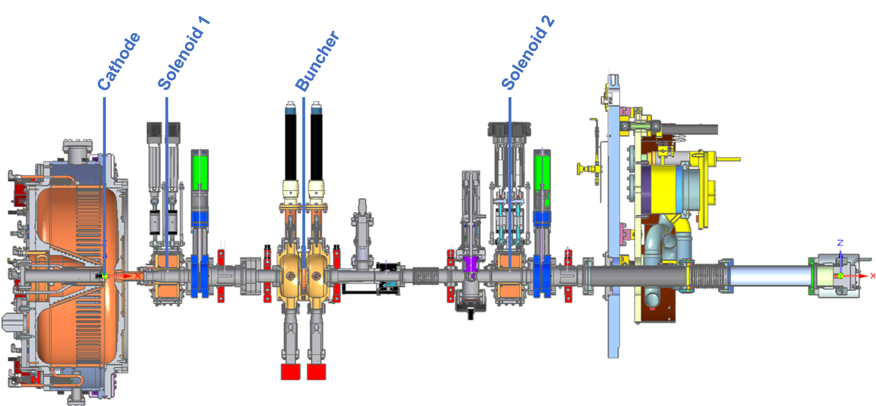
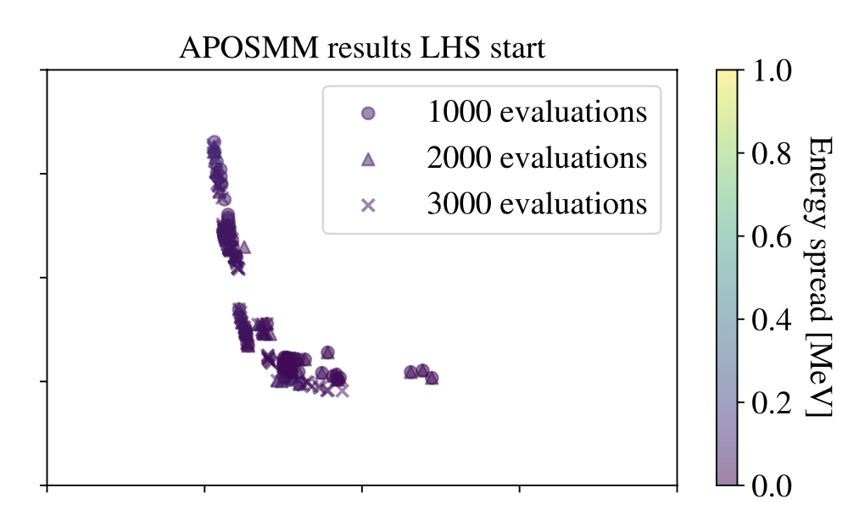
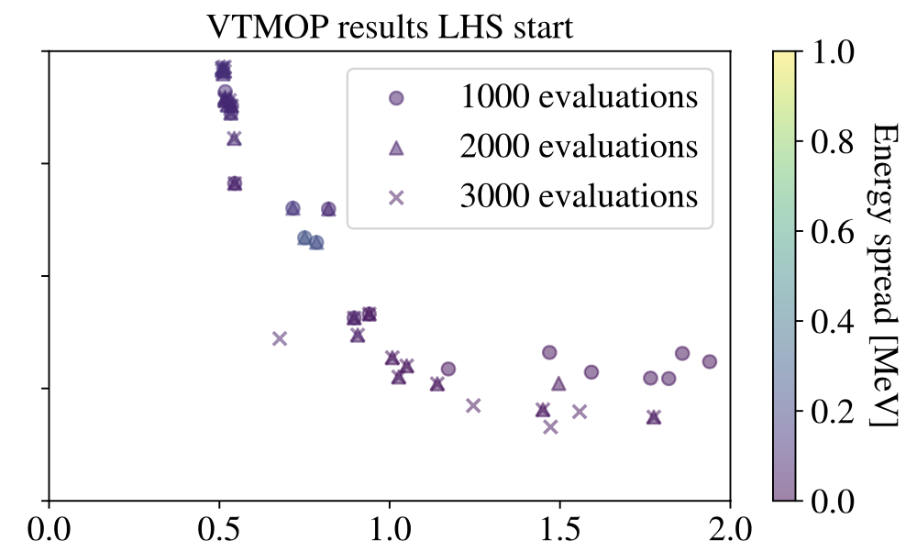
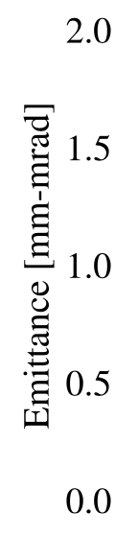


Multiobjective Optimization Methods for the LCLS-II Photoinjector
Scientific Achievement
Implement and compare three optimization algorithms for tuning the upgraded Linac Coherent Light Source (LCLS-II) at SLAC. Our modeling techniques
improve performance by an order of magnitude across all algorithms, allowing for optimization to be carried out in a dramatically shorter time.
Significance and Impact
Tuning particle accelerators is a complex process requiring considerable HPC simulation resources
Our improvements to problem formulations and solution methodologies greatly reduce computing costs over previous studies
Technical Approach
We propose a novel multiobjective penalty function to handle simulation failures that greatly accelerates convergence
We show that Latin hypercube sampling reduces computing needs
We show optimization algorithms performance on restrictive compute budgets
PI(s)/Facility Lead(s): Larson, Chang (ANL)
Collaborating Institutions: Stanford, SLAC
ASCR Program: SciDAC Institutes
ASCR PM: Lali Chatterjee
Publication(s) for this work: Neveu et al., "Comparison of multiobjective optimization methods for the LCLS-II photoinjector," Computer Physics Communication 283:108566.
(Top) LCLS-II diagram to be optimized including laser parameters, gun phase, and solenoid strength for the rf gun. (Bottom) Results of the optimization study for two optimization algorithms developed at Argonne.
Institution Logo #1
Notes:
LOCAL LAB POC:
Tyler Chang (tchang@anl.gov)
Jeffrey Larson (jmlarson@anl.gov)
TALKING POINTS:
In recently published works, accelerator physicists report that similar accelerator designs required 10,000 – 20,000 expensive simulations of the rf gun
Using the techniques proposed, are able to achieve similar performance with just 1,000 – 3,000 evaluations
Our simulation requires ~8-10 mins on 4 cores per simulation, so our techniques could save roughly 5,000 -- 10,000 core hours in each future particle accelerator design
Since we have implemented these techniques in the ECP software libEnsemble, we could see even greater reductions in wallclock time by utilizing parallel HPC systems
METADATA:
Name of the associated awarded project:
PI name(s): FASTMath SciDAC Institute (PI: Esmund Ng LBNL)
Name of the program manager: Lali Chatterjee
CITATIONS:
The notes section should also include full citations (including the DOI) to any important and associated publications, datasets or code developed as part this work.
N. Neveu, T. H. Chang, P. Franz, S. Hudson, and J. Larson. Comparison of multiobjective optimization methods for the LCLS-II photoinjector. Computer Physics Communications 283. 2023, p. 108566. https://doi.org/10.1016/j.cpc.2022.108566
REPRODUCIBILITY:
If this work has received any badges or recognitions for reproducibility, please note them here. (Alternatively, can associated these with specific publications listed above)
BACKGROUND AND CONTEXT INFORMATION:
You may include further background or other information that would be helpful in understanding and delivering the full impact of this research.

