Slide 1
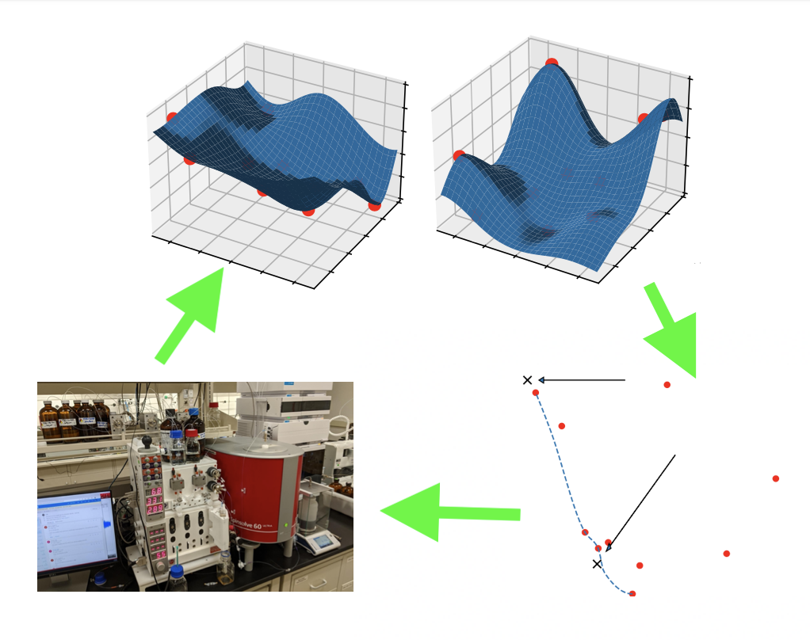
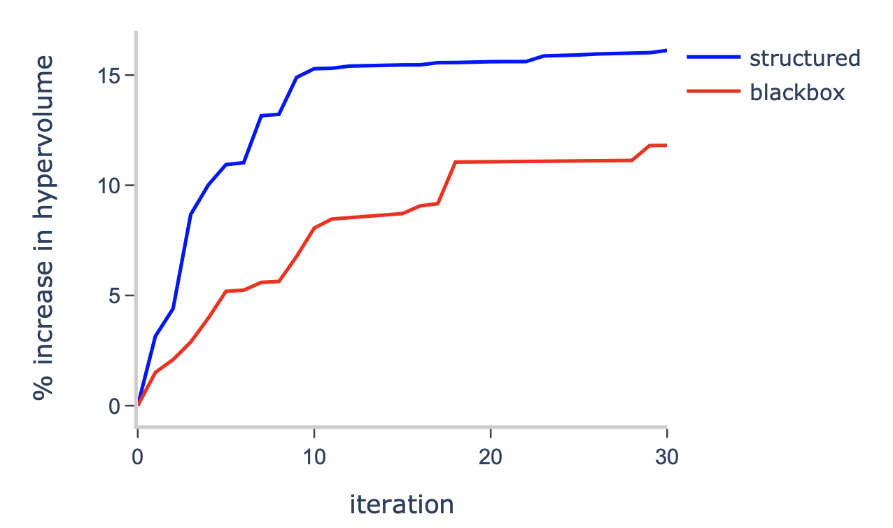

ParMOO: A Python library for parallel multiobjective simulation optimization
Scientific Achievement
A parallel Python library for customizing and deploying solvers for the optimization of expensive scientific and engineering processes involving multiple conflicting objectives, such as computer simulations and laboratory experiments.
Significance and Impact
Easy to deploy in workflows such as HPC systems and self-driving labs
Combines state-of-the-art techniques from nonlinear optimization, surrogate modeling, data acquisition, design-of-experiments, and representation learning
Supports complex problem types, including mixed variables and black-box constraints
Allows scientists to take advantage of domain knowledge and exploit problem structures
A diagram of ParMOO's approach for steering experiments, involving surrogate modeling, multiobjective optimization, and data acquisition in a closed loop.
Technical Approach
Combines several existing and novel methodologies for reducing diverse problems to a common form
Uses modular design and agile methodology for maintainability and extensibility
Software is open-source and documented with an automated CI/CD pipeline
Demonstrated the effectiveness of techniques on multiple real-world problems
Layers over existing ECP software libEnsemble to achieve parallelism on HPCs
PI(s)/Facility Lead(s): Tyler Chang (ANL) and Stefan Wild (LBL)
Collaborating Institutions: Argonne, Lawrence Berkeley
ASCR Program: FASTMath SciDAC Institute
ASCR PM: Lali Chatterjee
Publication(s) for this work: Chang and Wild, "ParMOO: A Python library for parallel multiobjective simulation optimization," Journal of Open Source Software 8(82):4468, 2023.
ParMOO's customized structure-exploiting solvers outperform a typical black-box solver on a material design problem.
Notes:
LOCAL LAB POC:
Tyler Chang (tchang@anl.gov)
Stefan Wild (wild@lbl.gov)
TALKING POINTS:
To achieve state-of-the-art performance on cutting-edge scientific problems, such as material design and particle accelerator design, customized methods are needed
Building customized solvers from scratch and deploying them on HPC systems and other scientific work environments is a slow and time-consuming process
For real-world problems with multiple competing objectives, perhaps derived from completely different processes, this process is only further complicated
By providing a flexible framework of common methods and building blocks we are able to accelerate this process, while still achieving state-of-the-art performance
METADATA:
Name of the associated awarded project:
PI name(s): FASTMath SciDAC Institute (PI: Esmund Ng LBNL)
Name of the program manager: Lali Chatterjee
CITATIONS:
The notes section should also include full citations (including the DOI) to any important and associated publications, datasets or code developed as part this work.
T. H. Chang and S. M. Wild. "ParMOO: A Python library for parallel multiobjective simulation optimization." Journal of Open Source Software 8(82):4468, 2023. https://doi.org/10.21105/joss.04468
T. H. Chang, J. R. Elias, S. M. Wild, S. Chaudhuri, and J. A. Libera. "A framework for fully autonomous design of materials via multiobjective optimization and active learning: challenges and next steps." In Proc. ICLR 2023, Workshop on Machine Learning for Materials (ML4Materials). url: https://openreview.net/forum?id=8KJS7RPjMqG
Code: https://github.com/parmoo/parmoo

