Slide 1
Machine Learning for Facial Image Super-resolution
CHEUNG Tsun Hin (15083269D)
Supervisor: Prof. Kenneth LAM
Date: 23 April 2019

Slide 2

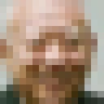
Image Super-resolution (SR)
upscale
low-resolution
image
high-resolution
image

Slide 3
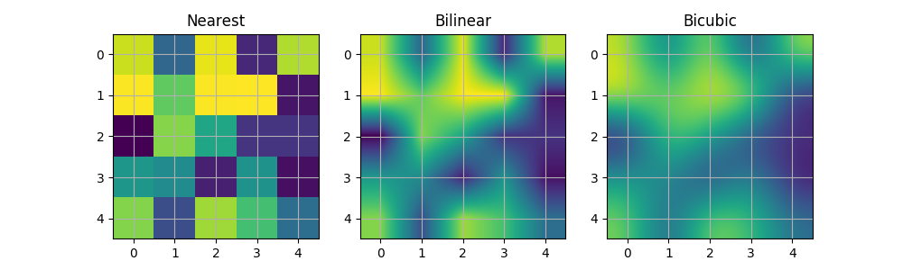
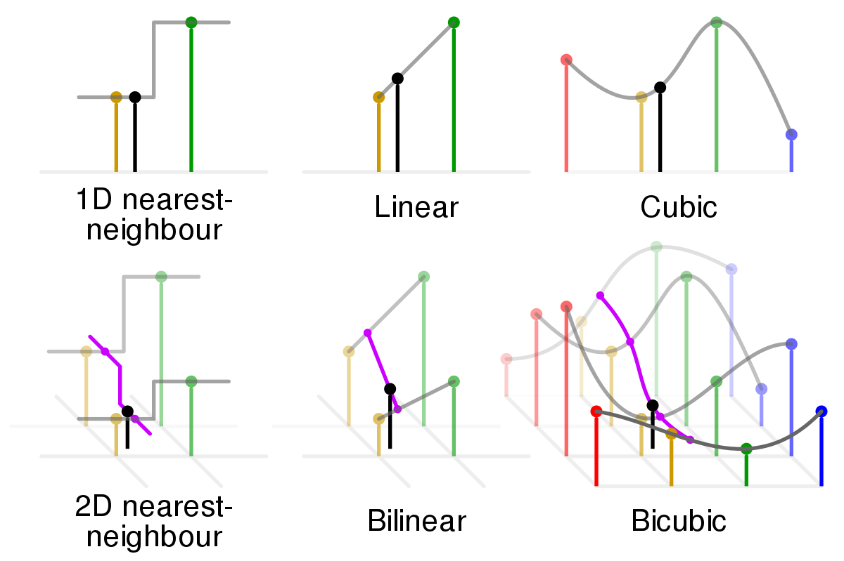



Polynomial-based interpolation
Interpolation is the simplest method of upscaling an image using known data points
Higher-order polynomial Interpolation maintains the continuity of adjacent pixels, but smooths the image

Slide 4
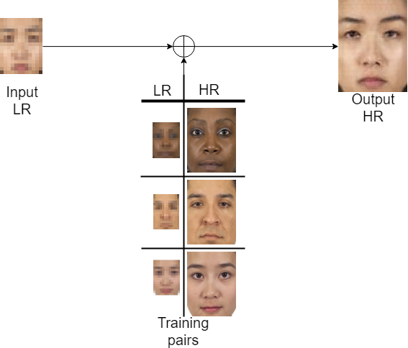
Example-based super-resolution

Slide 5
Contributions
Implementation of machine learning and deep learning algorithms for facial image super-resolution using C++ with OpenCV library and Python with Pytorch library
Modification and retraining the existing deep learning models for facial image super resolution
Evaluation and comparison of the performance of different methods on different datasets, with different upscaling factors, down-sampling kernels, and noise levels

Slide 6
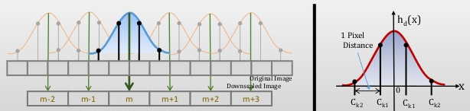
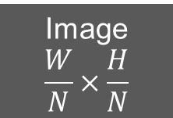



Problem formulation
General Approach:
Practical Approach:
Kernels: nearest neighbour, bilinear & bicubic kernels
Image
$$W×H$$
LPF
Down-sampler
↓N
Image
$$\frac{W}{N}×\frac{H}{N}$$
Image
$$W×H$$
Down-sampling
kernel
Image
$$\frac{W}{N}×\frac{H}{N}$$

Slide 7
Datasets
Chicago face database
200 images for training, 20 images for testing
Face alignment is done using dlib and cropped into the size of 96x128
LFW face database
10, 000 images for training, 20 images for testing
Face alignment is done using dlib and cropped into the size of 128x128

Slide 8
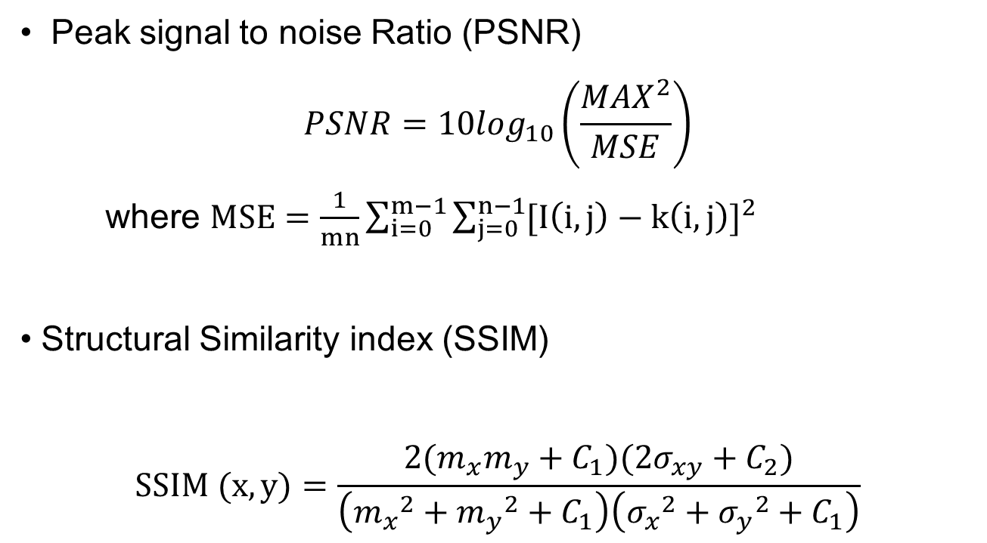
Measurements
Peak signal to noise Ratio (PSNR)
$$PSNR=10\log_{10}\left(\frac{{MAX}^{2}}{MSE}\right)$$
where $MSE=\frac{1}{mn}\sum_{i=0}^{m−1}{\sum_{j=0}^{n−1}{{[I\left(i,j\right)−k\left(i,j\right)]}^{2}}}$
Structural Similarity index (SSIM)
$$SSIM (x,y)=\frac{2(m_{x}m_{y}+C_{1})(2σ_{xy}+C_{2})}{\left({m_{x}}^{2}+{m_{y}}^{2}+C_{1}\right)\left({σ_{x}}^{2}+{σ_{y}}^{2}+C_{1}\right)}$$

Slide 9
Algorithm 1 – Eigentransformation (PCA)

Slide 10
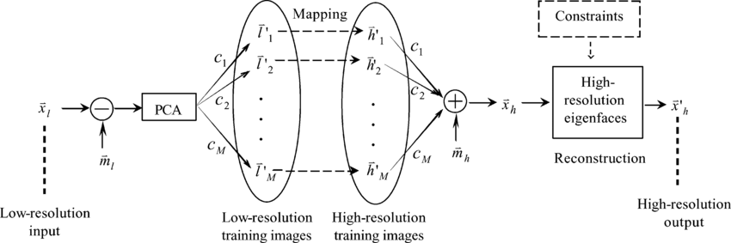
Algorithm 1 – Eigentransformation [1]
This method is a transformation based on mapping between LR and HR groups of training samples
The input LR image could be represented by a linear combination of LR training samples
Keeping all the coefficients, the LR training samples are replaced by the corresponding HR ones
[1] X. Wang, etc., "Hallucinating face by eigentransformation, " IEEE Transactions on Systems, Man, and Cybernetics, 2005.

Slide 11





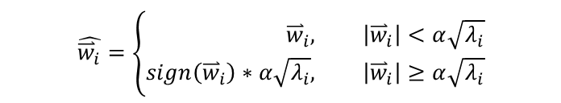
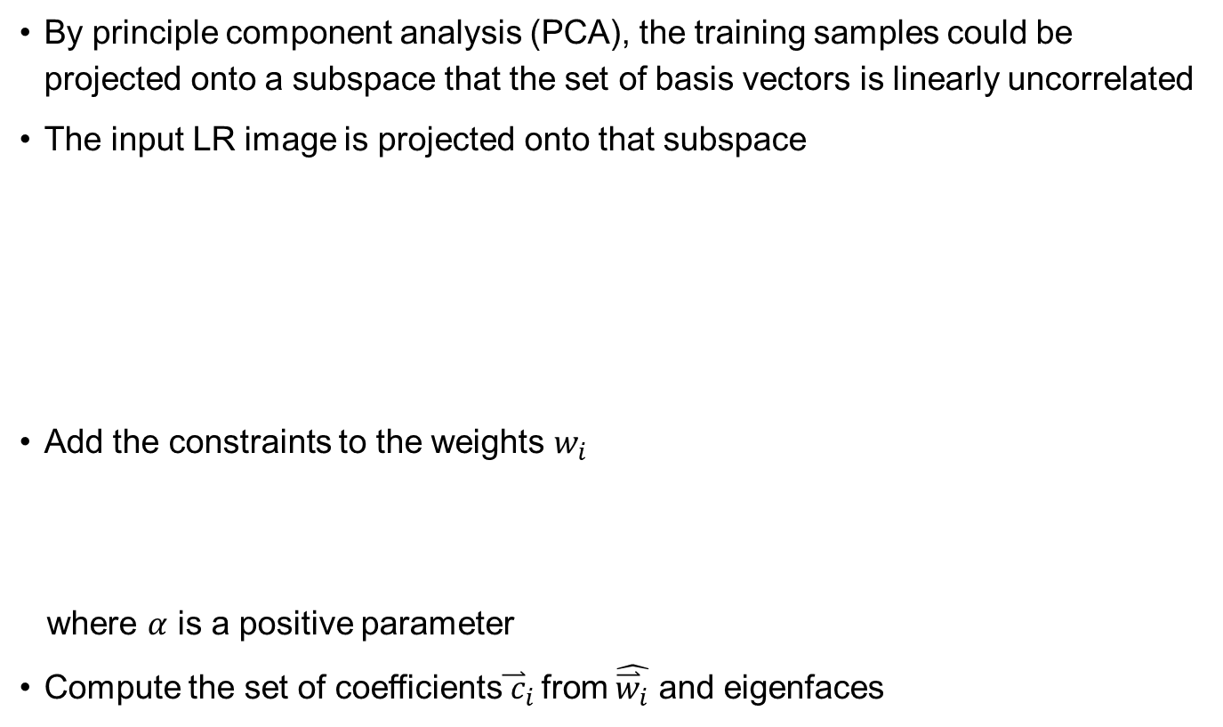
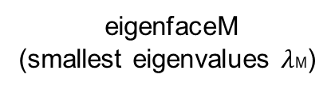
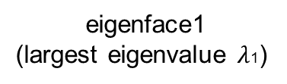
Algorithm 1 – Eigentransformation
By principle component analysis (PCA), the training samples could be projected onto a subspace that the set of basis vectors is linearly uncorrelated
The input LR image is projected onto that subspace
Add the constraints to the weights $w_{i}$
where $α$ is a positive parameter
Compute the set of coefficients${\overset{⃑}{ c}}_{i }$from $\hat{{\overset{⃑}{w}}_{i}}$ and eigenfaces
= + $w_{1}$ + $w_{2}$ +… +$w_{k}$
Input LR
mean LR face
eigenface1
(largest eigenvalue $λ$1)
eigenface2
eigenfaceM
(smallest eigenvalues $λ$M)
$$\hat{{\overset{⃑}{w}}_{i}}=\left\{\begin{aligned}{\overset{⃑}{w}}_{i}, &\left|{\overset{⃑}{w}}_{i}\right|<α\sqrt{λ_{i}} \\ sign\left({\overset{⃑}{w}}_{i}\right)∗α\sqrt{λ_{i}}, &\left|{\overset{⃑}{w}}_{i}\right|≥α\sqrt{λ_{i}}\end{aligned}\right.$$

Slide 12
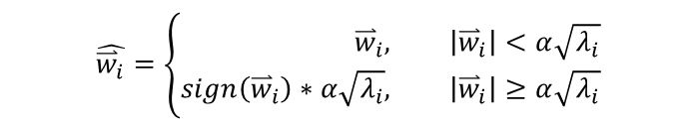
Result 1 – Eigentransformation
$$\hat{{\overset{⃑}{w}}_{i}}=\left\{\begin{aligned}{\overset{⃑}{w}}_{i}, &\left|{\overset{⃑}{w}}_{i}\right|<α\sqrt{λ_{i}} \\ sign\left({\overset{⃑}{w}}_{i}\right)∗α\sqrt{λ_{i}}, &\left|{\overset{⃑}{w}}_{i}\right|≥α\sqrt{λ_{i}}\end{aligned}\right.$$

Slide 13
Algorithm 2 – Neighbour Embedding (LLE)

Slide 14
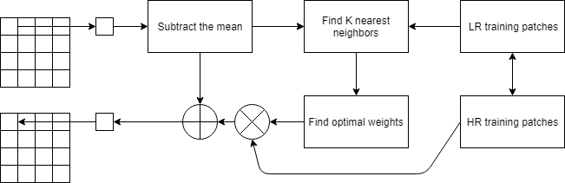

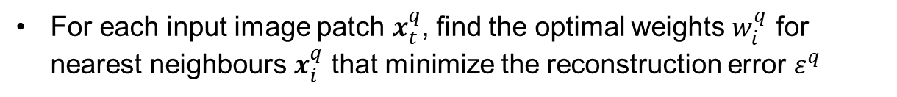
Algorithm 2 – Neighbour Embedding [2]
Locally linear embedding (LLE) is one of the manifold learning (nonlinear dimensionality reduction) methods
By neighbourhood-preserving embeddings of high-dimensional inputs, the nonlinear structure is recovered from locally linear fits
For each input image patch $x_{t}^{q}$, find the optimal weights $w_{i}^{q}$ for nearest neighbours $x_{i}^{q}$ that minimize the reconstruction error $ε^{q}$
$$ε^{q}={{\left\|x_{t}^{q}−\sum_{i=1}^{k}{w_{i}^{q}x_{i}^{q}}\right\|}_{2}}^{2}$$
s.t. $\sum_{i=1}^{k}{w_{i}^{q}=1}$
[2] H. Chang, etc., "Super-resolution through Neighbour Embedding, " IEEE Conference on Computer Vision and Pattern Recognition, 2004.

Slide 15
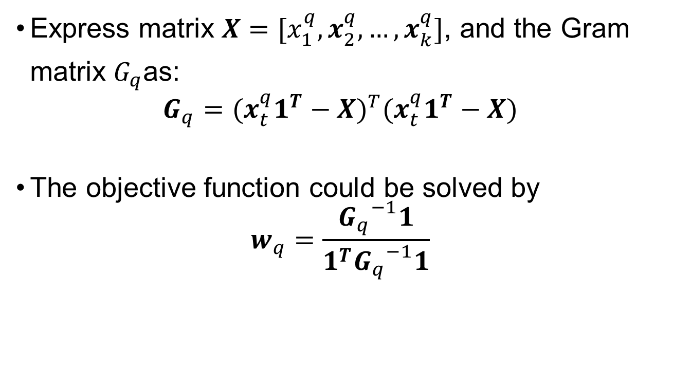
Algorithm 2 – Neighbour Embedding
Express matrix $X=[x_{1}^{q},x_{2}^{q},…,x_{k}^{q}]$, and the Gram matrix $G_{q}$as:
$$G_{q}={(x_{t}^{q}1^{T}−X)}^{T}(x_{t}^{q}1^{T}−X)$$
The objective function could be solved by
$$w_{q}=\frac{{G_{q}}^{−1}1}{1^{T}{G_{q}}^{−1}1}$$

Slide 16
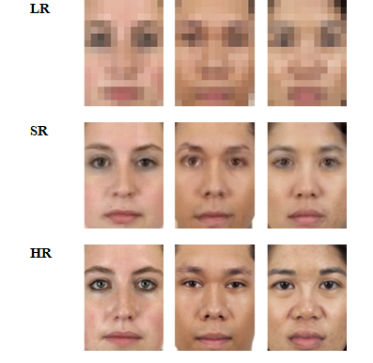
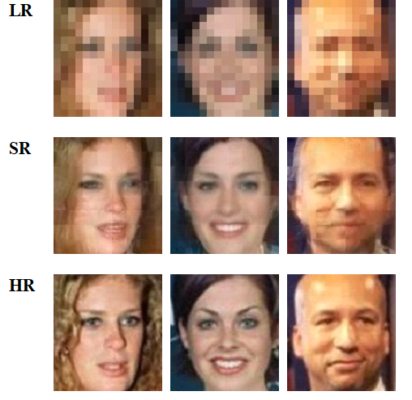
Result 2 – Neighbour Embedding
Effect of the number of nearest neighbours k for different datasets

Slide 17
Algorithm 3 – Sparse Representation (SR)

Slide 18
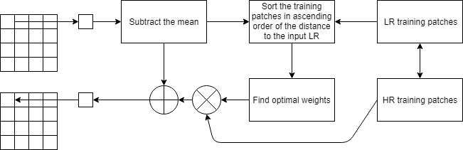
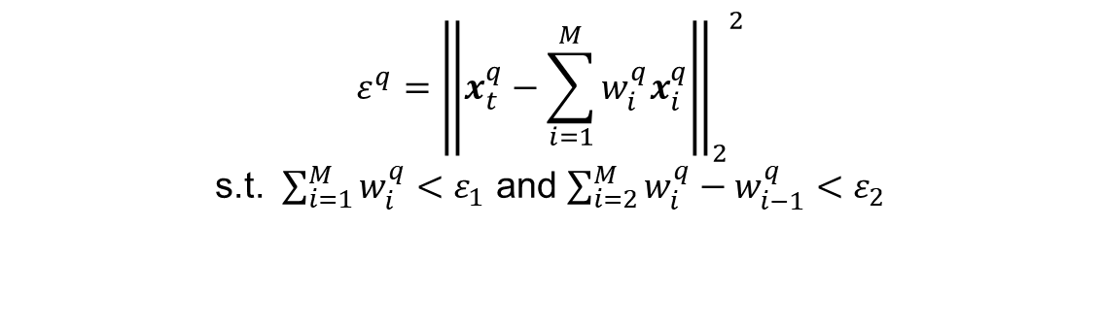
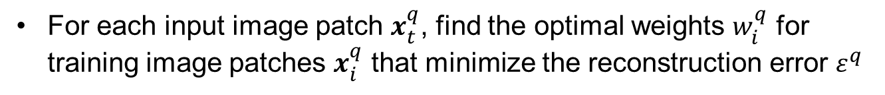
Algorithm 3 – Sparse Representation [3] [4]
Sparse representation deals with sparse solutions for systems of linear equations
For each input image patch $x_{t}^{q}$, find the optimal weights $w_{i}^{q}$ for training image patches $x_{i}^{q}$ that minimize the reconstruction error $ε^{q}$
$$ε^{q}={{\left\|x_{t}^{q}−\sum_{i=1}^{M}{w_{i}^{q}x_{i}^{q}}\right\|}_{2}}^{2}$$
s.t. $\sum_{i=1}^{M}{w_{i}^{q}<ε_{1}}$ and $\sum_{i=2}^{M}{w_{i}^{q}−w_{i−1}^{q}}<ε_{2}$
[3] J. Yang, etc., "Image Super-Resolution Via Sparse Representation, " IEEE Transactions on Image Processing, May 2010.
[4] J. Jiang, etc., "Noise Robust Face Image Super-Resolution Through Smooth Sparse Representation, “ IEEE Transactions on Cybernetics, Nov 2017.

Slide 19
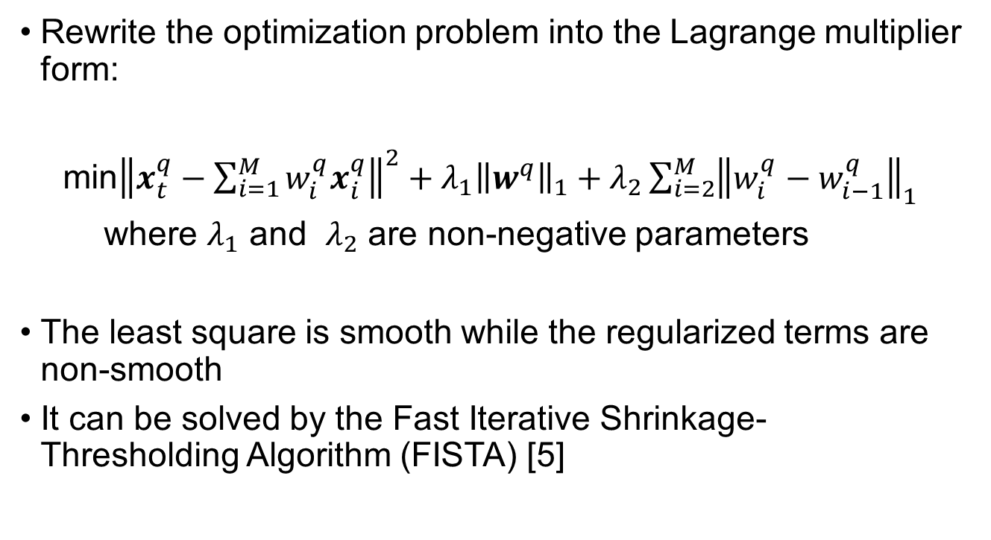
Algorithm 3 – Sparse Representation
Rewrite the optimization problem into the Lagrange multiplier form:
min${\left\|x_{t}^{q}−\sum_{i=1}^{M}{w_{i}^{q}x_{i}^{q}}\right\|}^{2}+λ_{1}{\left\|w^{q}\right\|}_{1}+λ_{2}\sum_{i=2}^{M}{{\left\|w_{i}^{q}−w_{i−1}^{q}\right\|}_{1}}$
where $λ_{1}$ and $λ_{2}$ are non-negative parameters
The least square is smooth while the regularized terms are non-smooth
It can be solved by the Fast Iterative Shrinkage-Thresholding Algorithm (FISTA) [5]
[5] A. Beck, "A Fast Iterative Shrinkage-Thresholding Algorithm for Linear Inverse Problems, " Imaging Sciences, 2009.

Slide 20

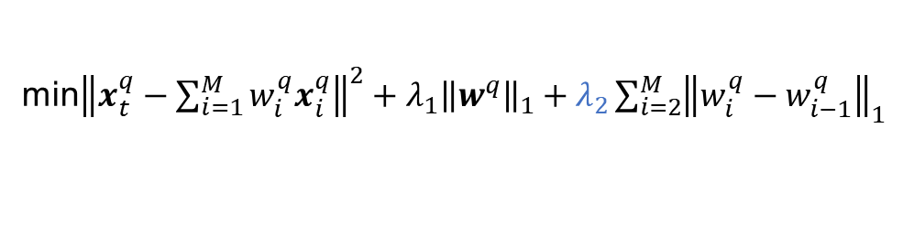
Result 3 – Sparse Representation
Effect of parameter $λ_{2}$
Noiseless images
Noisy images
with white noise (σ = 0.05)
min${\left\|x_{t}^{q}−\sum_{i=1}^{M}{w_{i}^{q}x_{i}^{q}}\right\|}^{2}+λ_{1}{\left\|w^{q}\right\|}_{1}+λ_{2}\sum_{i=2}^{M}{{\left\|w_{i}^{q}−w_{i−1}^{q}\right\|}_{1}}$

Slide 21
Algorithm 4 – Convolutional Neural Network (CNN)

Slide 22
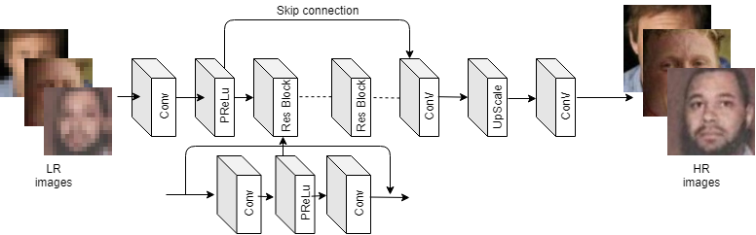
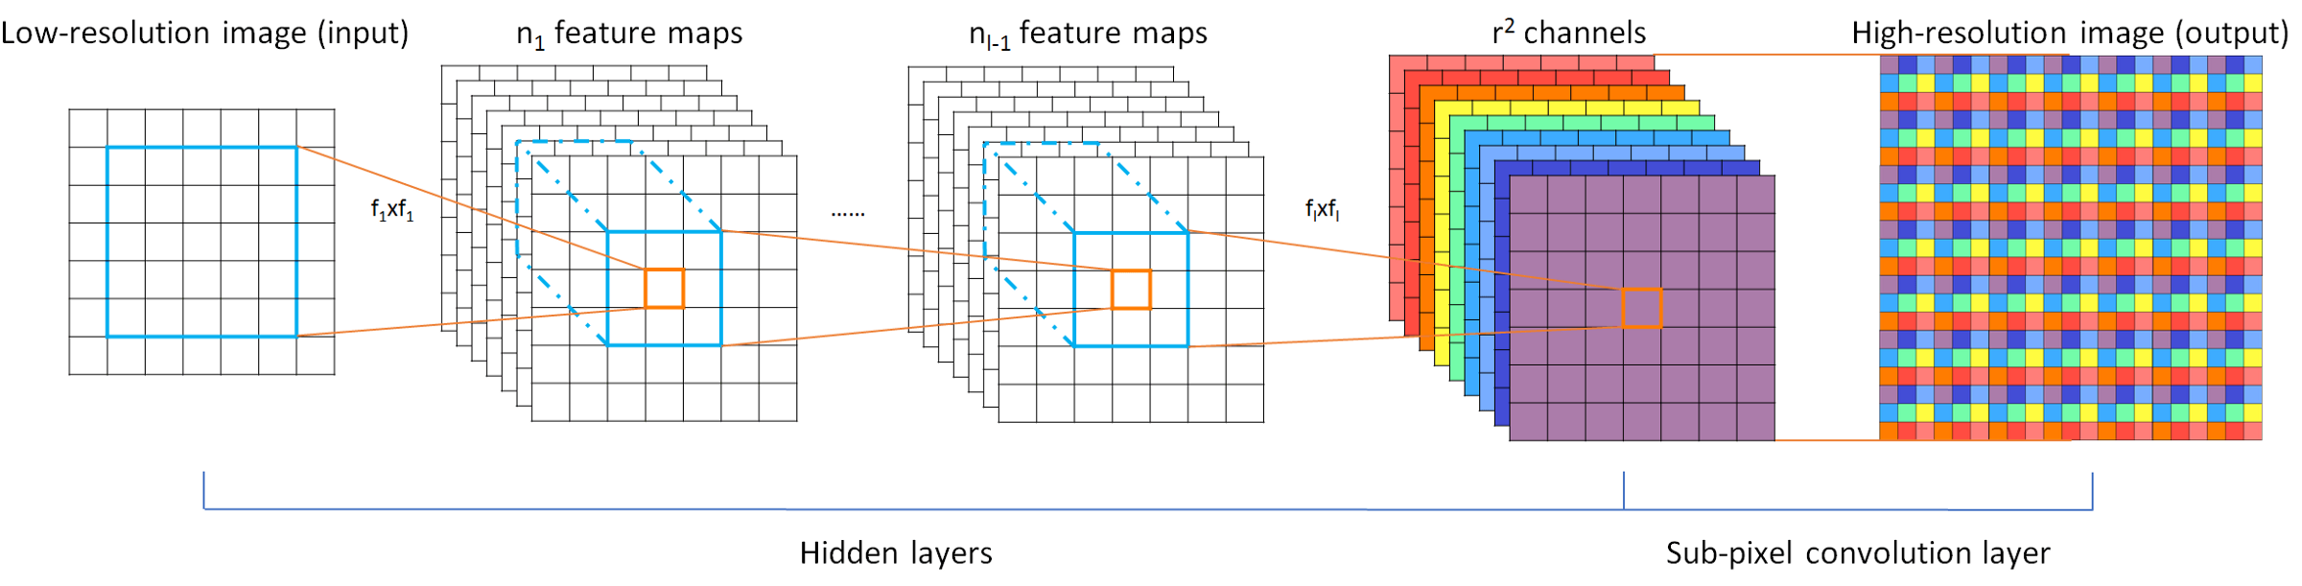
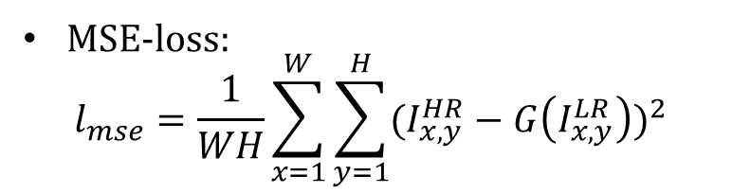
Algorithm 4 – Convolutional Neural Network (CNN) [6]
Network architecture
Upscaling block
MSE-loss:
$$l_{mse}=\frac{1}{WH}\sum_{x=1}^{W}{\sum_{y=1}^{H}{{(I_{x,y}^{HR}−G\left(I_{x,y}^{LR}\right))}^{2}}}$$
learning rate: 0.0001
batch size: 2
number of epochs: 200
[6] B. Lim, etc., "Enhanced Deep Residual Networks for Single Image Super-Resolution, " IEEE Conference on Computer Vision and Pattern Recognition Workshop, 2017.

Slide 23
Results 4 – CNN with different down-sampling kernels
down-sampling kernels of training images
down-sampling
kernels of
testing images
number of training images: 10, 000
number of testing images: 20

Slide 24
Algorithm 5 – Generative Adversarial Network (GAN)

Slide 25
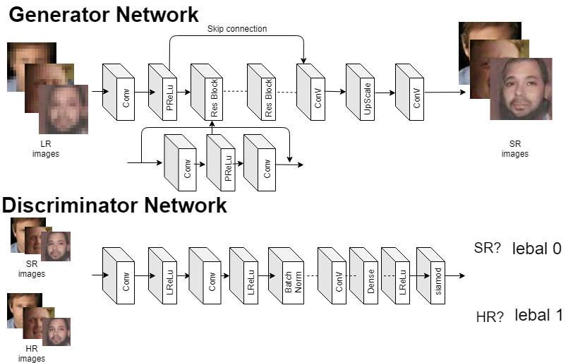
Algorithm 5 – Generative Adversarial Network (GAN) [7]
learning rates: 0.0001
batch size: 2
number of epochs: 200
The generator network fools the discriminator that the generated image is natural
The discriminator network distinguishes that the image is a natural or generated image
[7] C. Ledig, etc., "Photo-Realistic Single Image Super-Resolution Using a Generative Adversarial Network, " IEEE Conference on Computer Vision and Pattern Recognition, Aug 2017.

Slide 26
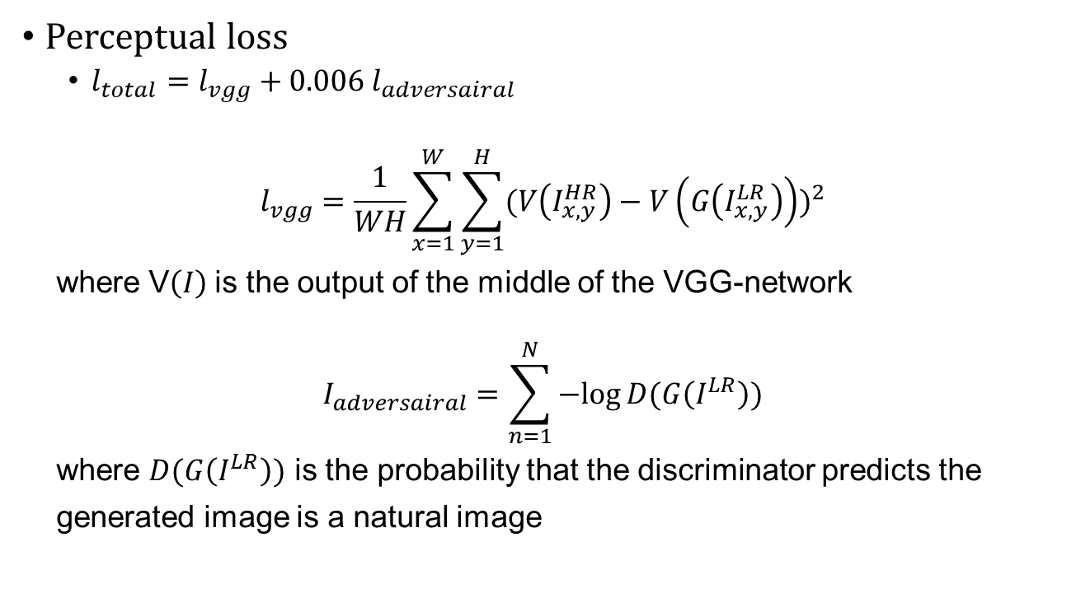
Algorithm 5 – Generative Adversarial Network (GAN)
Perceptual loss
$l_{total}=l_{vgg}+0.006 l_{adversairal}$
$$l_{vgg}=\frac{1}{WH}\sum_{x=1}^{W}{\sum_{y=1}^{H}{{(V\left(I_{x,y}^{HR}\right)−V\left(G\left(I_{x,y}^{LR}\right)\right))}^{2}}}$$
where V$\left(I\right)$is the output of the middle of the VGG-network
$$I_{adversairal}=\sum_{n=1}^{N}{−log⁡D(G\left(I^{LR}\right))}$$
where $D(G\left(I^{LR}\right))$ is the probability that the discriminator predicts the
generated image is a natural image

Slide 27
Overall Results – upscaling factor 8
number of training images: 200
number of testing images: 20

Slide 28
Overall Results – upscaling factor 4
number of training images: 200
number of testing images: 20

Slide 29
Overall Results – unconstrainted dataset
number of training images: 10, 000
number of testing images: 20

Slide 30
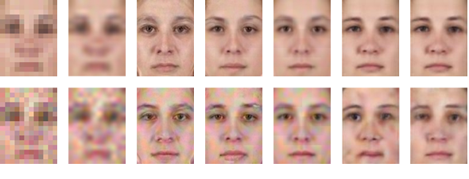

Overall Results – noise performance
σ = 0.01
σ = 0.05
number of training images: 200
number of testing images: 20
Noisy Image
$$LR$$
Image denoising&
super-resolution
Noiseless image
HR

Slide 31
Conclusion
Convolutional Neural Networks (CNNs) achieve the best performance in terms of PSNR and SSIM.
CNNs are very sensitive to the down-sampling kernels used to generate the input LR images.
Sparse representation has less dB drops in terms PSNR when noise increases.

Slide 32




Future work
1. Image super-resolution for noisy inputs
My current approach:
Other possible approaches:
Noisy
Image
$$LR$$
Image denoising&
super-resolution
Noiseless image
HR
Noisy
Image
$$LR$$
Image denoising&
super-resolution
Noisy
Image
$$LR$$
Image denoising
Image super-resolution
Noiseless image
HR
Noisy
Image
$$LR$$
Image super-resolution
Image denoising
Noiseless image
HR

Slide 33


Future work
2. Image degradation in real case
Image
$$W×H$$
?
Image
$$\frac{W}{N}×\frac{H}{N}$$

Slide 34
References
[1] X. Wang& X. Tang, "Hallucinating face by eigentransformation, " IEEE Transactions on Systems, Man, and Cybernetics, Jul 2005.
[2] H. Chang, D. Yeung& Y. Xiong, "Super-resolution through Neighbour Embedding, " IEEE Conference on Computer Vision and Pattern Recognition, 2004.
[3] J. Yang, J. Wright& T. S. Huang, "Image Super-Resolution Via Sparse Representation, “ IEEE Transactions on Image Processing, May 2010.
[4] J. Jiang, J. Ma& C. Chen, "Noise Robust Face Image Super-Resolution Through Smooth Sparse Representation, “ IEEE Transactions on Cybernetics, Nov 2017.
[5] A. Beck and M. Teboulle, "A Fast Iterative Shrinkage-Thresholding Algorithm for Linear Inverse Problems, " Imaging Sciences, 2009.

Slide 35
References
[6] B. Lim, S. Son, H. Kim, S. Nah, K. Mu Lee, "Enhanced Deep Residual Networks for Single Image Super-Resolution, " IEEE Conference on Computer Vision and Pattern Recognition Workshop, 2017.
[7] C. Ledig, L. Theis, F. Huszar, "Photo-Realistic Single Image Super-Resolution Using a Generative Adversarial Network, " IEEE Conference on Computer Vision and Pattern Recognition, Aug 2017.

