Slide 1
Machine Learning for Facial Image Super-resolution
CHEUNG Tsun Hin
Supervisor: Prof. Kenneth LAM
Department of Electronic and Information Engineering
Date: 11 January 2019

Slide 2
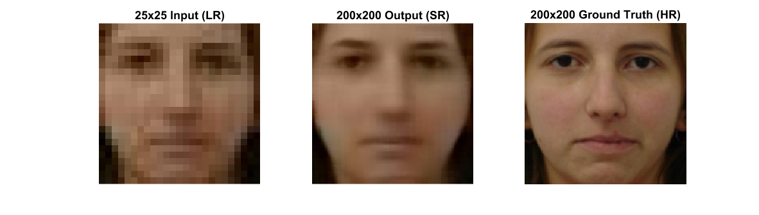
What is Image Super-resolution?
Image super resolution (SR) is the technique that estimates the high resolution (HR) image from a low resolution (LR) image.

Slide 3
Why do we need Super-resolution?
Medical usage
example: computed tomography (CT)
Video surveillance
example: low resolution face recognition

Slide 4
Methods of Super-resolution
Interpolation-based
Upscaling the image by using the known data points without prior knowledge.
Example: Bicubic interpolation
Example-based
Estimating the HR image by learning the training pairs of LR and HR samples.

Slide 5
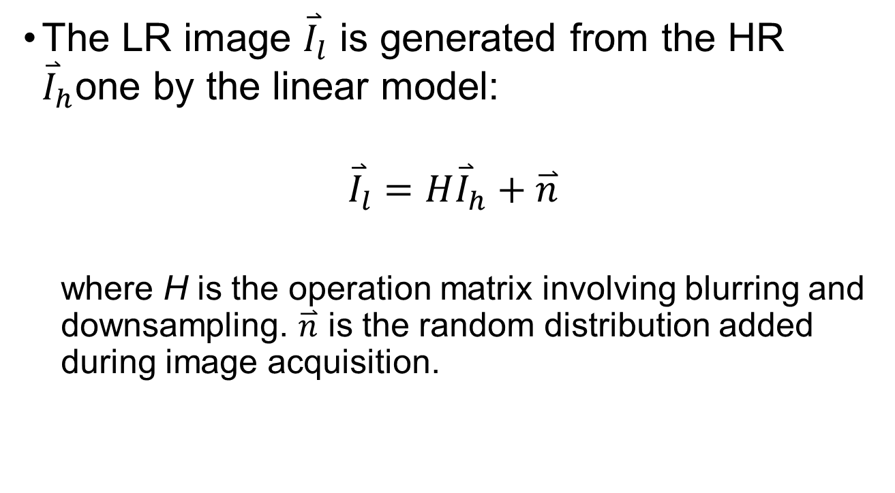
Problem Formulation
The LR image ${\overset{⃑}{I}}_{l}$ is generated from the HR ${\overset{⃑}{I}}_{h}$one by the linear model:
$${\overset{⃑}{I}}_{l}=H{\overset{⃑}{I}}_{h}+\overset{⃑}{n}$$
where H is the operation matrix involving blurring and downsampling. $\overset{⃑}{n}$ is the random distribution added during image acquisition.

Slide 6
Equipment
Windows 10 64bit
Microsoft Visual C++ 2017 with OPENCV library
MATLAB R2017b
Ubuntu 18.04
Python 3.6 with PYTORCH library

Slide 7
Datasets
Face image database
Chicago face database
This dataset consists of 597 facial images
200 for training and 20 for testing
Face alignment
All face images have been detected and aligned according to the eyes position using opencv and dlib before experiments. Then, the images are cropped into size of 168x200

Slide 8
Algorithms
Conventional machine learning algorithms
Eigen transformation (Principal component analysis)
Neighbour embedding (Locally linear embedding)
Sparse representation
Deep learning algorithms
Convolutional neutral network (CNN)
Generative adversarial network (GAN)

Slide 9
Progress
Work Done | Time
Implementation of Eigen transformation | Sep 2018
Implementation of Neighbour Embedding and Sparse Representation | Oct 2018
Measurements on the Eigen transformation, Neighbour Embedding and Sparse Representation | Nov 2018
Implementation of deep learning approaches | Dec 2018

Slide 10
Algorithm 1 Eigen Transformation
[1] X. Wang& X. Tang, "Hallucinating face by eigentransformation, " IEEE Transactions on Systems, Man, and Cybernetics, Jul 2005.

Slide 11
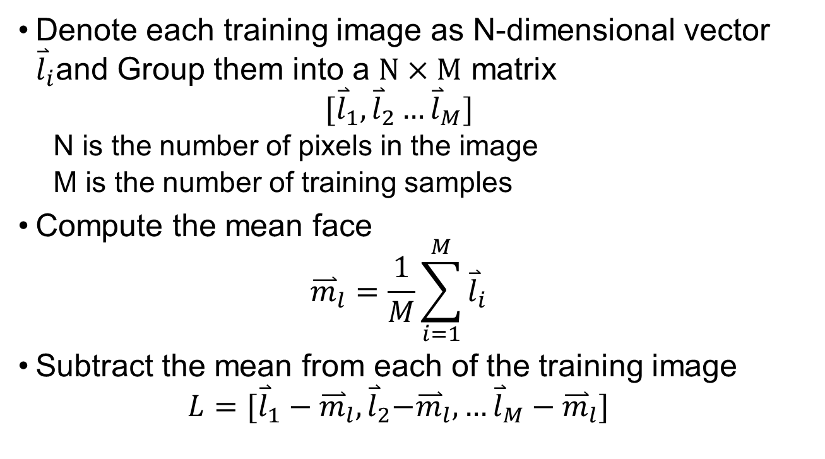
Algorithm - Eigen transformation
Denote each training image as N-dimensional vector ${\overset{⃑}{l}}_{i}$and Group them into a $N×M$ matrix
$$[{\overset{⃑}{l}}_{1},{\overset{⃑}{l}}_{2}…{\overset{⃑}{l}}_{M}]$$
N is the number of pixels in the image
M is the number of training samples
Compute the mean face
$${\overset{⃑}{m}}_{l}=\frac{1}{M}\sum_{i=1}^{M}{{\overset{⃑}{l}}_{i}}$$
Subtract the mean from each of the training image
$$L=[{\overset{⃑}{l}}_{1}−{\overset{⃑}{m}}_{l},{\overset{⃑}{l}}_{2}{−\overset{⃑}{m}}_{l},…{\overset{⃑}{l}}_{M}−{\overset{⃑}{m}}_{l}]$$

Slide 12
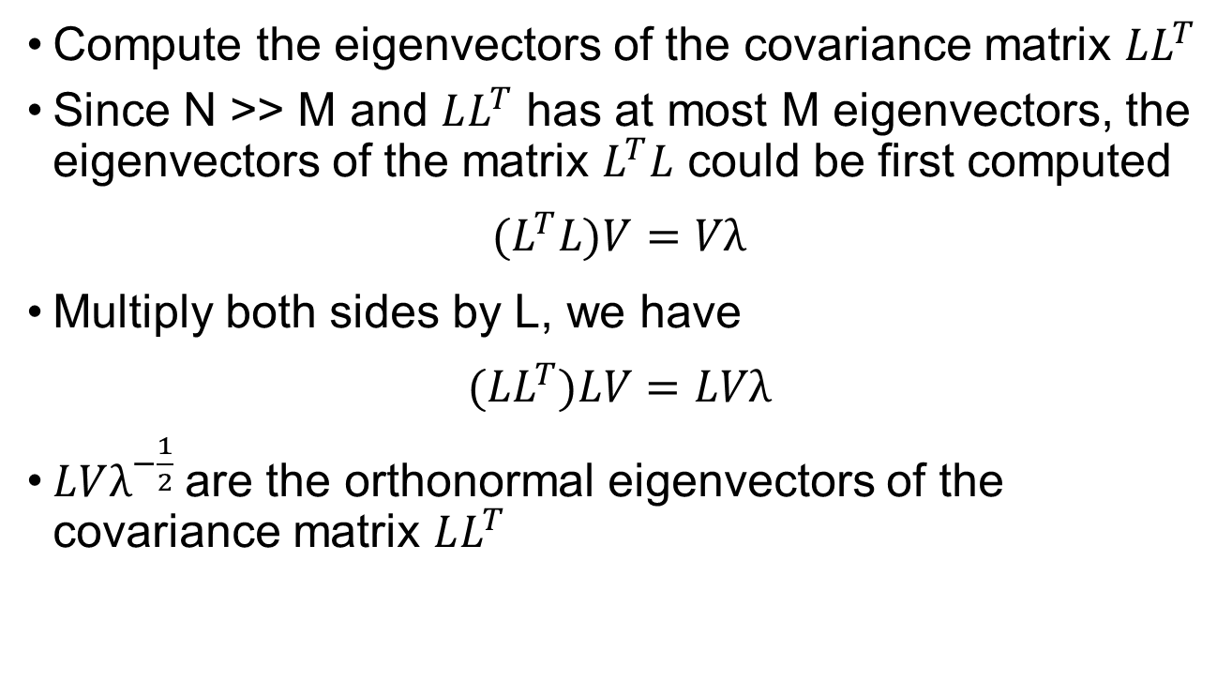
Algorithm - Eigen transformation
Compute the eigenvectors of the covariance matrix $LL^{T}$
Since N >> M and $LL^{T}$ has at most M eigenvectors, the eigenvectors of the matrix $L^{T}L$ could be first computed
$${(L}^{T}L)V=Vλ$$
Multiply both sides by L, we have
$${(LL}^{T})LV=LVλ$$
$LVλ^{−\frac{1}{2}}$are the orthonormal eigenvectors of the covariance matrix $LL^{T}$

Slide 13
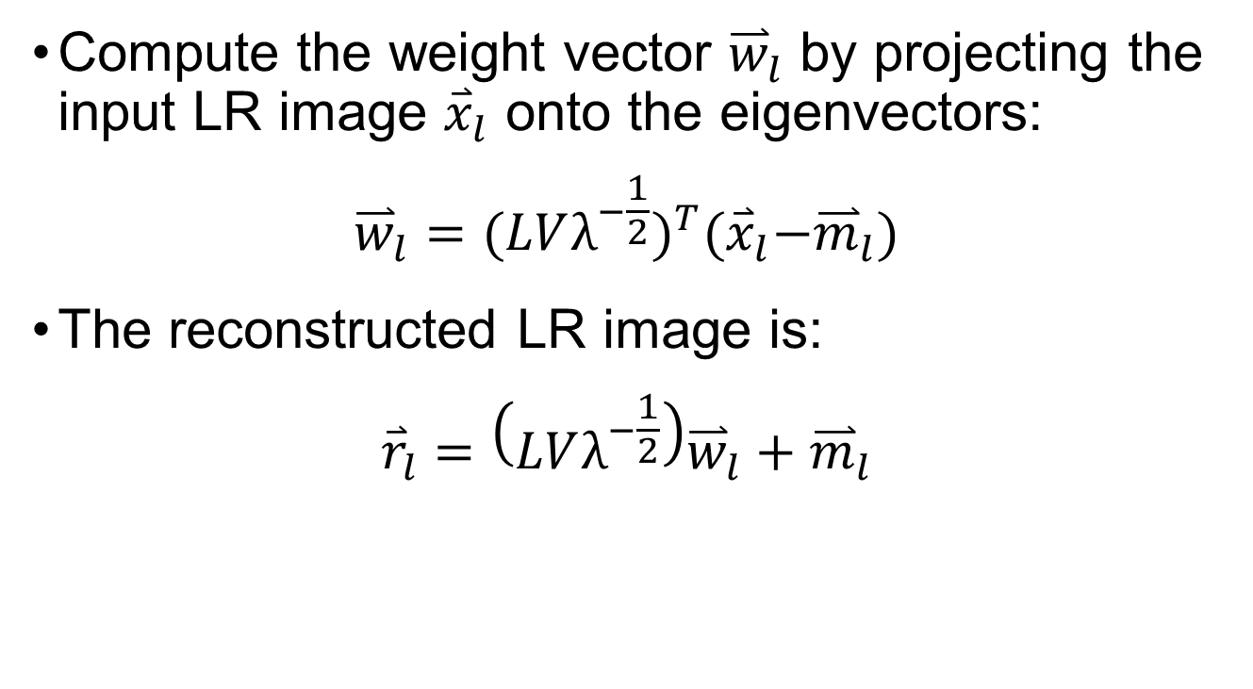
Algorithm - Eigen transformation
Compute the weight vector ${\overset{⃑}{w}}_{l}$ by projecting the input LR image ${\overset{⃑}{x}}_{l}$ onto the eigenvectors:
$${\overset{⃑}{w}}_{l}={(LVλ^{−\frac{1}{2}})}^{T}{(\overset{⃑}{x}}_{l}−{\overset{⃑}{m}}_{l})$$
The reconstructed LR image is:
$${\overset{⃑}{r}}_{l}=\left(LVλ^{−\frac{1}{2}}\right){\overset{⃑}{w}}_{l}+{\overset{⃑}{m}}_{l}$$

Slide 14
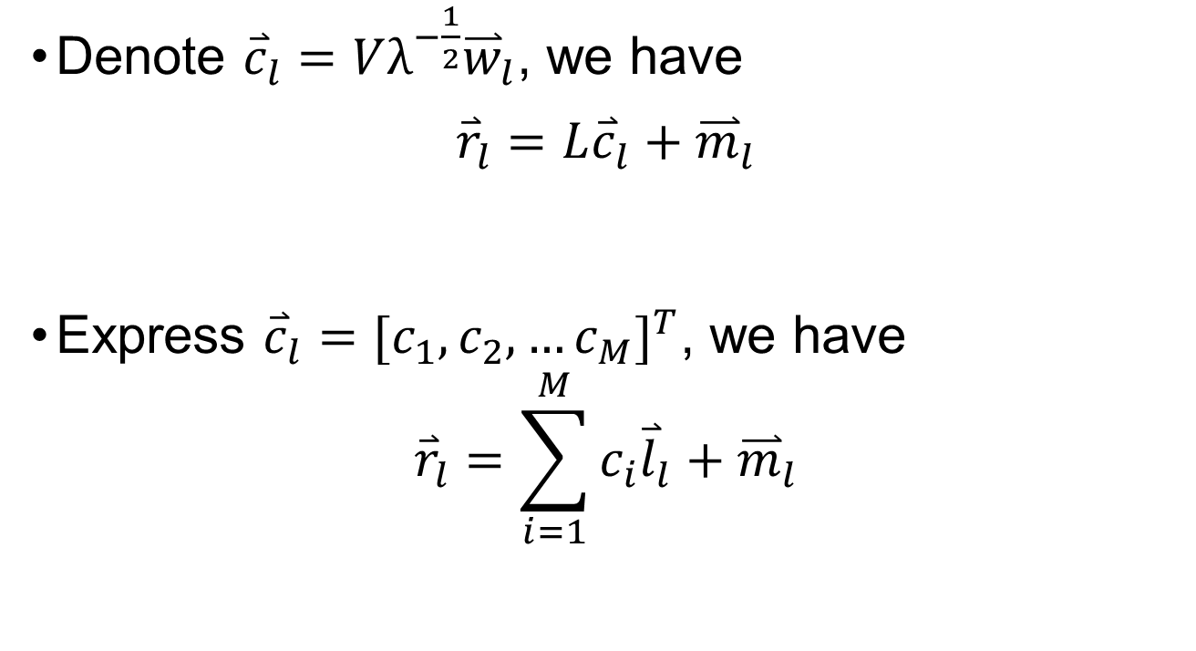
Algorithm - Eigen transformation
Denote ${\overset{⃑}{c}}_{l}=Vλ^{−\frac{1}{2}}{\overset{⃑}{w}}_{l}$, we have
$${\overset{⃑}{r}}_{l}=L{\overset{⃑}{c}}_{l}+{\overset{⃑}{m}}_{l}$$
Express ${\overset{⃑}{c}}_{l}={[c_{1},c_{2}, …c_{M}]}^{T}$, we have
$${\overset{⃑}{r}}_{l}=\sum_{i=1}^{M}{c_{i}{\overset{⃑}{l}}_{l}}+{\overset{⃑}{m}}_{l}$$

Slide 15
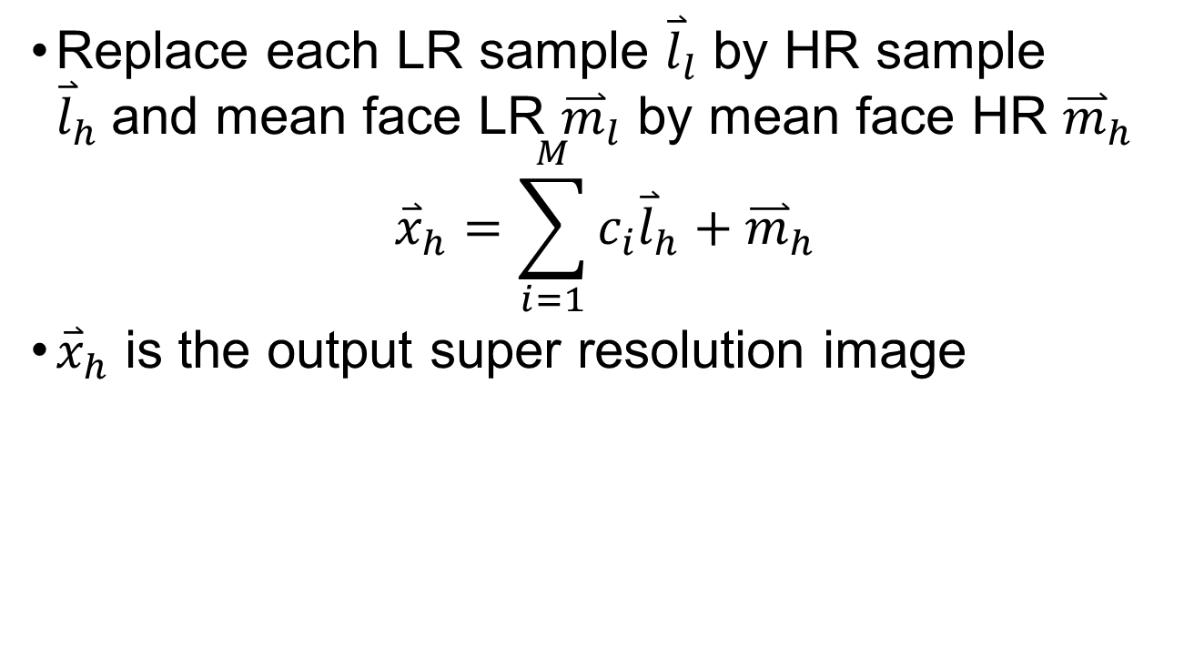
Algorithm - Eigen transformation
Replace each LR sample ${\overset{⃑}{l}}_{l}$ by HR sample ${\overset{⃑}{l}}_{h}$and mean face LR ${\overset{⃑}{m}}_{l}$ by mean face HR ${\overset{⃑}{m}}_{h}$
$${\overset{⃑}{x}}_{h}=\sum_{i=1}^{M}{c_{i}{\overset{⃑}{l}}_{h}}+{\overset{⃑}{m}}_{h}$$
${\overset{⃑}{x}}_{h}$ is the output super resolution image

Slide 16
Algorithm 2 Neighbour Embedding
[2] H. Chang, D. Yeung& Y. Xiong, "Super-resolution through Neighbour Embedding, " IEEE Computer Society Conference on Computer Vision and Pattern Recognition, 2004.

Slide 17
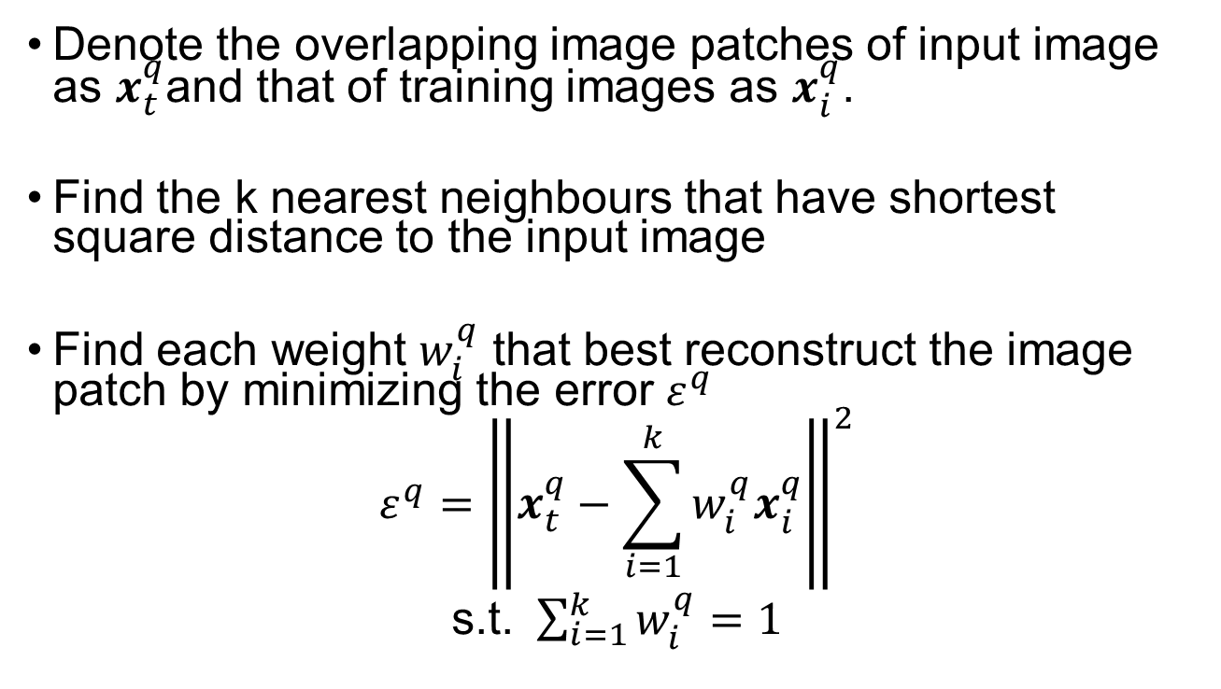
Algorithm – Neighbour Embedding
Denote the overlapping image patches of input image as $x_{t}^{q}$and that of training images as $x_{i}^{q}$.
Find the k nearest neighbours that have shortest square distance to the input image
Find each weight $w_{i}^{q}$ that best reconstruct the image patch by minimizing the error $ε^{q}$
$$ε^{q}={\left\|x_{t}^{q}−\sum_{i=1}^{k}{w_{i}^{q}x_{i}^{q}}\right\|}^{2}$$
s.t. $\sum_{i=1}^{k}{w_{i}^{q}=1}$

Slide 18
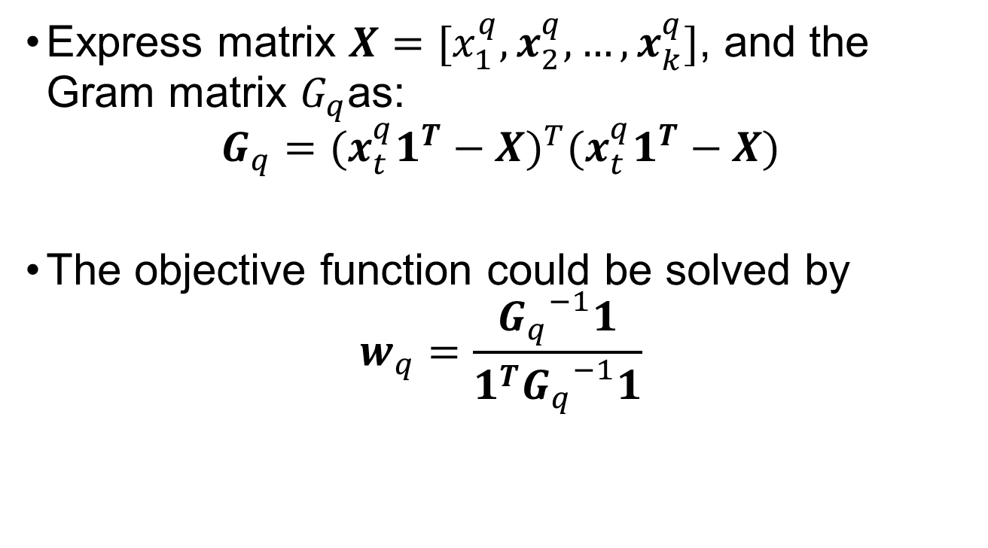
Algorithm – Neighbour Embedding
Express matrix $X=[x_{1}^{q},x_{2}^{q},…,x_{k}^{q}]$, and the Gram matrix $G_{q}$as:
$$G_{q}={(x_{t}^{q}1^{T}−X)}^{T}(x_{t}^{q}1^{T}−X)$$
The objective function could be solved by
$$w_{q}=\frac{{G_{q}}^{−1}1}{1^{T}{G_{q}}^{−1}1}$$

Slide 19
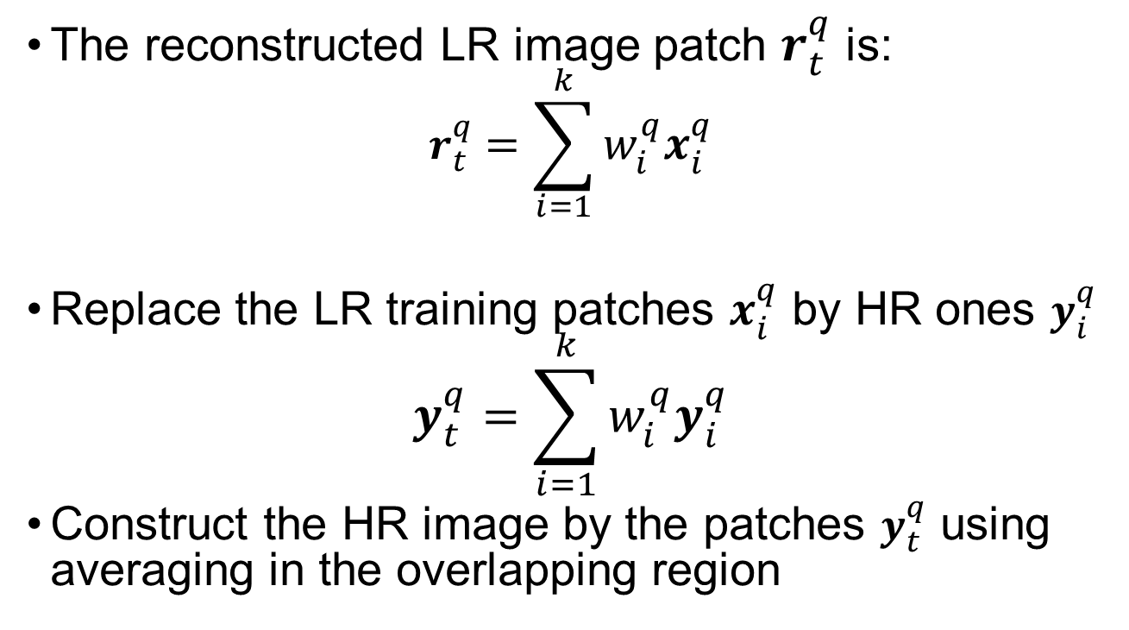
Algorithm – Neighbour Embedding
The reconstructed LR image patch $r_{t}^{q}$ is:
$$r_{t}^{q}=\sum_{i=1}^{k}{w_{i}^{q}x_{i}^{q}}$$
Replace the LR training patches $x_{i}^{q}$ by HR ones $y_{i}^{q}$
$$y_{t}^{q}=\sum_{i=1}^{k}{w_{i}^{q}y_{i}^{q}}$$
Construct the HR image by the patches $y_{t}^{q}$ using averaging in the overlapping region

Slide 20
Algorithm 3 Sparse Representation
[3] J. Yang, J. Wright& T. S. Huang, "Image Super-Resolution Via Sparse Representation, "IEEE Transactions on Image Processing, May 2010.
[4] J. Jiang, J. Ma& C. Chen, "Noise Robust Face Image Super-Resolution Through Smooth Sparse Representation, "IEEE Transactions on Cybernetics, Nov 2017.

Slide 21
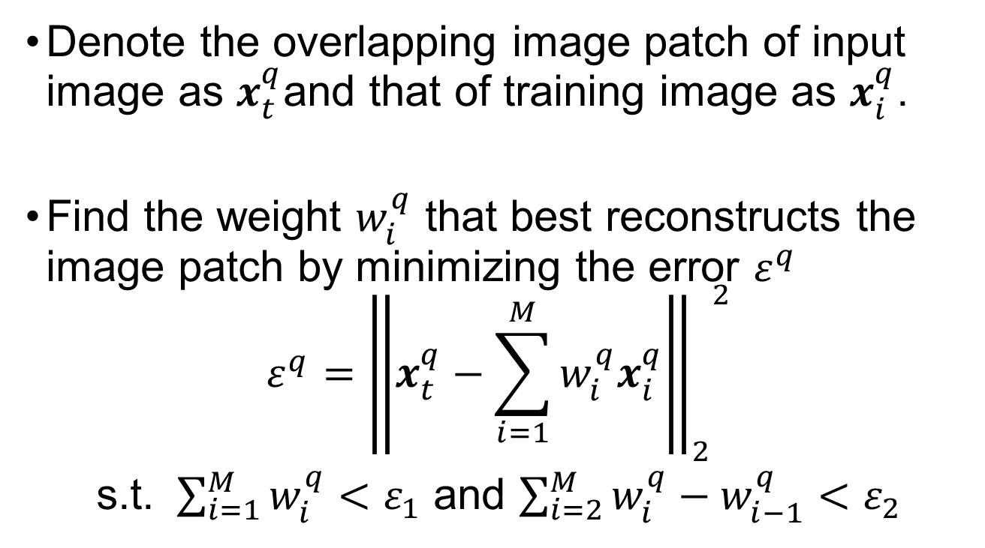
Algorithm – Sparse Representation
Denote the overlapping image patch of input image as $x_{t}^{q}$and that of training image as $x_{i}^{q}$.
Find the weight $w_{i}^{q}$ that best reconstructs the image patch by minimizing the error $ε^{q}$
$$ε^{q}={{\left\|x_{t}^{q}−\sum_{i=1}^{M}{w_{i}^{q}x_{i}^{q}}\right\|}_{2}}^{2}$$
s.t. $\sum_{i=1}^{M}{w_{i}^{q}<ε_{1}}$ and $\sum_{i=2}^{M}{w_{i}^{q}−w_{i−1}^{q}}<ε_{2}$

Slide 22
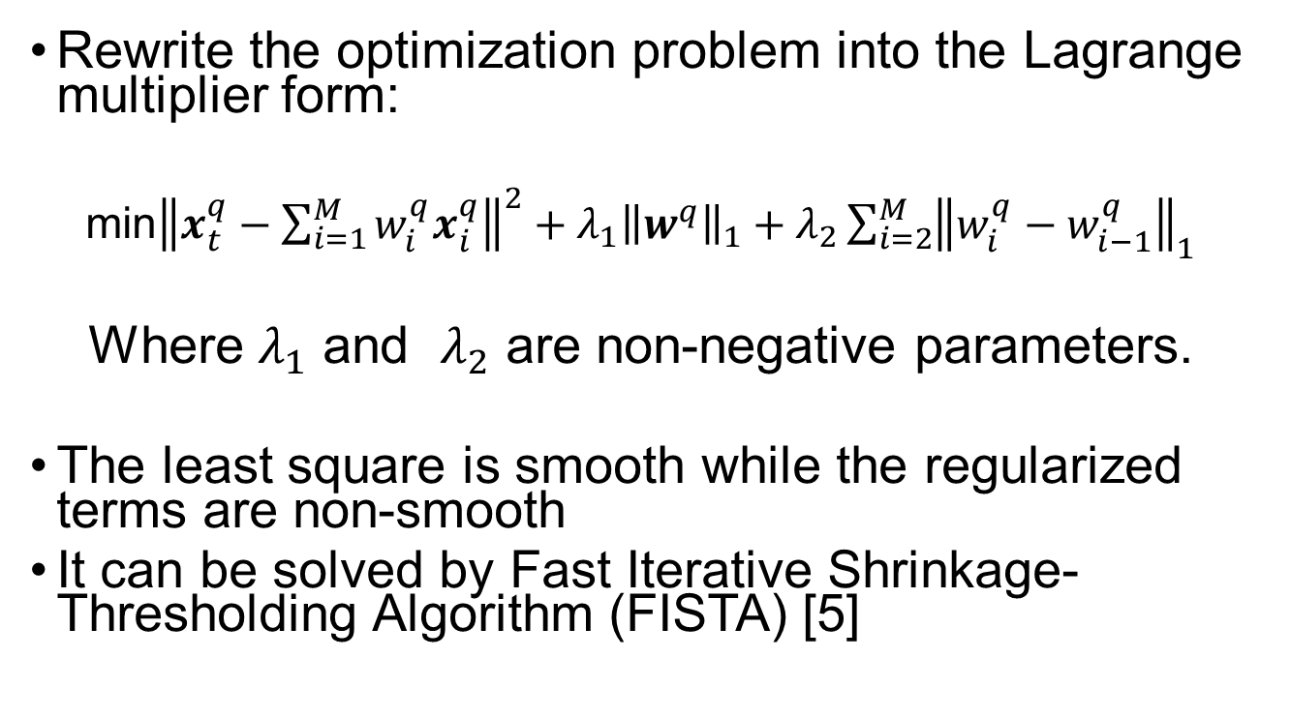
Algorithm – Sparse Representation
Rewrite the optimization problem into the Lagrange multiplier form:
min${\left\|x_{t}^{q}−\sum_{i=1}^{M}{w_{i}^{q}x_{i}^{q}}\right\|}^{2}+λ_{1}{\left\|w^{q}\right\|}_{1}+λ_{2}\sum_{i=2}^{M}{{\left\|w_{i}^{q}−w_{i−1}^{q}\right\|}_{1}}$
Where $λ_{1}$ and $λ_{2}$ are non-negative parameters.
The least square is smooth while the regularized terms are non-smooth
It can be solved by Fast Iterative Shrinkage-Thresholding Algorithm (FISTA) [5]

Slide 23
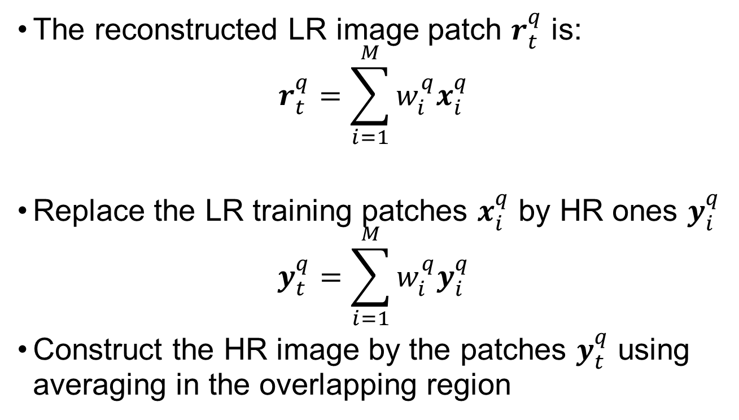
Algorithm – Sparse Representation
The reconstructed LR image patch $r_{t}^{q}$ is:
$$r_{t}^{q}=\sum_{i=1}^{M}{w_{i}^{q}x_{i}^{q}}$$
Replace the LR training patches $x_{i}^{q}$ by HR ones $y_{i}^{q}$
$$y_{t}^{q}=\sum_{i=1}^{M}{w_{i}^{q}y_{i}^{q}}$$
Construct the HR image by the patches $y_{t}^{q}$ using averaging in the overlapping region

Slide 24
Result – Eigen transformation
M | 25 | 50 | 75 | 100 | 125 | 150 | 175 | 200
PSNR (dB) | 23.73 | 24.73 | 25.29 | 25.76 | 26.05 | 26.34 | 26.41 | 26.39
Table 1 the results using different number of training samples M
Too many training samples reduces the performance

Slide 25
Result – Neighbour Embedding
k | 2 | 3 | 4
PSNR (dB) | 26.73 | 26.73 | 26.68
SSIM | 0.800 | 0.8027 | 0.8025
Table 2 the result using windows size of 5x5 and different values of k neighbours
k | 2 | 3 | 4
PSNR (dB) | 27.16 | 27.26 | 27.24
SSIM | 0.798 | 0.806 | 0.809
Table 3 the result using windows size of 3x3 and different values of k neighbours
The values of k is optimal at 3 using 3x3 windows

Slide 26
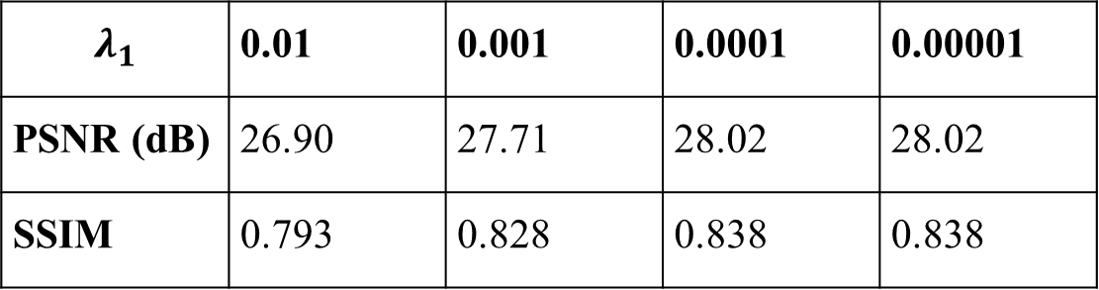
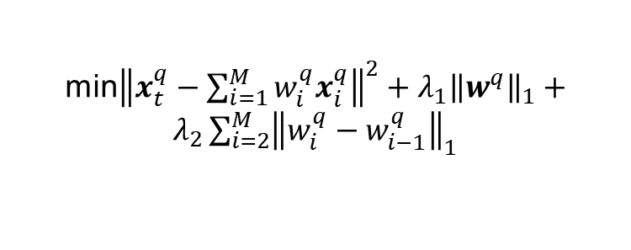
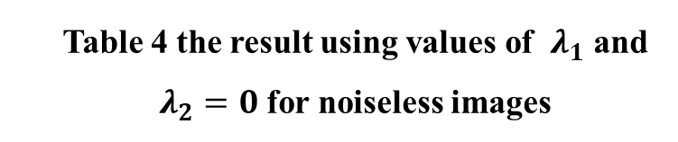
Result – Sparse Representation
$$λ_{1}$$ | 0.01 | 0.001 | 0.0001 | 0.00001
PSNR (dB) | 26.90 | 27.71 | 28.02 | 28.02
SSIM | 0.793 | 0.828 | 0.838 | 0.838
Table 4 the result using values of $λ_{1}$ and $λ_{2}=0$ for noiseless images
The values of $λ_{1}$ is optimal at 0.0001
min${\left\|x_{t}^{q}−\sum_{i=1}^{M}{w_{i}^{q}x_{i}^{q}}\right\|}^{2}+λ_{1}{\left\|w^{q}\right\|}_{1}+λ_{2}\sum_{i=2}^{M}{{\left\|w_{i}^{q}−w_{i−1}^{q}\right\|}_{1}}$

Slide 27

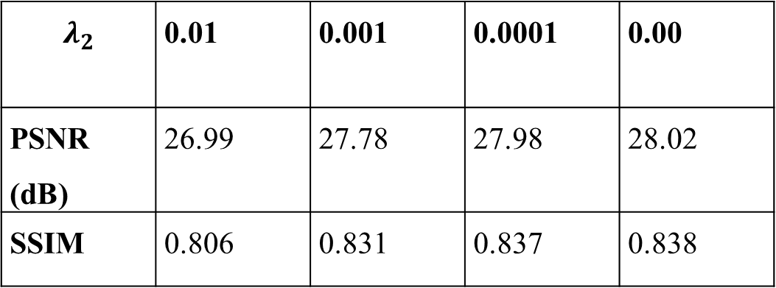
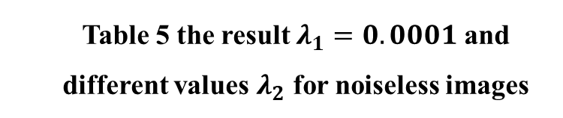
Result – Sparse Representation
$$λ_{2}$$ | 0.01 | 0.001 | 0.0001 | 0.00
PSNR (dB) | 26.99 | 27.78 | 27.98 | 28.02
SSIM | 0.806 | 0.831 | 0.837 | 0.838
Table 5 the result $λ_{1}=0.0001$ and different values $λ_{2}$ for noiseless images
$λ_{2}=0$ is optimal when there is no noise
min${\left\|x_{t}^{q}−\sum_{i=1}^{M}{w_{i}^{q}x_{i}^{q}}\right\|}^{2}+λ_{1}{\left\|w^{q}\right\|}_{1}+λ_{2}\sum_{i=2}^{M}{{\left\|w_{i}^{q}−w_{i−1}^{q}\right\|}_{1}}$

Slide 28
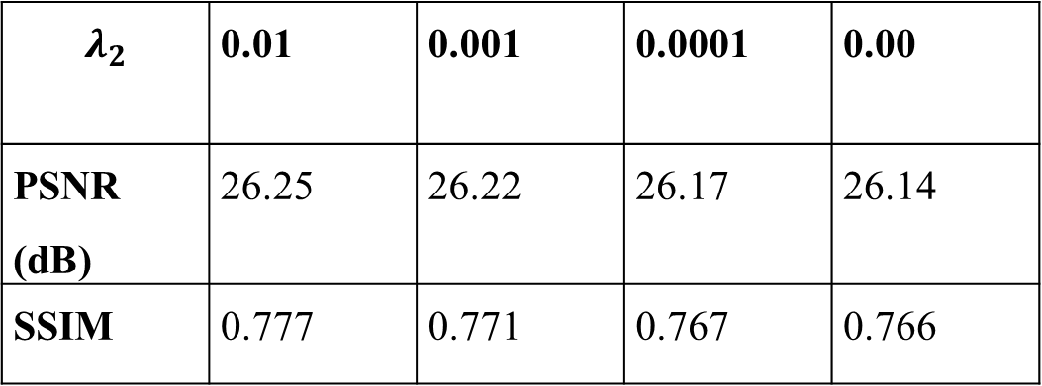
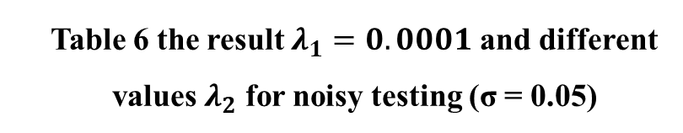
Result – Sparse Representation
$$λ_{2}$$ | 0.01 | 0.001 | 0.0001 | 0.00
PSNR (dB) | 26.25 | 26.22 | 26.17 | 26.14
SSIM | 0.777 | 0.771 | 0.767 | 0.766
Table 6 the result $λ_{1}=0.0001$ and different values $λ_{2}$ for noisy testing (σ = 0.05)
A suitable values for $λ_{2}$ improves the performance when there is noise
min${\left\|x_{t}^{q}−\sum_{i=1}^{M}{w_{i}^{q}x_{i}^{q}}\right\|}^{2}+λ_{1}{\left\|w^{q}\right\|}_{1}+λ_{2}\sum_{i=2}^{M}{{\left\|w_{i}^{q}−w_{i−1}^{q}\right\|}_{1}}$

Slide 29
Result
PSNR (dB) / SSIM Using Different algorithms with varying values of σ
σ | Bicubic | Eigen Transformation | Neighbour Embedding | Sparse Representation
0.02 | 25.29 / 0.729 | 25.38 / 0.706 | 25.76 / 0.763 | 26.60 / 0.779
0.05 | 23.86 / 0.665 | 24.94 / 0.707 | 25.04 / 0.747 | 26.46 / 0.778
0.1 | 20.00 / 0.500 | 23.90 / 0.708 | 22.85 / 0.691 | 24.78 / 0.750

Slide 30
Result

Slide 31
Result

Slide 32
Result
Sparse representation achieves the best result whenever there is noise.
Eigen transformation is more robust to noise than neighbour embedding

Slide 33
Cconclusion
Interpolation is not robust to noise and makes the image unclear
Examples-based algorithm recovers more details of the input image by learning the training samples
Sparse representation achieves the best performance

Slide 34
Future Plan
Work | Time
Measurement of deep learning approaches | Jan 2019
Implementation of GUI system | Feb 2019
Discovering the effects of super resolution to face recognition | Mar 2019
Finalizing the project and report writing | Apr 2019

Slide 35
References
[1] X. Wang& X. Tang, "Hallucinating face by eigentransformation, " IEEE Transactions on Systems, Man, and Cybernetics, Jul 2005.
[2] H. Chang, D. Yeung& Y. Xiong, "Super-resolution through Neighbour Embedding, " IEEE Computer Society Conference on Computer Vision and Pattern Recognition, 2004.
[3] J. Yang, J. Wright& T. S. Huang, "Image Super-Resolution Via Sparse Representation, "IEEE Transactions on Image Processing, May 2010.
[4] J. Jiang, J. Ma& C. Chen, "Noise Robust Face Image Super-Resolution Through Smooth Sparse Representation, "IEEE Transactions on Cybernetics, Nov 2017.
[5] A. Beck and M. Teboulle, "A Fast Iterative Shrinkage-Thresholding Algorithm for Linear Inverse Problems, " Imaging Sciences, 2009.

