Slide 1

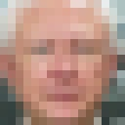

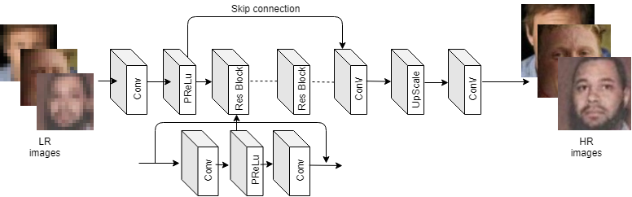
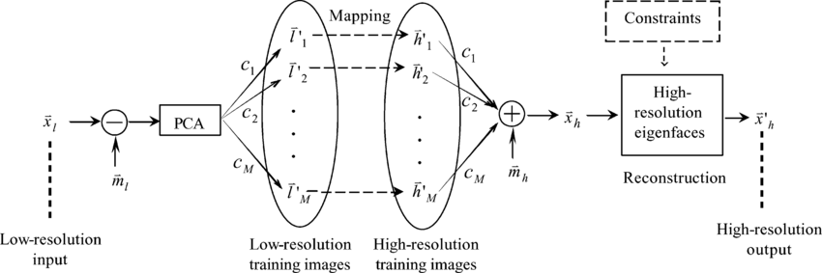
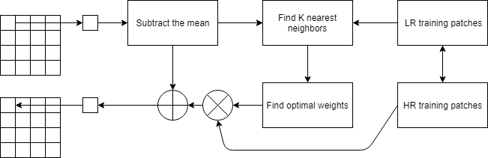
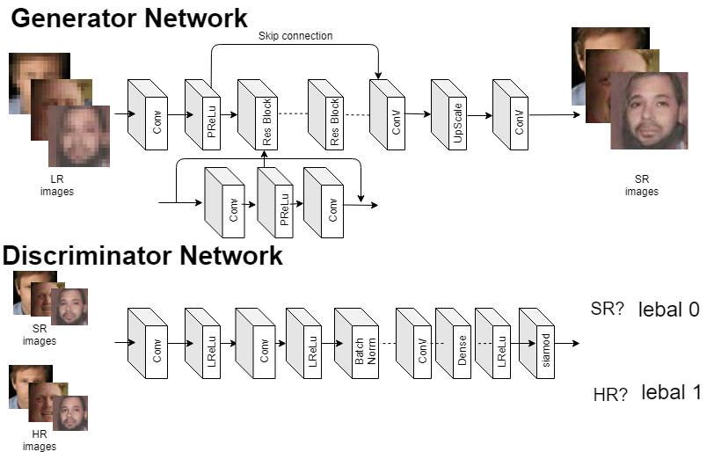
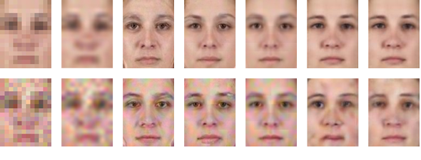
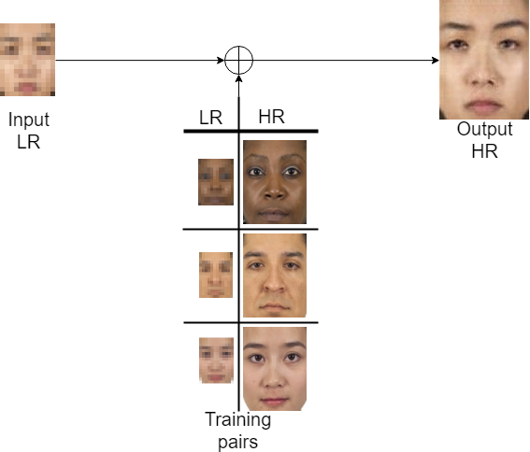
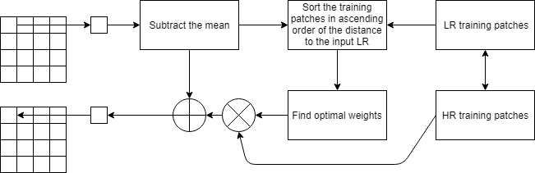
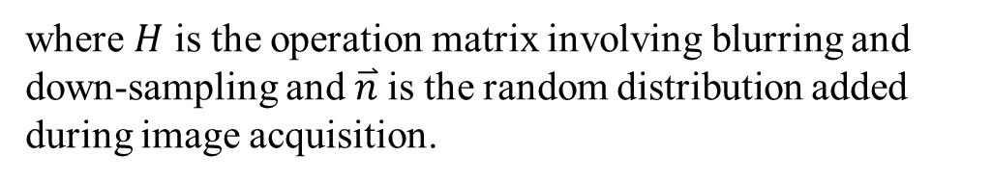


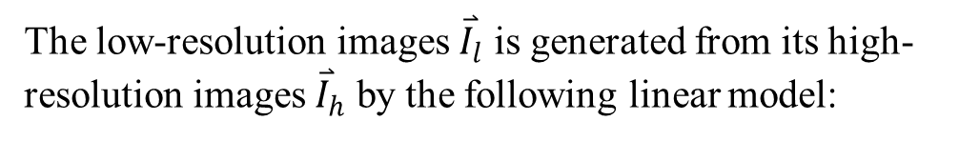
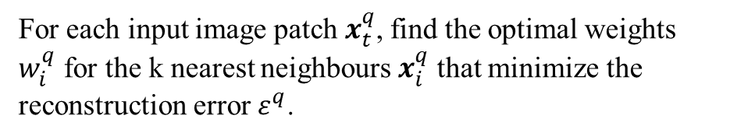
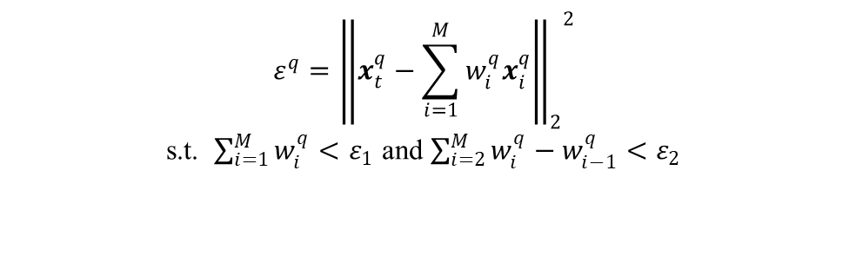

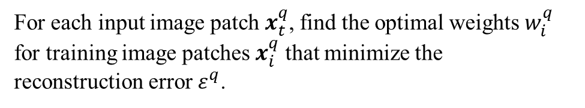
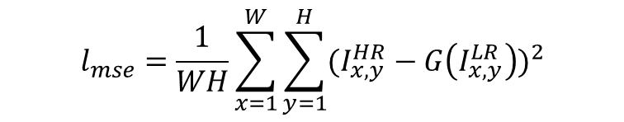
Machine Learning for Facial Image Super-resolution
CHEUNG Tsun Hin, 15083269D@connect.polyu.hk
Supervisor: Prof. Kenneth LAM
Department of Electronic and Information Engineering, The Hong Kong Polytechnic University
Introduction
Methodology
Methodology (Deep Learning approaches)
Results
Image Super-resolution
Algorithm 1 – Eigentransformation (PCA)
Algorithm 4 – Convolutional Neural Network
(CNN)
2. Upscaling factor 4
Image super-resolution (SR) is to generate a high resolution (HR) image from a low resolution (LR) one.
Eigentransformation is a transformation based on mapping between LR and HR groups of training samples.
By Principal Component Analysis (PCA), an input LR image can be represented as a linear combination of LR training samples.
Keep all the coefficients unchanged, but replace the LR training samples with the corresponding HR ones.
Convolutional Neural Network (CNN) is a deep learning method that learns an end-to-end mapping from LR input to HR output by back propagation.
upscale
low-resolution
image
high-resolution
image
MSE-loss:
3. Unconstrained dataset
$$l_{mse}=\frac{1}{WH}\sum_{x=1}^{W}{\sum_{y=1}^{H}{{(I_{x,y}^{HR}−G\left(I_{x,y}^{LR}\right))}^{2}}}$$
An ill-posed task
Lost of information during the down-sampling process
Multiple LR images corresponding to a single HR image
Algorithm 5 – Generative Adversarial Network
(GAN)
Algorithm 2 – Neighbour Embedding (LLE)
Generative Adversarial Network (GAN) is another deep learning method that consists of a pair of networks, a generator network and a discriminator network. The generator network fools the discriminator that the generated images are real HR images.
Machine learning approaches
Locally linear embedding (LLE) is one of the manifold learning methods.
By neighbourhood-preserving embeddings of high-dimensional inputs, the nonlinear structure is recovered from locally linear fits.
Machine learning method for image super-resolution is to generate a high-resolution image by learning from training pairs of low and high-resolution images.
4. Noise Performance
For each input image patch $x_{t}^{q}$, find the optimal weights $w_{i}^{q}$ for the k nearest neighbours $x_{i}^{q}$ that minimize the reconstruction error $ε^{q}$.
$$ε^{q}={{\left\|x_{t}^{q}−\sum_{i=1}^{k}{w_{i}^{q}x_{i}^{q}}\right\|}_{2}}^{2}$$
s.t. $\sum_{i=1}^{k}{w_{i}^{q}=1}$
Keeping all the weights unchanged, the LR patches are replaced by the corresponding HR ones.
Perceptual loss:
$$l_{total}=l_{vgg}+0.006 l_{adversairal}$$
$$l_{vgg}=\frac{1}{WH}\sum_{x=1}^{W}{\sum_{y=1}^{H}{{(V\left(I_{x,y}^{HR}\right)−V\left(G\left(I_{x,y}^{LR}\right)\right))}^{2}}}$$
$$I_{adversairal}=\sum_{n=1}^{N}{−log⁡D(G\left(I^{LR}\right))}$$
Algorithm 3 – Sparse Representation (SR)
Sparse representation (SR) deals with sparse solutions for systems of linear equations.
Conclusion
Problem Formulation
Image degradation process
Results
In this project, some machine learning algorithms for facial image super-resolution are implemented and their performances are measured.
The deep learning methods outperform all the conventional machine learning methods in terms of PSNR and SSIM.
These methods are efficient because no optimization is needed.
The conventional machine learning methods, such as sparse representation, enjoy the noise-robust characteristics for face hallucination.
The low-resolution images ${\overset{⃑}{I}}_{l}$ is generated from its high-resolution images ${\overset{⃑}{I}}_{h}$ by the following linear model:
1. Upscaling factor 8
For each input image patch $x_{t}^{q}$, find the optimal weights $w_{i}^{q}$ for training image patches $x_{i}^{q}$ that minimize the reconstruction error $ε^{q}$.
$${\overset{⃑}{I}}_{l}=H{\overset{⃑}{I}}_{h}+\overset{⃑}{n}$$
$$ε^{q}={{\left\|x_{t}^{q}−\sum_{i=1}^{M}{w_{i}^{q}x_{i}^{q}}\right\|}_{2}}^{2}$$
s.t. $\sum_{i=1}^{M}{w_{i}^{q}<ε_{1}}$ and $\sum_{i=2}^{M}{w_{i}^{q}−w_{i−1}^{q}}<ε_{2}$
where $H$ is the operation matrix involving blurring and down-sampling and $\overset{⃑}{n}$is the random distribution added during image acquisition.
Keeping all the weights unchanged, the LR patches are replaced by the corresponding HR ones.

