Slide 1
Book Exchange
A web service for exchanging second-hand books
Motivation & Main Functions:

Slide 2
Structure Overview

Slide 3
Front-End
Login/Registration Panel
Donation Panel: The user can only donate a book when they have logged in.

Slide 4
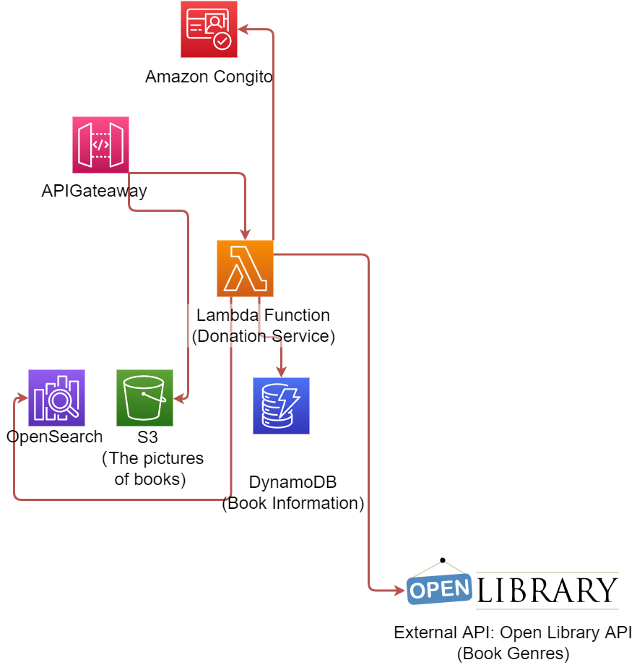
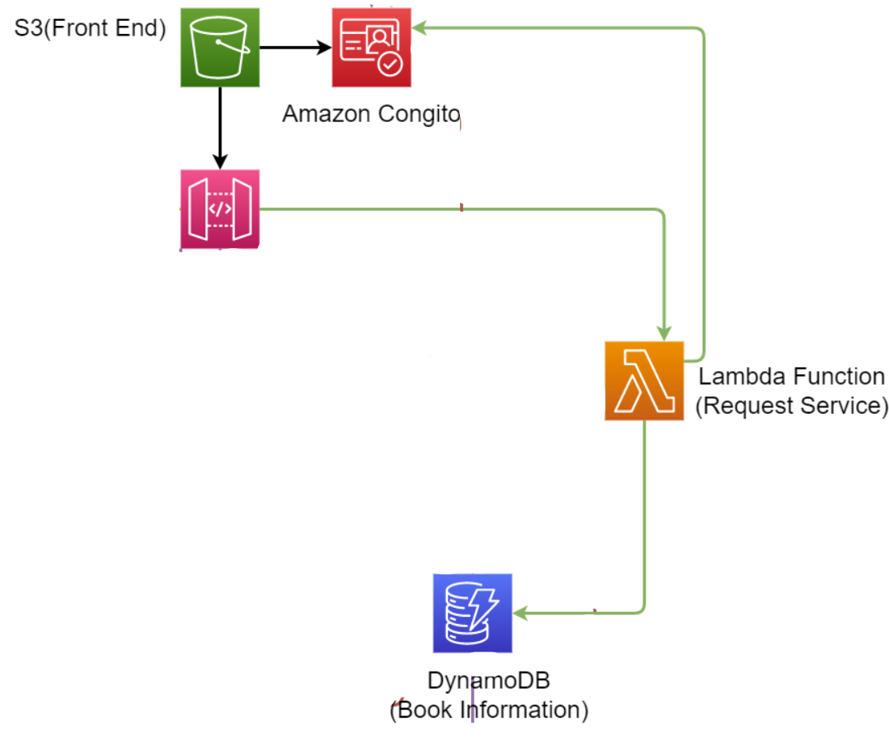
Donate & Request a second-hand book
Donate
Request-Anni
Determine whether the user has enough credits to make request
Once successful requested, update user history (add book_id)
Update book information to set status=’unavailable’, so it will no longer be searched
Using API Gateway to pass the photos directly to a S3 bucket
Using a Lambda Function to add the donation information to DynamoDB and OpenSearch.
The lambda function automatically generates the genre information for the donated book by using Open Library API. This can help other users find the book they want by genre.

Slide 5
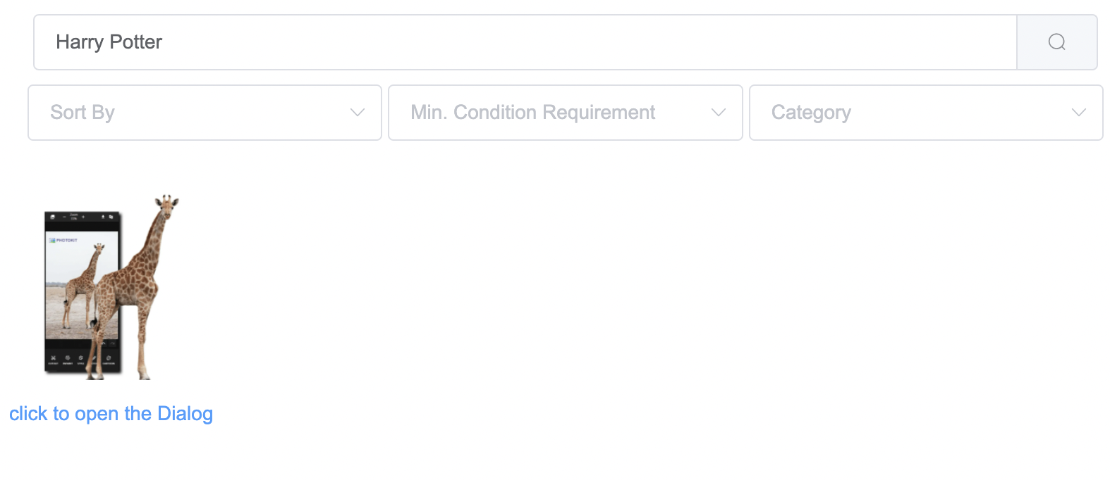
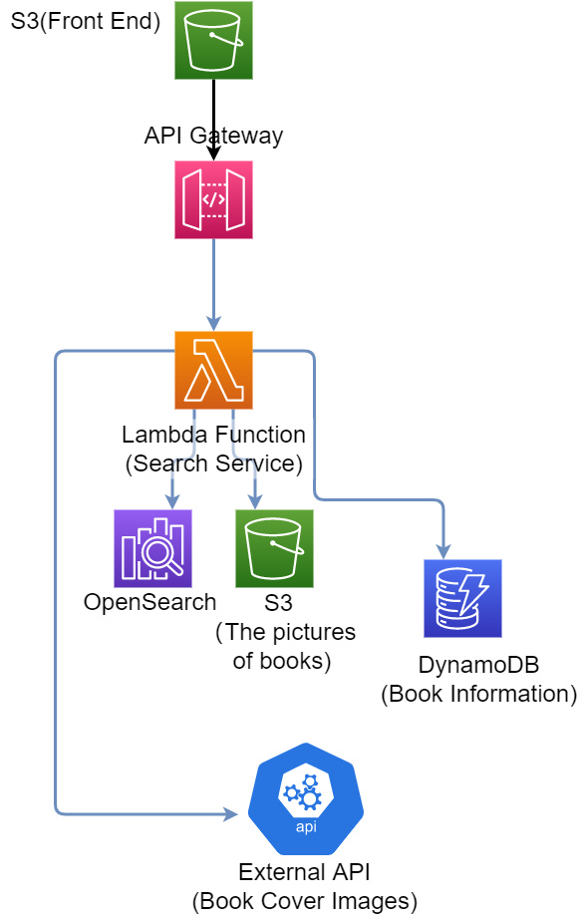
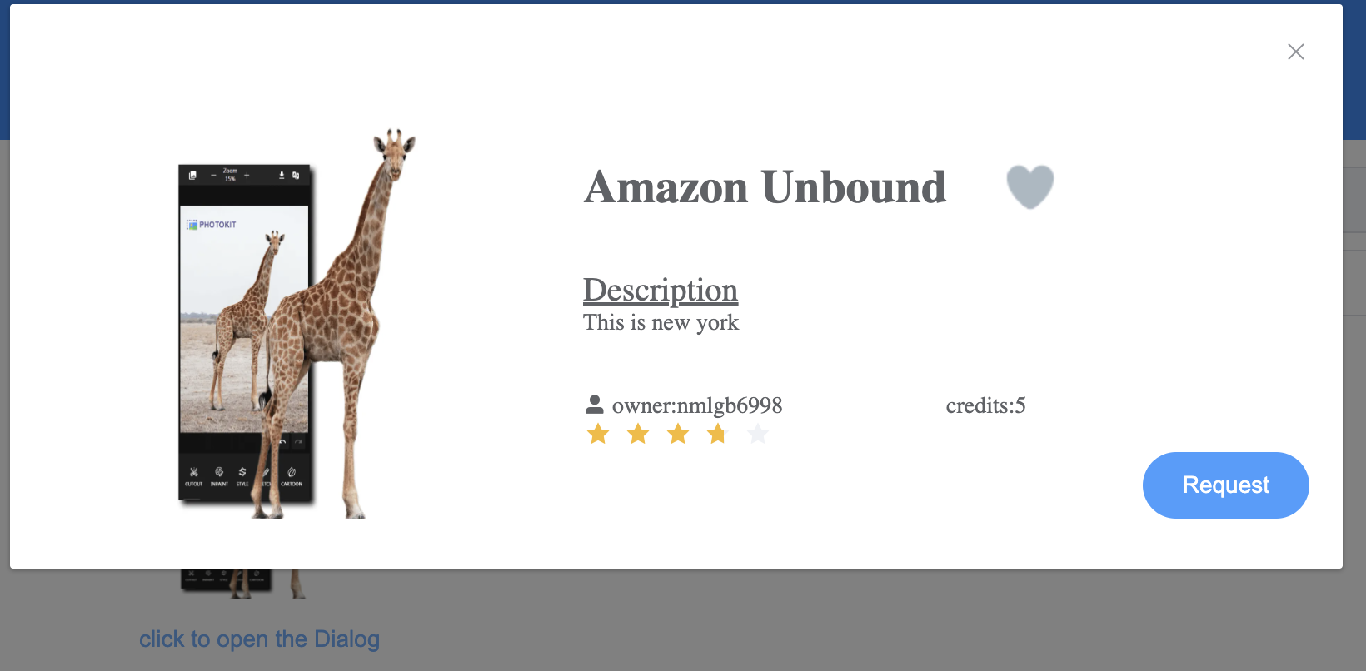
Search for a donated book
Search-Zhenrui
Using API Gateway to pass the query infomation from frontend input to lambda function
Using a lambda function to query corrsponding available donation books ftom DynamoDB through OpenSearch.
The lambda function also automatically get the book cover by using Open Library API and upload pic from S3
Frontend get the response from the image and display it under the search bar

Slide 6
Show user’s information & add a book to a user’s favorite list

Slide 7
Some Design Choice
Although we can link user’s account and their information directly in Cognito (which is convenient and good for keeping user’s information secure!), we decided to use DynamoDB to store the users’ non-sensitive information, rather than storing them in Cognito.
- The attributes stored in Cognito has to be key-value(string) pair, not good for complicated data structures.
We need to store many users’ requested/donate books, this list could be large and Cognito is not scalable as the DynamoDB.
The DynamoDB can handle query much more efficient than Cognito
We realized this is the pattern often done in the industry after searching the online information

