Slide 1
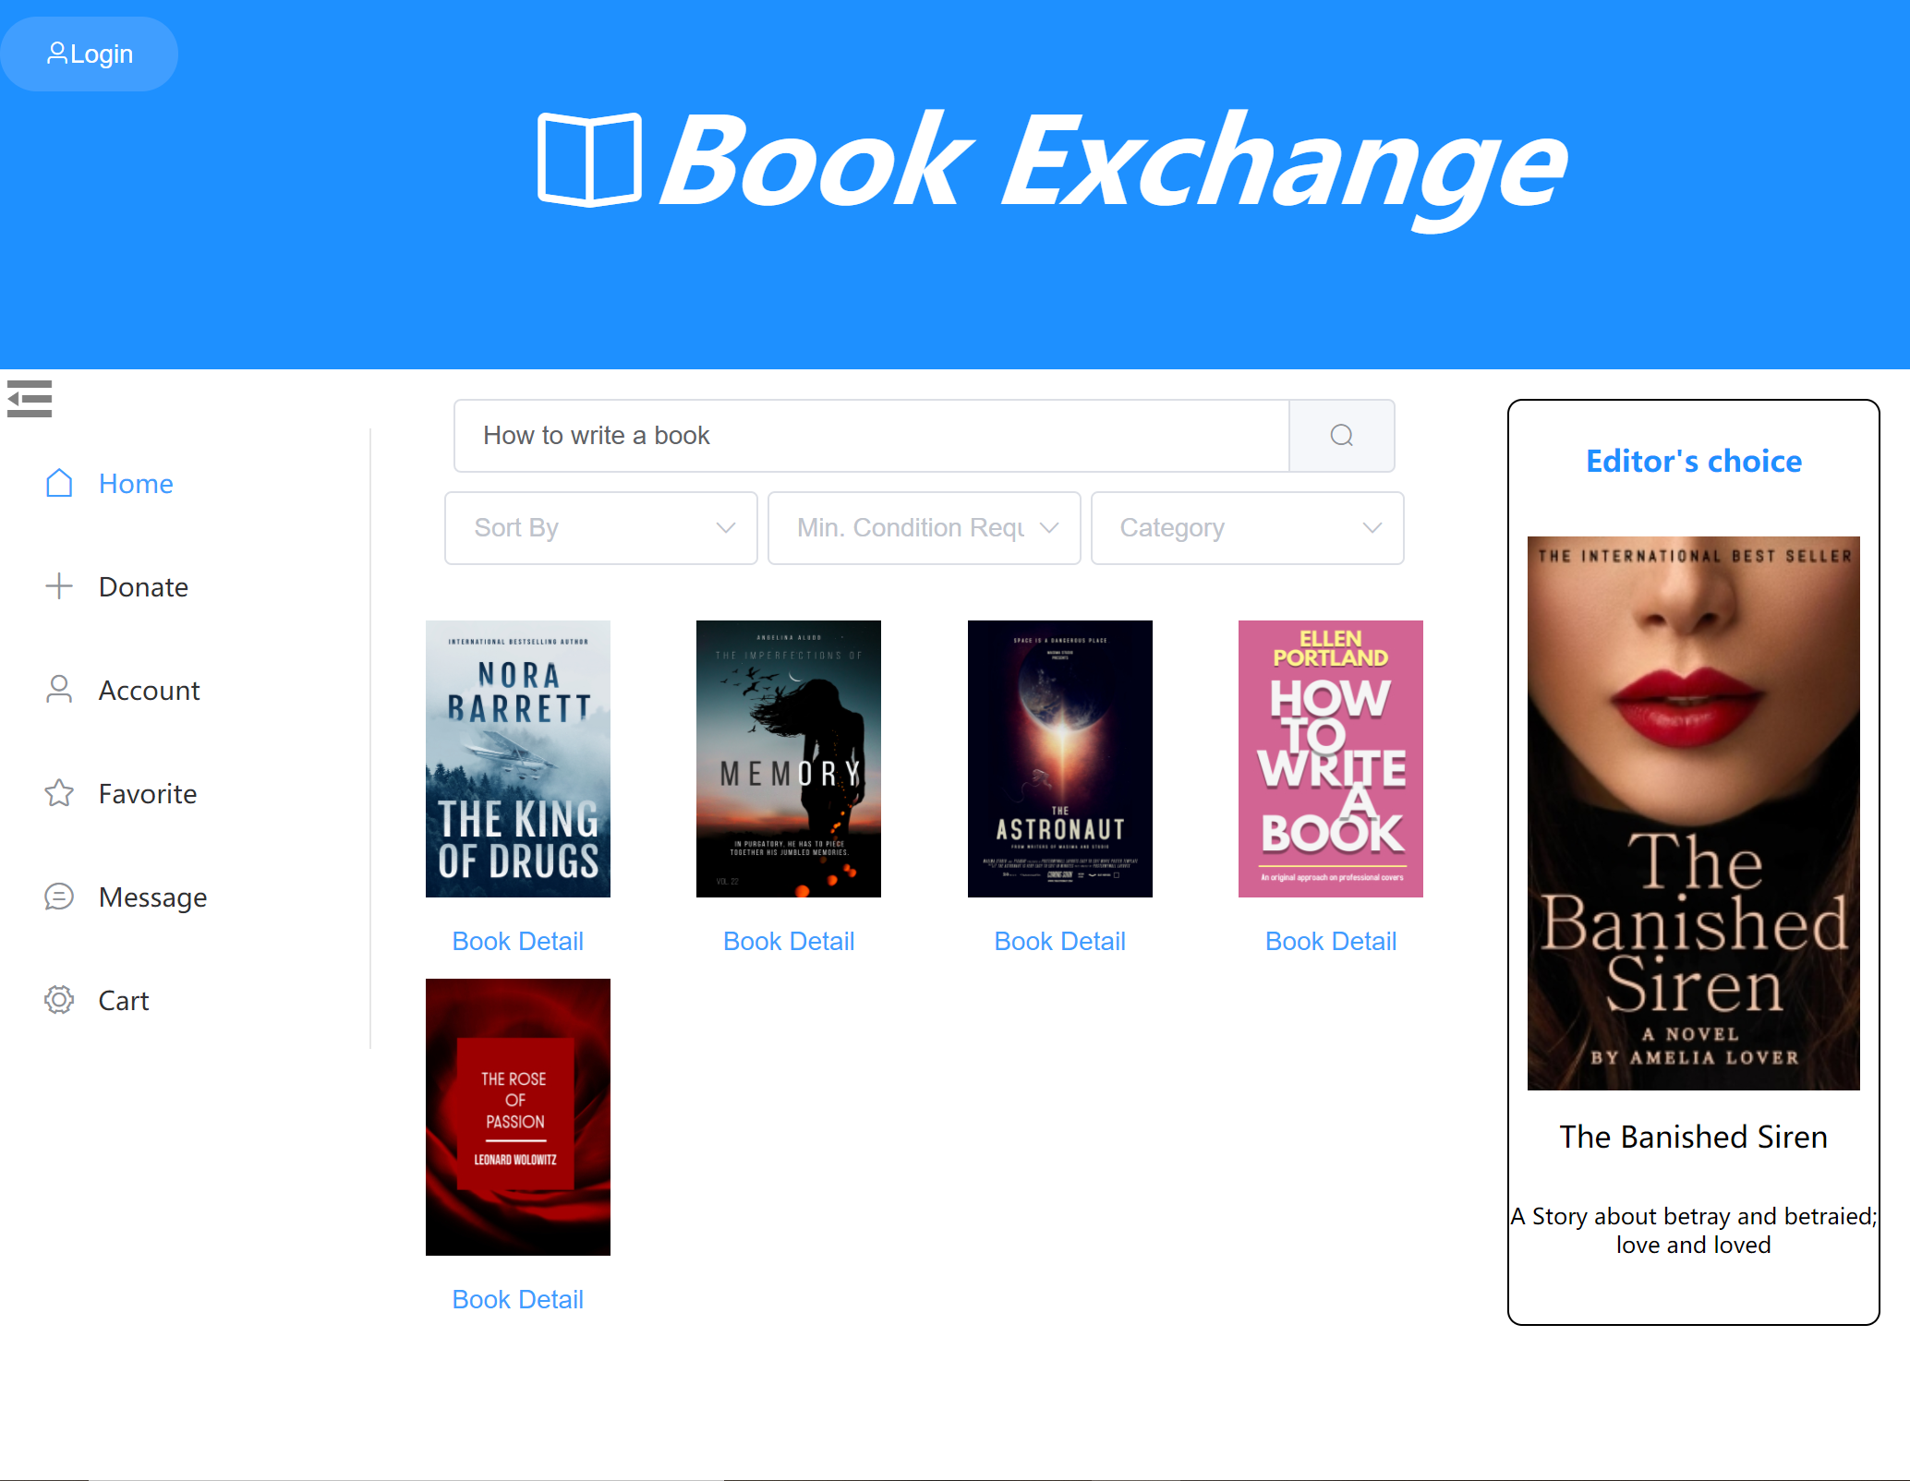
Book Exchange
A web service for exchanging second-hand books
Motivation
Many people prefer to have cheap, used books rather than the new paper books, this is especially the case for students’ textbook
A platform encourages Columbia University students to exchange books
Save money to buy new books
The more books you donate, the more books you can request from others
Welcome users with similar interests to contact each other
Group member: Dantong Zhu(dz2451), Tianhang Cui(tc3158), Anni Chen(ac4779), Zhenrui Chen(zc2569)
Notes:
Welcome, Today I will introduce to you a cloud application named Book Exchange, this is a platform that is used to exchang the used book among users. What motivated us to design such an application is we noticed there are many people especially students often need to buy new books, and they are willing to give their used books aways. Currently we limits our users to be only the Columbia University students, and I will explain why we made such a decision later.

Slide 2
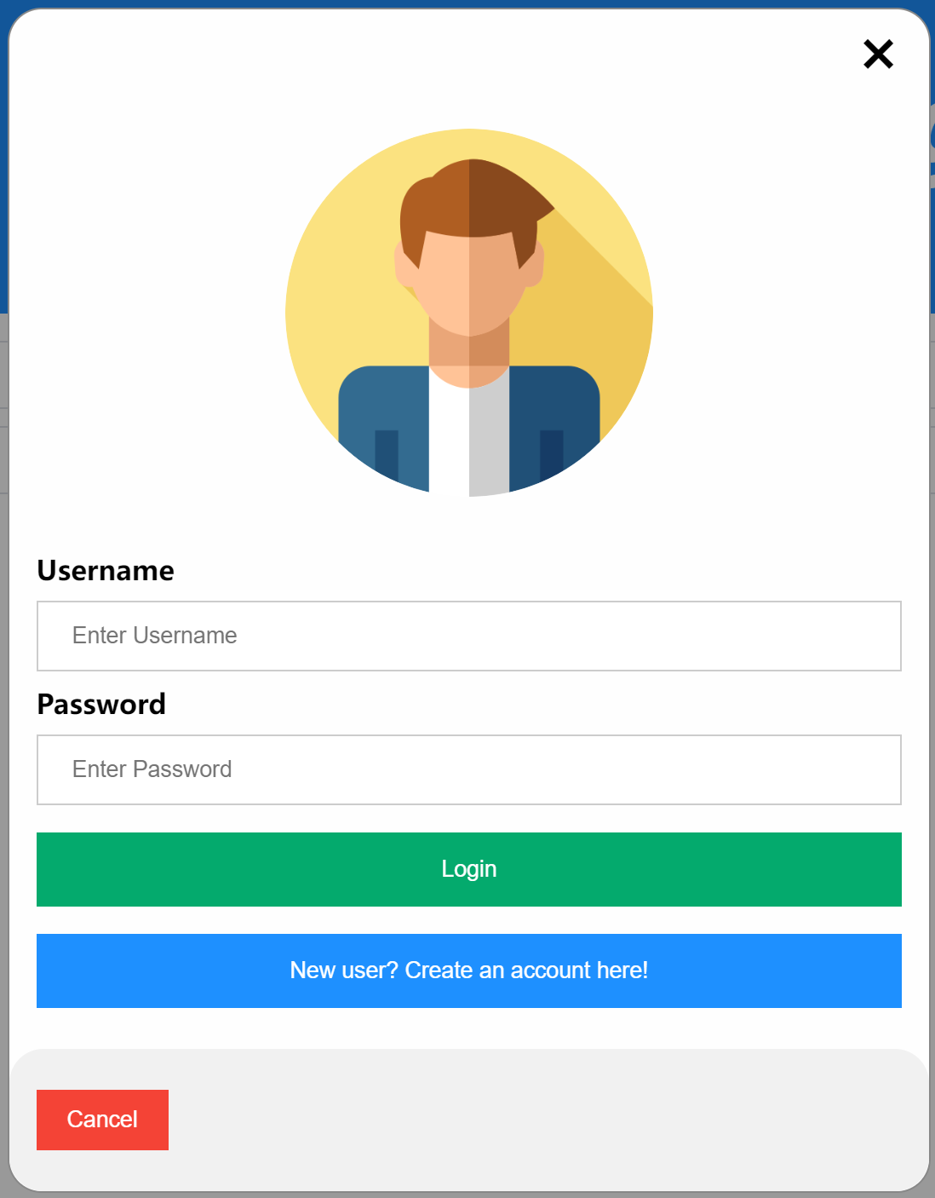
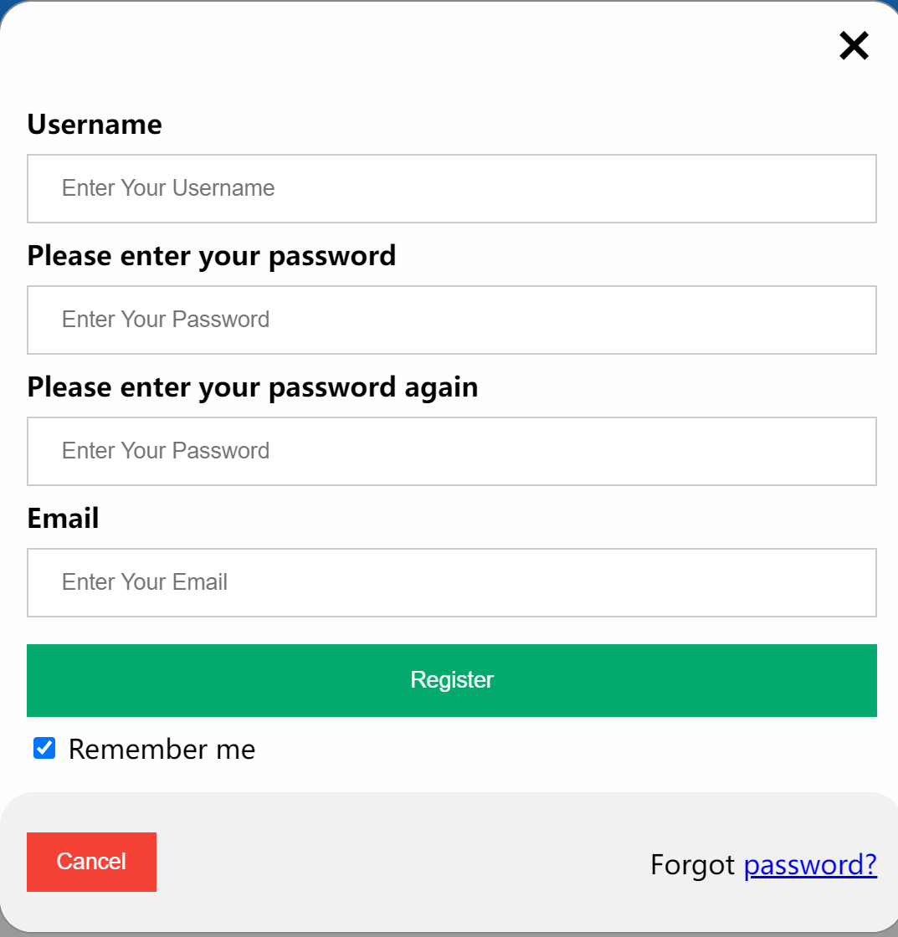
Front-End Overview
Editor’s choice
Login/Registration Panel
Function Panel
Notes:
Here is what our front-end looks like, it would be helpful be familiarize with these main parts here for understand the whole structure

Slide 3
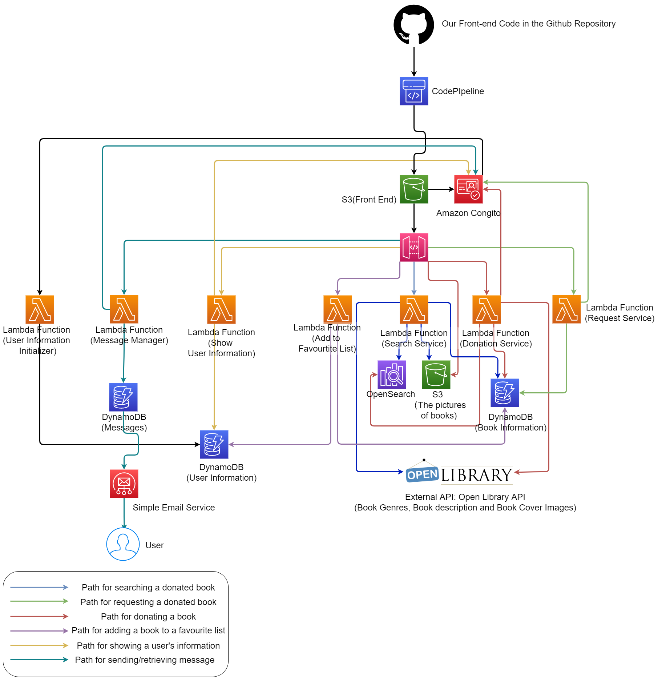
Structure Overview
POST /donation/
Body param: donation_id, book_name, user, condition, photos_links, credit.
Description: make a donation of a used-book, and add the corresponding information to the DynamoDB and OpenSearch
POST /donation/photos/
Body param: photos
Description: upload a photo for a donated book
GET /user-info/
Query param: user_id
Description: get the user information stored in the DynamoDB user information table
GET /message/
Query param: user_id
Description: get the all messages received for a user
POST /message/
Body param: sender, recipient, content
Description: send the message with the given content to the given recipient, by the given sender.
POST /request/
Body param: user_id, book_name
Description: Send a request for an used book posted.
GET /search/
Description: get the donated books’ information based on the input book_name
Query param: book_name, genres(optional), min_condition(optional)
Notes:
Here is our basic structure， as you may noticed there are 6 main paths in the structure ,and I will explain them in detail in the next few pages.

Slide 4
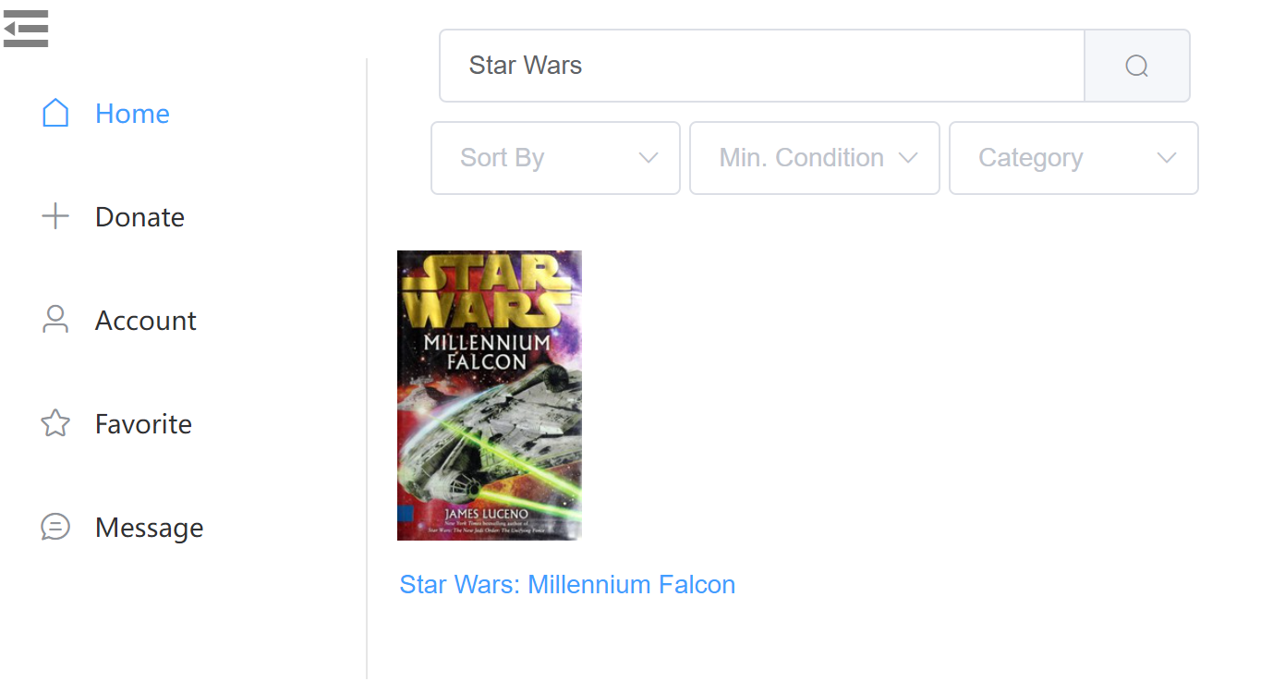
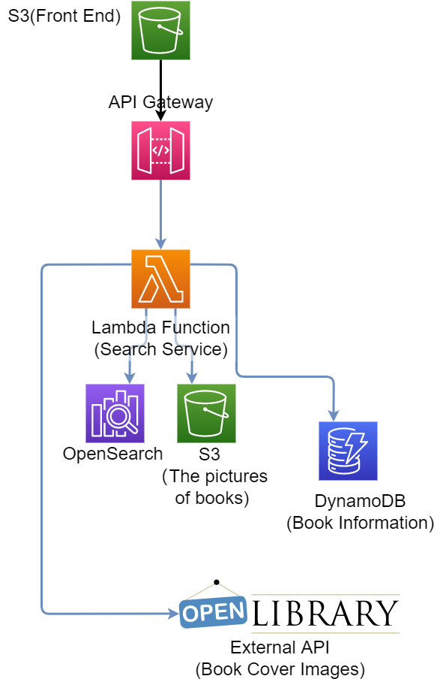
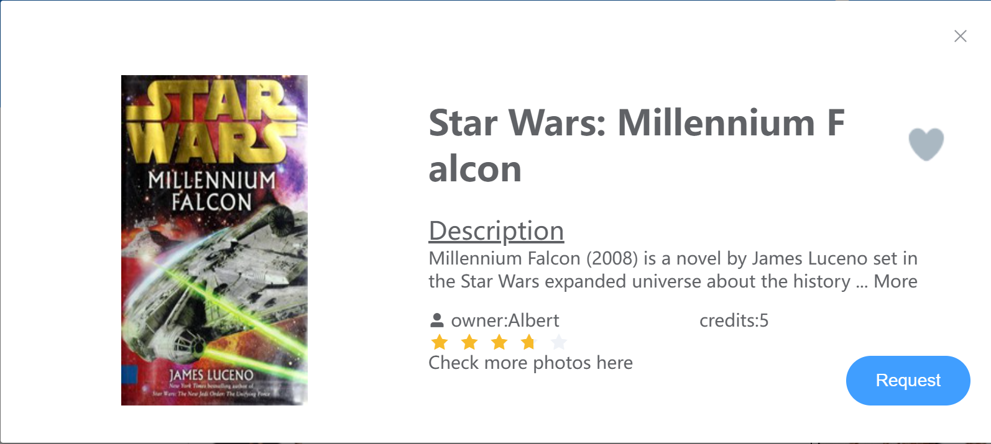
Search for a second-hand book
Implementation Detail
Using API Gateway to pass the query infomation from frontend input to lambda function
Using a lambda function to query corrsponding available donation books ftom DynamoDB through OpenSearch.
The lambda function also automatically get the book cover by using Open Library API and upload pic from S3
Frontend get the response from the image and display it under the search bar
Notes:
This is one of our main function for searching for all the books can be requested. It is a simple structure that we use opensearch and DynamoDB to get the books which match the input from the search bar. , we called these books can be requested as available donation as they are donated by a students for others to request.

Slide 5
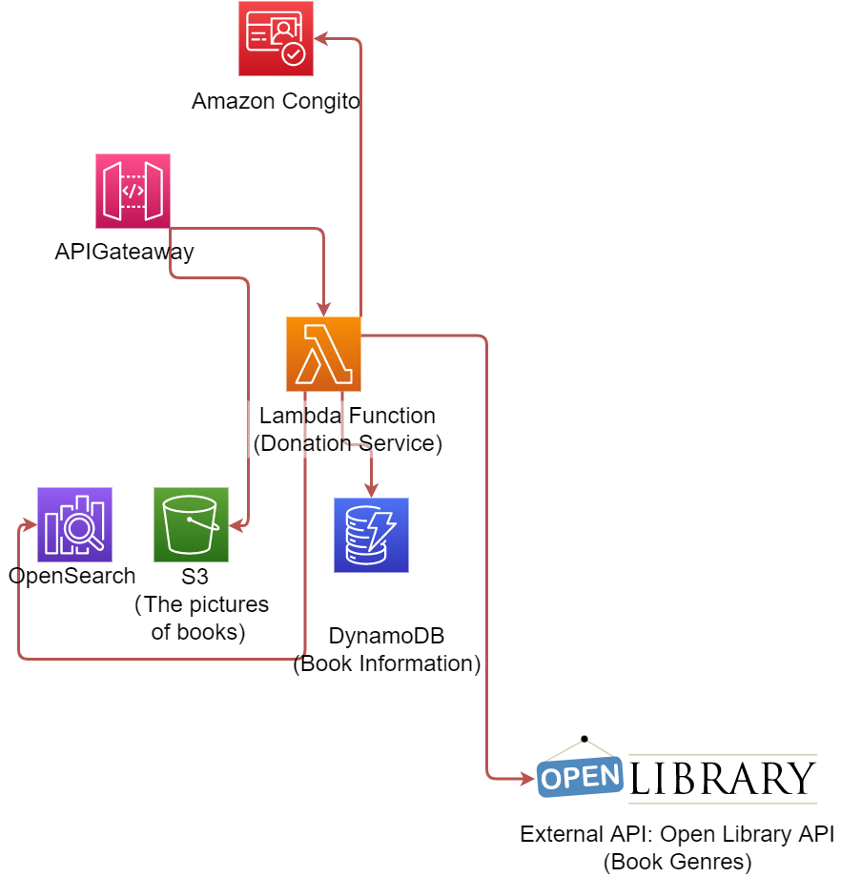
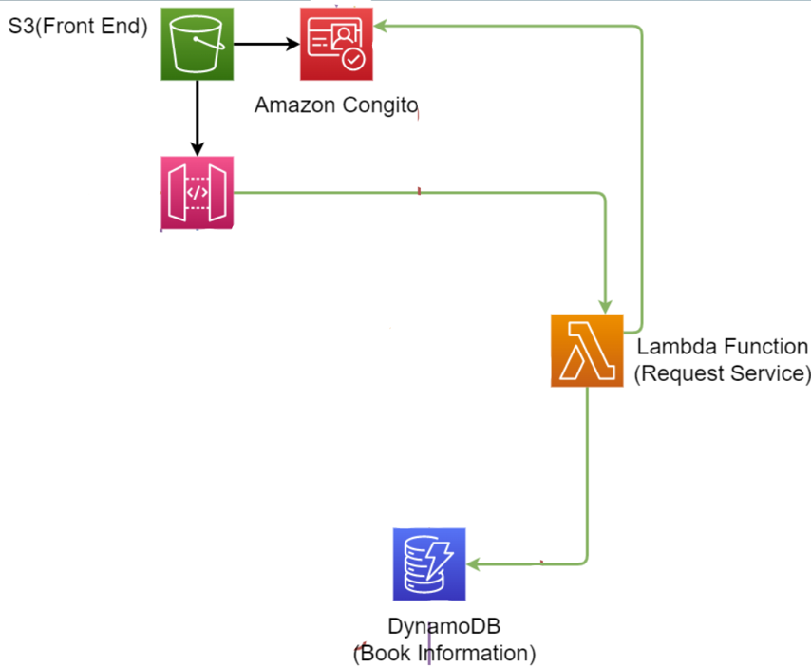
Donate& Request a second-hand book
Donate
Request
Using API Gateway to pass the photos directly to a S3 bucket
Using a Lambda Function to add the donation information to DynamoDB and OpenSearch.
The lambda function automatically generates the genre information for the donated book by using Open Library API. This can help other users find the book they want by genre.
Determine whether the user has enough credits to make request
Once successful requested, update user history (add book_id)
Update book information to set status=’unavailable’, so it will no longer be searched
Notes:
Making donation and request are other 2 main functions in our application. For the donation part, we used a lambda function, every time there is a request sent from the API Gateway, the lambda function will use Open Library API to generate the genres, and the donation information will be added to the DynamoDB and OpenSearch, and . It will also store the photos the S3 bucket if the user choose to upload one. The donator can gain credits after some one requested it.
For the request side, it is much simpler than the donation, it will simplify modify the data for the user as their credits may be changed and then set the book to be unavailable.

Slide 6
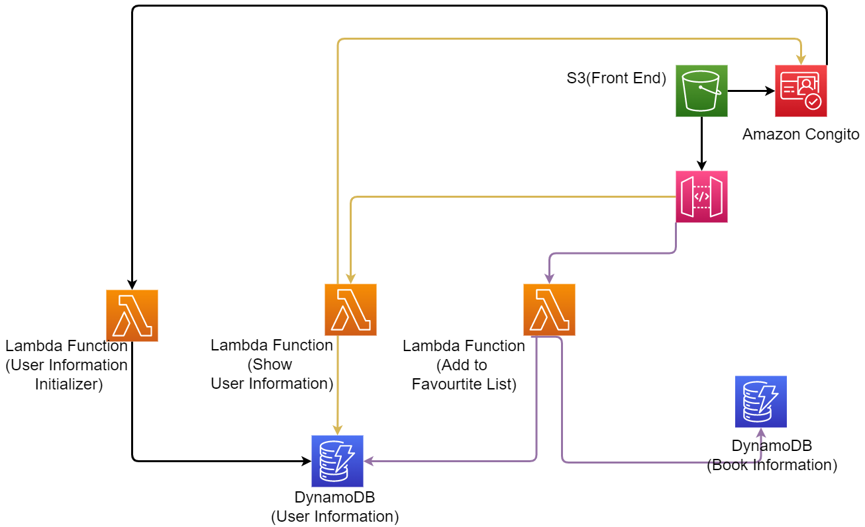
Other Functions
User Registration and Login
Show user’s info & add to favorite list
We use AWS Cognito to handle user management.
When the user first register an account, the AWS Cognito will call a post-registration lambda function named "User Information Initializer", this lambda function will initialized the User information table to have empty list for request_history, donation_history ,.etc. When the user have logged in, the AWS Cognito will handle the process for validating the user and retrieving some the user’s personal information such as email.
Send and Receive Messages
Every time the user selects a book they like, the system firstly will store this book’s id in Dynamo DB(user information) corresponding to the user.
When the user jumps to the favorite list page and want more information about these books, the system will search it in the DynamoDB(book info) by id
When the user chooses to add a book to their favorite list, the count of favorite’ for that book will increase by 1 and the book is removed when the user double click
After the front-end send the GET /message/ request through the API, it will wake a lambda function named ’Message Manager’. • If the request is a GET request, it will read the user’s message list from the DynamoDB table named ’Messages’, and return it to the front-end as an API response. • If the request is a POST request, it will append the new message to message list of the receiver in the DynamoDB table, along with the sender information. After that, it will access the user’s email address through AWS Cognito and then use AWS Simple Email Service to send an email(containing the message content) to the email address.
Associated API:
POST /request/
Body param: user_id, book_name
Description: Send a request for an used book posted.
Notes:
There are some other functions of our application that I will brefily mention here. The user can add a book to their favoutie list and show their donation or request history. We also allows the user to send messages between each other. And We used Cognito to handle the registration, verification and login process, this is necessary as we want to make sure every user is a Columbia student.

Slide 7
Some interesting subtleties
At first, we want to build this application for everyone on the internet and provide an way for them to exchanging books, but then we realized that would bring a lot of troubles which needs very careful plans and decisions.
If the target users are all the people on the internet, then the problem of sending the books from one person to another would be a problem. There are a lot of problem:
Should we let them use mail to exchange their books?
Who should pay for the ship cost?
How can we decrease the malicious behaviors?
How can we make sure every request is for real need?
As such design would need to ask more professional people and it is really relevant to our course material, we decided to put our focus on the students in Columbia University, as most of them would have the opportunity to meet in campus and we can efficiently limits the number of accounts everyone can have, to decrease the possibility of malicious use.
We want to auto-generate the cover photos based on the user’s input book name at first. However, we then realized that the user may not strictly input the book name and the API we used for book cover does not the covers for have all the books, so we decided to let the image shown for each book to be:
If the donator uploaded a photo, then the image would just be the photo uploaded. This can be a cover picture gotten from Internet, or it is the photos of the real book.
If the donator does not uploaded any photos, then we will use OpenLibrary API to search for the photo based on the donator’s input book name
If the donator did not upload any photos and we cannot get the image from API, we would shown an image indicates "The image is not available
Notes:
There are some interesting subtleties related to our design. First, as I mentioned, our application is only used for Columbia university students for now, but this is not what we want at the very first stage. We noticed that allowing any people to register is hard for users to send their books as they may live very far from each other and it will also lead to a large possibility of malicious uses.
Second, for the donation part, we decided to let user to upload a photo, which can be used to show how the books looks like, if the user does not upload one , we will generate one from the Api. We let the user’s uploaded photo to be the primary way of showing books because we realized the API we can find is not that reliable and it does not contains all the books we may need.

Slide 8
Some Design Choices
Although we can link user’s account and their information directly in Cognito (which is convenient and good for keeping user’s information secure!), we decided to use DynamoDB to store the users’ non-sensitive information, rather than storing them in Cognito.
- The attributes stored in Cognito has to be key-value(string) pair, not good for complicated data structures.
We need to store many users’ requested/donate books, this list could be large and Cognito is not scalable as the DynamoDB.
The DynamoDB can handle query much more efficient than Cognito
We realized this is the pattern often done in the industry after searching the online information
We do not use OpenSearch to store the availability of the book (i.e. already rent/available for request)
We stores the genres, book name, and donation id to the OpenSearch to improve the performance of searching.
Storing availability can help us filter out those unavailable books for search.
However, this would requires us to update OpenSearch each time there is a book was requested.
Given the current expected number of users (~10000 users in total) is not too large, it seems okay to get all the books fulfilled the search request and then filter out those unavailable.
This design may need to be changed when the expected number of user become larger.
Notes:
We used DynamoDB and Congito to store the user information, but not only using Cognito, this is because the attributes in Cognito has to be key-value pair, which is not good for storing complicated structure as we need.
We did not use OpenSearch to store the availability of the book as we may need to change them when we request, given the current expected number of users , it seems fine if we just filter them after we get all the books with name we need.

