Slide 1
Book Exchange
A web service for exchanging second-hand books

Slide 2
Structure Overview

Slide 3
Motivation & Main Functions

Slide 4
Front-End
Login/Registration Panel
Donation Panel: The user can only donate a book when they have logged in.

Slide 5
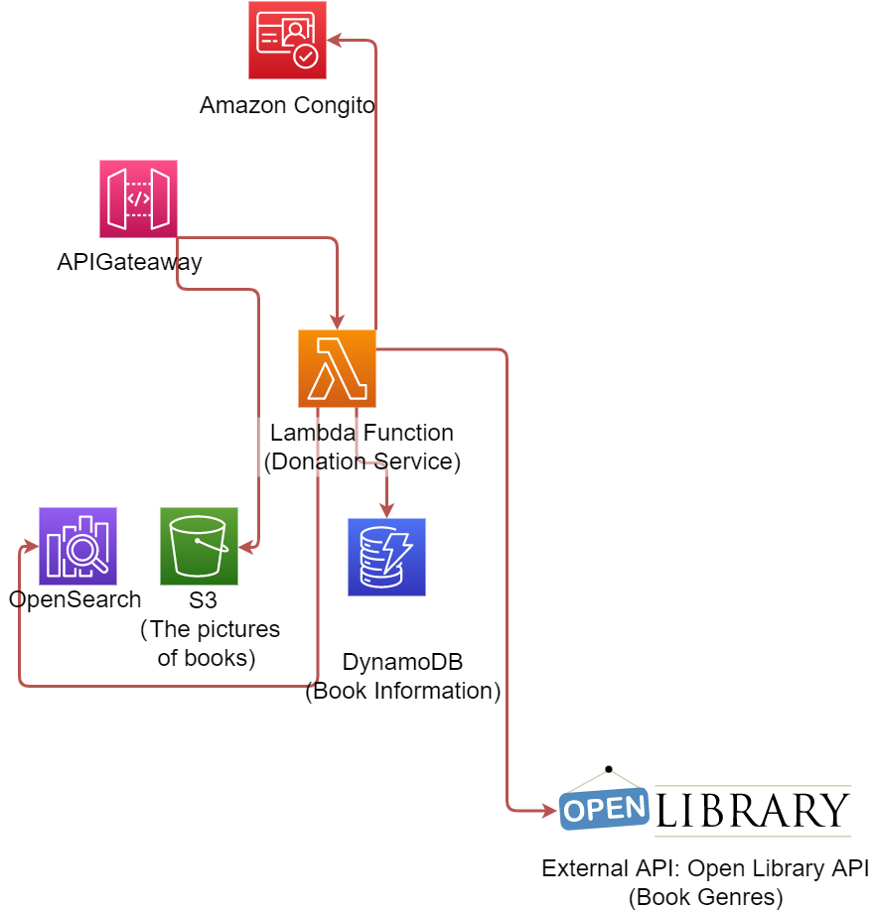
Donate & Request a second-hand book
Donate
Using API Gateway to pass the photos directly to a S3 bucket
Using a Lambda Function to add the donation information to DynamoDB and OpenSearch.
The lambda function automatically generates the genre information for the donated book by using Open Library API. This can help other users find the book they want by genre.

Slide 6
Search for a donated book

Slide 7
Show user information

Slide 8
Add a book to a favorite list

