Slide 1
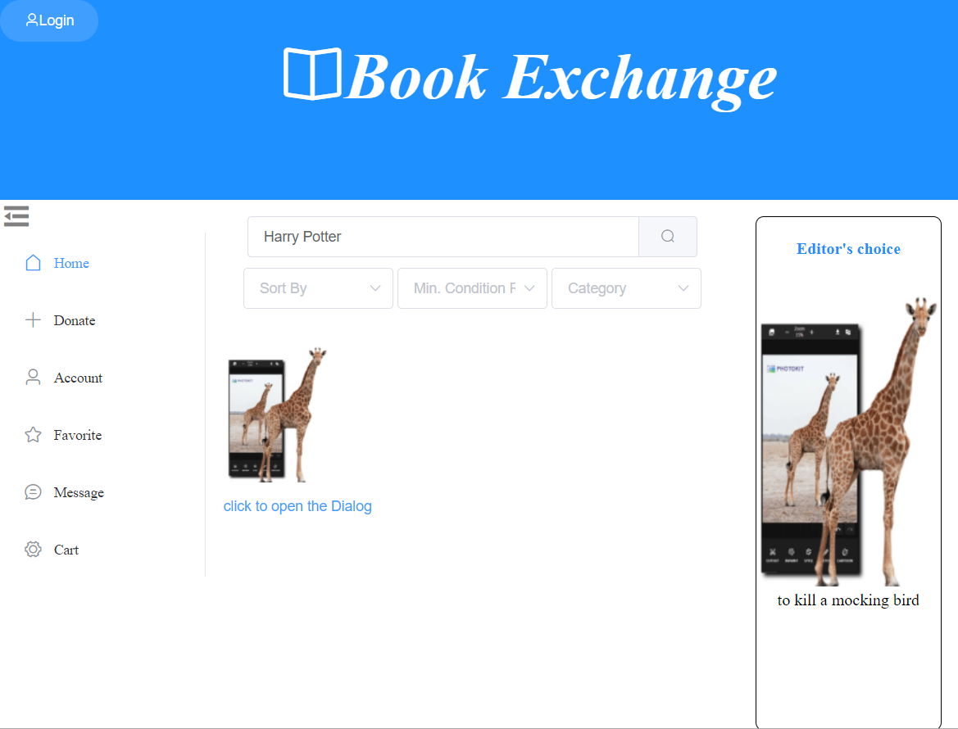
Book Exchange
A web service for exchanging second-hand books
Group member: Dantong Zhu(dz2451), Tianhang Cui(tc3158), Anni Chen(ac4779), Zhenrui Chen(zc2569)

Slide 2
Contents
Motivation
Structure Overview
Implementation Details
Some Design Choices

Slide 3
Motivation
A platform encourages people to exchange books
Save money to buy new books
The more books you donate, the more books you can request from others
Welcome users with similar interests to contact each other

Slide 4
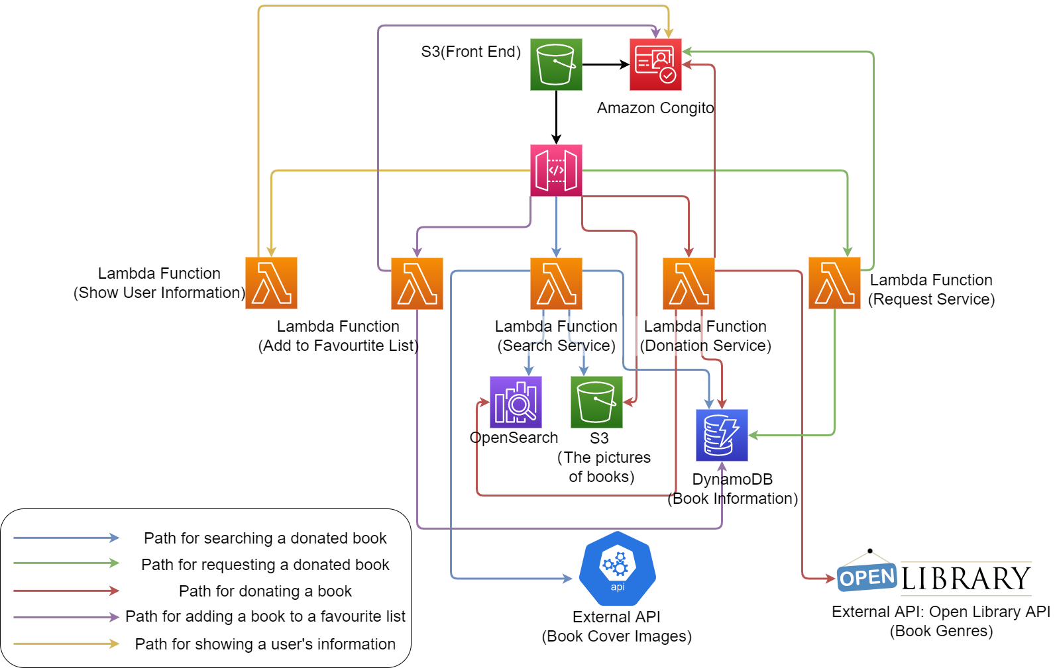
Structure Overview

Slide 5
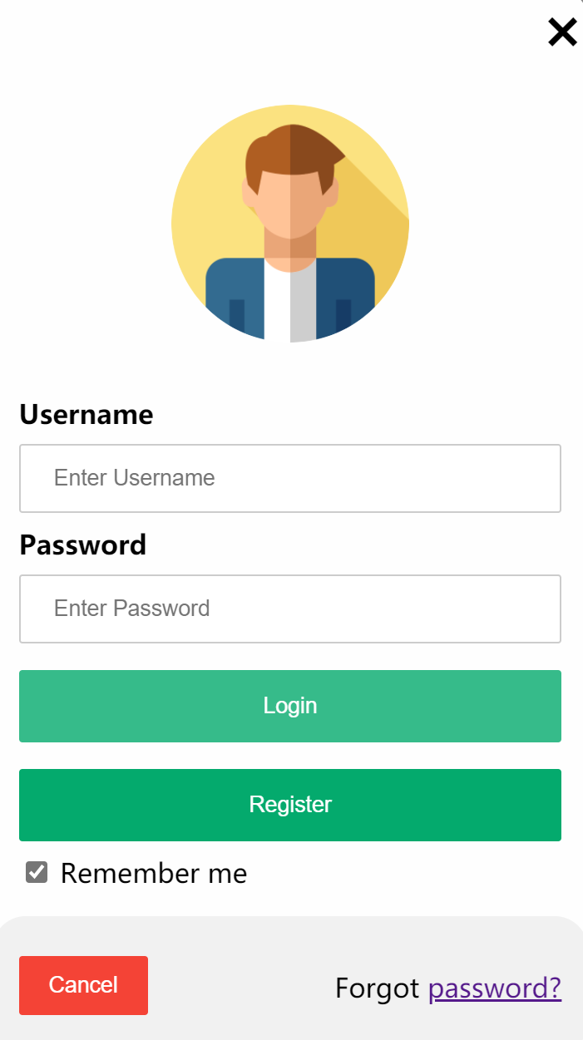
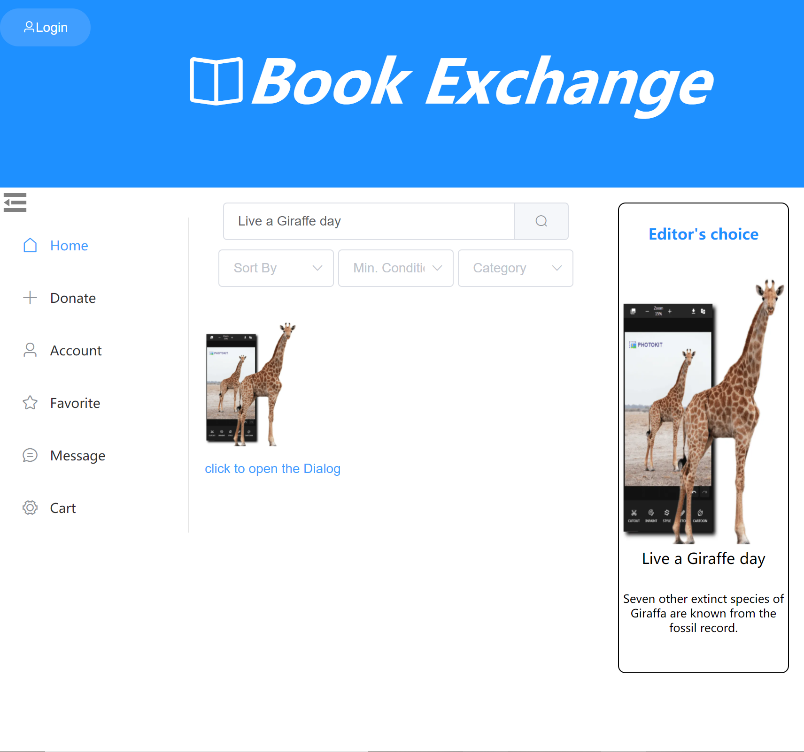
Implementation Details
Login/Registration Panel
Donation Panel: The user can only donate a book when they have logged in.
Login

Slide 6
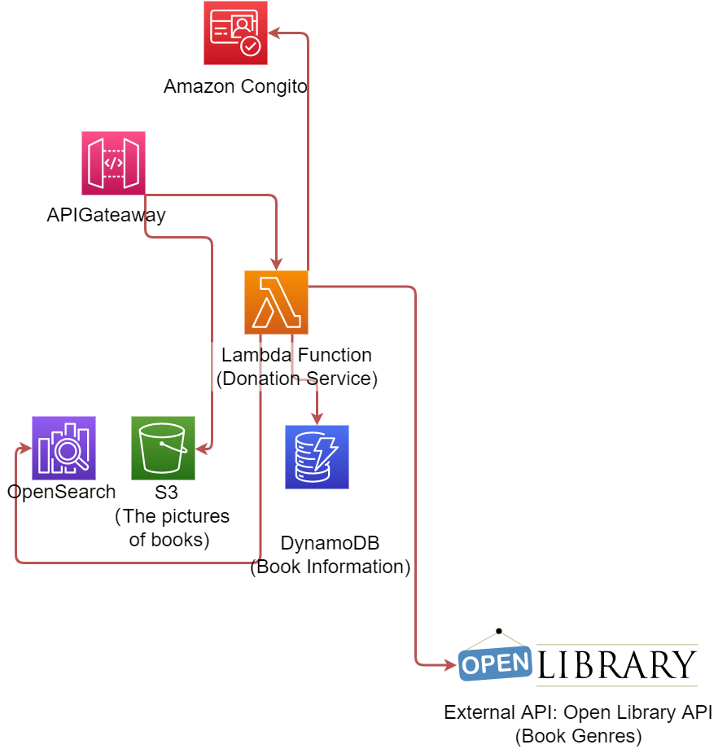
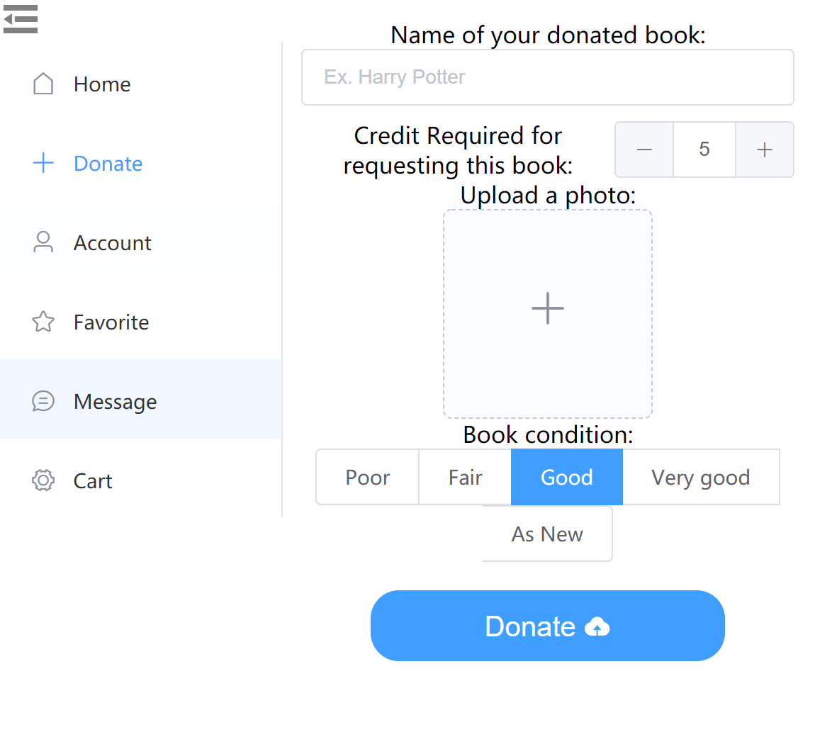
Implementation Details
Donate a second-hand book
Using API Gateway to pass the photos directly to a S3 bucket
Using a Lambda Function to add the donation information to DynamoDB and OpenSearch.
The lambda function automatically generates the genre information for the donated book by using Open Library API. This can help other users find the book they want by genre.

Slide 7
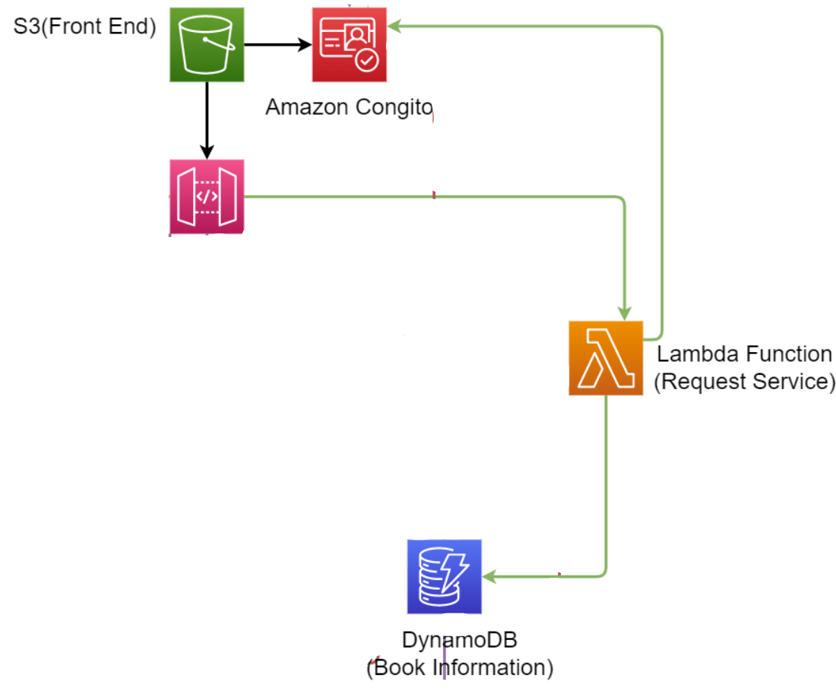
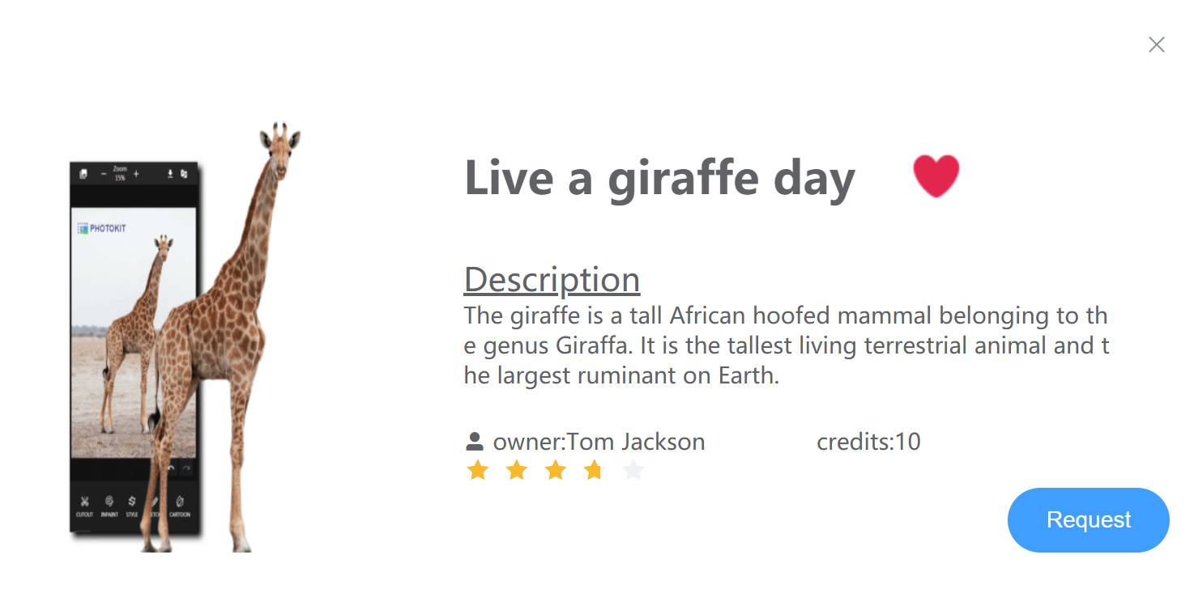
Implementation Details
Request a second-hand book
Determine whether the user has enough credits to make request
Once successful requested, update user history (add book_id)
Update book information to set status=’unavailable’, so it will no longer be searched
Click to request the book you want!

Slide 8
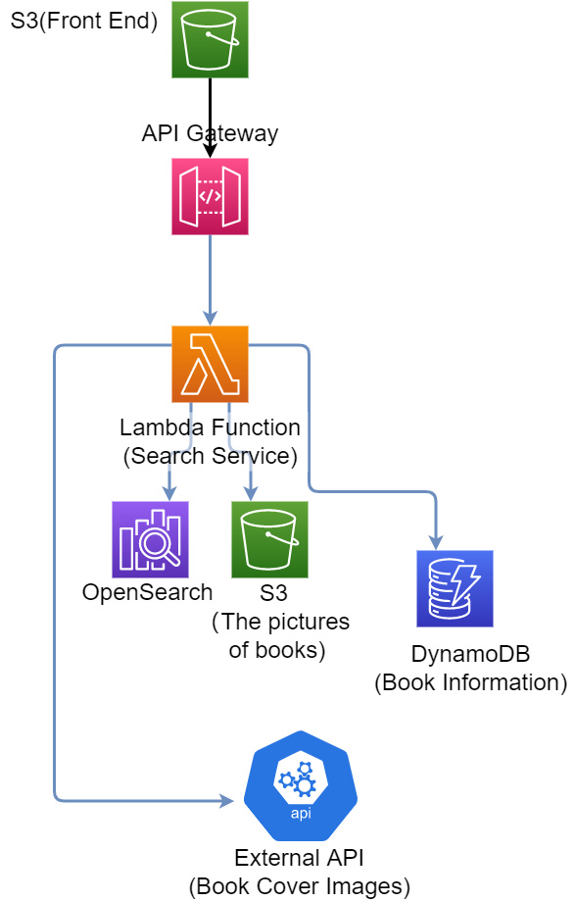
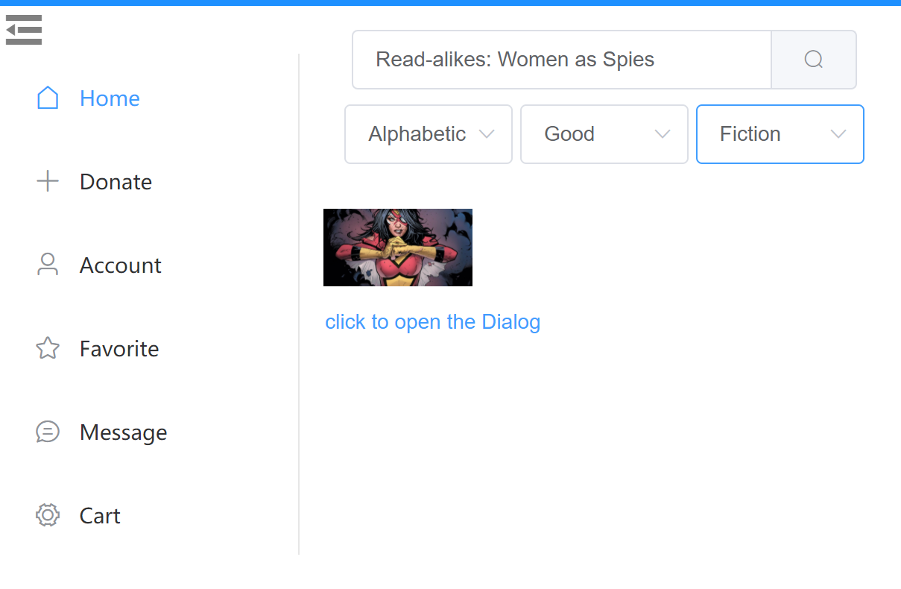
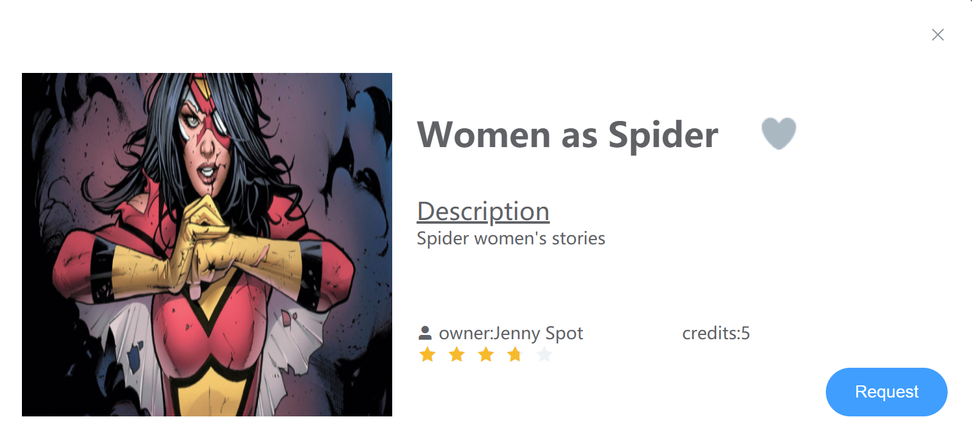
Implementation Details
Search-Zhenrui
Search for a donated book
Using API Gateway to pass the query infomation from frontend input to lambda function
Using a lambda function to query corrsponding available donation books ftom DynamoDB through OpenSearch.
The lambda function also automatically get the book cover by using Open Library API and upload pic from S3
Frontend get the response from the image and display it under the search bar

Slide 9
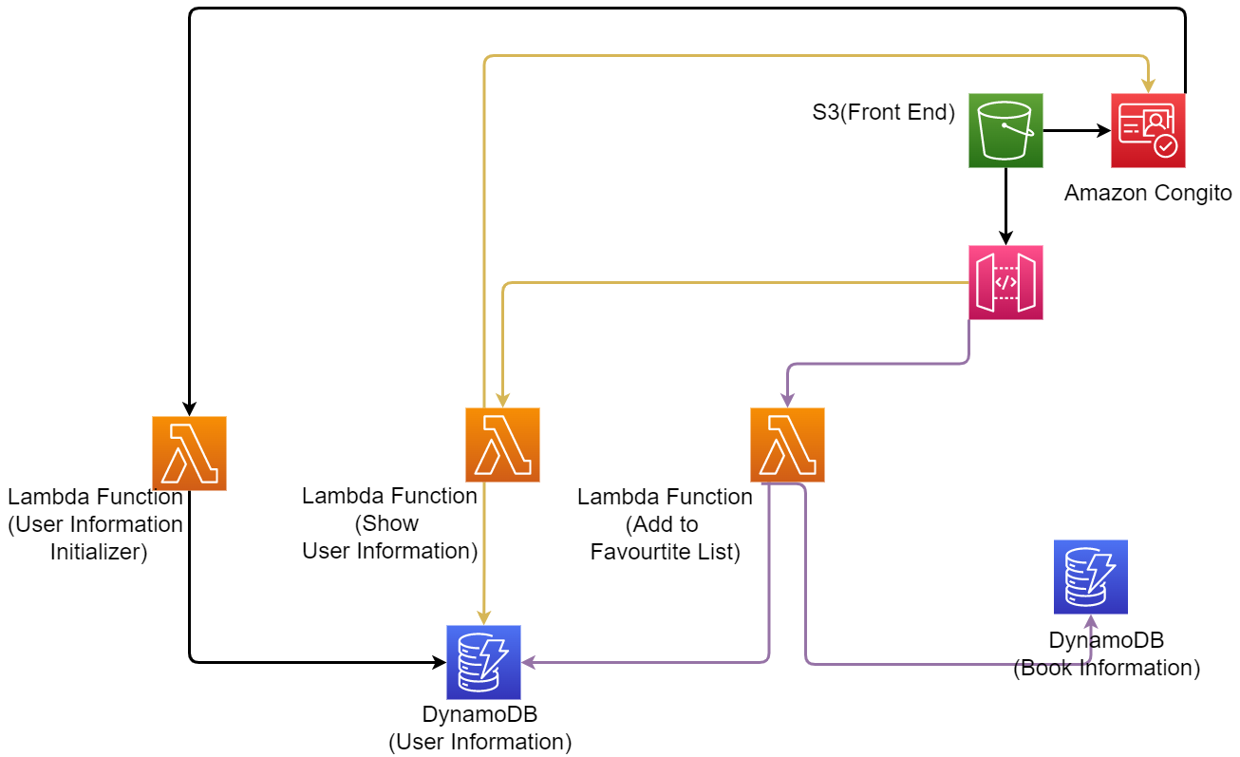
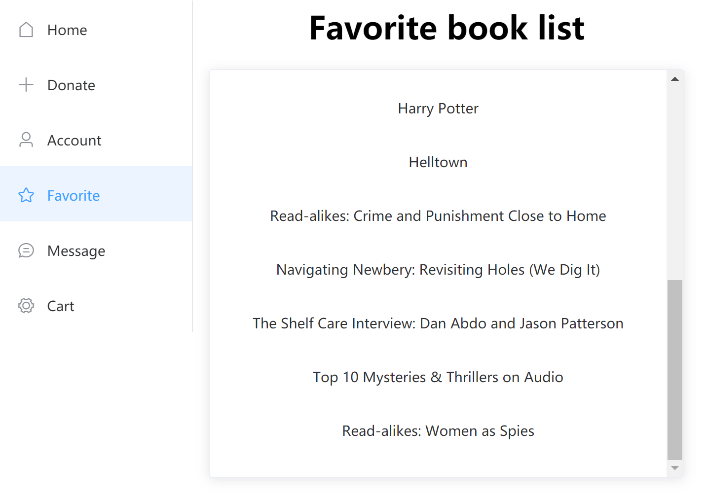
Implementation Details
Show user’s info & add to favorite list
Every time the user selects a book they like, the system firstly will store this book’s id in Dynamo DB(user information) corresponding to the user.
When the user jumps to the favorite list page and want more information about these books, the system will search it in the DynamoDB(book info) by id
When the user chooses to add a book to their favorite list, the count of favorite’ for that book will increase by 1 and the book is removed when the user double click

Slide 10
Some Design Choice
Although we can link user’s account and their information directly in Cognito (which is convenient and good for keeping user’s information secure!), we decided to use DynamoDB to store the users’ non-sensitive information, rather than storing them in Cognito.
- The attributes stored in Cognito has to be key-value(string) pair, not good for complicated data structures.
We need to store many users’ requested/donate books, this list could be large and Cognito is not scalable as the DynamoDB.
The DynamoDB can handle query much more efficient than Cognito
We realized this is the pattern often done in the industry after searching the online information

