Slide 1
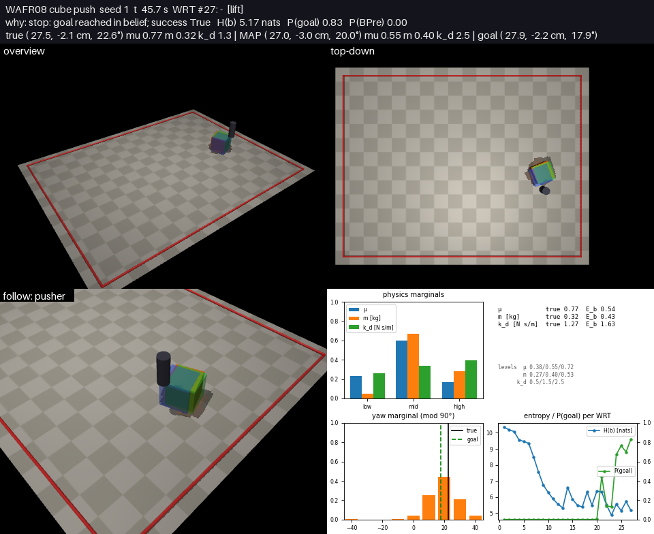
Cube push with WAFR08 belief-based execution (MuJoCo, skrl)
Hidden cube pose + friction μ, mass m, damping k_d; the only command is the wanted final cube pose
Setup
  Pusher: cylinder, position targets (x, y, z), sees its own position and actuator force (noisy)
  Cube: hidden start pose (x, y, yaw mod 90°) and μ ∈ [0.3, 0.8], m ∈ [0.2, 0.6] kg, k_d ∈ [0, 3] N s/m
  Goal: cube pose within 2 cm and 10°
Planner: WAFR08 (Hsiao, Lozano-Pérez, Kaelbling 2008)
  Grid belief over (x, y, yaw, μ, m, k_d): 36 × 35 × 9 × 3 × 3 × 3 cells
  World-relative trajectories at the MAP state w*: guarded touch, force probe, goal push
  Every WRT simulated from every belief hypothesis with batched mujoco.rollout
Result: 3 / 3 seeds reach the goal (21–27 WRTs, 35–46 s simulated)

Slide 2
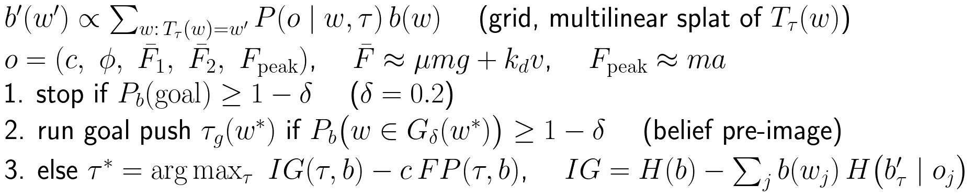
WAFR08 decision rule on the cube push
Belief update with each observed contact, travel and force
Changes vs. the paper: IG is measured on the next-state belief b'_τ (actions that scatter the cube lose what they disturb); G_δ uses 2× tolerance for waypoint pushes that do not end at the goal; force probes only once the pose entropy < 1.5 nats; FP = P(pusher lands on the cube) + P(cube leaves the table).

Slide 3
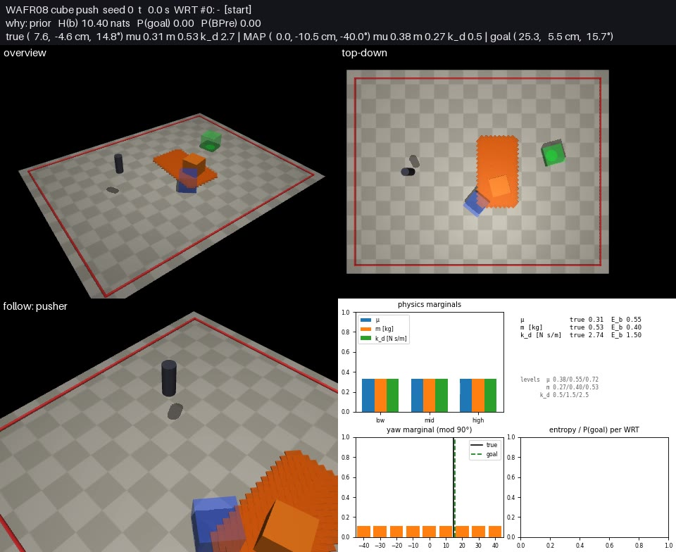
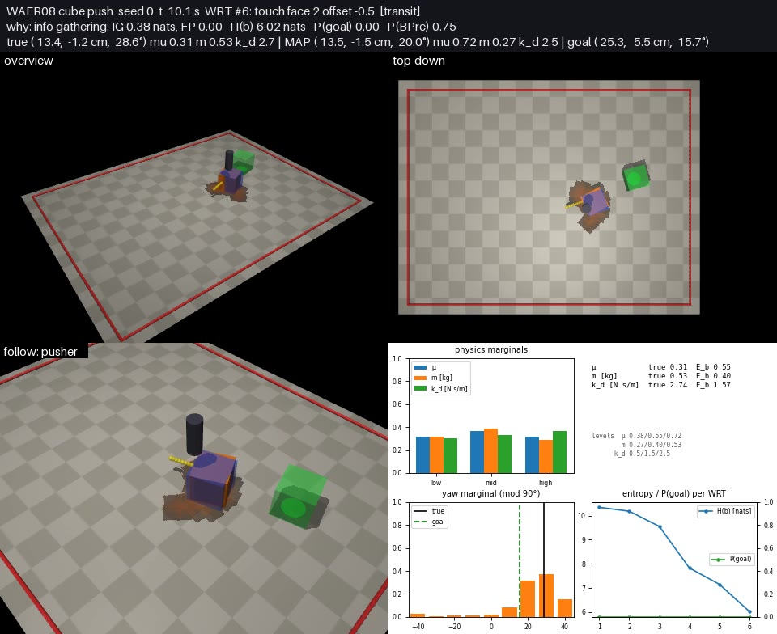
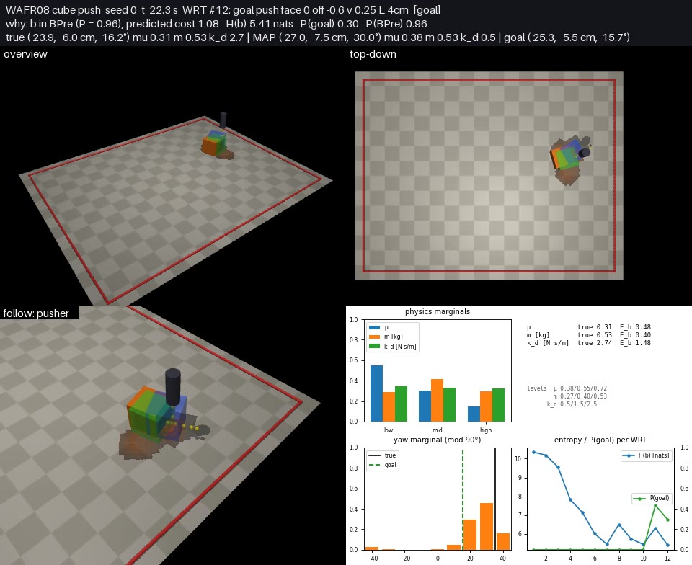
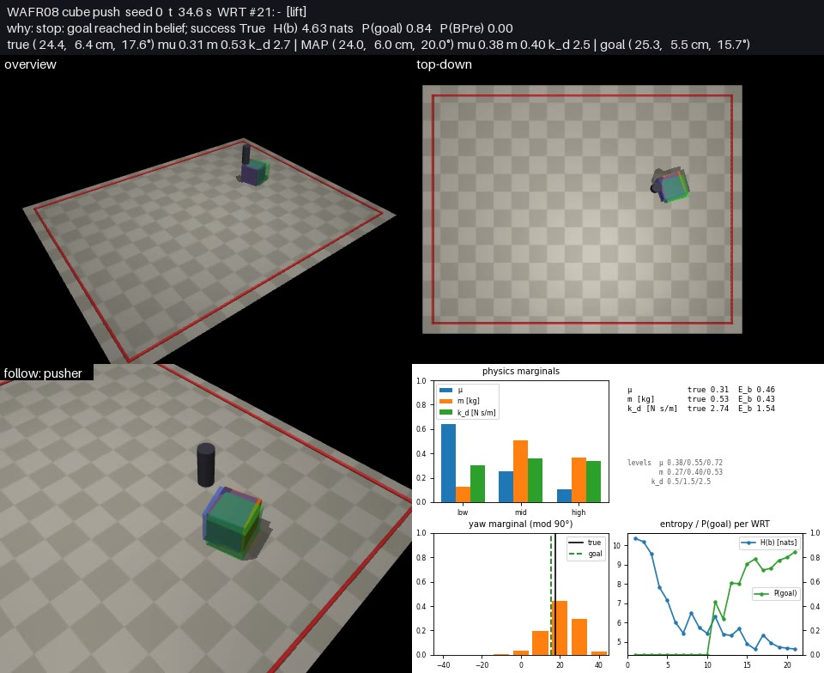
Seed 0: belief over time (keyframes)
true μ 0.31, m 0.53 kg, k_d 2.74 | 21 WRTs: 15 touches, 0 probes, 6 goal pushes | final error 1.3 cm, 1.9°
Panels: overview, top-down, pusher follow, belief plots
Orange tiles: most likely cube cells (opacity ∝ mass)
Blue box: MAP w*
Green box + disc: goal pose, 2 cm tolerance
Red: table limit
Yellow: current WRT path
Order: prior → touches → goal pushes → stop

Slide 4

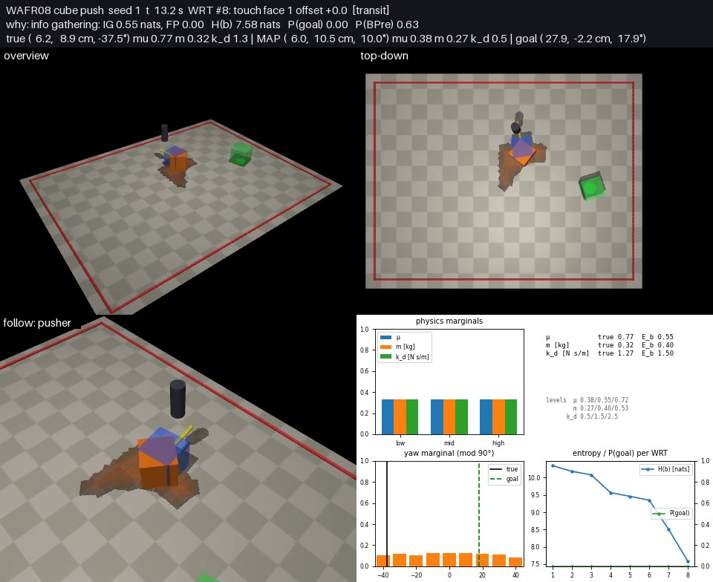
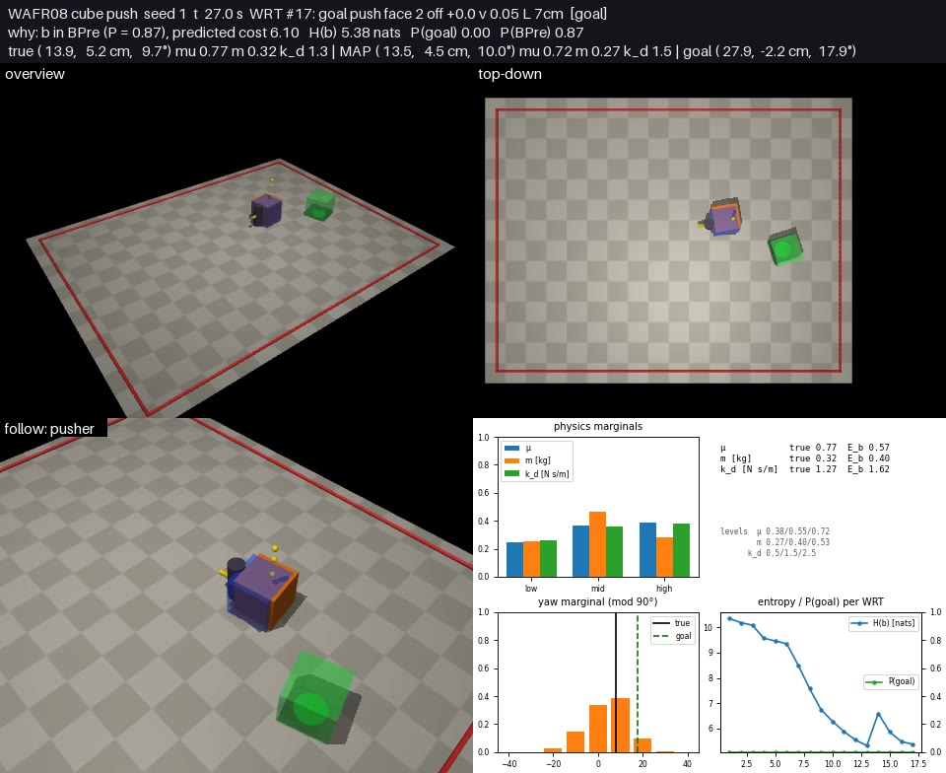
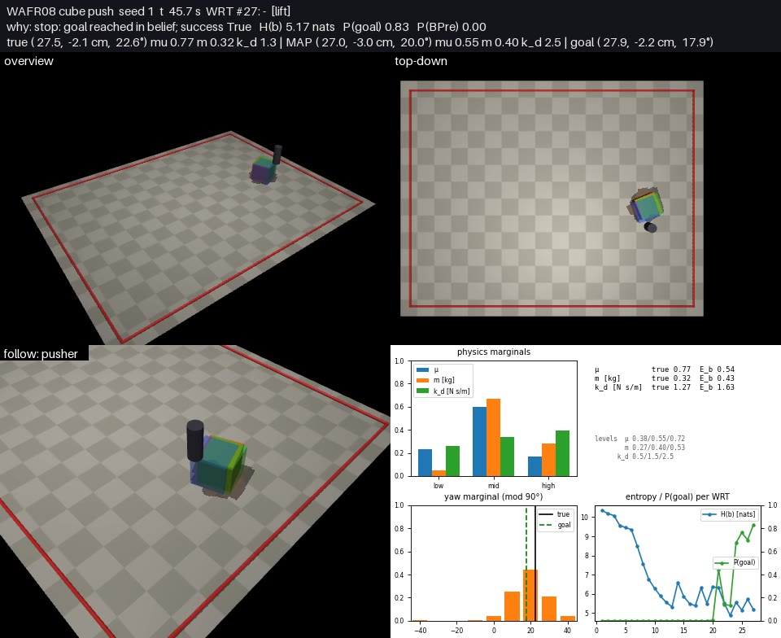
Seed 1: belief over time (keyframes)
true μ 0.77, m 0.32 kg, k_d 1.27 | 27 WRTs: 21 touches, 0 probes, 6 goal pushes | final error 0.4 cm, 4.8°
Panels: overview, top-down, pusher follow, belief plots
Orange tiles: most likely cube cells (opacity ∝ mass)
Blue box: MAP w*
Green box + disc: goal pose, 2 cm tolerance
Red: table limit
Yellow: current WRT path
Order: prior → touches → goal pushes → stop

Slide 5

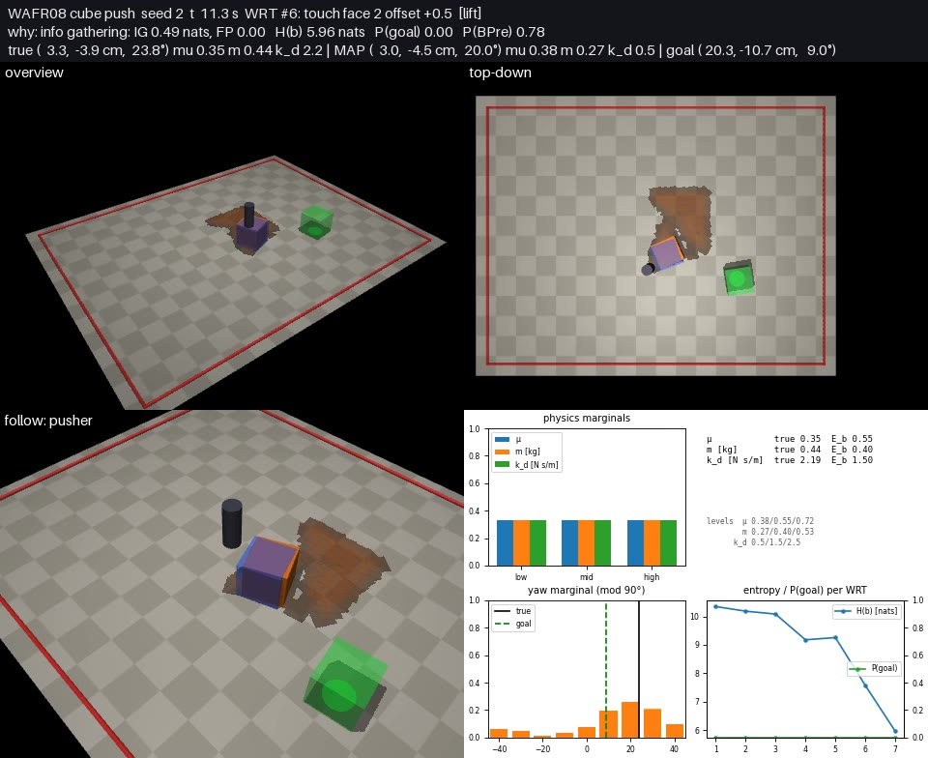
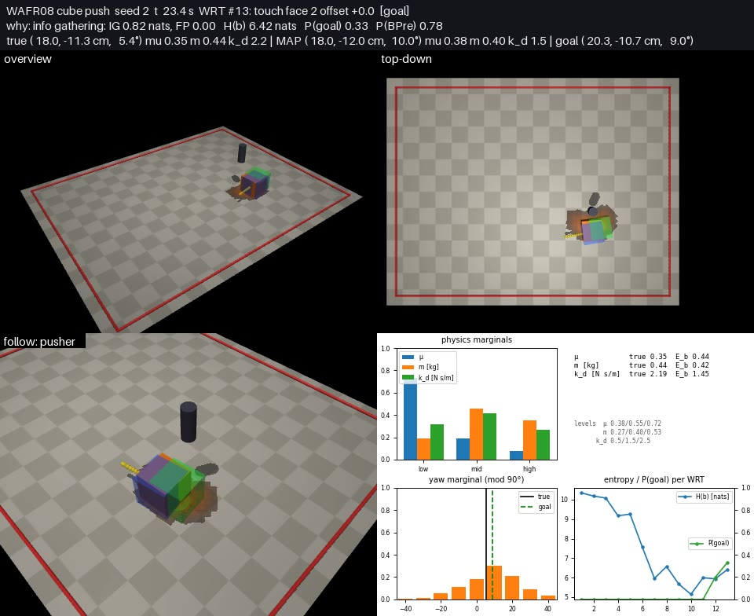
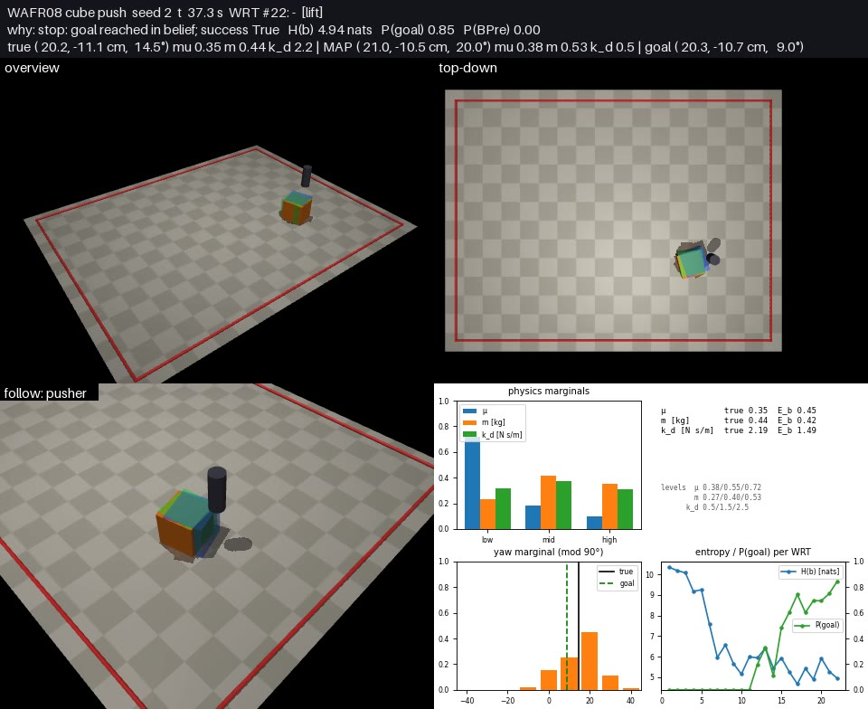
Seed 2: belief over time (keyframes)
true μ 0.35, m 0.44 kg, k_d 2.19 | 22 WRTs: 15 touches, 0 probes, 7 goal pushes | final error 0.4 cm, 5.5°
Panels: overview, top-down, pusher follow, belief plots
Orange tiles: most likely cube cells (opacity ∝ mass)
Blue box: MAP w*
Green box + disc: goal pose, 2 cm tolerance
Red: table limit
Yellow: current WRT path
Order: prior → touches → goal pushes → stop

Slide 6
Seed 0: full render
Drive video wafr08_seed0.mp4 (runs/cube_push_wafr08/videos/)

Slide 7
Seed 1: full render
Drive video wafr08_seed1.mp4 (runs/cube_push_wafr08/videos/)

Slide 8
Seed 2: full render
Drive video wafr08_seed2.mp4 (runs/cube_push_wafr08/videos/)

Slide 9
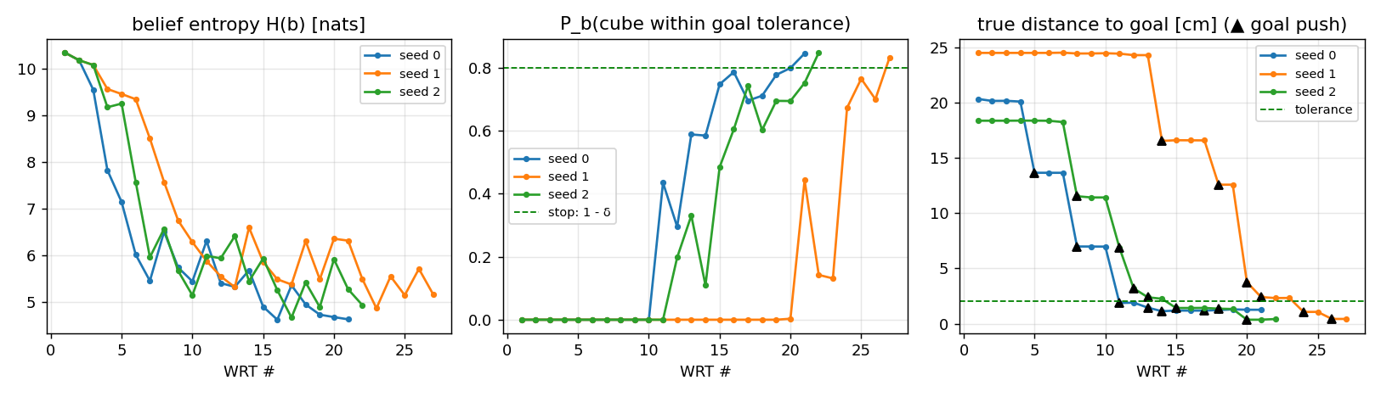
Belief evolution and results
3 / 3 seeds reach the 2 cm / 10° goal; WAFR08 stops on belief, and the true cube is inside the tolerance too
seed 0: 21 WRTs, 35 s simulated, error 1.3 cm 1.9°, true (μ, m, k_d) = (0.31, 0.53, 2.74), MAP levels (0.38, 0.40, 2.5)
seed 1: 27 WRTs, 46 s simulated, error 0.4 cm 4.8°, true (μ, m, k_d) = (0.77, 0.32, 1.27), MAP levels (0.55, 0.40, 2.5)
seed 2: 22 WRTs, 37 s simulated, error 0.4 cm 5.5°, true (μ, m, k_d) = (0.35, 0.44, 2.19), MAP levels (0.38, 0.53, 0.5)

Slide 10
What works, what does not yet
Works
  Guarded touches localize the cube from a 12 × 20 cm, any-yaw prior in ~10 WRTs
  Goal pushes are executed only from the belief pre-image; touches re-localize between them
  Hypothesis rollouts reproduce the real sensor trace exactly (same MuJoCo model, same controls)
Does not yet
  Physics is only coarsely identified: 3 levels per parameter, and push forces mostly measure μ·m
  Force probes almost never fire (gated on pose entropy); belief stays ~5 nats at the stop
  ~2 min wall per episode on the laptop CPU (400–6000 hypotheses per WRT)
Next
  Audit, GenAIF, quasi-static belief dynamics and RSS20 on the same env, same video tooling
Code: skrl/envs/cube_push/{sim,env,wafr08,render}.py, skrl/belief/grid_belief.py, examples/contact_rich_uncertainty/cube_push_wafr08.py (commit dc5467f5)

