Slide 1
Belief-based PPO in skrl
How BeliefPPO changes the PPO pipeline, plus status of the Transformer-policy workstream
branch feature/belief-pomdp-manipulation · 2026-10-10

Slide 2
Why a belief?
POMDP: the policy cannot see part of the state (contact, object pose, velocities)
Wirnshofer et al., RSS 2020: act on the belief, not on the raw observation
  Particle filter, NP particles: predict(a) → update(o) → resample
  Compress to an NG-component GMM: b̃ = [weights | means | log-diag-covs]
  dim(b̃) = NG + 2·NG·d (CartPole: NG=2, d=4 → 18)
BeliefDQN existed already. This session adds BeliefPPO, the on-policy version

Slide 3
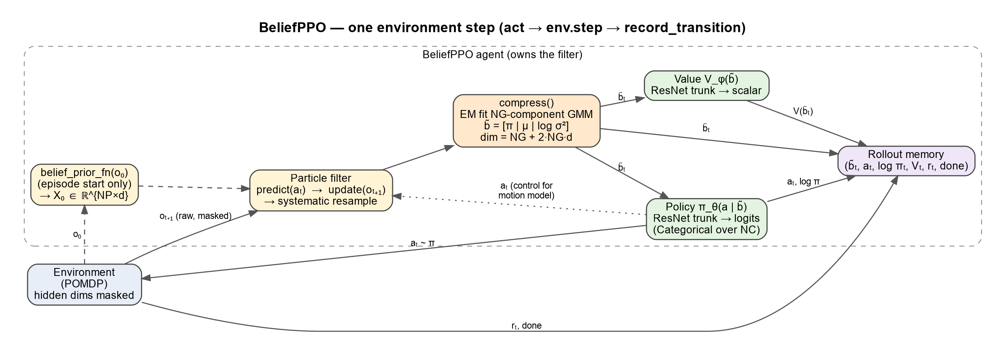
One environment step
act() uses b̃_t from the previous step; record_transition() advances the filter to b̃_{t+1}

Slide 4
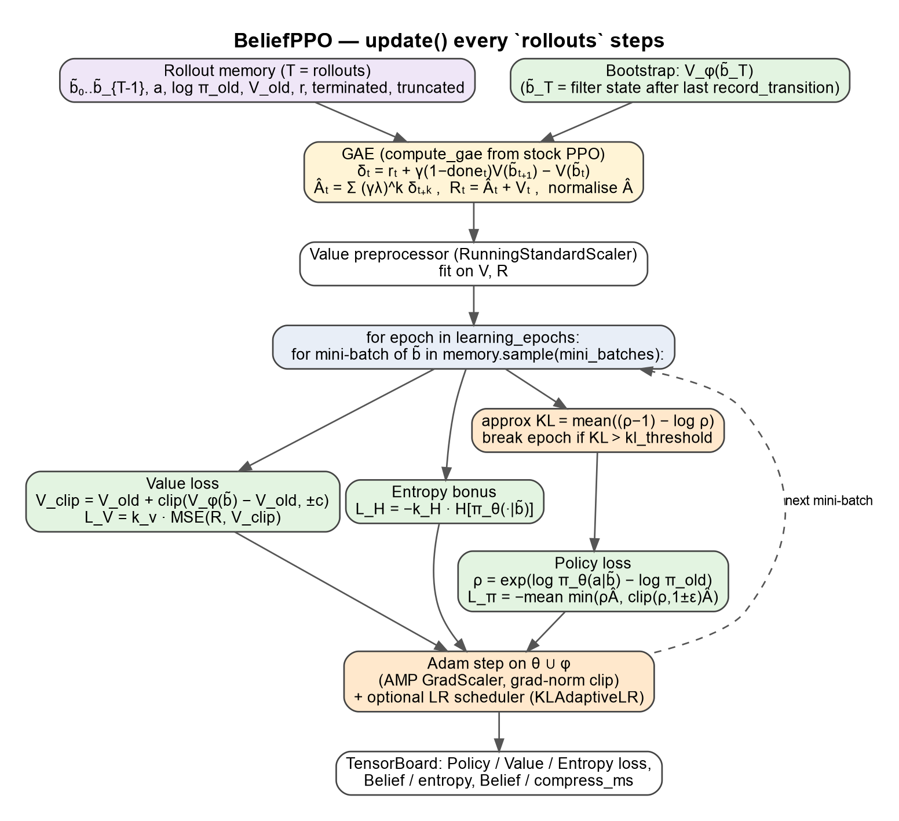
PPO update on beliefs

Slide 5
What changes compared with stock PPO
Network input: b̃ instead of the env observation; memory stores beliefs, not obs
GAE bootstrap: V(b̃_{t+1}) taken from the filter after the last transition
Episode reset: cfg.belief_prior_fn(o₀) re-seeds the particles on the first act() after a done
Unchanged: compute_gae, clipped surrogate, value clip, KL early stop, AMP, LR scheduler (reused from PPO)
Default nets: ResNet trunk (paper §V-A), Categorical policy over NC controllers + value
Limit: one filter → num_envs = 1. For massively parallel Isaac Lab use pattern B
Perf fix: act() reuses b̃ from record_transition() (a second GMM EM per step was ~5× slower)

Slide 6
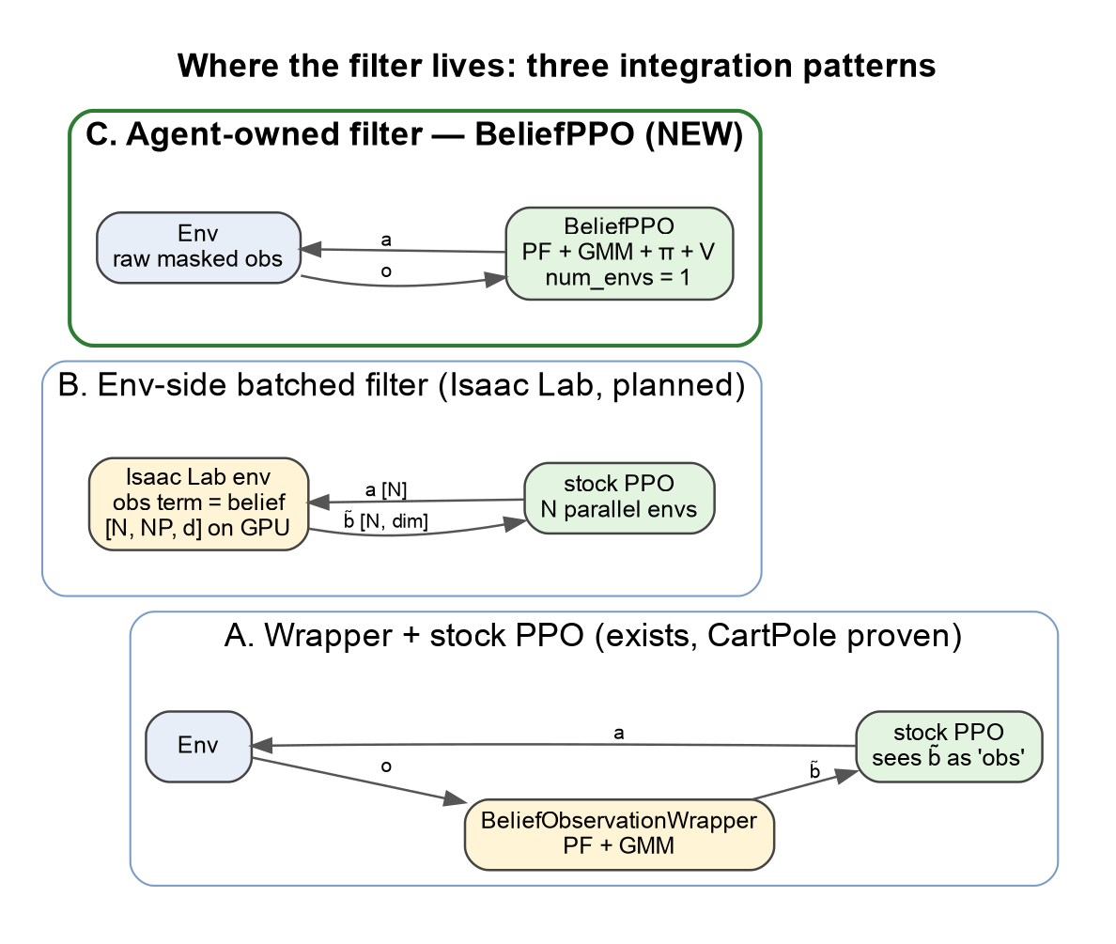
Where the filter lives

Slide 7
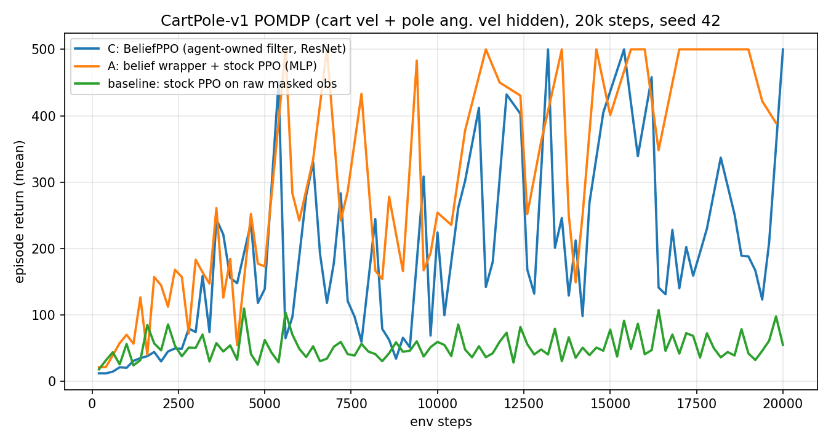
Smoke test: CartPole POMDP, 20k steps
Mean of last 10 logs: C BeliefPPO 239 · A wrapper+PPO 466 · raw-obs baseline 53 (max 500 / 500 / 110). One seed.

Slide 8
Tests and status
tests/agents/torch/test_belief_ppo.py: 8 tests (shapes, memory holds b̃, update changes params, prior reset, num_envs guard)
Belief suite (filter, compression, BeliefDQN, BeliefPPO): 44 passed; transformer models: 6 passed
Both belief runs reach the 500 cap; the raw-obs baseline stalls at about 100, so the belief carries the hidden velocities
C is noisier than A late in training. Network and prior differ and there is one seed, so the gap is not established
Next: multi-seed C vs A with the same MLP, batched BeliefPPO / pattern B for Isaac Lab

Slide 9
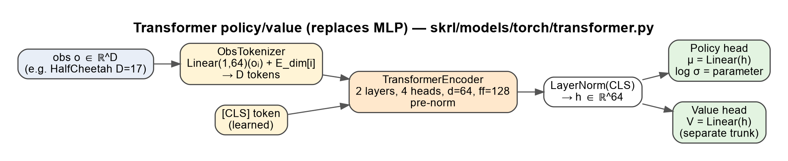
Transformer policies instead of MLPs
One token per observation dimension + CLS. PPO on HalfCheetah-v5, InvertedPendulum-v5, InvertedDoublePendulum-v5

Slide 10
Transformer smoke runs (8 envs, 1 seed, short)
InvertedPendulum-v5, 20k steps: transformer 43 · MLP 119 (final mean return)
InvertedDoublePendulum-v5, 20k steps: transformer 82
HalfCheetah-v5, 50k steps: transformer −287 (still learning)
Far too short to compare architectures; the transformer runs about 2× slower per step
No triple-pendulum env exists in gymnasium; it needs a custom MJCF
Next: ≥1M-step runs, multi-seed transformer vs MLP; feed b̃ tokens (per GMM component) to the transformer

