Slide 1
Belief-based manipulation: five methods, one Bayes filter
How RSS20 (Wirnshofer), WAFR08 (Hsiao et al.), Audit-Before-You-Commit, GenAIF and Quasi-static belief dynamics differ in what they believe, how they update it and how they act on it.
Plus: where skrl's PrivilegedPPO / BeliefPPO sit, the MuJoCo plan, and the encoder interface.

Slide 2
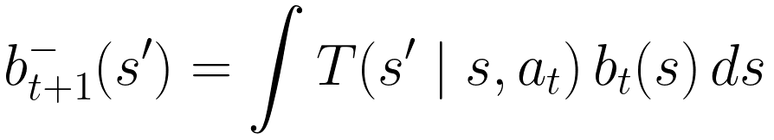
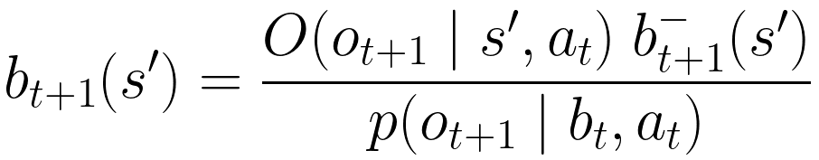
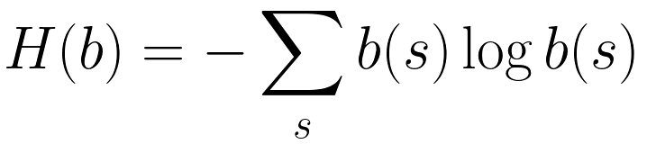
Common ground: the POMDP belief filter
Every method below is this filter with a different choice of s, representation of b, T, O, and decision rule.
Belief = posterior over hidden state given history
Prediction (transition model T)
Correction (observation model O)
Entropy (info-gathering criteria use it)
Expected information gain of action a
The methods differ on four axes: (1) what s is (object pose vs physical parameters vs discrete context vs learned latent), (2) how b is stored, (3) where T and O come from, (4) how b picks the action.

Slide 3
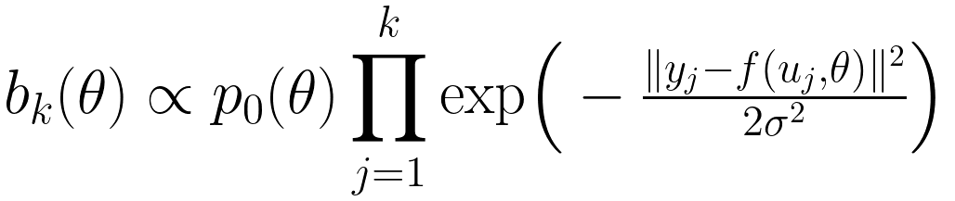
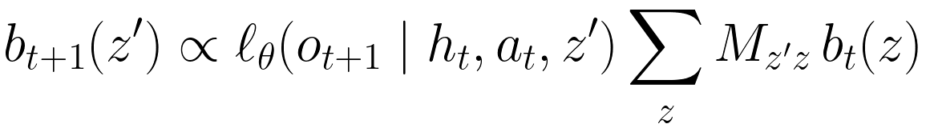
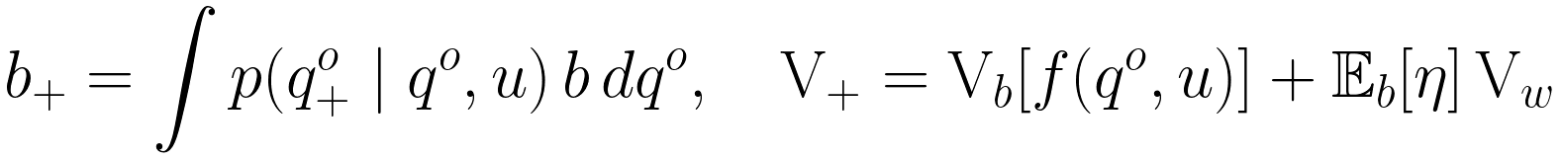
Same filter, different T and O
The single most useful slide: which term of the Bayes filter each method keeps, learns, tabulates or drops.
RSS20: T = simulate each particle, O = robot feedback
WAFR08: T ≈ identity (light touch), O = offline table
Audit: static parameters, T = identity, O = analytic f
GenAIF: T and O both learned (diffusion / CVAE)
Quasi-static: no O at all (open loop), only T
skrl PrivilegedPPO: no explicit b, regressed point latent

Slide 4
At a glance
Method | Belief over | Representation | Obs. model | Action selection | Information gathering | Commit / stop
RSS20 Wirnshofer (repo baseline) | object pose (x, y[, yaw]) | 300 particles → 2-comp. GMM | sim rollout per particle vs robot feedback | DQN picks a controller from a bank built around the GMM modes (2 Hz) | implicit (learned Q, r = −1) | goal reached
WAFR08 Hsiao, Lozano-Pérez, Kaelbling | object pose (x, y, θ) | uniform grid, multinomial | offline table Ω_τ(w,e) + Gaussian | world-relative trajectory at most-likely state w*(b) | explicit: argmax IG − c·FP | b ∈ belief pre-image of goal (P ≥ 1−δ)
Audit Before You Commit (Abouagour & Min 2026) | task params θ (hole x, clearance; μ, m, k_d) | 1024 particles + retained set C_{k,ν} | analytic forward model f(u, θ) | probes, then minimax over C_{k,ν} | fixed probe budget / cover schedule | single irreversible commit; audit coverage + optimism
GenAIF (Li, Jafari, Matta 2026) | hidden dynamics context (tilt) | discrete posterior, Markov switching M | learned generative trajectory model | MPC: min expected free energy over sampled U | −λ·I(Ξ; Y) inside EFE | none: replan every step
Quasi-static belief dyn. (Jankowski et al. IJRR 2025) | object pose q^o | particles → variance only | none (open loop) | CMA-ES over via-points (BS-VP-STO) | none: shrink variance by contact funnelling | open-loop plan, γ_k ≤ 1
skrl PrivilegedPPO (this fork) | privileged params / state x^priv | learned point latent ẑ | implicit (regression to z) | PPO policy on (o, ẑ) | implicit | —

Slide 5
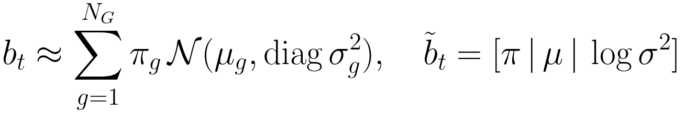
RSS20 (Wirnshofer et al.) — the Belief-based-pushing baseline
Belief over WHERE the object is. Information gathering is never scored explicitly: the Q-function learns when probing pays.
Hidden: object pose; robot joints observed with noise
Particle belief over object pose
Update: simulate every hypothesis under the same controller, compare robot feedback
Compress (weighted EM, diagonal)
Controller bank relative to each mode
Policy: Dueling Double DQN on the compressed belief

Slide 6
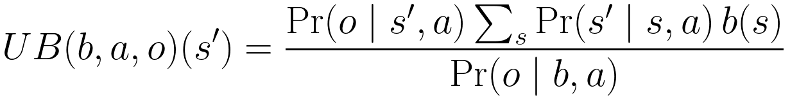

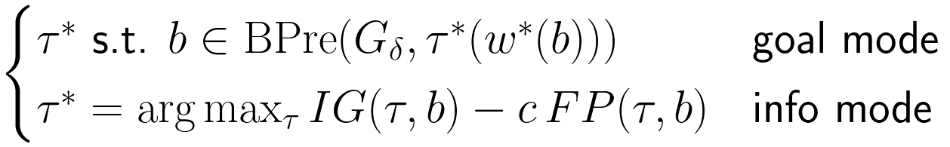
WAFR08 — Robust belief-based execution (Hsiao, Lozano-Pérez, Kaelbling)
Belief over WHERE the object is. Explicit, one-step information gain; commits when the belief is inside the goal's pre-image.
Grid belief over object pose
Discrete Bayes filter
Obs. model from offline geometric sim of WRT τ run for estimate e in true world w
Act at the most likely state
Goal on beliefs, and the belief pre-image
Failure probability (undetected contact)
Information gain of a WRT (first contact only)
Mode switch

Slide 7
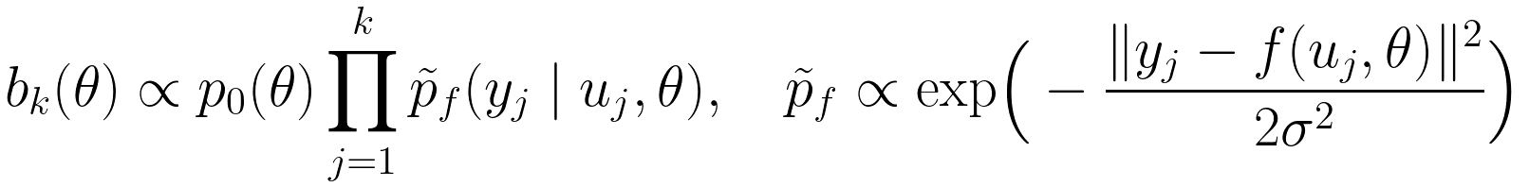
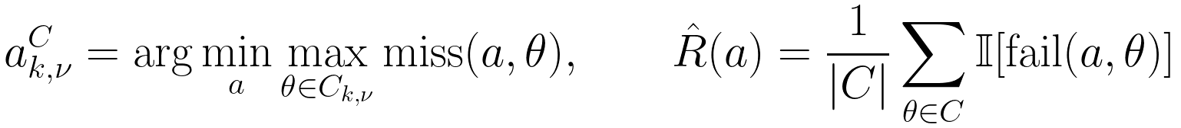

Audit Before You Commit (Abouagour & Min, arXiv 2609.30608)
Belief over WHAT the physics/geometry is. Not a planner: it asks whether the belief can be trusted before the one irreversible action.
Hidden task parameters (insertion example; pushing: μ, m, k_d)
Particle belief from k probes (static θ: no prediction step)
Retained set: shortest top-weight prefix with mass ν (=0.8)
Commit once: scenario minimax (binary: failure fraction)
Probe budget trade-off
Audit 1: coverage of the decision coordinate
Audit 2: failure-model optimism
Limit of any history-based commit gate

Slide 8
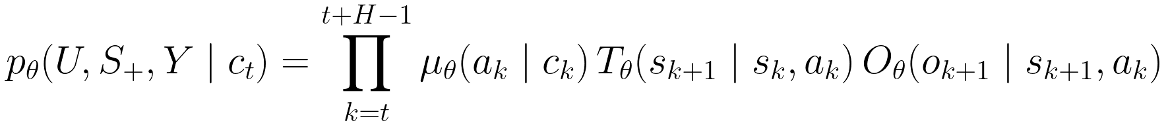
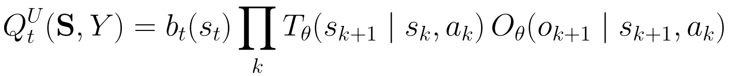
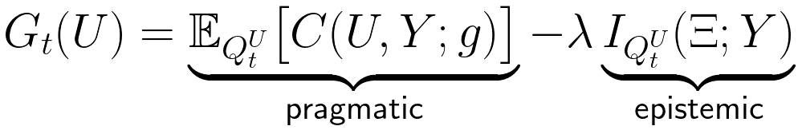
GenAIF — generative models for active inference (Li et al., arXiv 2610.05692)
Belief over WHICH dynamics regime holds. Info gain is a term in the objective, traded off continuously against task cost.
One generative model gives proposals, dynamics and likelihood
Belief over hidden context z (benchmark: lateral tilt)
Update as variational free-energy minimisation
Candidate rollout distribution under do(U)
Expected free energy: task cost minus info gain
MPC: sample U from μ_θ, keep safe ones, take min
Note: the paper's hidden variable is surface tilt (9 conditions incl. obstacle position), not friction/mass. μ, m, damping are a natural extension in our MuJoCo env.

Slide 9

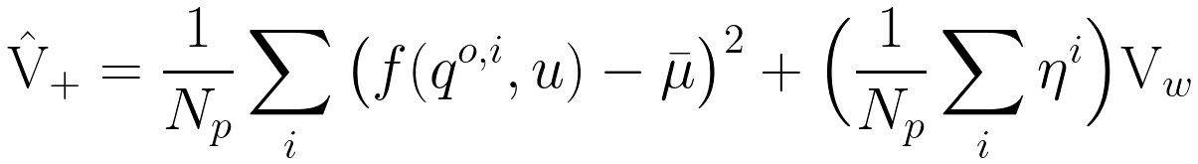
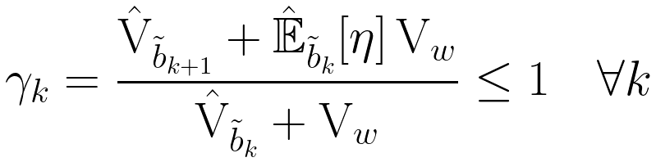
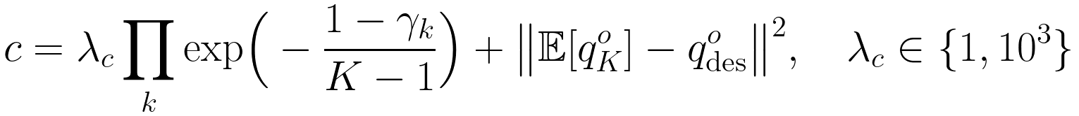
Quasi-static belief dynamics for robust pushing (Jankowski et al., IJRR 2025)
Belief over WHERE the object is, but never corrected by sensing: robustness comes from choosing contacts that funnel (contract) the belief.
Quasi-static contact: object moves the least to stay non-penetrating
Noise only while in contact
Variance propagation without sampling w
Particle estimate (nominal f only)
Variance gain per step; robustness constraint
Cost for CMA-ES over via-points (BS-VP-STO)

Slide 10

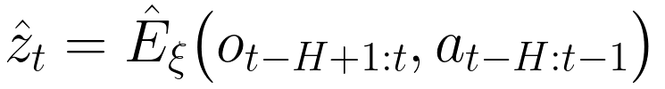
Where this skrl fork sits: PrivilegedPPO / BeliefPPO
Amortised belief: fast and scalable (1000s of envs), but uncertainty and information value are implicit in the RL value function.
Teacher latent from privileged values (sim only)
History estimator (MLP / Conv1d / LSTM / Transformer)
Policy input, masked by curriculum
Estimator / sysid losses
What the latent is, in belief terms
BeliefPPO (explicit): particle filter + GMM as obs.

Slide 11
How they differ, in belief terms
• WHAT is uncertain
  – pose of the object: RSS20, WAFR08, Quasi-static; physical / task parameters: Audit (θ), GenAIF (tilt), skrl (x^priv)
• HOW uncertainty is stored
  – full posterior: WAFR08 grid, Audit particles; compressed: RSS20 2-GMM; 2nd moment only: Quasi-static; point: skrl ẑ
• WHERE the likelihood comes from
  – offline table (WAFR08), analytic model (Audit), per-particle simulation (RSS20), learned generative model (GenAIF), none (Quasi-static)
• HOW information is valued
  – entropy drop IG(τ,b) (WAFR08) · mutual information I(Ξ;Y) inside EFE (GenAIF) · fixed probe budget + coverage audit (Audit)
  – · variance gain γ_k ≤ 1 (Quasi-static) · learned implicitly by Q / V (RSS20, skrl)
• WHEN to act on it
  – most-likely state + pre-image test (WAFR08) · worst case over retained set (Audit) · expectation (GenAIF) · every step (RSS20, skrl)

Slide 12
Proposed MuJoCo implementation in skrl (to agree before coding)
• One env: planar cube push (port of Belief-based-pushing mujoco_repro), hidden pose + μ, m, k_d, batched, debug video
• Shared belief core: skrl.belief ParticleFilter (exists) + grid filter + retained-set / coverage utilities
• Methods as pluggable deciders on the same filter:
  – wafr08: WRT library, offline Ω-table, IG − c·FP vs. pre-image test
  – audit: probe-then-commit, scenario minimax, coverage + optimism report
  – genaif: CVAE trajectory model (fast) → likelihood + EIG, EFE-MPC
  – quasistatic: nominal-particle variance propagation, γ_k constraint, CMA-ES over via-points
  – rss20: existing BeliefDQN on the 2-GMM (baseline)
• Benchmarks: success / miss vs. probes, belief coverage, wall-clock; sweeps on dl

Slide 13
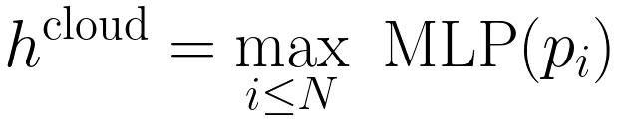

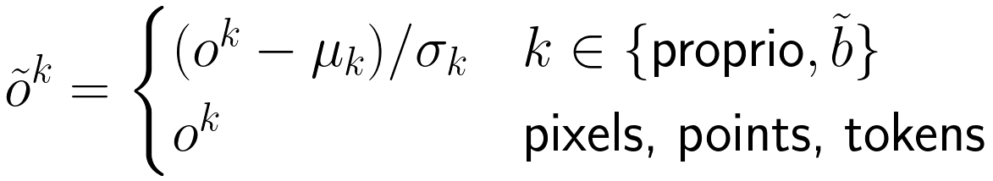
Encoders: pluggable observation encoders (DINO, CLIP, PointNet, FiLM, any)
Today skrl flattens dict observations and RunningStandardScaler would normalise pixels and token ids; PrivilegedPPO requires no preprocessor.
Dict observation, one encoder per key
Frozen pretrained (DINOv2 / CLIP image)
PointNet (permutation invariant)
CLIP text as condition
FiLM fuses condition into features
Per-key preprocessors (scaler only on low-dim keys)
YAML: models.policy.encoders: {rgb: {type: dino, frozen: true}, text: {type: clip_text}, cloud: {type: pointnet}}, fusion: {type: film, condition: text}

Slide 14
Sources
• K. Hsiao, T. Lozano-Pérez, L. P. Kaelbling. Robust Belief-Based Execution of Manipulation Programs. WAFR 2008. lis.csail.mit.edu/pubs/tlp/wafr08.pdf
• L. Wirnshofer, P. Schmitt, G. v. Wichert, W. Burgard. Controlling Contact-Rich Manipulation Under Partial Observability. RSS 2020.
• M. Abouagour, B.-C. Min. Audit Before You Commit: Locating Belief Failures in Active Identification for One-Shot Manipulation. arXiv 2609.30608.
• Y. Li, M. A. Jafari, A. Matta. Benchmarking Generative Trajectory Models for Active-Inference Control. arXiv 2610.05692.
• J. Jankowski et al. Robust Pushing: Exploiting Quasi-static Belief Dynamics and Contact-informed Optimization. IJRR 2025, arXiv 2404.02795.
• github.com/ebasatemesgen/Belief-based-pushing (mujoco_repro = RSS20 MuJoCo reproduction track).

