Slide 1
Deep Learning with Keras Text classification
Themistoklis Diamantopoulos

Slide 2
Text Classification Problem
Sentiment Analysis
Identify positive and negative emotions in text
Dataset from Twitter: http://thinknook.com/twitter-sentiment-analysis-training-corpus-dataset-2012-09-22/
POSITIVES ☺
NEGATIVES ☹
The weather is great today!
What a boring movie!
Yo, I had so much fun
I dn’t feel like doing anythin
Source: https://codeburst.io/use-tensorflow-dnnclassifier-estimator-to-classify-mnist-dataset-a7222bf9f940

Slide 3
Feature Representation
Each word has an ID (lower ID ←→ higher frequency)
PHRASES
"Is is a common word“
"So is the“
"the is common“
"disco is not common"
SEQUENCES
[1, 1, 4, 2]
[1, 3]
[3, 1, 2]
[1, 2]
DICTIONARY
Word | Index | Word | Index
a | 4 | not | 8
common | 2 | so | 6
disco | 7 | the | 3
is | 1 | word | 5
PADDED SEQUENCES
[1, 1, 4, 2]
[0, 0, 1, 3]
[0, 3, 1, 2]
[0, 0, 1, 2]
Source: http://www.developintelligence.com/blog/2017/06/practical-neural-networks-keras-classifying-yelp-reviews/

Slide 4
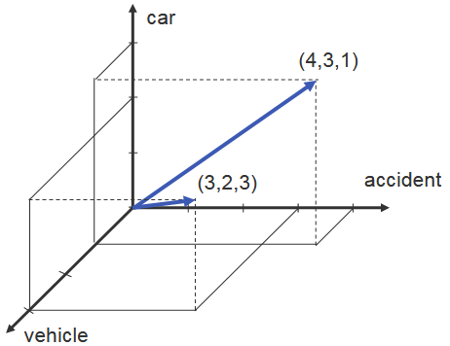
One-hot Encoding
Document Representation (similar to Vector Space Model)
Each word is a dimension
Each document is a vector
Can be used to find similar
documents
WORD FREQUENCIES
 | Doc1 | Doc2
accident | 4 | 3
car | 3 | 2
vehicle | 1 | 3
Source: http://slideplayer.com/slide/4174408/

Slide 5
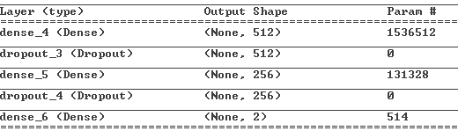
Solution using MLP
3-layer fully connected network
Input vector size: 3000 (number of words)
Output layer: 2 nodes
2 Intermediate layers
Source: https://github.com/wxs/keras-mnist-tutorial/blob/master/MNIST%20in%20Keras.ipynb

Slide 6
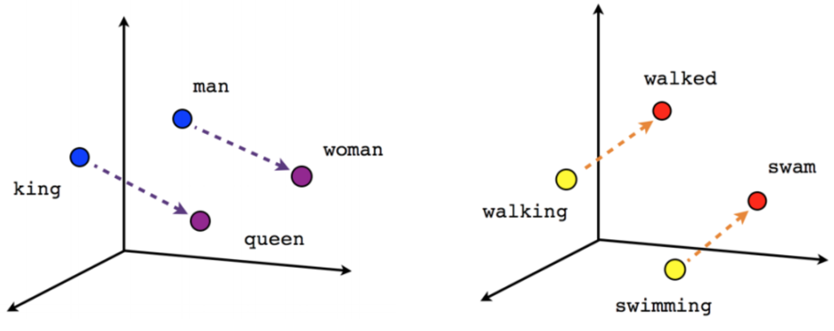
Word Embedding
Distributed representation of words
Each word is a vector
Similar words have similar vectors
Can be used to generate analogies
Source: http://www.developintelligence.com/blog/2017/06/practical-neural-networks-keras-classifying-yelp-reviews/

Slide 7
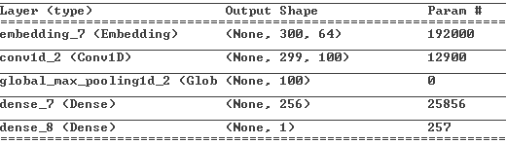
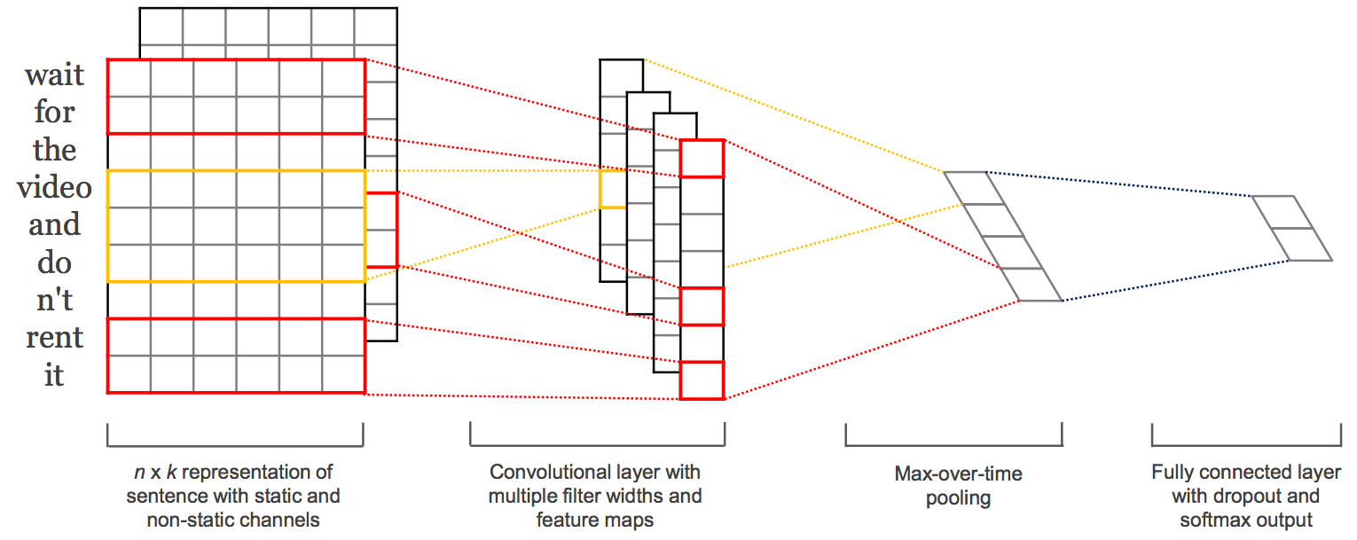
Solution using CNN
Embedding
1 Conv. layer
Connected MLP
Source: https://machinelearningmastery.com/best-practices-document-classification-deep-learning/

Slide 8

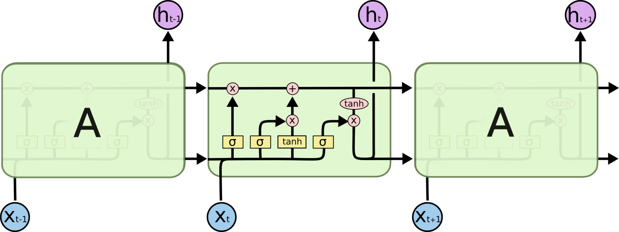
Solution using LSTM
Embedding
1 LSTM
Like RNN but also
determines how much
to go back
Source: http://colah.github.io/posts/2015-08-Understanding-LSTMs/

