Slide 1
Deep Learning with Keras Image Recognition
Themistoklis Diamantopoulos

Slide 2
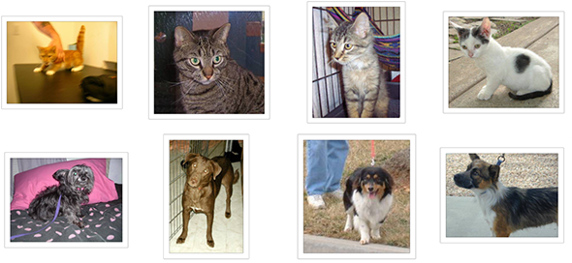
Image Recognition
Cats vs Dogs
Binary Classification problem
Source: https://www.kaggle.com/c/dogs-vs-cats/data

Slide 3
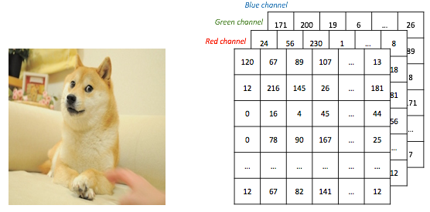
Feature Representation
150 x 150 x 3
3 channels for RGB
Source: http://www.subsubroutine.com/sub-subroutine/2016/9/30/cats-and-dogs-and-convolutional-neural-networks

Slide 4
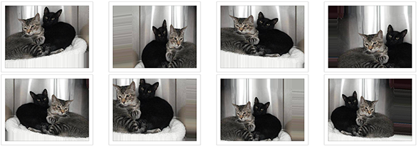
Data Augmentation
What to do when data are few?
Augment them!
Source: https://blog.keras.io/building-powerful-image-classification-models-using-very-little-data.html

Slide 5
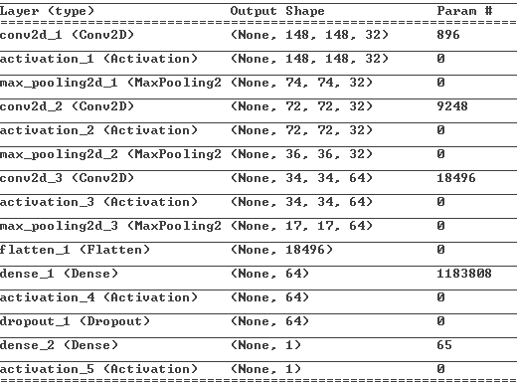
Solution using CNN
3-layer
convolutional
3-layer dense

Slide 6
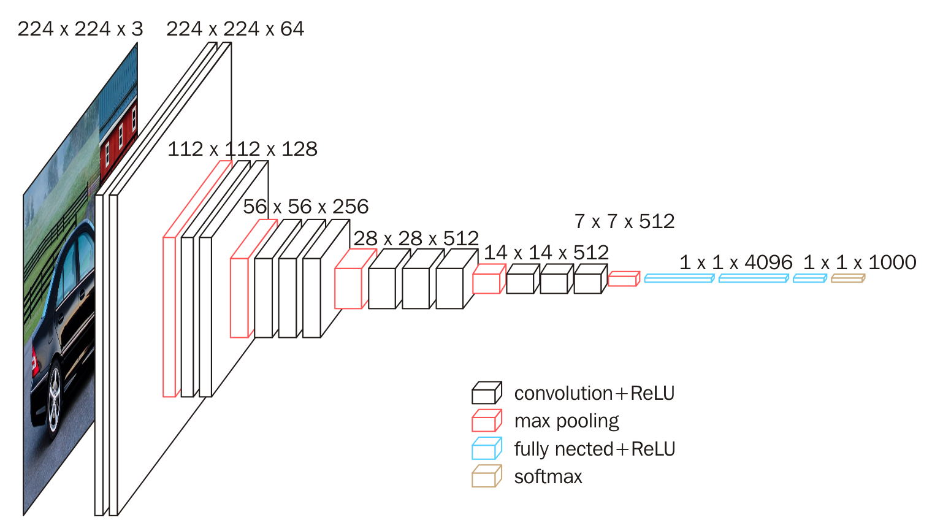
Use pretrained model
VGG16 architecture
Source: https://www.researchgate.net/figure/VGG16-architecture-16_fig2_321829624

Slide 7
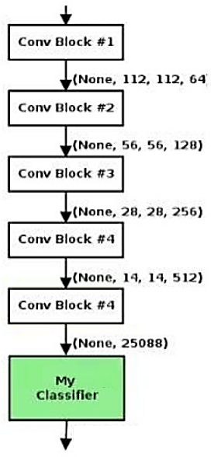
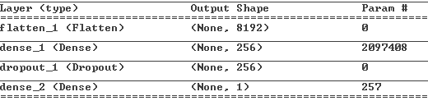
Solution using VGG16
Pretrained on Imagenet
Extract bottleneck features
Attach own classifier at the bottom
(a fully connected MLP)
Source: https://www.slideshare.net/LalitJain29/object-classification-using-cnn-vgg16-model-keras-and-tensorflow

