Slide 1
Deep Learning with Keras OCR
Themistoklis Diamantopoulos

Slide 2
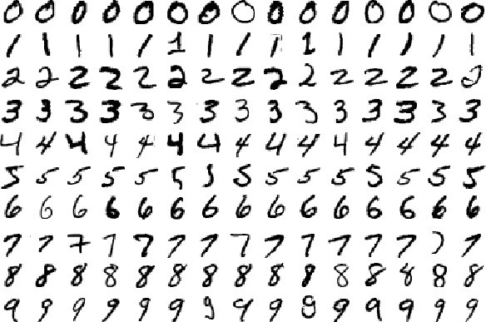
Optical Character Recognition
Handwritten digits
Classification problem
Source: https://codeburst.io/use-tensorflow-dnnclassifier-estimator-to-classify-mnist-dataset-a7222bf9f940

Slide 3
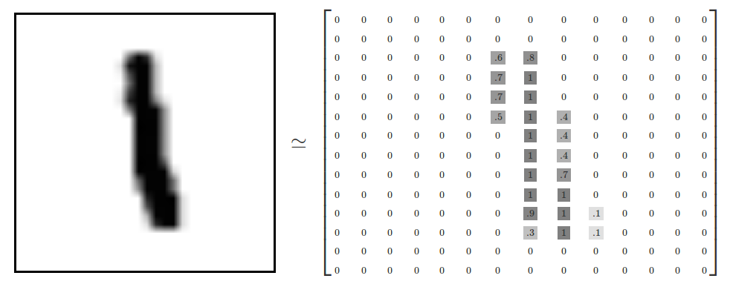
Feature Representation
28 x 28 pixel images
Pixel intensity between 0 and 1
Source: https://www.tensorflow.org/versions/r1.0/get_started/mnist/beginners

Slide 4
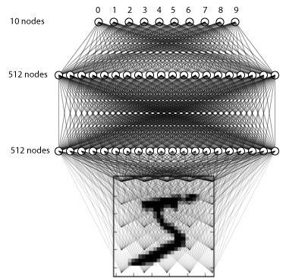
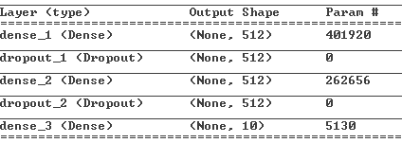
Solution using MLP
3-layer fully connected
network
Input vector size: 784
Output layer: 10 nodes
2 Intermediate layers
Source: https://github.com/wxs/keras-mnist-tutorial/blob/master/MNIST%20in%20Keras.ipynb

Slide 5
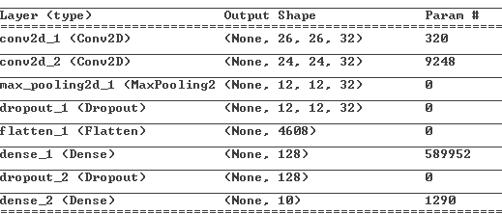
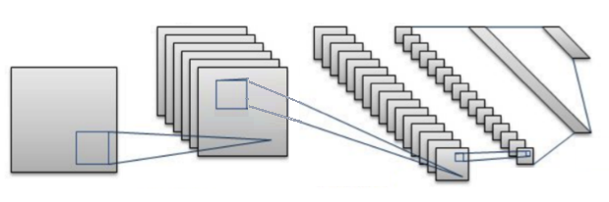
Solution using CNN
2 Conv. layers
1 Pooling layer
Fully Connected
Output
Fully
Connected
Convolution
Convolution
Pooling
Source: https://towardsdatascience.com/a-simple-2d-cnn-for-mnist-digit-recognition-a998dbc1e79a

Slide 6
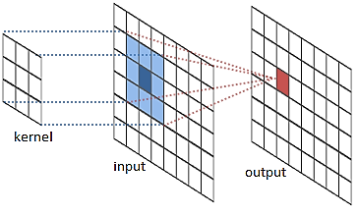
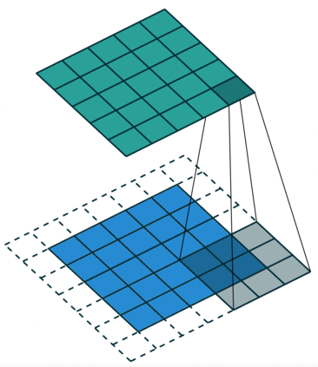
Convolution
Apply kernel to data to provide transformation
Use padding to preserve input dimensions
Source: http://cs231n.github.io/convolutional-networks/

Slide 7
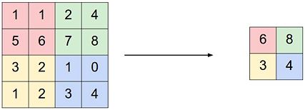
Pooling
Reduce dimensionality, i.e. reduce number of parameters
Controls overfitting
Different ways of pooling, e.g. max
Source: https://medium.freecodecamp.org/an-intuitive-guide-to-convolutional-neural-networks-260c2de0a050

Slide 8
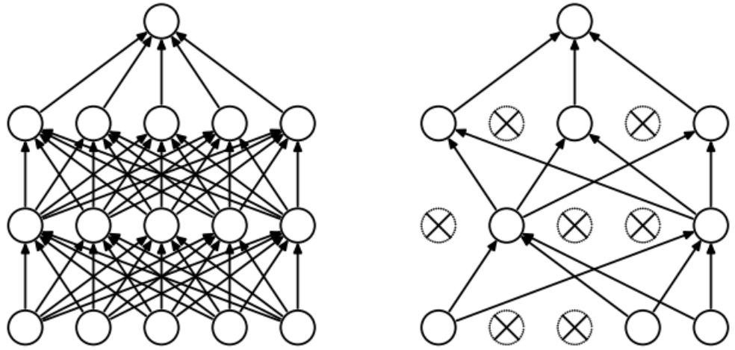
Dropout
Drop some nodes for a pass of the algorithm
Avoid overtraining certain nodes
Source: https://medium.com/p/74334da4bfc5/

